Slide 1
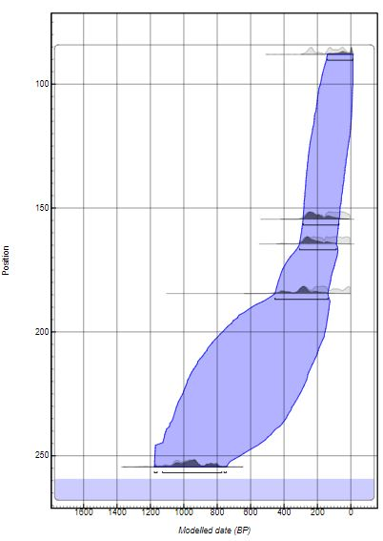
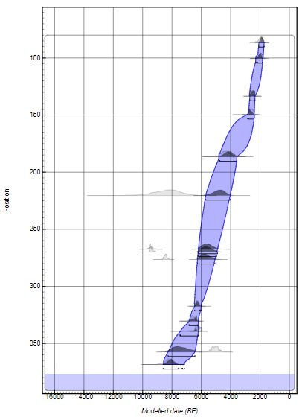
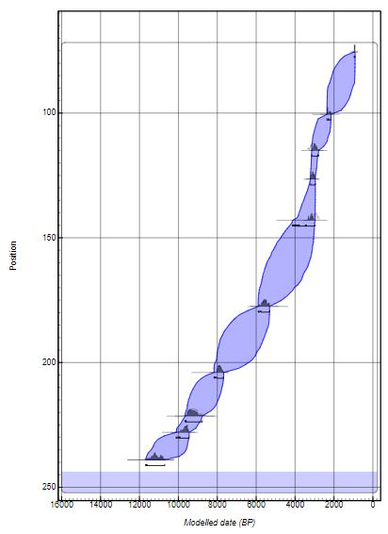
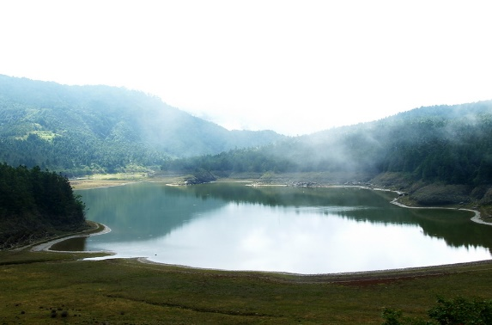
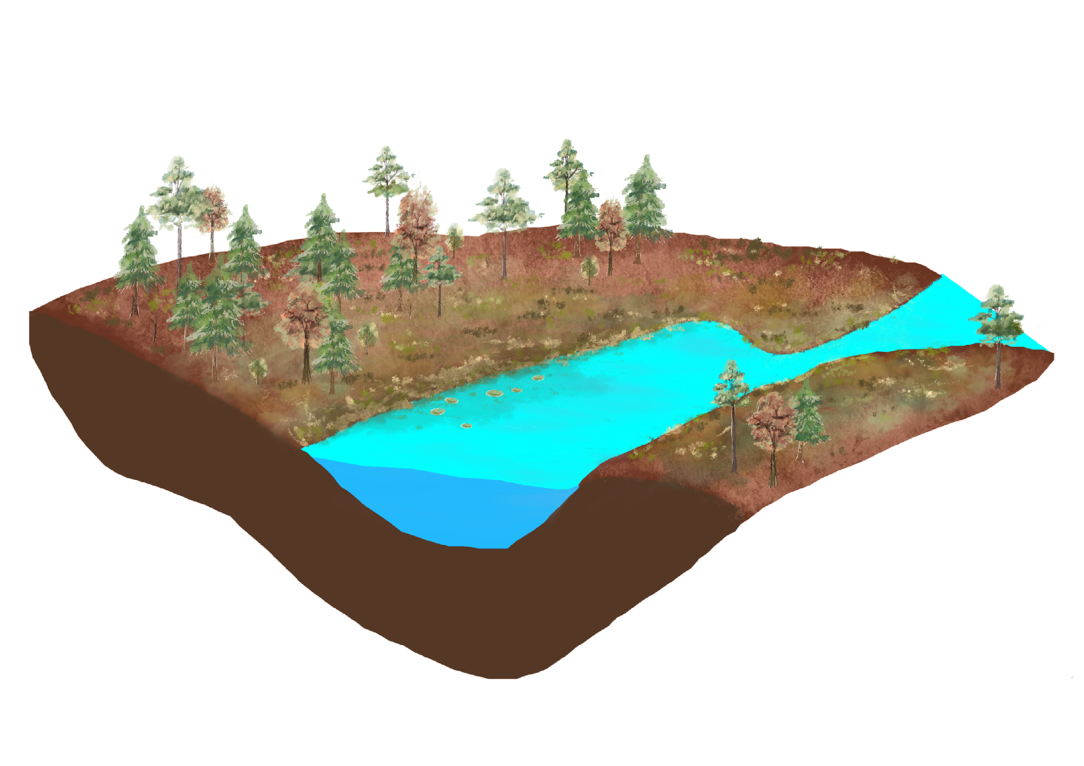
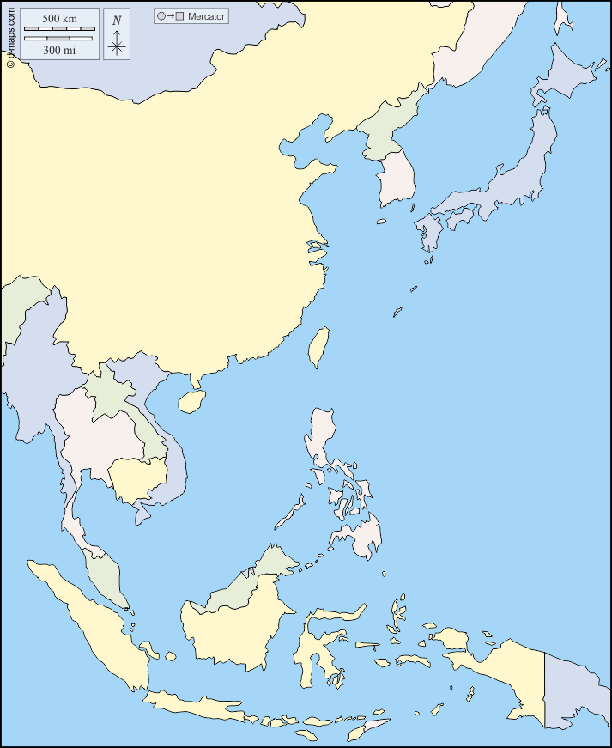
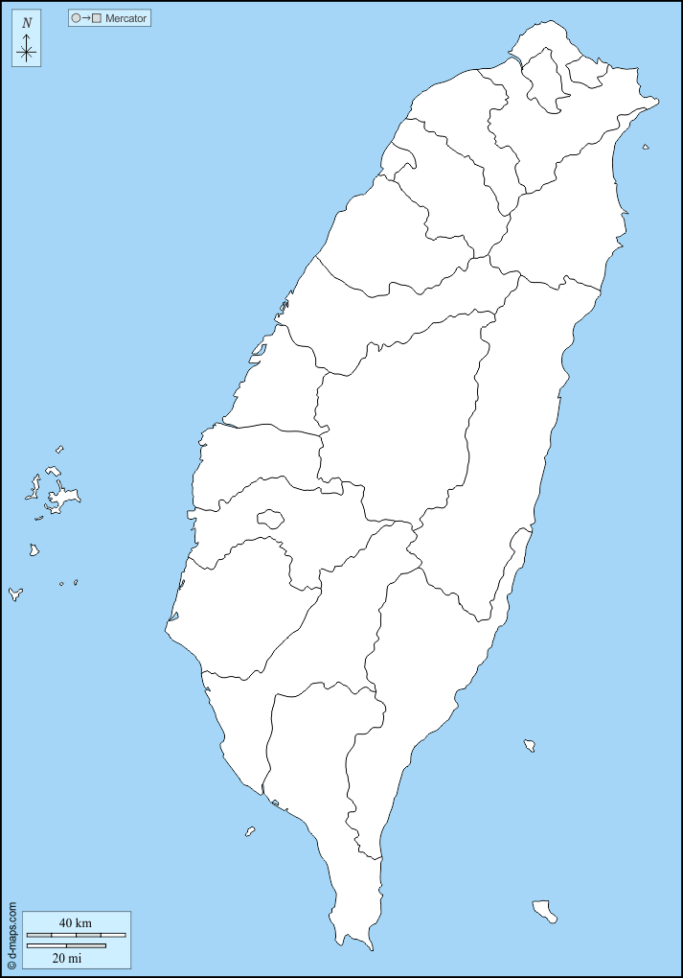
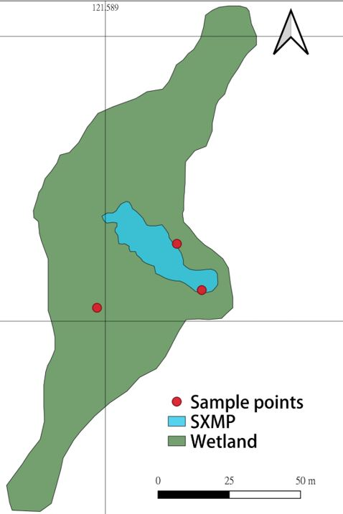
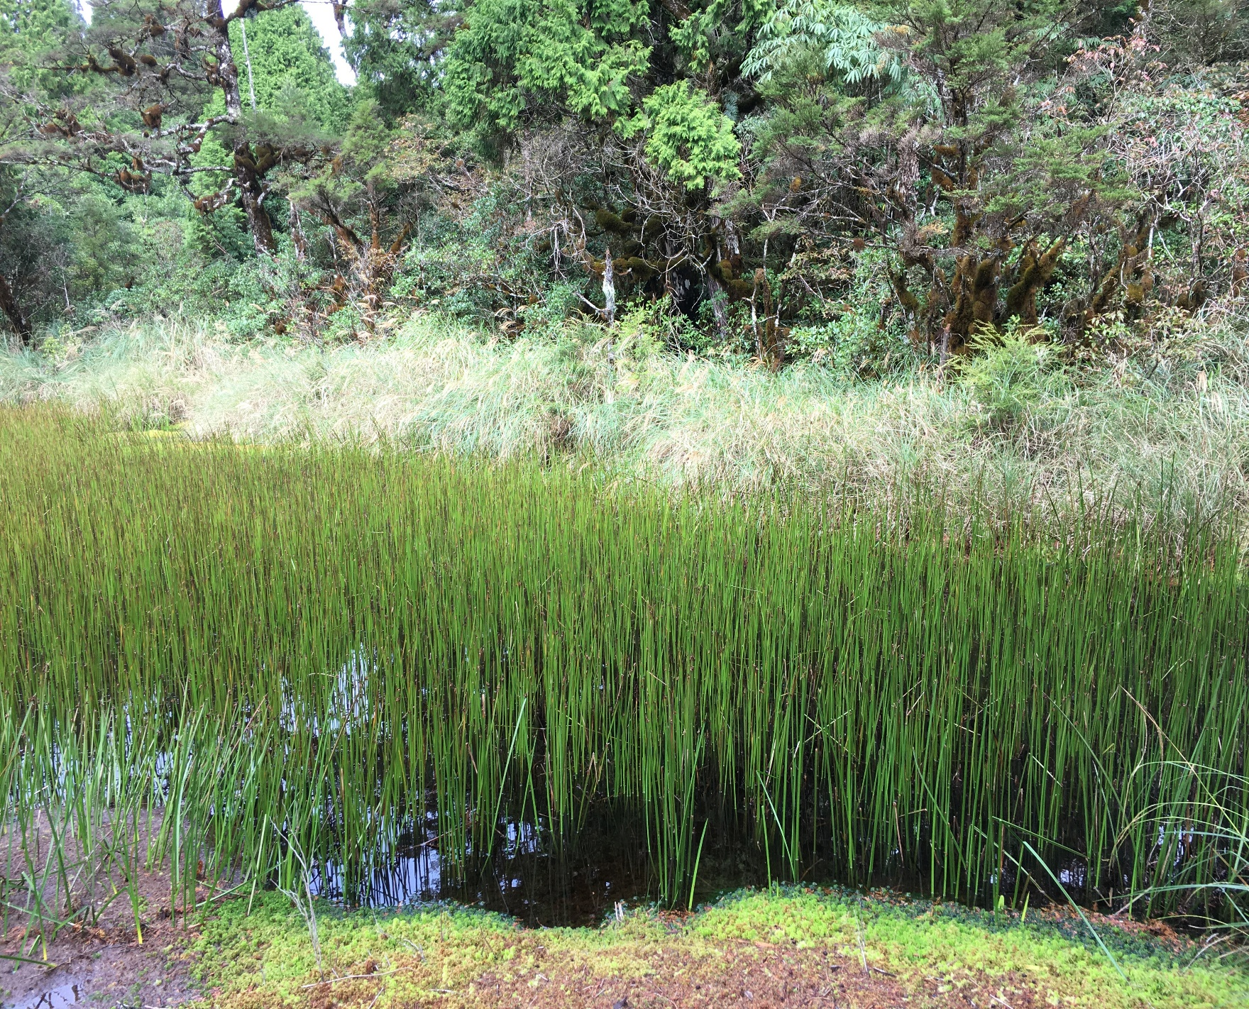
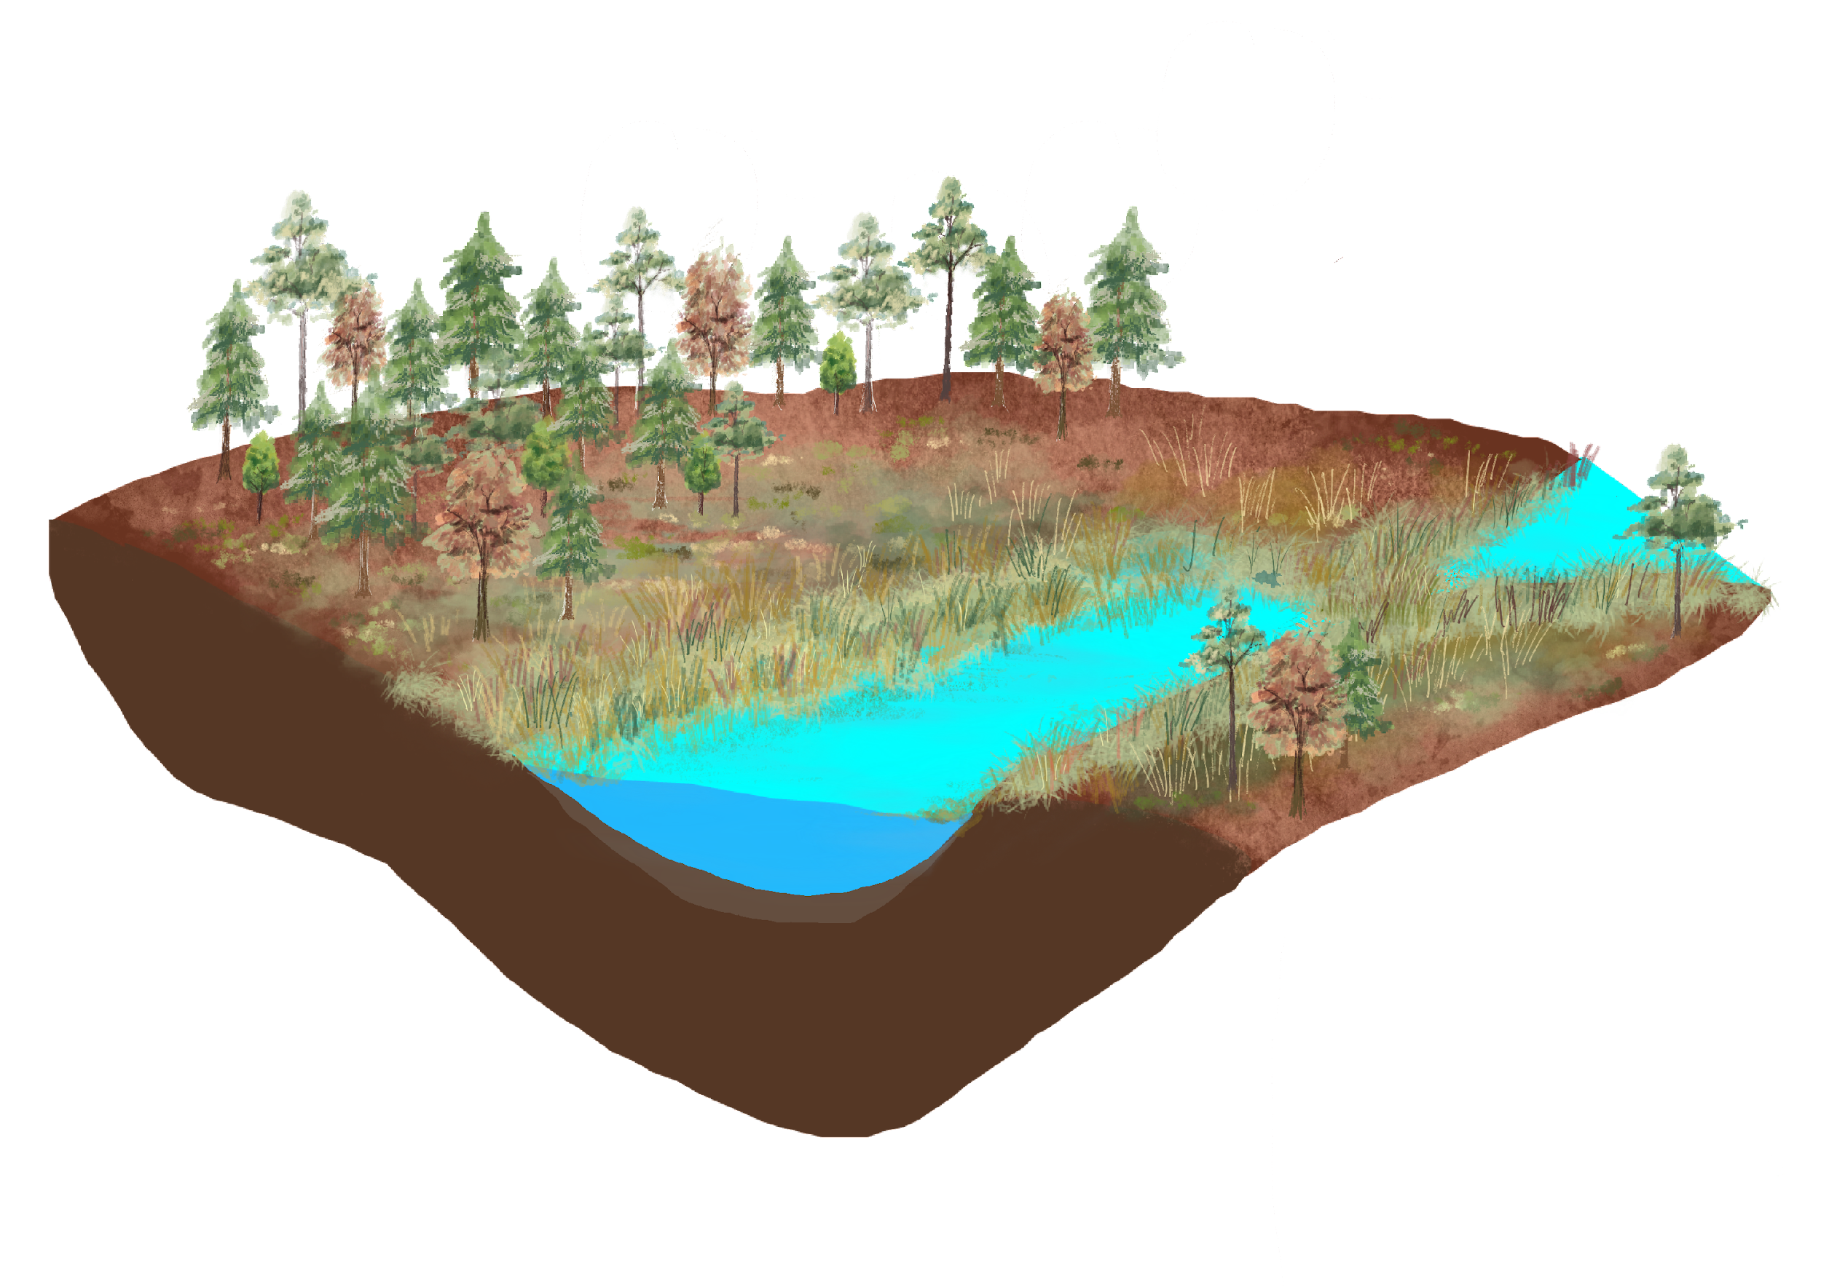
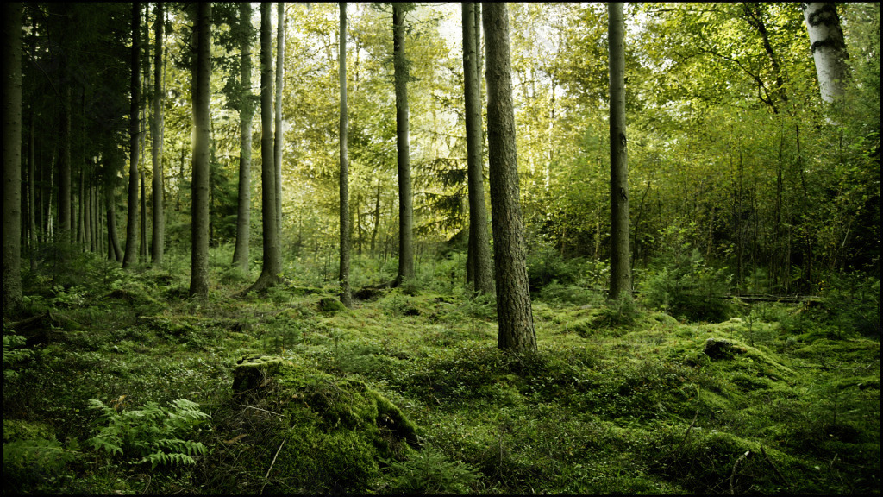
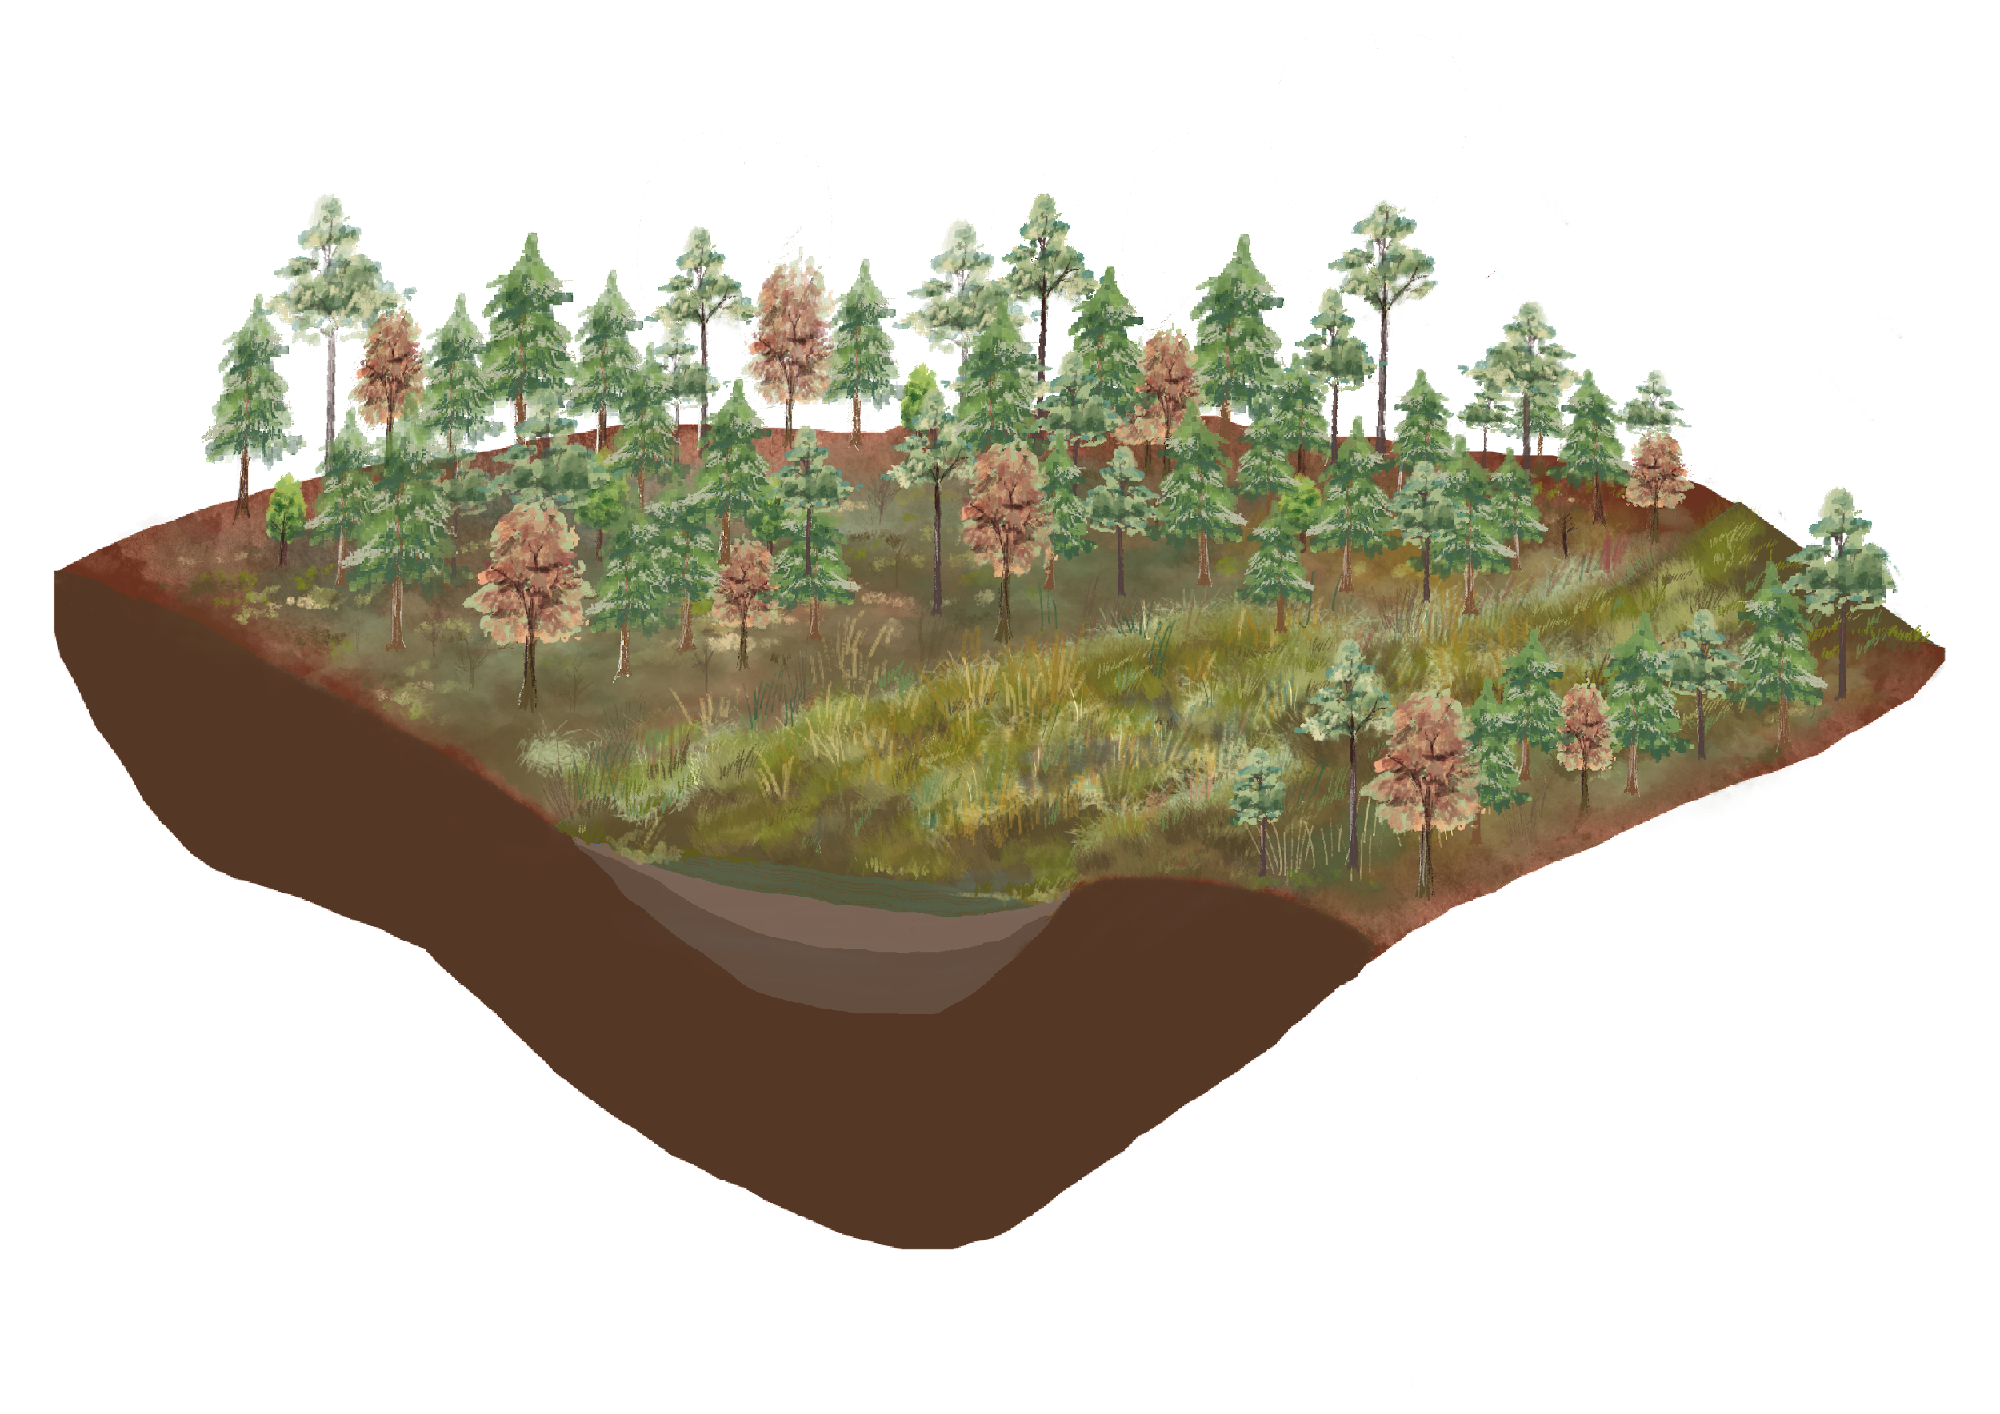
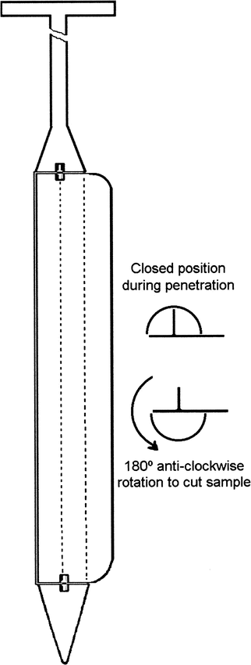
Radiocarbon constraints on lake succession and sedimentation processes in a small mountainous lake in NE Taiwan
Kuan-Yi Hsu ^{1,}*, Ludvig Löwemark ¹
^{1.} Department of Geosciences, National Taiwan University
* r09224213@ntu.edu.tw
1. Introduction
4. Results & Discussions
P3_0-287 cm
Land1B_0-400 cm
1_0-250 cm
Taiwan, an island in the subtropical East Asian monsoon system, provides the unique opportunity to study monsoon and typhoon variability over the western subtropical Pacific on both historical and geological time scales. However, the Holocene paleoclimate records retrieved from various lakes in Taiwan have shown discrepancies in their recorded climate variability. This could partly be caused by the lack of modern sedimentological observations, limiting our understanding of the mechanisms controlling lake sedimentation and thus introducing uncertainty in the interpretation of lake records. To understand the paleoclimate records archived in lacustrine sediments, a robust age model is essential. The aim of this study is to understand the complex processes that led to the formation of a small wetland. In this study, we use several cores from different parts of the wetland, including wooded swamps, fens, and the open pond, to construct a robust model for lake formation and succession.
¹⁴C age-depth model
100
100
The blue shadow region, determined through the Oxcal calibration software (Ramsey, C. B. (2009), characterizes the probability distribution of the proper age obtained from radiocarbon dating analysis of three sediment cores. The acquired results were subsequently utilized to compute sedimentation rates, thereby providing valuable insights into the chronological evolution of the sediment cores.
150
100
150
Depth (cm)
200
150
200
250
2. Background
300
200
Lake succession model
Study area
250
350
(Cal BP)
1400
1000
600
200
14000
10000
6000
2000
250
14000
10000
6000
2000
Past
Lake
Sedimentation rate (cm/yr)
Core descriptions
2000
4000
Age (BP)
0 cm
P3_0-287 cm
Land1B_0-400 cm
1_0-250 cm
1
6000
8000
10000
12000
Fen
P3
800 BP
P3
Land 1B
2000 BP
Land 1B
1
100 cm
800 BP
Forested swamp
inflow
y=0.016x + 75.126
R² = 0.97
4000 BP
Sample points
Depth (cm)
Future
Sanxingmei Pond
200 cm
Region of East Asia
Taiwan map
Wetland
6000 BP
(Modified from Rydin et al., 2013)
8000 BP
3. Material & Method
y=0.16x + 115.72
R² = 0.85
y=0.04x + 8.1204
R² = 0.98
300 cm
Missing
Organic rich gyttja
Sampling tool
Dating materials
Radiocarbon dating
Peaty mud
400 cm
Grayish clay
Russian Corer
Plants macrofossils and exoskeletons
Detritus comprising leaf, cone, stem fragments, and other organic matter can function as valuable indicators of prior vegetation communities inhabiting a specific geographic location. Additionally, Stenström et al. (2011) suggest that exoskeletons or elytra may serve as viable materials for this purpose.
Radiocarbon dating of lake sediment is a frequently employed technique to date organic material contained within sediment layers of lakes. Quantifying the level of ¹⁴C present in the organic material and comparing it to the regular ¹⁴C decay rate makes it possible to deduce the material's age and reconstruct past environments. In this study, three cores will undergo radiocarbon dating to reconstruct the pond's age model. The NTUAMS lab developed the experimental design in this study, and the calibration program was facilitated by OxCal IntCal 20 (Ramsey, C. B. (2009)).
Yellow clay
5. Conclusions
(Scoot., 2003)
Given the relatively small size of the pond and paleo wetland areas, our research produced inconsistent results across three different core sites, suggesting some paradoxes within our study.
In this study, P3 exhibited a sedimentation rate that was ten times greater than the other two sites. This disparity may be attributed to the fact that P3 was located within the pond and had a larger sediment influx due to its proximity to the inflow, in contrast to the other sites.
The sedimentation rate in our three cores showed a stable condition, which means it might not be influenced by climate change. Combining the result of core descriptions and the age-depth model, we find no prominent layer influenced by the extreme climate. Our study finds that the catchment size is too tiny, so it is not sensitive to climate change.
Closed position during penetration
180° anti-clockwise rotation to cut sample
Leaves
1 mm
Elytra
1 mm

