Slide 1
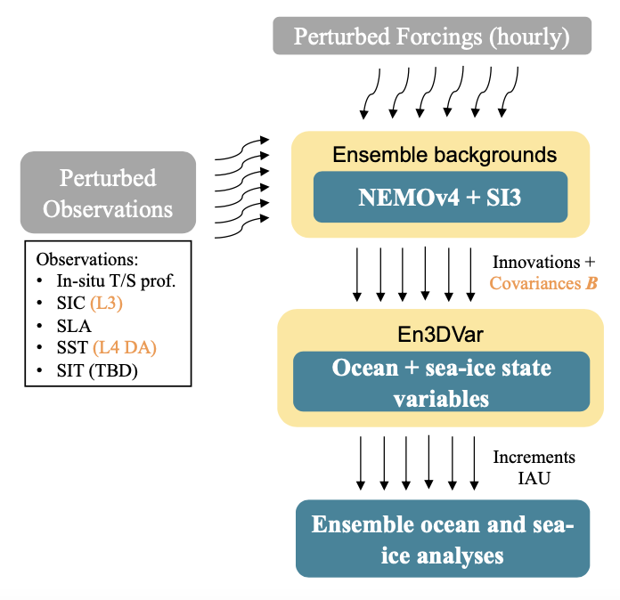
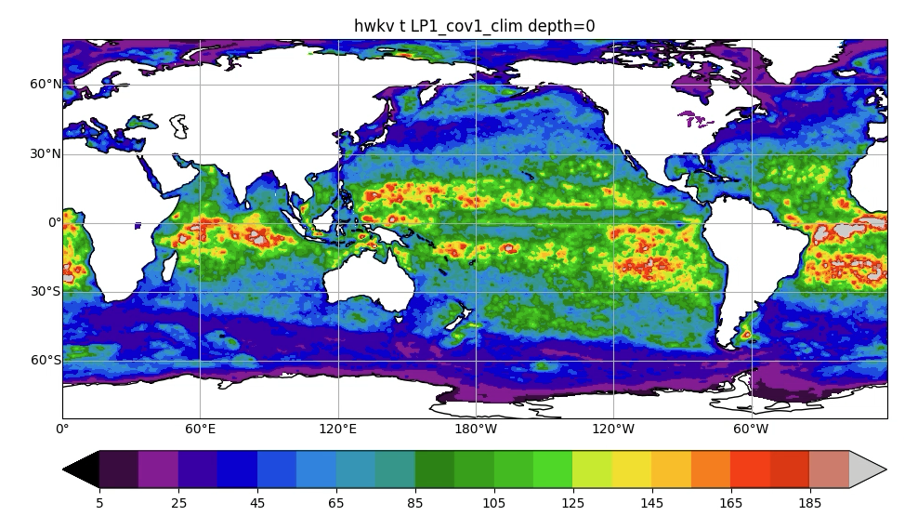
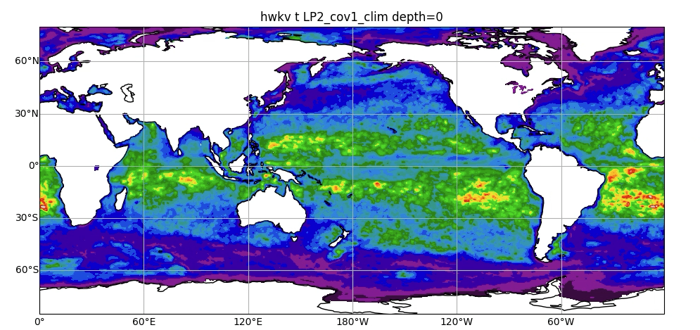
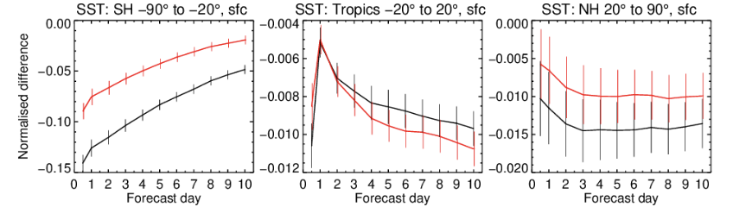
ECMWF’s 6th generation ocean and sea-ice reanalysis system (ORAS6)
Hao Zuo^{1*}, Eric de Boisseson¹, Philip Browne¹, Marcin Chrust¹, Magdalena A. Balmaseda¹, Sarah Keeley¹, Kristian Mogensen¹, Patricia de Rosnay¹, Beena Balan Sarojini²
(1) European Centre for Medium-Range Weather Forecasts (ECMWF); (2) University of Oxford; (*) Hao.Zuo@ecmwf.int
1. Overview of ORAS6
ORAS6 will be ECMWF’s 6th generation ocean and sea-ice reanalysis system:
Based on NEMOv4.0.6 and SI³ ocean and multi-category sea ice framework forced by hourly ERA5 boundary conditions
Observations: In-situ T/S, SLA, L4 SST and L3 SIC
Ensemble of ocean and sea-ice reanalysis (1 control + 10 members) generated with an En3DVar system
The background error covariance matrix B is updated every cycle from ensemble background states generated by perturbed forcings and observations
3. Sea-ice data assimilation in a multi-category model
Considerations in SIC DA with SI³ (multi-category sea-ice model with melt ponds)
ORAS6 sea-ice concentration – June 2010
Introduce thermodynamic balance between sea-ice and ocean state variables
How to distribute increments among different thickness categories
Where to apply increments in the ice time-stepping scheme
Grow sea-ice from open water with DA increment
Interaction between sea-ice increment and ice advection
Ice pack in SI³ using multiple categories with different concentrations ($a_{l} for l=1,…, L$), thickness, snow depth, temperature and salinity (T, S) and a single velocity vector (u)
0 0.2 0.4 0.6 0.8 1
2. Impacts of ocean EDA and direct SST assimilation
ORAS6 will use an ocean EDA with hybrid formulation of the B matrix, which is essential for direct L4 SST DA.
4. Potential impacts on Numerical Weather Predictions
T RMSE changes for FC with ocean ICs from ORAS6 prep v2 wrt ORAS5 ICs
Outputs from preparation runs for ORAS6 were used as ocean initial conditions for ECMWF medium-range coupled forecasts:
Improved SST forecast at all latitudes
Improvements are transferred to the atmosphere with significantly better temperature forecast at all latitudes in the troposphere (500-1000hPa)
This formulation includes:
a seasonally varying climatology- based diffusion tensor
an ensemble-based vertical diffusion tensor that updates every cycle
hybrid BGE variances: parameterized + climatology + ensemble
Climatological de-correlation lengthscales
Zonal
Meridional
5 65 125 185
Normalized SST RMSE changes for FC with ocean ICs from ORAS6 prep v2 and ORAS6 prep v1 wrt ORAS5 ICs
km
Climatological (left) zonal and (right) meridional de-correlation length-scales (in km) for temperature and salinity at 0 m, DJF season.
S. Extratropics: 90S-20S Tropics: 20S-20N N. Extratropics: 20N-90N
a) Climatological B only
b) Hybrid-B with Ens V-tens
Changes in upper-ocean temperature RMSE between the parameterized B formulation (as in ORAS6’s predecessor, ORAS5) and new B formulations show best fit to observations when using the hybrid-B formulation with ensemble-based vertical diffusion tensor
-0.4 -0.2 0 0.2 0.4
K
SST RMSE changes (in K) for forecast range 0-10 days when using ocean IC from two iterations of ORAS6 preparation runs instead of ORAS5 ocean ICs for 2014-2019 starting dates. Verified against ERA5. Negative (positive) values indicate better (worse) forecasting skill
Atmospheric T RMSE changes (in K) for forecast range 0-10 days when using ocean ICs from ORAS6 preparation runs instead of ORAS5 ocean ICs for 2014-2019 starting dates. Verified against ERA5. Blue (red) pixels indicate better (worse) skill
-0.45 -0.2 0 0.2 0.45
K
T RMSE changes (in K) wrt in situ T/S profiles (0-25m). Blue (red) pixels indicate a better (worse) fit to observations
Direct assimilation of L4 SST with the new ocean EDA system:
reduces SST biases in the Gulf Stream region. Weaker biases are also partly attributed to ERA5 forcing and improved upper ocean mixing in the physical model.
improves the diurnal cycle of SST wrt previous systems relying on SST nudging (not shown)
a) ORAS5 (SST nudging)
b) ORAS6-prep (SST DA)
Summary
ECMWF is developing its 6th generation of ocean and sea-ice ensemble reanalysis-analysis system (ORAS6) based on NEMOv4.0.6 and SI³ ocean and sea-ice model and an ensemble based variational data assimilation system
The final version of ORAS6 will include 11 ensemble members from 1979 to Near Real Time. A backward extension of ORAS6 to cover the 1950-1978 period will also be produced
ORAS6 outputs will eventually be used for both climate monitoring and as ocean initial conditions for ECMWF forecast activities
-4.5 -2 0 2 4.5
K
SST biases (in K) wrt ESA-CCI2 SST in the Gulf Stream region

