Slide 1
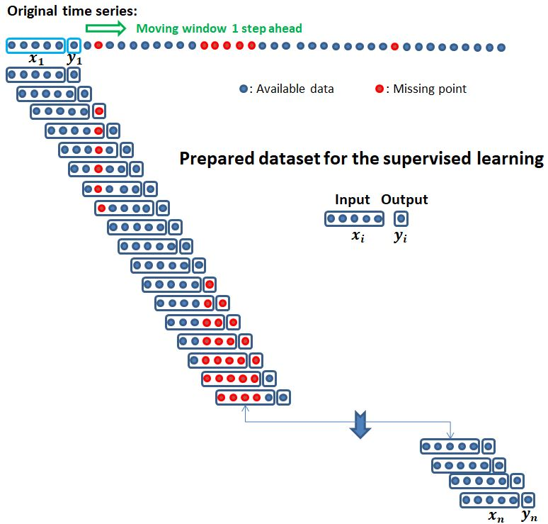
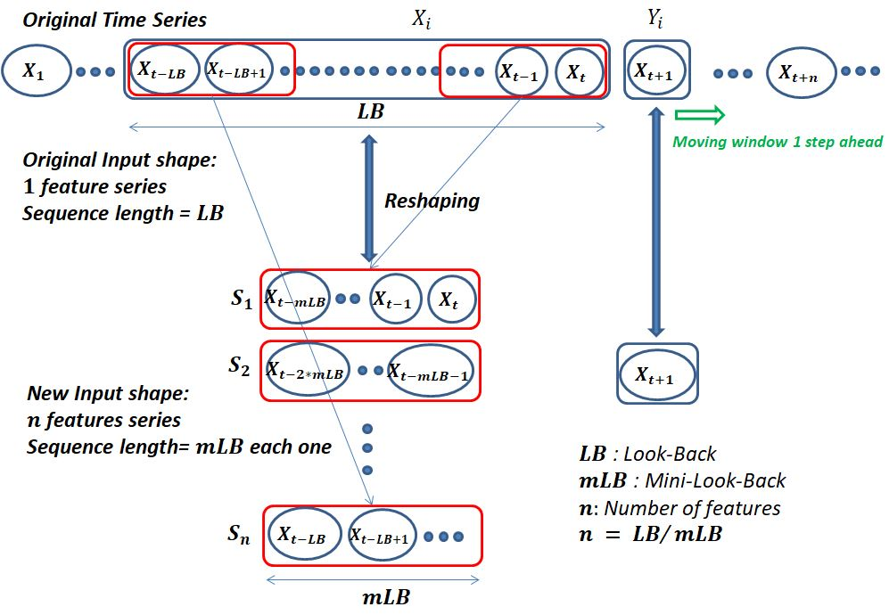
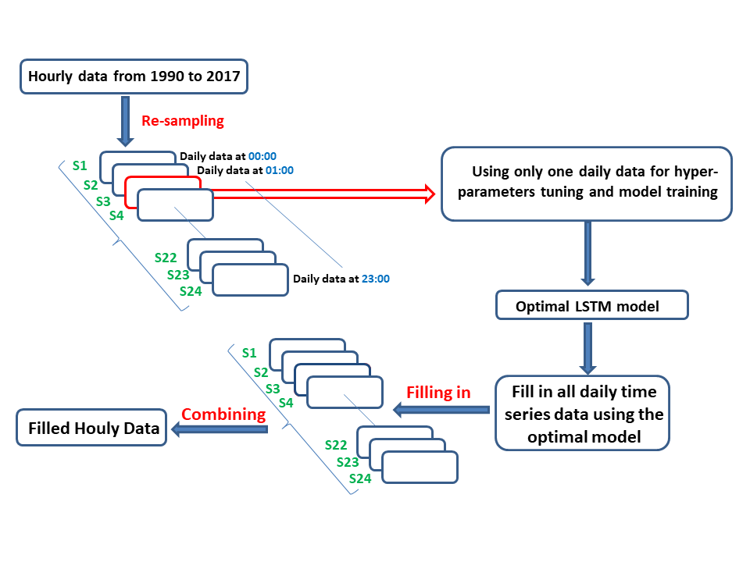
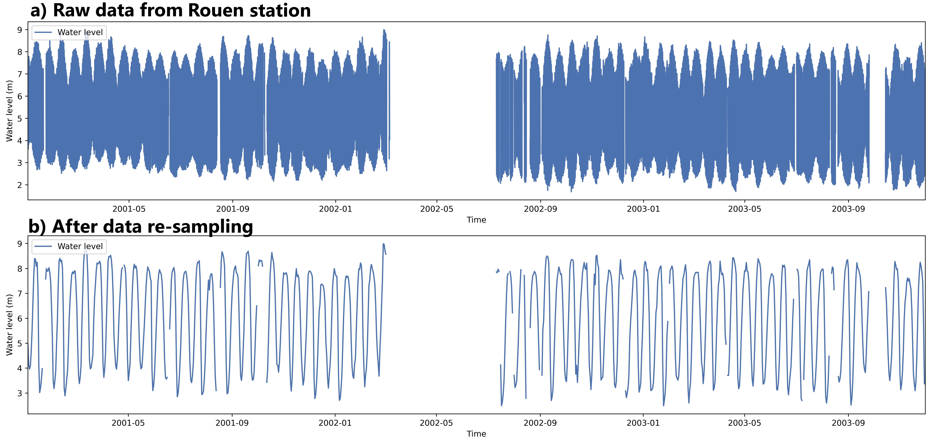
Use of Long-Short Term Memory network (LSTM) in the reconstruction of missing water level data in the Seine River.
Abstract
Imad Janbain *¹ , Abderrahim Jardani ¹, Julien Deloffre ¹, Minh Tan Vu ¹, Nicolas Massei¹
¹ Univ Rouen Normandie, UNICAEN, CNRS, M2C UMR 6143, F-76000 Rouen, France
Email address: imad.janbain@univ-rouen.fr
Project Funding: Normandy Region 100%
Study Area
Methodology
Analysis
Results
Motivation and Challenge
A historical water level database is essential for managing water resources and forecasting future events such as floods.
Obtaining reliable past data can be challenging and costly, especially in complex systems such as estuaries.
Simulating the run-off using external forces (meteorological data), was inaccurate.
Our database contains missing parts from 1 hour to 8 months in some years, arbitral distributed in different seasons.
All the stations share the same missing period → Reconstructing one station’s data using the other in a multivariate approach way was impossible.
Scenario 0: Traditional filling method using moving window concept
The basic moving window concept is used for both data preparation (Regression samples) and the filling-in process later.
Removing all samples having any missing points.
An intermediate interpolation of the short missing period was necessary (Threshold = 6 hours to remain on the tide characteristics) to remains enough data for the training phase.
Water Level Stations
The larger missing period will be filled by the LSTM model
Error accumulation problem for only 1 week missing periods
Increasing the Look-Back size (Sequence length)?
Objective
Applying the LSTM model in a univariate approach (Self-learning): using only the station data itself as input.
Historical Reconstruction of water level database:
Target: Five stations along the Seine river.
Period: 1990 to 2022.
Step = 1 hour.
Investigating our approach efficiency for filling different data behaviors.
LSTM memory problem and high computation time!
Scenario 1: Mini-Look-Back Decomposition
Look-Back analysis and comparison
Transforming the model’s input from a single time series (univariate approach) of sequence length Look-back ($LB$) into $n$ virtual time series with Mini-Look-Back ($mLB$) size each one.
The model is exempted from complex learning of chronological correlation, which is computationally expensive for high look-backs → Reducing the computation time → Ability to use a larger look-back.
Capturing more complex patterns and seasonal correlation leading to more accurate long-term predictions.
Mini-Look-Back analysis and comparison
Resolving the error accumulation problem
Low Robustness in front of fluctuations
Scenario 2: Data downscaling from hourly to daily + $mLB$ decomposition
Computational Resources
All this work was conducted in Python version 3.8.
Hyperparameters tuning: Optuna.
Experimentations were conducted on both the CRIANN computational resources and a Dell workstation with an NVIDIA Quadro RTX 5000 GPU and 128GB RAM.
Data Resources:
Water Level data: https://hydro.eaufrance.fr/
Reducing more and more the computation time.
Working on a daily scale helps the model to catch more long-term trends and fluctuations → A better robustness.
Validating the filling approach over a large period
Filling in the original missing parts (up to 8 months) in the raw hourly data

