Slide 1
Nightside Plasmaspheric Plume-To-Core Migration of Whistler-Mode Hiss Waves
Zhiyong Wu, Zhenpeng Su, Jerry Goldstein, Nigang Liu, Zhaoguo He, Huinan Zheng, Yuming Wang
University of Science and Technology of China
04/24/2023 Vienna

Slide 2
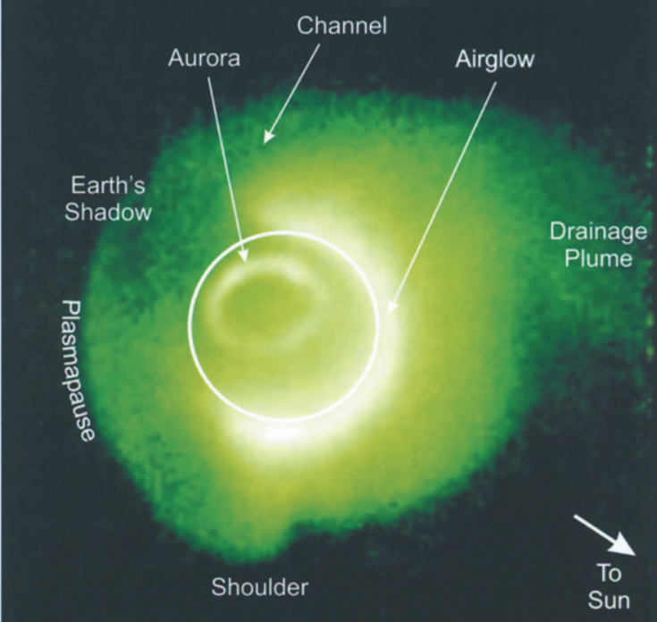
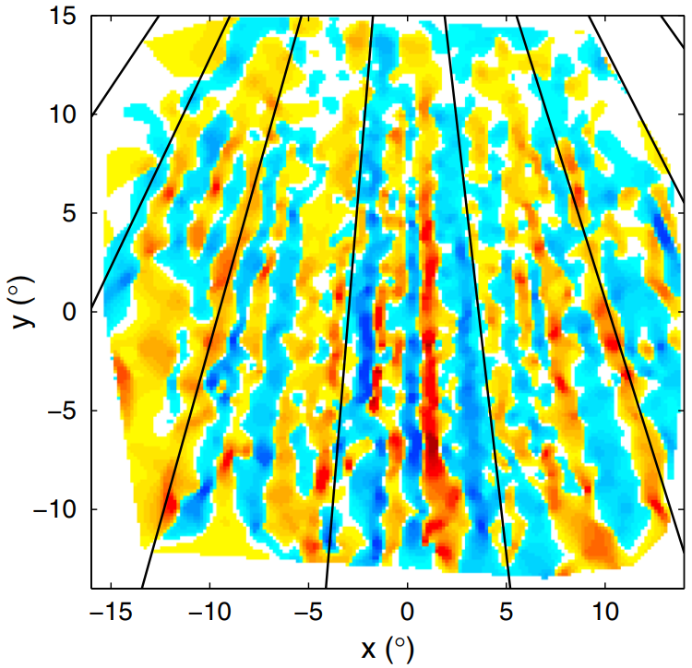
Earth’s plasmaspheric structure: non-uniform, multi-scale, dynamic
Large scale plasmaspheric structures
(Sandel et al., 2003)
Small scale plasmaspheric structures
(Loi et al., 2015)

Slide 3
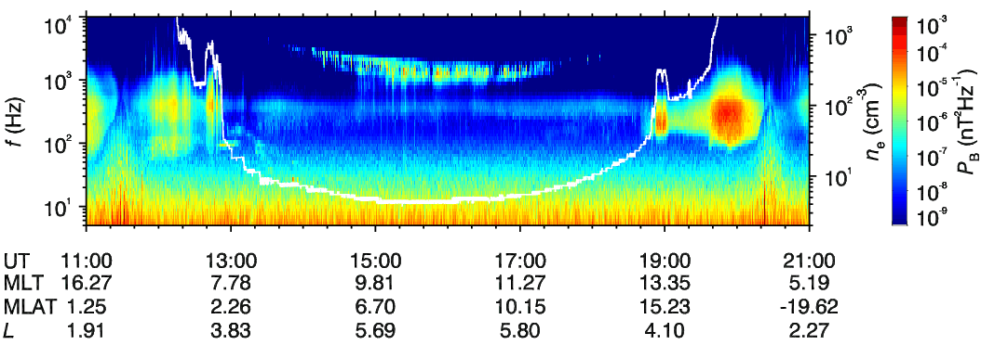
Whistler-mode hiss waves
Plasmasphere
Plasma Trough
Plasmaspheric Plume
Exohiss
Plasmaspheric hiss

Slide 4
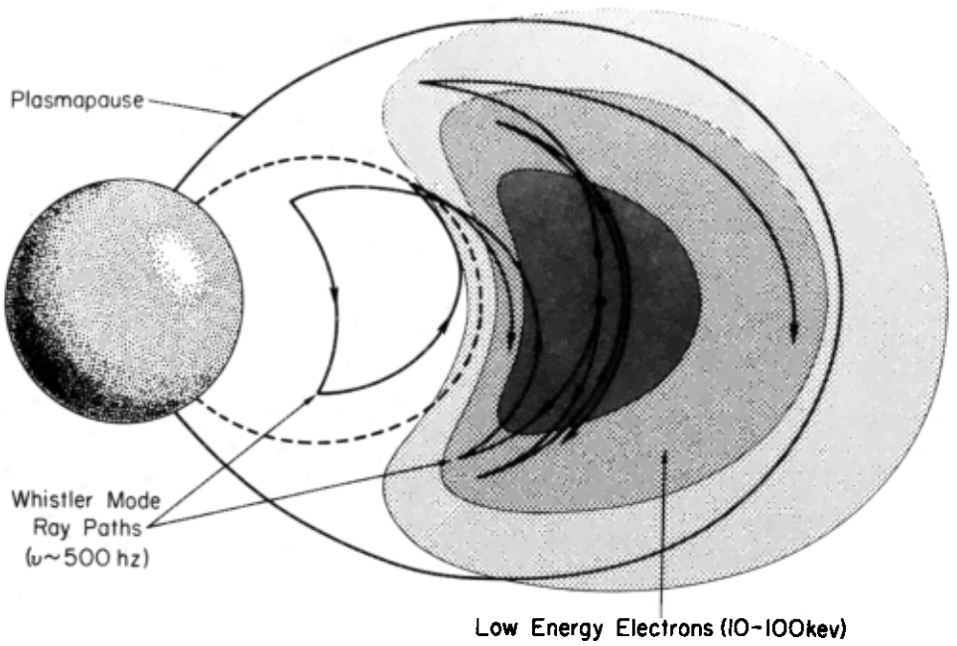
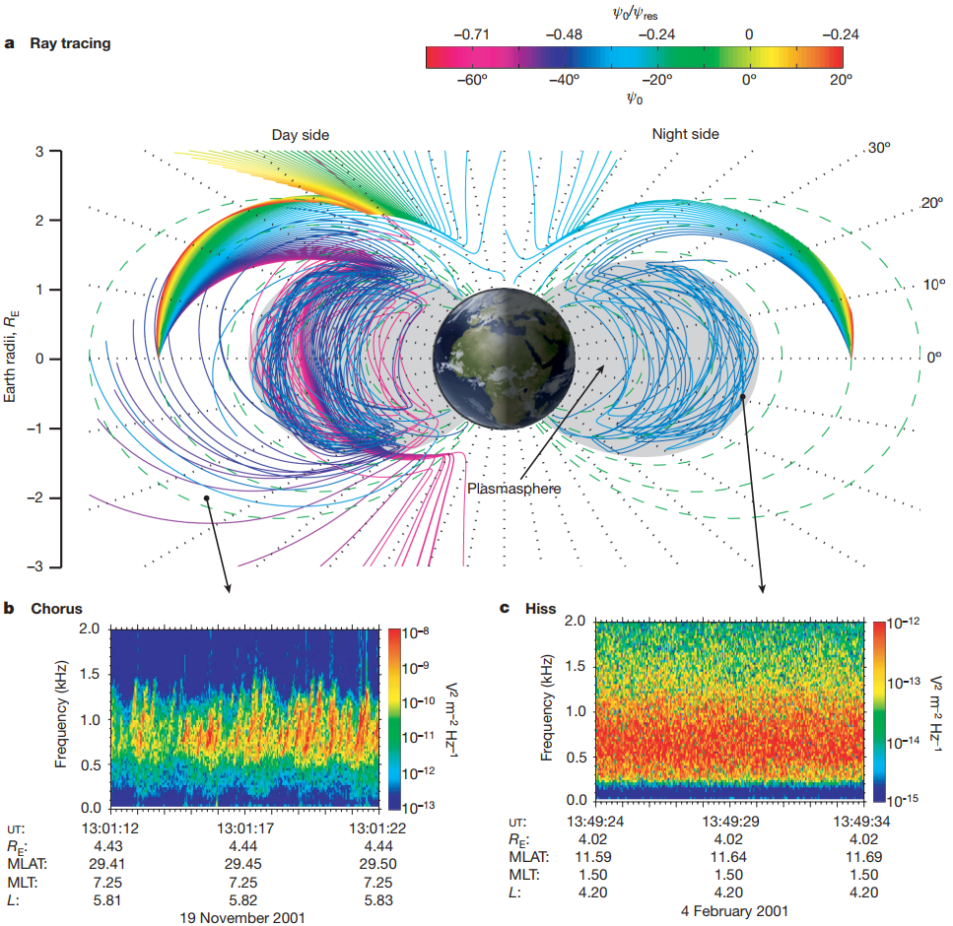
How plasmaspheric hiss waves are generated?
Internal source (Thorne et al., 1973)
External source (Bortnik et al., 2008)

Slide 5
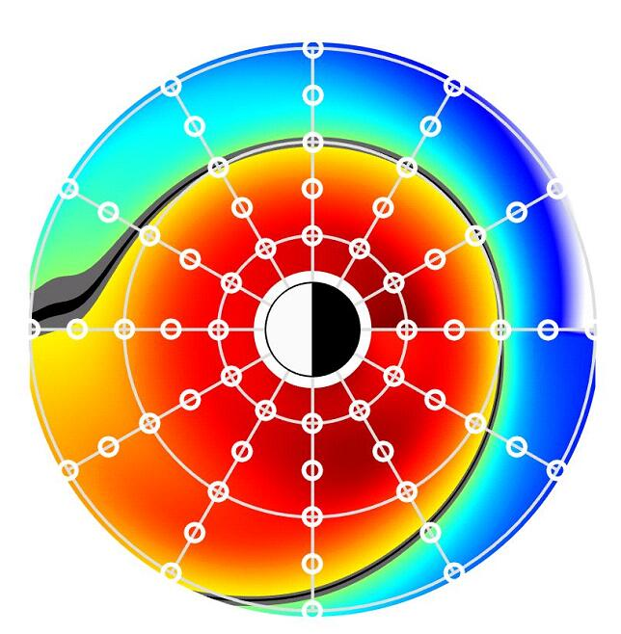
The connection between hiss waves in plasmaspheric plume and core
Plasmaspheric plume
Su et al., 2018
Hiss waves in plasmaspheric plume can have larger intensity than that in plasmaspheric core
Hiss waves in plasmaspheric plume tend to propagate away from the equator (source region)
Plasmaspheric core

Slide 6
Observation: The evolution of plasmaspheric plume
Low altitude (GPS)
Mid and high altitudes (RBSP & THEMIS)

Slide 7
Observation: Relationship between hiss waves in plume and core
In plume
In core
Wave spectrum
Wave normal angle
PYT flux direction
RBSP-A (in core) and RBSP-B (in plume) observed hiss waves with highly-similar structures

Slide 8
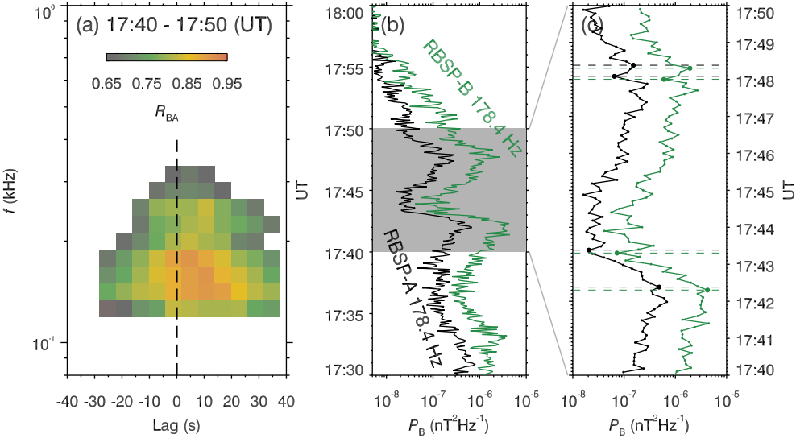
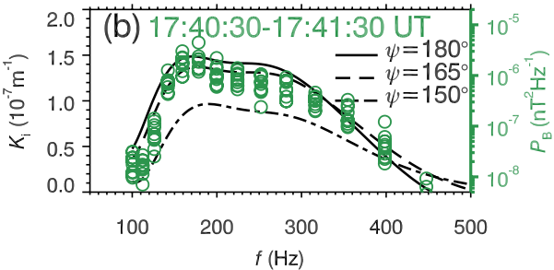
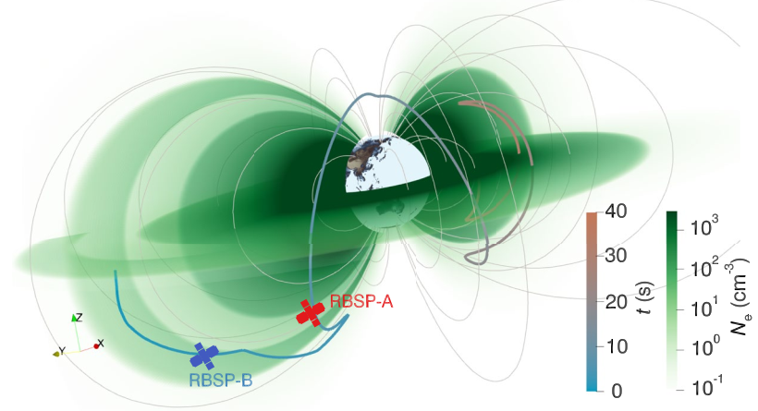
Modeling: Plasmaspheric plume can act as an engine for plasmaspheric hiss
Correlation coefficients
Hiss waves are triggered by energetic electrons in plasmaspheric plume
Plasmaspheric plume can guide the hiss waves to core region (4-10 s)

Slide 9
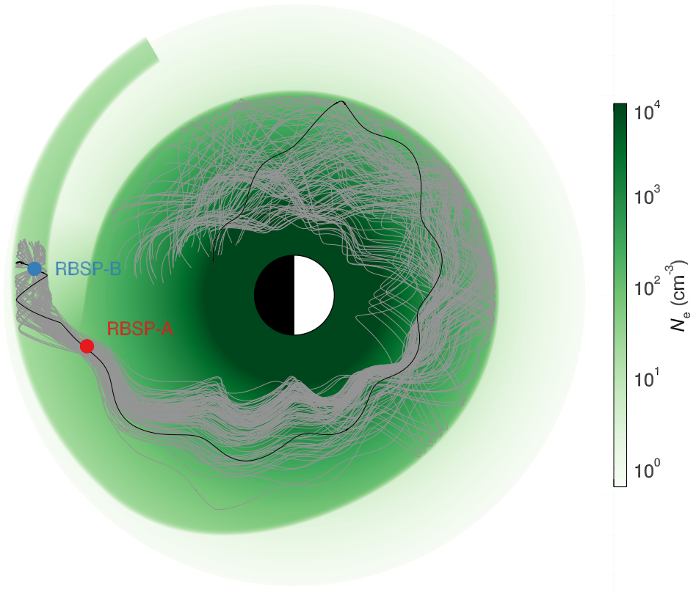
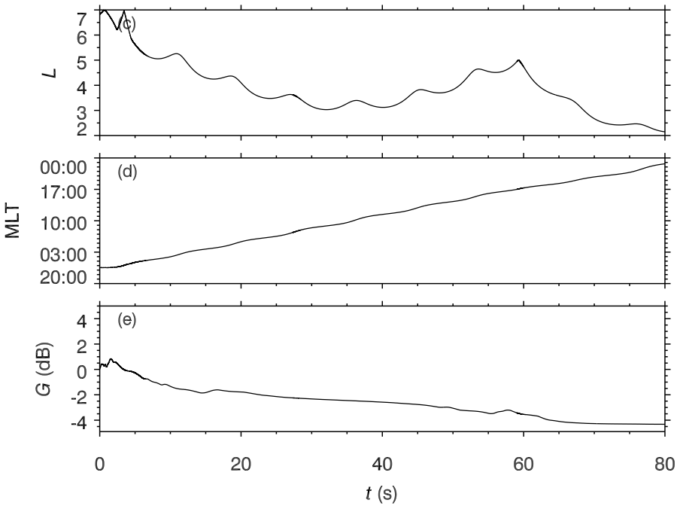
Modeling: Plasmaspheric plume can act as an engine for plasmaspheric hiss
Wave gain

Slide 10
Summary
Three ground and space missions observed the formation and evolution of plasmaspheric plume following a strong substorm
Hiss waves propagating oppositely in the nightside plasmaspheric plume and core correlated highly with each other at a time lag of 4–10 s
Numerical modeling supports that the plasmaspheric plume (engine) allows hiss waves to grow and then migrate to the plasmaspheric core
Other plasmaspheric structures extending outward such as the plasmaspheric bulge, fingers, and crenulations could also become engines for plasmaspheric hiss

Slide 11
The End
Thanks for listening !

Slide 12
