Slide 1
Fourier Neural Operator surrogate model for the prediction of 3D seismic waves
Fanny Lehmann^{1,2}
Filippo Gatti², Michaël Bertin¹, Didier Clouteau²
1 CEA/DAM/DIF, F-91297, Arpajon, France
2 Université Paris-Saclay, ENS Paris-Saclay, CentraleSupélec, CNRS, LMPS - Laboratoire de Mécanique Paris-Saclay, 91190 Gif-sur-Yvette, France
EGU 2023 – ITS 1.12 / NH 0.2
Hybrid modeling of natural hazards : blending deep-learning, data-driven approaches and physics-based simulations

Slide 2
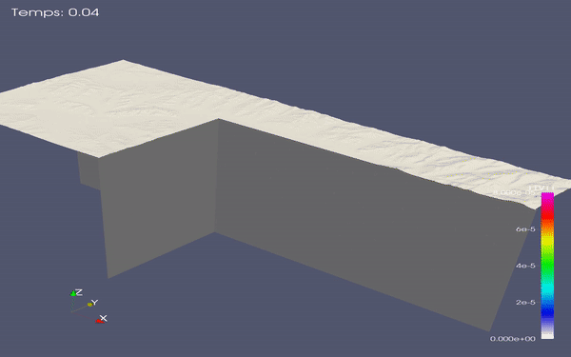
Introduction
Earthquakes are devastating natural hazards.
Numerical simulations are key to compute ground motion and predict the most vulnerable areas.
high-fidelity
computationally expensive
uncertainties on the parameters (geology, source…) strongly affect the results
Goal: Design a neural network that predicts ground motion from the geology.

Slide 3
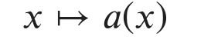
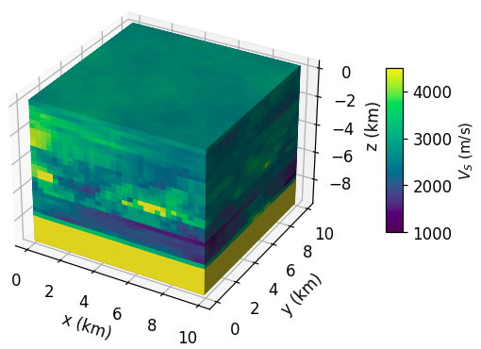
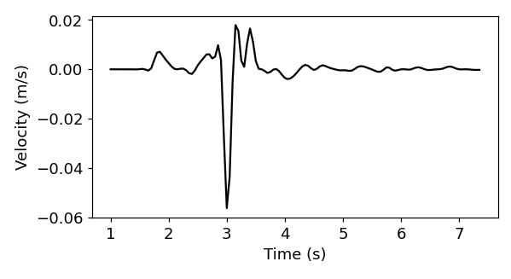
Introduction
Physical system described by a 3D parameter and a Partial Differential Equation to predict the solution.
S-wave velocity
Ground motion timeseries
Wave propagation equation
Workflow:
1
Numerical simulations to get a database of timeseries $u$ associated with geologies $a$
2
Train a neural network to learn the function $a↦u$
3
Predict timeseries for new geologies

Slide 4
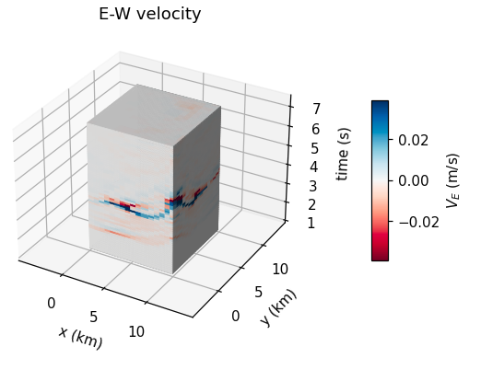
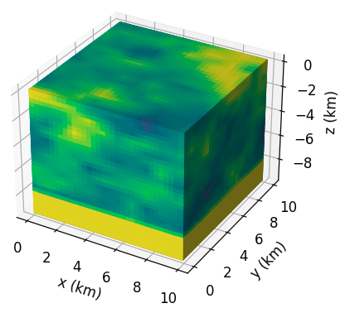
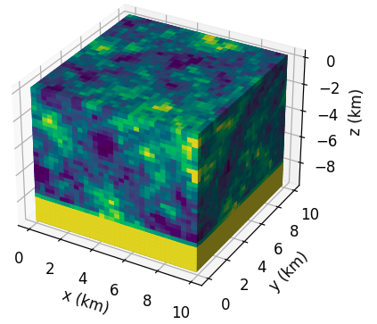
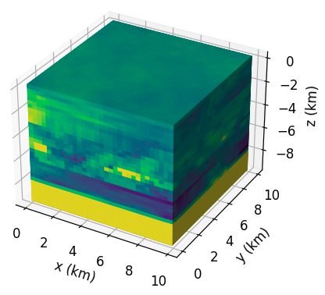
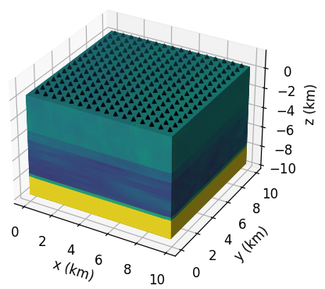
1. Database
Inputs
Geological cubes of size 10km
Layers of random fields with various properties
64 x 64 x 64 image
Outputs
6.4s of ground motion at the surface
3 components
3 images 64 x 64 x 128
Spectral Element Method
SEM3D
30,000 pairs (geologies, ground motion)
Computational cost: 1.6 million hours CPUs
Data size: 200 Go
Geological details in [Lehmann 2022]

Slide 5
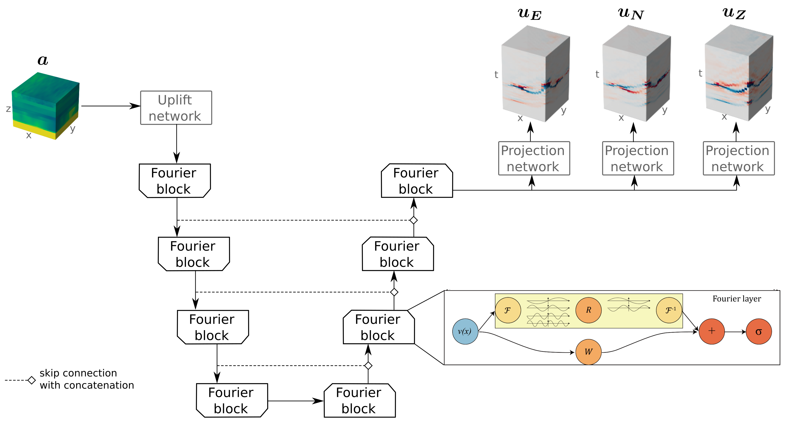
2. Training a Fourier Neural Operator
Fourier Neural Operator [Li 2021] uses Fast Fourier Transform to learn functionals
U-shaped architecture [Rahman 2022] allows for a deeper neural network

Slide 6
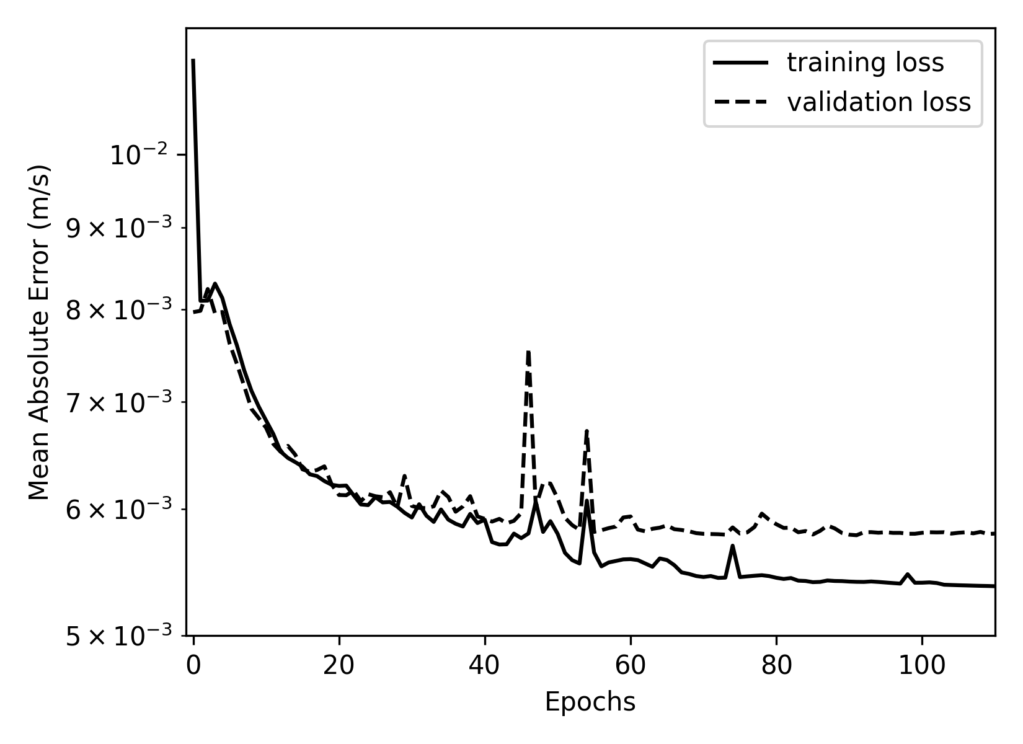
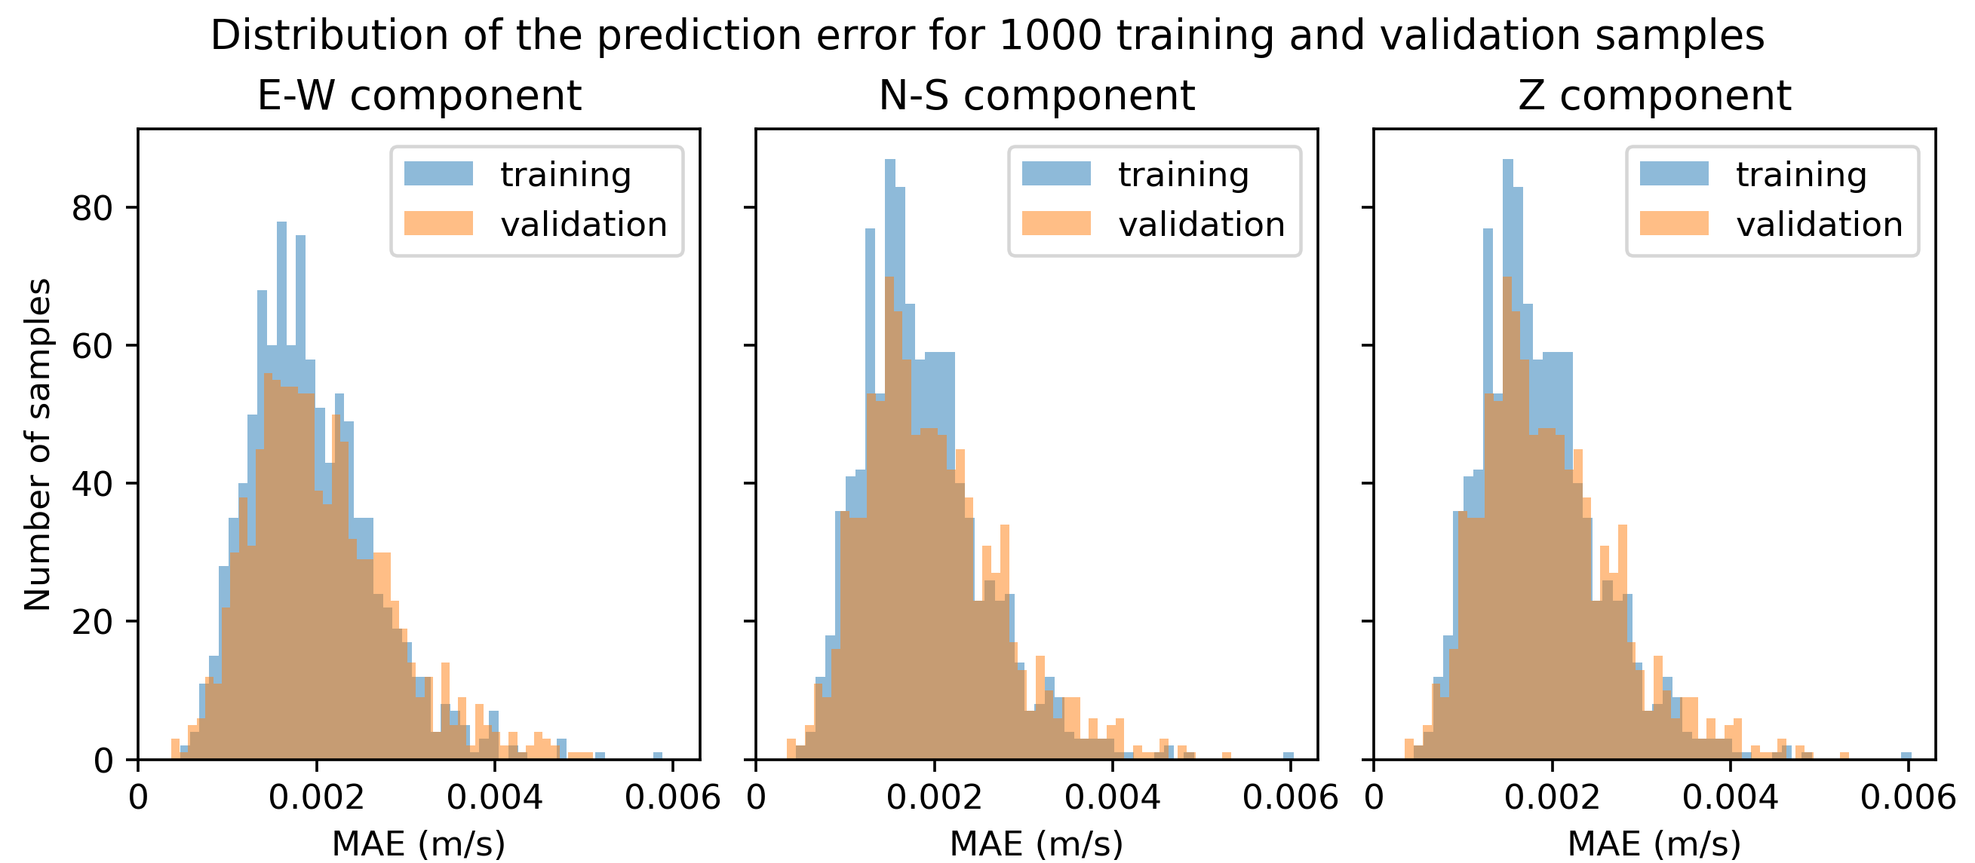
2. Training a Fourier Neural Operator
Training:
27,000 training data + 3,000 validation data
120 epochs ; 87 million parameters
11 hours of training on 4 GPUs
→ Training is satisfactory since there is no overfitting
→ Predictions have the same accuracy on all components

Slide 7
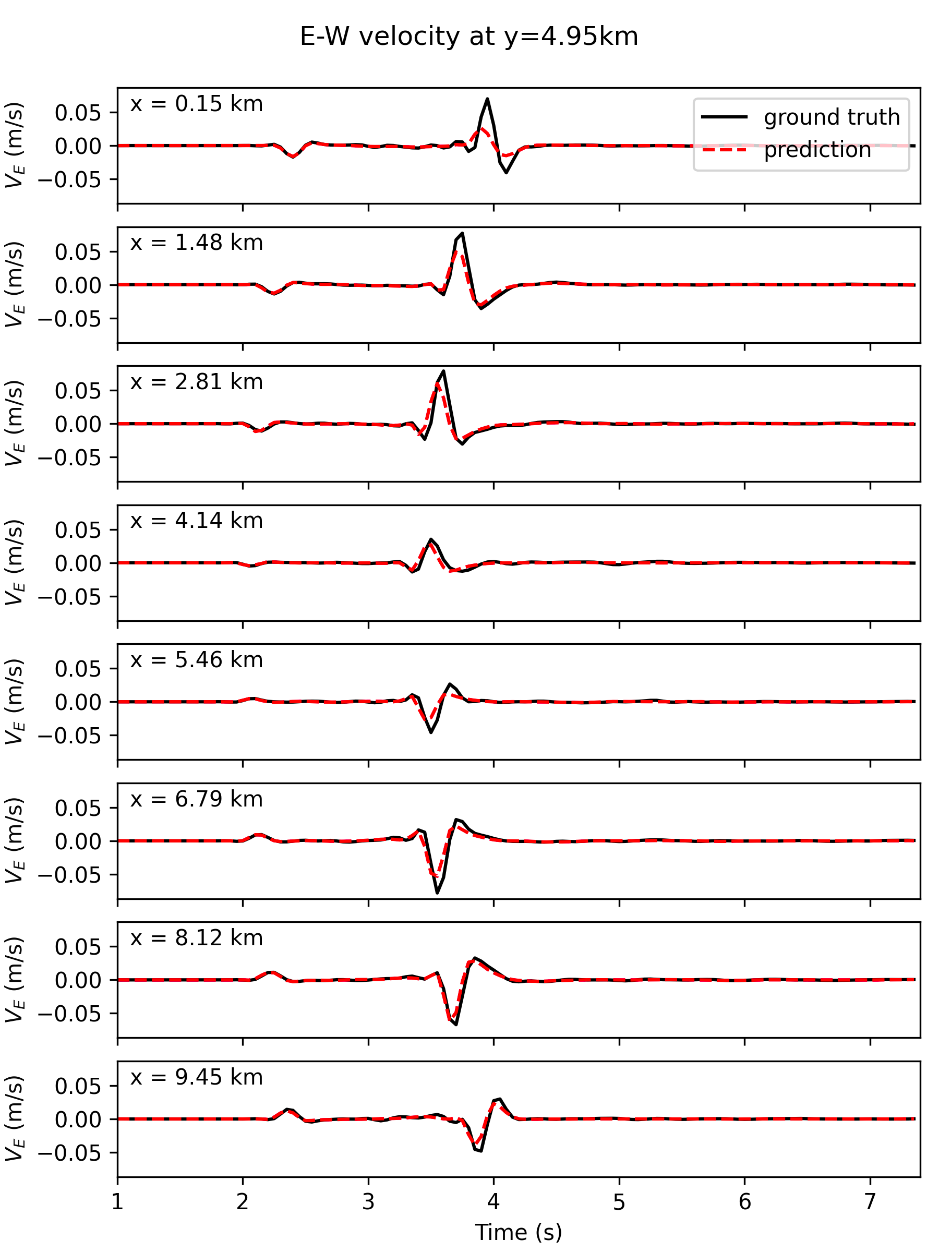
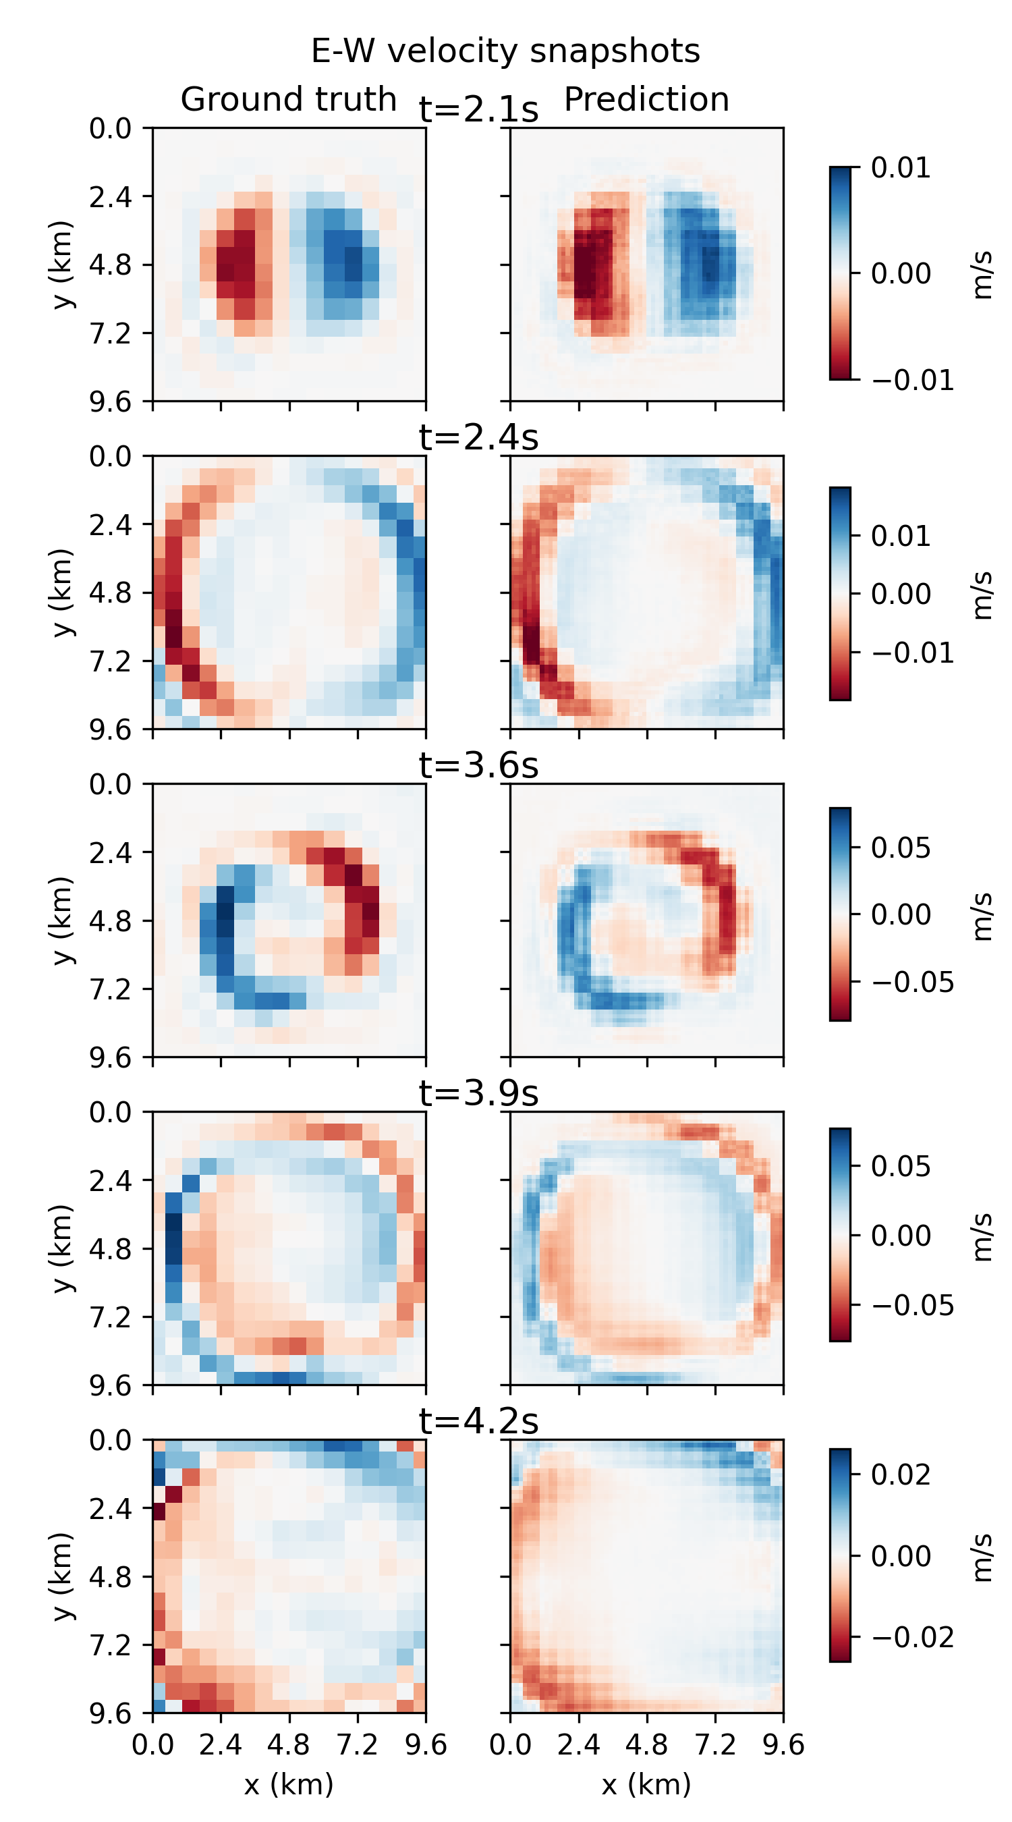
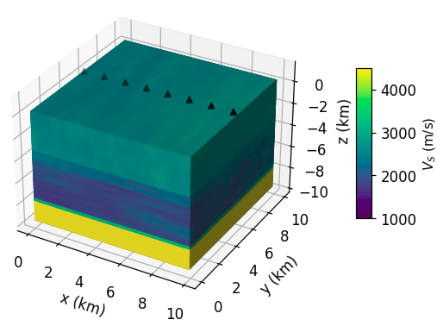
3. Prediction on unseen geologies
Geology with high velocity contrasts
Wave arrival times are accurate
Spatial coherency
Highest peaks are missed

Slide 8
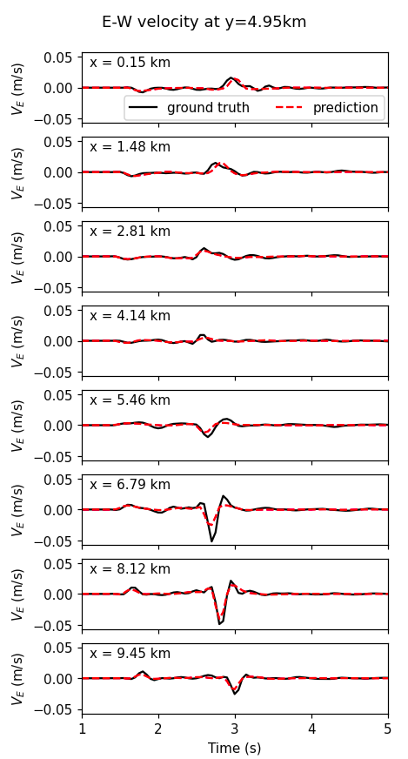
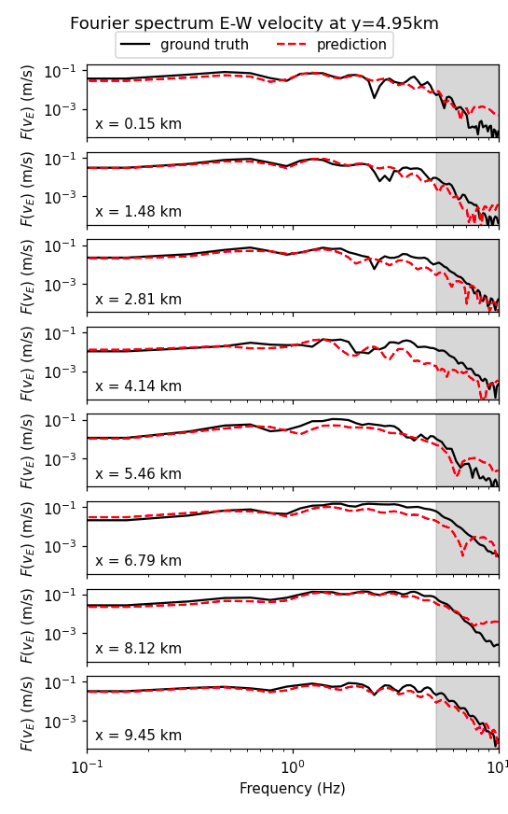
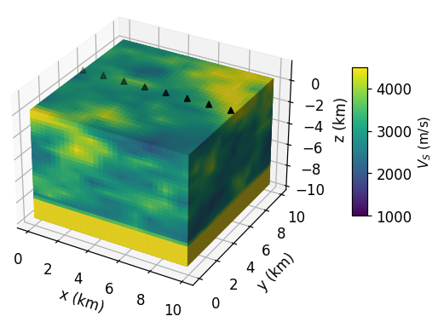
3. Prediction on unseen geologies
Geology with large heterogeneities
Excellent predictions up to 1Hz
Frequency decay is correct
High frequencies more difficult to capture

Slide 9
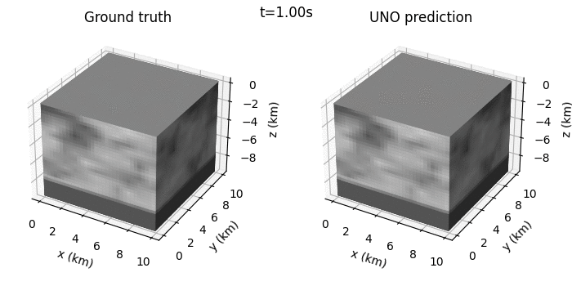
Conclusions and Perspectives
First successful application of Fourier Neural Operators in 3D seismology
We introduced a domain conversion between space $z$ (inputs) and time $t$ (outputs)
We achieved a satisfying accuracy on the validation dataset
→ Test the prediction on more realistic geologies (e.g. sedimentary basins)
→ Develop a model to include a source with a varying position
Methodology is general and could be applied to any 3D hyperbolic equation.
preprint available!

Slide 10
References
Lehmann F. et al. 2022. “Machine Learning Opportunities to Conduct High-Fidelity Earthquake Simulations in Multi-Scale Heterogeneous Geology.” Frontiers in Earth Science 10. https://doi.org/10.3389/feart.2022.1029160.
Lehmann F. et al. 2023. “Fourier Neural Operator Surrogate Model to Predict 3D Seismic Waves Propagation.” arXiv. https://doi.org/10.48550/arxiv.2304.10242.
Li Z. et al. 2021. “Fourier Neural Operator for Parametric Partial Differential Equations.” arXiv. http://arxiv.org/abs/2010.08895.
Rahman, Md A. et al. 2022. “U-NO: U-Shaped Neural Operators.” arXiv. https://doi.org/10.48550/arXiv.2204.11127.

