Slide 1
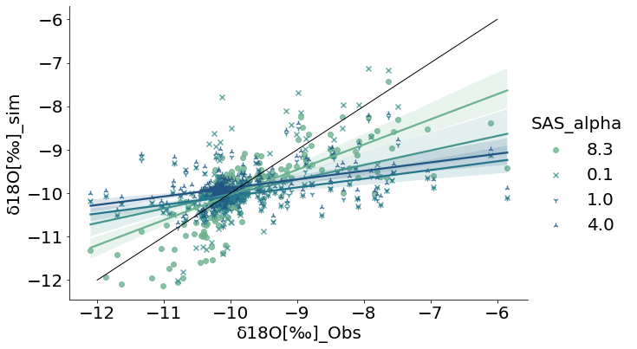
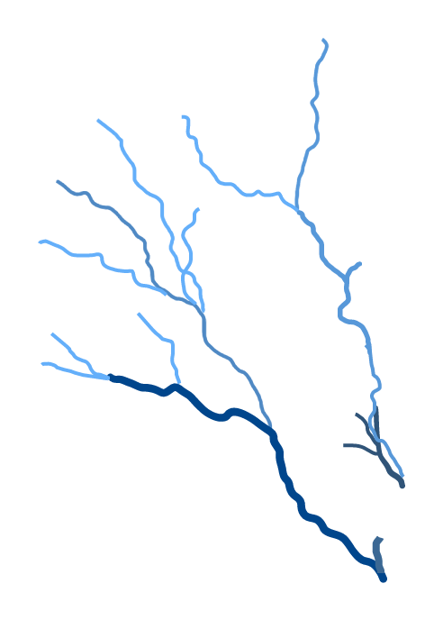
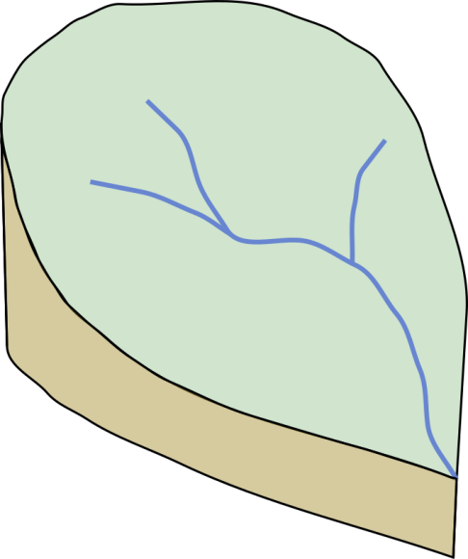
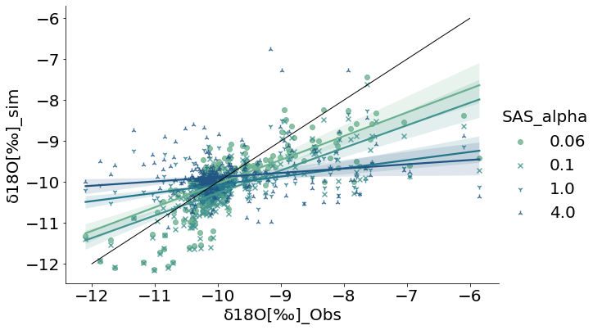
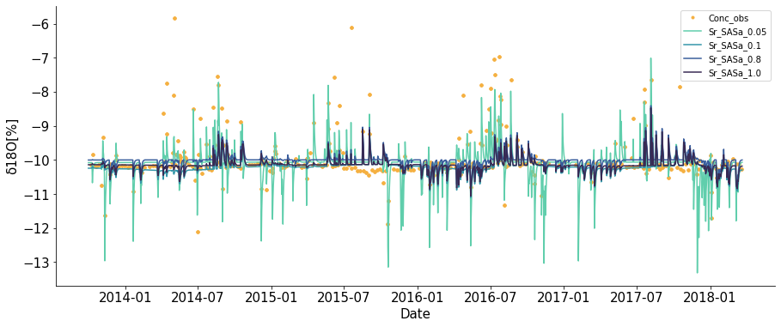
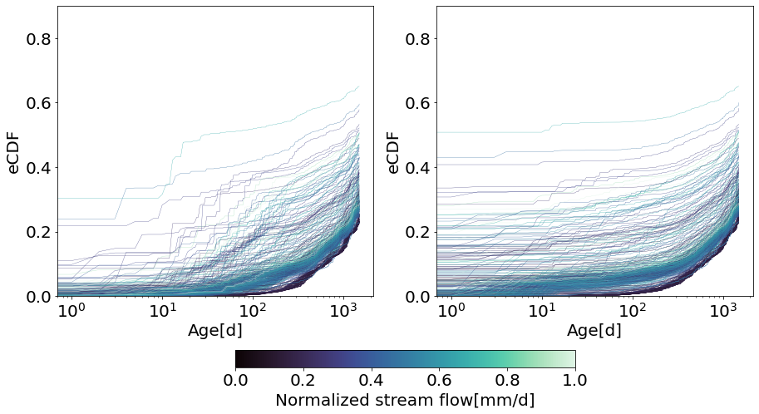
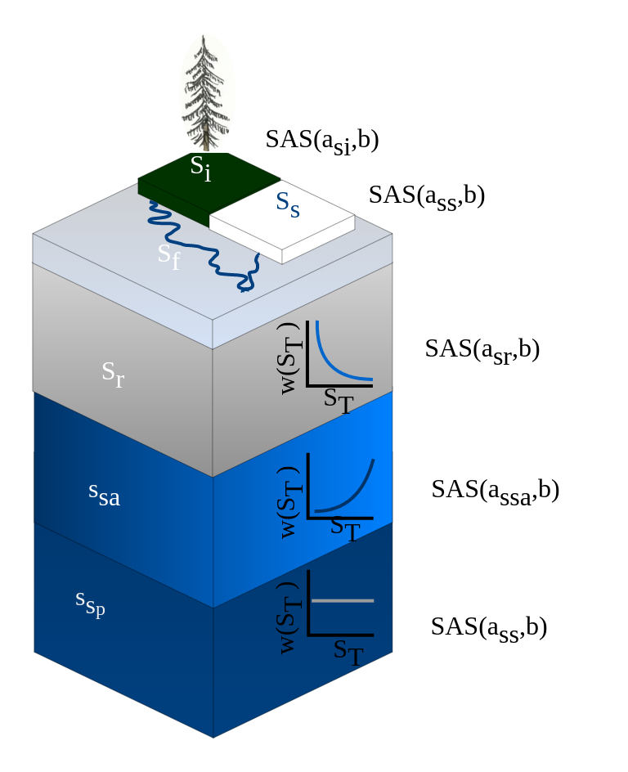
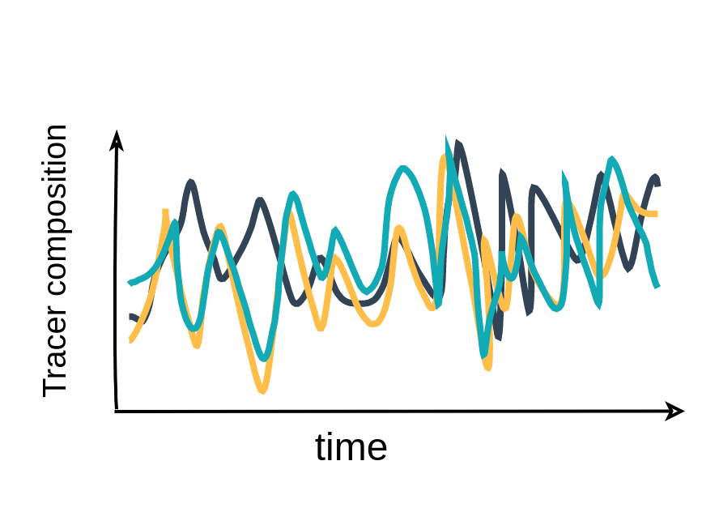
Tracking water movement through a small agricultural catchment using StorAge Selection functions and hydrologic modeling
Hatice Turk¹, Markus Hrachowitz², Karsten Schulz³, Peter Strauss⁴, Günter Blöschl⁵,
Christine Stumpp¹ and Michael Stockinger¹
1 University of Natural Resources and Life Sciences, Vienna, Department of Water, Atmosphere and Environment, Institute of Soil Physics and Rural Water Management, Masseuse 18, 1190 Vienna, Austria
2 Delft University of Technology, Faculty of Civil Engineering and Geo sciences, Department of Water management, Delft, The Netherlands
3 University of Natural Resources and Life Sciences, Vienna, Department of Water, Atmosphere and Environment, Institute of Hydrology and Water Management, Masseuse 18, 1190 Vienna, Austria
4 Institute for Land and Water Management Research, Federal Agency for Water Management, Petzenkirchen, Austria
5 Institute for Hydrology and Water Resource Management, TU Wien, Vienna, Austria
Grant Number: P34666
Introduction
Research questions
The Storage Age Selection functions (SAS) are probability density functions, which quantify how catchments store and release water. The SAS function shape is a key factor in modelling the timescales and variability of water movement within catchments. However, the SAS function shapes for distinct storage components, such as groundwater and the root zone, and their effcets on tracer tracking model calibration remains unknown. To address this knowledge gap, we conducted tests on various shapes for the Storage Selection functions of individual storage components in the Hydrological Open Air Laboratory (HOAL) to disentangle feedbacks between surface and subsurface processes by modelling water travel and residence times.
i) How does the change in the SAS function shape affect the simulations of the tracer concentrations in the stream flow and model efficiency based on the sampling frequency (weekly, event-based)?
ii) What is the SAS alpha parameter range in the root zone and groundwater for headwater flashy catchment?
Study Site
Hydrological and tracer data
Results
Sensitivity of isotope data in the stream when using different SAS fuctions for root zone and groundwater storage
A
1:1 line
1:1 line
Efficiency
Nse = 0.52
Nse = 0.37
Nse = 0.18
Nse = 0.13
Efficiency
Nse = 0.52
Nse = 0.32
Nse = 0.34
Nse = 0.31
B
C
Figure 4: Simulated tracer concentrations based on SAS-a variations in root zone. The red rectangle represents the weekly samples. Efficiency is based on Nash–Sutcliffe efficiency
Figure 5: Simulated tracer concentrations based on SAS-a variations
in groundwater storage.The red rectangle represents the weekly samples.
Efficiency is based on Nash–Sutcliffe efficiency
Figure1: Agricultural headwater catchment (HOAL), located in the western part of Lower Austria, 64 ha. The catchment has a variety of runoff generation mechanisms, including overland flow, wetlands, and tile drains, as well as high-resolution tracer and hydrological data (2013 to 2019)
Sensitivity of event based isotope data in the stream
Variations in TTD with different SAS functions for root zone
Figure2: (A) Measured precipitation, (B) oxygen isotopes in precipitation, and (C) stream flow weekly (yellow) and event-based oxygen isotopes samples (grey)
SAS_a Efficiency
0.06 Nse = 0.52
0.1 Nse = 0.37
0.8 Nse = 0.22
1.0 Nse = 0.18
TTD SAS_a = 0.8
TTD SAS_a = 0.1
Method
Calibrate Tracer/Flow model parameters
Test different SAS functions for
root zone and groundwater
Compare simulated tracer compositions
A
B
C
Figure 6: Simulated tracer compositions based on SAS-a variations in the root zone. Yellow dots are measured data, while lines are simulations based on the SAS_a variation.
Figure 7: Travel time distributions based on variation in SAS-a x-axis represent age in date , y-axis represent empirical cumulative distribution function.
Conclusion
i)
Variations in the Storage Age Selection (SAS) function did not show a significant effect on simulations of tracer compositions for weekly sampled data due to the dominance of the groundwater component in the system
Alpha shape parameter for the SAS function significantly affects simulations tracer composition for event-based samples, and typically falls within the range of 0.01 to 0.1 for this flashy headwater catchment.
A
B
C
Figure 3: Tracer/Flow model: Based on solving water balance, tracer balance and water age balance with multi objective optimization
Illustration of the three main conceptual shapes of StorAge-Selection (SAS) as beta distribution functions where A is release of younger storage, B is uniform release, C is release of older storage.
ii)

