Slide 1
Using Time Series Data and Machine Learning Estimating Agricultural Groundwater Extraction in Huwei Town, Taiwan
Yu-Kai Tseng
Dept. of Bioenvironmental Systems Engineering
National Taiwan University
Feb. 1, 2023

Slide 2
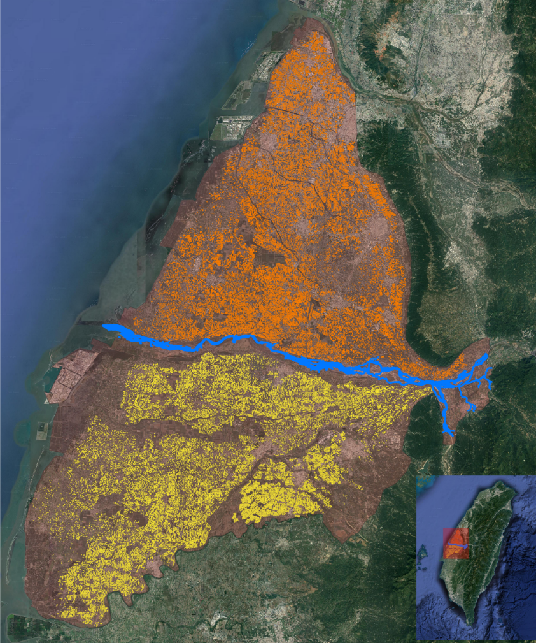
Introduction
Groundwater is an important water resource for irrigation in Taiwan, especially when the first crop rice begins being cultivated in central Taiwan.
Choushui River alluvial fan, located in central Taiwan, has an abundance of groundwater resources.
Hourly groundwater level observations have been widely collected since 1992; however, …
Yunlin

Slide 3
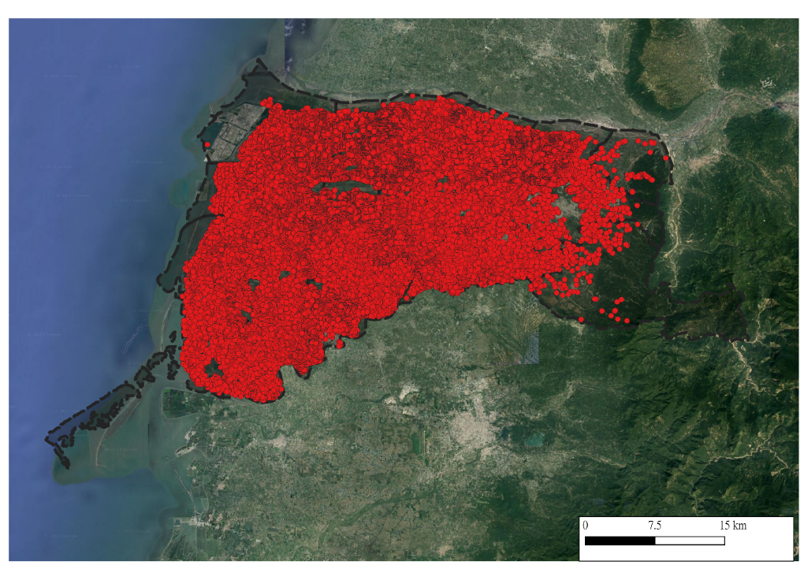
Introduction
Due to cost and political issues, Taiwan has not systematically collected and monitored the pumping volume of private wells.
Yunlin has more than 100,000 private wells, but only has monthly electricity data and almost no water meter monitoring of pumping measurement.
Therefore, it is very difficult to obtain the pumping volume of groundwater.
Private pumping wells in Yunlin

Slide 4
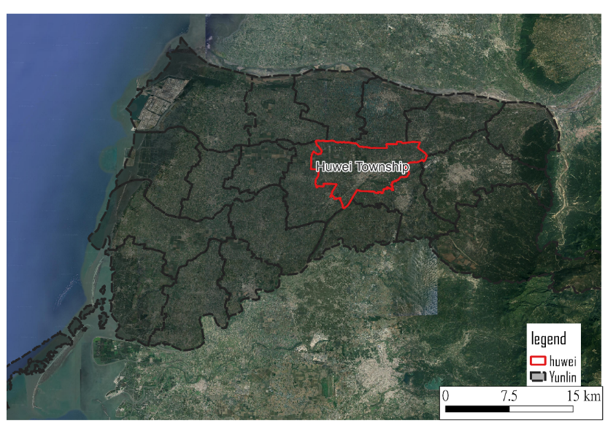
Introduction
The purpose of this study is to analyze the limited amount of pumping series data, identifying some key influencing factors affecting the pumping patterns. And try to build a machine learning model to estimate water withdrawal in Huwei, a town in Yunlin.
Notes:
One of the areas with the most severe subsidence.

Slide 5
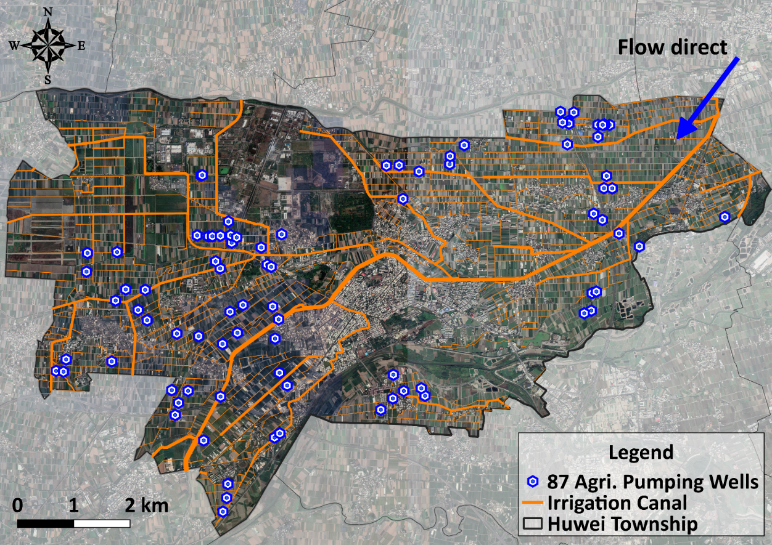
Study Area
Pumping amount data of 87 private pumping wells for irrigation were collected.
The cumulative pumping amount of each well was recorded every 10 minutes.
More than half of the wells (56%) are used for paddy field irrigation.
Water Resources Agency, 2017. Trail implementation plan for water use survey and analysis of available groundwater yield (in Chinese). Water Resources Planning Institute, Water Resources Agency, Ministry of Economic Affairs.

Slide 6
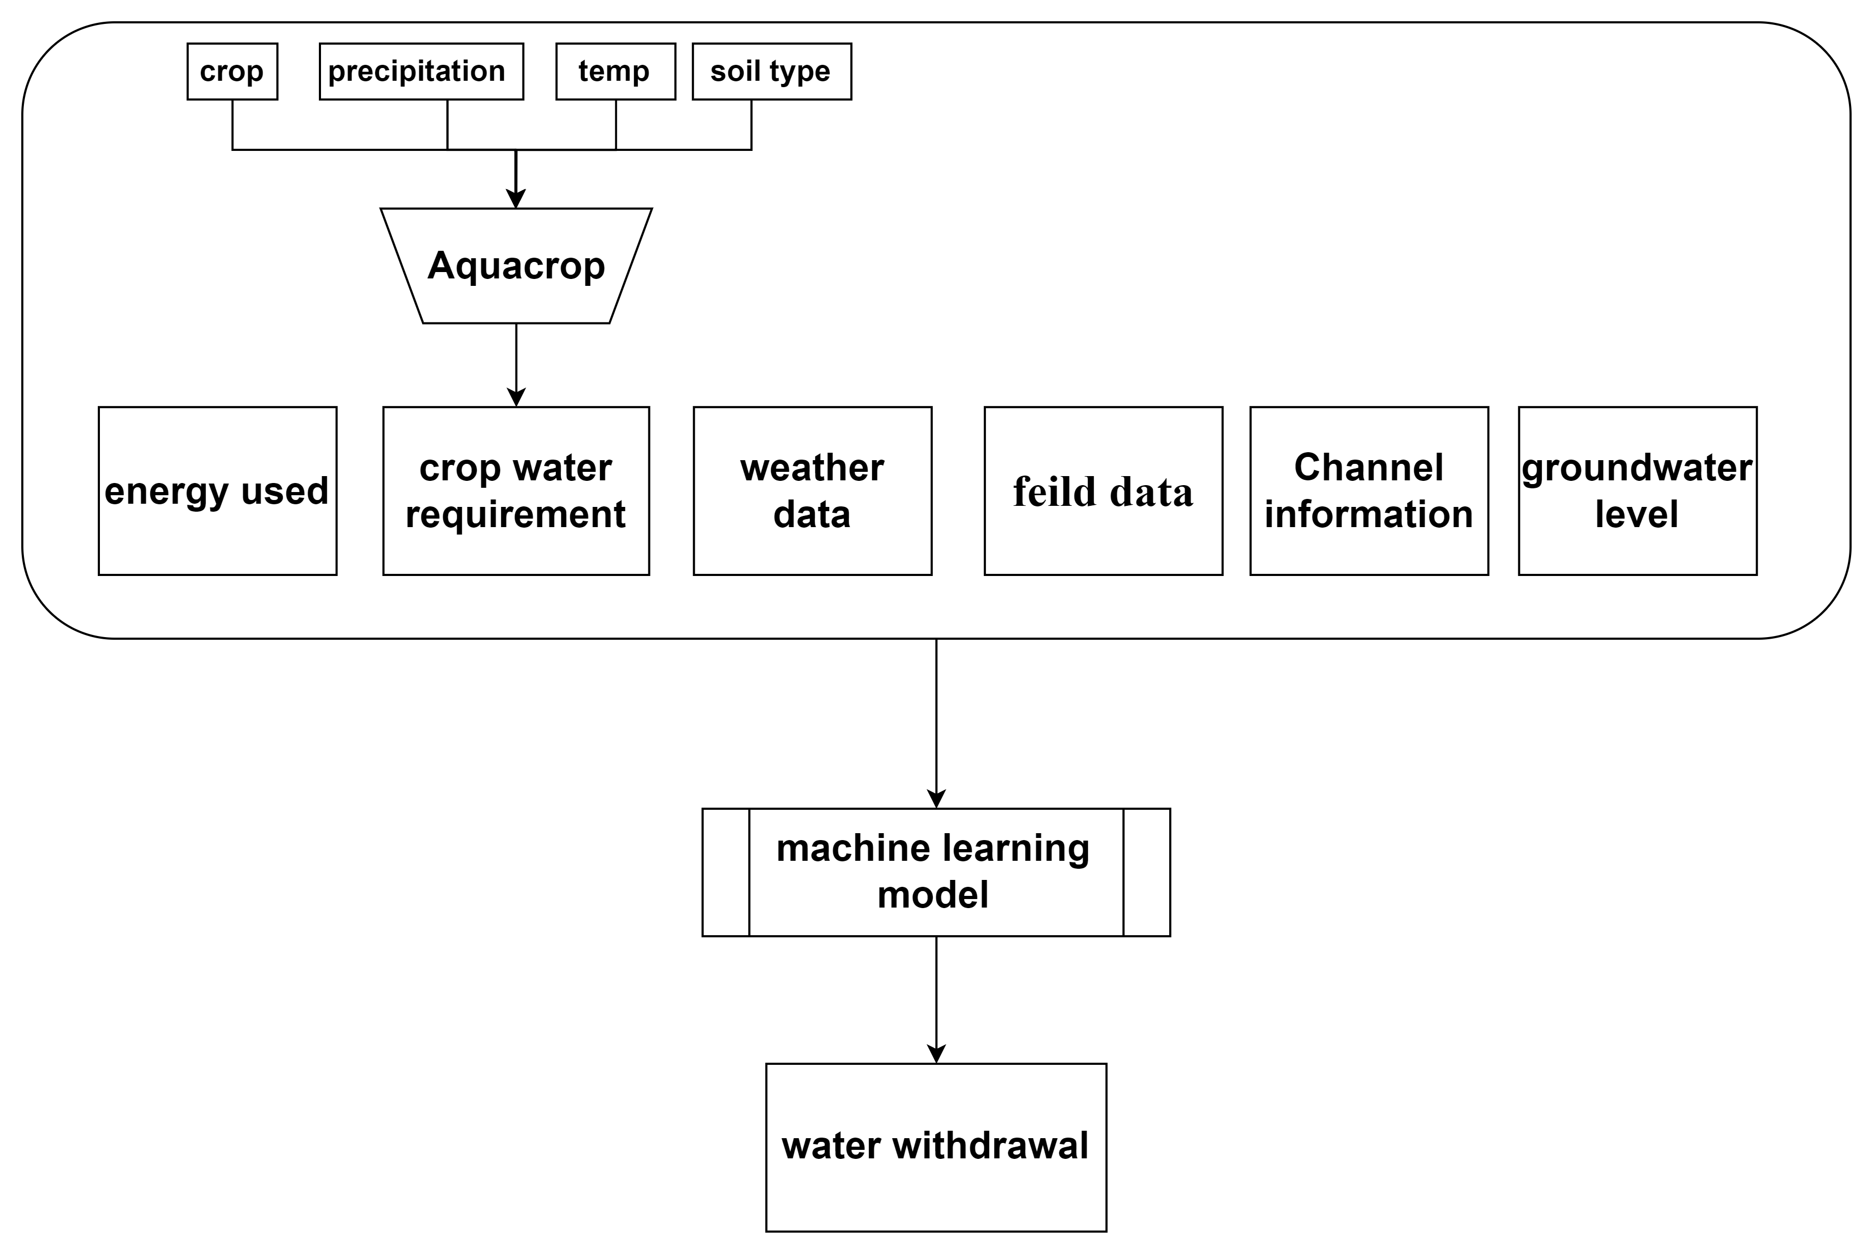
Method
monthly water pumping = f (monthly electricity consumption, crop, rainfall, ...)
features
electricity consumption

Slide 7
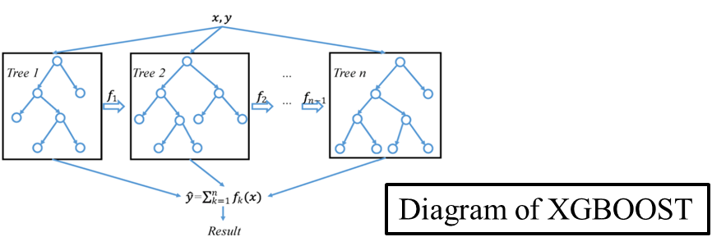
Method - XGBoost
XGBoost is gradient boosting decision tree (GBDT) machine learning algorithm
It is commonly used in machine learning competitions
Can handle a large amount of data and accept limited missing values
It has several methods to prevent overfitting

Slide 8
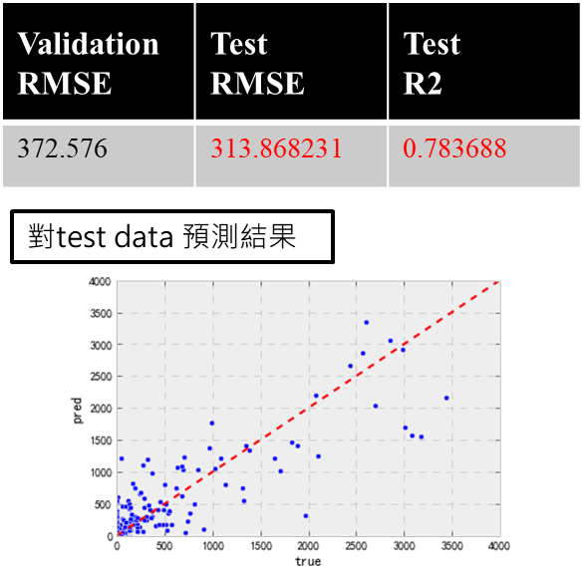
workflow and model result
Using 87 private pumping wells time series data combine other feature and split it to training and validation data
validation
validation

Slide 9
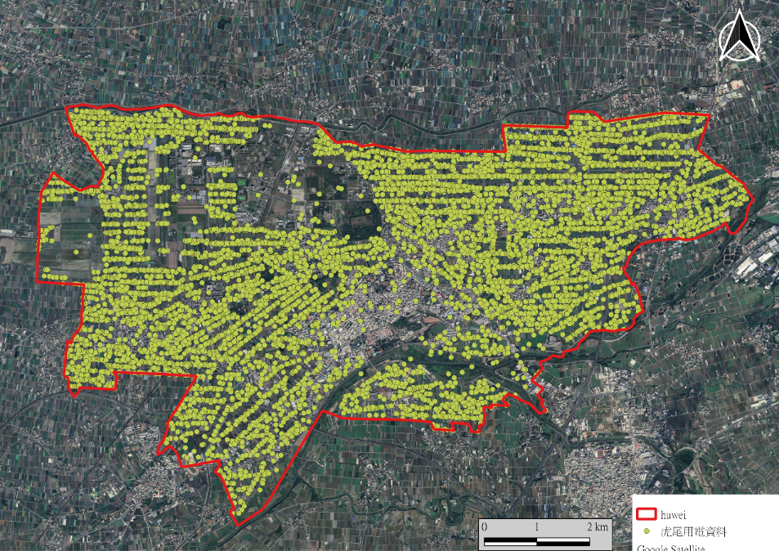
Results – build estimation data set
Using GIS system to overlay electric use data with basic information to create a data set for estimation.
A total of 8,646 well estimation datasets were created.

Slide 10
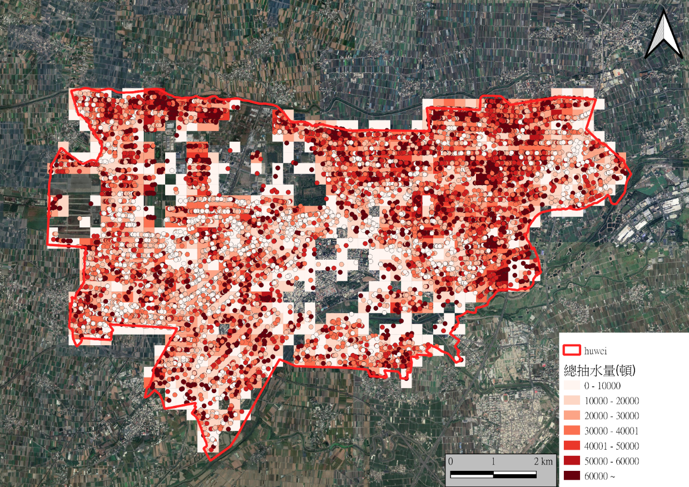
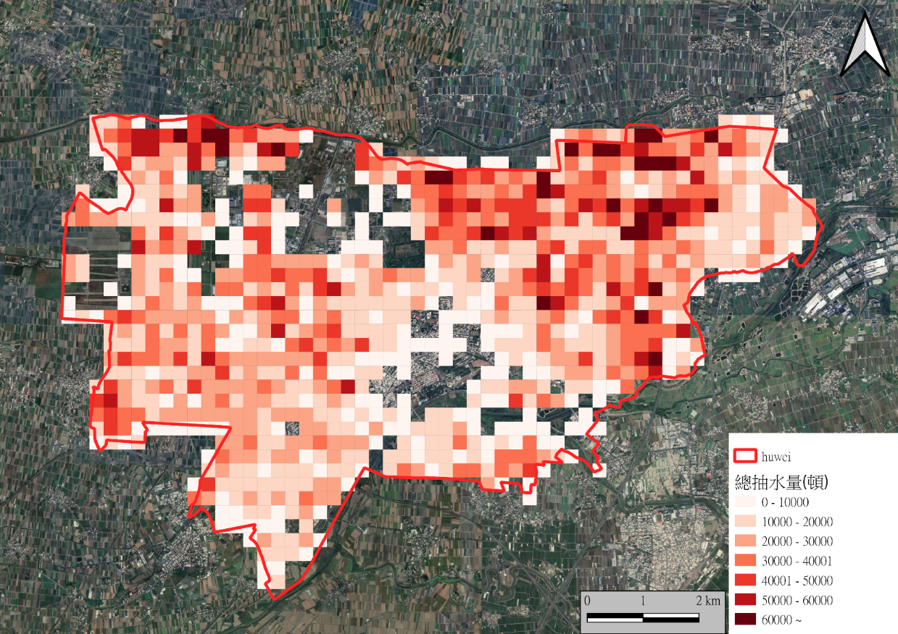
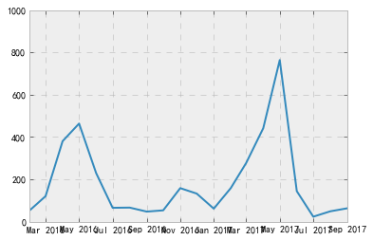
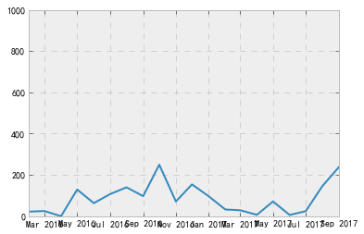
Results - water withdrawal estimate
Estimated total water pumping from 2016/2 to 2017/1 : 28,852,580 tons
2016/2 ~ 2017/1 water withdrawal estimate
Well ID：5756
crops： rice
Well ID : 1429
crops： peanut
Water withdrawal (ton)

Slide 11
Results & Discussion
First crop season
second crop season
First crop season

Slide 12
Conclusions
This project collects cross-domain attribute feature data in the Huwei area, and establishes a supervised learning model by labeling attribute data
Using indirect data to estimate the water pumped in the Huwei area from 2016 to 2017, the time and space distribution of water pumped in the Huwei area was obtained.
the water pumped in the Huwei area 2016/2 ~ 2017/1 was estimated to be 28,852,580 tons, and April to May was the pumping peak.
Thank you!
Yu-Kai Tseng
Dept. of Bioenvironmental Systems Engineering
National Taiwan University

Slide 13
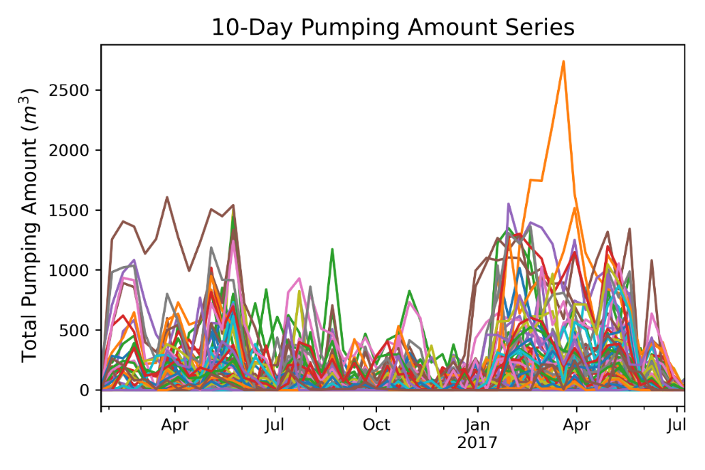
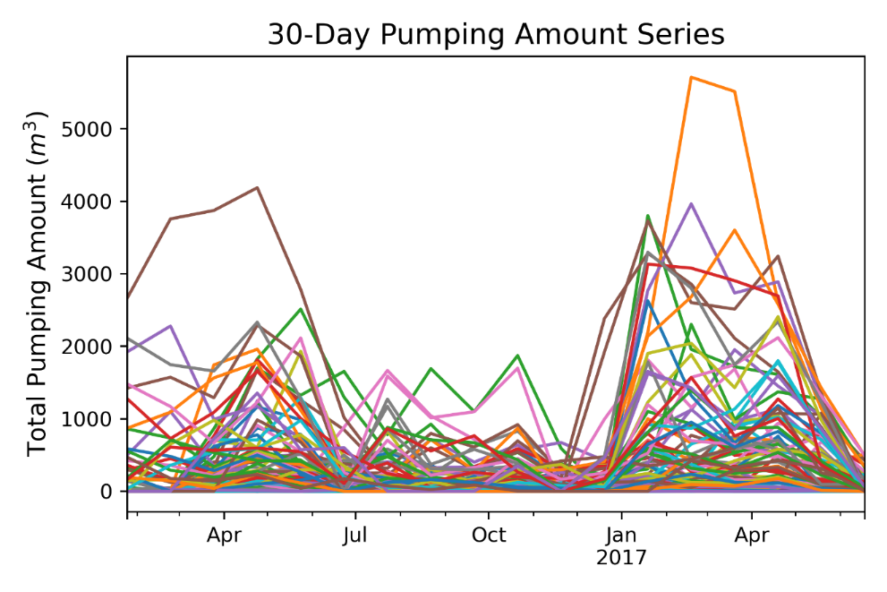
Method
Data pre-processing
10-minute pumping amount series are derived by the first-order difference.
The pumping amount of each well is divided by its corresponding field area.

Slide 14
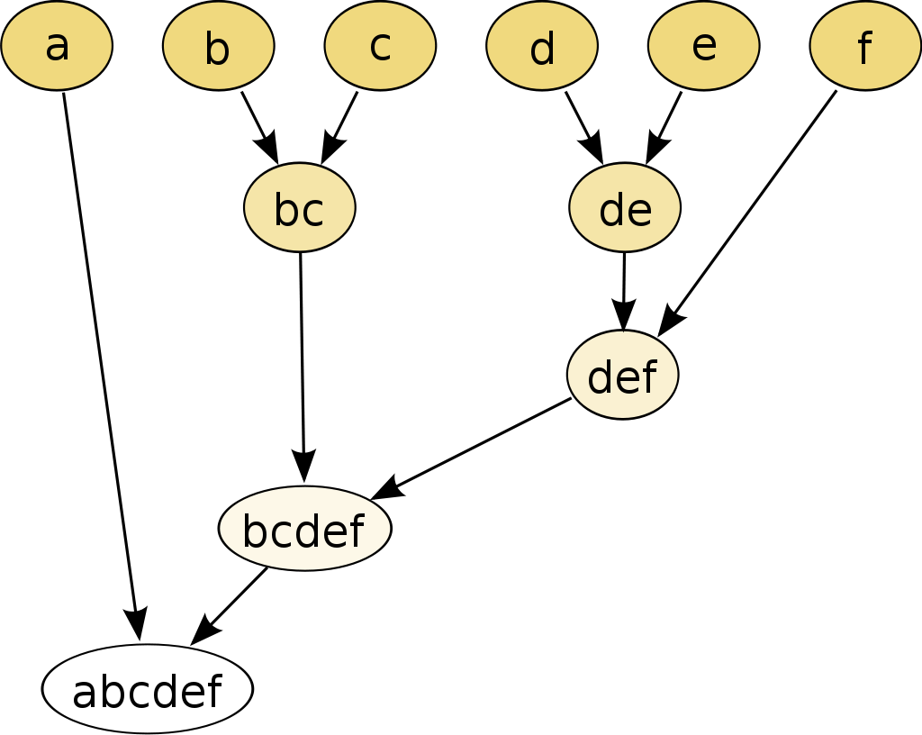
Method
$$d\left(X_{i},X_{j}\right)=\sum_{a∈X_{i}∪X_{j}}{\left\|a−μ_{X_{i}∪X_{j}}\right\|}$$
Hierarchical clustering analysis is applied to analyze the data in this study.
In the agglomerative strategy, each observation starts in its own cluster, and pairs of clusters are merged as one moves up the hierarchy.
Ward’s minimum variance method: minimizes the variance of the two merged clusters.
(From: User:Mhbrugman @Wikipedia)

Slide 15
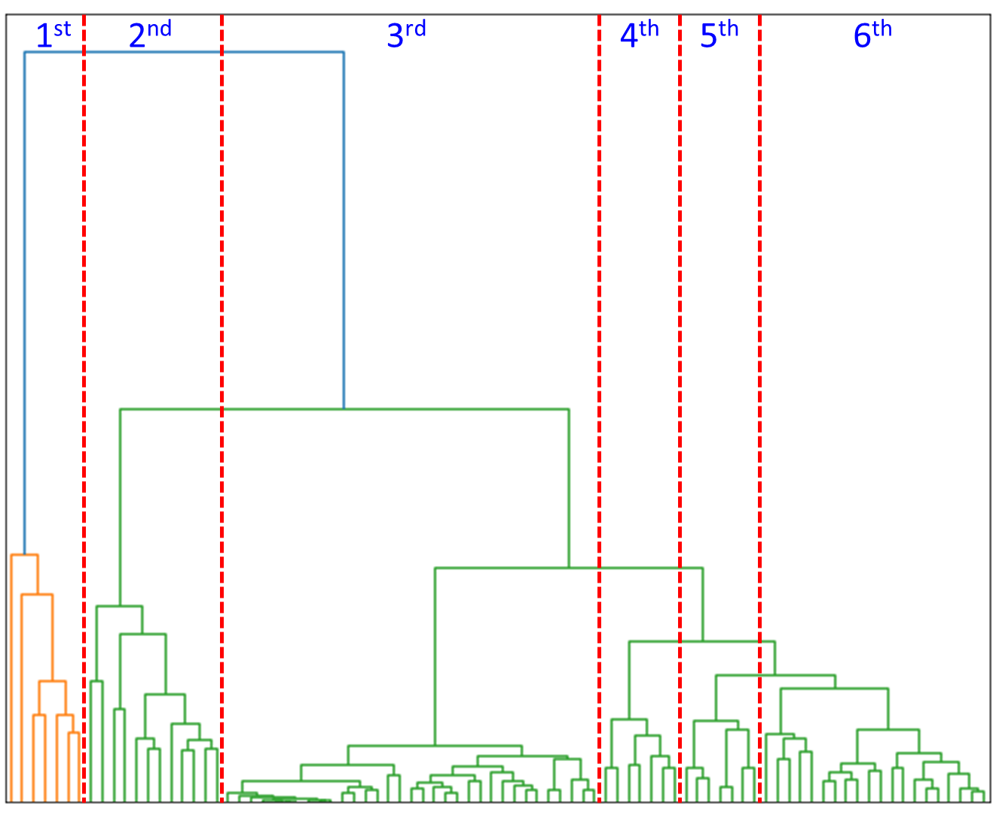
Results & Discussion
The hierarchical clustering analysis is first applied to the 87 monthly pumping amount series.
The dendrogram illustrate the arrangement of the clusters, and these clusters are then classified into six main categories.

Slide 16
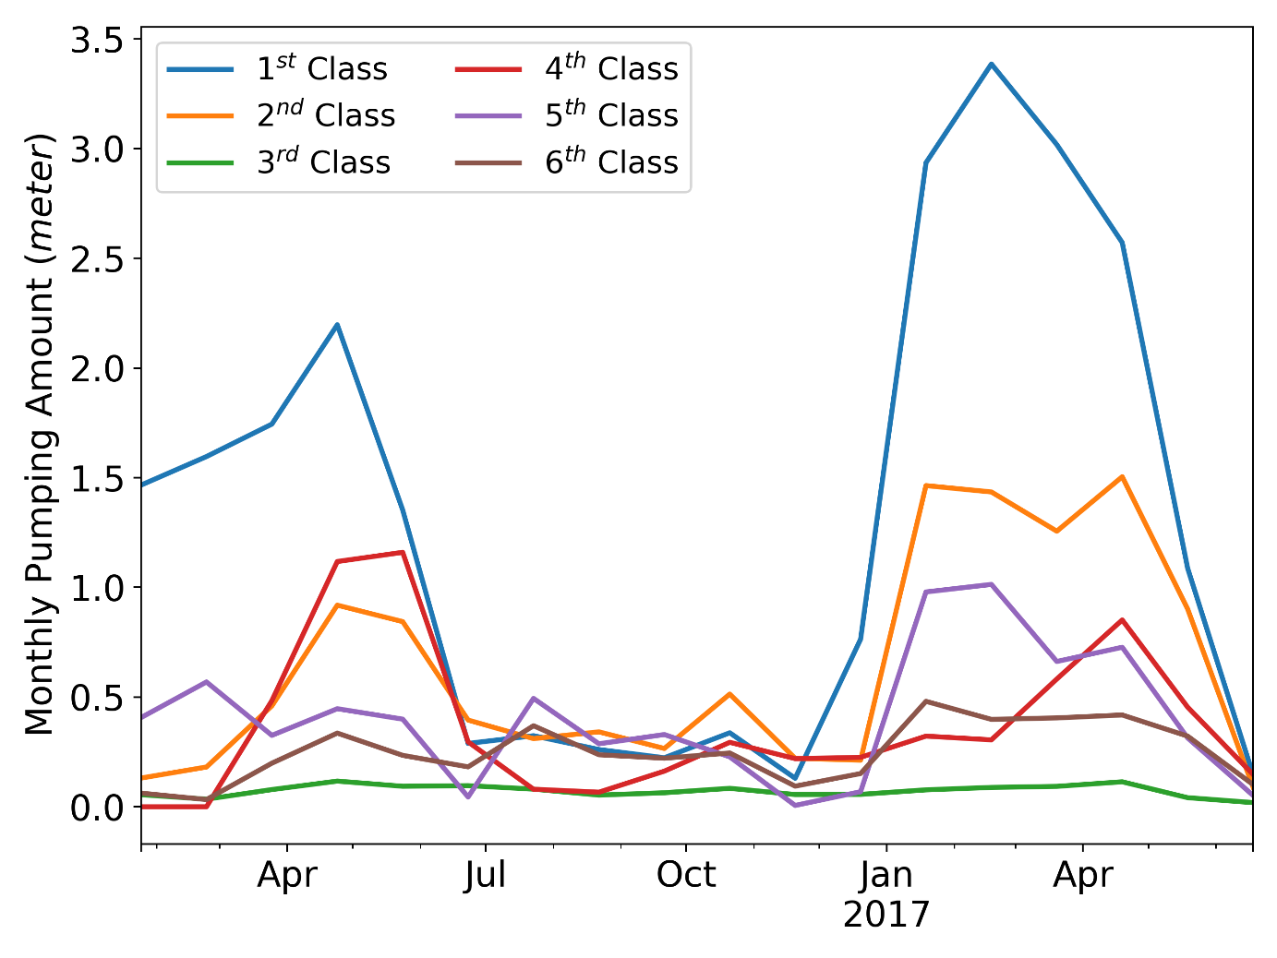
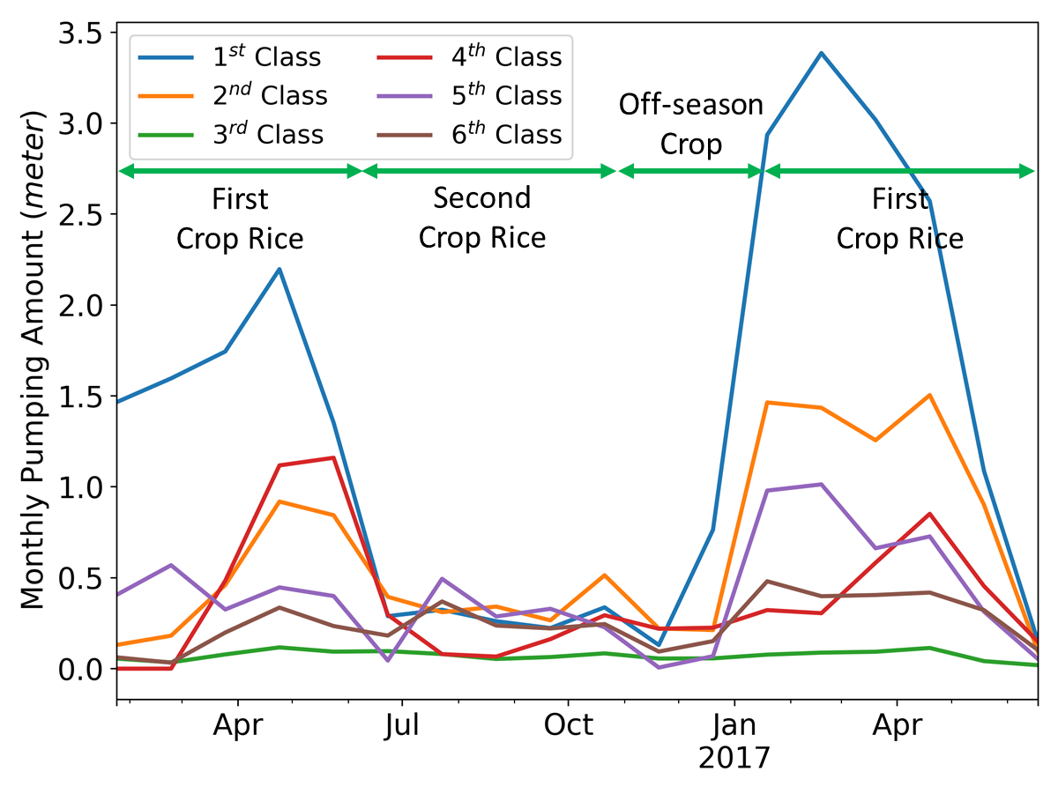
Results & Discussion
Pumping patterns & crop types
The pattern of the third category is obviously different from the others. Upland crops were cultivated on most of the fields irrigated with the wells of the third category while the first crop rice, at least, was cultivated on the others.

Slide 17
Results & Discussion
Pumping patterns & water supply
There are two peaks during the first crop rice cultivation. In Huwei, only little amount of surface water is supplied during the first cultivation period so farmers can only rely on groundwater for irrigation.

Slide 18
Results & Discussion
Pumping patterns & cultivation periods
Some fields lay fallow during the off-season crop cultivation, so the pumping amounts dropped in November.

Slide 19
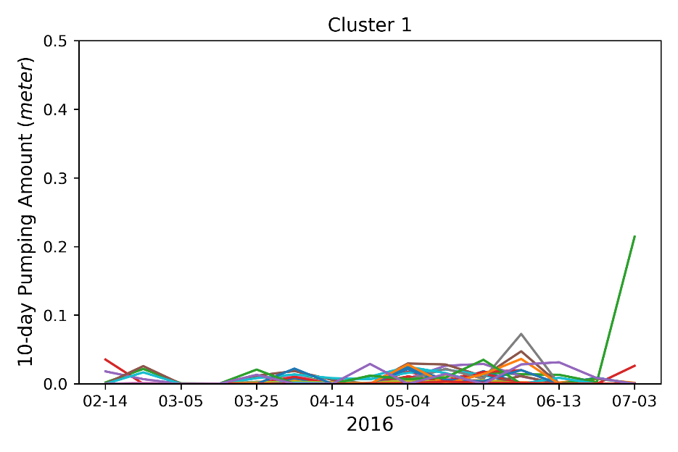
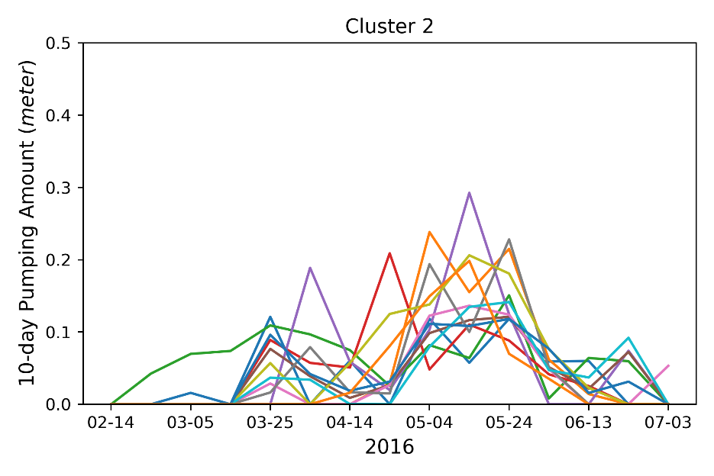
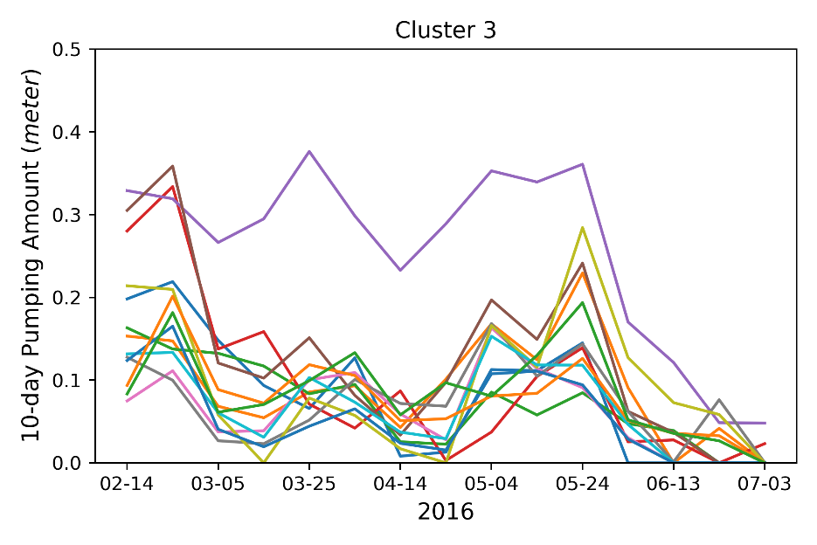
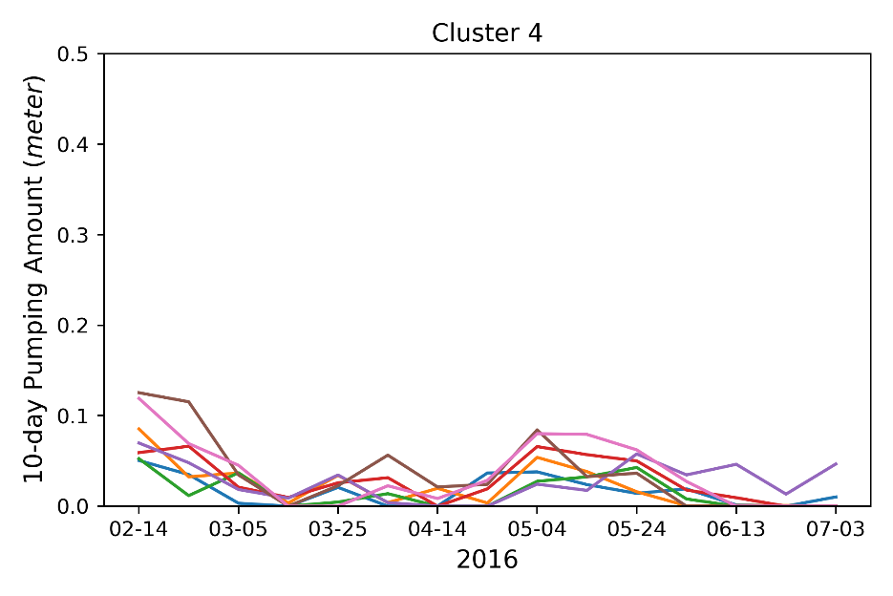
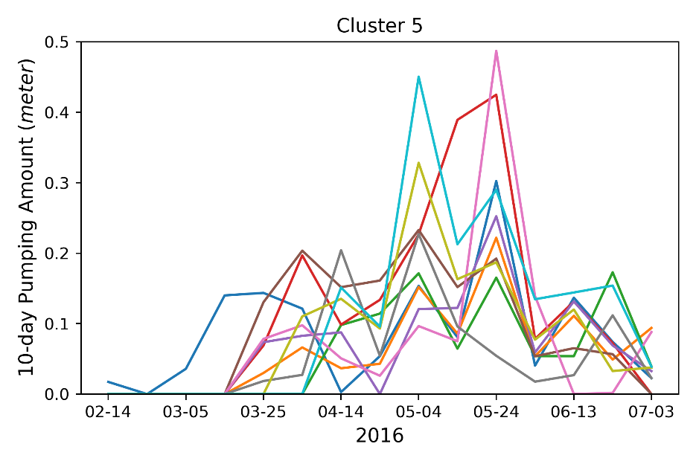
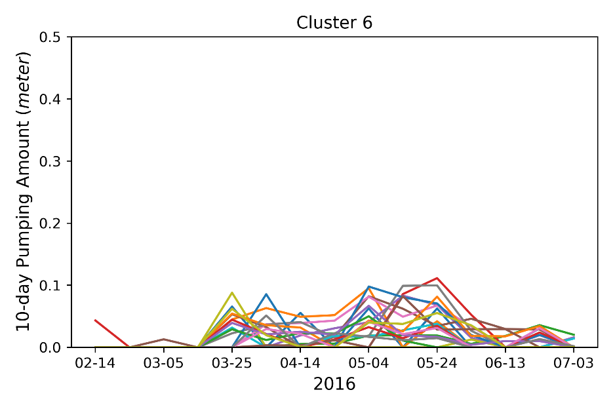
Results & Discussion
1
2
3
Rice
Rice
4
5
6
Rice

Slide 20
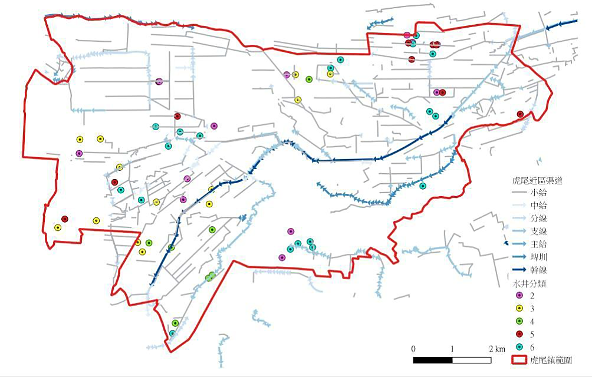
Results & Discussion
4
3
4
5

