Slide 1
A LASER DIFFRACTOMETRY TECHNIQUE FOR DETERMINING THE SOIL WATER STABLE AGGREGATES INDEX
JAN-FRANTIŠEK KUBÁT · MICHAL VRÁNA · DAVID ZUMR · PETR KAVKA

Slide 2
WATER STABLE AGGREGATES INDEX
WSAi
WHY
Gives us a quick indication of the soil condition
AIM
Develop a technique that is comparable to the commonly used wet sieving technique
Fast, reliable and simple to perform
METHODS
Six sampling sites
Eijkelkamp wet sieving apparatus – wet-sieving (WS technique)
Mastersizer 3000 – sonication and laser diffractometry (SLD technique)

Slide 3
INTRODUCTION OF SLD TECHNIQUE
SLD - SONICATION AND LASER DIFFRACTOMETRY
PRINCIPLE
Comparison of two particle size distributions
Kemper and Rosenau
$${WSAi}_{WS}=\frac{Soil Mass in Solution}{Soil Mass in Water+Soil Mass in Solution}$$
Kubát and Vrána (simplified eq. – full eq. here)
$${WSAi}_{SLD}=\frac{Volume Residue in Solution}{\frac{Volume Residue in Water+Volume Residue in Solution}{Number of Size Classes}}$$

Slide 4
A Laser Diffractometry Technique for Determining the Soil Water Stable Aggregates Index
NAVIGATION MAP
tap to navigate
PRINCIPLE
PRINCIPLE
WORKFLOW
SETTINGS
RESULTS
JAN-FRANTIŠEK KUBÁT · MICHAL VRÁNA · DAVID ZUMR · PETR KAVKA

Slide 5
A Laser Diffractometry Technique for Determining the Soil Water Stable Aggregates Index
PRINCIPLE
Comparison of particle size distributions
$${WSAi}_{SLD, soil}=\frac{\sum_{1}^{n}{\frac{SR_{sol,n}}{SR_{w,n}+SR_{sol,n}}}}{n} ·100$$
SR_{sol,n} is the volume residue in the n-th size class in the dispersion solution (%)
SR_{w,n} is the residue in the n-th size class in water (%)
WSAi_{SLD,soil} is the water stable aggregates index of the soil (%)
n is the number of size classes (80 in this case)
NAVIGATION
PRINCIPLE
WORKFLOW
SETTINGS
RESULTS

Slide 6
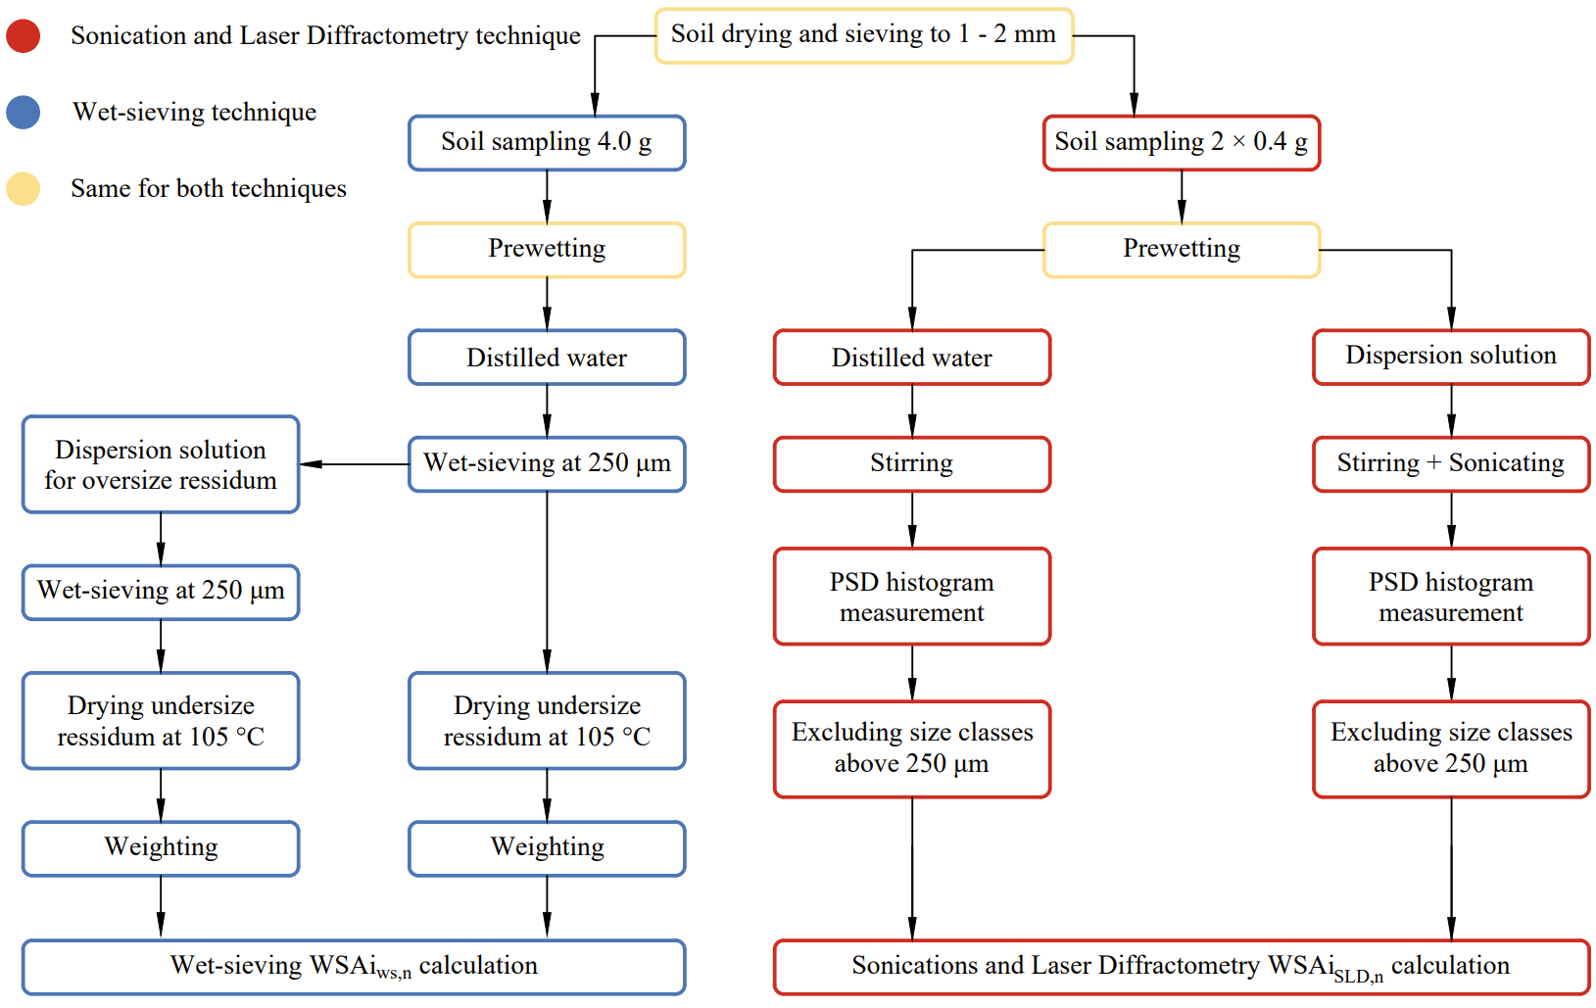
A Laser Diffractometry Technique for Determining the Soil Water Stable Aggregates Index
WORKFLOW
NAVIGATION
PRINCIPLE
WORKFLOW
SETTINGS
RESULTS

Slide 7
A Laser Diffractometry Technique for Determining the Soil Water Stable Aggregates Index
SETTINGS
Mastersizer 3000
Parameter |  | Distilled water | Dispersion solution
Soil properties | Refractive index | 1.457
 | Absorption index | 0.01
 | Particle density (g·cm⁻³) | 2.64
 | Sample amount (g) | 0.4
Properties of the solution | Refractive index | 1.33
Hydro LV properties | Sonicating level (%) | 0 | 100
 | Sonicating time (s) | 0 | 70
 | Stirrer/pump speed (rpm) | 2500
Measurement Properties | Red-laser duration (s) | 10
 | Blue-laser duration (s)
 | Repetitions | 5
 | Weighted residua (%) | < 1
Total operating time (s) |  | 100 | 170
Total measurement time (s) |  | 100
Instrument settings during the measurement of the particle size distribution
NAVIGATION
PRINCIPLE
WORKFLOW
SETTINGS
RESULTS

Slide 8
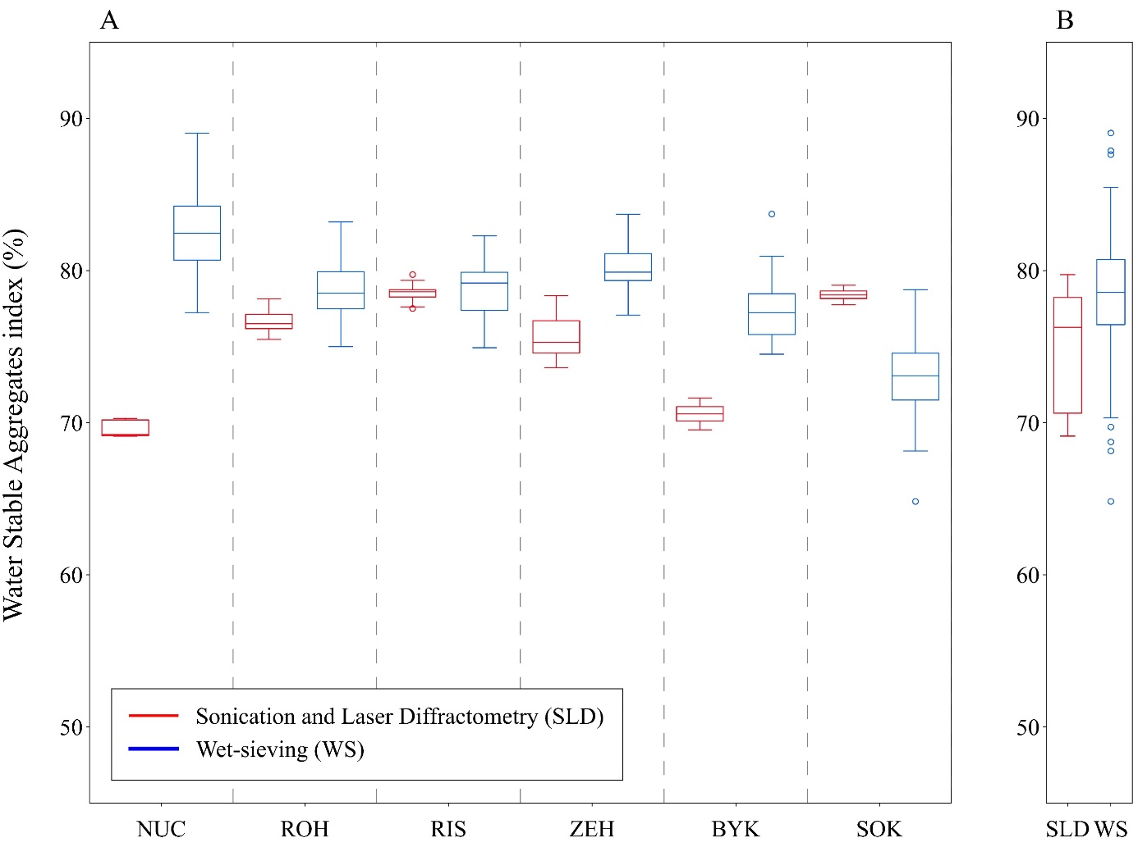
A Laser Diffractometry Technique for Determining the Soil Water Stable Aggregates Index
RESULTS
RMSE – 6.7 %
ANOVA p-value – 0.11
NAVIGATION
PRINCIPLE
WORKFLOW
SETTINGS
RESULTS

