Slide 1



Climate Change Mitigation in The Bahamas
The Power of Earth Observation for Blue Carbon Accounting
Alina Blume
European Space Agency
24.04.2023 EGU 2023

Slide 2


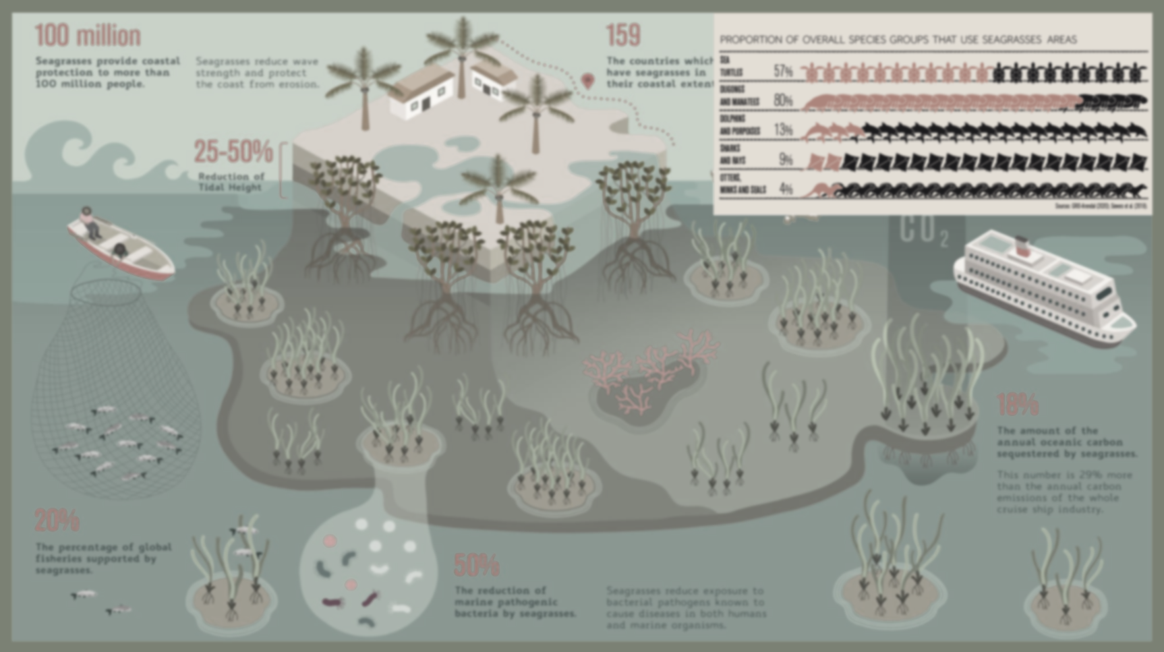
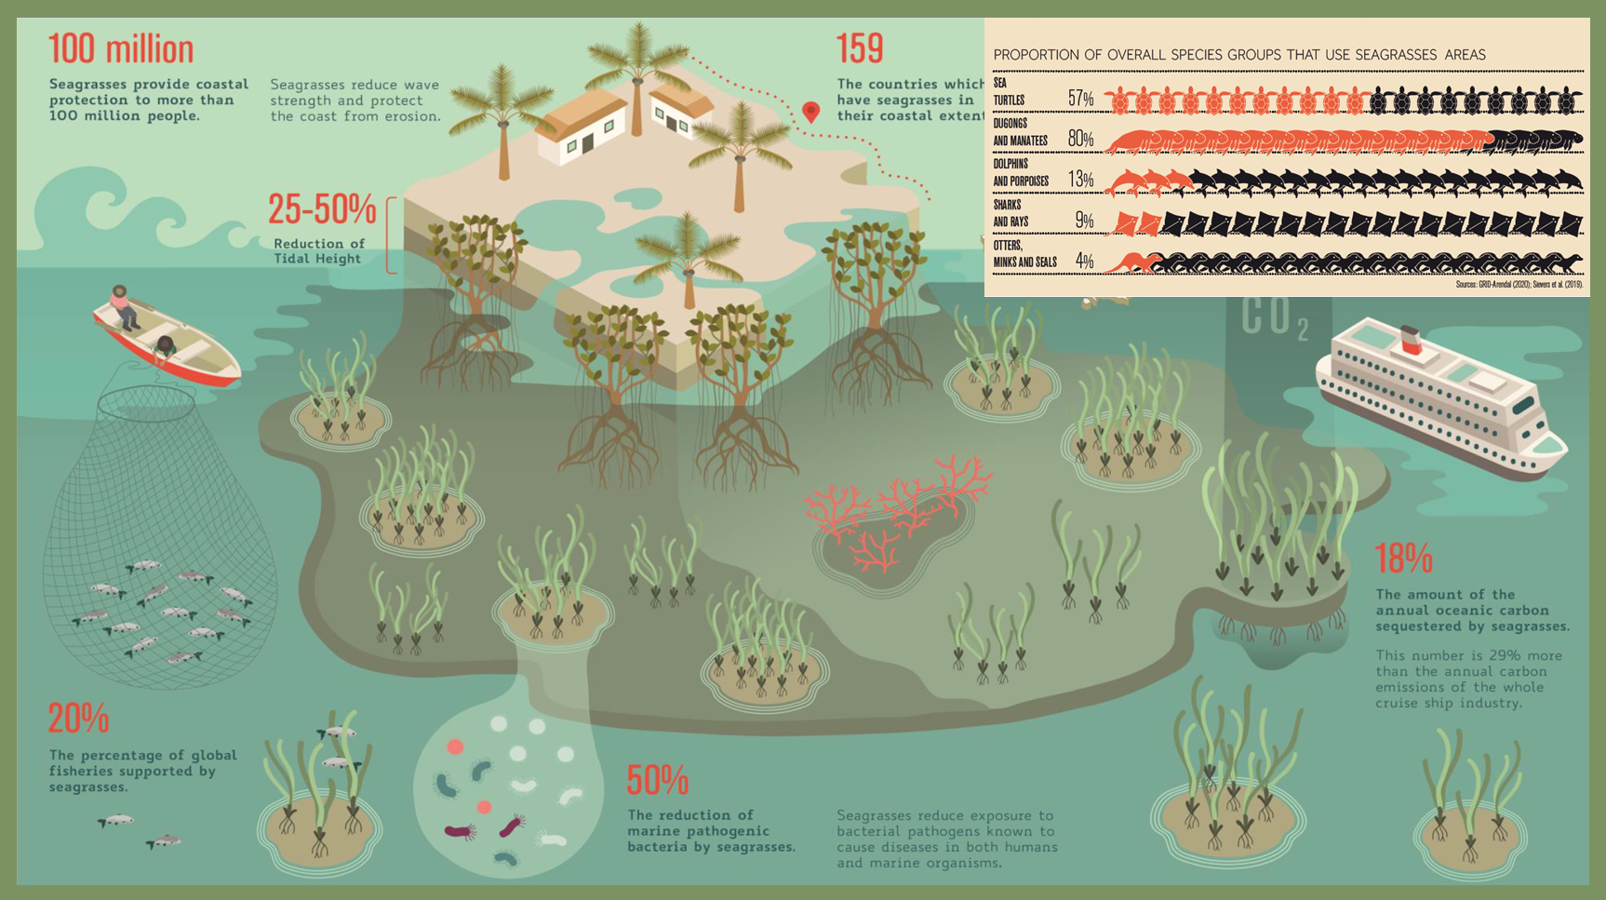
Seagrass Ecosystem Services
Global Seagrass Watch (2019)
Alina Blume – EGU 2023 – 24.04.2023

Slide 3
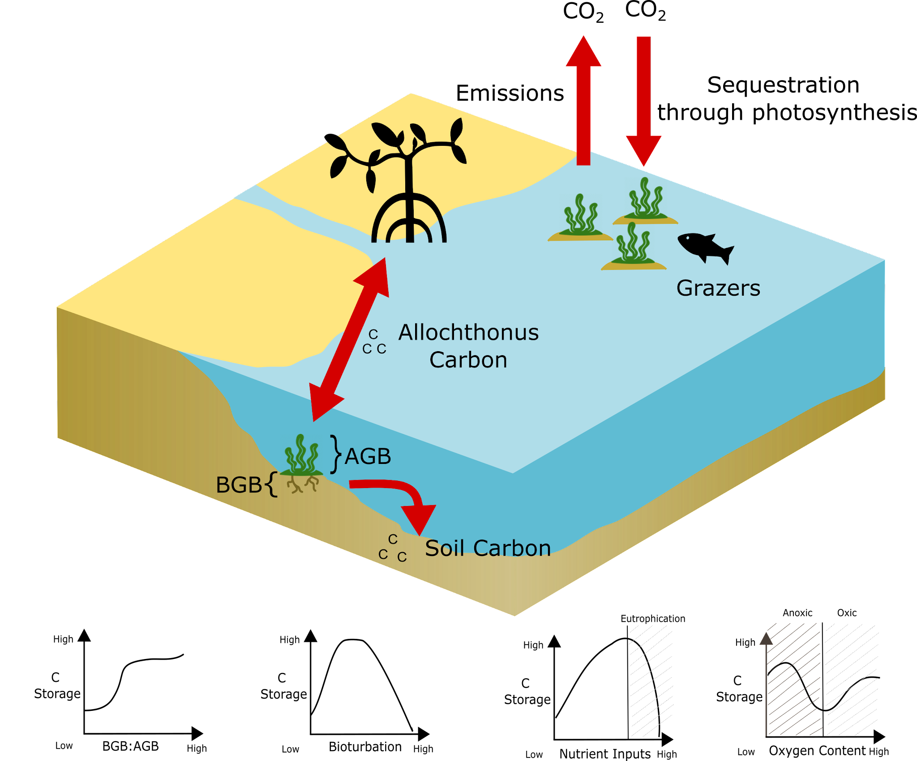
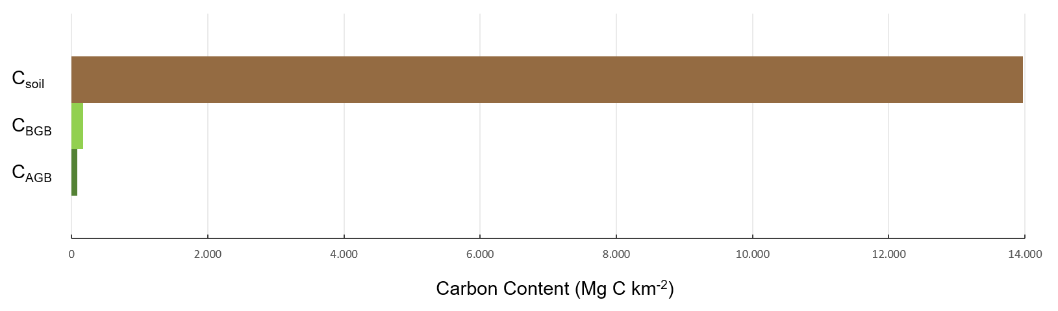
Seagrass Blue Carbon
Sequestration rates 35x faster than tropical rainforests
C_{total} = C_{AGB} + C_{BGB} + C_{soil}
Soil carbon can be stored for millennia
Global carbon stock 9.8 – 19.8 Pg C
13,970
168
84
(Howard et al., 2014)
AGB = Above-Ground Biomass
BGB = Below-Ground Biomass
Adapted from Howard et al. (2014)
Alina Blume – EGU 2023 – 24.04.2023

Slide 4
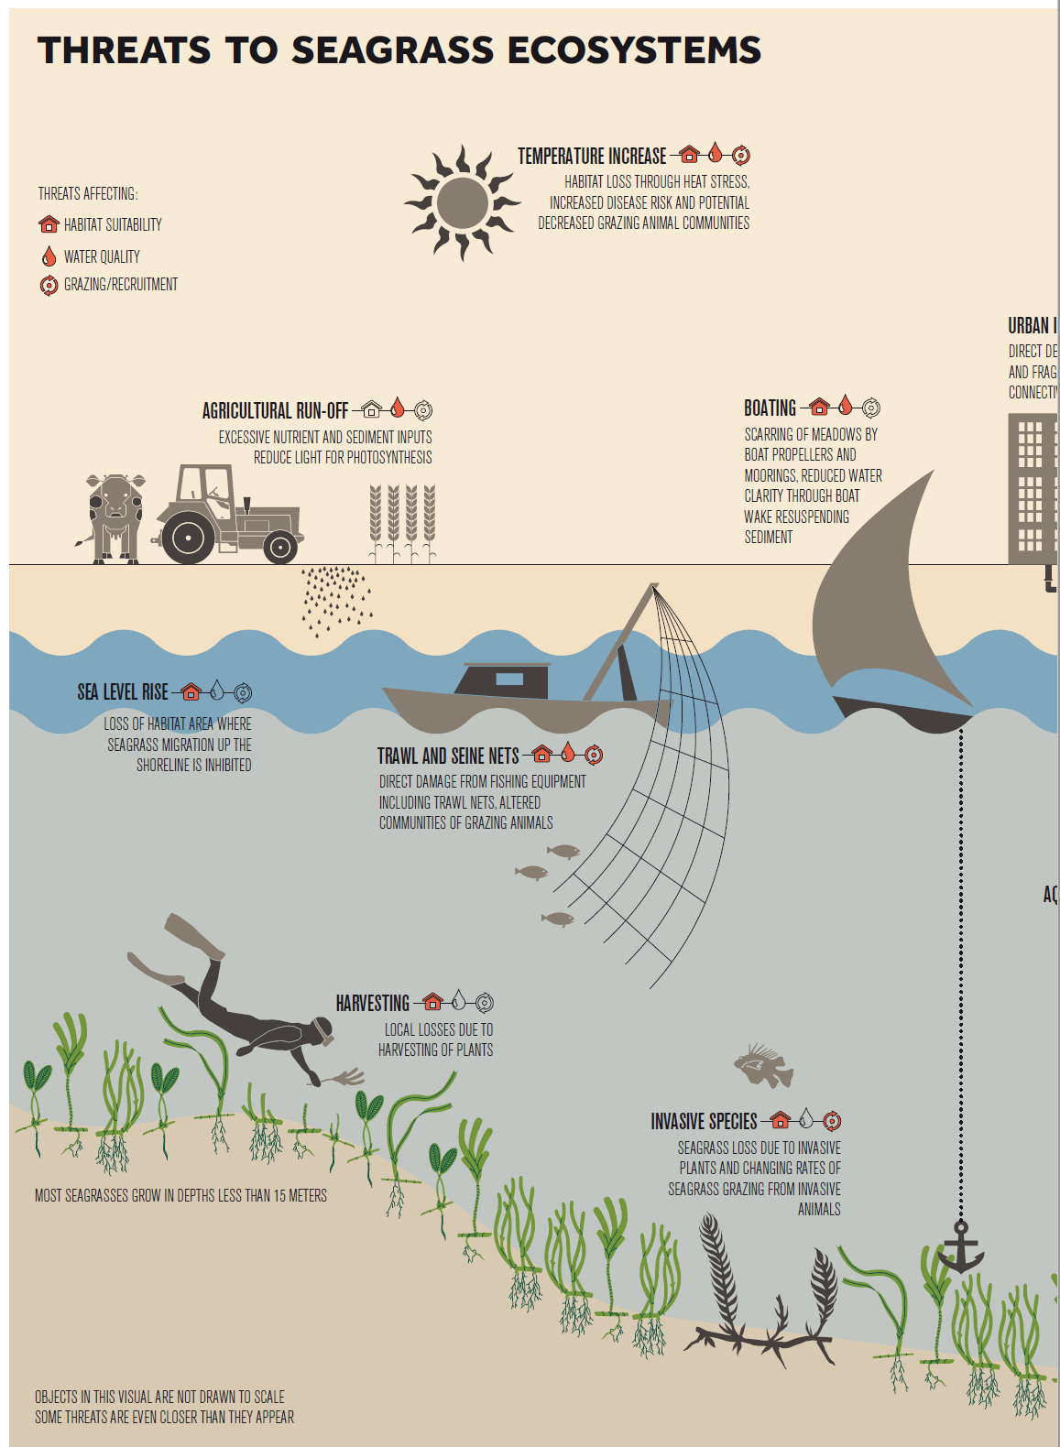
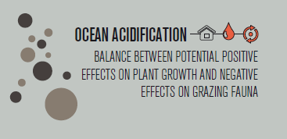
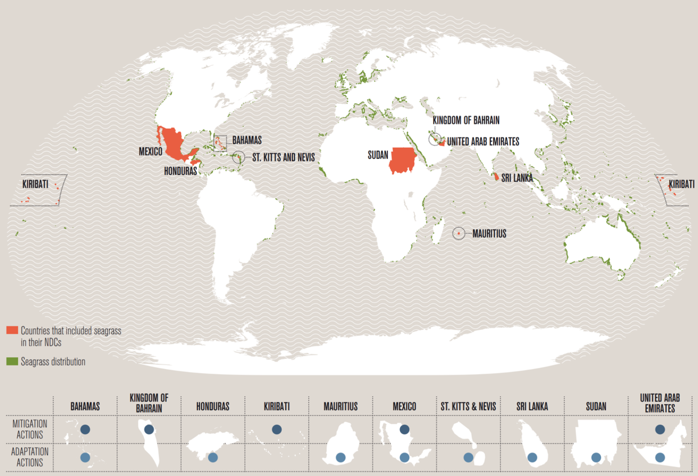

Seagrasses & the Paris Agreement
Cape Verde
Seychelles
Mozambique
(UNEP, 2020)
Alina Blume – EGU 2023 – 24.04.2023

Slide 5
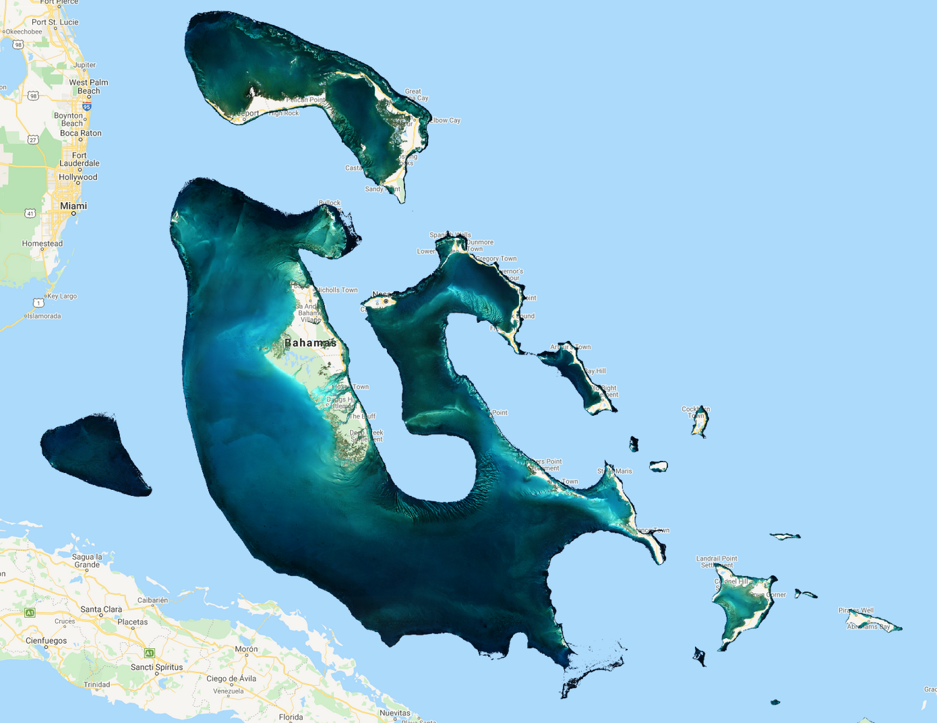
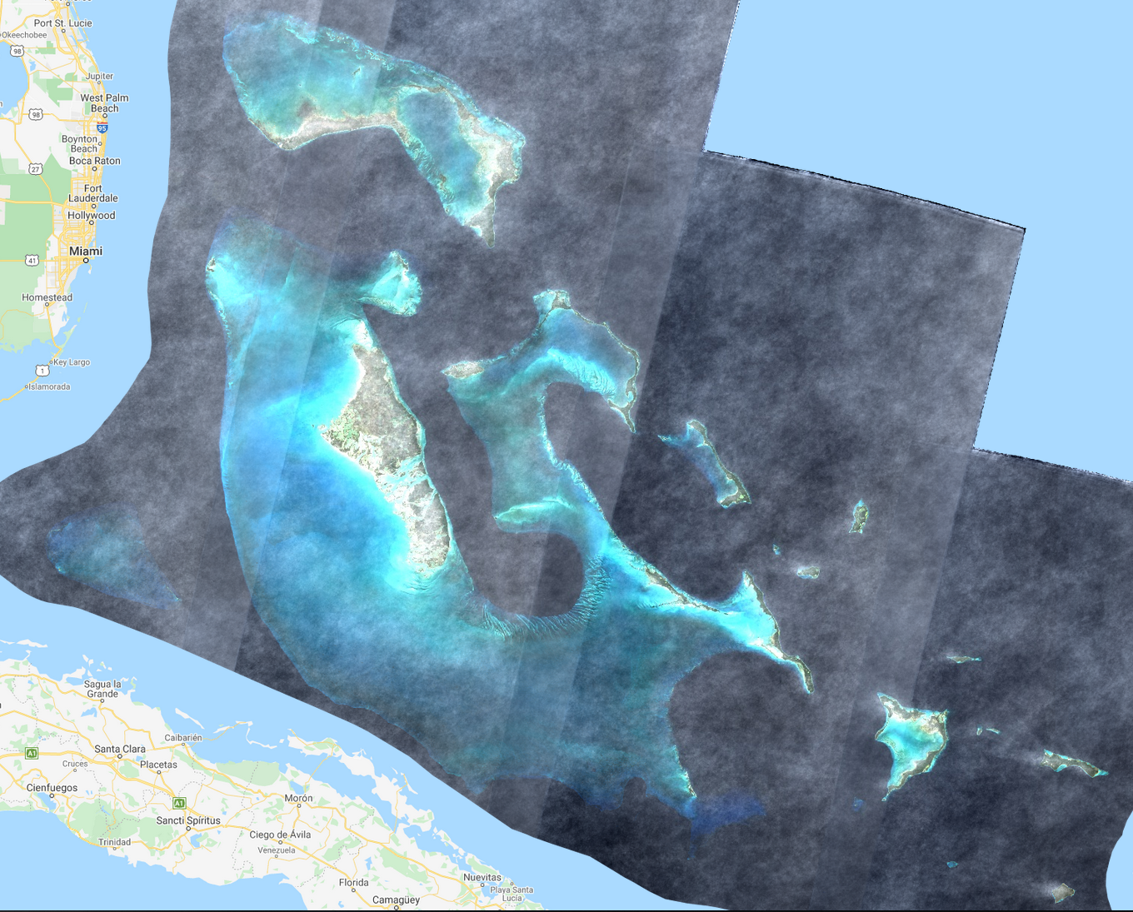
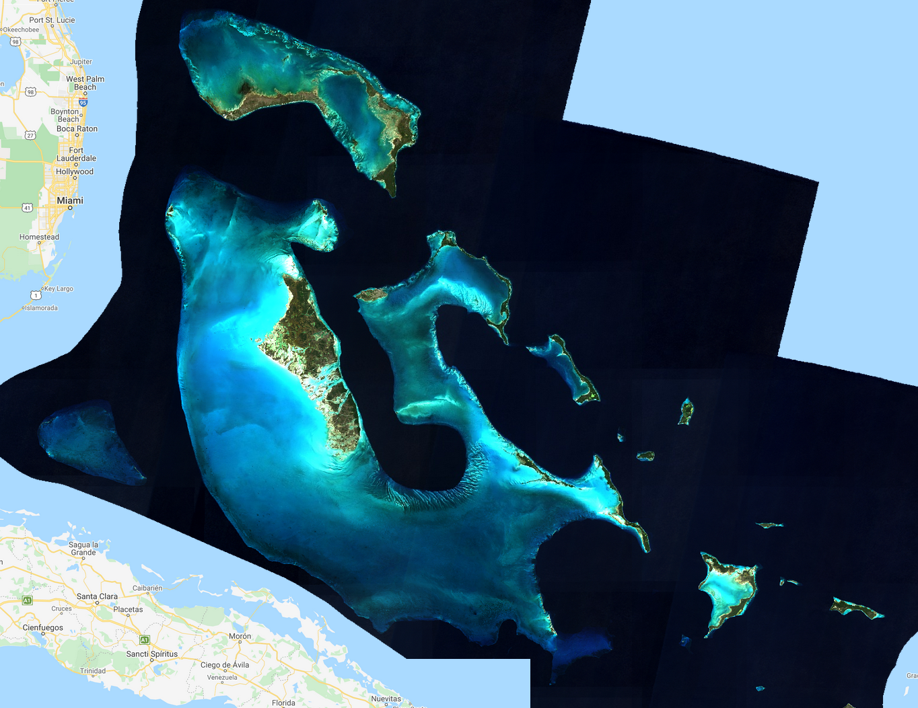
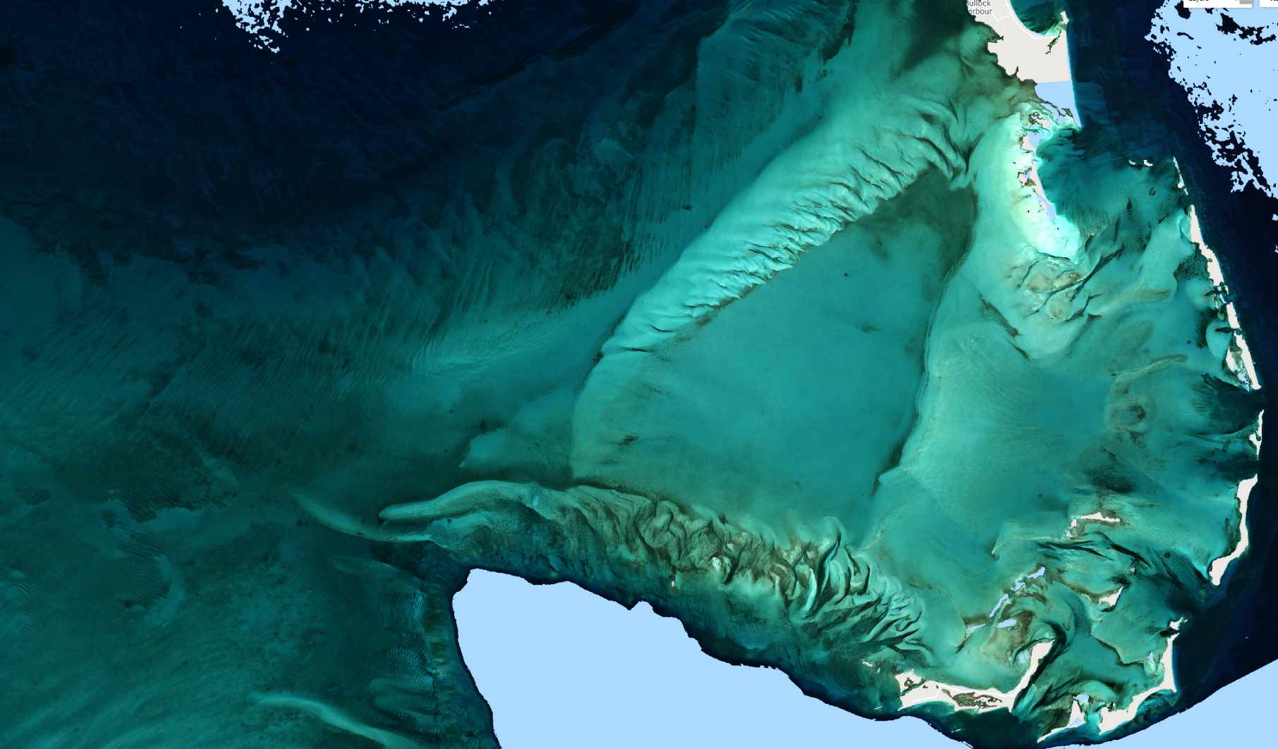

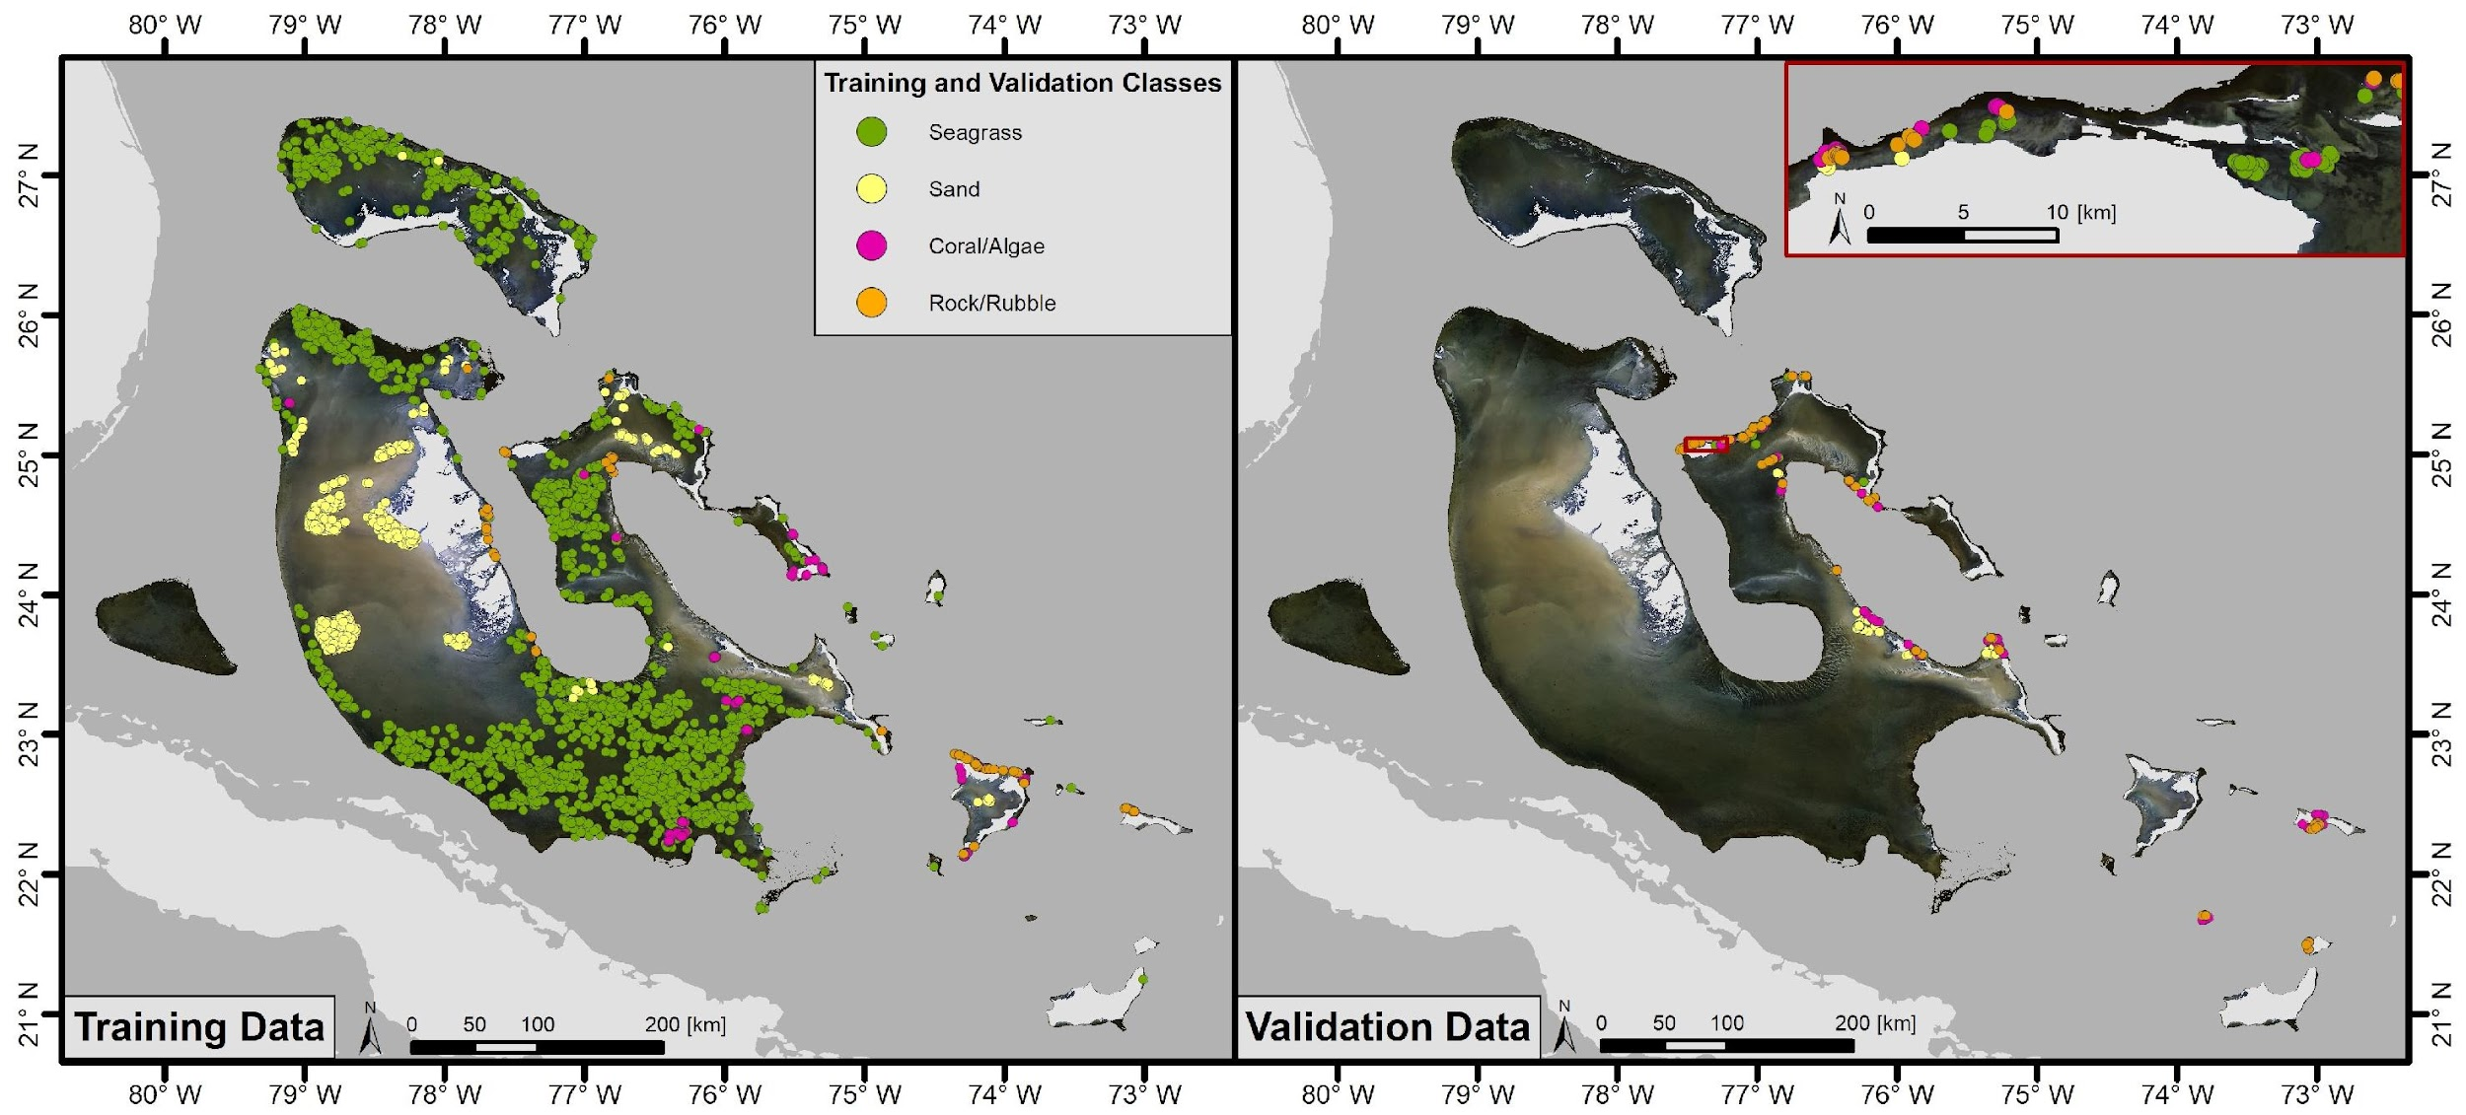
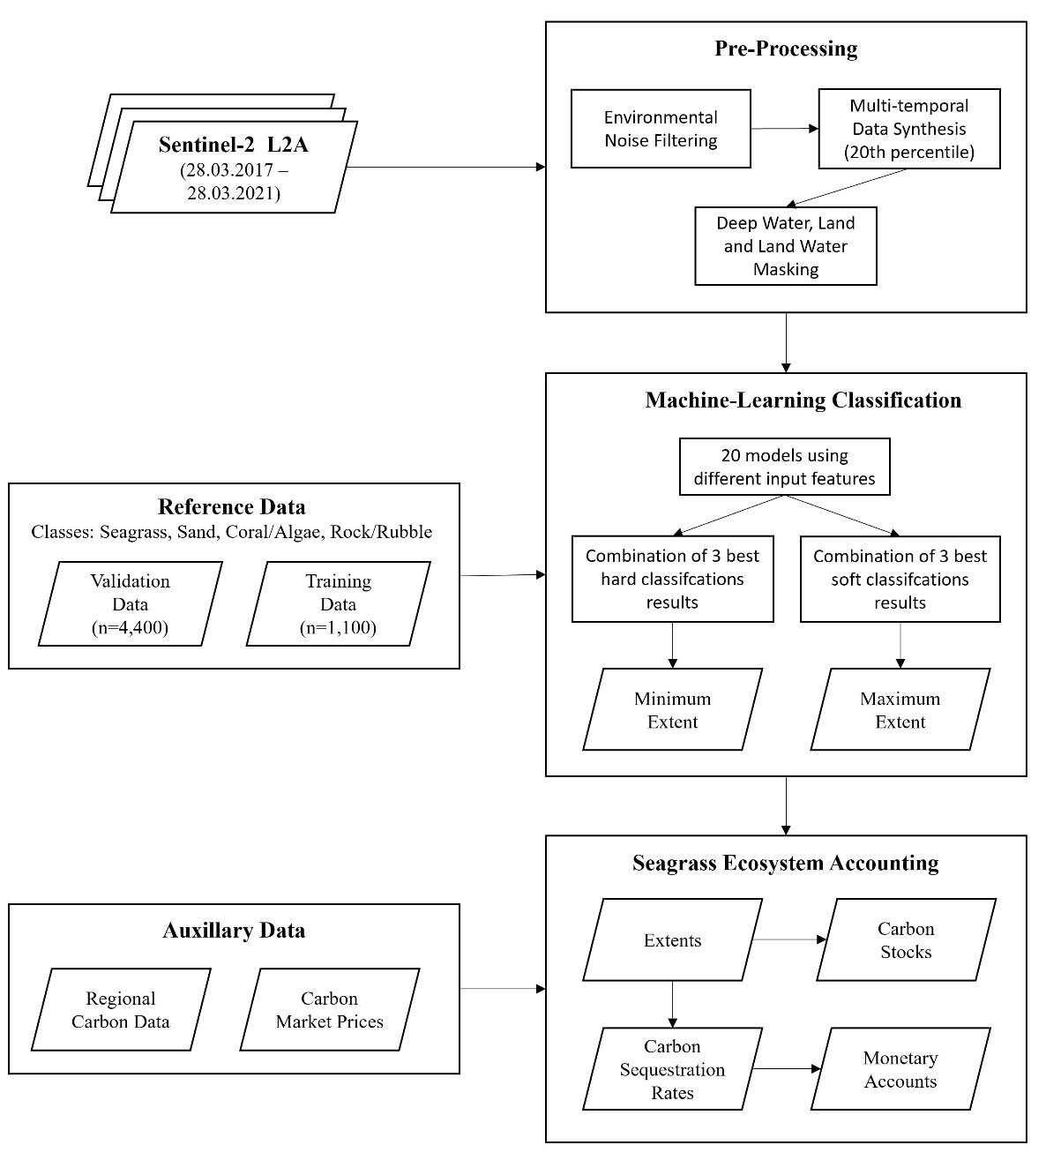
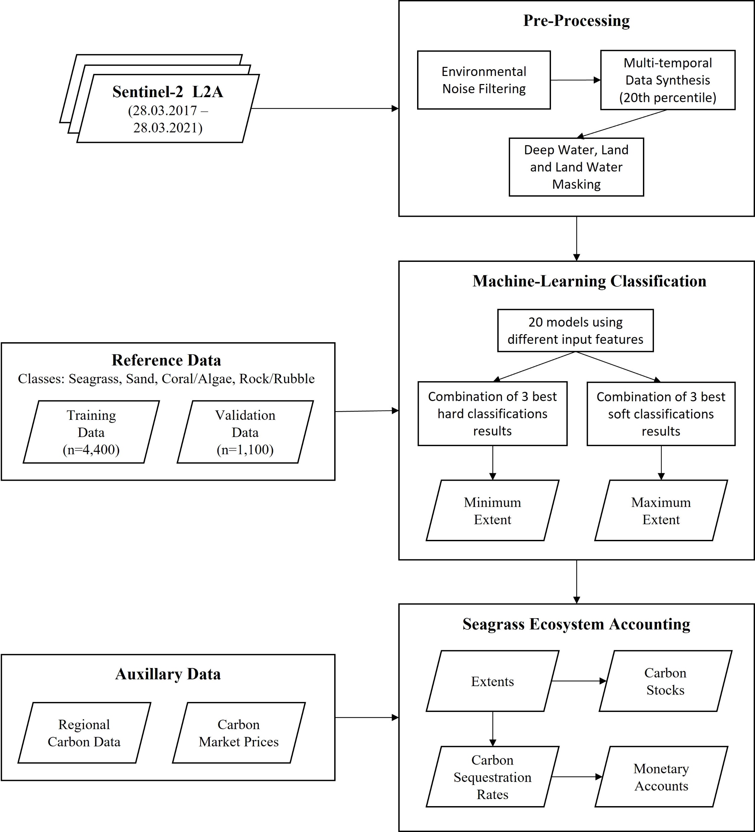

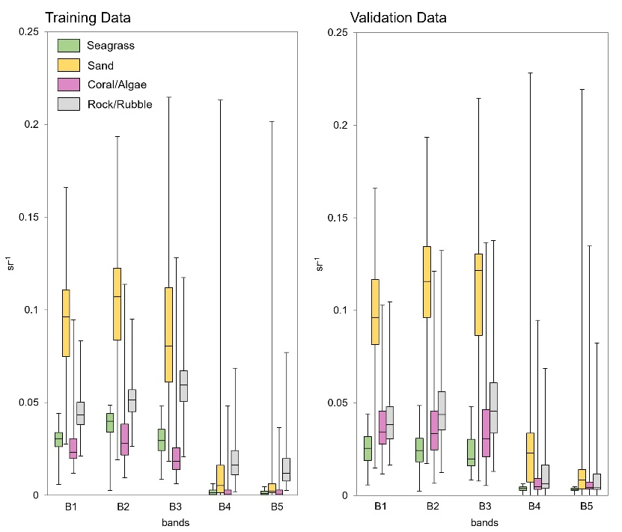

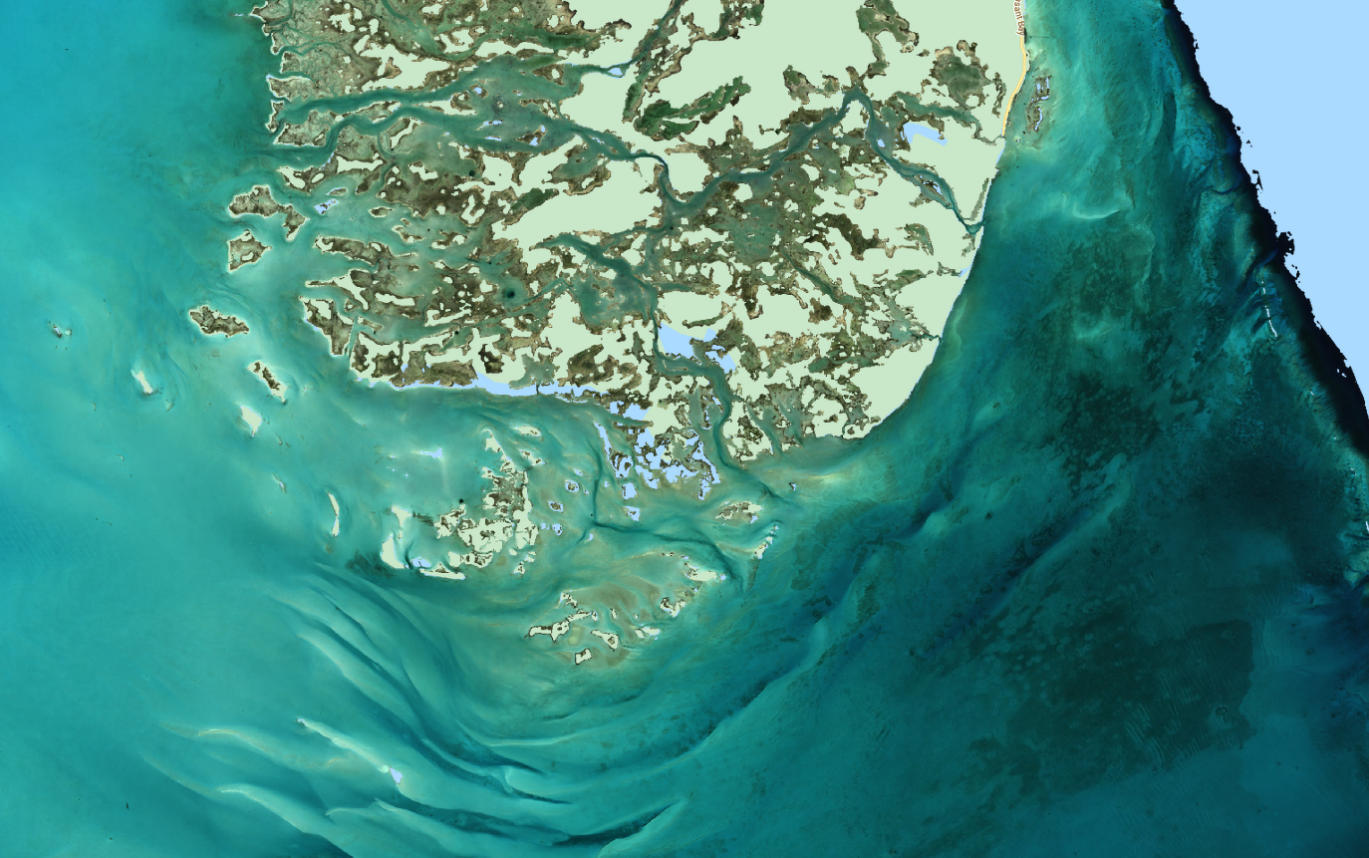
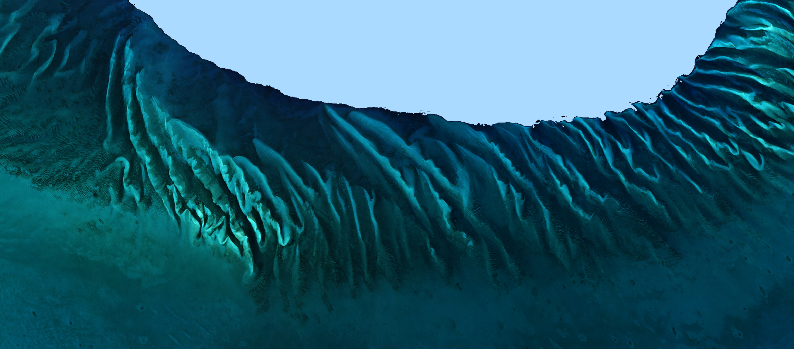
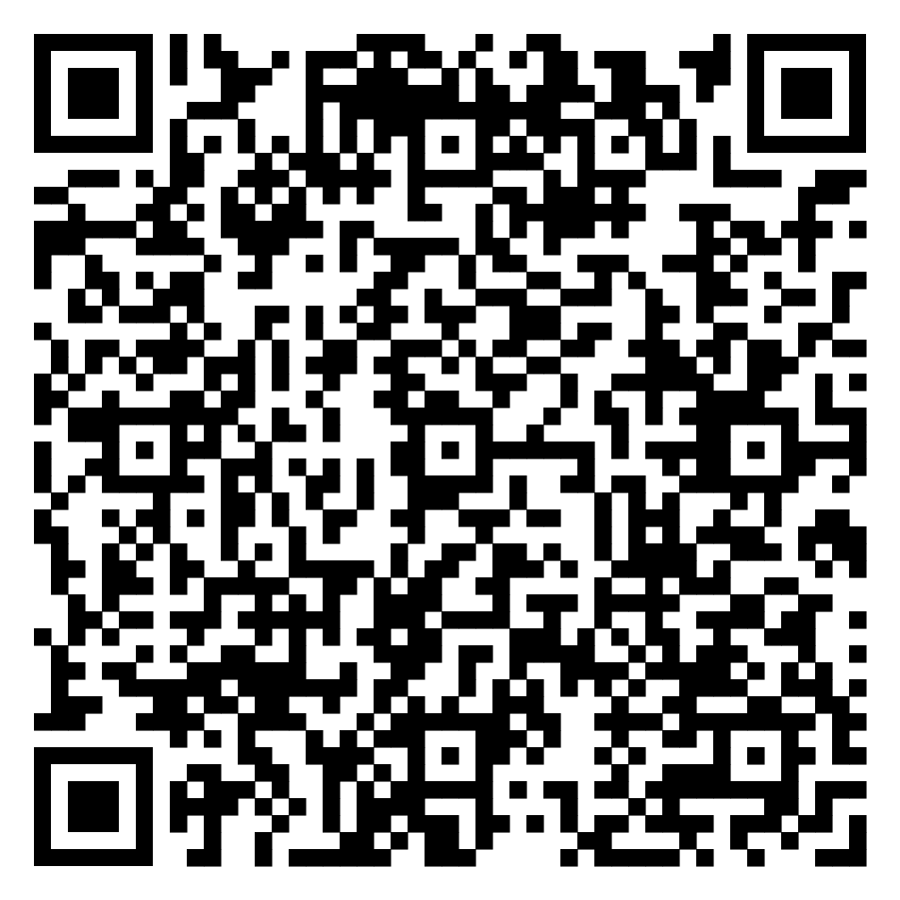
Workflow
4 year‘s worth of
Sentinel-2 imagery
Pre-Processed
Composite
(made of ~19,000 single images)
Land and Deep Water Masked Composite
S2 Bands 1-5
HSV (Hue, Saturation, Value)
Clusters
GLCM (Grey Level Occurrence Matrix)
Eigens of PCA
Tier Assessment | Requirements
1 | IPCC default factors
2 | Country-specific data for key factors
View Paper here:
Blume et al. (2023) Bahamian seagrass extent and blue carbon accounting using Earth Observation
(The Blue Carbon Initiative , 2021)
Alina Blume – EGU 2023 – 24.04.2023

Slide 6
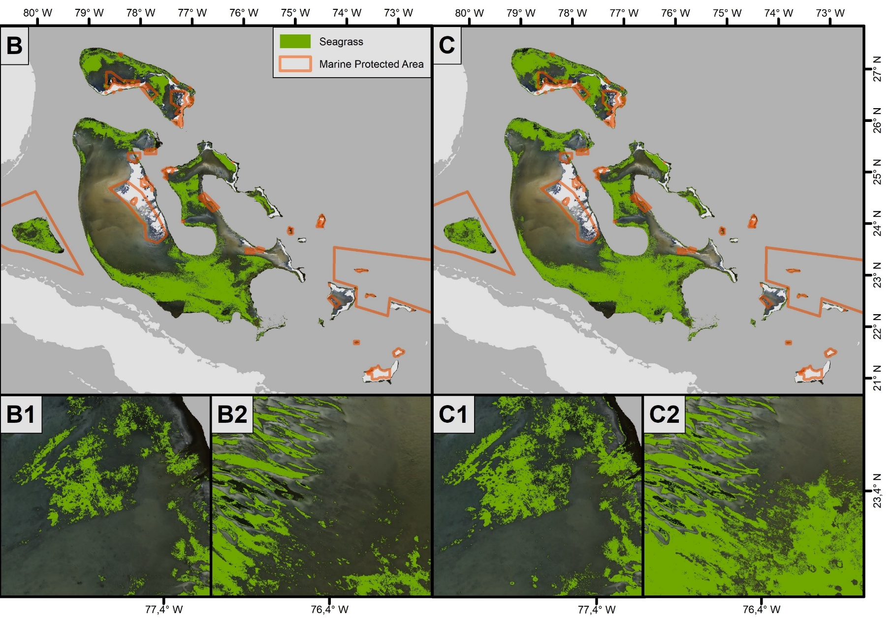
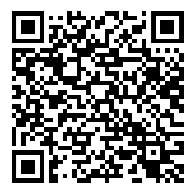
Distribution & Carbon Stocks
Minimum Extent
Extent: 39,210 km²
(OA: 71.00%, F1: 61.70%)
Carbon Storage: 605 Million Mg
Yearly Sequestration: 57x the amount of CO₂ emitted by The Bahamas in 2019
→ 7 billion €
Minimum
Extent
Maximum
Extent
1
2
1
2
Maximum Extent
Extent: 46,792 km²
(OA: 76.55%, F1: 74.76%)
Carbon Storage: 771 Million Mg
Yearly Sequestration: 68x the amount of CO₂ emitted by The Bahamas in 2019
→ 8.5 billion €
View detailed
results here:
Blume et al. (2023)
Alina Blume – EGU 2023 – 24.04.2023

Slide 7
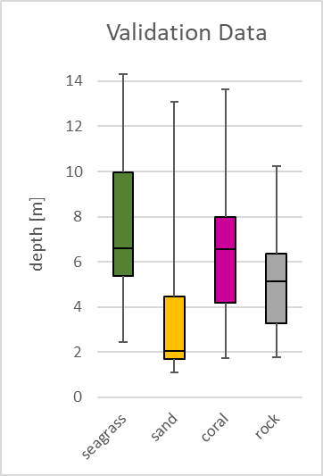
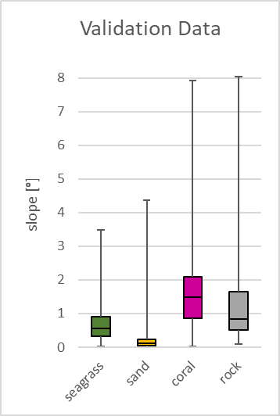
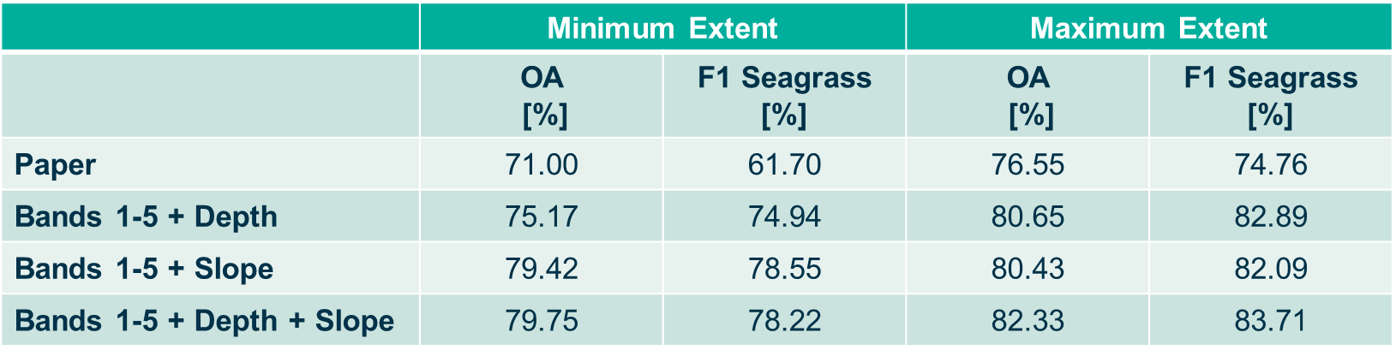
Current Developments
Depth of
Ground Truth
Slope of
Ground Truth
Slope
Bathymetry based on the dataset of Thomas et al. (2022)
Blume et al. (2023)
+ 5 to 10%
Alina Blume – EGU 2023 – 24.04.2023

Slide 8
Remaining Challenges
Artifacts in composite
Lack of ground truth data
Lack of in-situ data
Looking Forward
Depth dependent mapping
Refinement of carbon stocks (Depth dependent assessments + inclusion of new field data)
Time series analysis (based on historic imagery e.g. Landsat)
Alina Blume – EGU 2023 – 24.04.2023

Slide 9
Upcoming Invitation to Tender
The Blue Carbon project
Aim: Developing new methods to improve the estimation and to monitor the changes of the extent and carbon stock of major Blue Carbon Coastal ecosystems (mangroves, salt marshes, and seagrasses).
The project to be implemented in close collaboration with key end-users: government agencies, environmental organisations and also local communities. The activity also aims at the provision of the necessary information products and tools to support countries integrating Blue Carbon into their national carbon accounts.
The project shall have a multi-sensor approach and leverage on state-of-the-art existing datasets (e.g., global mangrove watch) and integrate open non-EO data as necessary, in-situ measurements of both blue carbon extent and stock.
Plan: ITT Q2 2023. Single Contract. | Duration: 24 months. | Budget: 1 Meuro. | PEOPLE-series

Slide 10


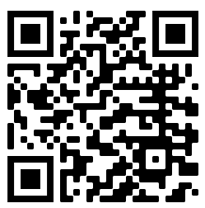


Thank you!
Alina Blume
alina.blume@esa.int
Contact
me

Slide 11


