Slide 1
Abrupt late 1980s surface climate warming effects on drought risk over main french crop production basins
Supplementary materials
Léa Laurent^{1,2}, Albin Ullmann¹, Thierry Castel¹
27/04/2023
¹CRC, Biogéosciences, UMR 6282 CNRS/Université de Bourgogne Franche-Comté, 6 boulevard Gabriel, 21000 Dijon, France
²Domaine Assurance Récolte, Groupama Rhône-Alpes Auvergne, 24 rue Charles Durand, 18020 Bourges Cedex, France

Slide 2
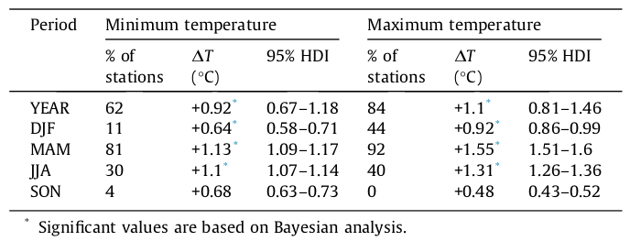
Context & issues
Material & methods
Results
Conclusion
Warming, stationarity break and yields stagnation in France
Percentage of the 119 Météo France stations recording 1987/1988 shift, anomalies and 95% confidence interval of the difference in the mean at annual and seasonal scales. Brulebois et al., 2015.

Slide 3
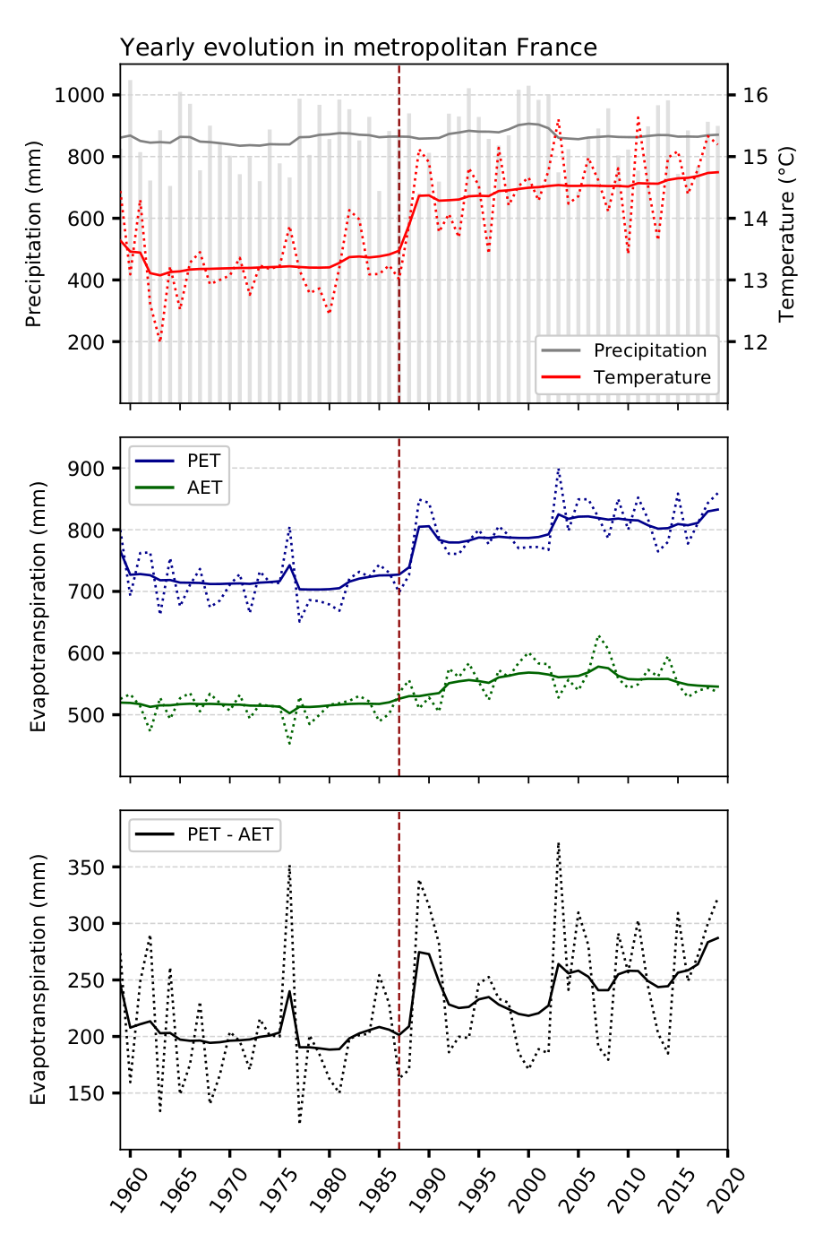
Context & issues
Material & methods
Results
Conclusion
Warming, stationarity break and yields stagnation in France
Yearly evolution of variables linked to hydrological cycle between 1959 and 2019. PET: Potential EvapoTranspiration; AET: Actual EvapoTranspiration.

Slide 4
Context & issues
Material & methods
Results
Conclusion
Warming, stationarity break and yields stagnation in France
Printemps
Été
Seasonal evolution of variables linked to hydrological cycle between 1959 and 2019. PET: Potential EvapoTranspiration; AET: Actual EvapoTranspiration.
Automne
Hiver

Slide 5
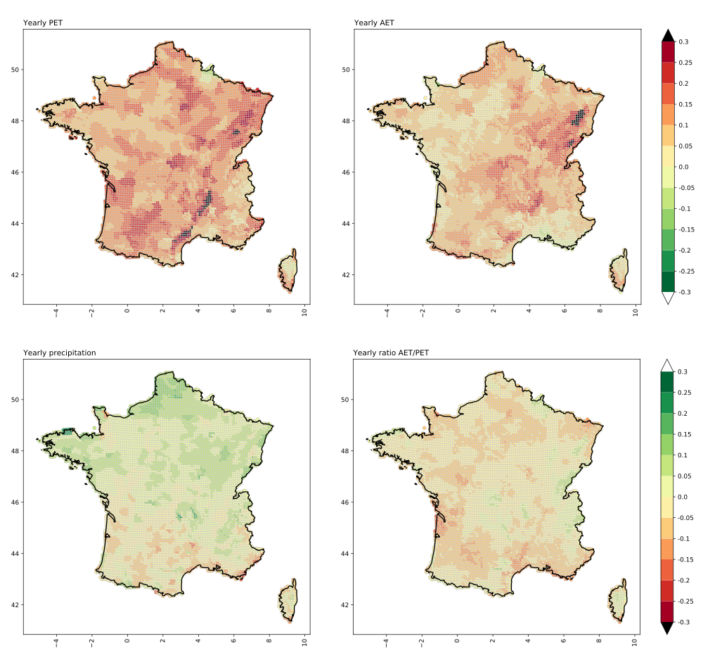
Context & issues
Material & methods
Results
Conclusion
Warming, stationarity break and yields stagnation in France
Annual anomalies of period 1988-2019 compared to period 1959-1987 for potential evapotranspiration (PET), actual evapotranspiration (AET), liquid precipitation and ratio AET/PET.

Slide 6
Context & issues
Material & methods
Results
Conclusion
Data and water balance model
Winter bread wheat
Potential EvapoTranspiration (PET) (SIM, Météo France)
Surface and deep water supply (GISSol, INRAE)
Maximal EvapoTranspiration (MET)
Liquid precipitation (SIM, Météo France)
Simplified 2-reservoir water balance model (Jacquart & Choisnel, 1995)
Kc corresponding to each growth stage (Beauvais, 2021)
Relative extractible water (value between 1: full and 0: empty)
Growing degree days model computing beginning date of each growing state (Gate, 1995)
Variable input
Fixed input
Output
Model
Runoff
Notes:
To model water balance on winter bread wheat: choice of a simplified 2-reservoir water balance model developed by Jacquart & Choisnel in 1995
Inputs:
Liquid precipitation coming from SIM dataset
Water supply values weighted for each SIM grid point using GISSol database developed by INRAE
Maximal evapotranspiration computed using potential evapotranspiration daily dataset and a crop coefficient dynamically varying with crop growth
Crop growth is modeled using a growing degree-day model for which degree-day requirement of the plant where found in literature
Most interesting output of the model is relative extractible water (value between 0 and 1)

Slide 7
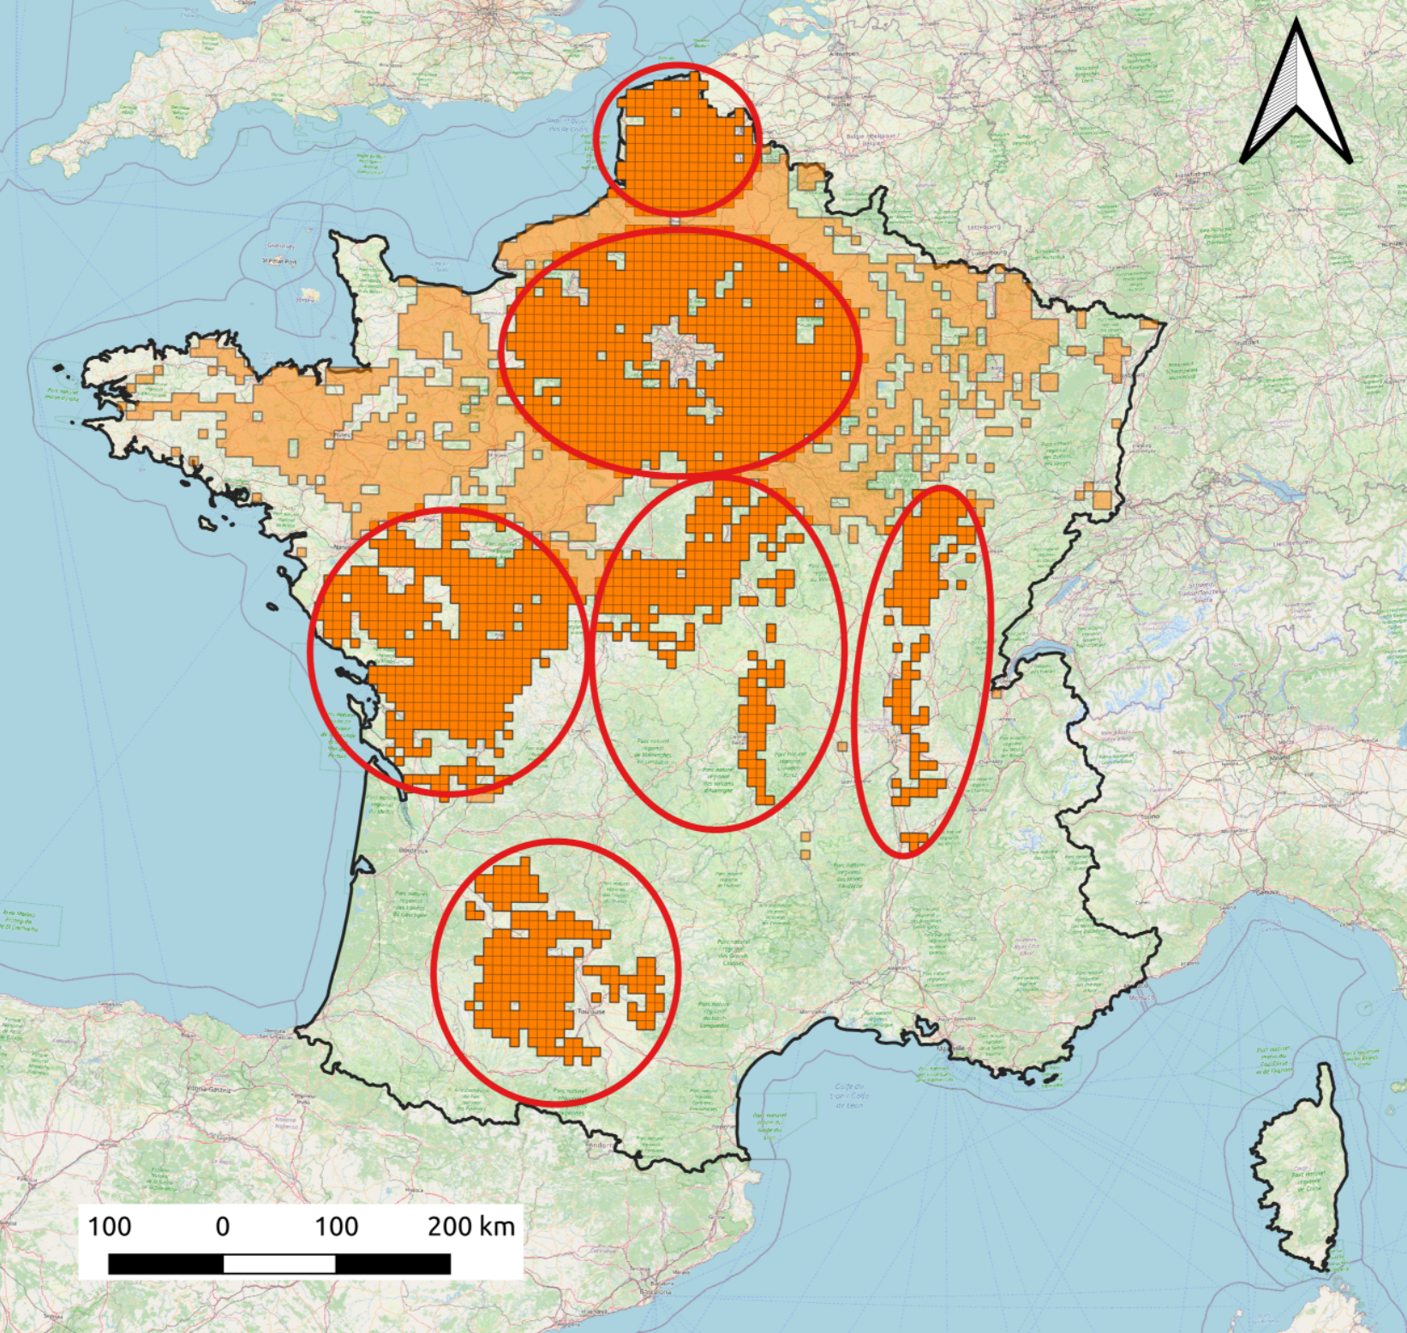
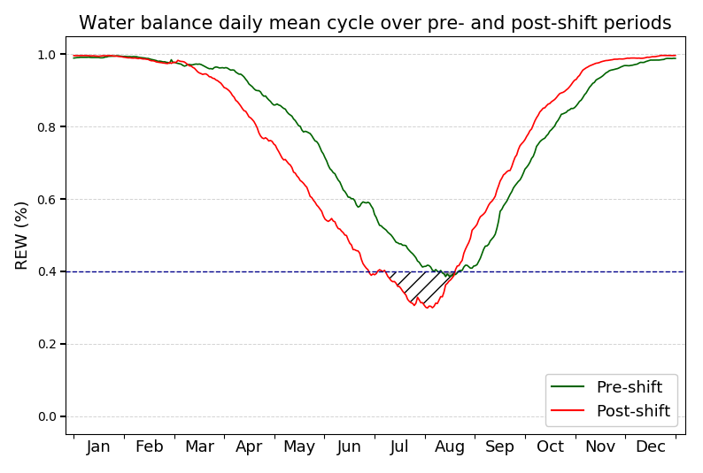
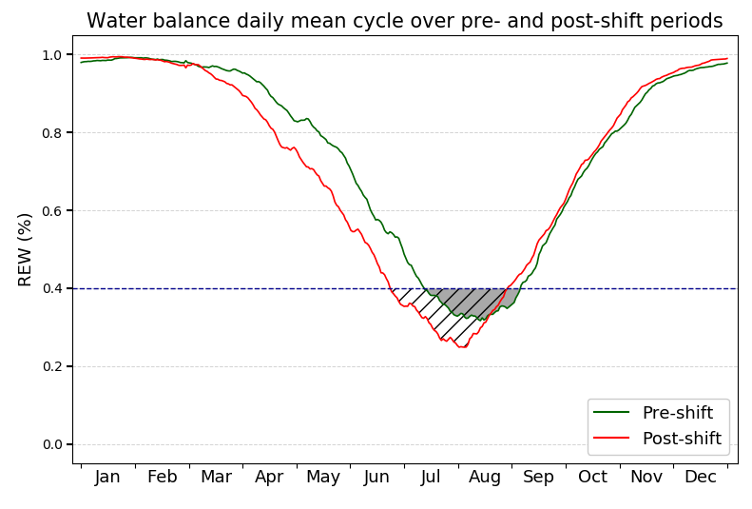
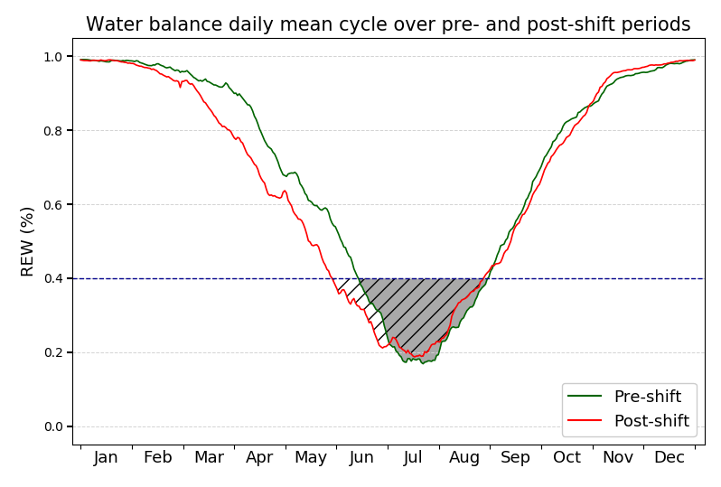
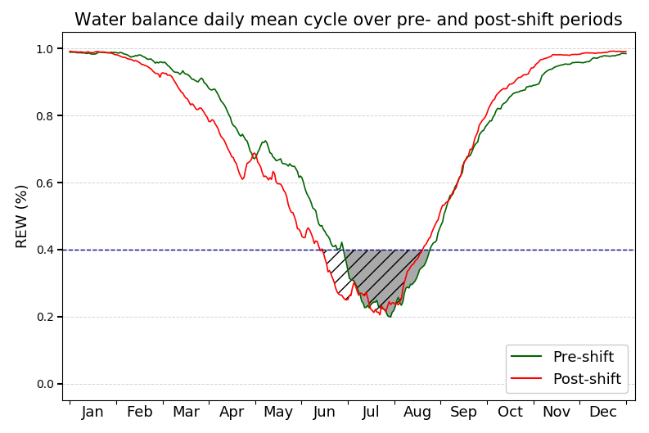
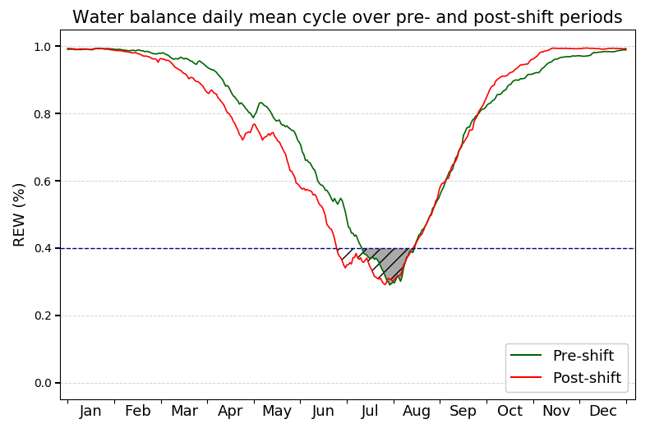
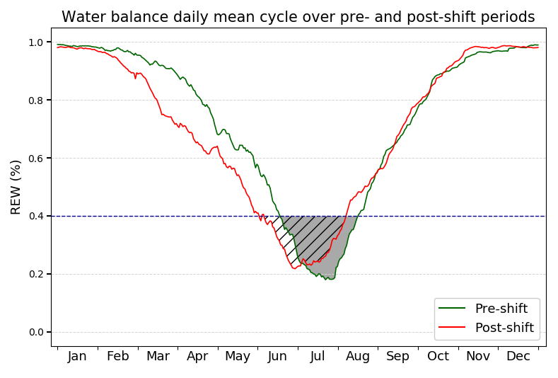
Context & issues
Material & methods
Results
Conclusion
1
Water balance modeling results
Water balance cycle evolution
2
3
4
5
6
Zone 1
Zone 2
Zone 3
Zone 4
Zone 5
Zone 6
Mean annual water balance cycle pre- and post-shift (1960-1987/1988-2021).

Slide 8
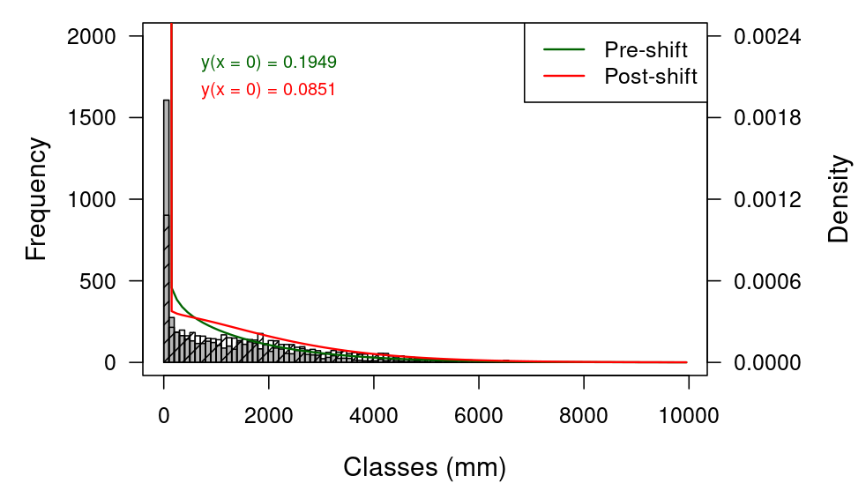
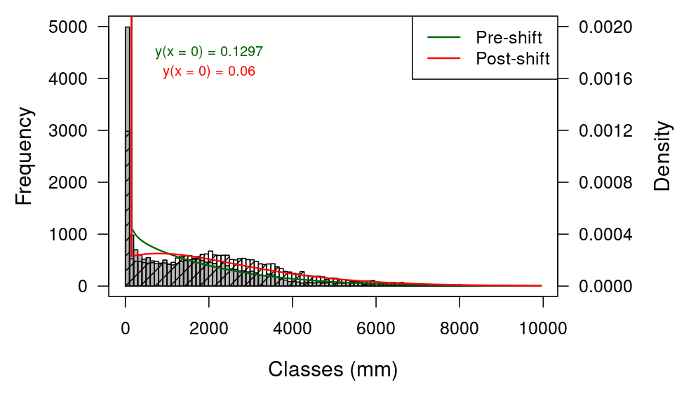
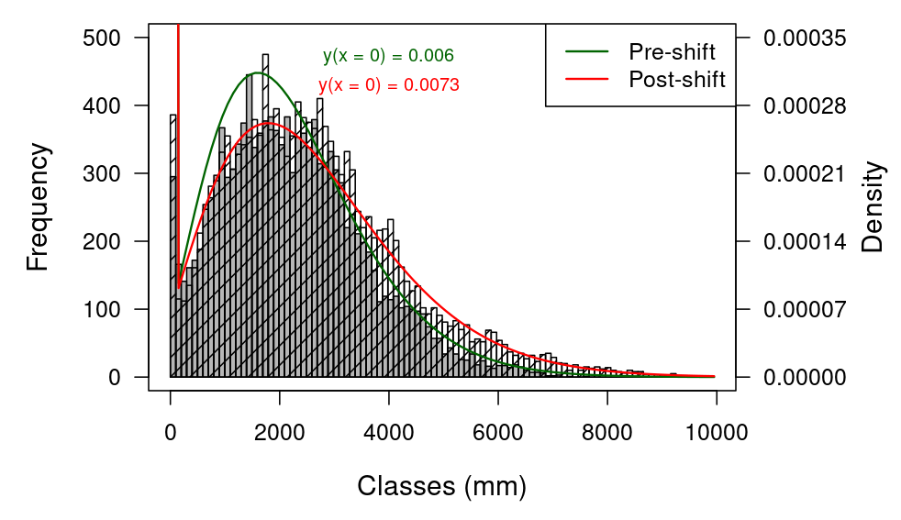
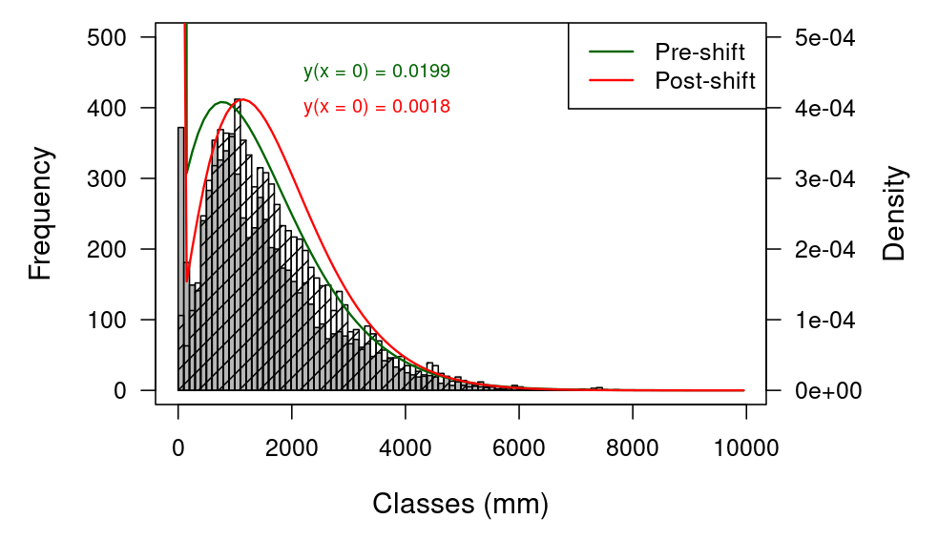
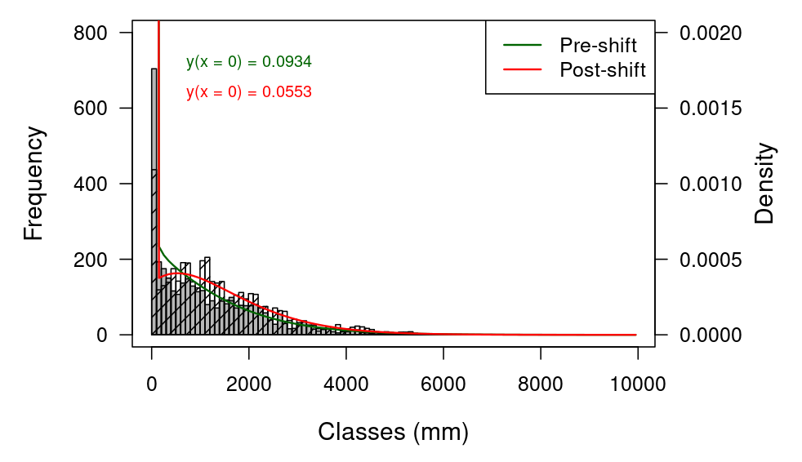
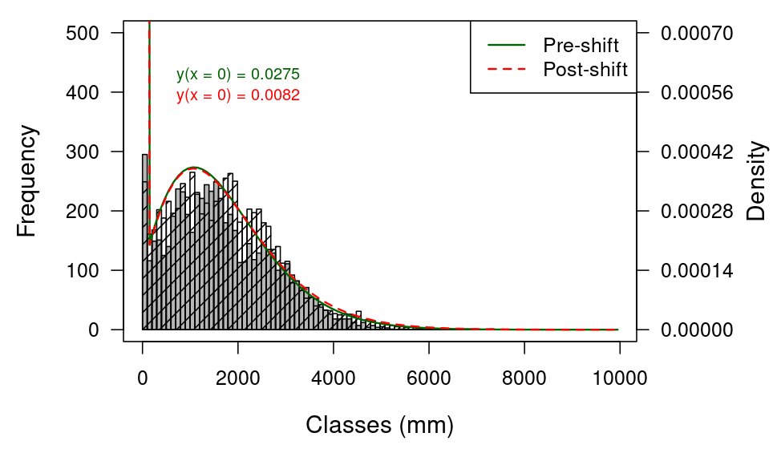
Context & issues
Material & methods
Results
Conclusion
1
Water balance modeling results
Hydric stress events modifications
2
3
4
5
6
Zone 1
Zone 2
Zone 3
Zone 4
Zone 5
Zone 6
Histograms of annual cumulative hydric stress index (mm) for each zones grid points and associated Tweedie distributions. Grey bars: pre-shift period; striped bars: post-shift period.

Slide 9
Context & issues
Material & methods
Results
Conclusion
1
Conclusion
Drought risk evolution over main french wheat production basins
2
3
4
5
6
Zone | Pre-shift | Post-shift | Percentage of evolution
1 | 0,1 | 0,17 | 71
2 | 0,1 | 0,17 | 68
3 | 0,1 | 0,18 | 75
4 | 0,1 | 0,11 | 15
5 | 0,1 | 0,13 | 31
6 | 0,1 | 0,12 | 15
Probability to overcome pre-shift 90th percentile pre-shift and post-shift on each production basin and percentage of evolution of this probability.

