Slide 1
Supplementary material to EGU23-5632, HS4.3
Ben Maybee⁽¹⁾, Cathryn E Birch⁽¹⁾, Steven J Böing⁽¹⁾, Thomas Willis⁽²⁾, Linda Speight⁽³⁾, Aurore N Porson⁽⁴⁾, Charlie Pilling⁽⁵⁾, Kay L Shelton⁽⁶⁾, Mark Trigg⁽⁷⁾
A copy of the current paper draft will shortly be made available here:
https://leeds365-my.sharepoint.com/:f:/g/personal/foubwm1_leeds_ac_uk/EvgrfUw30q9EsYWriH02Da8B57FjbAyZsvoATivZb-Zc3A?e=LggOXx
The draft will be submitted to Natural Hazards and Earth System Sciences. This journal uses a public, interactive peer review process – the draft will therefore soon be available for comments from the community.
In addition to the paper draft, the following presentation from November 2022 gives further details on aspects of the project highlighted in the EGU oral presentation.
We welcome all comments! Get in touch: b.w.maybee@leeds.ac.uk, c.e.birch@leeds.ac.uk.

Slide 2
Enhanced Surface Water Flood forecasting using worst case scenarios from MOGREPS-UK
Ben Maybee⁽¹⁾, Cathryn E Birch⁽¹⁾, Steven J Böing⁽¹⁾, Thomas Willis⁽²⁾, Linda Speight⁽³⁾,
Aurore N Porson⁽⁴⁾, Charlie Pilling⁽⁵⁾, Kay L Shelton⁽⁶⁾, Mark Trigg⁽⁷⁾
1) School of Earth and Environment, University of Leeds, UK 2) School of Geography, University of Leeds, UK
3) School of Geography and the Environment, University of Oxford, UK
4) Met Office, Exeter, UK
5) Flood Forecasting Centre, Exeter, UK
6) JBA Consulting, Skipton, UK 7) School of Civil Engineering, University of Leeds, UK
UM Convective Working Group
21/11/2022

Slide 3
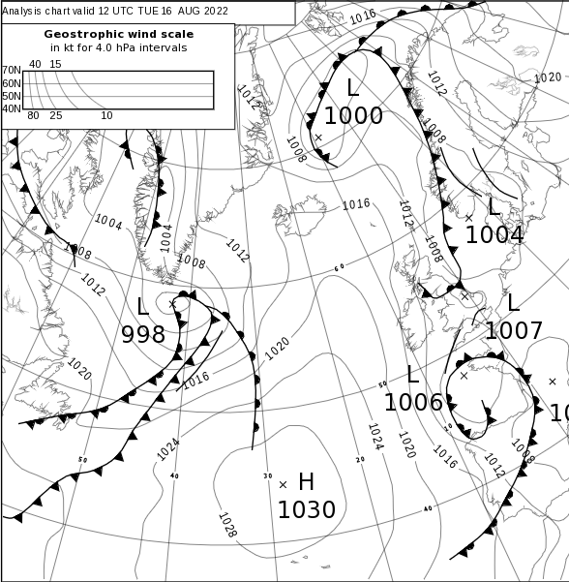
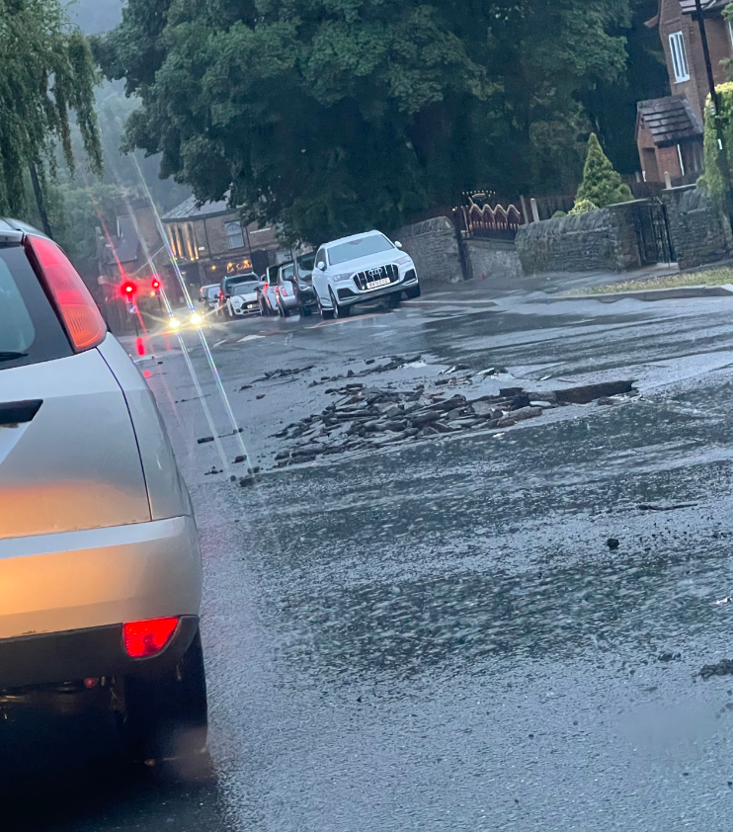
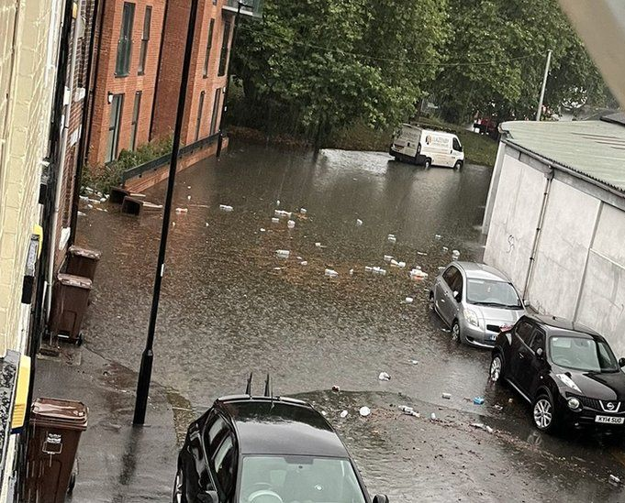
Surface Water Flooding (SWF)
Heavy rainfall creates flood before reaching major watercourse.
In UK often due to heavy, localised convective summer showers.
e.g. Sheffield, S Yorkshire, 16/08/2022:
Forecasting requires accurate:
Precipitation estimates: duration, intensity, spatial extent
Catchment information: topography, soil moisture, drainage.
Notes:
There are two common types of pluvial flooding:
Intense rain saturates an urban drainage system. The system becomes overwhelmed and water flows out into the streets.
Directly or Run-off or flowing water from rain falling onto hillsides that are unable to absorb the water.
Although usually relatively shallow, a pluvial flood can cause significant property damage.

Slide 4
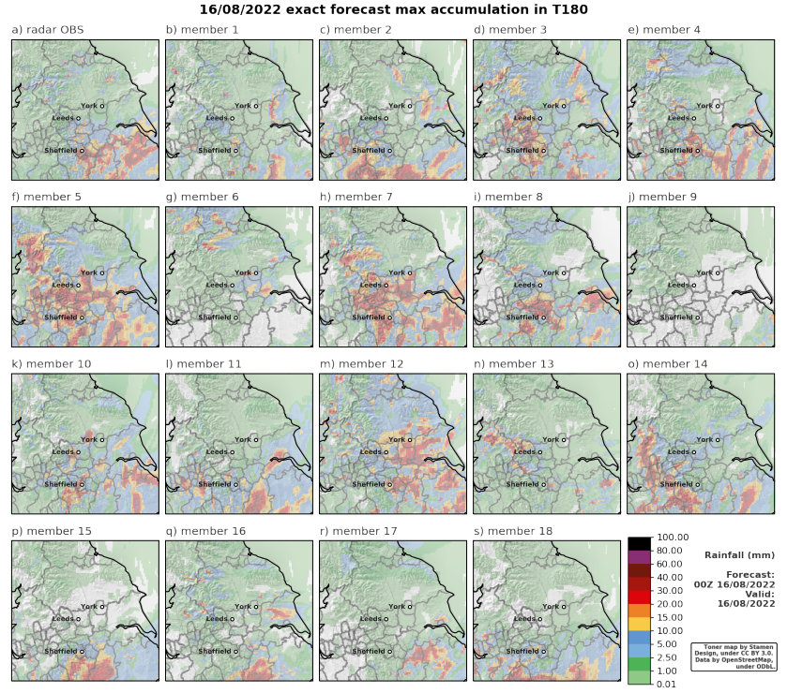
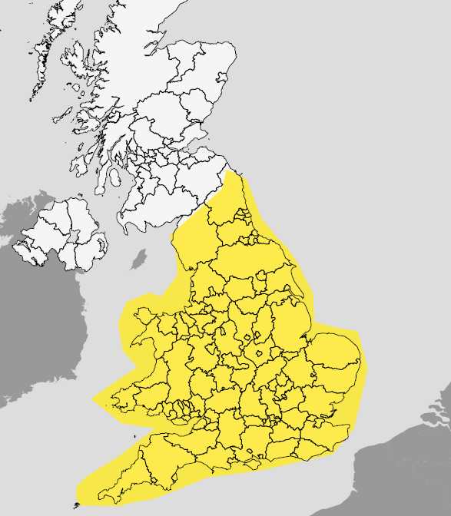
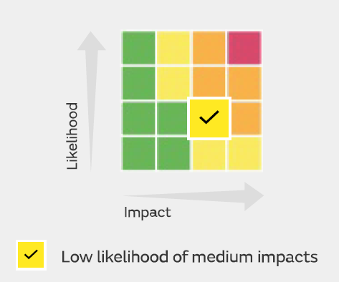
Current UK SWF forecasting
MOGREPS-UK: convection permitting 2.2km 18 member ensemble.
National Severe Weather Warning Service (NSWWS): issued by national guidance unit.
Flood Guidance Statements: rain-to-grid hydraulic modelling and forecaster input.
NSWWS, 16/08/22
FGS, 16/08/22
MOGREPS-UK, 00BST 16/08/22

Slide 5
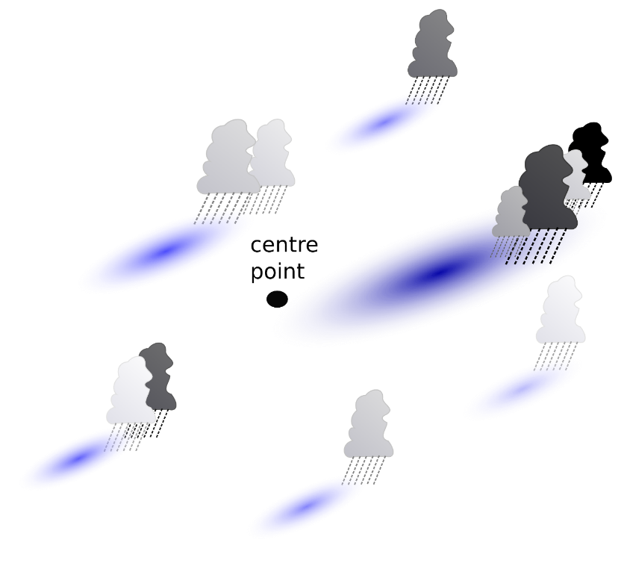
Reasonable worst case rainfall scenarios
To account for spatial forecast uncertainty, and provide more local SWF focussed forecast, we post-process daily operational forecasts:
Find day’s maximum 1, 3 and 6 hour accumulations at each grid point
Rank all values in 30km-radius neighbourhood about each point
Select the 98th percentile value; take as forecast accumulation.
Doing for all outputs gives a reasonable worst-case scenario of possible rainfall across the region
Apply both to individual members and full ensemble.
S Böing et al, Meteorological Applications (2020), 20 6, pp.1-16

Slide 6
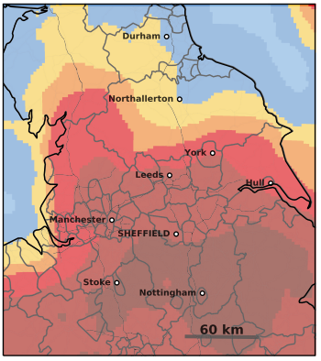
Example
Forecast initialisation 00:00BST, 16/08/2022, valid same day: maximum rainfall accumulation in 3 hours.
Exact members
98%le processed
Post-processed full ensemble (from 18 members): reasonable worst case scenario

Slide 7
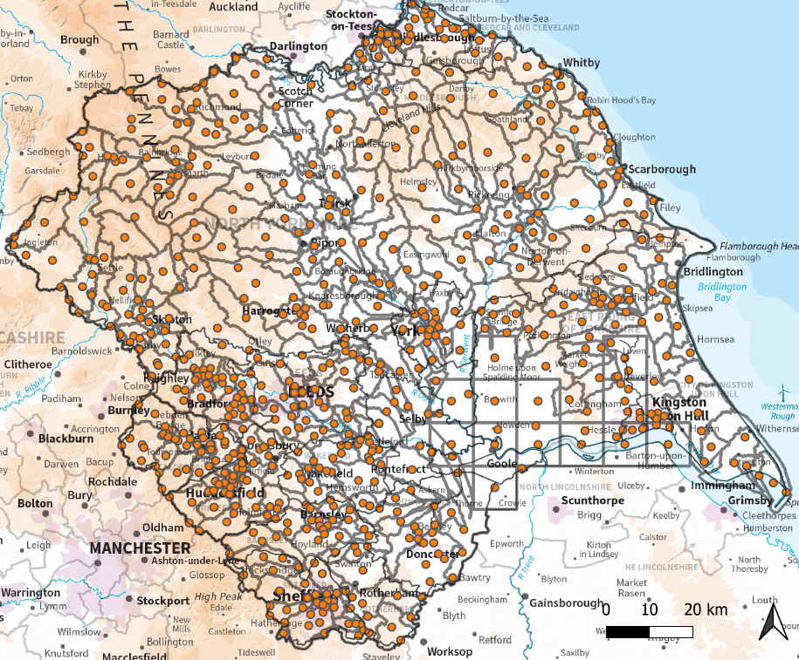
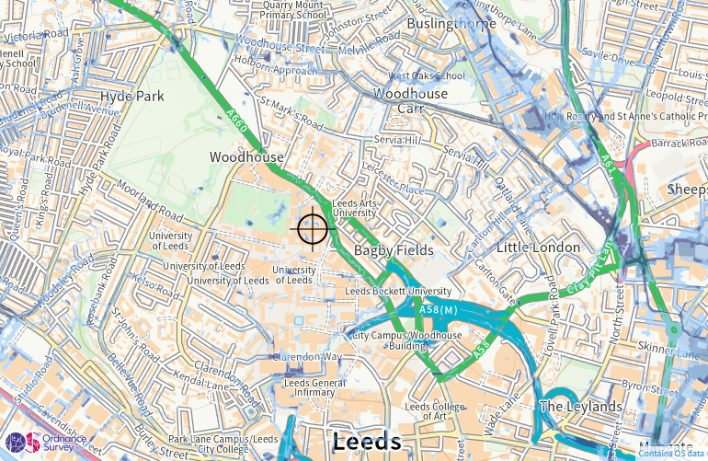
RoSWF threshold look-up flood forecast
Forecast uncertainties propagate through dynamic flood models: use a look-up flood forecast.
Lookup data: model rainfall inputs underpinning UK national Risk of Surface Water Flood maps. Currently do lookup at centroid of each 10km scale Yorkshire river catchment.
Rainfall fcst: extract 1, 3 and 6 hour accumulations for each catchment
Compare values against the closest RoSWF rainfall curve
Threshold comparison selects associated return period
Repeat for all catchments → full regional flood forecast: reports associated return period.

Slide 8
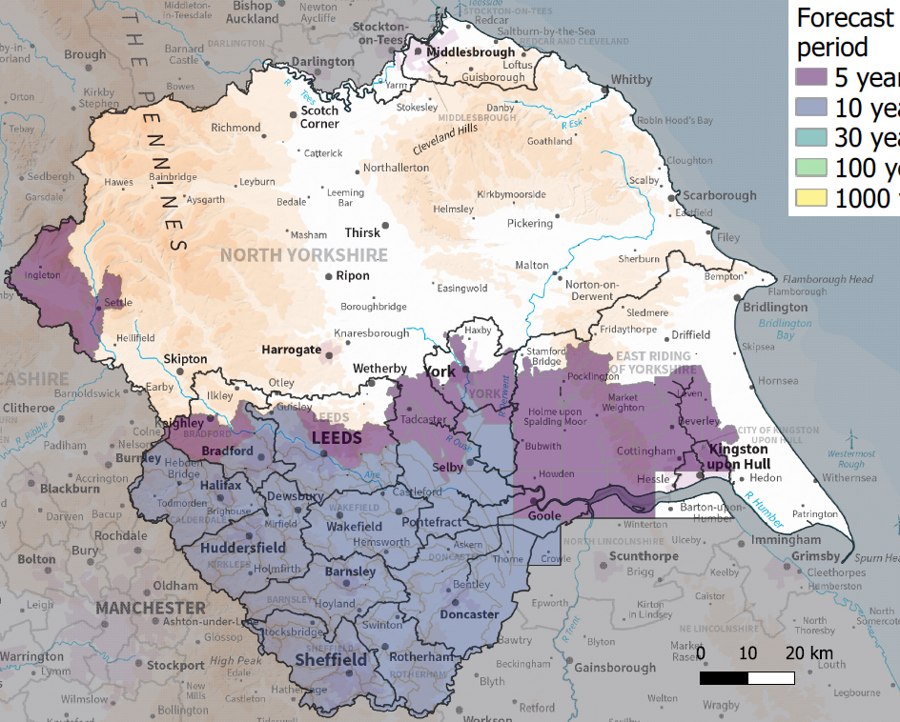
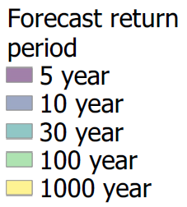
Sheffield enhanced SWF forecast
Forecast initialisation 00:00BST 16/08/2022, valid 16/08/2022:
98pp maximum rainfall accumulation in 3 hours: reasonable worst case scenario
Flood forecast

Slide 9
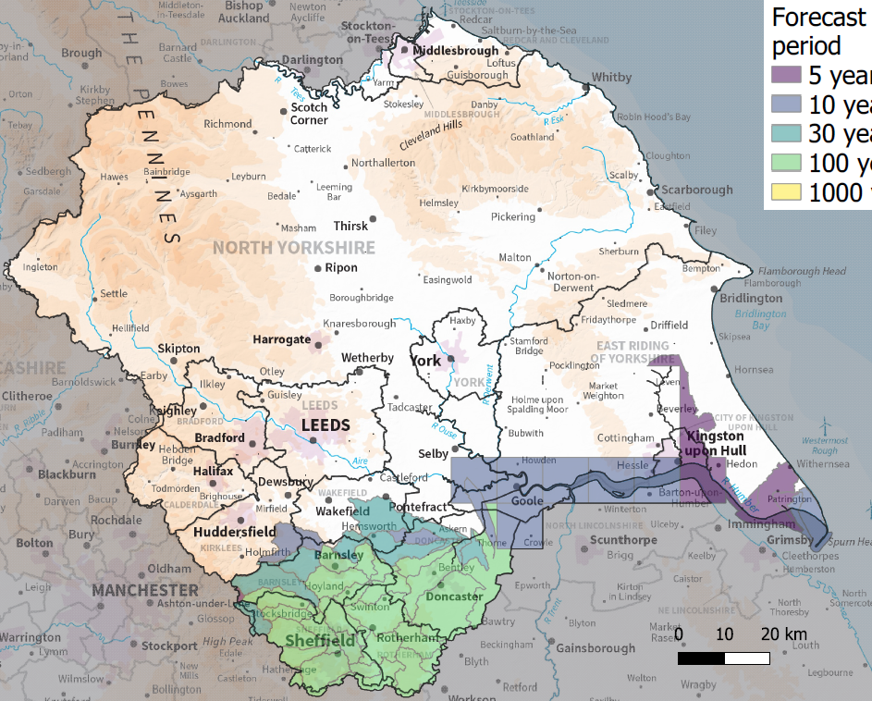
Verifying daily forecasts: radar benchmarking
To verify our daily forecasts, we compare against post-processed radar observations
eg 16th August 2022
Used to generate a flood “forecast”
Observed 3 hour rainfall accumulations
Neighbourhood-processing applied to observations
Proxy for flood observations

Slide 10
Evolution with lead time
With current MOGREPS-UK system, forecasts can be generated at up to 4 days lead time:
Date issued
All forecasts valid 16/08/2022
decreasing lead time

Slide 11
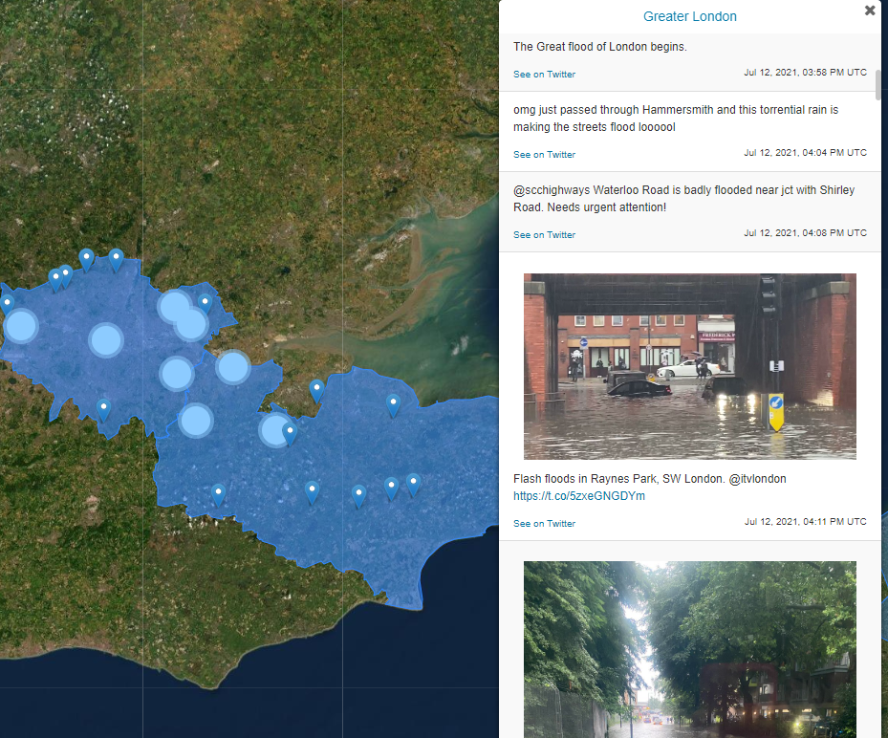
Verifying the method
Summer 2022 testbed – live forecast and observations system, focussed on Yorkshire. Drought summer, but two events.
Testing different thresholds: percentile rank, accumulation time, return periods.
globalfloodmonitor.org
Forecasts and benchmarking for known SWF events; ~80 identified since 2013 across Northern England
Investigation of forecast skill at varying spatial resolution and lead time (daily, post 2019)
Plan not fixed, investigations in progress: suggestions welcome!

