Slide 1

Additions of ochre to soil increase the retention of organic carbon
mark.hodson@york.ac.uk
@MarkEHodson
Mark E Hodson, Mahmuda Islam, Matty Metcalf, Amy CM Wright
Dept. Environment and Geography, University of York
Hodson ME, Mahmuda I, Metcalf M, Wright A (2023) Amendments of waste ochre from former coal mines can potentially be used to increase soil carbon persistence. Applied Geochemistry 151 105618. doi.org/10/1016/j.apgeochem/2023/105618

Slide 2
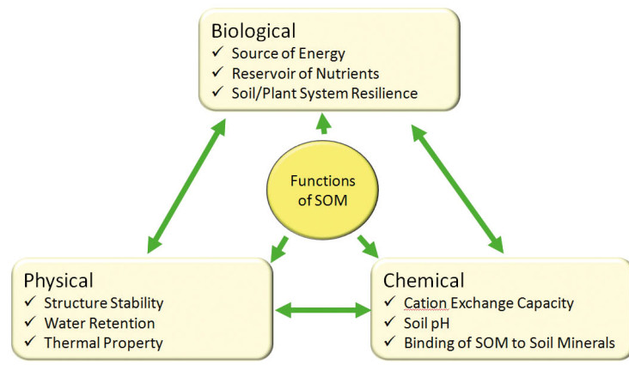


Rationale – soil organic carbon is good
mark.hodson@york.ac.uk
@MarkEHodson
Image from PitchCare Magazine, Martin Ward, 2014 Graph from GlobalChange.gov

Slide 3
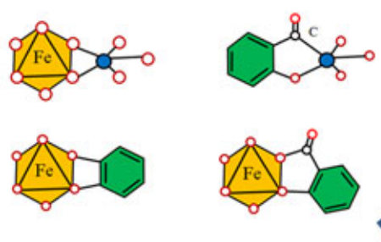
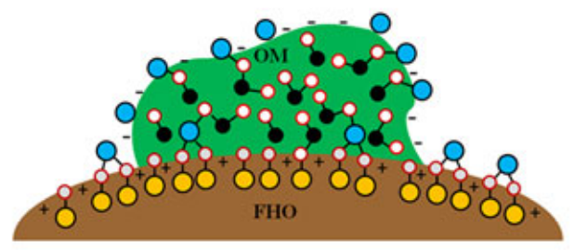
Rationale – Fe oxides adsorb organic carbon
mark.hodson@york.ac.uk
@MarkEHodson
Images from Bao et al. (2022) Crit Rev Environ Sci Technol

Slide 4

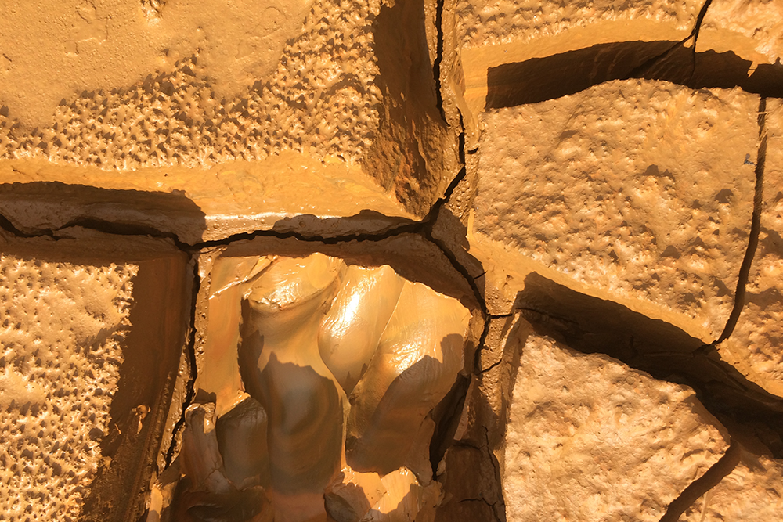
Rationale – Ochre is an Fe-oxide waste product from former coal mines
mark.hodson@york.ac.uk
@MarkEHodson
Images from Keith Pattison / Café Royal Books, the UK Coal Authority website

Slide 5
Batch experiments – ochres sorb organic carbon
mark.hodson@york.ac.uk
@MarkEHodson
Two soils (3.5, 5.6 % OM)
Multiple ochres (5, 10 wt %)
Shake them together for 24 hours in suspension
Typically ochre amendments reduce DOC (and P)
Least well performing ochres:
  lower surface area
  lower Fe oxide content
  higher Na content
Dissolved organic C / mg L⁻¹
Email: mark.hodson@york.ac.uk Twitter: @MarkEHodson Paper: Applied Geochemistry 151 105618

Slide 6
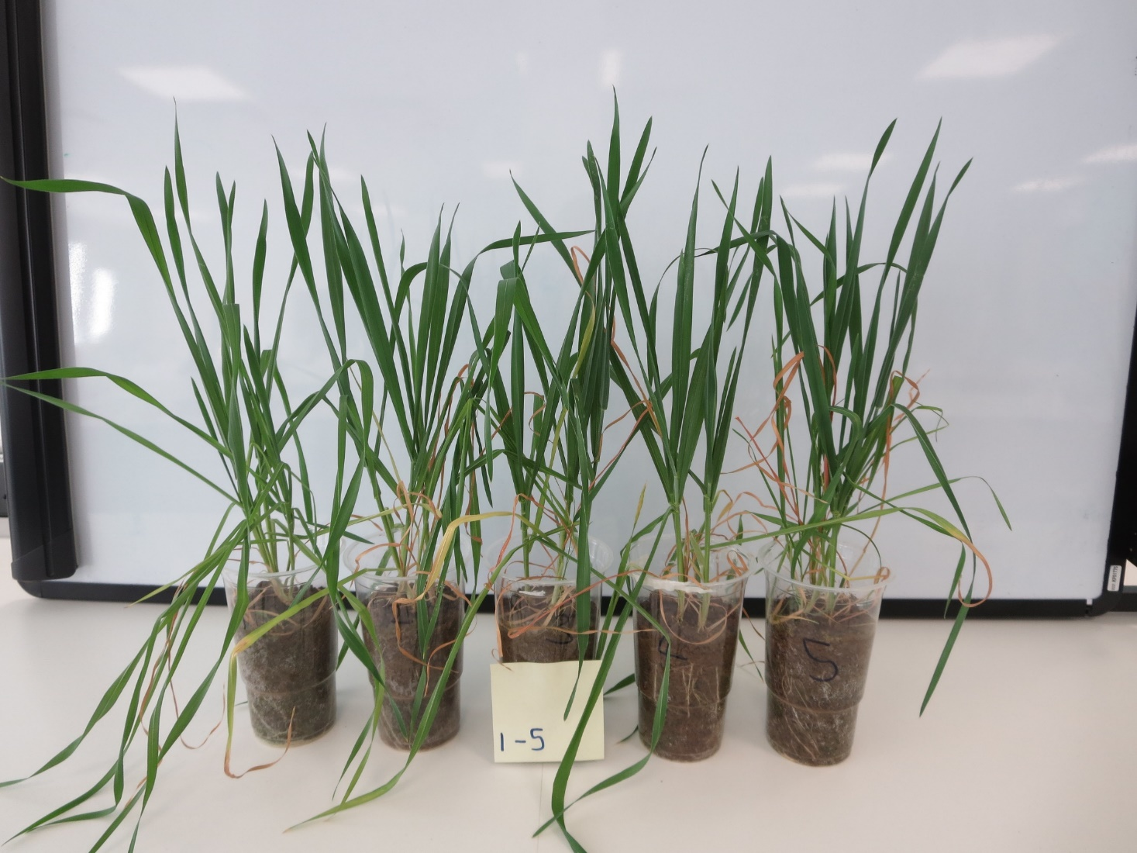
Plant experiment 1
mark.hodson@york.ac.uk
@MarkEHodson
One soil (5.6% OM)
Three ochres (5 wt%)
Grow wheat for 42 days
Water weekly
Collect leachate
Measure soil and plant properties
Email: mark.hodson@york.ac.uk Twitter: @MarkEHodson Paper: Applied Geochemistry 151 105618

Slide 7
Plant experiment 1 – leached C
mark.hodson@york.ac.uk
@MarkEHodson
Ochres reduced C export
Weekly exported OC / mg kg⁻¹
Total exported OC / mg kg⁻¹
Day
Email: mark.hodson@york.ac.uk Twitter: @MarkEHodson Paper: Applied Geochemistry 151 105618

Slide 8
Plant experiment 1 – extractable C
mark.hodson@york.ac.uk
@MarkEHodson
Ochres reduced C export
Ochres reduced extractable C
a
a
a
a
b
b
b
b
Cold water extractable C / mg kg⁻¹
Hot water extractable C / mg kg⁻¹
Email: mark.hodson@york.ac.uk Twitter: @MarkEHodson Paper: Applied Geochemistry 151 105618

Slide 9
Plant experiment 1 – plant biomass
mark.hodson@york.ac.uk
@MarkEHodson
Ochres reduced C export
Ochres reduced extractable C
Ochres reduced plant biomass
a
Airdry plant bioamss / g
b
b
b
Email: mark.hodson@york.ac.uk Twitter: @MarkEHodson Paper: Applied Geochemistry 151 105618

Slide 10
Plant experiment 1 – available P
mark.hodson@york.ac.uk
@MarkEHodson
Ochres reduced C export
Ochres reduced extractable C
Ochres reduced plant biomass
Ochres reduced available P
a
a
b
c
Available P / mg kg⁻¹
Email: mark.hodson@york.ac.uk Twitter: @MarkEHodson Paper: Applied Geochemistry 151 105618

Slide 11
Plant experiment 2
mark.hodson@york.ac.uk
@MarkEHodson
One soil (5.6% OM)
One ochre (5 wt%)
Two different, realistic P levels as KH₂PO₄
Grow wheat for 42 days
Collect leachate
Measure soil and plant properties
Email: mark.hodson@york.ac.uk Twitter: @MarkEHodson Paper: Applied Geochemistry 151 105618

Slide 12
Plant experiment 2 – leached C
mark.hodson@york.ac.uk
@MarkEHodson
Ochres reduced C export
No ochre
b
Ochre
a
a
d
Exported C / mg kg⁻¹
c
c
Email: mark.hodson@york.ac.uk Twitter: @MarkEHodson Paper: Applied Geochemistry 151 105618

Slide 13
Plant experiment 2 – leached P
mark.hodson@york.ac.uk
@MarkEHodson
Ochres reduced C export
Ochres limited P export
No ochre
Ochre
cA
Exported P / mg kg⁻¹
bA
bB
aA
aA
aB
Email: mark.hodson@york.ac.uk Twitter: @MarkEHodson Paper: Applied Geochemistry 151 105618

Slide 14
Plant experiment 2 – available P
mark.hodson@york.ac.uk
@MarkEHodson
Ochres reduced C export
Ochres limited P export
P was still plant available
No ochre
Ochre
cA
bA
bA
bB
Available P / mg kg⁻¹
aA
aA
Email: mark.hodson@york.ac.uk Twitter: @MarkEHodson Paper: Applied Geochemistry 151 105618

Slide 15
Plant experiment 2 – plant biomass
mark.hodson@york.ac.uk
@MarkEHodson
Ochres reduced C export
Ochres limited P export
P still plant available
Plant biomass unaffected by ochre additions when P added
No ochre
Ochre
bA
bA
bA
bA
aA
Airdry plant biomass / g
aB
This demonstrates that agronomically realistic P fertiliser levels compensate for P sorption with minimal eutrophication risk and C is still locked up
Email: mark.hodson@york.ac.uk Twitter: @MarkEHodson Paper: Applied Geochemistry 151 105618

Slide 16
How much carbon?
mark.hodson@york.ac.uk
@MarkEHodson
ASSUMPTIONS AHEAD!
Reduction in hot water extractable carbon = non-labile
c. 300 mg kg⁻¹ C moved to non-labile pool
c. 0.5 wt% increase in OC held in soil
c. 3.96t CO_{2eq} ha⁻¹
Carbon cost of transport and application of 0.007-0.022t CO_{2eq} per tonne of material (Lefebvre et al., 2019; Moorsdorf et al., 2014)
Still gives a net reduction in carbon emissions
Email: mark.hodson@york.ac.uk Twitter: @MarkEHodson Paper: Applied Geochemistry 151 105618

Slide 17

But….
mark.hodson@york.ac.uk
@MarkEHodson
c. 5000 t per year waste ochre
Could treat 0.5 km² of land
c. 100 million t per year Fe-rich sludge produced globally (Chen et al., 2015)
Could treat 10 000 km²
Retain 3.96 Mt CO_{2 eq}
And it’s a one off treatment
Questions / discussion to mark.hodson@york.ac.uk OR DM @MarkEHodson
Email: mark.hodson@york.ac.uk Twitter: @MarkEHodson Paper: Applied Geochemistry 151 105618

Slide 18
Conclusions
mark.hodson@york.ac.uk
@MarkEHodson
Amendments of waste ochre from former coal mines increases organic carbon retention in soil – a good thing
Need agronomically realistic phosphorus applications to counter reduced phosphorus availability and consequent reduced plant growth
Trace metals (and As) in ochres are not an issue (data not shown)
Amendments could offset carbon emissions locally
Regardless of other issues there is not enough waste for this to be a viable carbon sequestration strategy to combat climate change
Questions / discussion to mark.hodson@york.ac.uk OR DM @MarkEHodson
Email: mark.hodson@york.ac.uk Twitter: @MarkEHodson Paper: Applied Geochemistry 151 105618

