Slide 1
A novel approach to improve the accuracy of locating agricultural tile drain and ditch networks
By:
Estifanos Addisu, Shahla Yadollahi, Fatima-Ezzahra Riakhi, Imeshi Weerasinghe, Charlotte Wirion,
Jiri Nossent , Ann van Griensven
April 2023

Slide 2
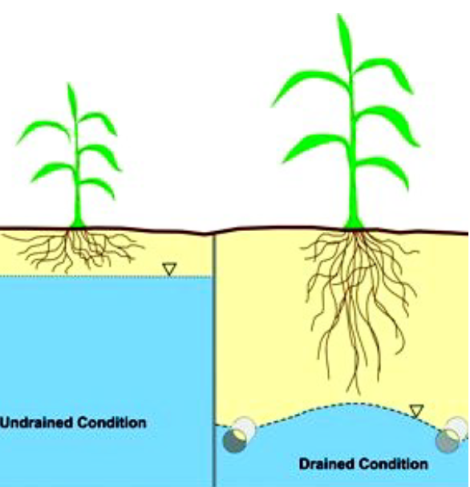
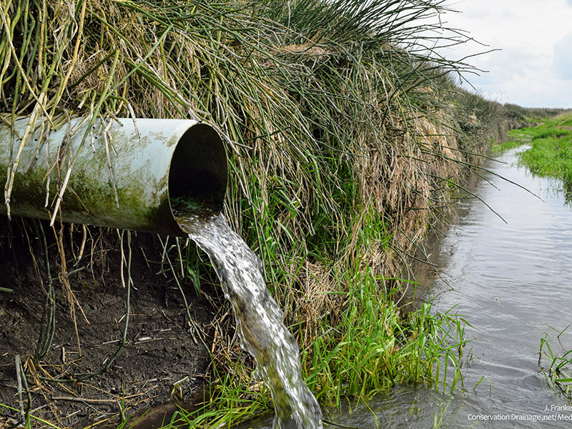
Introduction and Problem statement
Drainage units (subsurface – tile drains / surface – ditches are needed!)

Slide 3
Introduction and Problem statement
Advantages and disadvantages of drainage units
Advantages
Disadvantages
Increased water loss from GW
Increased ET
Increased pollutant transport
Increased vulnerability to drought
Increased salinity
Impact on water quality
Increases crop productivity
Consistent yields
Fewer plant diseases

Slide 4
Introduction and Problem statement
Hence, they are important elements to investigate further!
Keep in mind agricultural drainage started centuries ago (2000 BC)
However, their location is not well identified
Decision tree classification (DTC)
Remote sensing-based approaches (RS)

Slide 5
Research objective
Apply already existing methodologies of drainage unit identification
Apply novel additional filtering technique to improve the accuracy

Slide 6
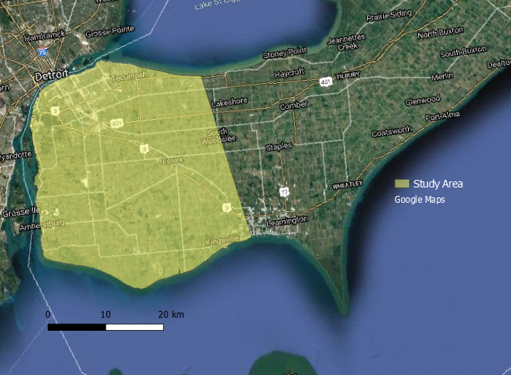
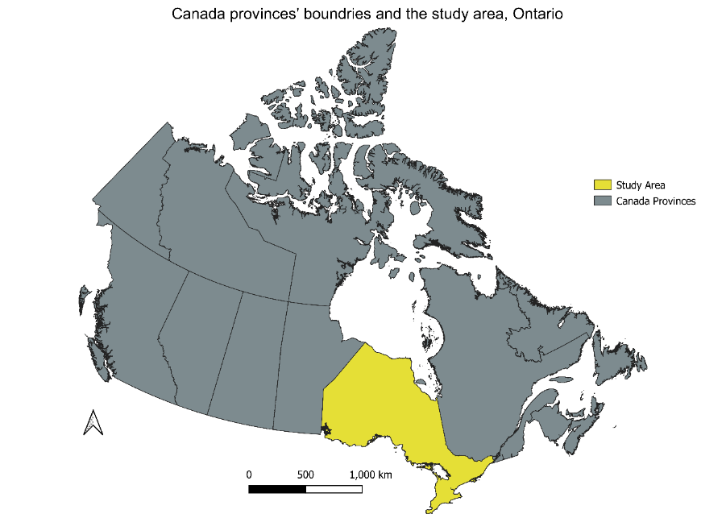
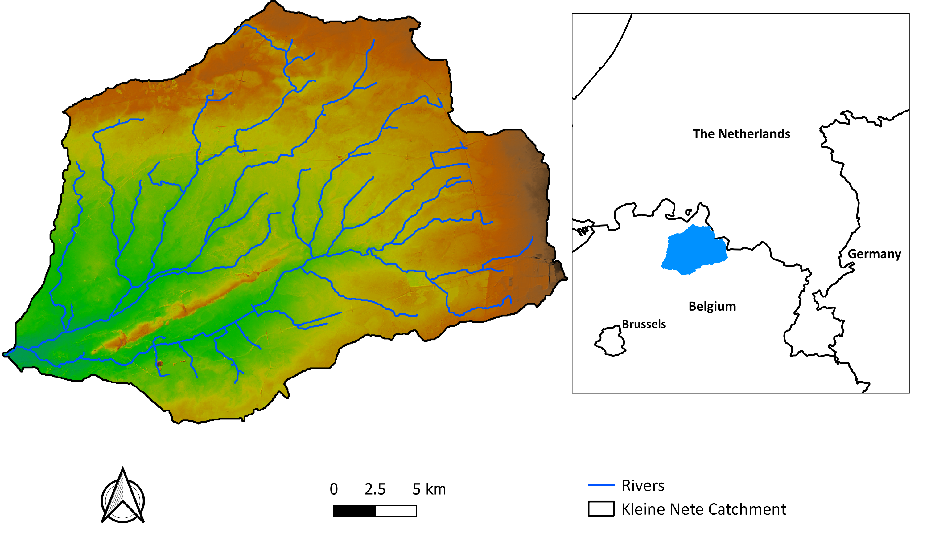
Study area and methodology

Slide 7
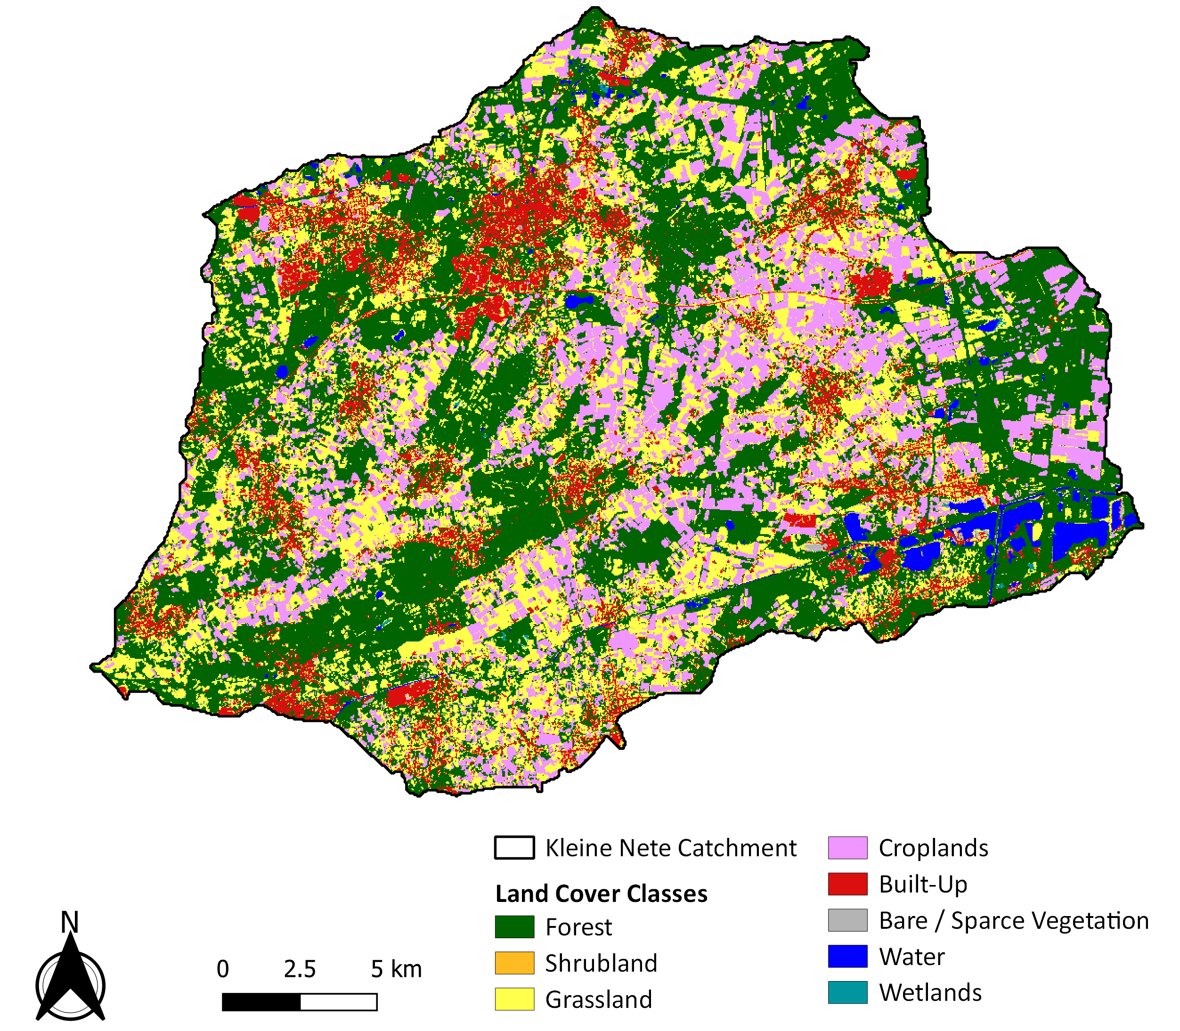
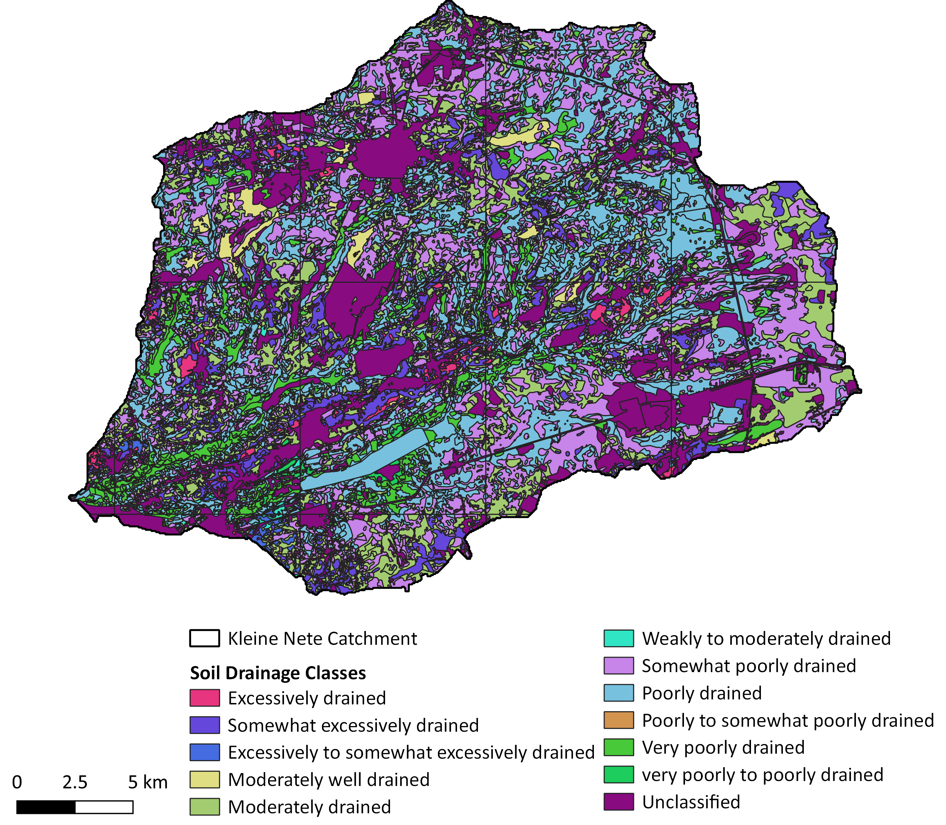
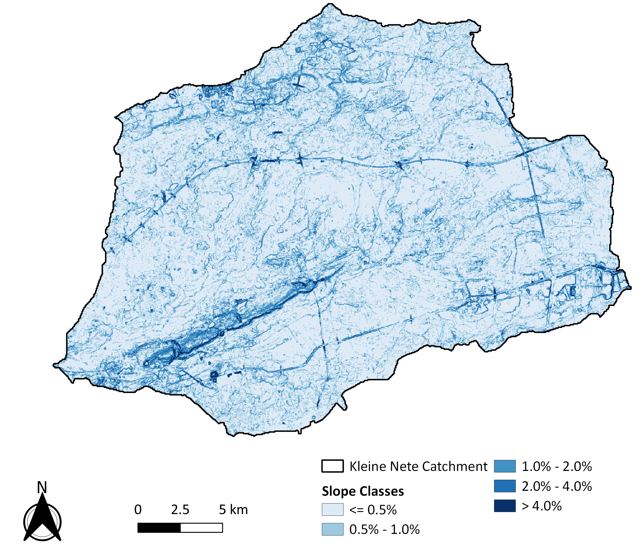
Study area and methodology
Two already existing approaches applied → DTC and RS
1. Decision tree classification (DTC) – based on different land use, drainage class and slope

Slide 8
Study area and methodology
2. RS-based approach
- Applying orbit file
- Thermal noise removal
- Radiometric calibration
- Speckle filtration
- Terrain correction
- Subset the study area out of the whole tile
https://github.com/google/snappy
Major steps:
Select a date with significant rainfall event (e.g around 25 mm)
Acquire surface reflectance imagery for days before and after the rainfall event
Deduct the imagery values after and before the rainfall event

Slide 9
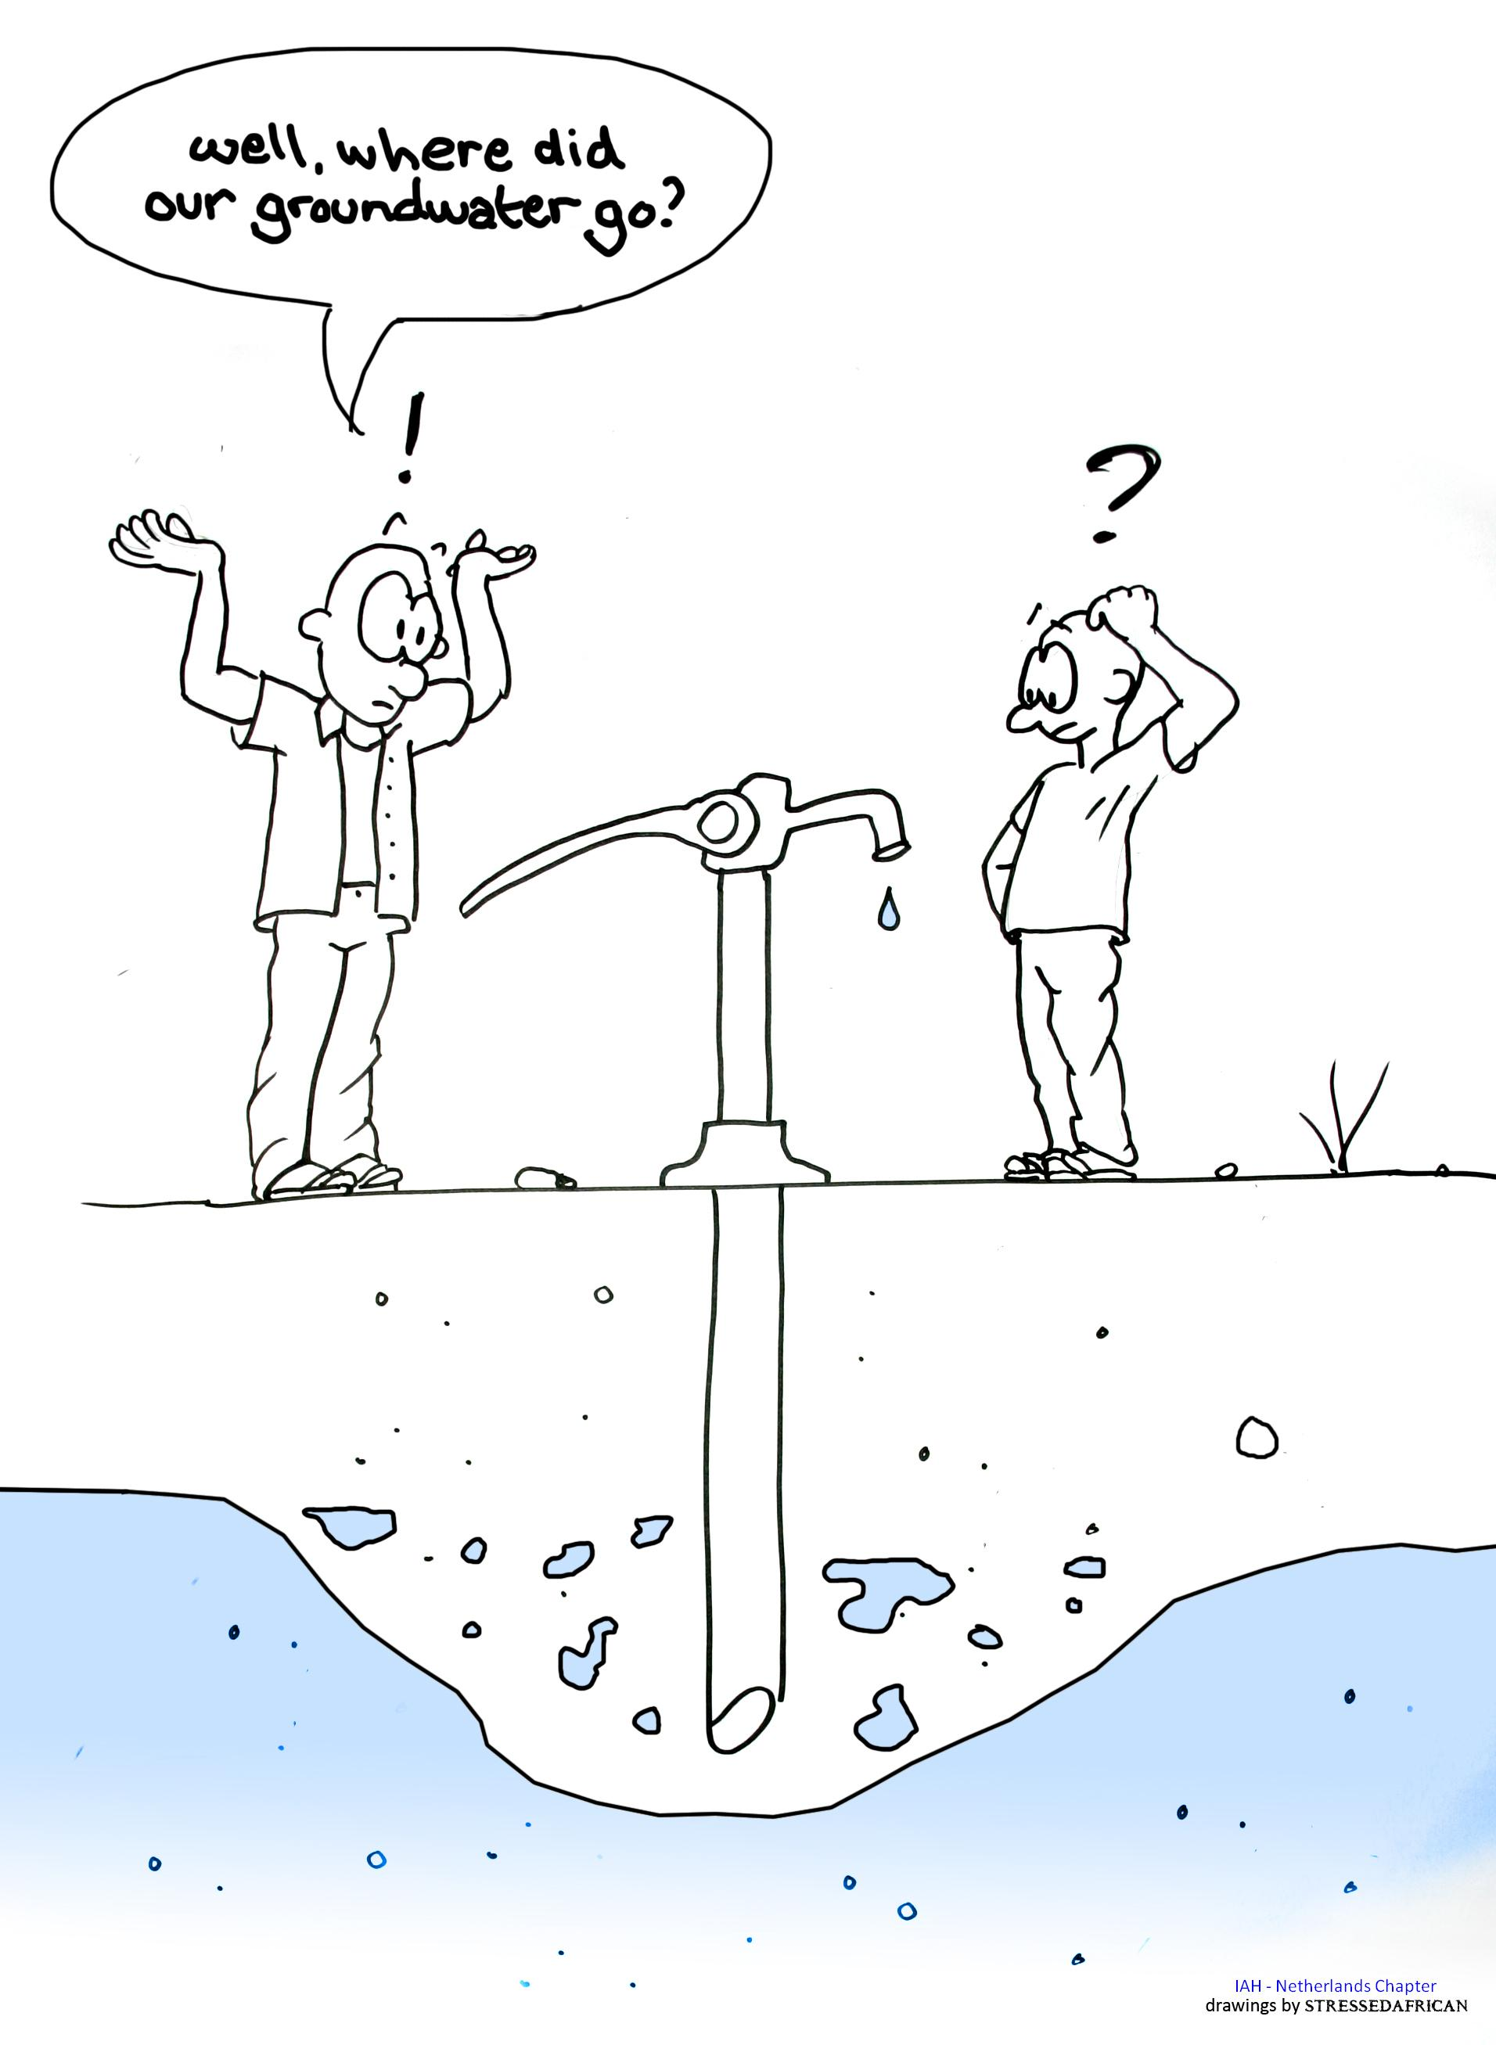
Study area and methodology
3. What do you think is missing?
Groundwater is the cause for drainage unit application, but its not used in any of the methods to identify drainage units

Slide 10
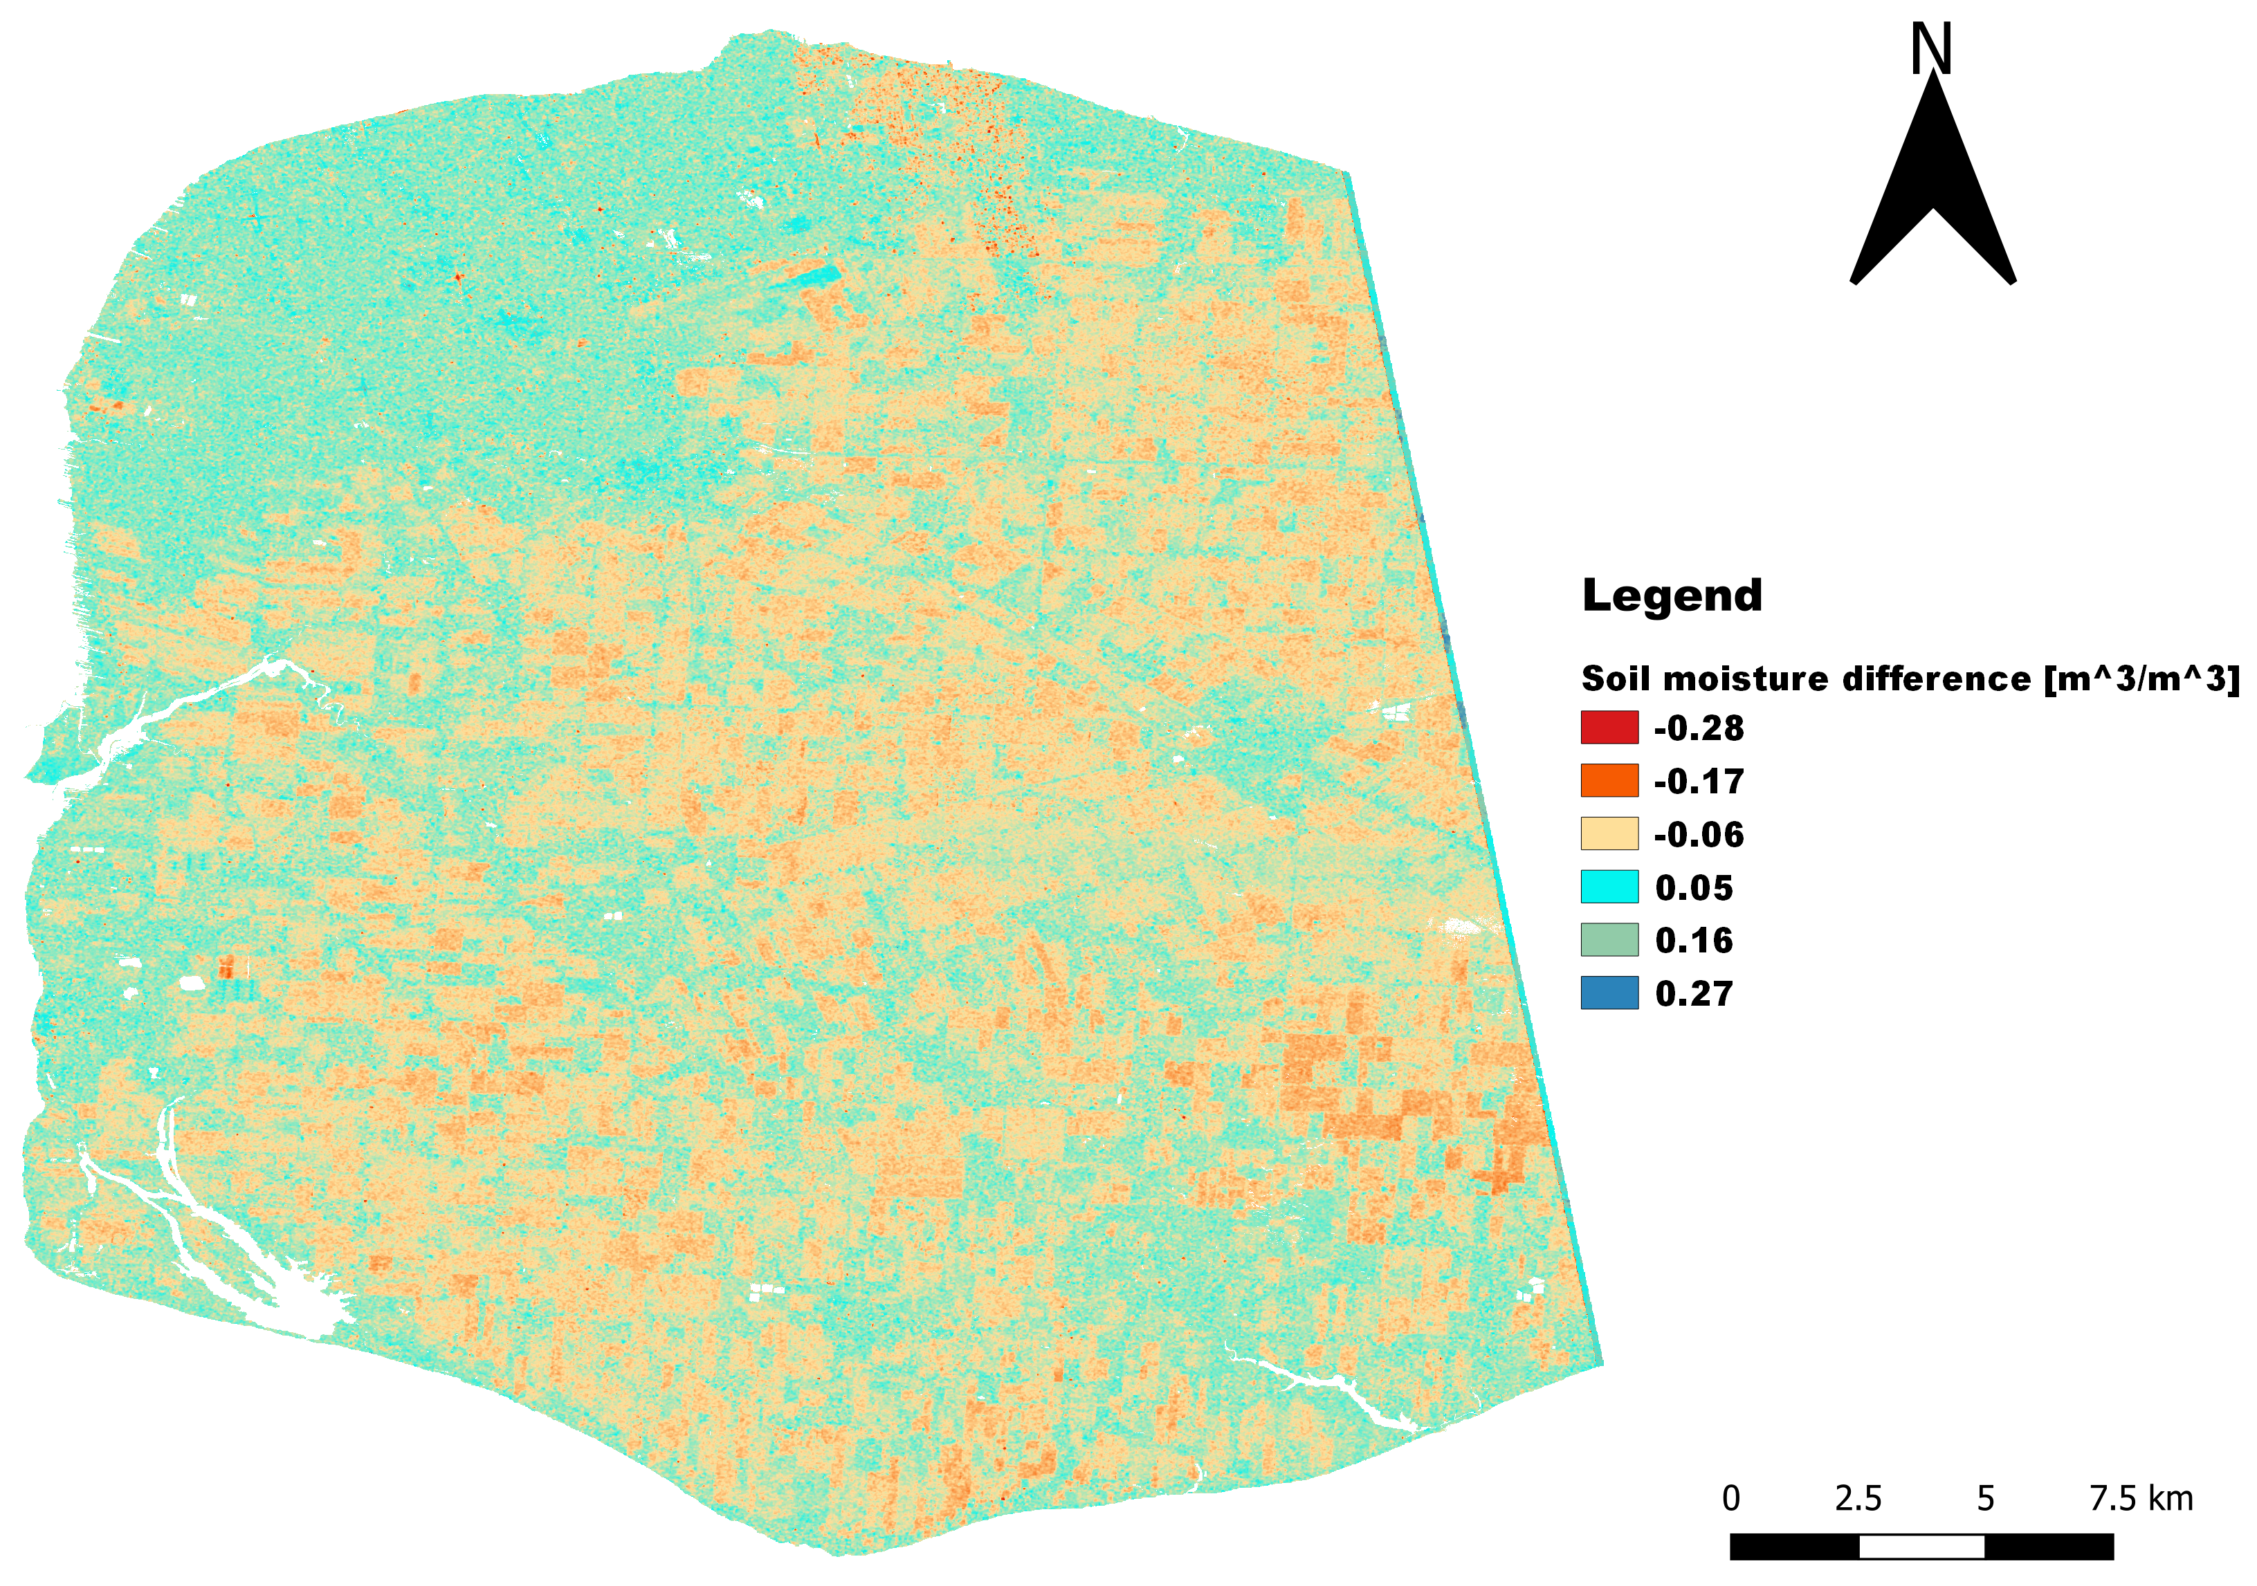
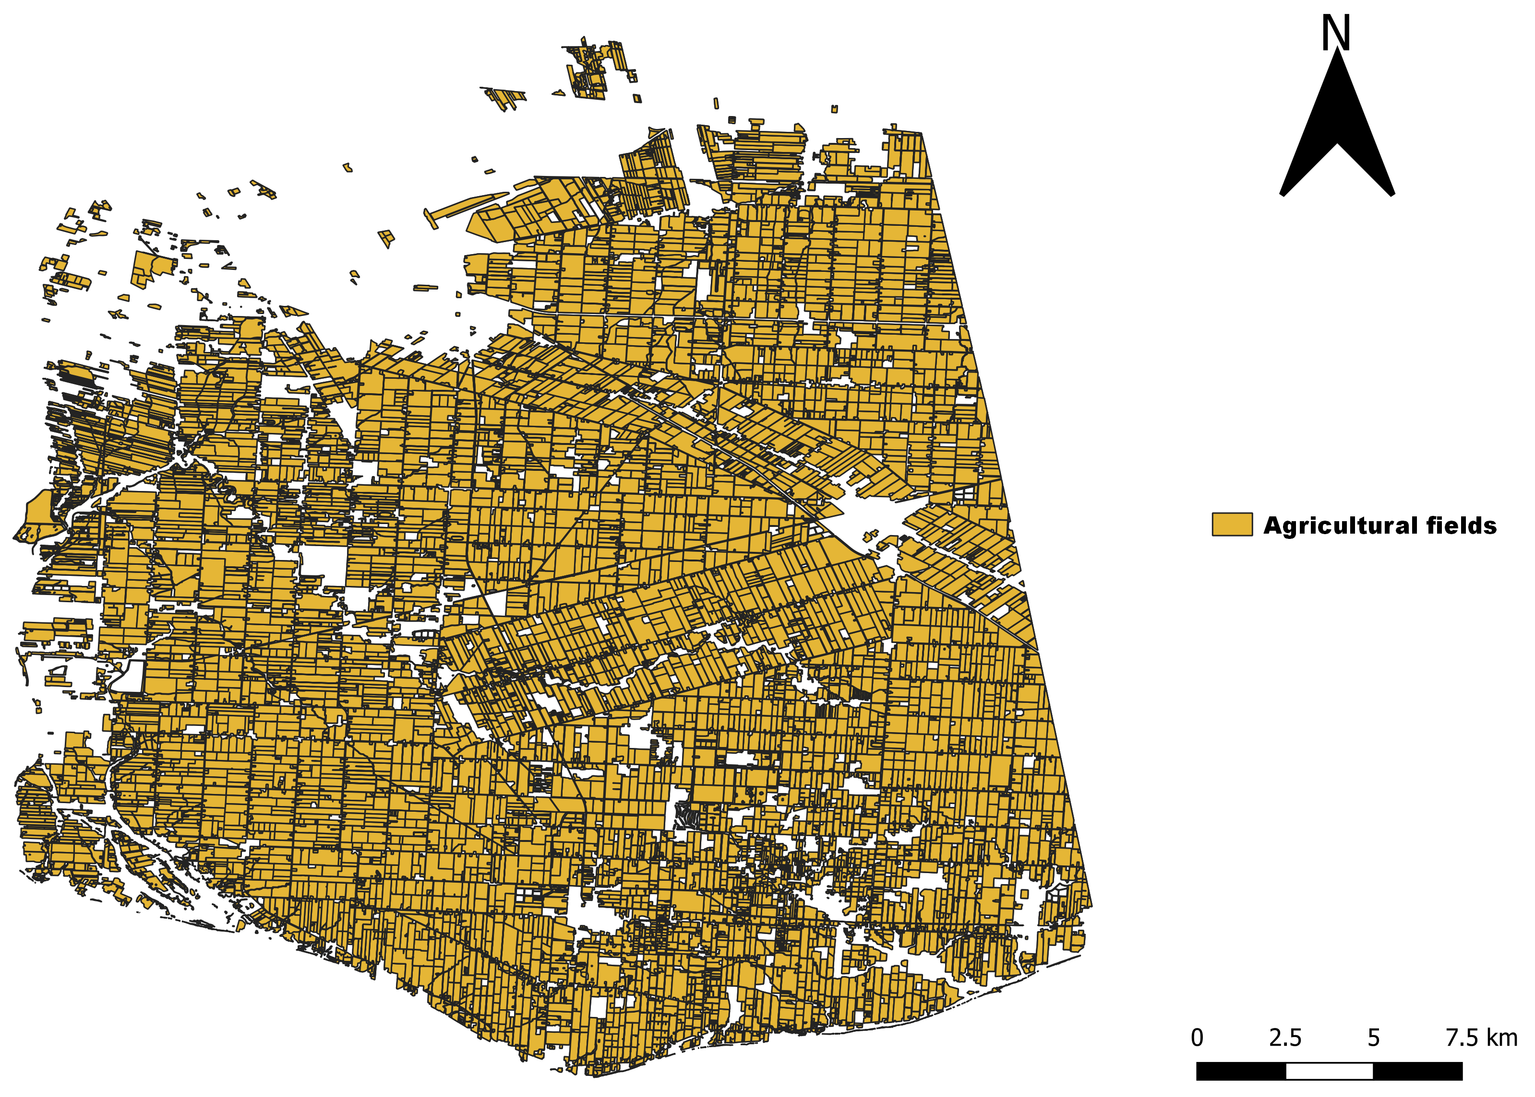
Results
1. RS based approach (Ontario – Canada)

Slide 11
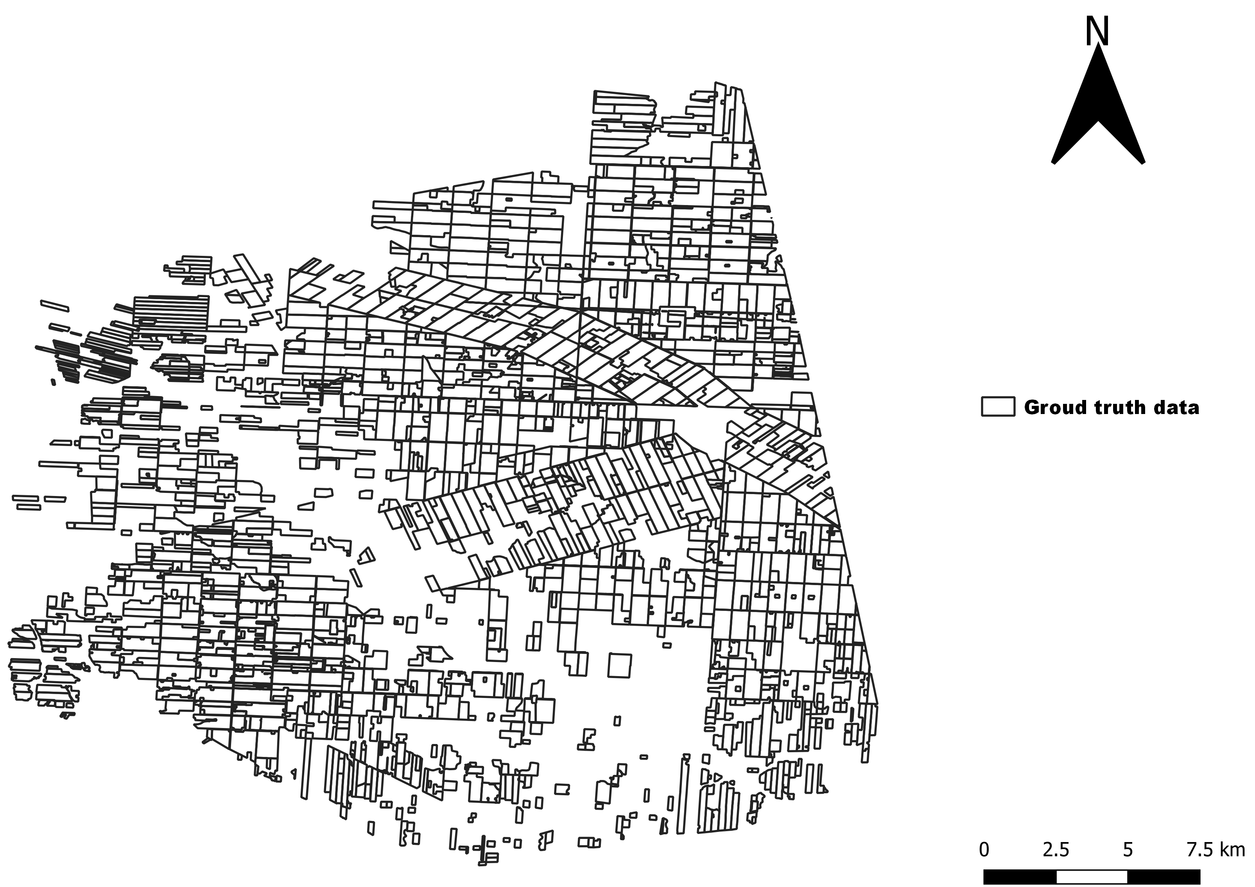
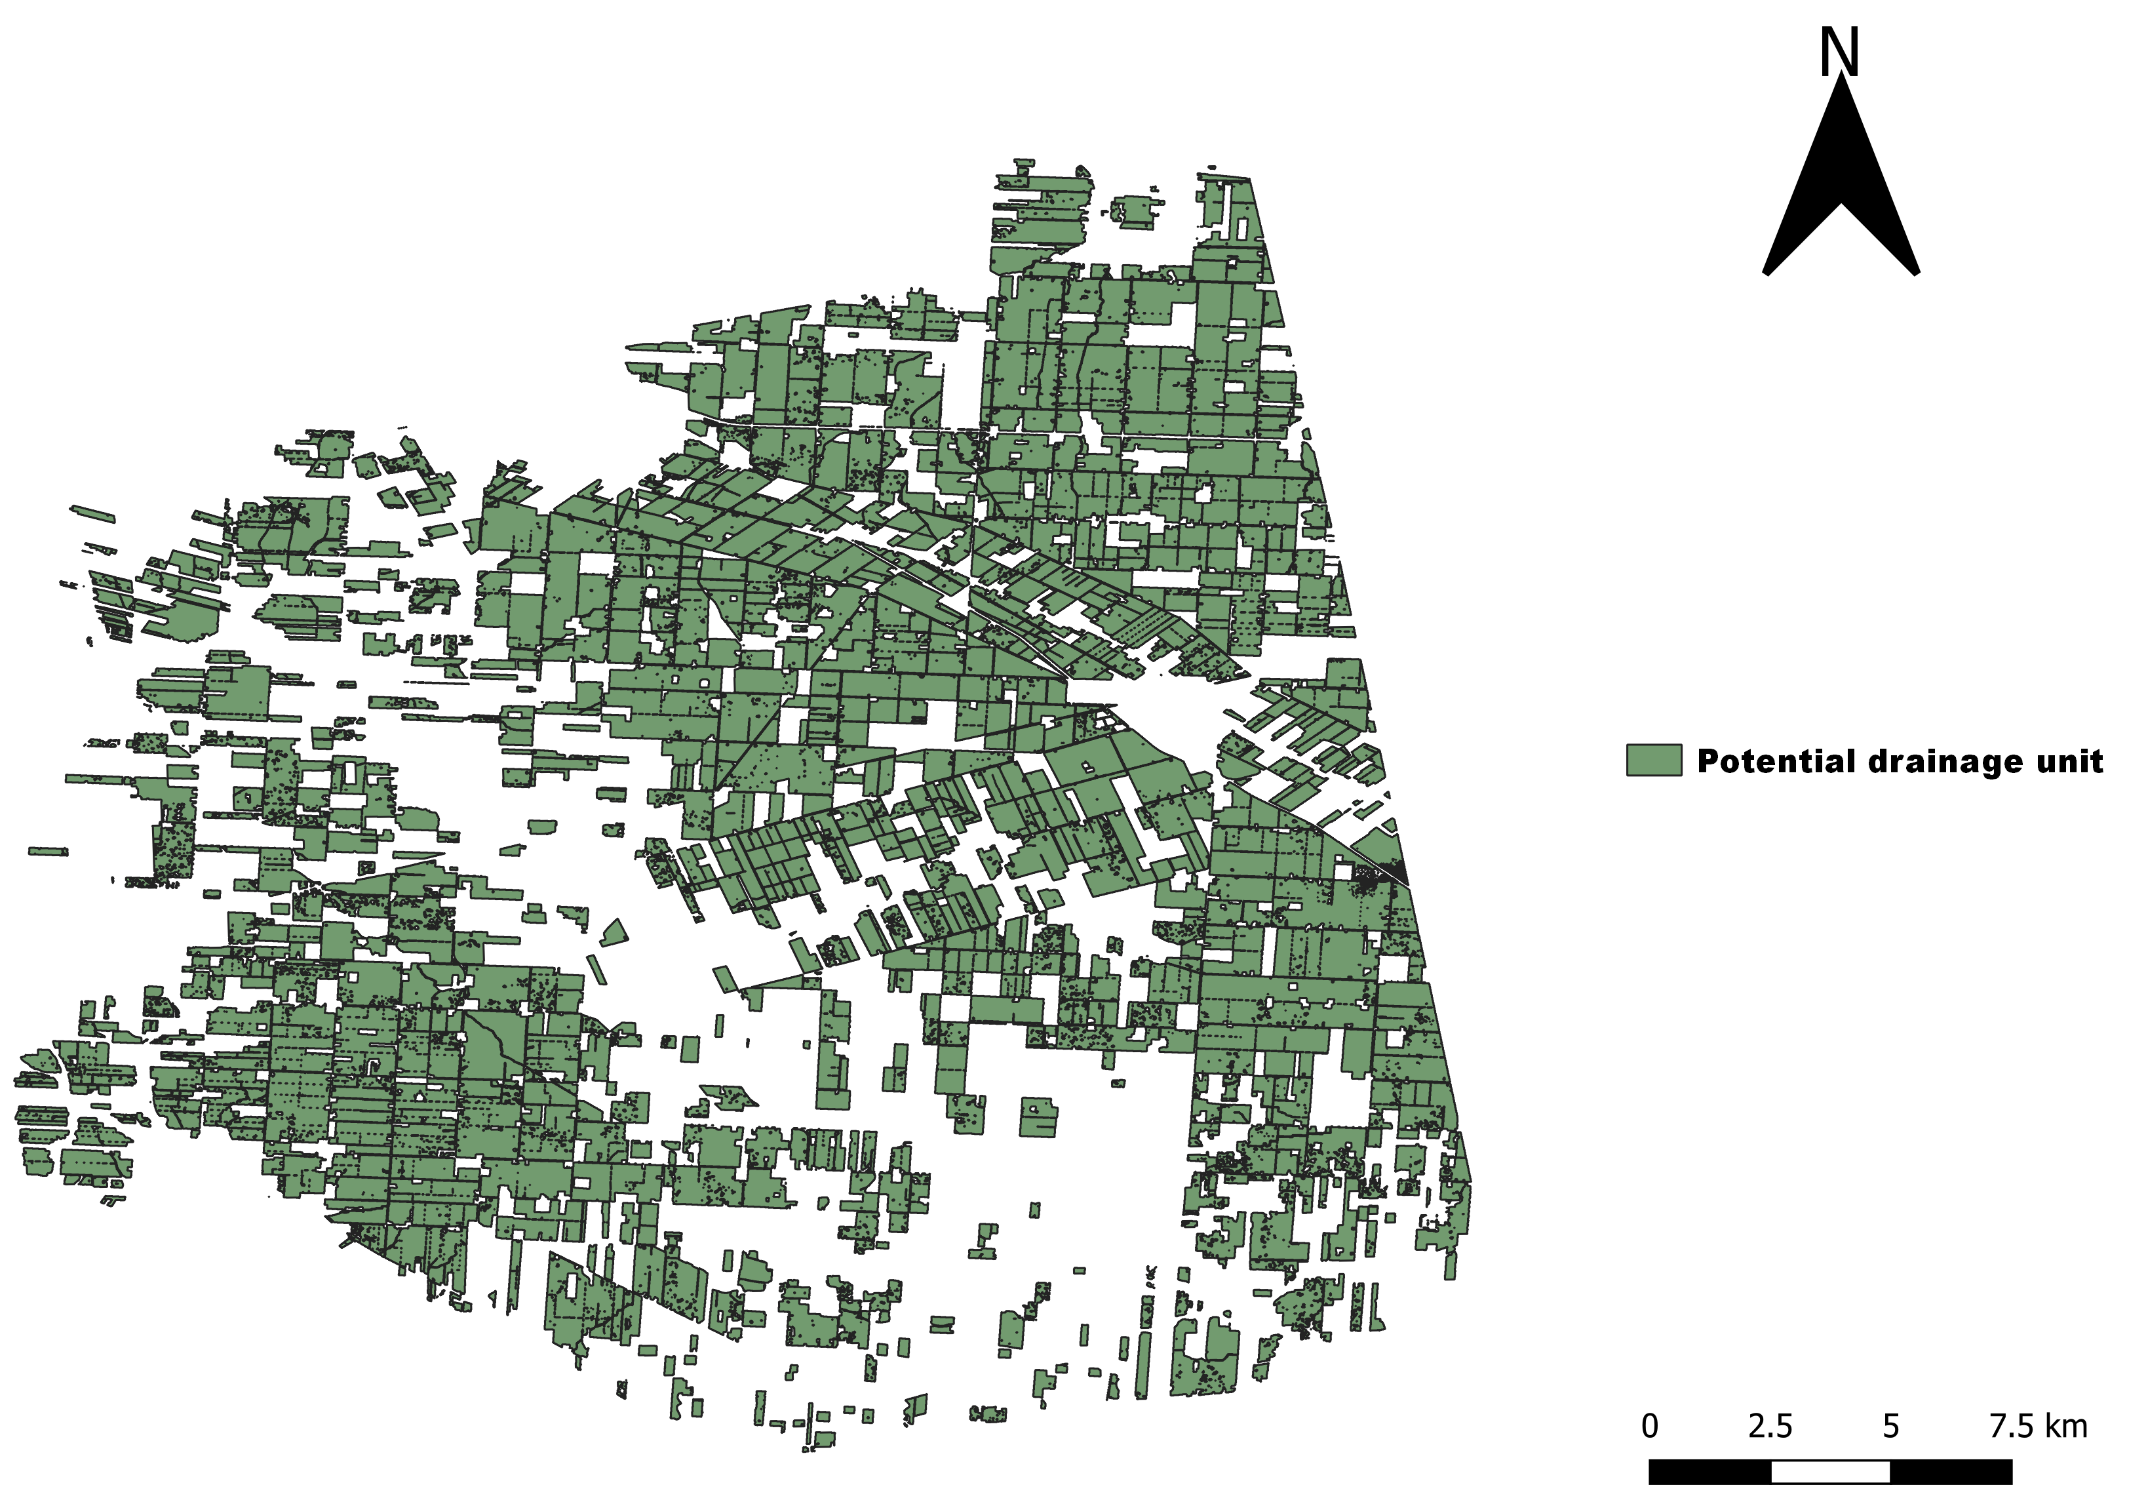
Results
1. RS based approach (Ontario – Canada)
Accuracy of 87.8%

Slide 12
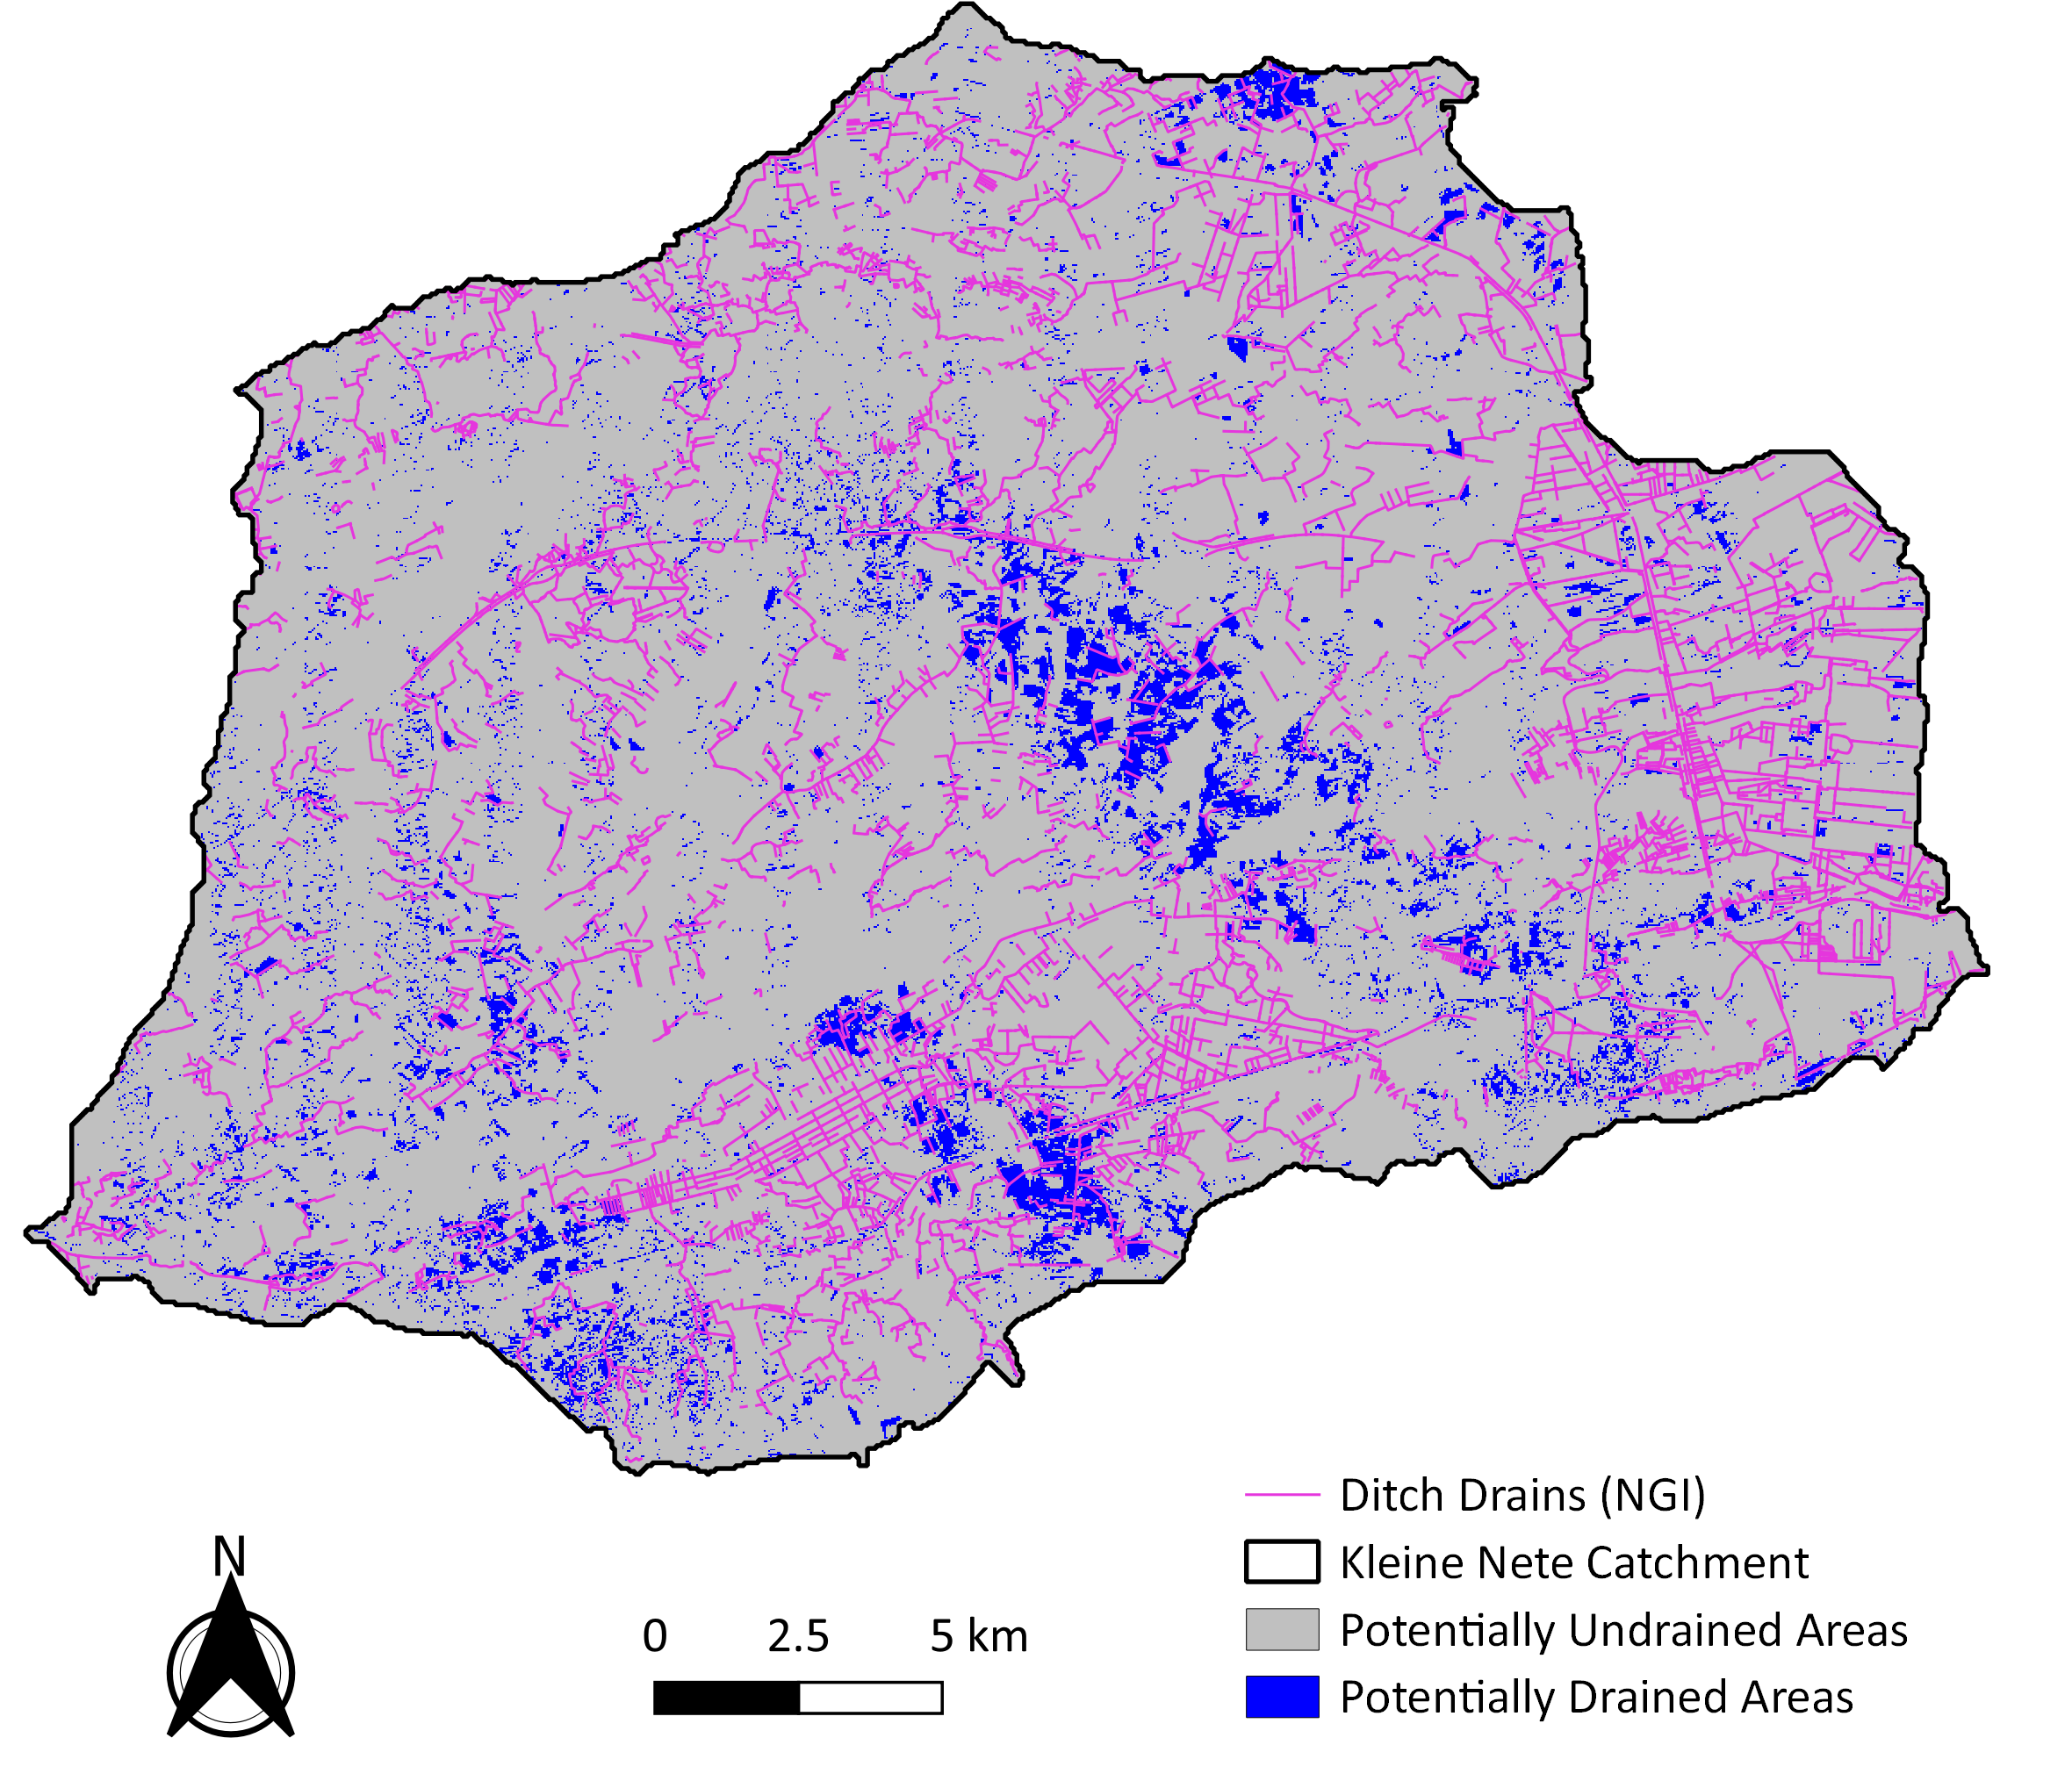
Results
1. RS based approach (Kleine Nete - Belgium)
Accuracy of 17.3%

Slide 13
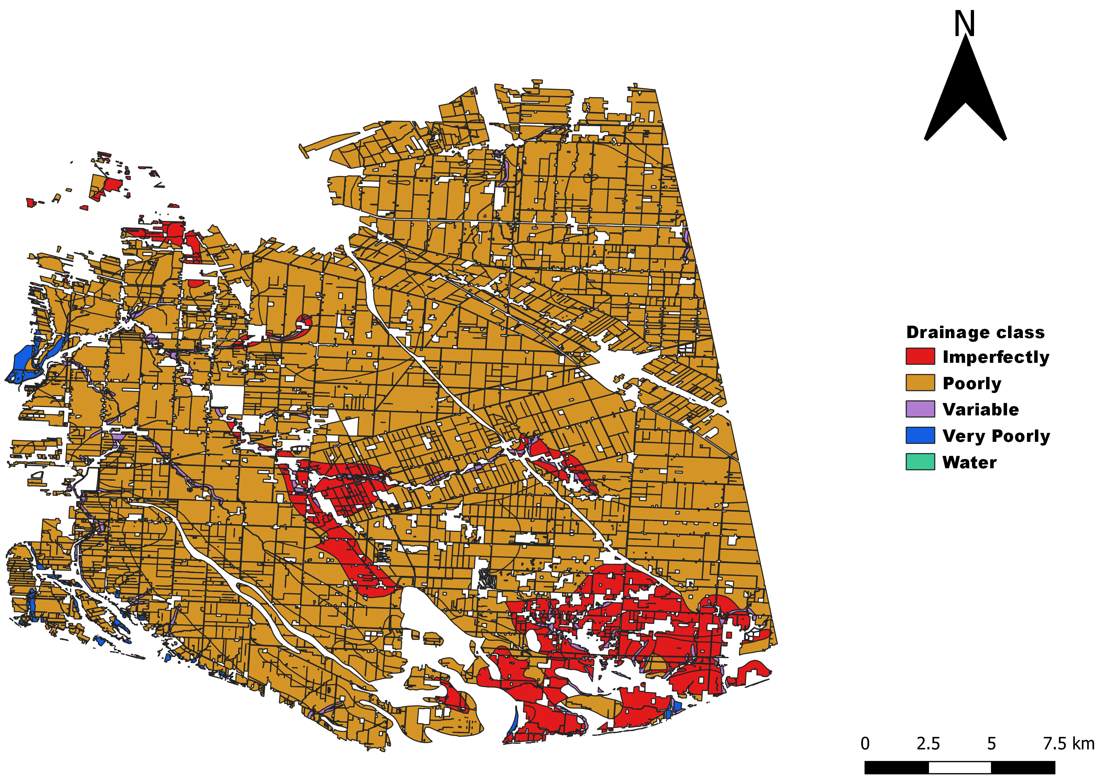
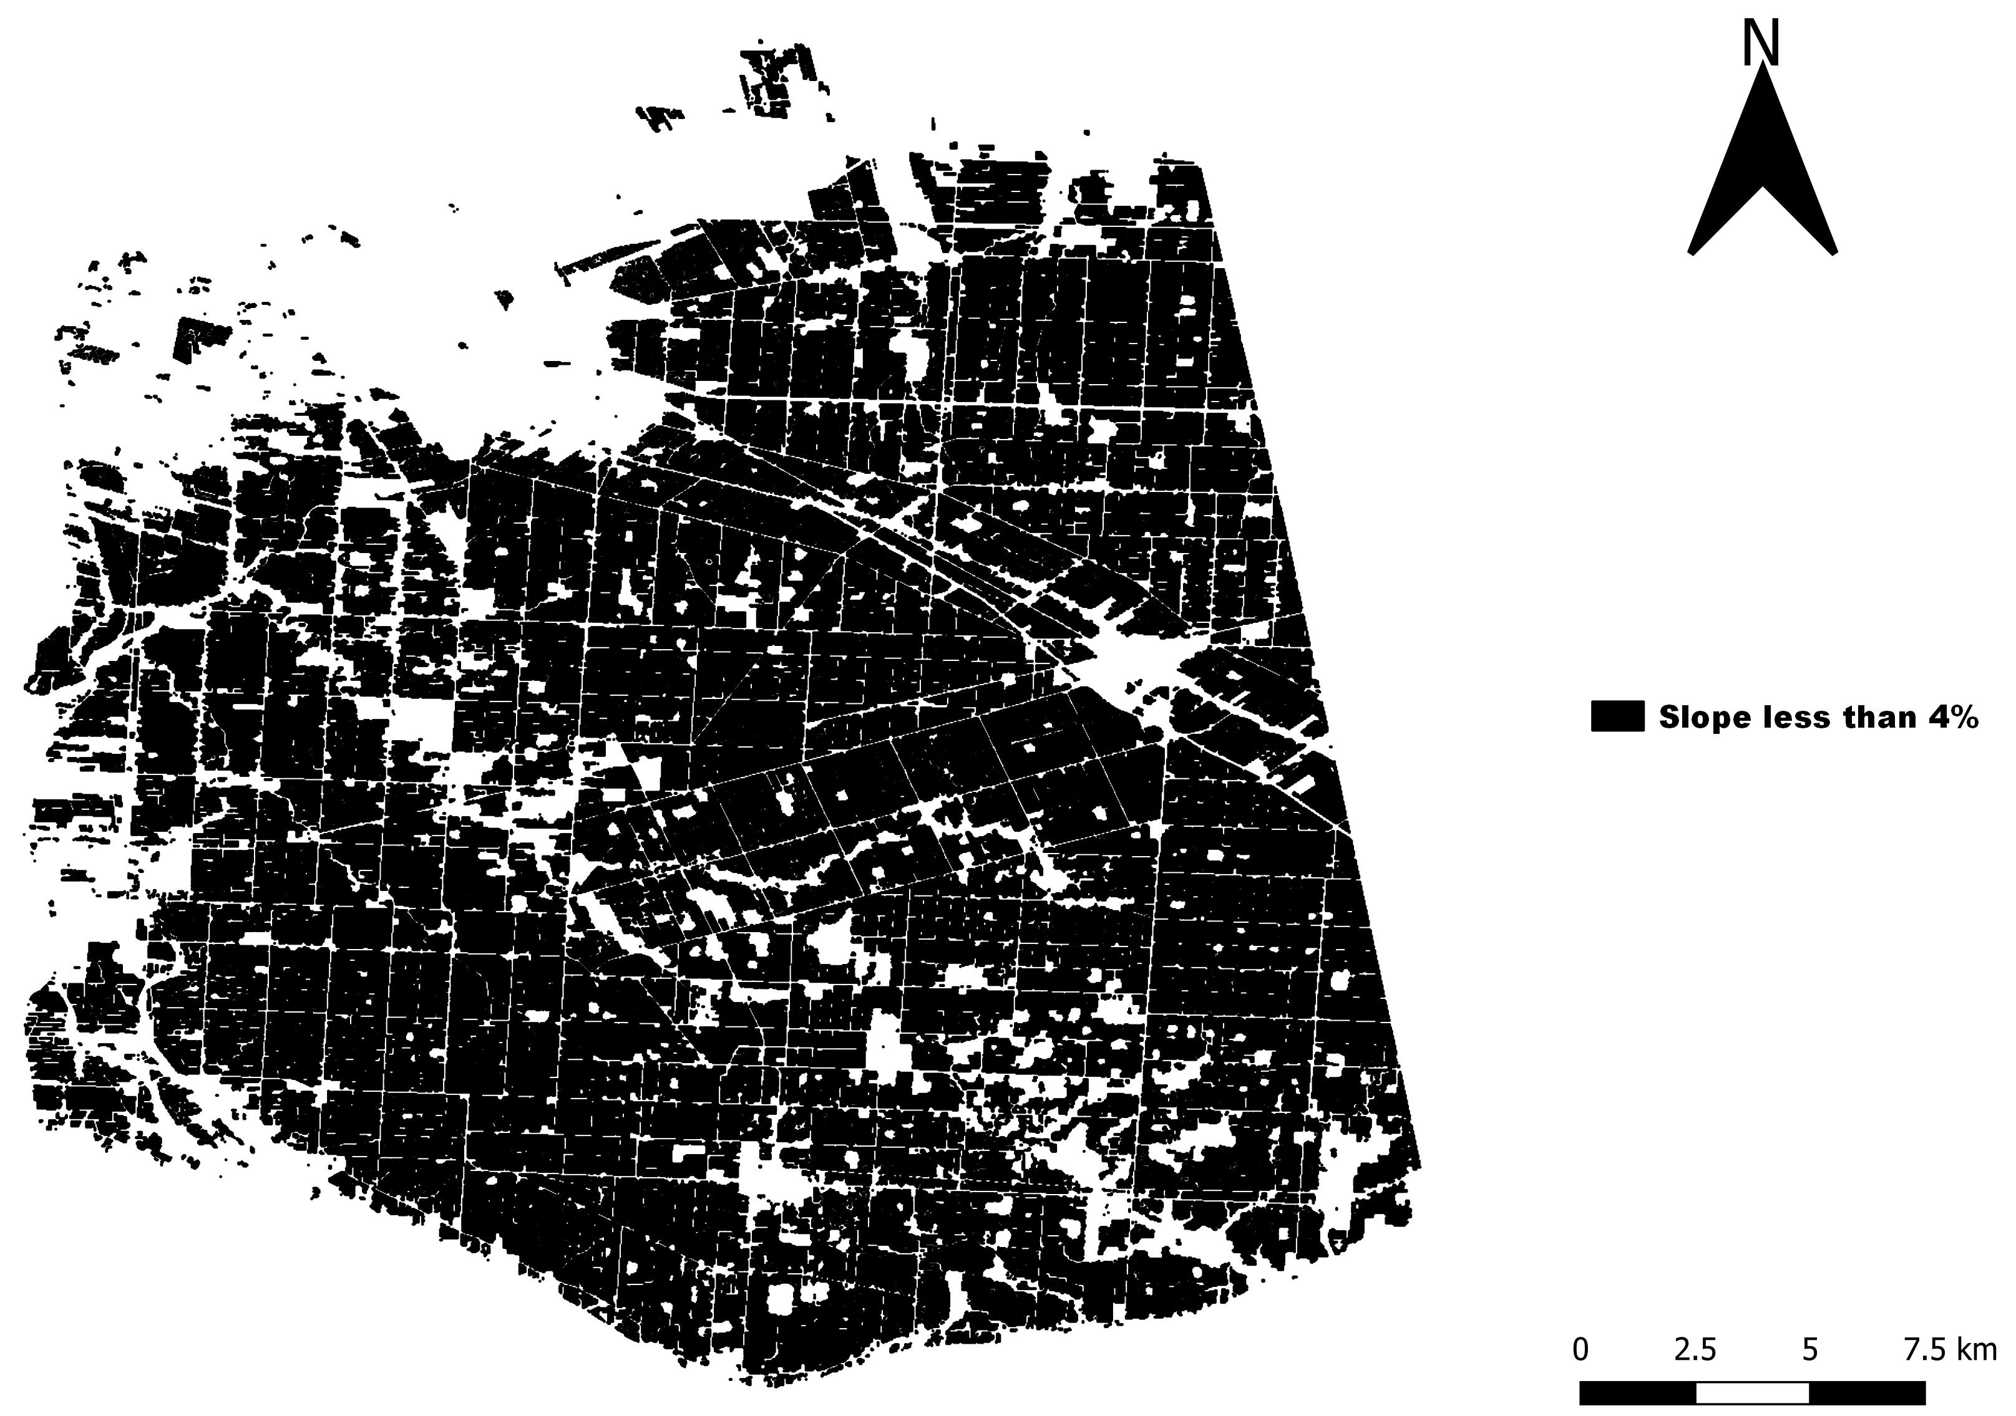
Results
2. DTC (Ontario - Canada)

Slide 14
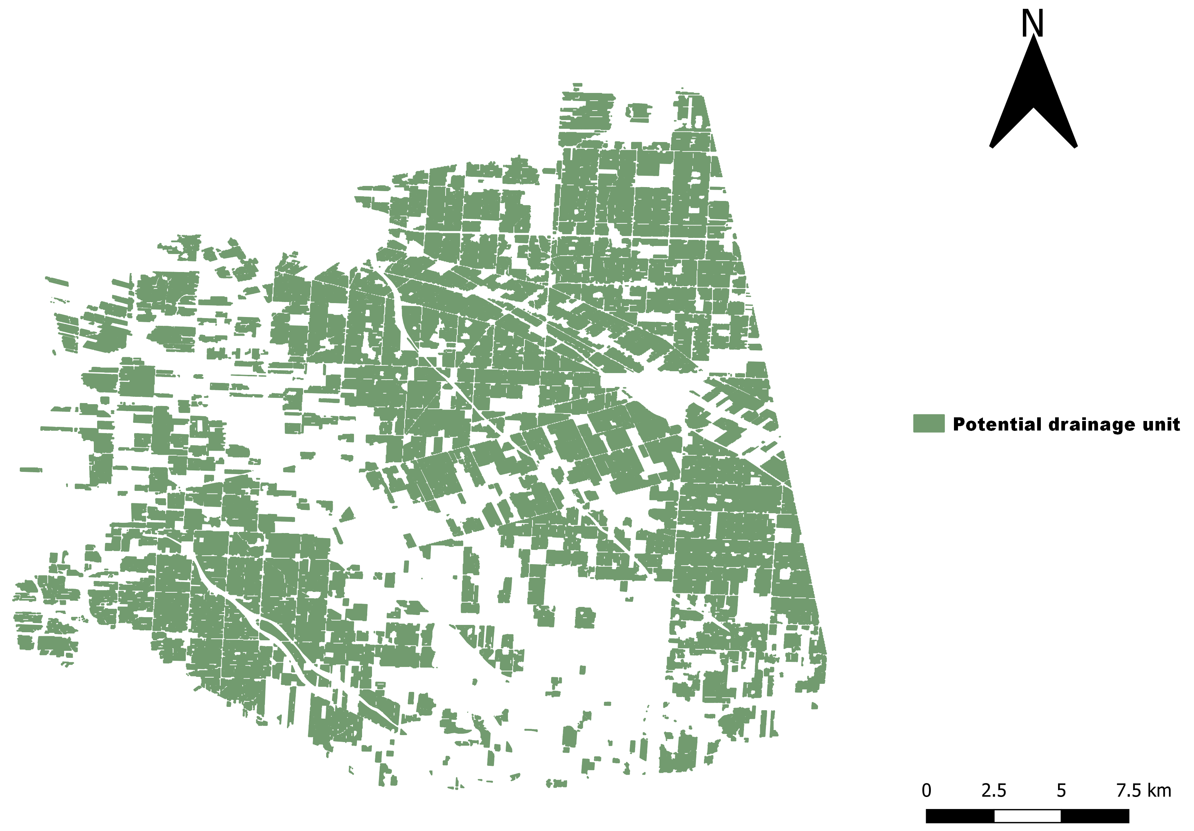
Results
2. DTC (Ontario - Canada)
Accuracy of 96.7%

Slide 15
Results
2. DTC (Kleine Nete)

Slide 16
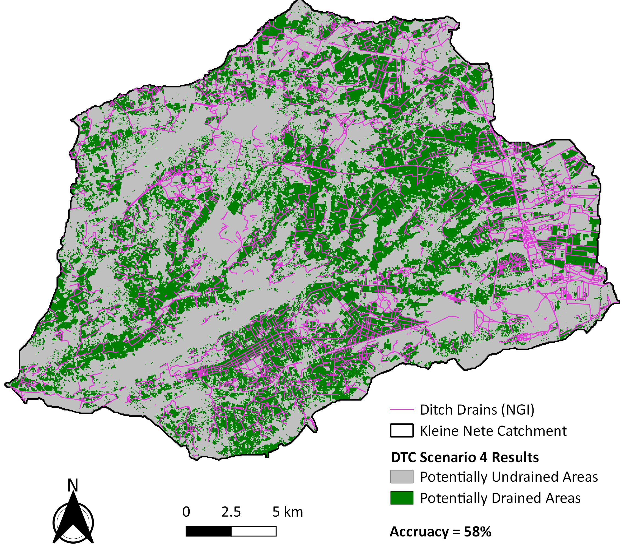
Results
2. DTC (Kleine Nete)
Accuracy of 58%

Slide 17
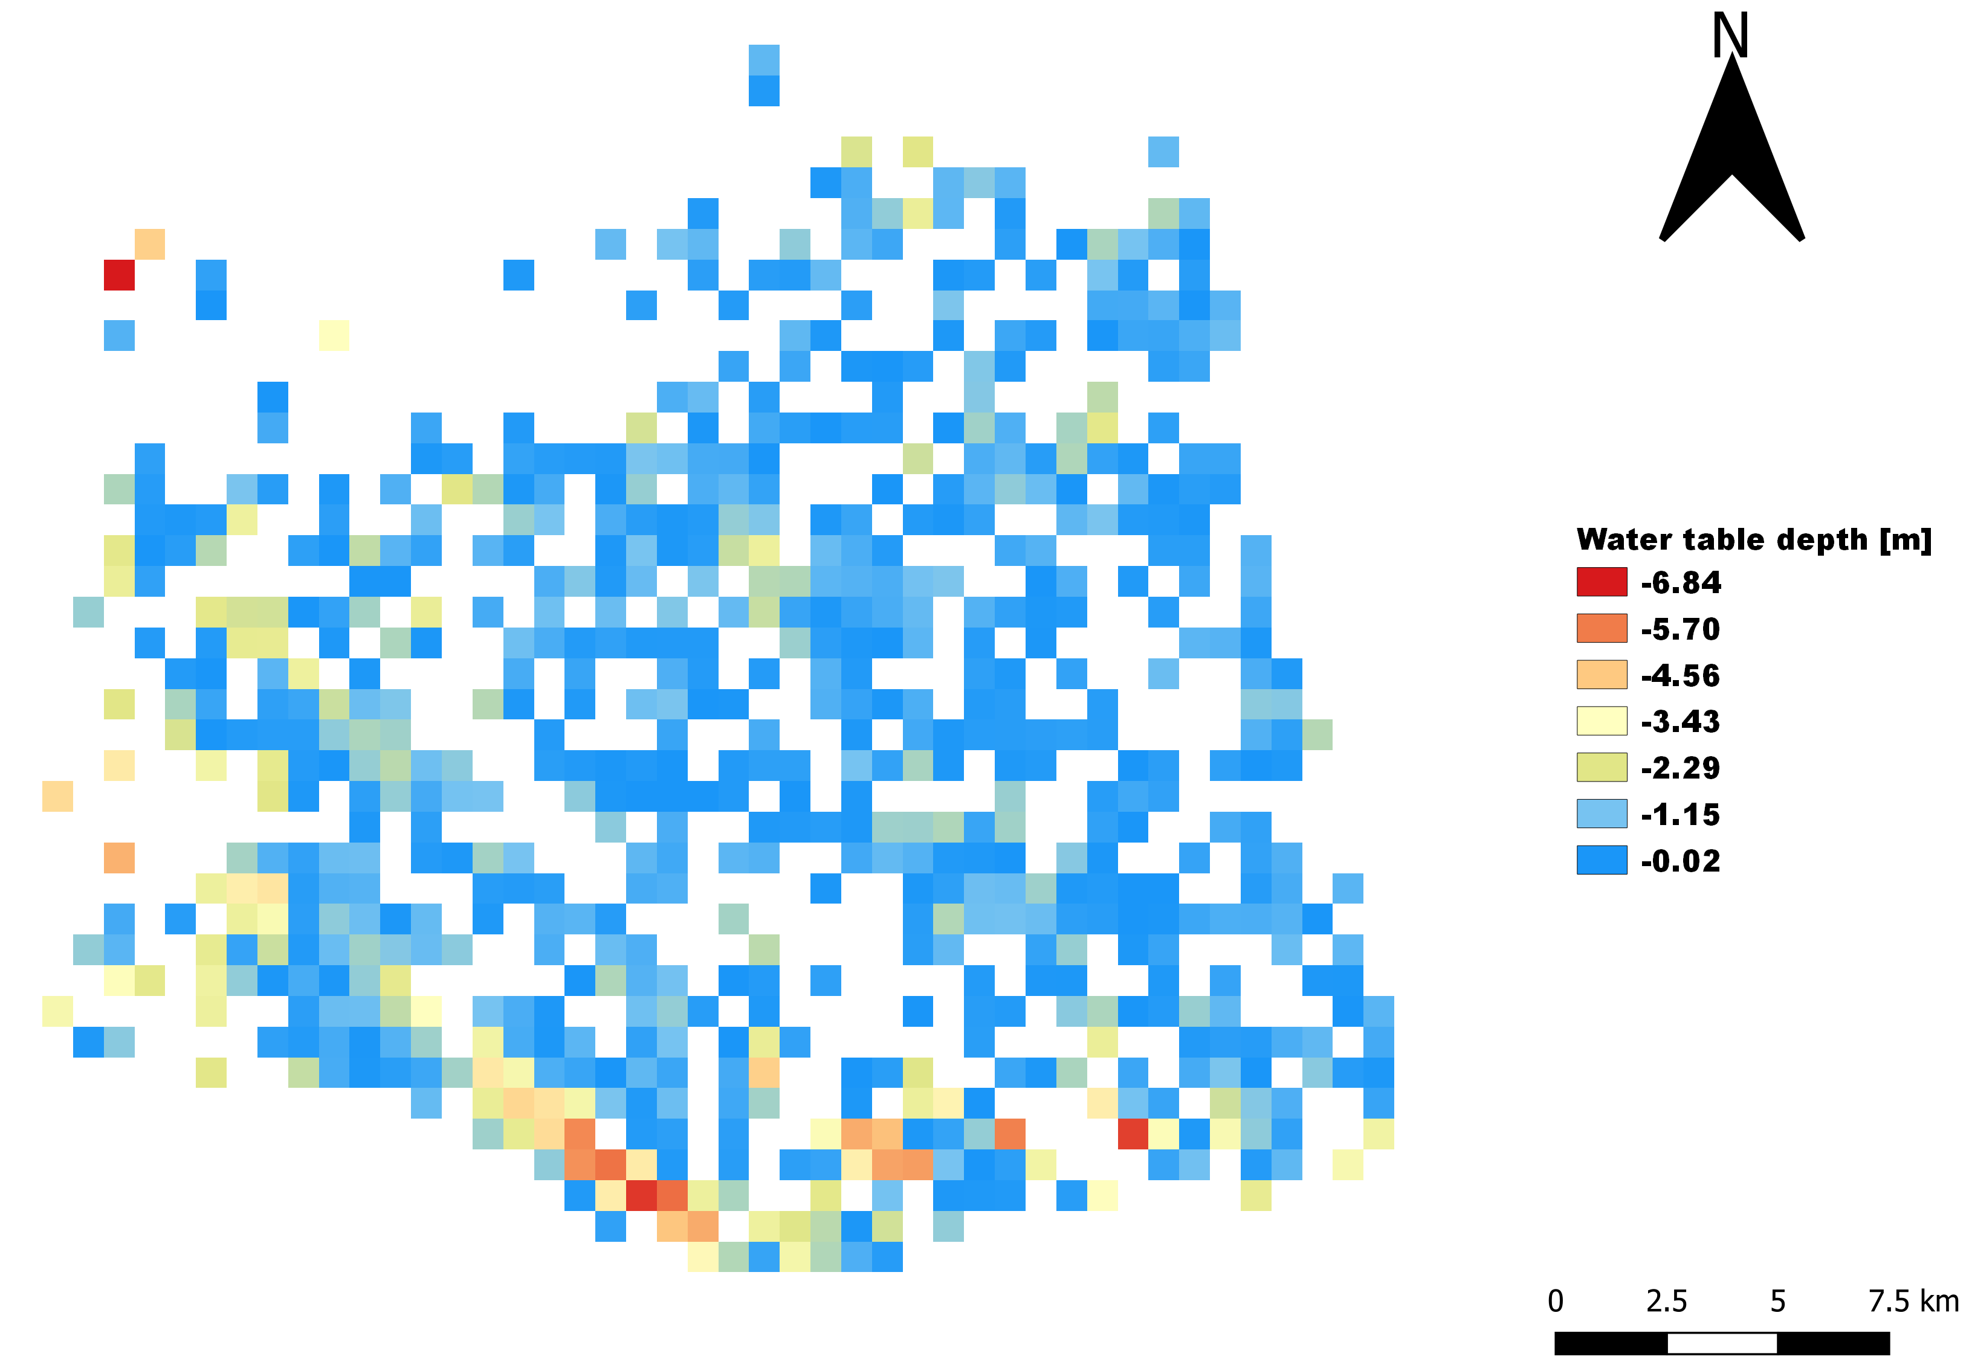
Results
3. Additional technique based on groundwater (Ontario - Canada)
Additional 19.4 km² area identified

Slide 18
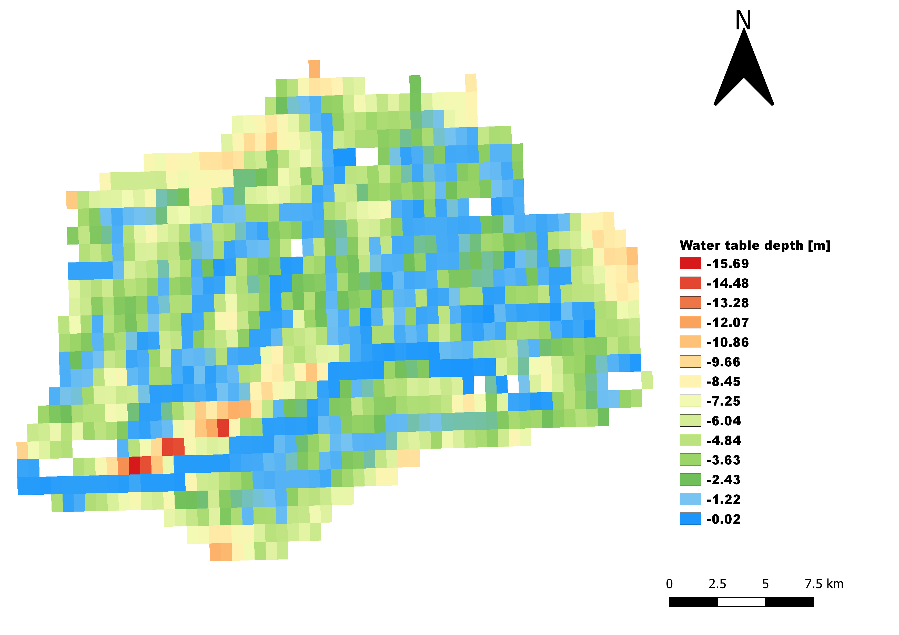
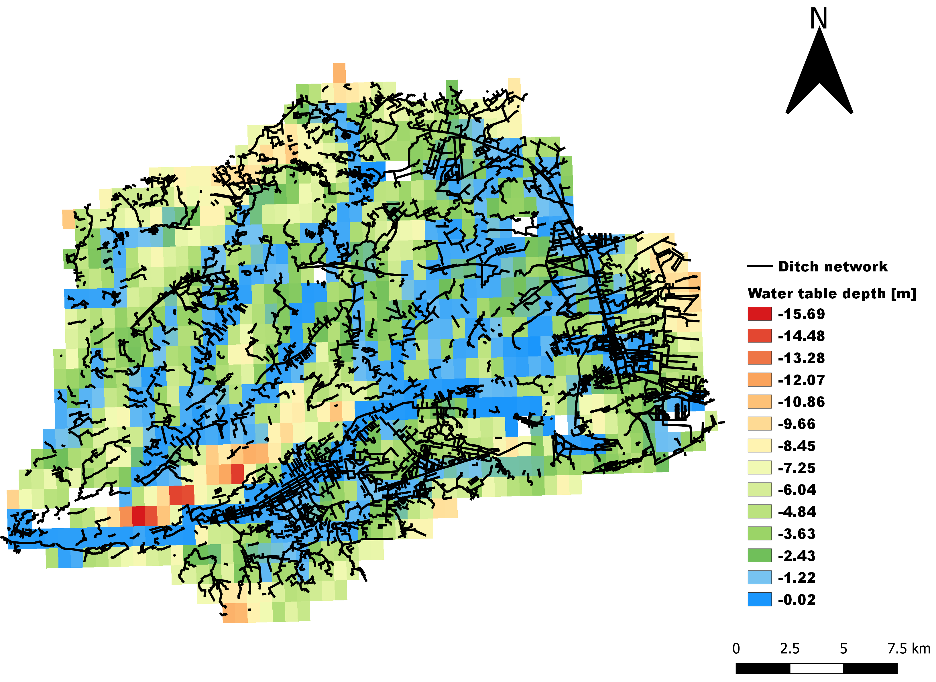
Results
1. Additional technique based on groundwater (Kleine Nete - Belgium)

Slide 19
Conclusions
RS approach has indicated an accuracy of 87.8% for case study 1 → useful method
1.1 But for the second case study, it resulted in poor performance → the method is not always accurate
DTC resulted in 96.75 and 58% accuracy for the first and second case study area, respectively.
The novel approach of using groundwater increased the accuracy of RS by 19.4km² area

Slide 20
How will this affect the hydrology? Next question
for your time

