Slide 1


Variability and the odds of Total and Pathogenic Vibrio abundance in Chesapeake Bay
Mayank Gangwar, Kyle Brumfield, Moiz Usmani, Yusuf Jamal*, Antar Jutla, Anwar Huq, and Rita Colwell
April 24, 2023

Slide 2
Introduction
Climate change is causing shifts in the distribution of pathogens and their vectors, this leads to an increased risk of outbreaks in new areas.
Climate variability is creating conditions that allow infections to spread widely and establish themselves as endemics in specific places.
The likelihood of negative and pervasive repercussions on ecosystems, the environment, and human well-being is the main problem with climate variability.
Unknown linkages between environmental, climatic, and weather processes and sociological determinants, which will directly affect the spread of disease and have detrimental effects on the human population.
The distribution of pathogens and their adaptation to various ecological factors remains uncertain with climate variability.
Due to factors including population expansion and urbanization, the burden of infectious diseases is anticipated to rise in the coming years.

Slide 3
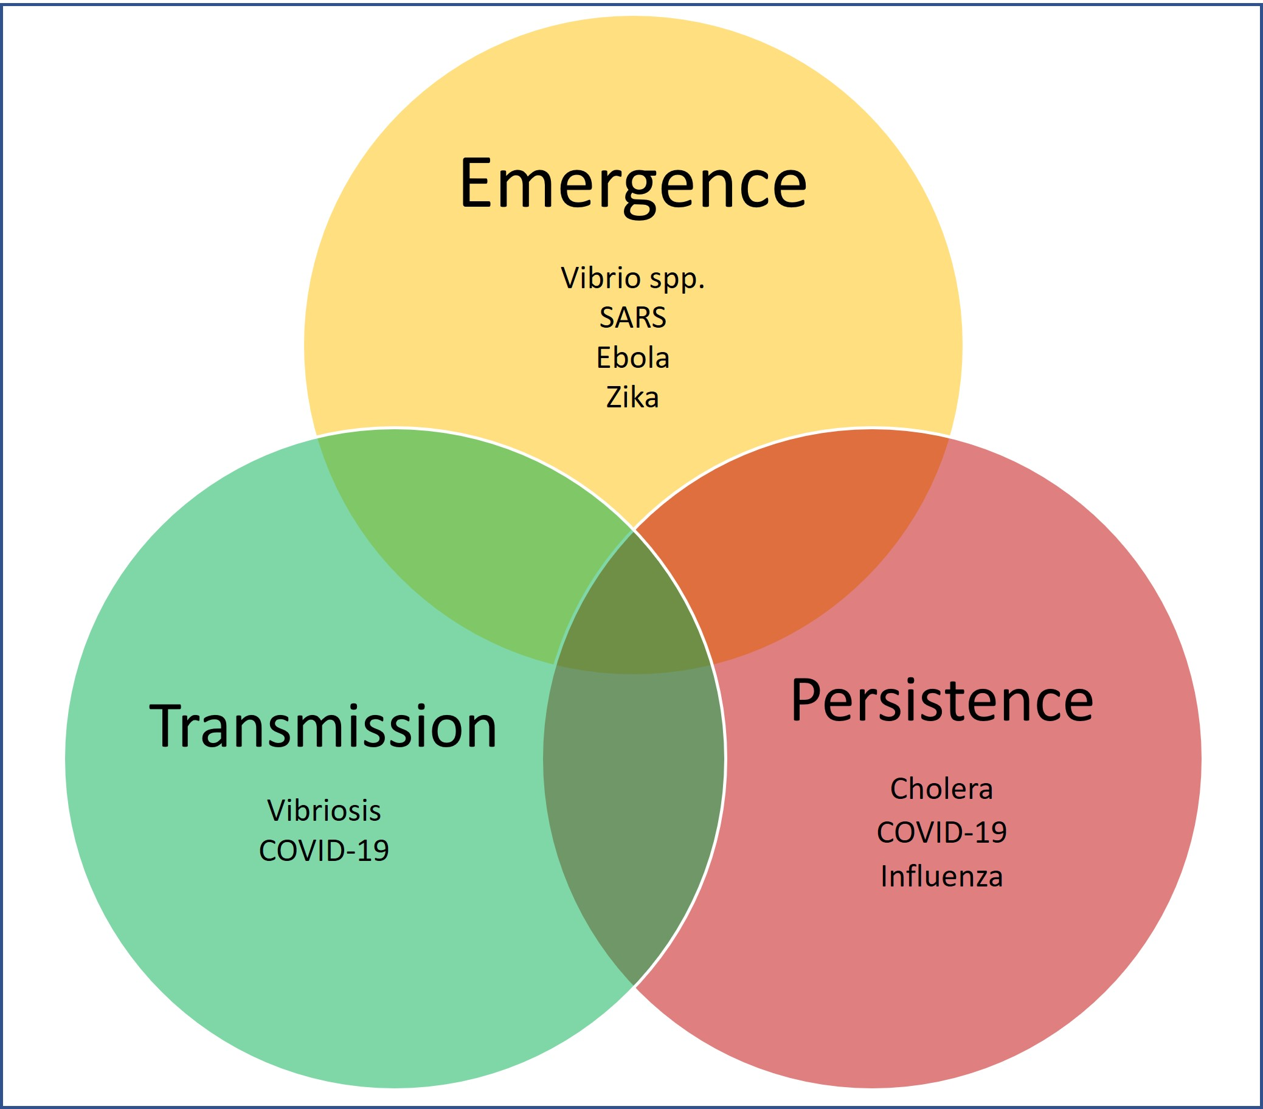
Introduction
Climate Variability
The emergence, transmission, and persistence behavior of a pathogen are closely linked and play a critical role in the spread and persistence of infectious diseases.
Emerging pathogen- novel genetic traits (can have increased virulence or transmissibility).
Transmission - routes can vary depending on the pathogen and the host species
Persistence - viable and infectious in the environment or within a host population.
High risk

Slide 4
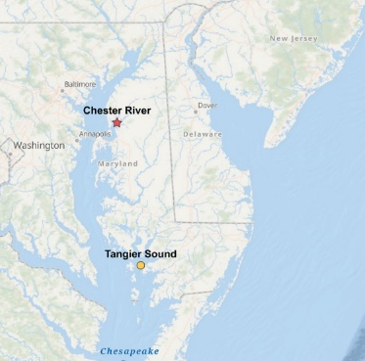
Data Collection
Old Data
Two Sites
  Chester River - 39°05.09'N, 76°09.50'W and
  Tangier Sound - 38°10.97'N, 75°57.90’W
Duration- June, 2009, to August, 2012
Frequency
  warmer months of June through August – twice / month
  September to May – once / month
Samples – 54

Slide 5
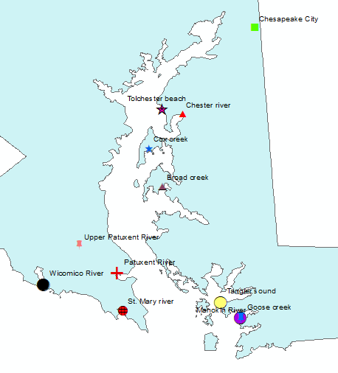
New Data
Duration – April 2019 to August 2022
More sites were sampled
  Broad Creek
  Choptank River
  Cox Creek
  Goose Creek
  Manokin River
  Patuxent River
  St. Mary's River
  Upper Patuxent River
  Wicomico River
Samples -86

Slide 6
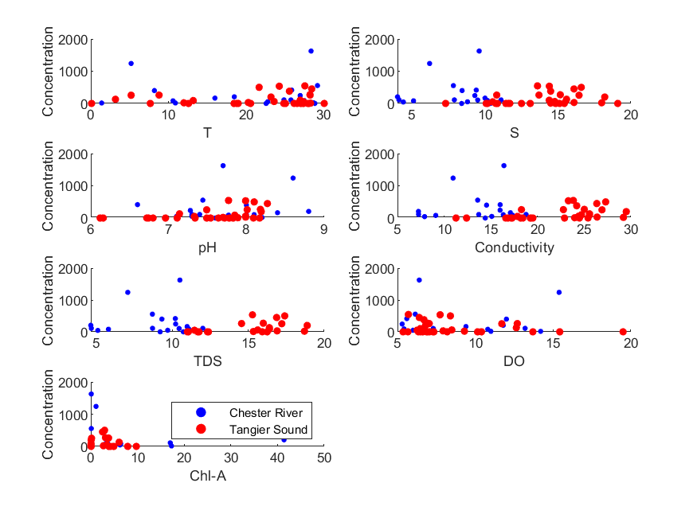
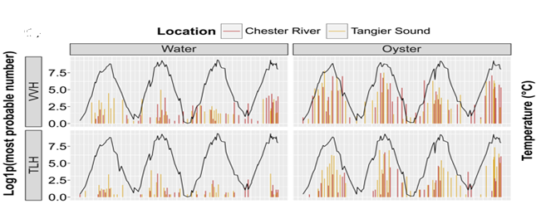
In-situ observations for water temperature, conductivity, salinity, total dissolved solids, chlorophyll-a, pH, dissolved oxygen, and turbidity were obtained for water and oyster samples.
Figure: Densities of genetic markers populations

Slide 7
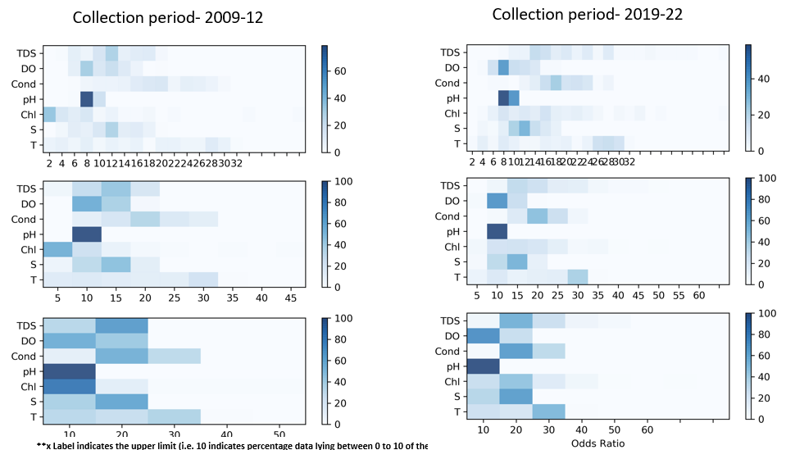
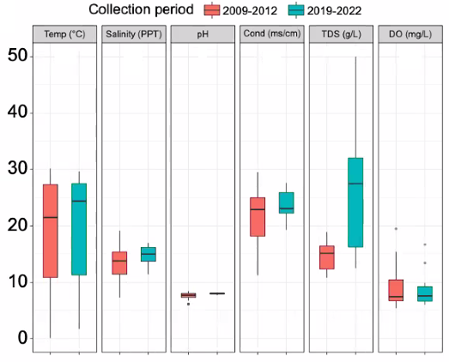
Differential evaluation
Figure. Sampling comparisons
Figure. Percentage of data in the range

Slide 8
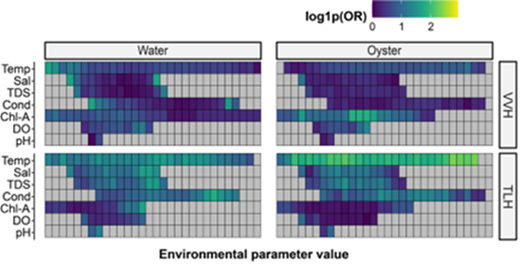
Odds Ratio
Statistical analysis showed the weak correlation.
Odds Ratio (OR) is used determine epidemiological associations
OR determines how likely an exposure will cause a particular occurrence
Figure: Odds Ratio heatmap for total (TLH) and pathogenic (TDH and TRH) VP and total VV (VVH)
$$Odds Ratio= \frac{odds of the event in the exposed group}{odds of the event in the non−exposed group}$$

Slide 9
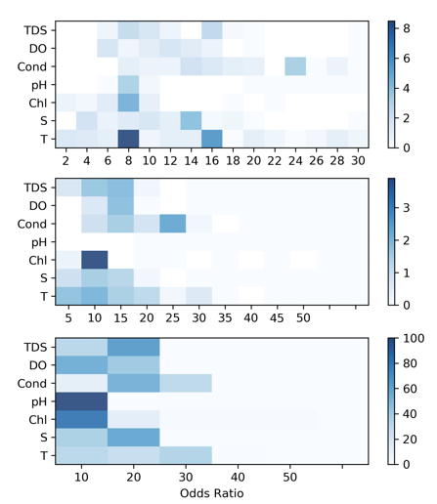
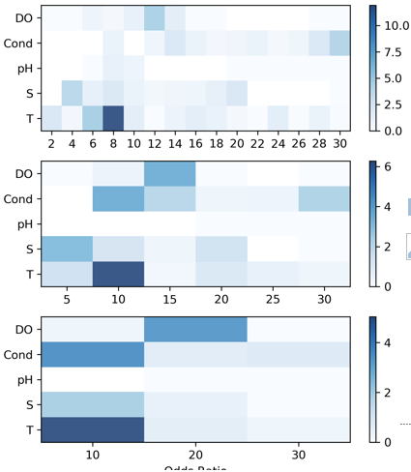
Vibrio Parahaemolyticus
Collection period – 2009-2012
Collection period – 2019-2022

Slide 10
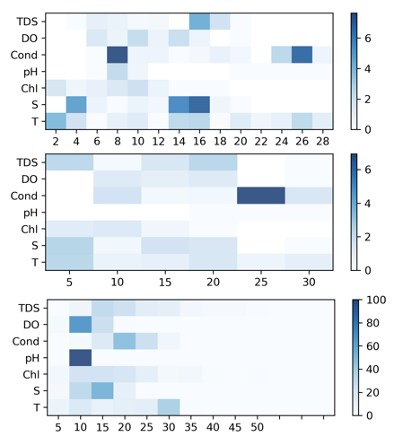
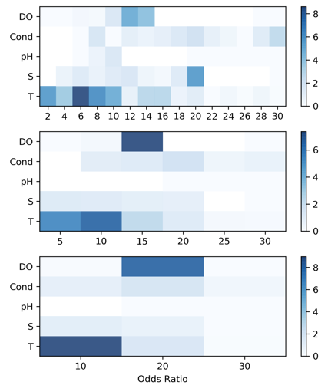
Vibrio Vulnificus
Collection period – 2009-2012
Collection period – 2019-2022

Slide 11
Findings
Vibrios presence is observed in the majority of the samples.
Occurrence is more relevant when the likelihood of Vibrio-associated illness in humans
Only occurrence is not sufficient to find the threshold for environmental variables.
New data incorporation has increased representativeness and variability,
enhanced ability to detect trends over time

Slide 12
Thank You
For any questions
Contact: mayankgangwar@ufl.edu

