Slide 1
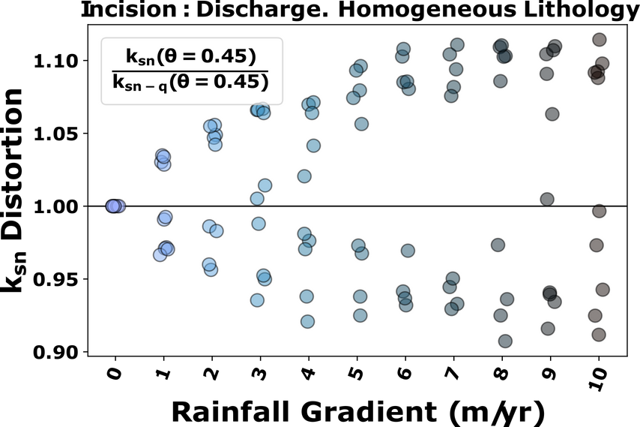
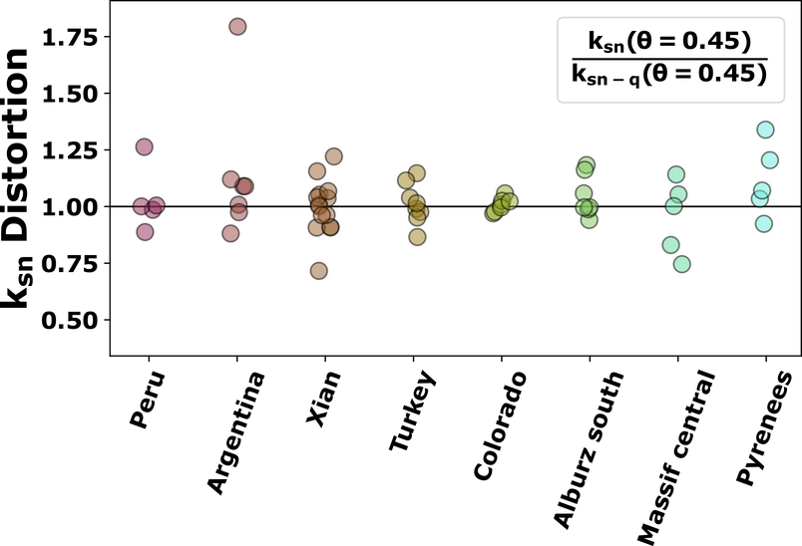
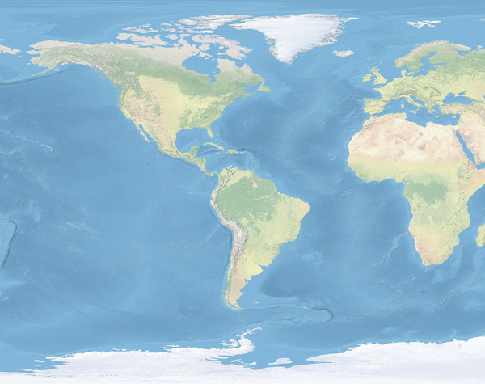
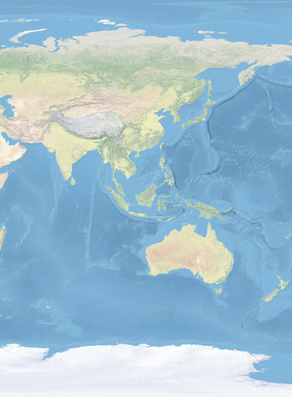
SIMULATED LANDSCAPES
What about...
Lithology
Initial m/n
θ optimal ≠ 0.45
RAINFALL GRADIENT
EFFECTS OF RAINFALL GRADIENTS ON TOPOGRAPHY AND EROSION RATES
NATURAL LANDSCAPES
Marina Ruiz Sánchez-Oro (marina.ruiz.so@ed.ac.uk),
Simon M Mudd, Boris Gailleton
The incorrect choice of incision rule and concavity can cause bias in erosion rates
OSPP

Slide 2
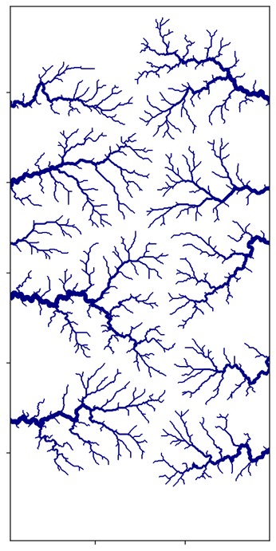
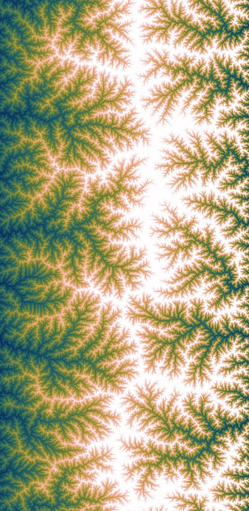
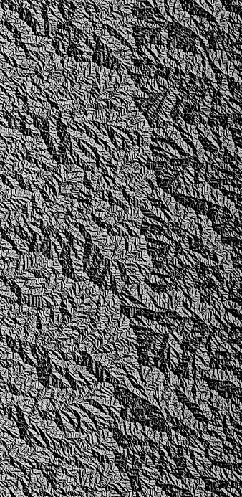
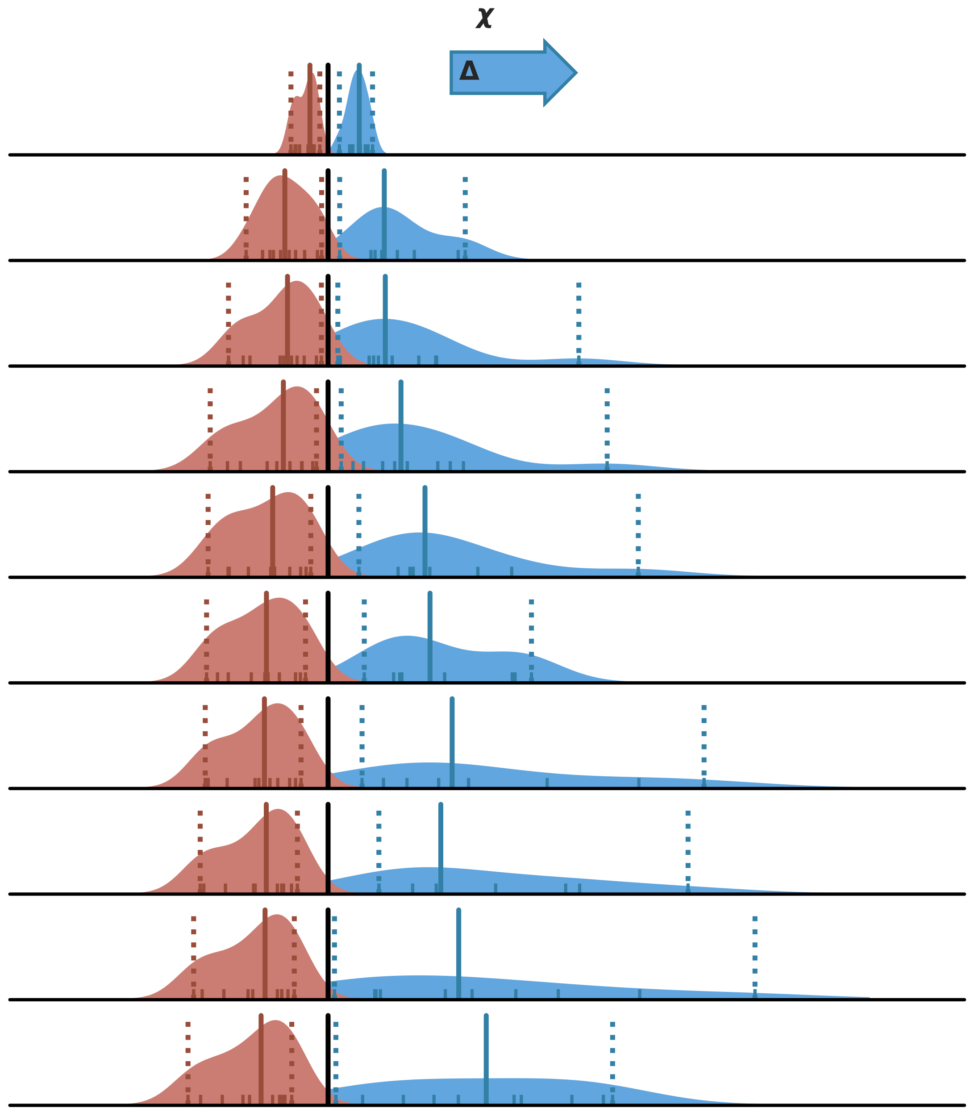
25
20
15
10
5
RESULTS
Responses to:
Lithology
Northing (km)
Initial m/n
SIMULATION SET-UP
θ optimal ≠ 0.45
MODELLING
5 10
Easting (km)
Interactive! Click on each section to learn more
NATURAL LANDSCAPES
WHY IS IT IMPORTANT?
EFFECTS OF RAINFALL GRADIENTS ON TOPOGRAPHY AND EROSION RATES
WHAT HAVE WE LEARNT
BACKGROUND
The incorrect choice of incision rule and concavity can cause bias in erosion rates
Channel Steepness
Concavity Index, θ
AIMS
Disorder
Marina Ruiz Sánchez-Oro (marina.ruiz.so@ed.ac.uk),
Simon M Mudd, Boris Gailleton
OSPP

Slide 3
AIMS
Can we identify a landscape shaped by rainfall gradients?
What is the imprint of rainfall?
Sensitivity of topographic metrics to rainfall vs other factors.
Does lithology muddle the rainfall signal?
Can we see this in natural landscapes?
OSPP

Slide 4
WHY IS IT IMPORTANT ?
Rainfall gradients affect the evolution of hillslope rivers, but it is hard to disentangle the signal from tectonics or lithological changes
The choice of incision regime can bias erosion rate calculations
What metrics are affected by rainfall?
Concavity index, θ
Channel Steepness index, ksn
Disorder
Other metrics: river width, etc
OSPP

Slide 5
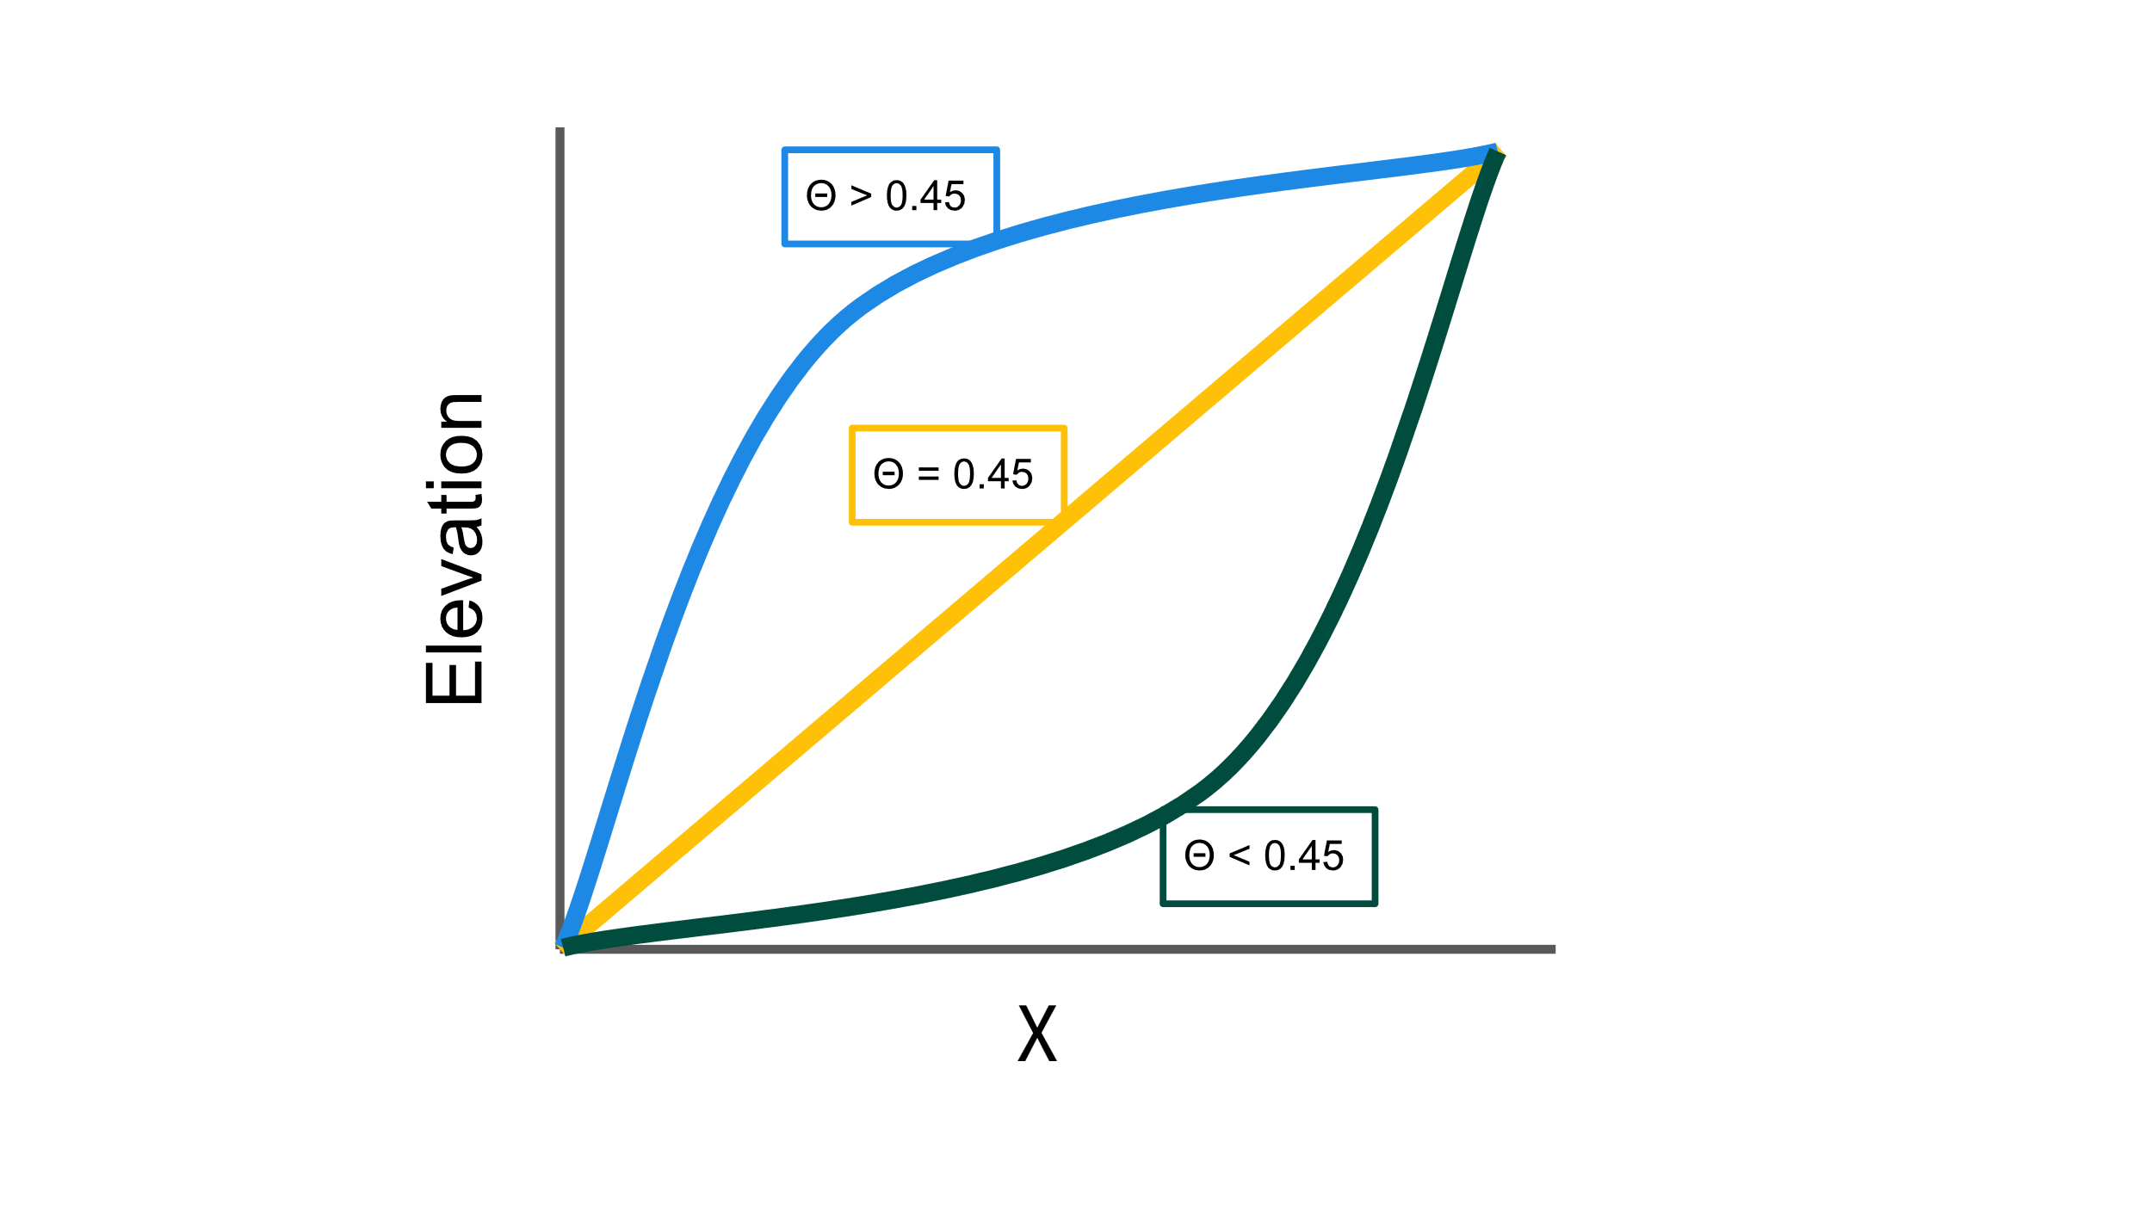
CONCAVITY INDEX, Θ
Indicates how fast the slope of a channel changes as we go downstream
Must constrain θ to get accurate results for ksn: we use disorder minimisation
Most literature chooses 0.45, but variations occur
OSPP

Slide 6
KSN DISTORTION
A
C
Distortions in ksn can lead to bias in erosion rate calculations
How much bias do rainfall gradients introduce?
B
D
0.3 < Drainage area < 0.8
0.3 < Drainage area < 0.8
Drainage area > 0.8
Drainage area > 0.8
Median of ksn for A and B zones (ksn-A and ksn-B)
Ratio of ksn-A/ksn-B (ksn-AB)
Median of ksn for C and D zones (ksn-C and ksn-D)
Ratio of ksn-C/ksn-D (ksn-CD)
Distortion ratio: ksn-AB/ksn-CD
OSPP

Slide 7
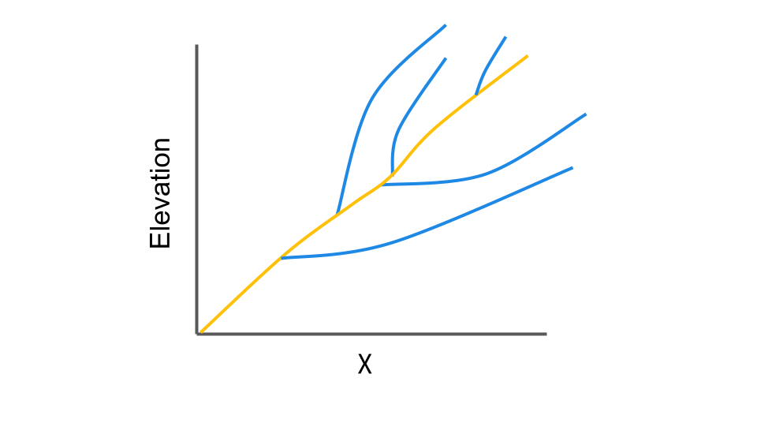
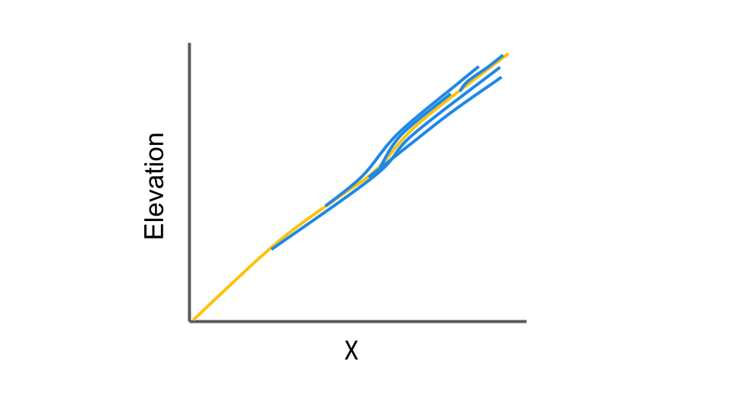
DISORDER: FINDING THE OPITIMAL CONCAVITY
Disorder explains how much the concavity differs between tributaries and the main stem.
The optimal concavity is found by minimising the disorder of a basin.
High disorder
Low disorder
OSPP

Slide 8
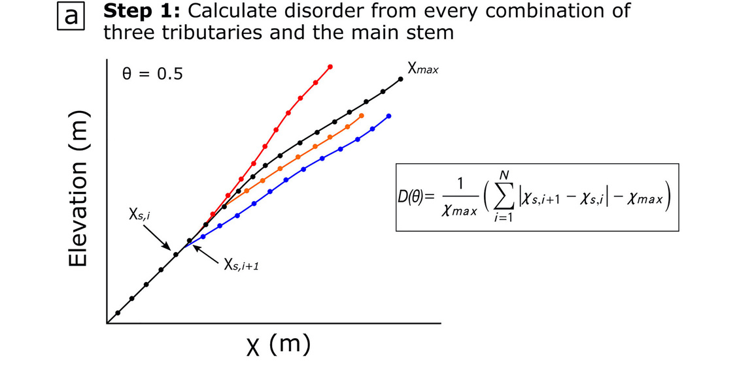
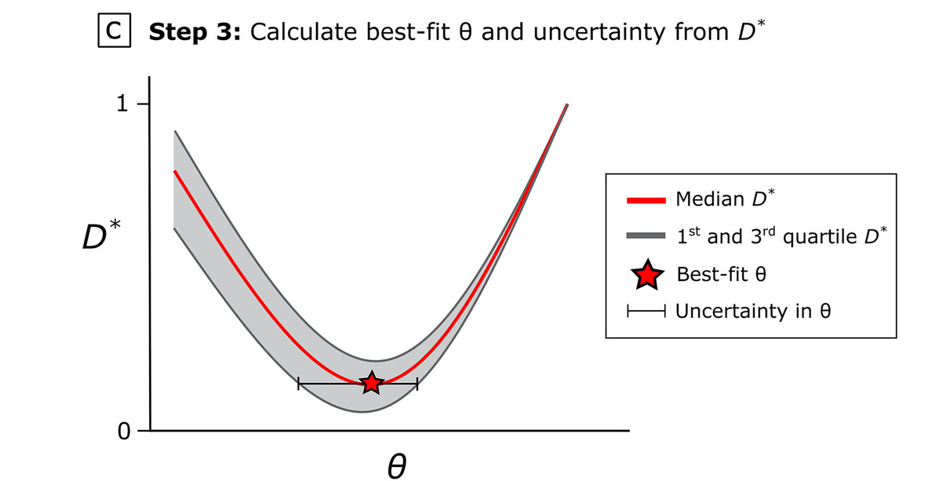
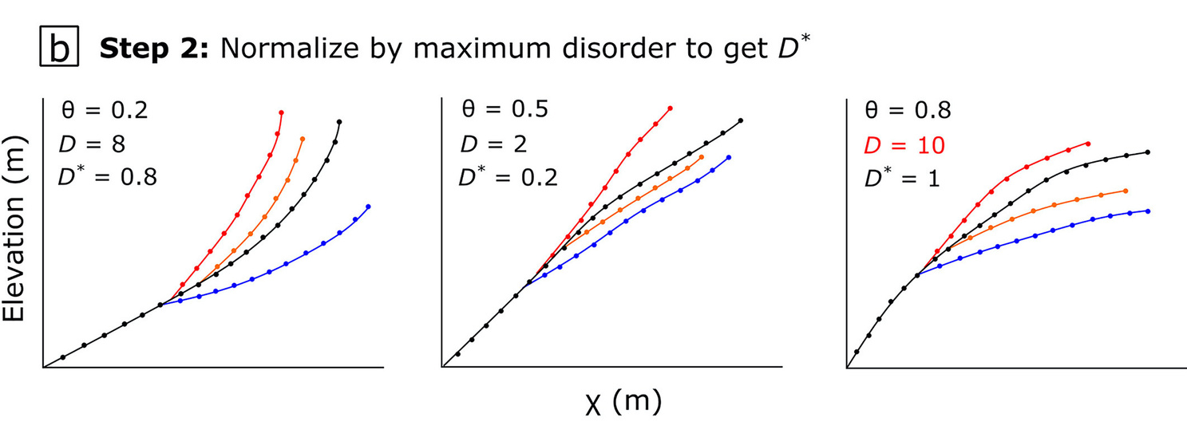
QUANTIFYING CHANGE: DISORDER MINIMISATION
OSPP
Figure adapted from Gailleton, B. et al (2021). Impact of changing concavity indices on channel steepness and divide migration metrics. JGR: Earth Surface.

Slide 9
SIMULATION SET UP
Linear Rainfall Gradient (0-10m/yr)
4 Lithological scenarios
3 m/n scenarios (0.35, 0.45, 0.55)
Calculate metrics: 𝜃, ksn, disorder
25
20
15
10
5
With precipitation
Incision rule: discharge
Steady State
Northing (km)
Without precipitation
5 10
Easting (km)
25
20
15
10
5
With precipitation
Incision rule: drainage area
Steady State
Northing (km)
OSPP
Without precipitation
5 10
Easting (km)

Slide 10
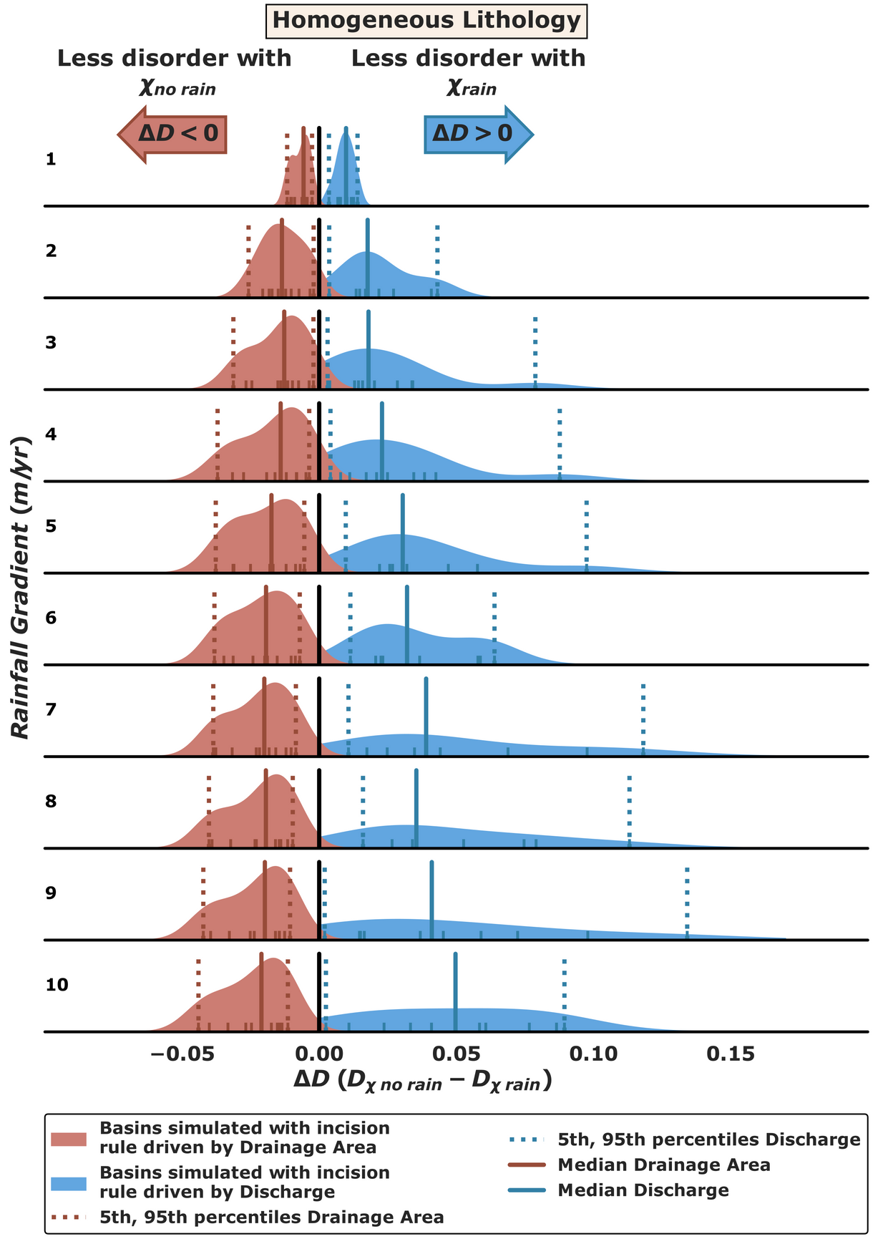
HOMOGENEOUS LITHOLOGY
OSPP

Slide 11
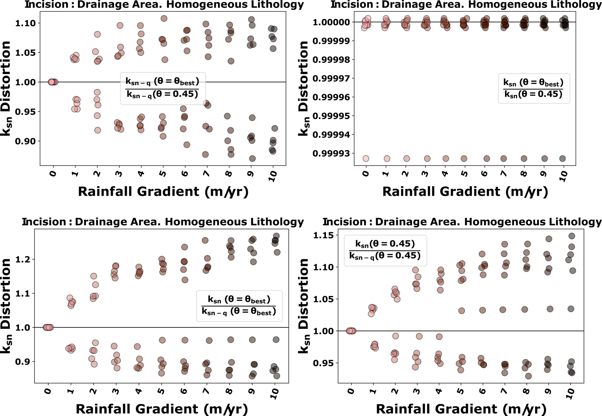
OSPP

Slide 12
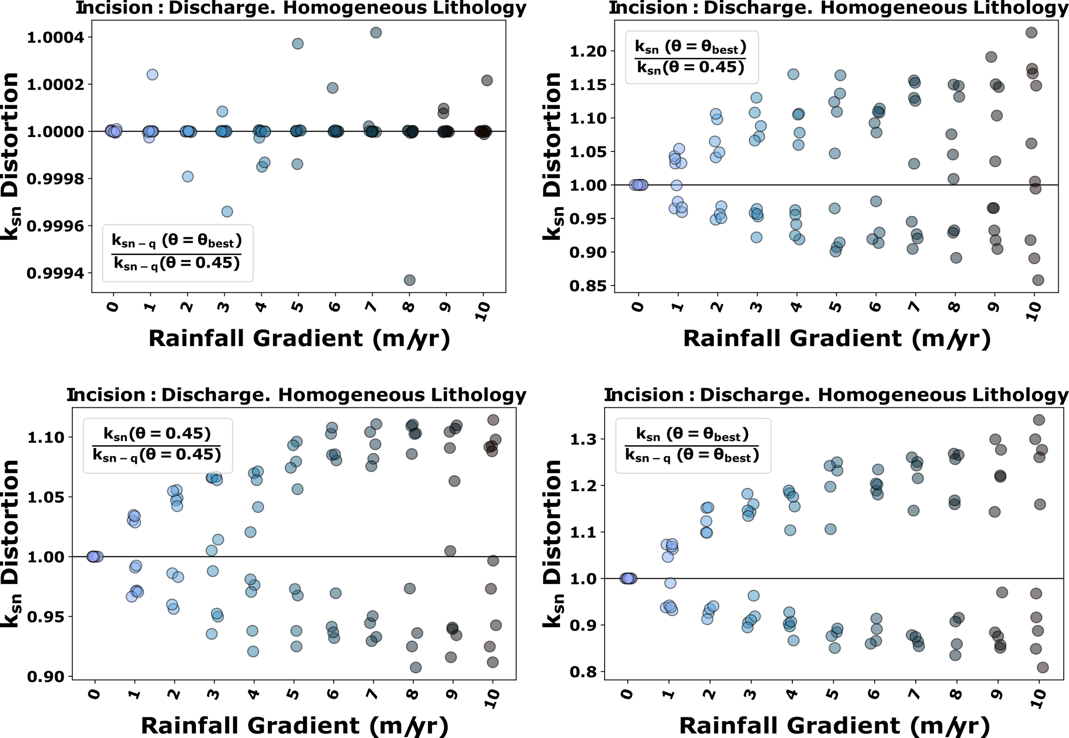
OSPP

Slide 13
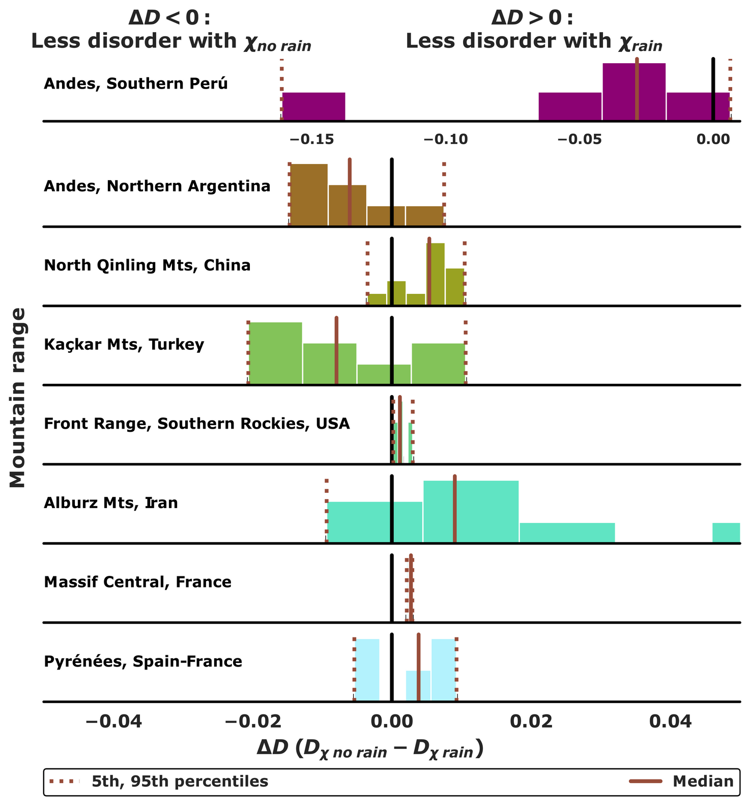
NATURAL LANDSCAPES
OSPP

Slide 14
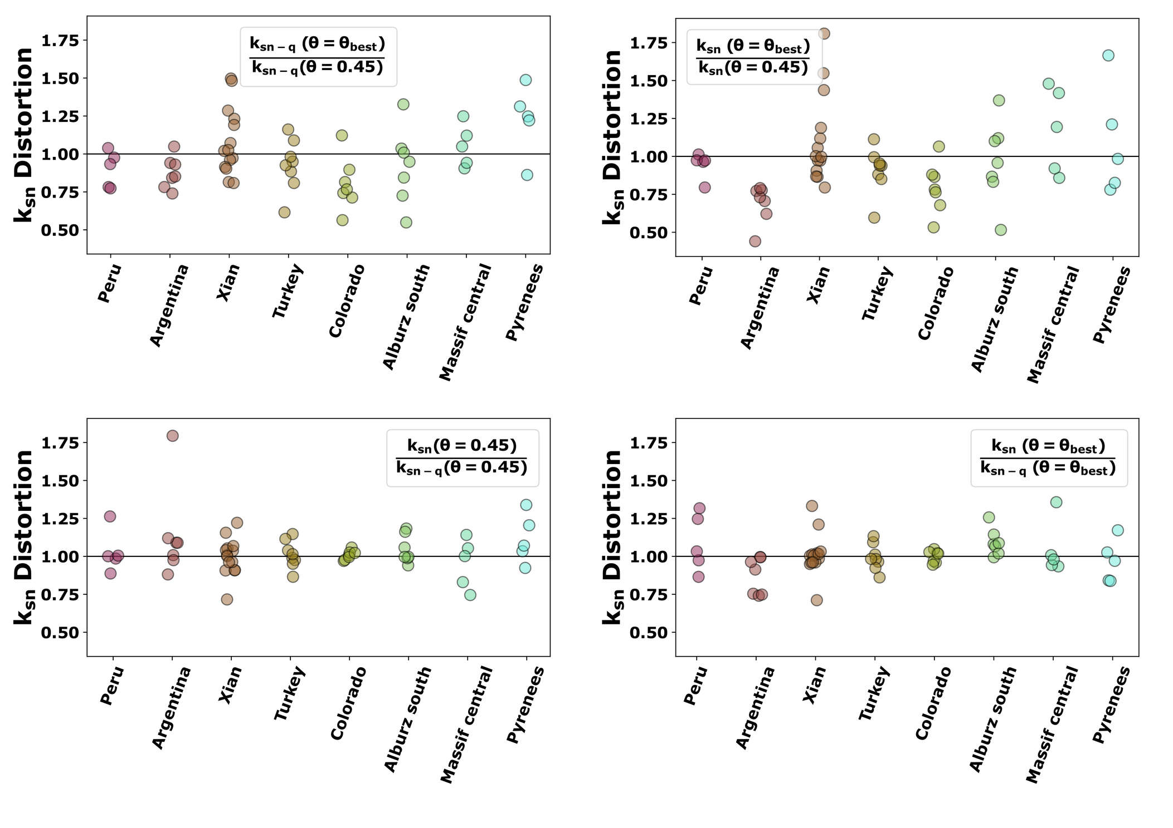
OSPP

Slide 15
LITHOLOGY SCENARIOS
OSPP

Slide 16
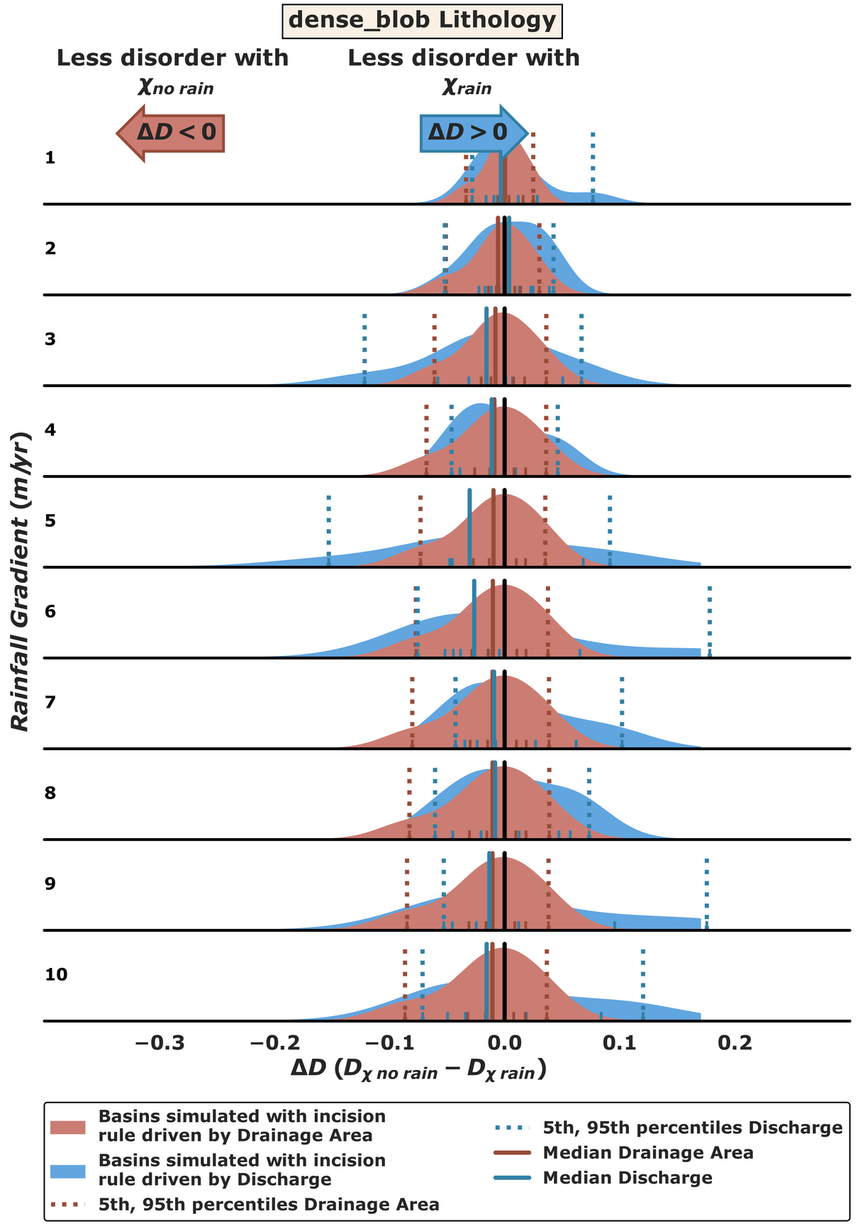
DENSE BLOB LITHOLOGY

Slide 17
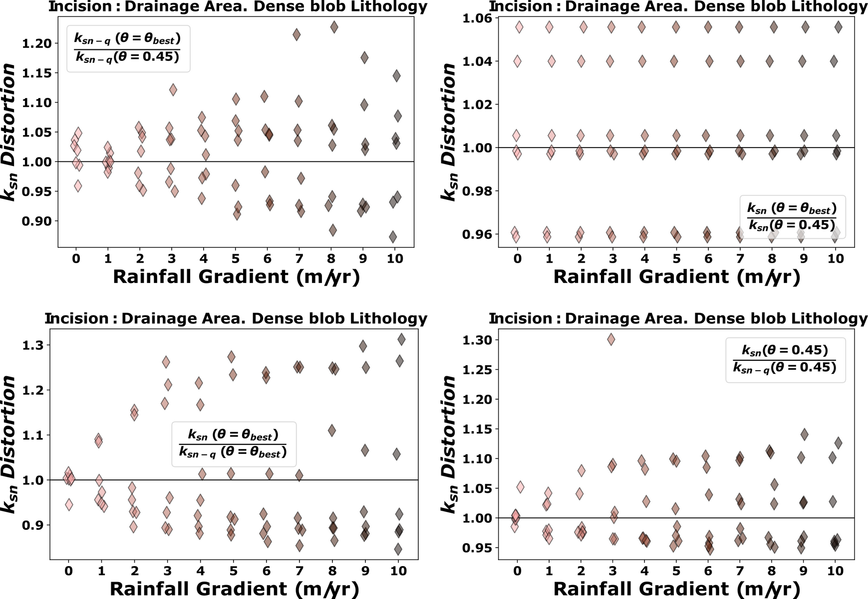
OSPP

Slide 18
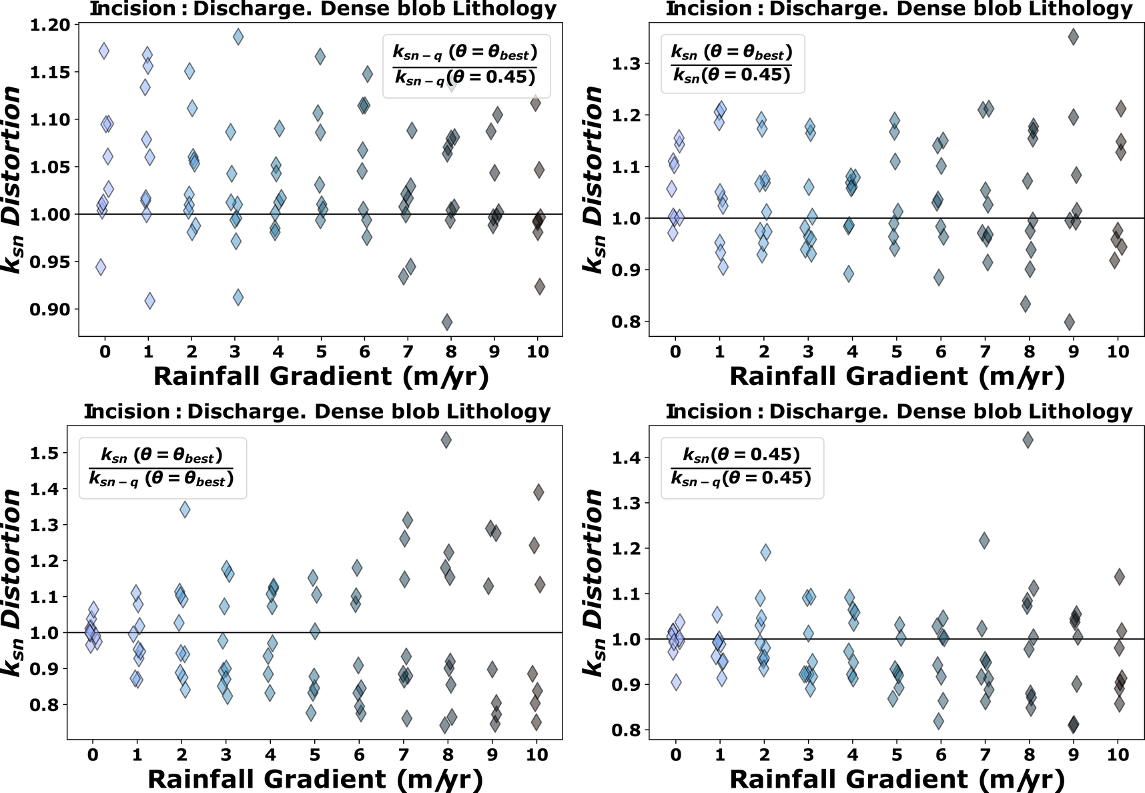
OSPP

Slide 19
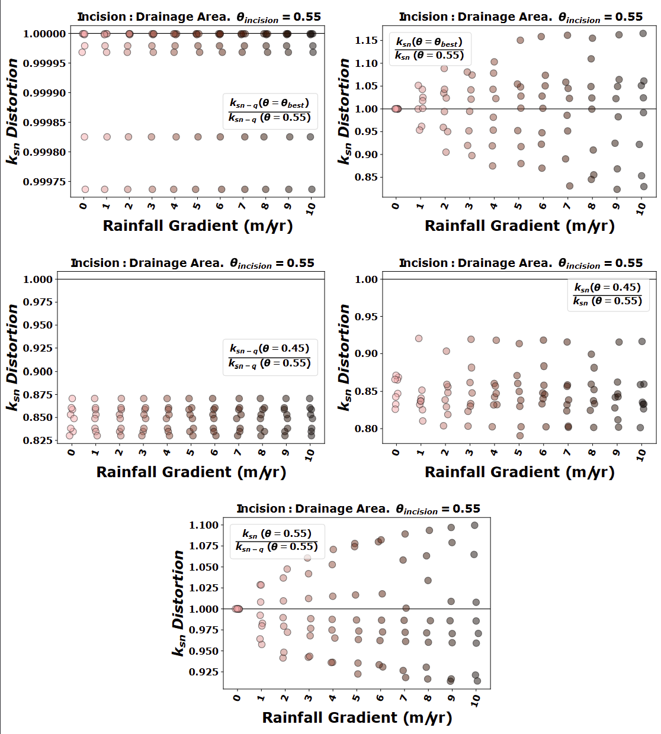
INITIAL M/N = 0.55
OSPP

Slide 20
INITIAL M/N = 0.55
OSPP

Slide 21
WHAT HAVE WE LEARNT
Under modelling conditions, we can identify when the landscape has been incised by a rainfall gradient. In natural landscapes, the complexity of the interation muddles the signal.
We can use drainage area or discharge to describe incision rule mechanisms.
We use channel steepness to calculate erosion rates.
Channel steepness calculations depend on the incision rule used.
Including the incorrect incision rule can lead to the wrong erosion rates.
Ksn uncertainty origin | Simulated Landscapes | Natural Landscapes
Incision rule | 15 % | 25 %
Concavity | 20 % | 50 %
OSPP

