Slide 1
Projected changes in the distribution of global Mediterranean climate-type regions
George Zittis, Diego Urdiales Flores, Annalisa Cherchi, PanosHadjinicolaou

Slide 2
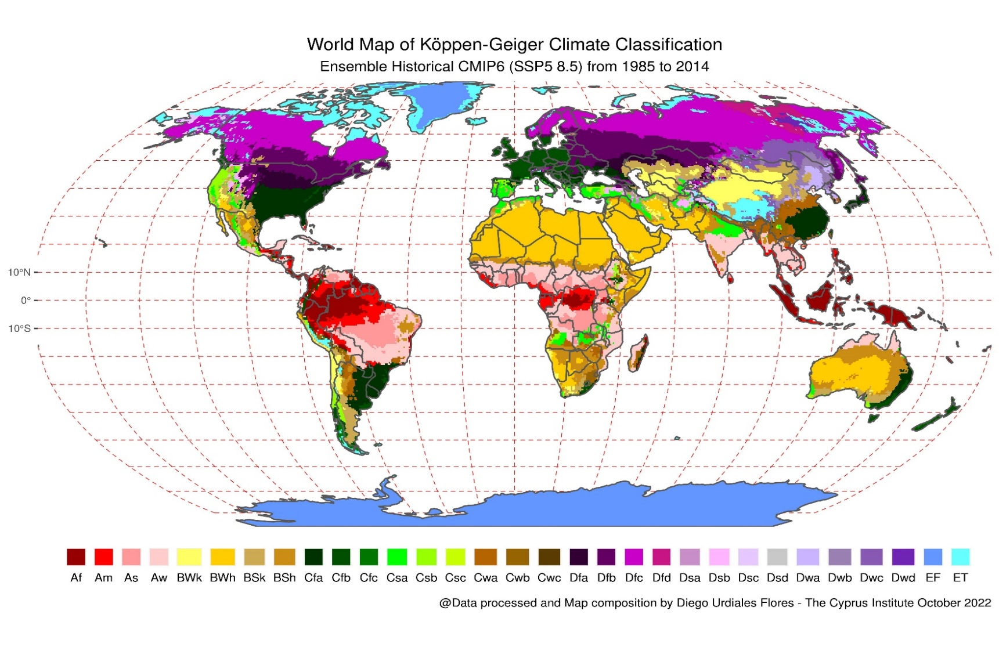
Köppen-Geiger climate clasification
MED
NAC
Csa
Csb
SAC
SAF
SAU
wet winters, and hot or warm dry summers.
winter storm tracks and summer subtropical anticyclones.
1

Slide 3
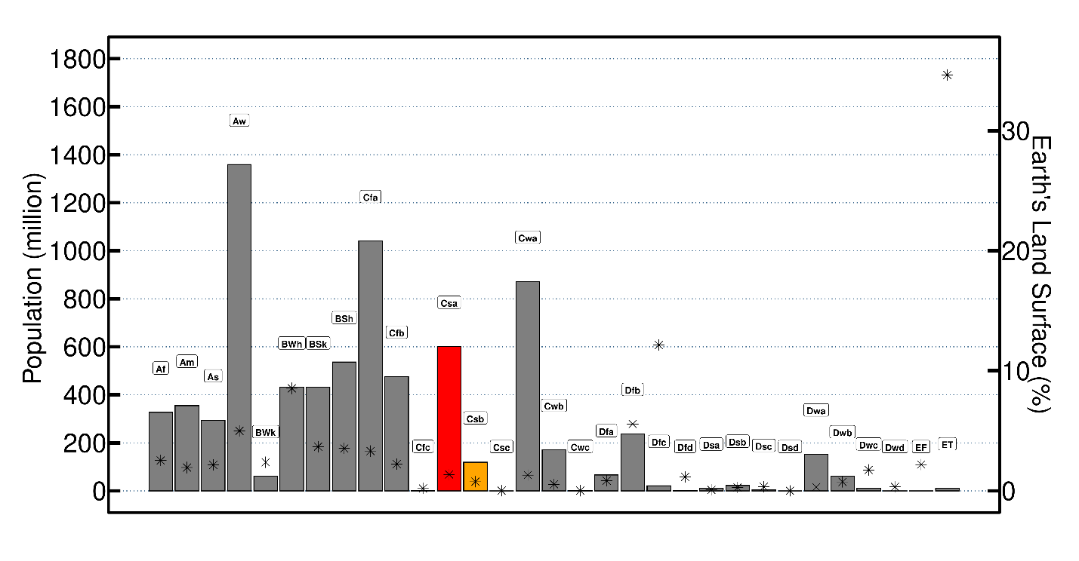
Population in Mediterranean climate-type regions
MCRs = Csa + Csb
MCRs ~ 2 % Earth’s Land Surface
MCRs ~ 700 million inhabitants (10% of global)
Total population in million for 2020 from Socioeconomic Data and Applications Center (SEDAC) at Columbia University and Earth’s land surface in percentage and 31 categories of Köppen- Geiger Climate Classification for the period 1991-2020 from CRU dataset.
2

Slide 4
Common challenges in MCRs
IPCC AR6: Summary for policymakers (2021)
3

Slide 5
Common challenges in MCRs
IPCC AR6: Summary for policymakers (2021)
4

Slide 6
Research objectives
Two research questions motivated this study:
Q1: How have the main climate characteristics of Mediterranean climate-type regions changed during the last 120 years?
Q2: What will be the future regional response of MCRs under different Global Warming Levels?
5

Slide 7
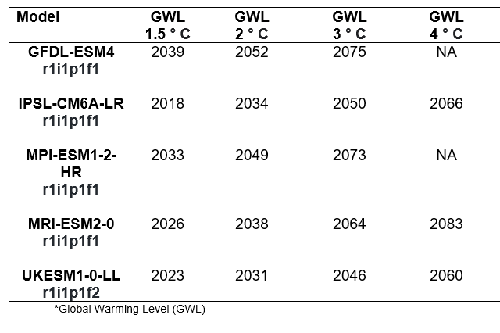
Q3: Data
Five CMIP6 Global Models with bias correction and statistically downscaled.
Business as usual scenario (SSP5-8.5).
Historical: 1850-2014
Future: 2015-2100
Spatial resolution ( 0.5°x 0.5°).
Temporal resolution (daily)
Precipitation.
Tmin.
Tmax.
Tmean
6

Slide 8
Q1/Q2: Method
4 Observed (CRU)
Observed (CRU)
Csa
Observed
(ISI-MIP)
4 Observed (ISI-MIP)
Csb
4 Historical
Change
CMIP6 models
SSP5-8.5
4 GWLs
Total Change
Partial Change
Minor Change
No
Change
7

Slide 9
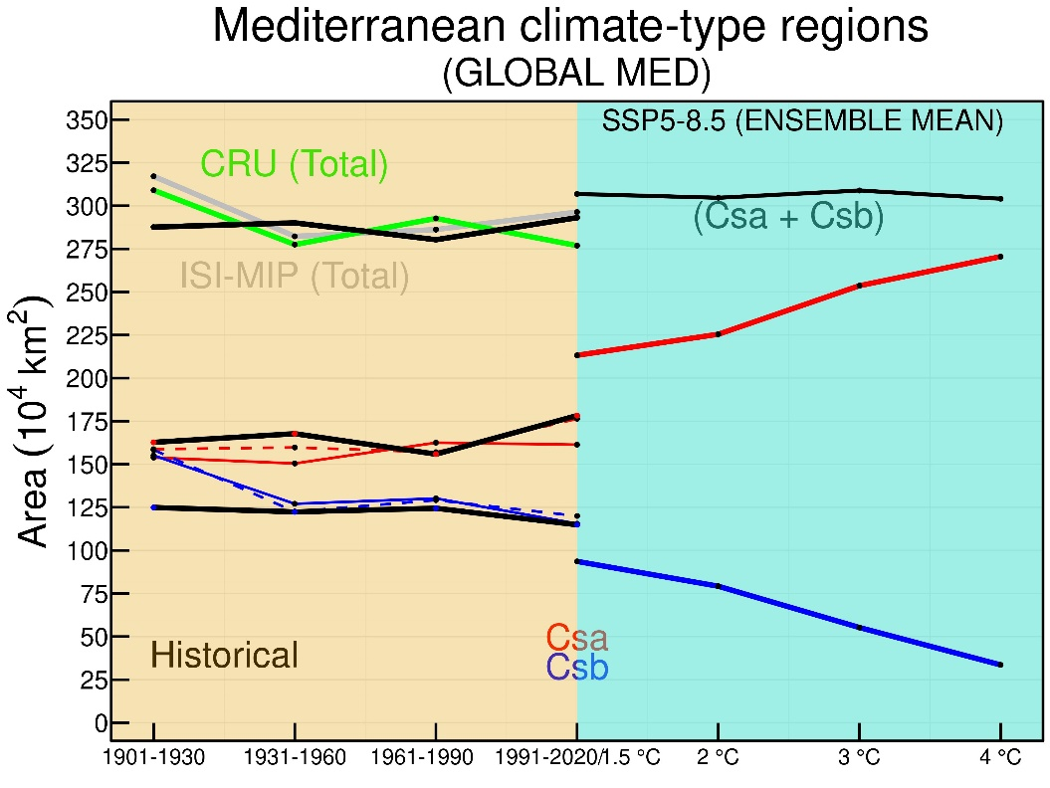
Q1/Q2: Temporal Distribution of MCRs
No significant MCRs changes during the last 120 years and projected.
CMIP6 ensemble (Historical) represents well the Csa and Csb global area.
A clear increase of Csa category (hot summer) and a decrease Csb areas ( Warm- summer).
8

Slide 10
Q1/Q2: Temporal and Spatial Distribution of MED
Poleward and eastward expansion.
Projected Area is around 21 % of that Observed.
9

Slide 11
Q1/Q2: Temporal and Spatial Distribution of NAC
Astonishing, poleward and eastward expansion (prominent from 40° N to 50° N )
Projected Area is around 41 % of that
Observed Csa and
Csb categories.
10

Slide 12
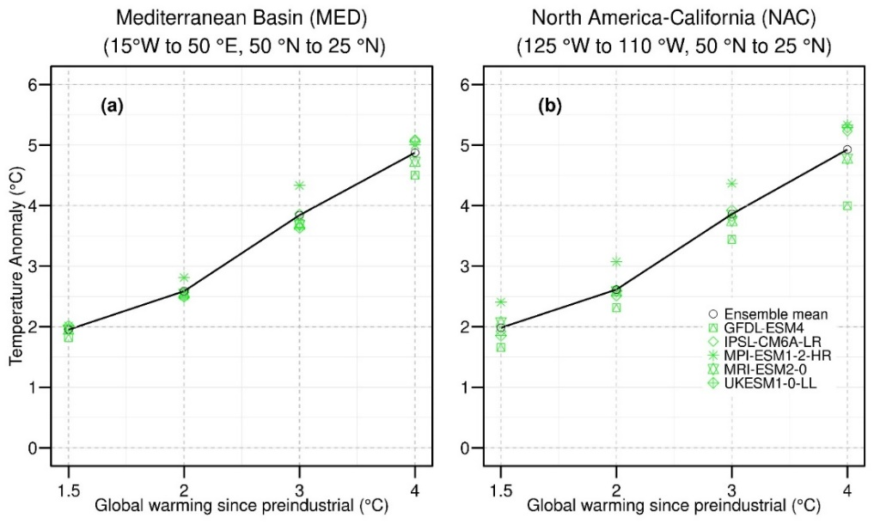
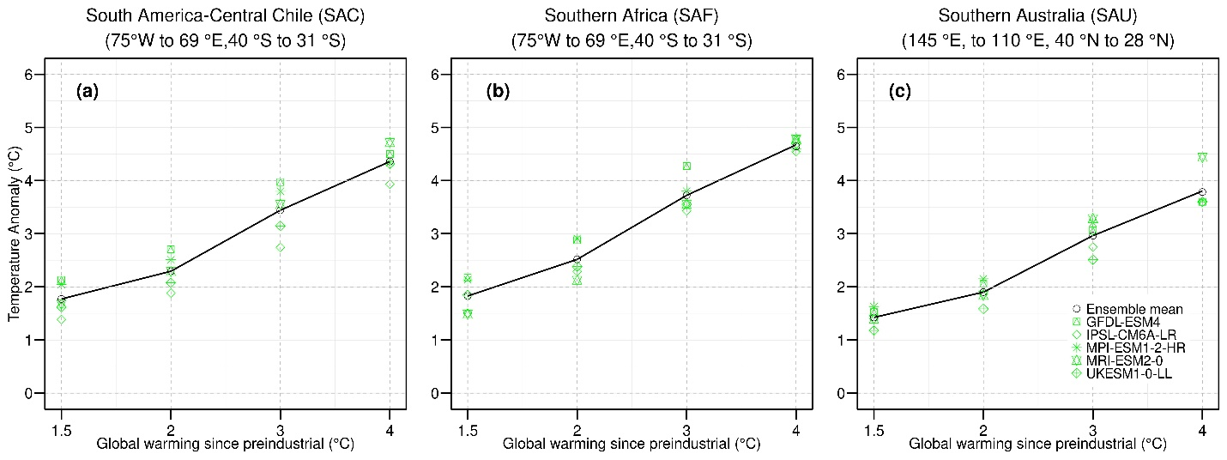
Q2: Temperature Projections
Northern Hemisphere:
For every degree of global warming, mean temperature anomaly ensemble will likely increase by above 1 °C most of the Mediterranean Basin and North America.
MED
NAC
SAC
SAF
Southern Hemisphere:
SAC and SAF mean temperature anomaly ensemble will increase by 0.5 °C for every GWL
SAU mean temperature ensemble will be close to GWL.
SAU
11

Slide 13
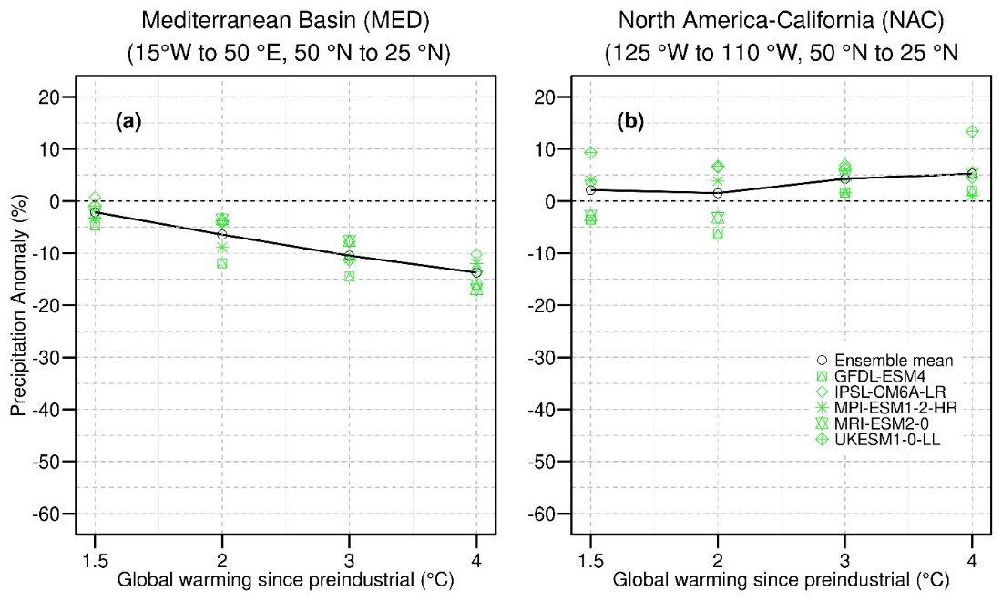
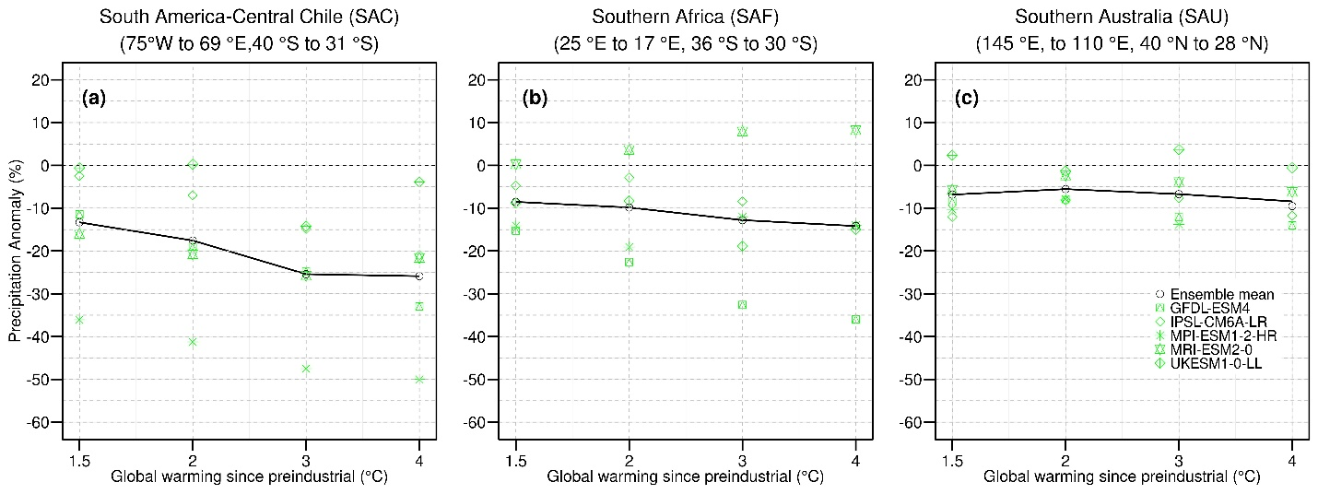
Q2: Precipitation Projections
MED
NAC
Northern Hemisphere:
For every degree of global warming, mean rainfall will likely decrease by about 4-5 % in Mediterranean Basin.
On the contrary, for every degree of global warming, mean rainfall will likely increase by about 5% in North America-California.
Southern Hemisphere:
One additional degree of global warming, mean rainfall will likely decrease by about 4-5 % in SAF, and SAU, while in SAC, this decrease is more pronounced (nearly 10%).
SAC
SAF
SAU
12

Slide 14
Conclusions
Q1: The spatial extent of Csa/Csb regions has declined by 8.5 % in the past 120 years.
Q1: Most changed to BSk and BSh regimes (hot –semiarid).
Q2: Our analysis highlights a robust poleward/eastward expansion of Csa zones at the expense of cooler climates over three regions, corresponding to a 21% increase in their area in the MED, a 41% increase in NAC, and 12.2% increase in SAC.
Q2: For every additional degree of global warming, mean rainfall will likely decrease by about 4-5 % in most of the MED, SAF, and SAU, while in SAC, this decrease is more pronounced (near 10%). On the contrary, for every degree of global warming, mean rainfall will likely increase by about 5% in NAC.
Q2: Regional temperature will likely increase more than 1°C most of the Mediterranean Basin and North America for every degree of GWL. SAC and SAF mean temperature anomaly ensemble will increase a slower pace than the global average (~0.5 °C for every °C of GW).
13

Slide 15
Thank you for your attention !!!
Acknowledgments. This research was supported by the EMME-CARE project that has received funding from the European Union’s Horizon 2020 Research and Innovation Programme, under Grant Agreement No. 856612, as well as matching co-funding by the Government of the Republic of Cyprus

