Slide 1
Fireworks: A Major source of elemental aerosols during Diwali in Delhi-NCR
Comparative study of 2019,2020,2021 Diwali
By
MOHD FAISAL
IIT DELHI

Slide 2
Research highlights
Fireworks are a direct and indirect sources of various organic and inorganic particles.
Fireworks during diwali release large amounts of K+, Cl−, S.
The burning of firecrackers elevated PM2.5 in a short time.
The burning of firecrackers changed the chemical compositions of PM2.5
Average concentration on Diwali day 2020 was 107ug/m3, around 1.5 times less than (154ug/m3) compared to 2019 Diwali day, whereas concertation increase to 137 ug/m3 in 2021.

Slide 3
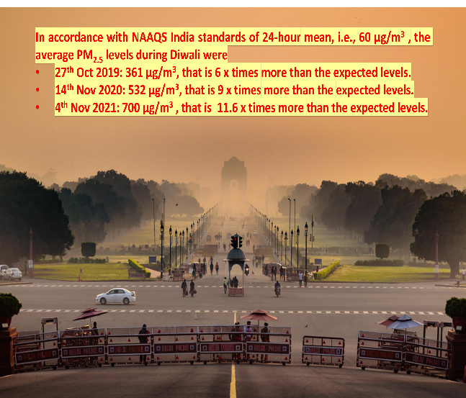
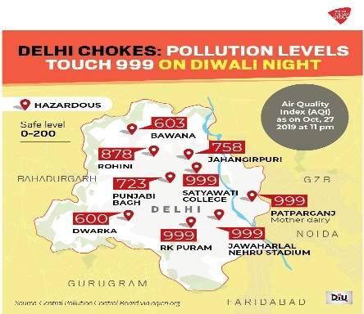
Introduction

Slide 4
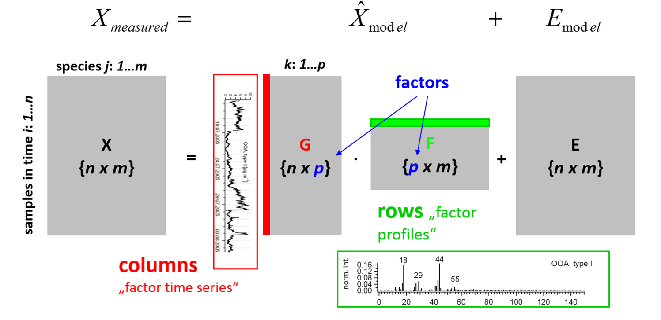
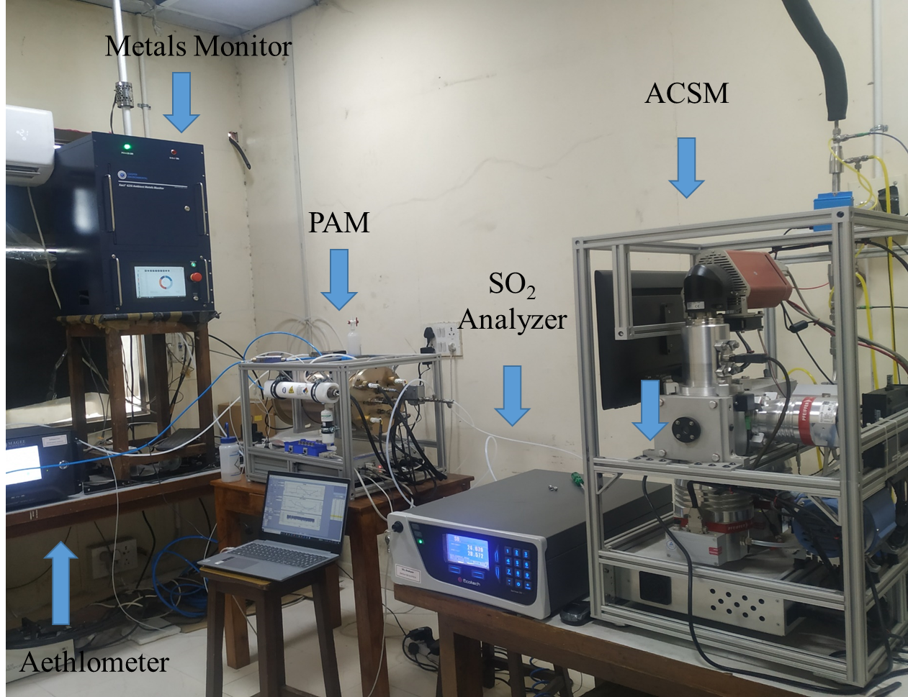
Data and Methods
Instrumentation
Xact 625i Ambient Metal Monitor
Quadruple-Aerosol Chemical Speciation Monitor .
Methodology
A multivariate method was applied for factor analyses known as the Positive Matrix Factorization (PMF) (Paatero and Tapper, 1994).

Slide 5
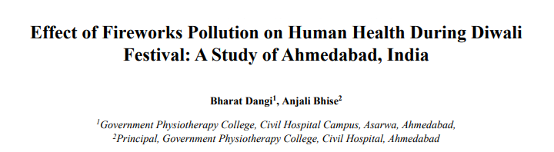
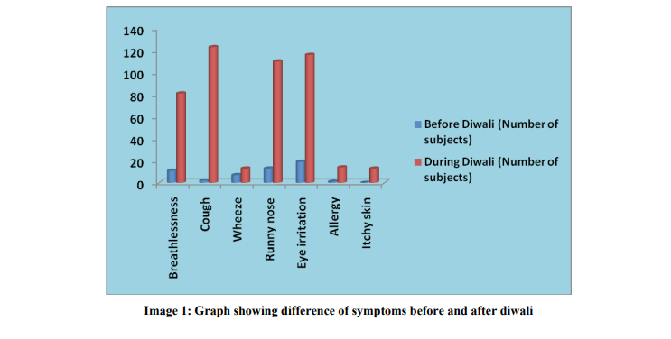
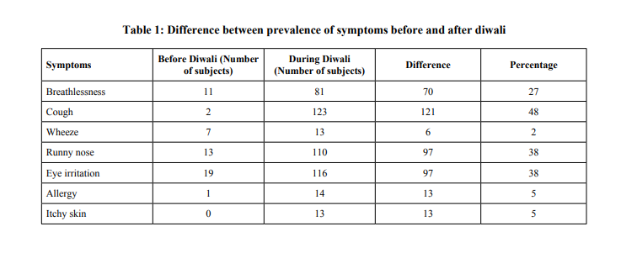

Slide 6
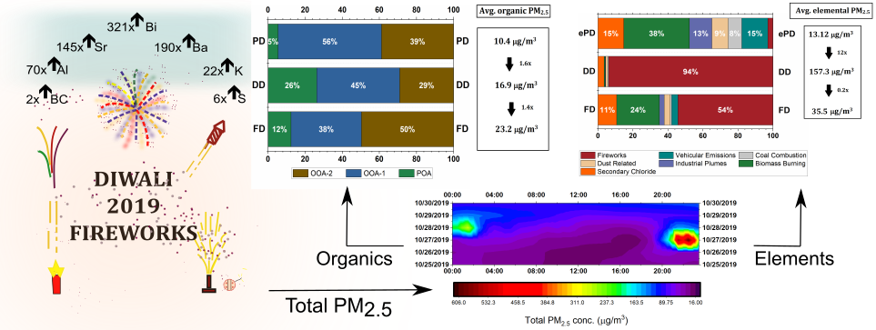
Quantifying the impact of Diwali fireworks on PM concentration in Delhi
Manchanda, C., Kumar, M., Singh V. et al. (2020). Chemical characterization of PM2.5 bound species during the Diwali fireworks in Delhi: An insight from source apportionment and airborne hazardous elements.
Preprint: https://arxiv.org/abs/2011.14402
--Extended Pre-Diwali phase (ePD) (20th October 2019 24:00 IST – 27th October 2019 18:00 IST)
--Pre-Diwali (PD) (25th October 2019 24:00 IST – 27th October 2019 18:00 IST)
--During Diwali (DD) (27th October 2019 18:00 IST – 28th October 2019 6:00 IST)
--Following Diwali (FD) (28th October 2019 6:00 IST – 31st October 2019 24:00 IST)

Slide 7
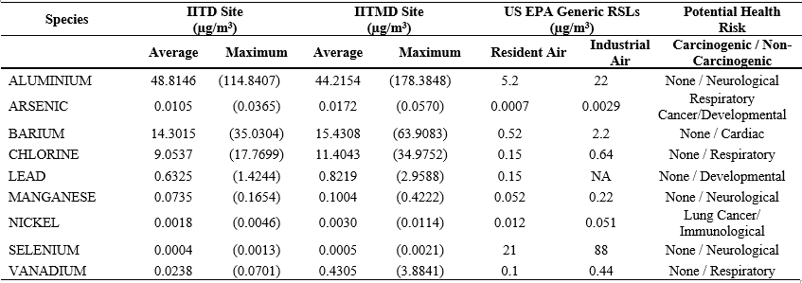
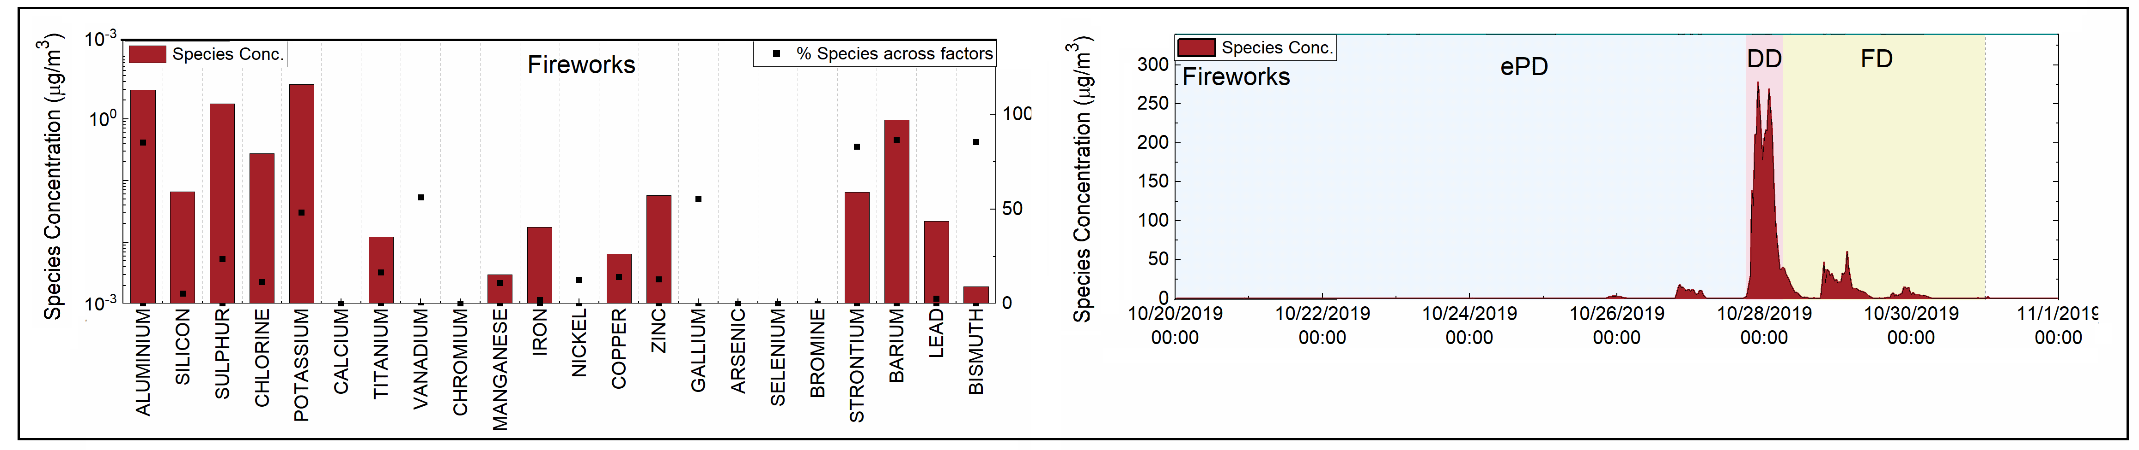
Quantifying the impact of Diwali fireworks on PM concentration in Delhi
Particle bound metallic concentration during Diwali in Delhi v/s the EPA risk based screening levels for industrial and residential air
PMF resolved Fireworks factor and corresponding temporal variation

Slide 8
Extending fireworks study to the multiyear

Slide 9
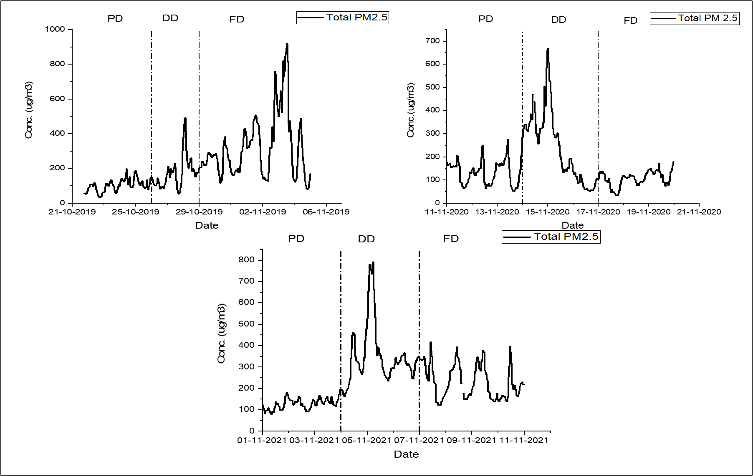
Summary of the Results
Total PM_{2.5}
Elemental PM_{2.5}

Slide 10
Diwali Fireworks Comparison 2019-21
Total PM_{2.5} (μg/m³)
 | 2019 | 2020 | 2021
Max | 550 | 640 | 653
Min | 160 | 207 | 302
Average | 361 | 460 | 501
12h average PM_{2.5} during Diwali night → 2019 < 2020 < 2021

Slide 11
PM_{2.5, EL} (μg/m³)
 | 2019 | 2020 | 2021
Max | 294.8 | 175.6 | 206.5
Min | 46.8 | 46.9 | 79.7
Average | 175.0 | 116.7 | 151.3
12-hour average concentration of metals during Diwali night → 2020 < 2021 < 2019

Slide 12
Fireworks Factor (μg/m³)
 | 2019 | 2020 | 2021
Max | 242.4 | 166.6 | 200.1
Min | 33.9 | 29.6 | 64.8
Average | 154.0 | 108.8 | 137.4
12h average concentration of firework factor during Diwali night → 2020 < 2021 < 2019
Impact of lockdown (2020) and increasing firecracker restrictions (2021)
Other sources were relatively more important in 2020 and 2021 – further analysis underway

Slide 13
Fireworks:Also a source of oragnics

Slide 14
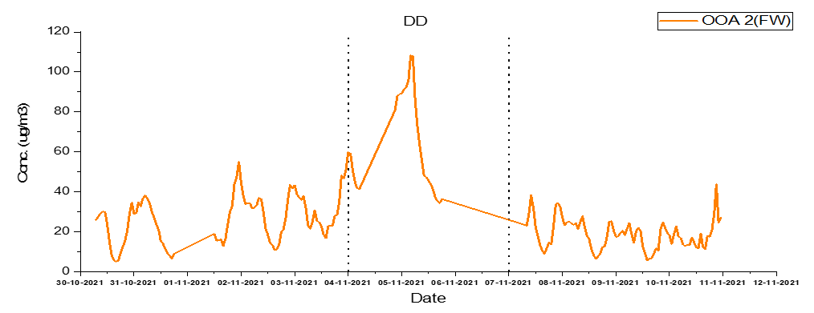
Fireworks: Also, a source of organics
(21:00 hrs-06:00 hrs) | PD | DD | FD
Organics | 113 | 295 | -
NH3 | 13 | 42 | -
NO3 | 10 | 35 | -
FW-OOA is likely mixed with the aerosol produced by the burning of binding agents, such as dextrin or shell paper
The FW-OOA is related to the organic aerosol released from FW, as shown by co-varying trends with the K and the elemental fireworks factor during Diwali night.
Mass spectra of the FW-OOA was similar to the MO-OOA (more oxidized organic aerosol) factors that indicates that FW-OOA was highly oxidized or secondary, having been rapidly oxidized in the high temperatures of FW burning.

Slide 15
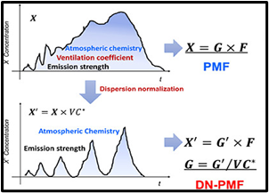
Conclusions and Future Work
This work demonstrates the potential influence of firecracker combustion and stubble burning on PM_{2.5} aerosol concentration after Diwali night. The results of this work can be essential for guiding policies and to control strategies to alleviate haze events in such firework events.
The reported enhancement in the mass concentration of elemental metals like Al, Ba, Cl, Pb, and Mn poses a severe threat to the health of the exposed population as the average mass concentration of these species exceeded the standard EPA risk-based levels by orders of magnitude during the DD phase. Moreover, possible carcinogens like As also exceeded the risk-based concentration by magnitude.
The Diwali festival frequently overlaps with the harvesting season and increased stubble-burning events negatively influence ambient air quality. These overlapping occurrences often make determining either impact on ambient air pollution challenging.
Future Work

