Slide 1
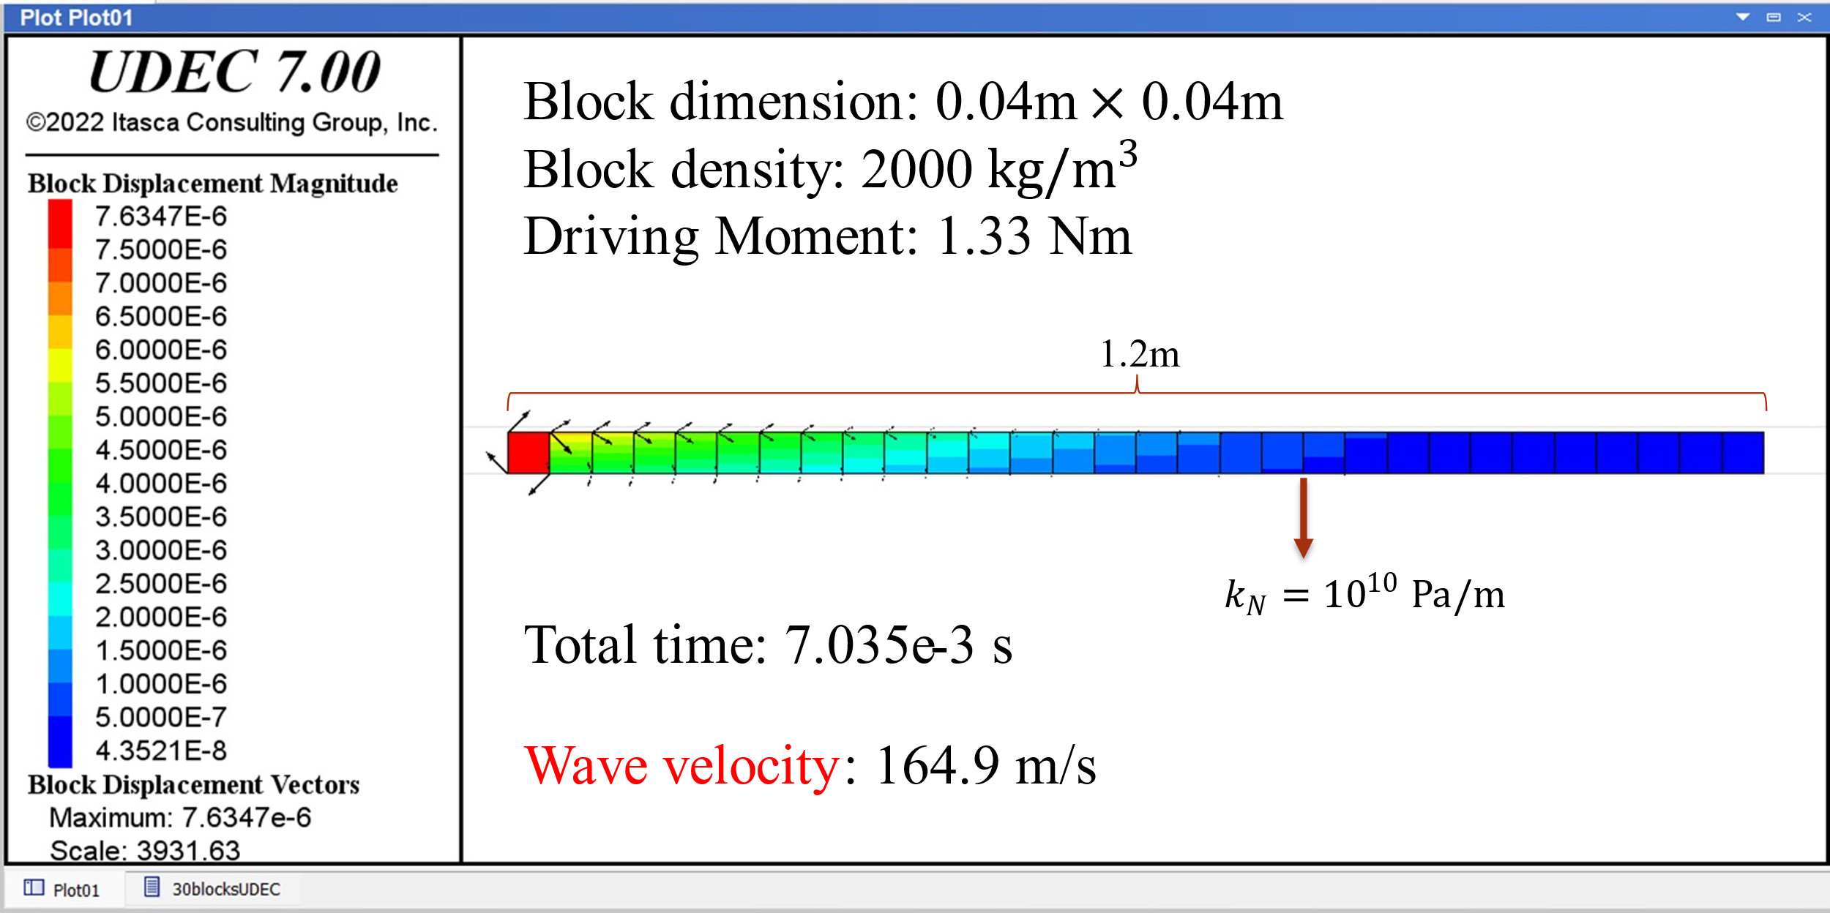
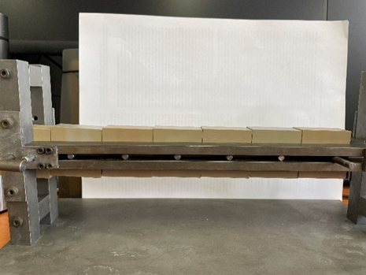
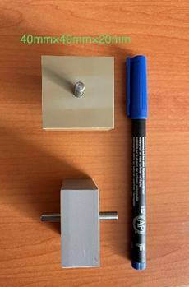
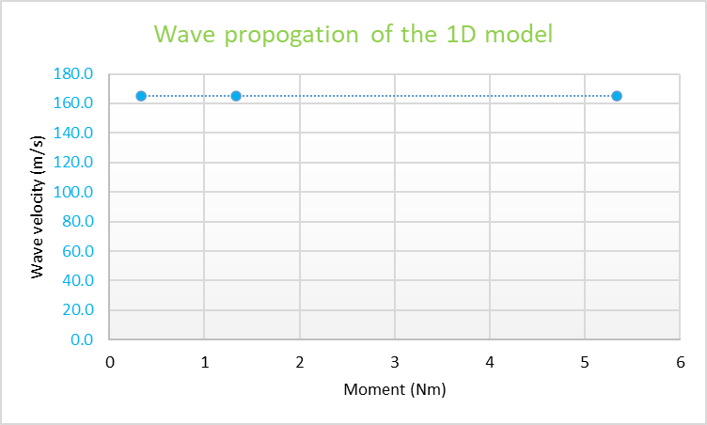
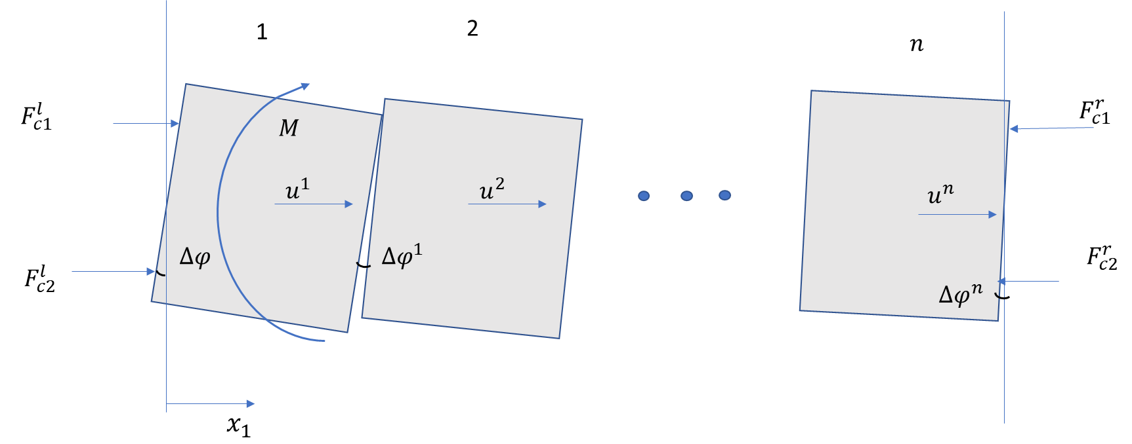
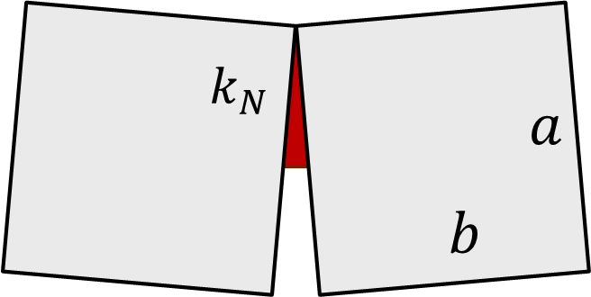
Rocks With Rotating Blocks: 1D Displacement, Rotation and Wave Propagation
M. Zhang^{1,3,a*}, E. Pasternak^{2,3,b}, A.V. Dyskin^{1,3,c}
¹Department of Civil, Environmental and Mining Engineering, UWA, Australia; ²Department of Mechanical Engineering, UWA, Australia; ³International Space Centre, UWA, Australia; ª 22407361@student.uwa.edu.au; ^{b}elena.pasternak@uwa.edu.au; ^{c}arcady.dyskin@uwa.edu.au;
Models and Results
Result: A typical result of numerical modelling of wave motion is shown in Fig. 3. The wave velocity is calculated under different moment which activated the initial blocks. Fig. 4 shows the relationship between driving moment and rotational wave velocity. The wave velocity is 165m/s and is independent of the magnitude of initiation moment.
Introduction
Physical Model
The device developed by I. Shufrin, E. Pasternak and AV Dyskin is used to demonstrate the effect of elbowing (Fig. 2). Blocks can be installed or removed from the device; the maximum number of blocks is seven including the driving block which is fixed on the left side. The blocks can be connected by tension springs or rubber bands which provide resistance to the block displacement.
Conclusions
Rock masses are often fragmented, split into blocks which can exhibit relatively independent displacement and/or rotation. Modelling deformation of blocky/fragmented rocks is complicated by the phenomenon of elbowing [1] whereby the rotating block pushes away the neighboring blocks. The direction of the push can be independent of the direction of block rotation making the problem strongly non-linear (the “absolute value” type non-linearity).
In experiments, it is found that when one block (the initial block) is rotated, the neighbouring blocks may not rotate, only displace. This depends on the magnitude of friction and the number of blocks in the chain.
Developed DEM model in UDEC demonstrates that the instantaneous application of the rotating moment to the first block introduces rotational wave.
The velocity of wave propagation among the 1D model in UDEC is 165m/s, which has a good agreement with the analytical solution (158m/s). The relative error between the numerical result and analytical solution is around 4.4%.
The rotational wave velocity is independent of the magnitude of the initiation moment, which confirms the initial assumption that the in unidirectional rotation the system behaviour is linear.
Objectives
This study aims to investigate the elbowing through a simple 1D model (shown in Fig. 1) of a chain of blocks with one translational and one rotational degrees of freedom by experimental approach. Then, the model is extended and numerically modelled in UDEC to study the wave propagation.
Fig. 3 Numerical 1D model
Fig. 2 Physical 1D model
Result: Schematics of two typical modes of block motion (a four-block case and a seven-block case). A pair of springs of stiffness around 1N/cm is applied.
References
[1] Pasternak, E., Dyskin, A.V., Estrin, Y. (2006) Deformations in transform Faults with rotating crustal blocks. Pure Appl. Geophys. 163 2011–2030.
Motion in the 4-block case
Fig. 4 Driving moment vs wave velocity
Analytical Model of rotational wave propagation
As the blocks rotate in one direction and rotation is small the model is linear. The interface stiffness is $k_{N}$. The interface length is a/2 due to delamination in rotation. Block density is $ρ$. The rotational wave velocity is calculated by:
Motion in the 7-block case
Acknowledgment
Numerical model of rotational wave propagation
The discrete element method (DEM) software, UDEC is used to model the elbowing between blocks. The model includes up to 30 blocks. The model shows the rotational wave propagation following a pulse rotation of the initial block.
The authors are grateful to Dr I. Shufrin and School of Engineering workshop for help with designing and manufacturing of the physical model. EP and AVD acknowledge support from the Australian Research Council through project DP210102224.
Fig. 1 One dimensional model of fragmented rock
$$c_{φ}^{}=\sqrt{\frac{bk_{N}}{8ρ}}=158 m/s$$

