Slide 1
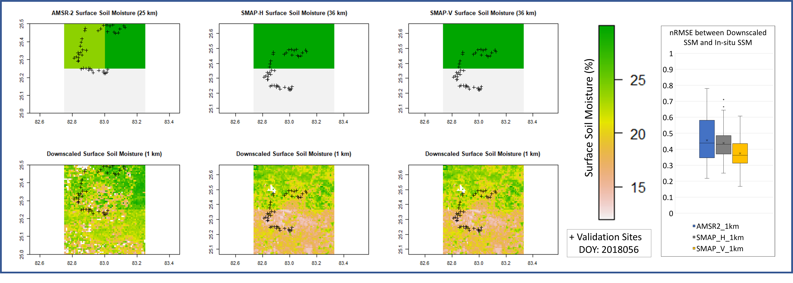
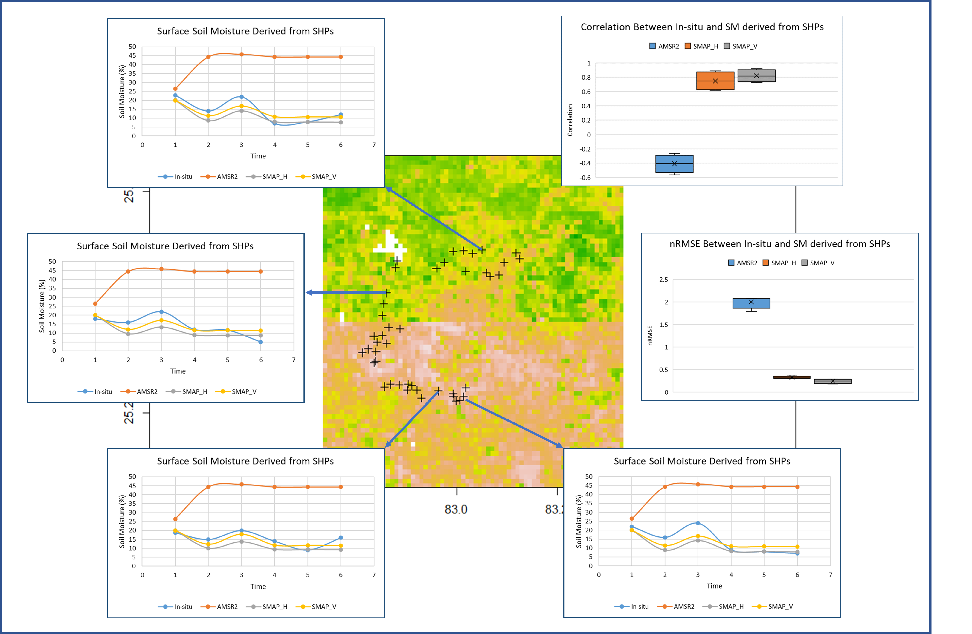
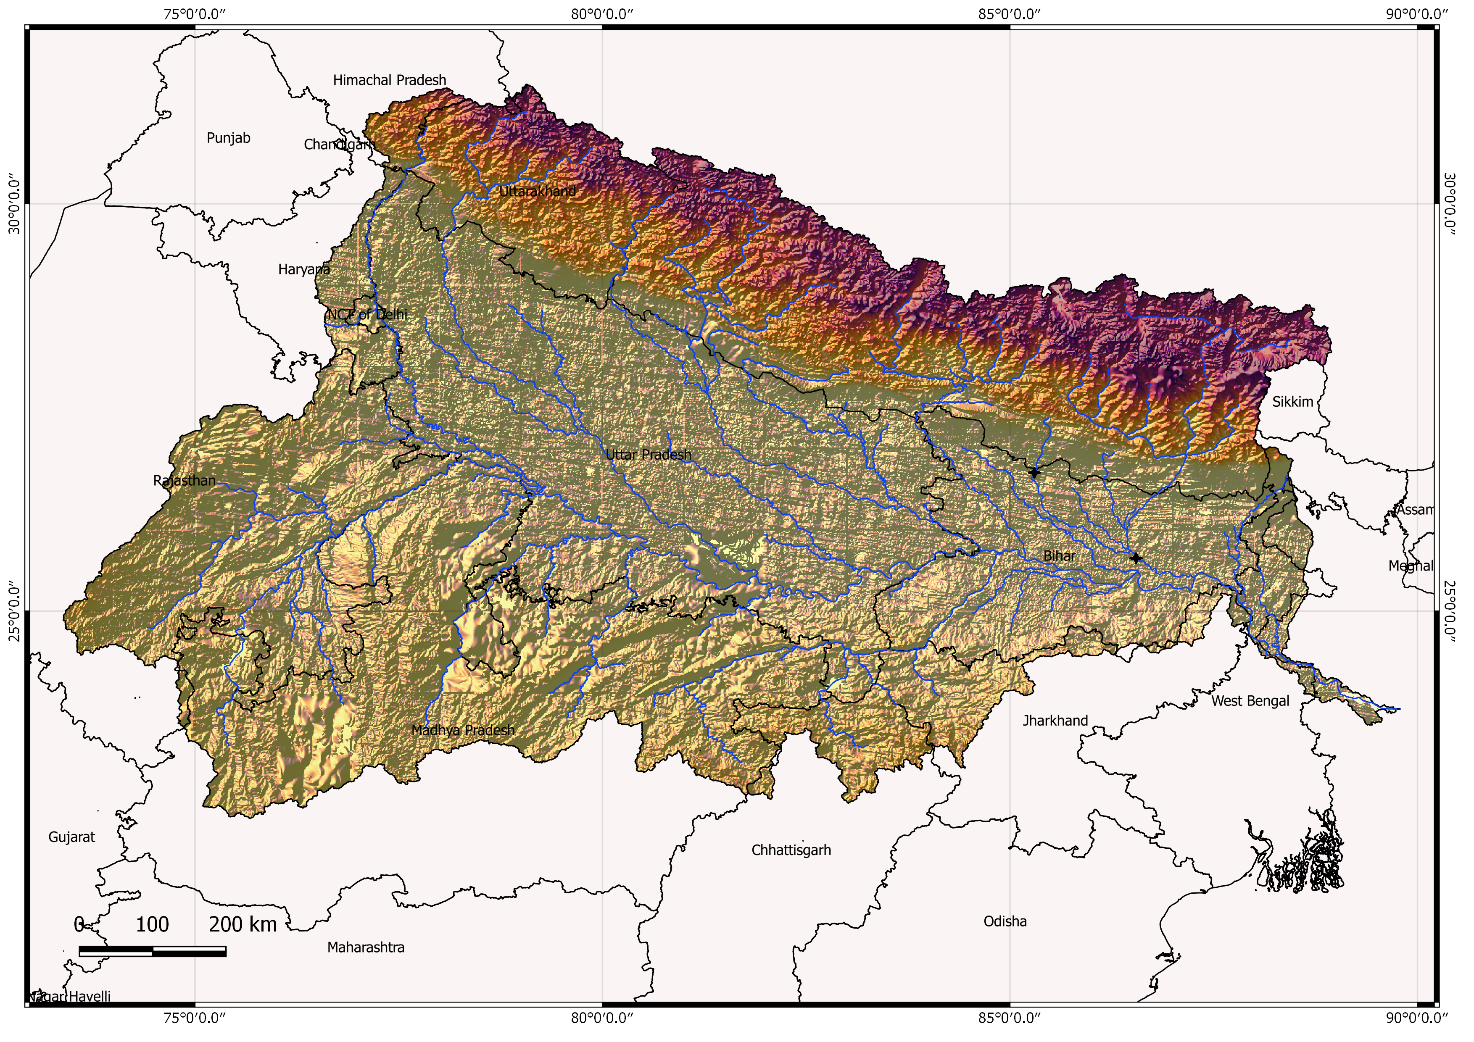
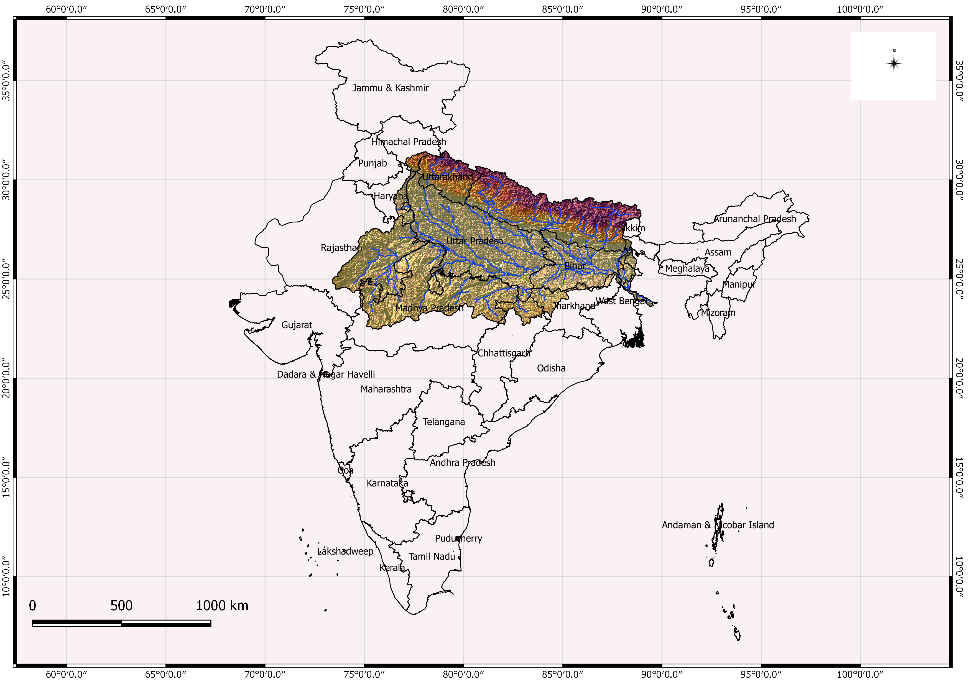
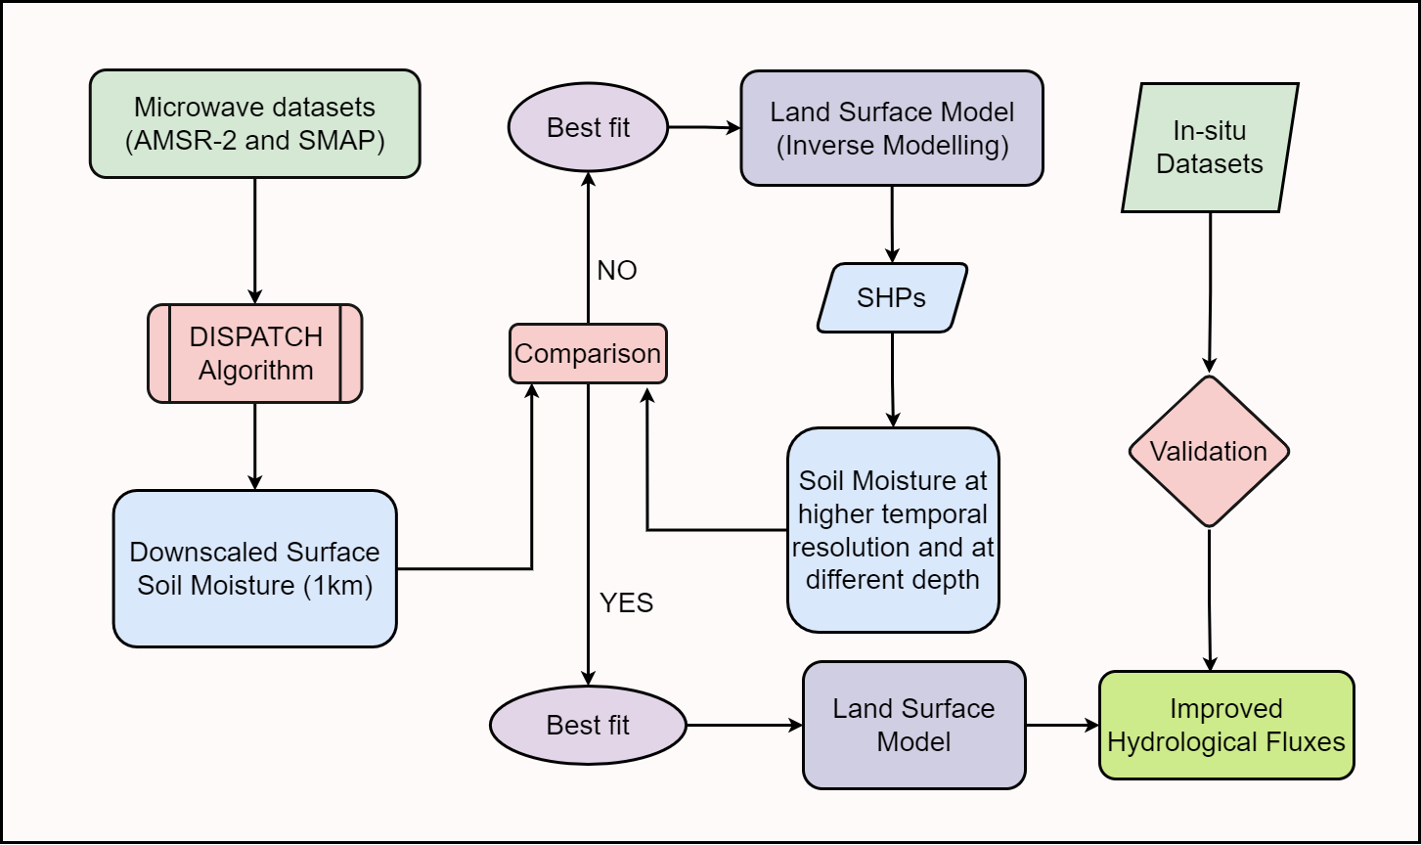
Assessment of the impact of Soil Hydraulic Parameters based on various Microwave
datasets on estimation of Hydrological fluxes
Vikrant Maurya¹, Manika Gupta¹, Juby Thomas¹, Prashant Kumar Srivastava², Dharmendra K. Pandey³, Naresh Chandra Pant¹, Atul Kumar Sahai⁴
Introduction
Soil hydraulic parameters (SHPs) are critical in estimating hydrological fluxes such as soil moisture (SM), and runoff. Various remote sensing technologies, including Microwave sensors, have been utilized to estimate these parameters. However, the accuracy of these estimates remains uncertain. The study will use various Microwave datasets, including L-band, C-band, and X-band, to estimate SHPs. The estimated parameters will then be used to estimate hydrological fluxes such as soil moisture, evapotranspiration, and runoff. The accuracy of the estimates will be assessed using in-situ measurements.
Results
Discussion
The results of this study show that the choice of microwave dataset have a significant impact on the accuracy of hydrological flux estimates. The derived SHPs from the downscaled SM of SMAP-H (Horizontal) and SMAP-V (Vertical) datasets improved the accuracy of the estimation of hydrological fluxes, as compared to AMSR-2 datasets. Inspite of the limitation that the study relied upon the limited datasets for analysis, the results highlight the importance of utilizing the higher resolution SHPs to estimate the improved hydrological fluxes and the choice of microwave dataset in hydrological monitoring and modeling.
Objectives
The coarse scaled SM products from different microwave datasets such as Advanced Microwave Scanning Radiometer 2 (AMSR-2) and Soil Moisture Active Passive (SMAP) are downscaled to 1km spatial resolution using DISPATCH algorithm
Conclusion
The study concludes that the hydrological fluxes can be more accurately estimated if SHPs are considered at finer resolution spatially and temporally. The derivation of SHPs from downscaled SM of SMAP-V performs better in the Ganges basin.
The effective SHPs are optimized through inverse modelling from downscaled SM using Genetic Algorithm (GA)
Assessment of the impact of derived finer resolution SHPs on hydrological fluxes through physically based Land Surface Model.
Study Area & Methodology
References
Merlin, Olivier, et al. "Disaggregation of SMOS soil moisture in Southeastern Australia." IEEE Transactions on Geoscience and Remote Sensing 50.5 (2012): 1556-1571.
Thomas, Juby, et al. "Development of High-Resolution Soil Hydraulic Parameters with Use of Earth Observations for Enhancing Root Zone Soil Moisture Product." Remote Sensing 15.3 (2023): 706.
Peng, Jian, et al. "A review of spatial downscaling of satellite remotely sensed soil moisture." Reviews of Geophysics 55.2 (2017): 341-366.
Mohanty, Binayak P. "Soil hydraulic property estimation using remote sensing: A review." Vadose Zone Journal 12.4 (2013).
Acknowledgements
The Authors acknowledge the support and facilities provided by the Department of Geology, University of Delhi, Delhi, India where this work has been carried out. The authors also acknowledge the Earth Observation datasets from NASA and JAXA and the web portals which host the datasets. The authors are grateful for the data provided from the HDS at the ISRO site, BHU, Varanasi, which are hosted and maintained by IESD, BHU, India.
Author’s Affiliation
¹University of Delhi, University of Delhi, Department of Geology, Delhi, India (vikrant.maurya18@gmail.com)
²Institute of Environment & Sustainable Development, BHU, Varanasi, India
³Space Application Centre, ISRO, Ahmedabad, India
⁴Indian Institute of Tropical Meteorology, Pune, India

