Slide 1


Global Hybrid Simulations of Soft X-ray emissions in the Earth’s Magnetosheath
Jin Guo(郭进)¹, Tianran Sun(孙天然)², San Lu(卢三)¹, Quanming Lu(陆全明)¹, Yu Lin(林郁)³, Xueyi Wang(汪学毅)³, Chi Wang(王赤)², Rongsheng Wang(王荣生)¹, Kai Huang(黄楷)¹
¹University of Science and Technology of China, Hefei, China
²National Space Science Center, Chinese Academy of Sciences, Beijing, China
³Auburn University, Auburn, Alabama, USA
2023.4.11 福州

Slide 2
Outlines
Introduction
Soft X-ray Imaging of the Magnetopause, Cusps and Magnetosheath
Identifying the magnetopause by using tangent fitting approach (TFA)
Simulation Model & Results
Conclusion

Slide 3
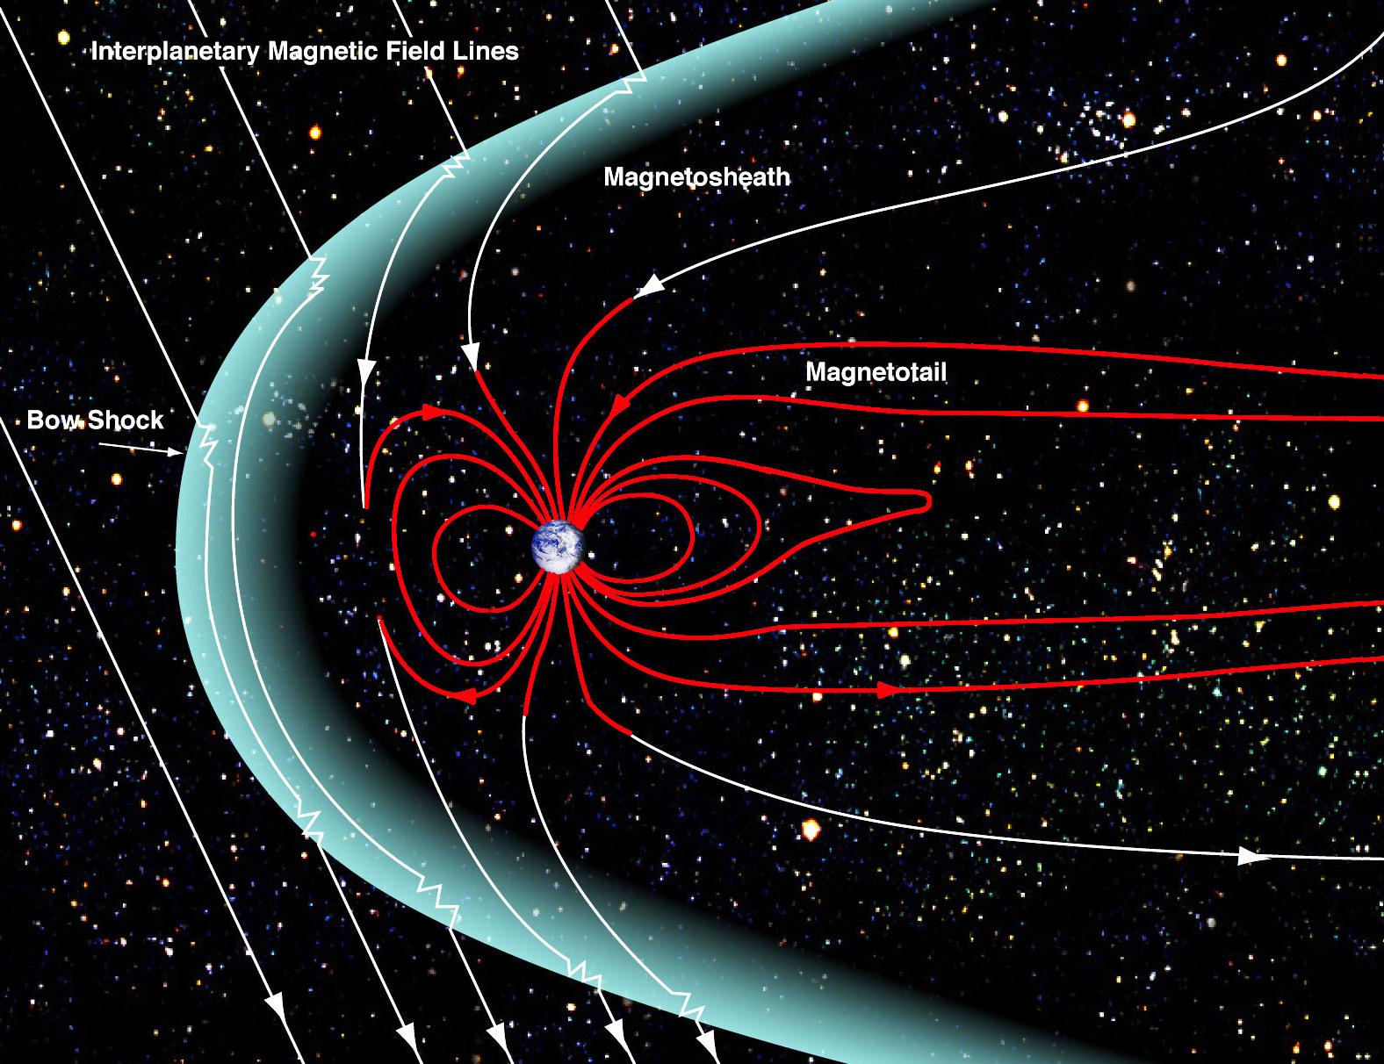
The magnetosphere of Earth
There is dense solar wind ions and neutral atoms (or molecules) in the magnetosheath
The solar wind cannot directly penetrate the magnetopause, and thus, the plasma with solar wind origin is quite tenuous inside the magnetosphere.
The solar wind plasma can enter into the cusp directly, and thus, the solar wind ions is expected to be high inside of the cusps.
Notes:
In the magnetosheath, the density of the highly charged ions is enhanced as the solar wind slows down after the bow shock. The solar wind cannot directly penetrate the magnetopause, and thus, the plasma with solar wind origin is quite tenuous inside the magnetosphere. This leads to a sharp boundary at the magnetopause in terms of the soft X-ray emissivity. The cusps are special regions on the magnetopause. The solar wind plasma can enter directly, and thus, the X-ray emissivity is expected to be higher inside of the cusps.
This leads to a sharp boundary at the magnetopause in terms of the soft X-ray emissivity

Slide 4
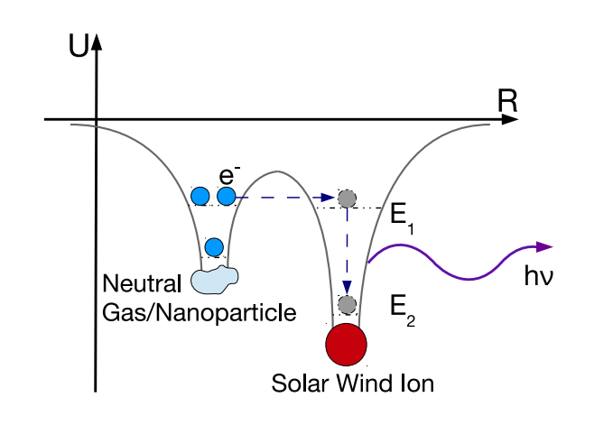
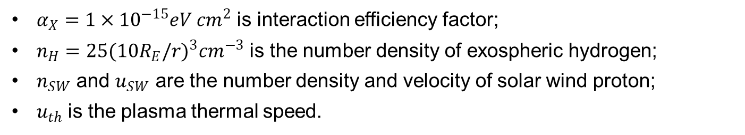
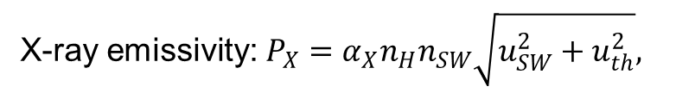
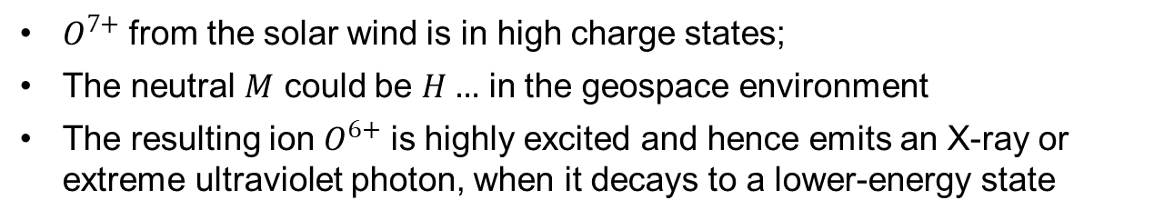

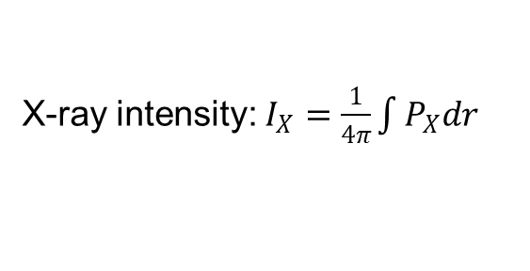
X-ray emission by the solar wind charge exchange mechanism
$$O^{7+}+M→O^{6+}+M^{+}+hυ$$
$O^{7+}$ from the solar wind is in high charge states;
The neutral $M$ could be $H…$ in the geospace environment
The resulting ion $O^{6+}$ is highly excited and hence emits an X-ray or extreme ultraviolet photon, when it decays to a lower-energy state
X-ray emissivity:${P_{X}=α}_{X}n_{H}n_{SW}\sqrt{u_{SW}^{2}+u_{th}^{2}},$
X-ray intensity: $I_{X}=\frac{1}{4π}\int{P_{X}dr}$
From Snios, 2016
$α_{X}=1×{10}^{−15}eV {cm}^{2}$ is interaction efficiency factor;
$n_{H}={25(10R_{E}/r)}^{3}{cm}^{−3}$ is the number density of exospheric hydrogen;
$n_{SW}$ and $u_{SW}$ are the number density and velocity of solar wind proton;
$u_{th}$ is the plasma thermal speed.
Cravens & Robertson, 2001; Sun et al., 2015 …
Notes:
$O^{7+}$ 怎么读？
We usually use this expression for the overall soft X-ray and EUV power density, the Px is the X-ray emissivity, and the integration of the Px is the X ray intensity Ix.
In this expression, the $α_{X}$ is a constant, the $n_{H}$ is proportional to the inverse of r, and r is the distance from the center of the Earth.
For example，the charge exchange reaction of 07+ with a neutral atom or molecule can be represented by

Slide 5
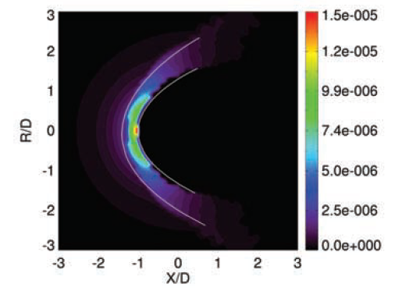
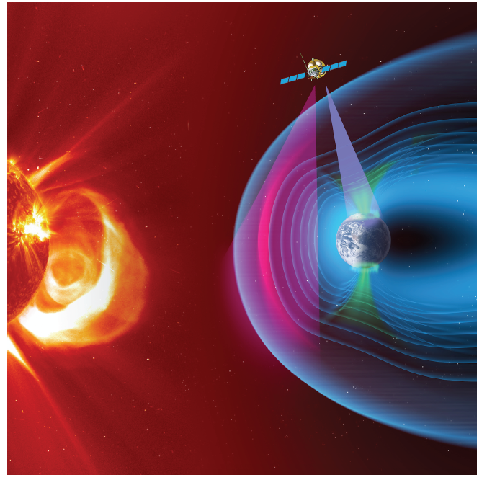
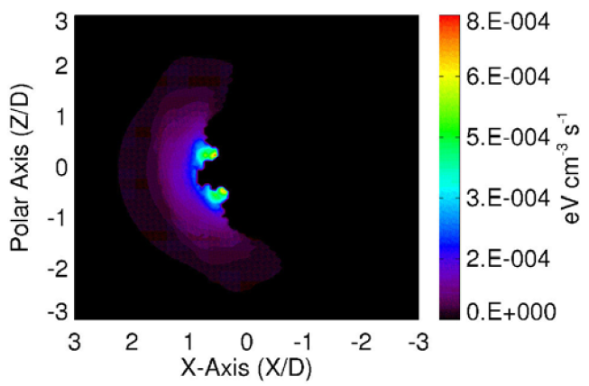
Soft X-ray imaging of the magnetosheath and the cusps
Solar wind Magnetosphere Ionosphere Link Explorer (SMILE)
Model: X-ray emission from the magnetosheath
Robertson & Cravens, 2003
MHD simulation: X-ray emission from the cusps
SMILE red book
Robertson et al., 2006
Notes:
在TFA方法中，首先需要分析X射线成像图，得出X射线强度的极大值方向，以此作为真实磁层顶的切线方向。然后，使用含可变参数的磁层顶模型获得一系列磁层顶位形，并计算出这些位形的切线。通过对比X射线成像图得出的磁层顶切向方向与模型反演得到的磁层顶切线方向，找到最匹配的磁层顶位形，此即为三维磁层顶的反演结果。

Slide 6
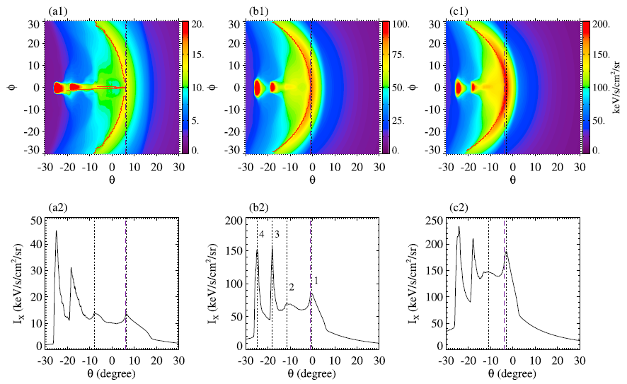
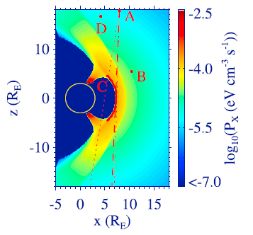



Magnetopause identification in the X-ray images: MHD Simulations
$n_{SW}=5 {cm}^{−3}$
$n_{SW}=20 {cm}^{−3}$
$n_{SW}=35 {cm}^{−3}$
Point A (7.95, 0.32, 17.73) R_{E}
P_{x} is enhanced in the magnetosheath and the cusps
The maximum of $I_{x}$ in the magnetosheath coincides with the tangent direction of the magnetopause.
Sun et al., 2019
Notes:
The maximum gradient of Ix near the magnetopause is marked by the thick dashed line, and beyond the dashed line is the magnetosheath.
The two red regions with very high X-ray emissions are the cusps.
The location with a sharp variation of $I_{x}$ could potentially indicate the position of a boundary

Slide 7
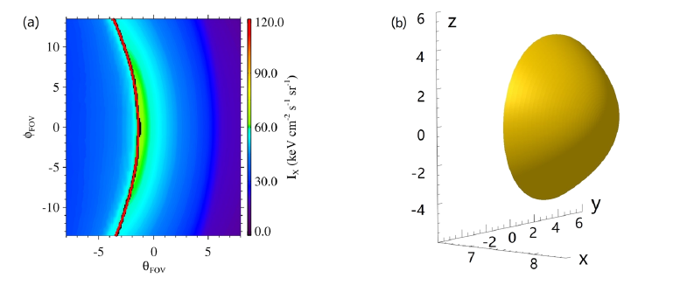
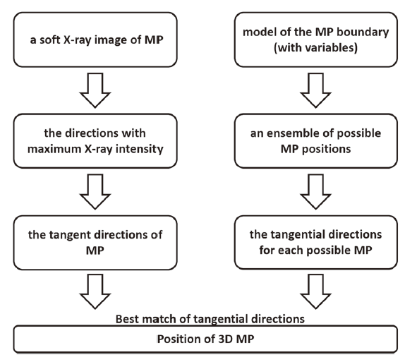
Identifying the magnetopause by using tangent fitting approach (TFA)
Tangent fitting approach (TFA)
Simulated X-ray image inside the FOV
Reconstructed 3-D magnetopause
Sun et al., 2020

Slide 8
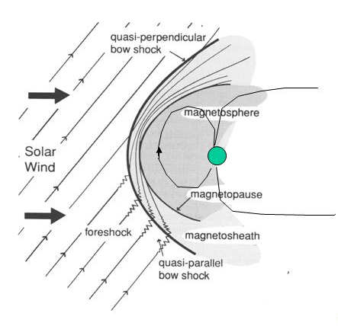
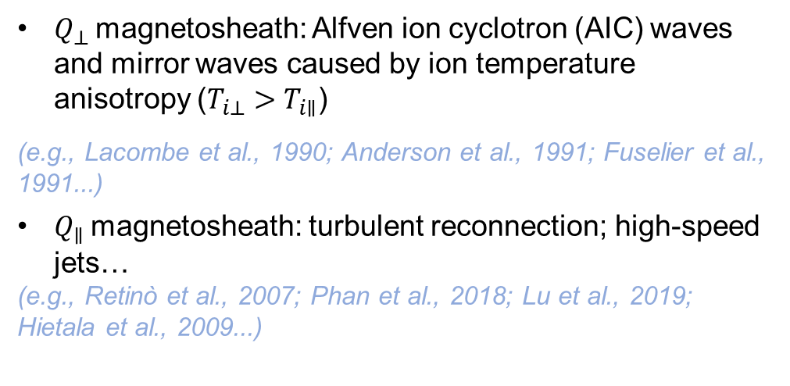
Turbulent magnetosheath downstream of a shock
$Q_{⊥}$magnetosheath: Alfven ion cyclotron (AIC) waves and mirror waves caused by ion temperature anisotropy ($T_{i⊥}>T_{i∥}$)
(e.g., Lacombe et al., 1990; Anderson et al., 1991; Fuselier et al., 1991...)
$Q_{∥}$magnetosheath: turbulent reconnection; high-speed jets…
(e.g., Retinò et al., 2007; Phan et al., 2018; Lu et al., 2019; Hietala et al., 2009...)
These effects are mostly due to particle kinetics which cannot be resolved in the MHD simulations.
Can the magnetopause still be identified in the turbulent environment?
Bow shock
Notes:
The magnetosheath is turbulent because of many plasma waves and structures.

Slide 9
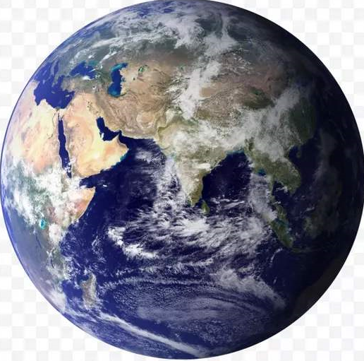


3-D global hybrid simulation
Ions are treated as particles, and electrons are treated as a massless fluid
The magnetic field is advanced in time using Faraday’s law, the electric field is calculated from the electron momentum equation, and the flow velocity of electrons is derived from Ampere’s law
$$Z/R_{E}$$
Outflow boundary
r
Outer boundary
θ
Magnetopause
IMF
Earth
3
7
10
27
$$X/R_{E}$$
Inner
boundary
Hybrid
Notes:
In this model, a spherical coordinate system ($r, \text{θ}, \text{φ}$) is used
The Earth is located at r = 0.
Solar wind inflow boundary conditions are applied for the outer boundary, and outflow boundary conditions are utilized at the tailward boundary
Initially, the Earth’s dipole magnetic field is limited to $\text{r} \text{≤ 10} R_{E}$, and it interacts with the uniform solar wind placed in r > 10 $R_{E}$.
The inner boundary at r = 3 $R_{E}$is perfectly conducting.

Slide 10
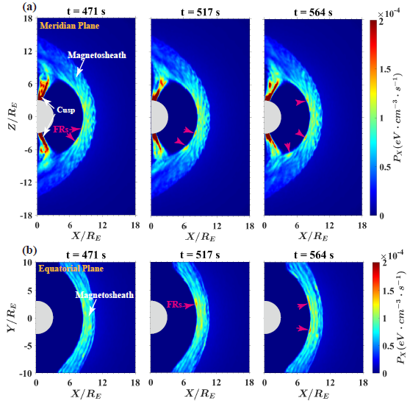
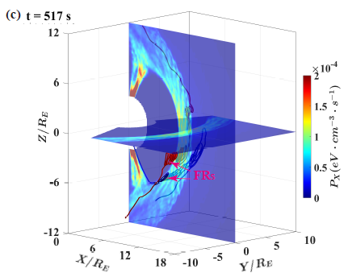

Results: X-ray emissivity obtained from Case 1
X-ray emissivity
3-D view
$$N_{i0}=20 {cm}^{−3}$$
$$B_{swy}=0$$
$$B_{swz}=−7.07 nT$$
The X-ray emissivity is high in the magnetosheath and the cusps, whereas it is low in the magnetosphere and the solar wind

Slide 11
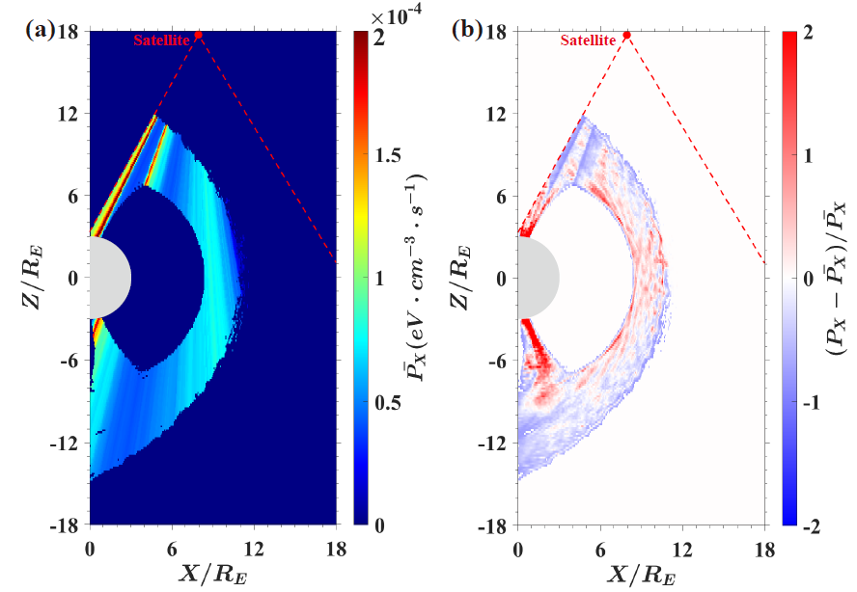
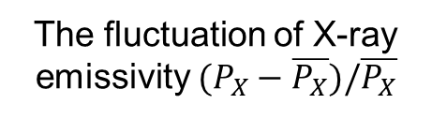

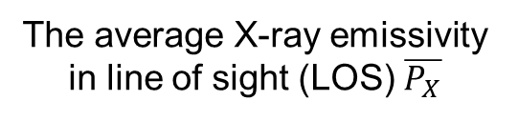
Results: Fluctuation of X-ray emissivity in the magnetosheath (Case 1)
The average X-ray emissivity in line of sight (LOS) $\overline{P_{X}}$
The fluctuation of X-ray emissivity $(P_{X}−\overline{P_{X}})/\overline{P_{X}}$
There is a large amplitude fluctuation (up to 160%) of the X-ray emissivity in the magnetosheath
$$N_{i0}=20 {cm}^{−3}$$
$$B_{swy}=0$$
$$B_{swz}=−7.07 nT$$

Slide 12
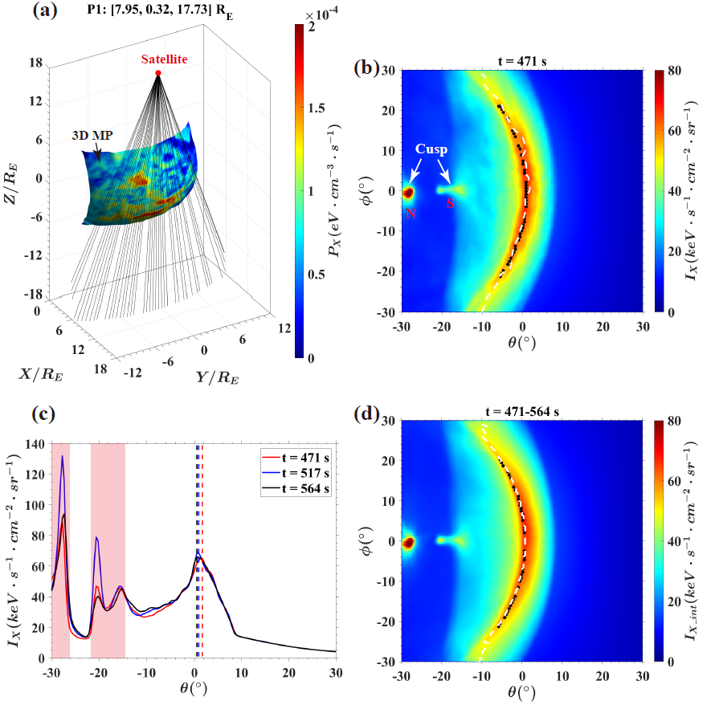
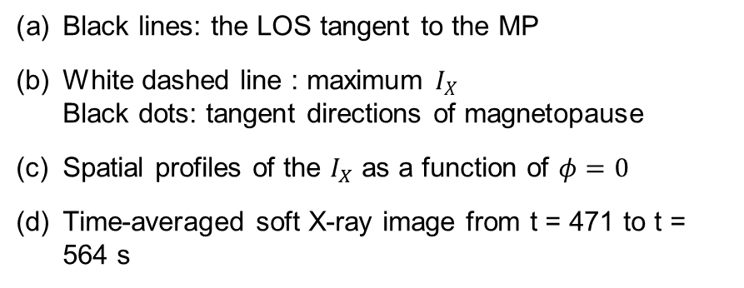
Results: MP boundary (Case 1)
X-ray image
Black lines: the LOS tangent to the MP
White dashed line : maximum $I_{X}$
Black dots: tangent directions of magnetopause
Spatial profiles of the $I_{X}$ as a function of $φ=0$
Time-averaged soft X-ray image from t = 471 to t = 564 s
Although there is a large amplitude fluctuation of the X-ray emissivity in the magnetosheath, the maximum X-ray intensity matches the tangent directions of the magnetopause well
cusp
MP

Slide 13
Results: MP boundary identified with different satellite positions (Case 1)
The magnetopause boundary can be identified with different positions of the satellite

Slide 14



Results: MP boundary identified with different solar wind conditions
Case 2
Case 3
Case 4
$$N_{i0}=20 {cm}^{−3}$$
$$B_{swy}=5 nT$$
$$B_{swz}=−5 nT$$
$$N_{i0}=5 {cm}^{−3}$$
$$B_{swy}=0$$
$$B_{swz}=−7.07 nT$$
$$N_{i0}=5 {cm}^{−3}$$
$$B_{swy}=5 nT$$
$$B_{swz}=−5 nT$$
In Cases 2 and 3, the tangent directions of the magnetopause match the maximum X-ray intensity well
In Case 4, the tangent directions of the 3-D magnetopause deviate from the maximum X-ray intensity in some localized regions, while the general shape of the magnetopause is identified.

Slide 15
Conclusions
3-D global hybrid simulation is applied to estimate the soft X-ray imaging of Earth’s magnetosheath under different solar wind conditions
Plasma waves and local structures in the magnetosheath lead to large amplitude fluctuations of X-ray emissivity.
The influence of magnetosheath fluctuations on identifying magnetopause boundary in the X-ray image is limited under different solar wind conditions and viewing geometries.
Contact me: gj0507@mail.ustc.edu.cn

Slide 17
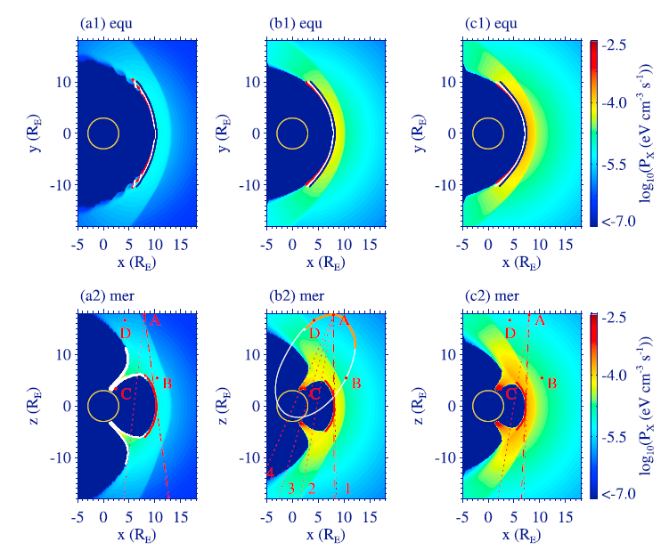
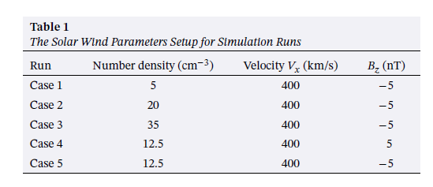
Soft X-ray Imaging of the Cusps and Magnetosheath: MHD Simulations
The denser the ions in the solar wind, the larger the P_{x}
Sun et al., 2019
Notes:
maximum PX occurs in the cusp region where the neutral density is higher. PX near the subsolar magnetopause is enhanced with an increasing solar wind number density, and the reasons for this enhancement are as follows: (1) increased number density in the solar wind, (2) increased thermal pressure in the magnetosheath caused by a stronger bow shock, and (3) larger neutral density as the magnetopause is closer to the Earth.

Slide 18
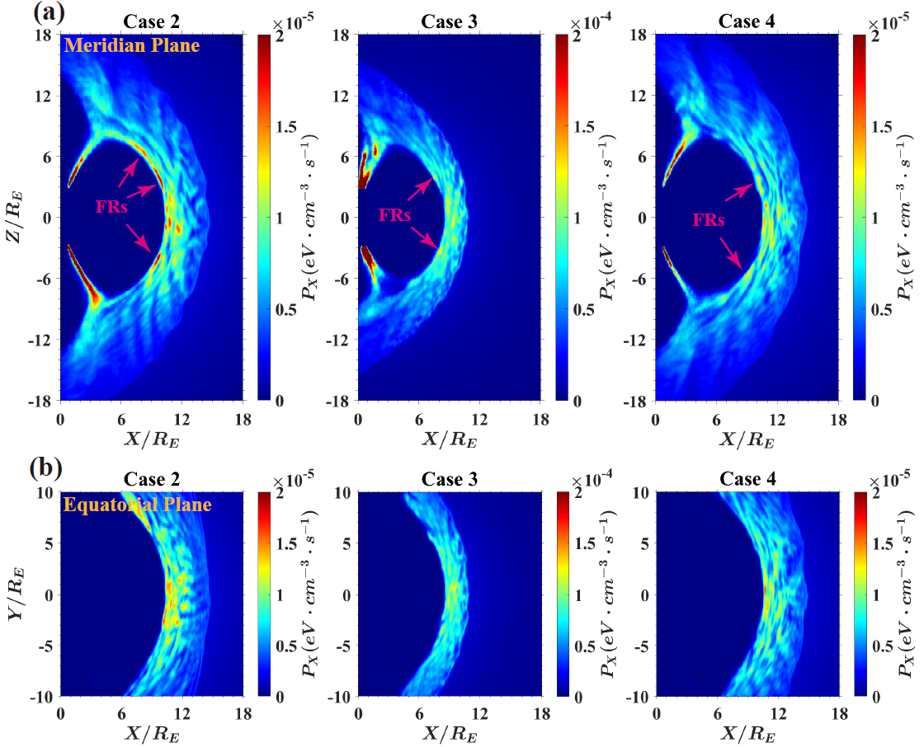



Results: X-ray emissivity under different solar wind conditions
$$N_{i0}=5 {cm}^{−3}$$
$$B_{swy}=0$$
$$B_{swz}=−7.07 nT$$
$$N_{i0}=20 {cm}^{−3}$$
$$B_{swy}=5 nT$$
$$B_{swz}=−5 nT$$
$$N_{i0}=5 {cm}^{−3}$$
$$B_{swy}=5 nT$$
$$B_{swz}=−5 nT$$

