Slide 1
Soil lipidomics
Supplementary materials

Slide 2
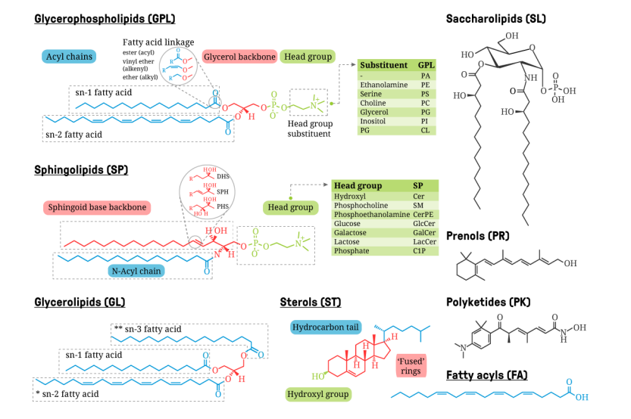
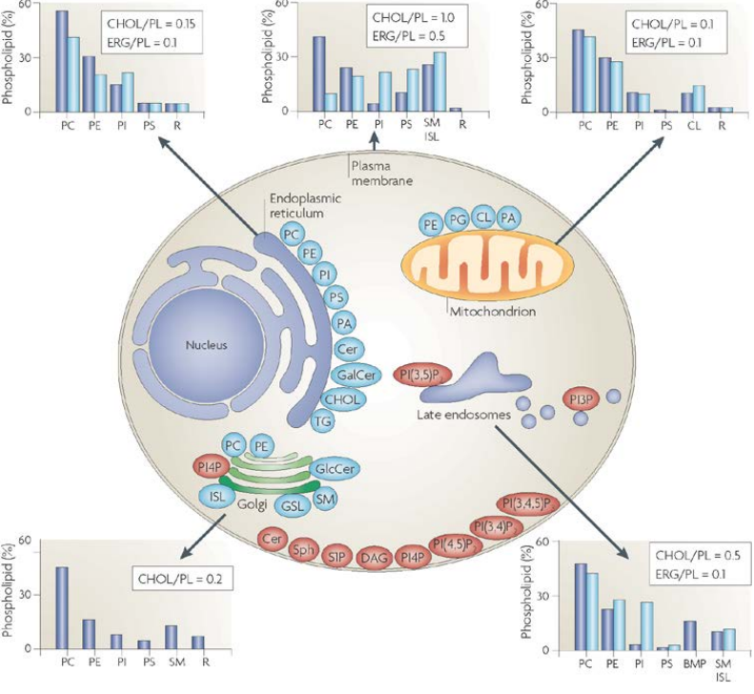
Lipid diversity
Chemical (Molecular structure of cellular lipids)
Head group, i.e. lipid class
Bond types (ester vs. ether)
Number of double bonds
Length of the fatty acyl chain(s)
Compositional (Ratio of different lipids)
Collective behaviour of lipid membranes
Level of variation – a. Species b. Tissues/Cell within an organism c. Different organnelles d. membrane leaflets e. membrane subdomain
4. Harayama, T., & Riezman, H. 2018
Novel biomarkers!
5. Laura Martin, M. 2011
Notes:
Harayama, T., & Riezman, H. (2018). Understanding the diversity of membrane lipid composition. Nature reviews Molecular cell biology, 19(5), 281-296.
Laura Martin, M. (2011). Role of the regulation of cell lipid composition and membrane structure in the antitumor effect of 2-hydroxyoleic acid (Doctoral dissertation, Universitat de leComan, ISBN 978-3-8440-6916-7, 2019
s Illes Balears).

Slide 3
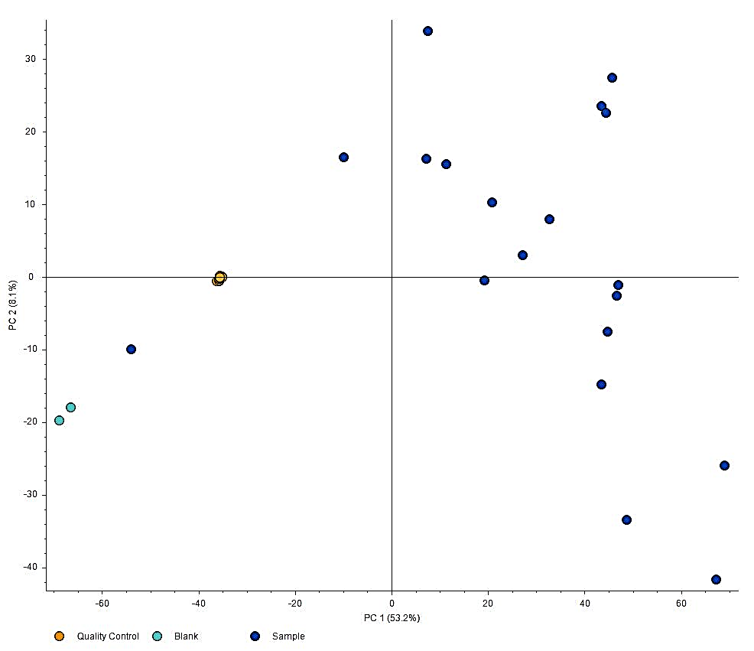
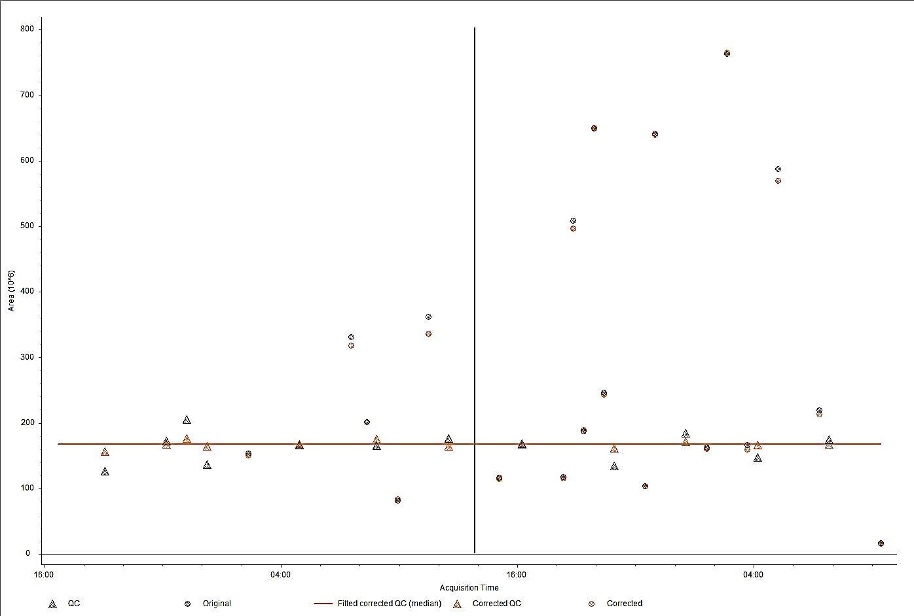
Tight QC Clustering
Correction using QC

Slide 4
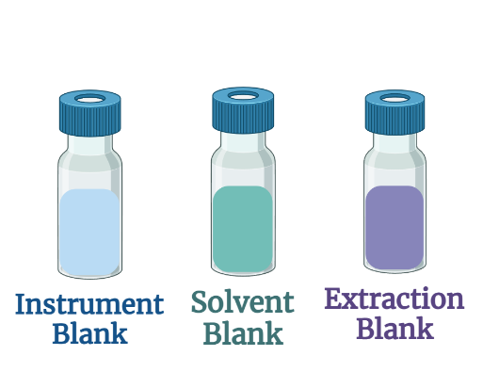
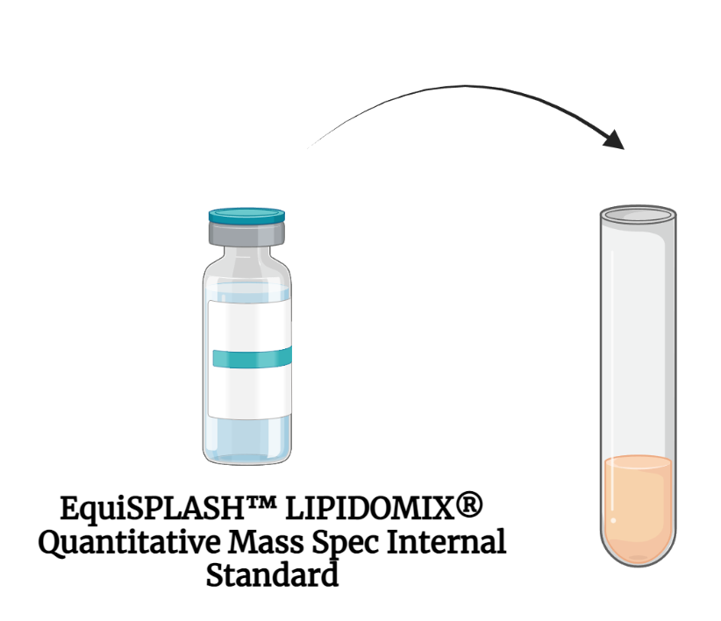
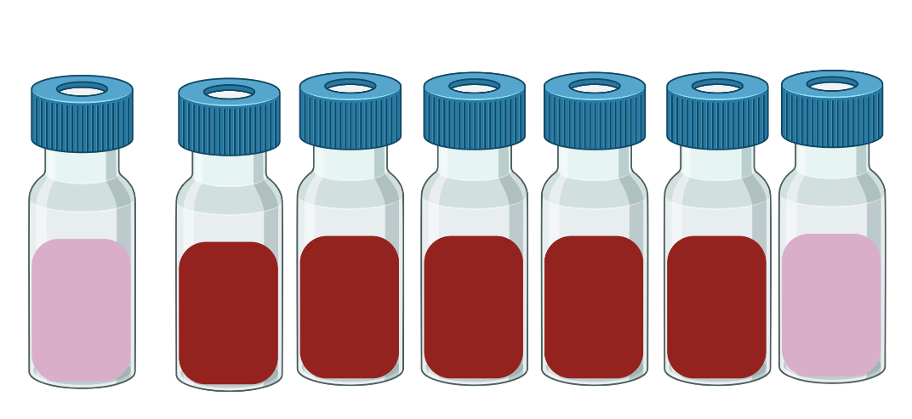
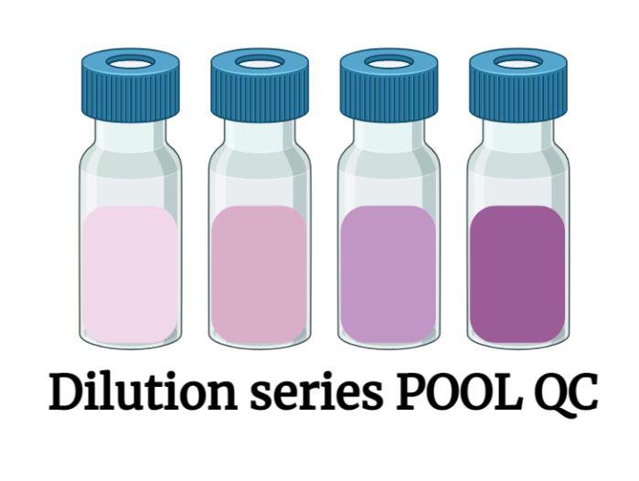
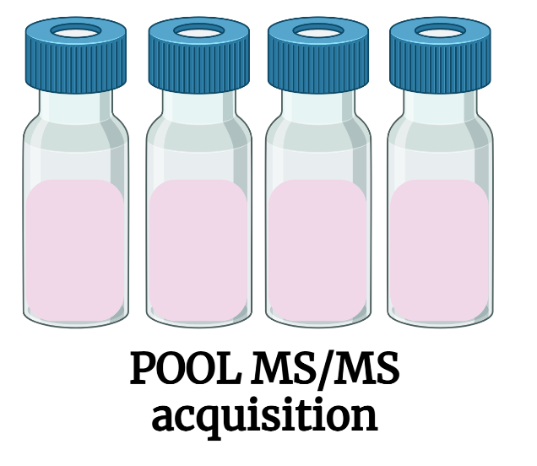
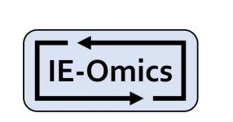
Quality Controls (QC)
Instrument QC
Lipid Extraction
Background feature removal
IB: Batch variation, Instrument stability etc.
Contamination monitoring
POOLQC: All sample mixture
13 Different lipid class, addition prior extraction
Extraction efficiency
Matrix effect
Intra-study data assessment
Finding sample features & filtering
Enhanced Data dependent acquisition (DDA) using exclusion list
MS² for lower concentration features

Slide 5
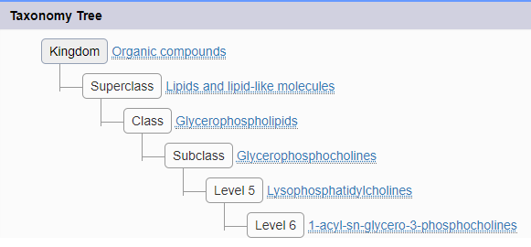
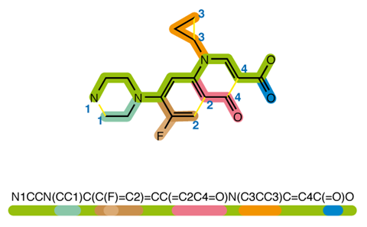
Feature identification
Organic compounds
Lipid and lipid-like molecules
Glycerophospholipids
PC 34:1 or PC O-35:1
PC
PC 34:1
PC 16:0/18:1w9
PC 16:0/18:1
Precursor ion search (MS¹)
Retention time search (RT)
MSMS spectral libraries (MS²)
Different annotation level
Multiple conflicting annotations for single peak/feature
Non-comparable score of matches
GNPS: Gold, Silver, Bronze
LipidSearch: A, B, C
MzVault: MS similarity score
RT prediction models: Batch RMS values
SIRIUS: CANOPUS score
SMILES notation
Src: Wikipedia

Slide 6
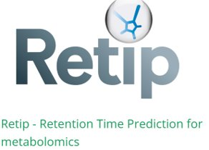
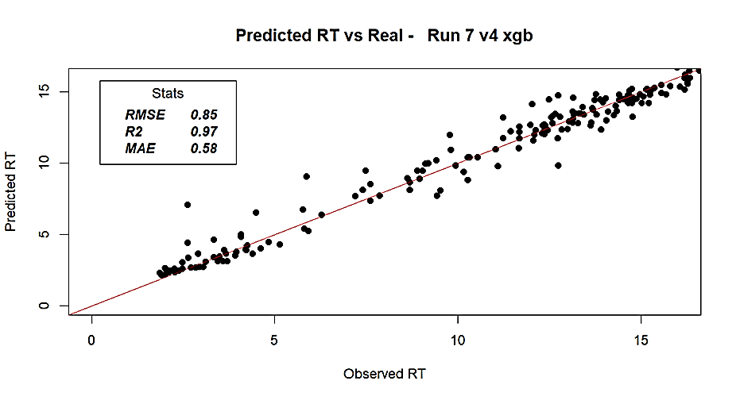
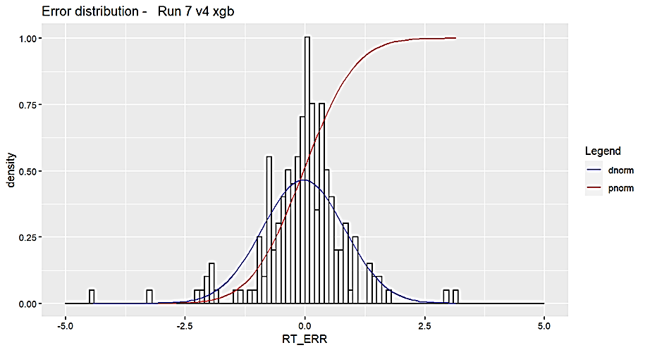
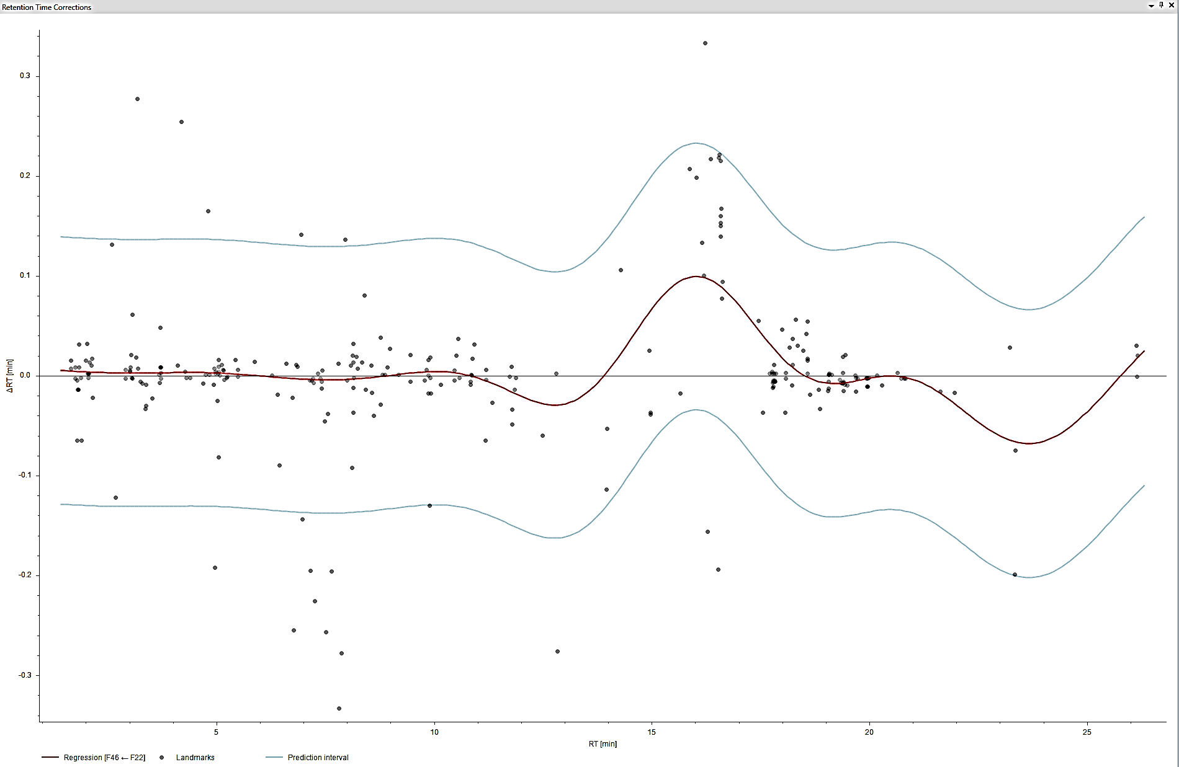
Retention time search
2. RT Modeling Based on cheminformatics (Retip)
In-house Calibration table
Standards
Targeted analysis
Regression based modeling (Carbon number, Double-bonds, Class-specific lipids)
SMILES
Molecular fingerprint
ML models
RT correction using landmark feature & QC
Multiple feature alignment algorithm
Replicate RT tolerance: RSD < 0.1 min
Use ML models to predict SMILES RT
Narrowing down of compounds annotation predicted RT & logP values

Slide 7
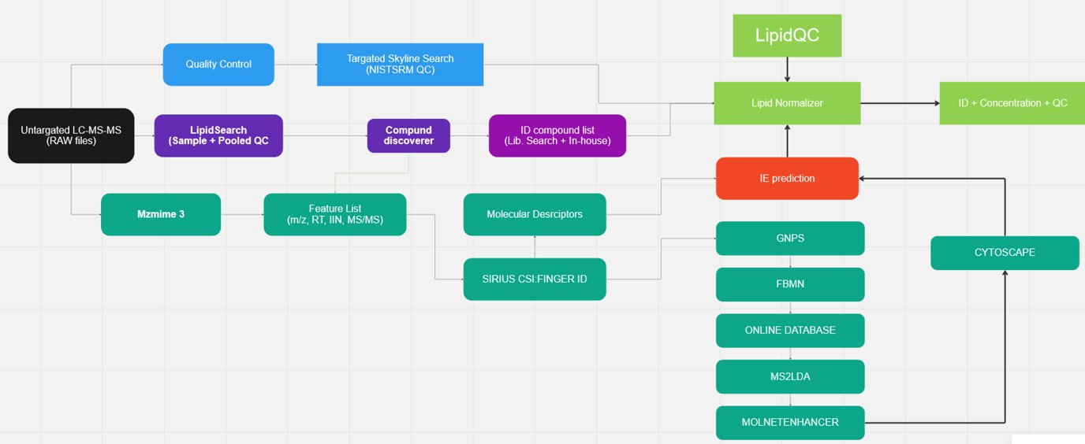
Full workflow v3

Slide 8
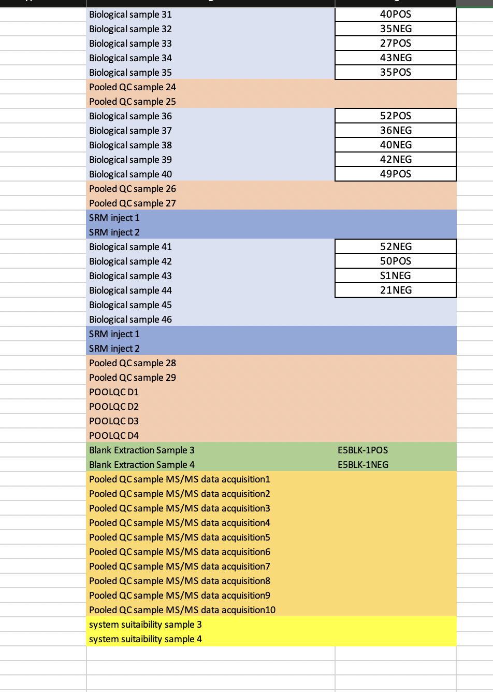
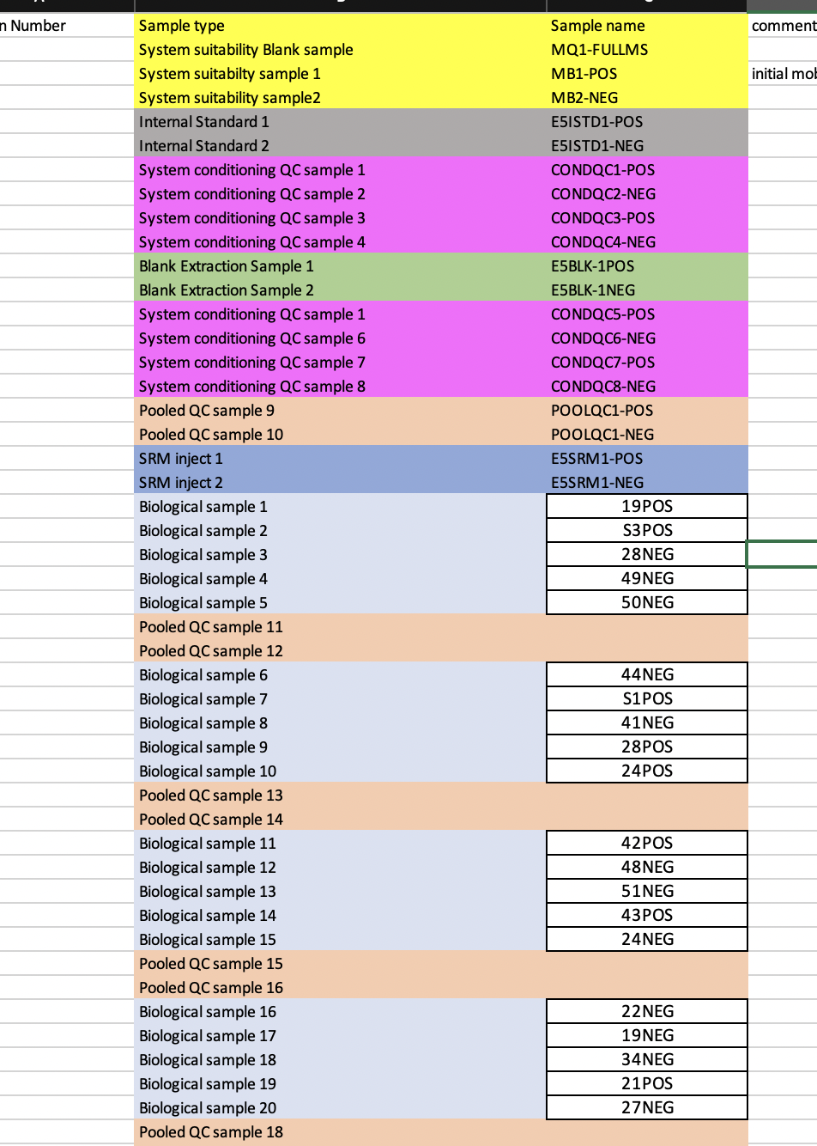
Sample worklist

Slide 9
References
Potapov, A. M., Rozanova, O. L., Semenina, E. E., Leonov, V. D., Belyakova, O. I., Bogatyreva, V. Y., ... & Tiunov, A. V. (2021). Size compartmentalization of energy channeling in terrestrial belowground food webs. Ecology, 102(8), e03421.
Barrios, E. (2007). Soil biota, ecosystem services and land productivity. Ecological economics, 64(2), 269-285.
Creamer, R. E., Barel, J. M., Bongiorno, G., & Zwetsloot, M. J. (2022). The life of soils: Integrating the who and how of multifunctionality. Soil Biology and Biochemistry, 166, 108561.
Thies, J. E. (2015). Molecular approaches to studying the soil biota. Soil microbiology, ecology, and biochemistry, 151-185.
Su ding (thesis)
Fahy, E., Subramaniam, S., Murphy, R. C., Nishijima, M., Raetz, C. R., Shimizu, T., ... & Dennis, E. A. (2009). Update of the LIPID MAPS comprehensive classification system for lipids1. Journal of lipid research, 50, S9-S14.
Yang, K., & Han, X. (2016). Lipidomics: techniques, applications, and outcomes related to biomedical sciences. Trends in biochemical sciences, 41(11), 954-969.
Harayama, T., & Riezman, H. (2018). Understanding the diversity of membrane lipid composition. Nature reviews Molecular cell biology, 19(5), 281-296.
Laura Martin, M. (2011). Role of the regulation of cell lipid composition and membrane structure in the antitumor effect of 2-hydroxyoleic acid (Doctoral dissertation, Universitat de les Illes Balears).
Sohlenkamp, Christian, and Otto Geiger. "Bacterial membrane lipids: diversity in structures and pathways." FEMS microbiology reviews 40.1 (2016): 133-159.
Koelmel, J. P., Napolitano, M. P., Ulmer, C. Z., Vasiliou, V., Garrett, T. J., Yost, R. A., ... & Bowden, J. A. (2020). Environmental lipidomics: understanding the response of organisms and ecosystems to a changing world. Metabolomics, 16(5), 1-22.
Jeremy P. Koelmel, Nicholas M. Kroeger, Emily L. Gill, Candice Z. Ulmer, John A. Bowden, Rainey E. Patterson, Richard A. Yost, Timothy J. Garrett: Expanding lipidome coverage using LC-MS/MS data-dependent acquisition with automated exclusion list generation. Journal of the American Society for Mass Spectrometry. (2017) 28: 908. doi:10.1007/s13361-017-1608-0
Ulmer, Candice Z., et al. "LipidQC: method validation tool for visual comparison to SRM 1950 using NIST interlaboratory comparison exercise lipid consensus mean estimate values." Analytical chemistry 89.24 (2017): 13069-13073.
Schmid, Robin, et al. "Integrative analysis of multimodal mass spectrometry data in MZmine 3." Nature biotechnology (2023): 1-3.
Schmid, Robin, et al. "Ion identity molecular networking for mass spectrometry-based metabolomics in the GNPS environment." Nature communications 12.1 (2021): 3832.
Schmid, Robin, et al. "Ion identity molecular networking for mass spectrometry-based metabolomics in the GNPS
Wandy, Joe, et al. "Ms2lda. org: web-based topic modelling for substructure discovery in mass spectrometry." Bioinformatics 34.2 (2018): 317-318. environment." Nature communications 12.1 (2021): 3832.
Ernst, Madeleine, et al. "MolNetEnhancer: Enhanced molecular networks by integrating metabolome mining and annotation tools." Metabolites 9.7 (2019): 144.
Dührkop, Kai, et al. "SIRIUS 4: a rapid tool for turning tandem mass spectra into metabolite structure information." Nature methods 16.4 (2019): 299-302.
Bonini, Paolo, et al. "Retip: retention time prediction for compound annotation in untargeted metabolomics." Analytical chemistry 92.11 (2020): 7515-7522.

