Slide 1

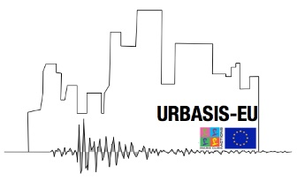



Using ambient vibration data for
predicting site amplification
for the city of Lucerne (Switzerland):
comparison between canonical correlation and
hybrid standard spectral ratio methods
Paulina Janusz ¹, Francesco Panzera ^{1,2}, Vincent Perron³, Paolo Bergamo¹, Donat Fäh¹
¹SED, ETH Zürich, Switzerland
²University of Catania, Italy
³CEA, France
paulina.janusz@sed.ethz.ch

Slide 2
Introduction
paulina.janusz@sed.ethz.ch

Slide 3
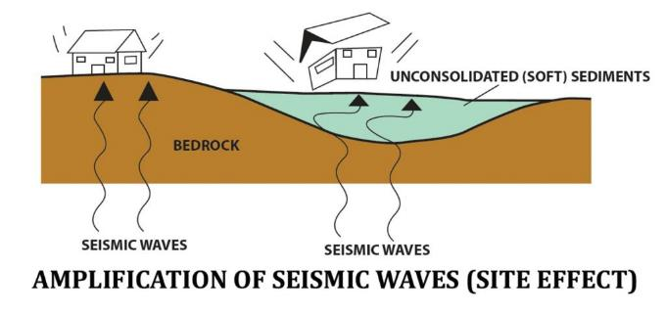
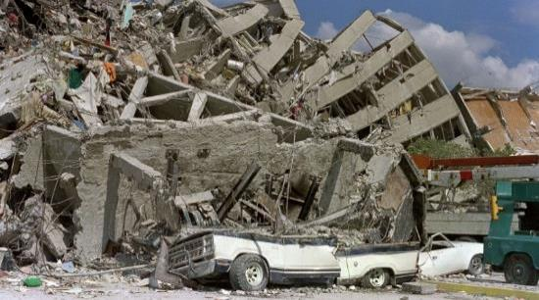
Introduction
Seismic risk in urban areas
Urban vulnerability
Site effects
+
=
Elevated seismic risk
Mexico 1985
Ciaccio and Cultrera (2014)
theguardian.com
paulina.janusz@sed.ethz.ch

Slide 4
Introduction
How to get site amplification?
Aim: spatial variability of the soil response
Earthquakes
Ambient noise
Proxies
Direct measurements
Expensive
Time-consuming
Relatively cheap and fast
Quite good estimate
Just an estimate
Cheap and fast
Quite inaccurate
Only some methods
paulina.janusz@sed.ethz.ch

Slide 5
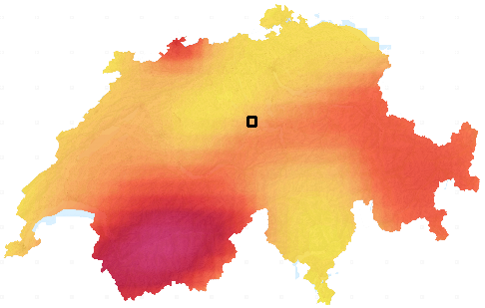
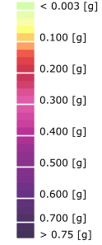

Introduction
The idea and case study
Idea:
Case study:
Comparison of two noise-based methods:
canonical correlation (CC)
hybrid standard spectral ratio (SSRh)
LUCERNE in Central Switzerland
SEISMIC HAZARD MAP
Lucerne
SA 5Hz 10% in 50 years
Very soft alluvial deposits (Vs30 ~ 300m/s)
Mw 5.9 in year 1601
Low-to-moderate seismicity area
with some strong historical earthquakes
seismo.ethz.ch
paulina.janusz@sed.ethz.ch

Slide 6
Methods and data
paulina.janusz@sed.ethz.ch

Slide 7



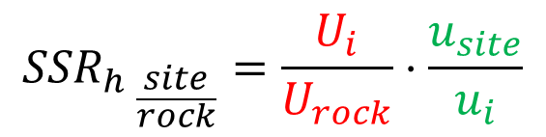

Methods
ambient noise
$$u_{site}$$
Hybrid Standard Spectral Ratio
(SSRh - Perron et al., 2018)
earthquake
$$U_{rock}$$
earthquake recordings + ambient vibration
relatively cheap and fast, high spatial resolution
sediments
$$U_{i}$$
rock
$$u_{i}$$
Earthquake ground motion
Ambient noise recording
$${{SSR}_{h}}_{ \frac{site}{rock}}=\frac{U_{i}}{U_{rock}}⋅\frac{u_{site}}{u_{i}}$$
Janusz et al. 2022, Frontiers in Earth Science
paulina.janusz@sed.ethz.ch

Slide 8
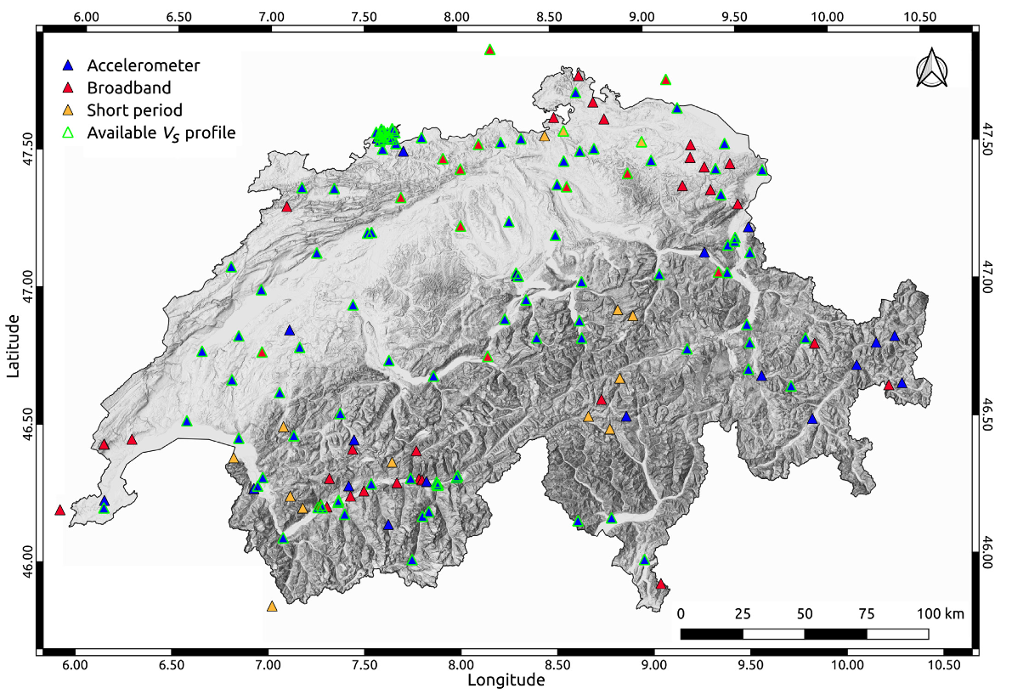
Methods
Canonical correlations (CC, Cultrera et al. 2014, Panzera, et al. 2021, BSSA)
Empirical Amplification Functions
(EAF, Edwards, et al. 2013)
Earthquake ground motion
Direct measurement
Seismic stations of Swiss network
CORRELATION
of EAF and H/V
PREDICTING
EAF from H/V
Horizontal-to-Vertical spectral ratios
(H/V, Nakamura, 1989)
Ambient noise recording
Just a proxy of amplification
Panzera, et al. 2021, BSSA
paulina.janusz@sed.ethz.ch

Slide 9
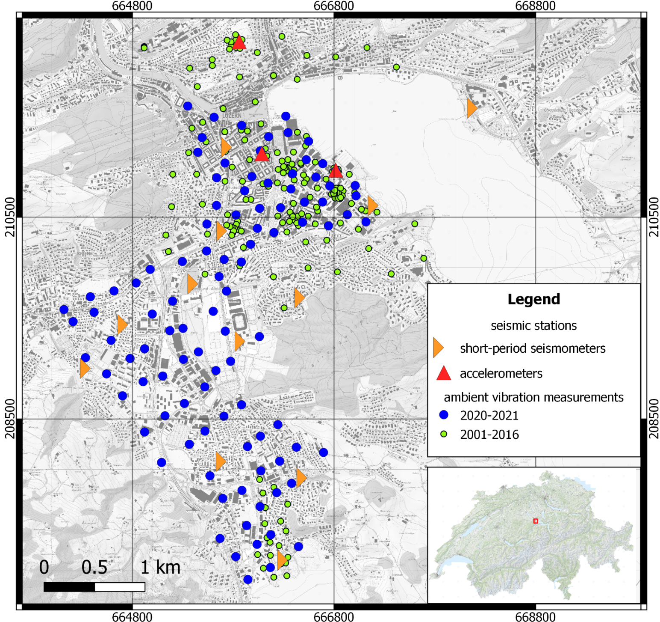
Data
map.geo.admin.ch
Seismic stations
velocimeters
accelerometers
Ambient vibration measurements
100 points (2020-2021)
213 points (2001-2016)
Verification
SSRh amplification map
CC amplification map
paulina.janusz@sed.ethz.ch

Slide 10
Results
Comparison and verification
paulina.janusz@sed.ethz.ch

Slide 11
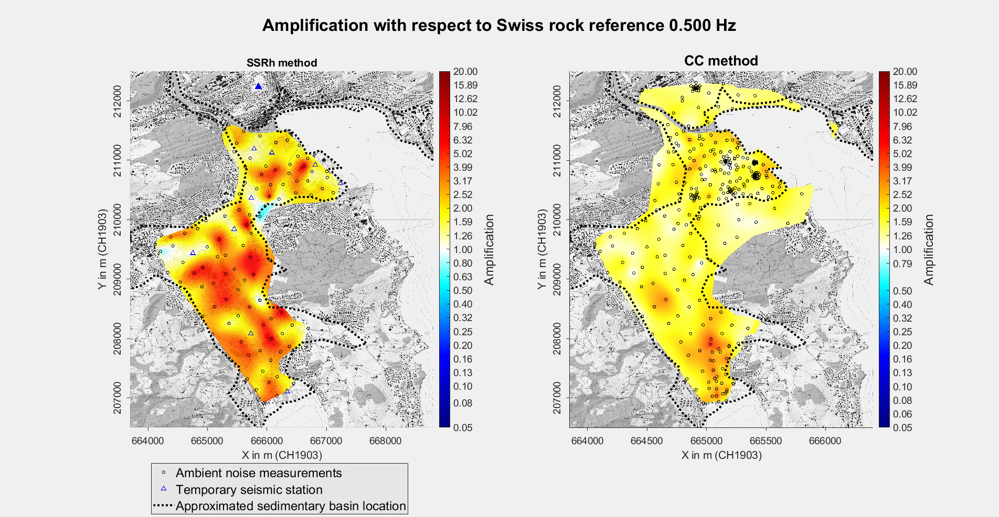
Comparisons
map.geo.admin.ch
Increased seismic hazard !!!

Slide 12
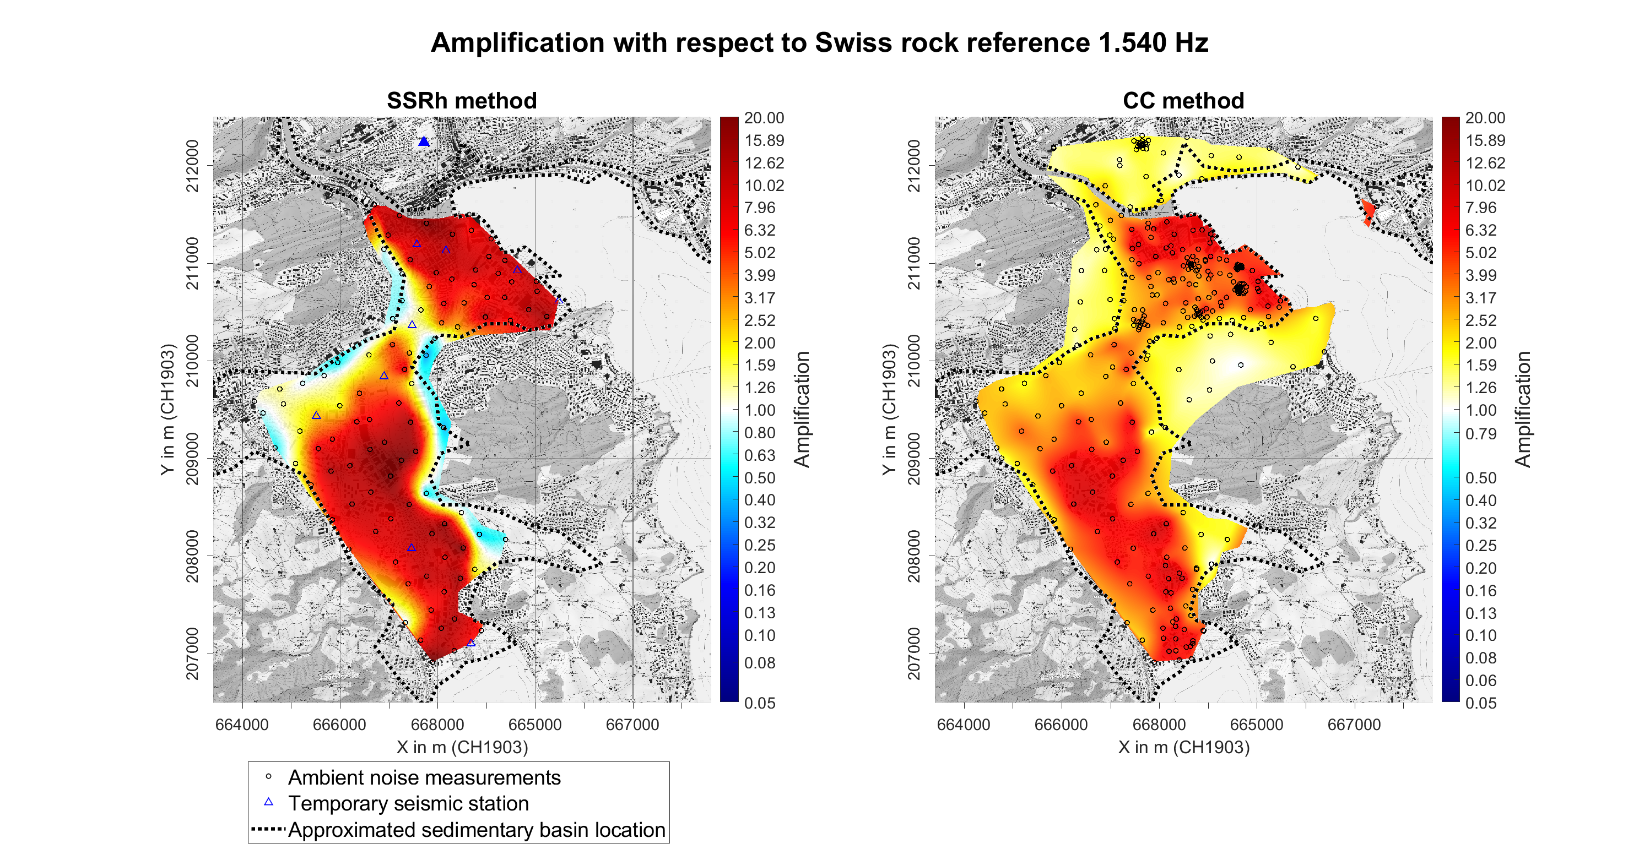
Comparisons
map.geo.admin.ch
Increased seismic hazard !!!

Slide 13
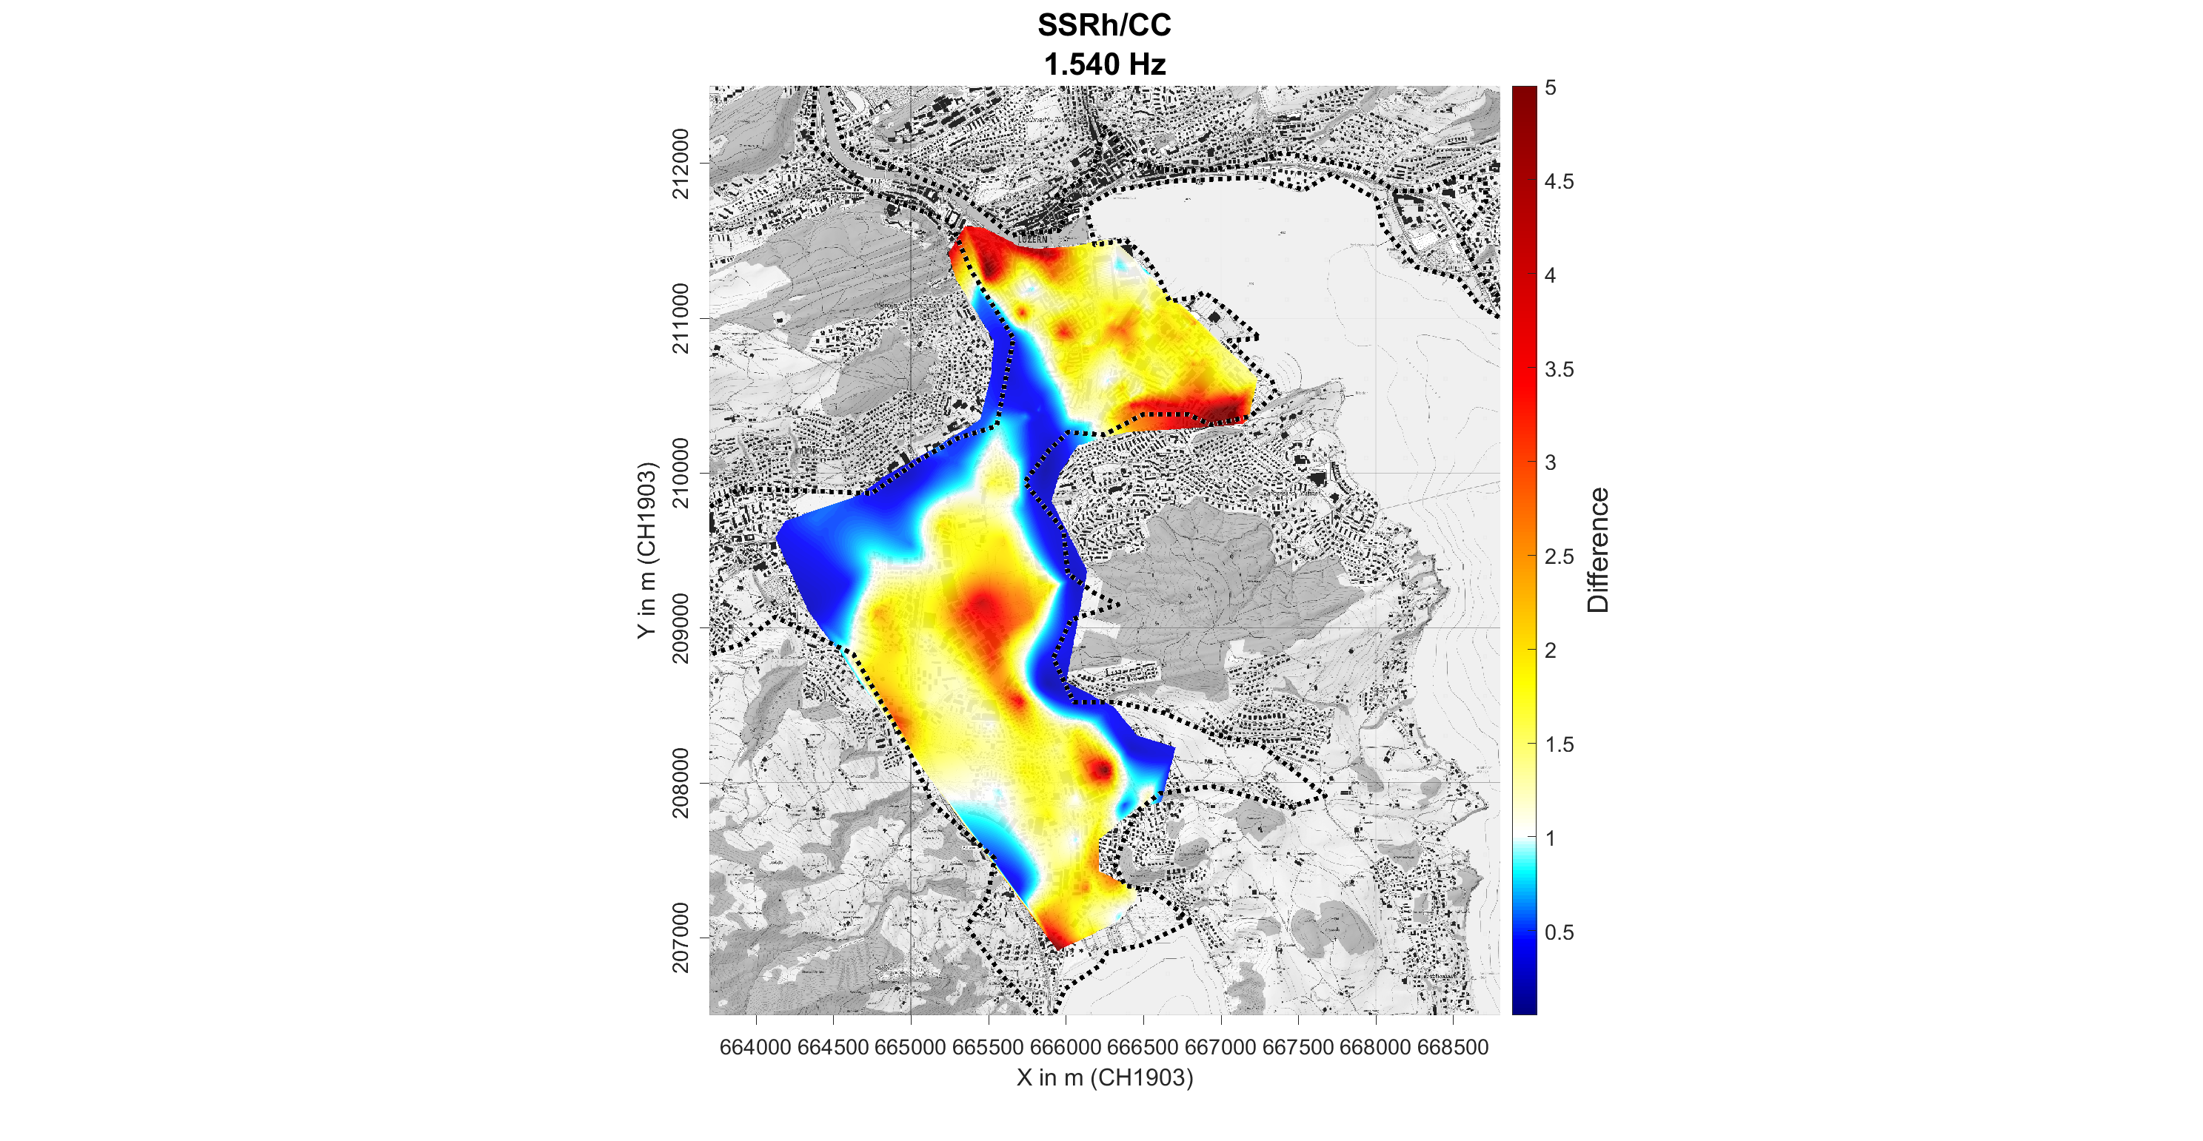
Comparisons
SSRh/CC amplification
Which is closer to the reality?
Deep basin
SSRh > CC
Basin borders
SSRh < CC
map.geo.admin.ch

Slide 14
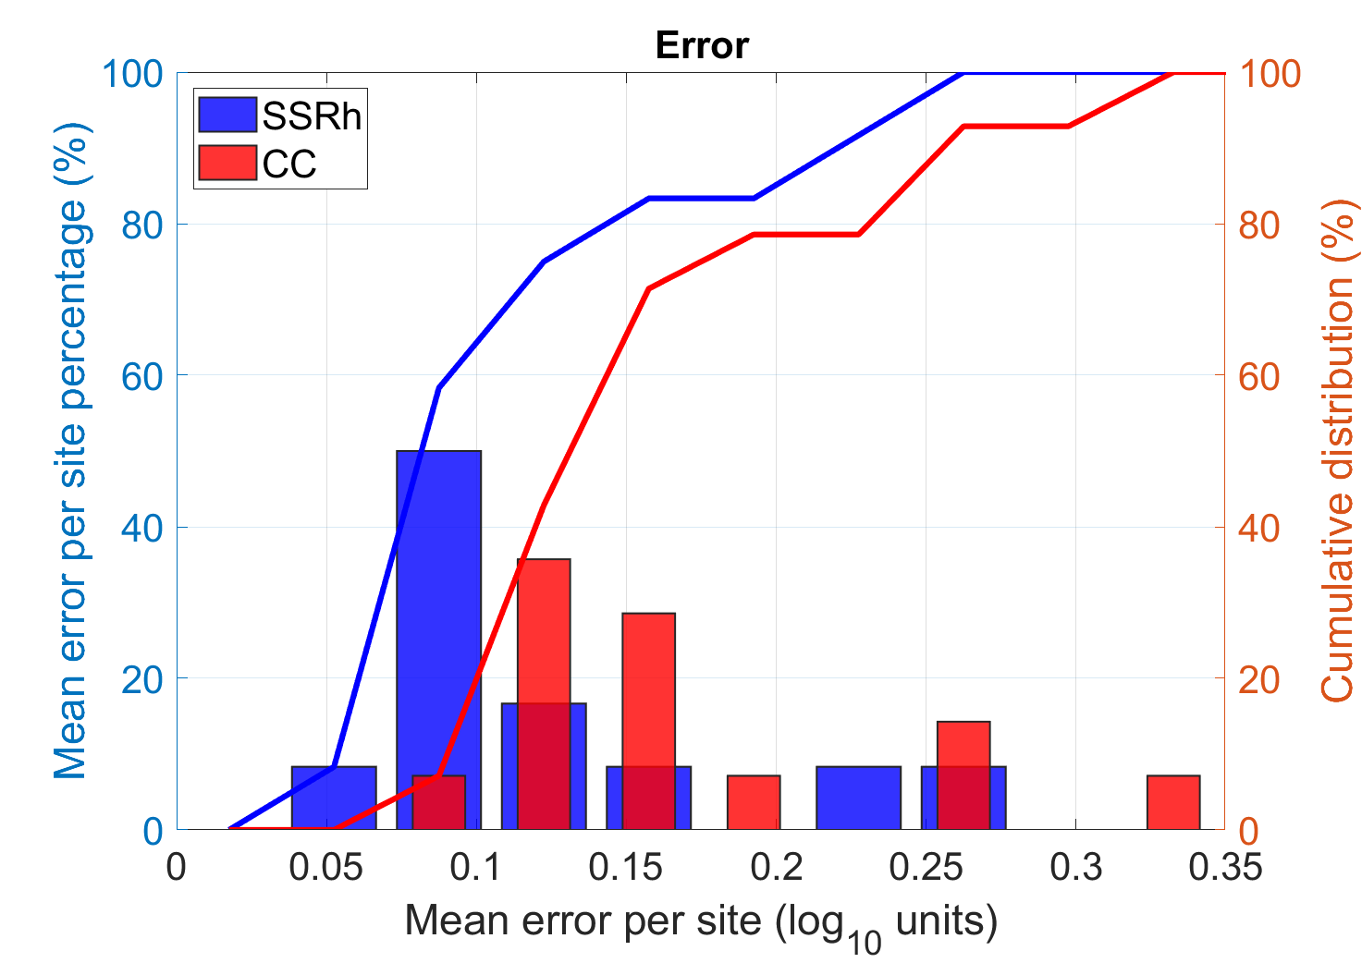
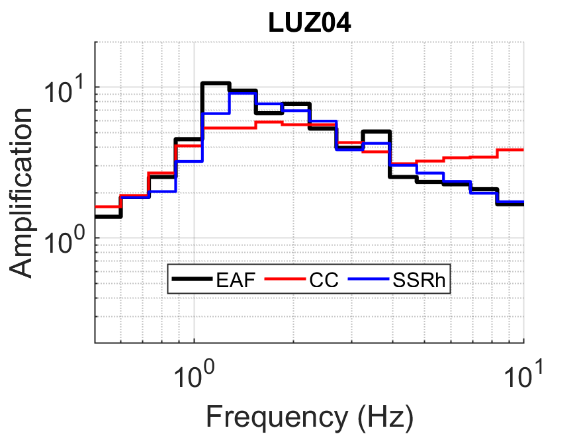
Verification
SSRh generally better than CC
Good performance for both
Mean absolute error (MAE)
All seismic stations
paulina.janusz@sed.ethz.ch

Slide 15
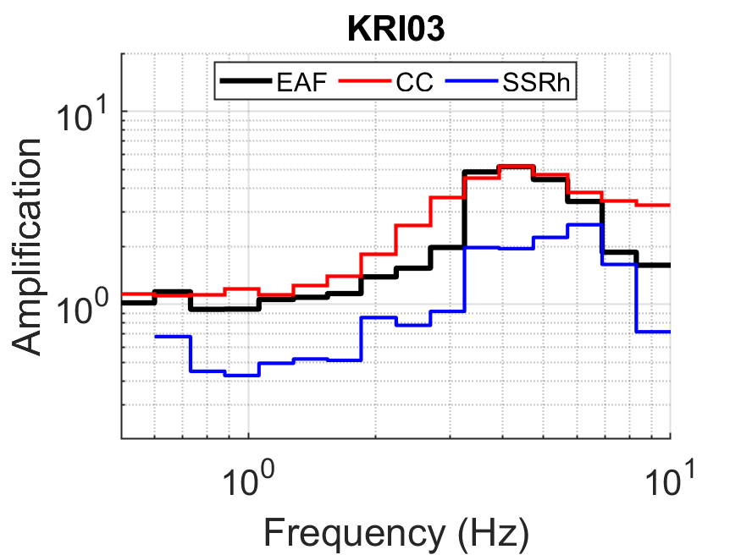
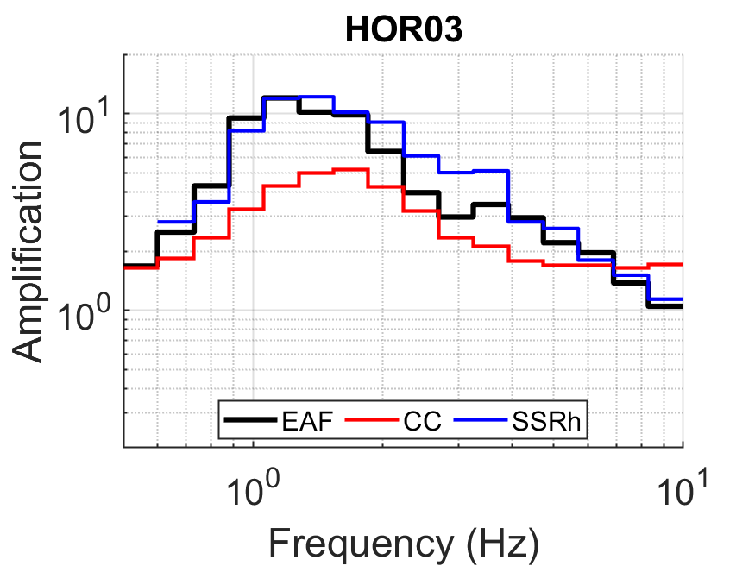
Comparisons
CC better
SSRh/CC amplification
Deep basin
SSRh > CC
Basin borders
SSRh < CC
Deep basin
SSRh > CC
Basin borders
SSRh < CC
SSRh better
Closer to the reality?
Conservative model:
SSRh in deep basin
CC at the borders
map.geo.admin.ch

Slide 16
Summary and conclusions
paulina.janusz@sed.ethz.ch

Slide 17

Summary
Both CC and SSRh:
reasonable estimate of amplification
increased seismic hazard for Lucerne
Even though,
SSRh performs generally better,
CC has wide applications
paulina.janusz@sed.ethz.ch

Slide 18




References
Ciaccio, M. G. and Cultrera, G. (2014). Terremoto e rischio sismico, Ediesse, Italy
Cultrera, G., V. De Rubeis, N. Theodoulidis, H. Cadet, and P. Y. Bard (2014). Statistical correlation of earthquake and ambient noise spectral ratios, Bull. Earthq. Eng. 12, 1493–1514.
Edwards, B., Michel, C., Poggi, V., Fäh, D. (2013). Determination of Site Amplification from Regional Seismicity: Application to the Swiss National Seismic Networks. Seismol. Res. Lett. 84, 611–621. https://doi.org/10.1785/0220120176
Janusz, P., Perron, V., Knellwolf, C., & Fäh, D. (2022). Combining Earthquake Ground Motion and Ambient Vibration Recordings to Evaluate a Local High-Resolution Amplification Model—Insight From the Lucerne Area, Switzerland. Frontiers in Earth Science, 10. https://doi.org/10.3389/feart.2022.885724
Nakamura, Y., 1989. A method for dynamic characteristics estimation of subsurface using microtremor on the ground surface. Railw. Tech. Res. Inst. Q. Rep. 30, 25–33.
Panzera, F., Bergamo, P., & Fäh, D. (2021). Canonical Correlation Analysis Based on Site‐Response Proxies to Predict Site‐Specific Amplification Functions in Switzerland. Bulletin of the Seismological Society of America. https://doi.org/10.1785/0120200326
Perron, V., Gélis, C., Froment, B., Hollender, F., Bard, P.-Y., Cultrera, G., Cushing, E.M. (2018). Can broad-band earthquake site responses be predicted by the ambient noise spectral ratio? Insight from observations at two sedimentary basins. Geophys. J. Int. 215, 1442–1454. https://doi.org/10.1093/gji/ggy355
paulina.janusz@sed.ethz.ch

