Slide 1
A New Lumped Descriptor of Basin-Wide Hydrologic Connectivity
Francesco Dell’Aira and Claudio I. Meier
University of Memphis
Department of Civil Engineering

Slide 2
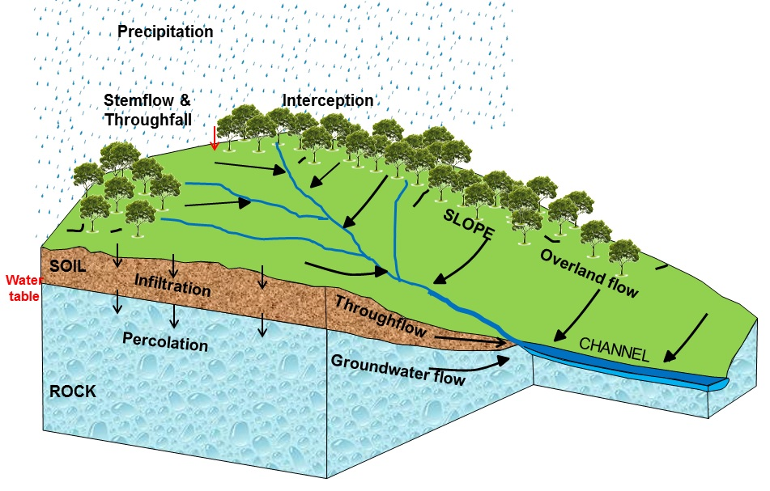
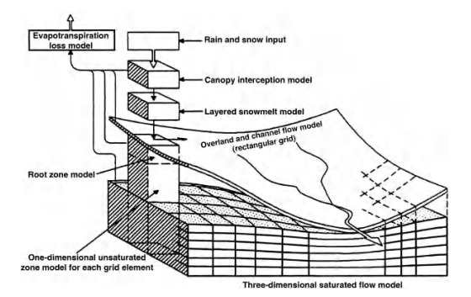
Trade-offs between distributed vs lumped watershed characterization
Surface area
Mean slope
Shape factor
Fraction impervious area
Average soil porosity
Vegetation type
…
Drainage Basins (coolgeography.co.uk)
Drainage basin
Beven (2011)
Lumped basin characterization
Distributed model of the basin
Easy to find relationships between general properties of a basin and its hydrologic response (e.g., flood quantiles)
Captures basin hydrologic processes at different time and spatial scales
Loss of information: Averages cannot reflect the spatial distributions of basin characteristics, which are known to strongly affect hydrologic response
Difficult to transfer gained knowledge to other watersheds

Slide 3
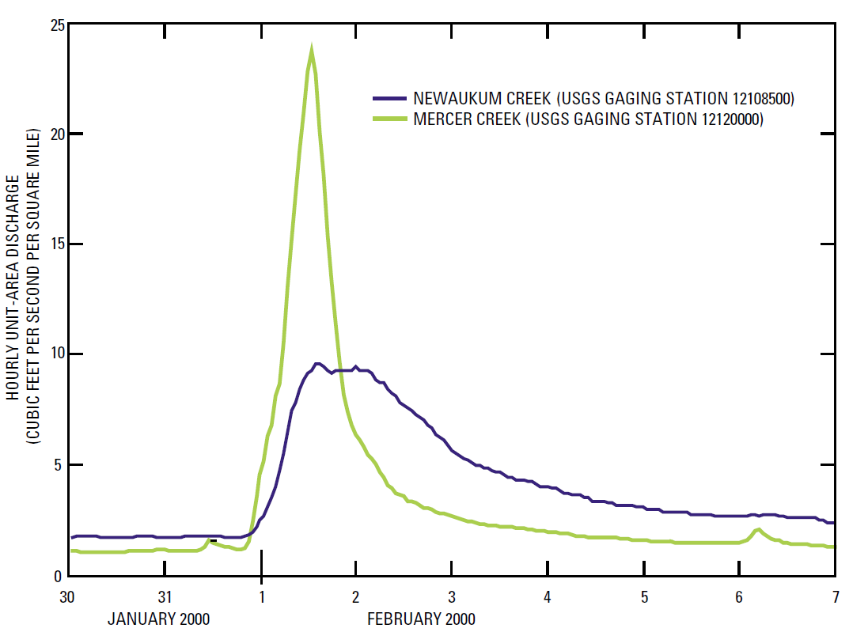
An example with the “percentage of impervious surface”
Land development significantly affects a basin’s hydrologic response, resulting in increased peak flows and volumes while reducing response or lag time (Konrad, 2003)
In the U.S., the “percentage of impervious area” is generally used as a basin-scale descriptor of the level of urbanization. (U.S. Geological Survey 2022; VDOT 2019).
Fig.1. Concurrent flows for an urban (Mercer) and a rural (Newaukum) stream in western Washington, involved by the same one-day storm on February 1, 2000 (Konrad 2003).

Slide 4
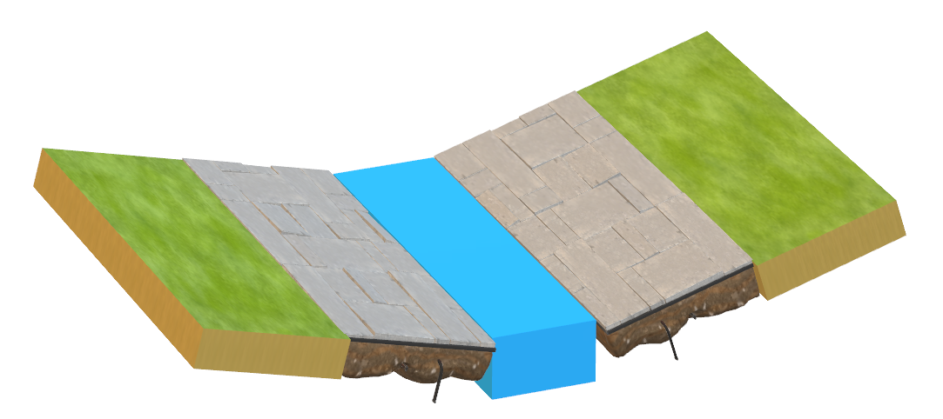
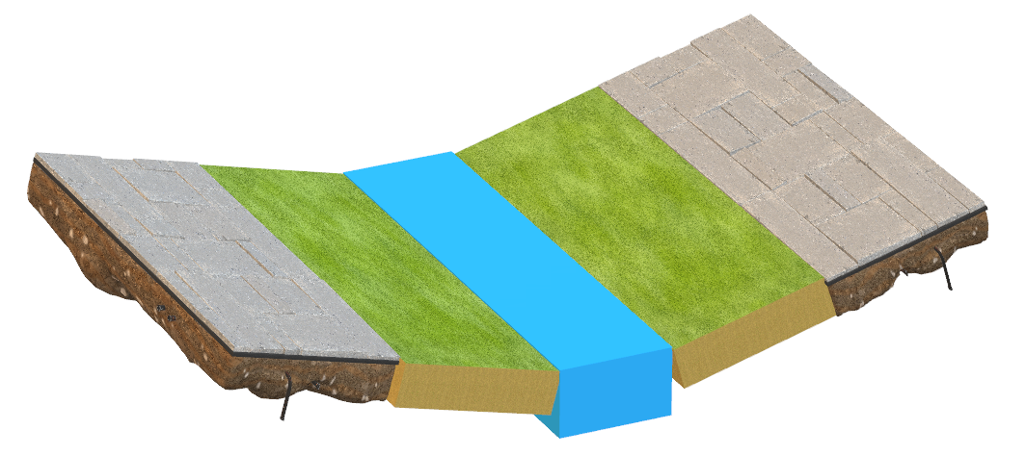
Issues with this approach
a)
b)
Fig. 2. Comparison of two “open textbook” basins with the same area, shape, slope, and percentage of impervious areas, but different spatial distribution of the impervious areas with respect to the drainage network
Both basins feature the same “percentage of impervious area,” but for the same rainfall input, basin a) generates a greater peak flow than b), more quickly, since all rain falling on the impervious areas along the stream gets converted into runoff, which is able to reach the outlet promptly.
In case b), on the other hand, water contributed from the paved areas would be routed through the pervious patch before reaching the stream, where it would be subjected to increased infiltration, detention, and travel times.

Slide 5
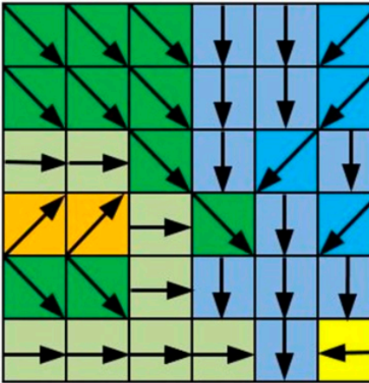
Lumped approaches do not consider hydrologic connectivity
Using “percentage of impervious surface” as a proxy for the level of urbanization exposes the limits of lumped basin approaches.
To obtain a more informative descriptor of urbanization, we need to consider how impervious areas across the basin are connected between each other and to the stream network.
Fig. 3. Flow direction raster (Li et al. 2019), which shows how adjacent cells are connected to each other (D8 algorithm).

Slide 6
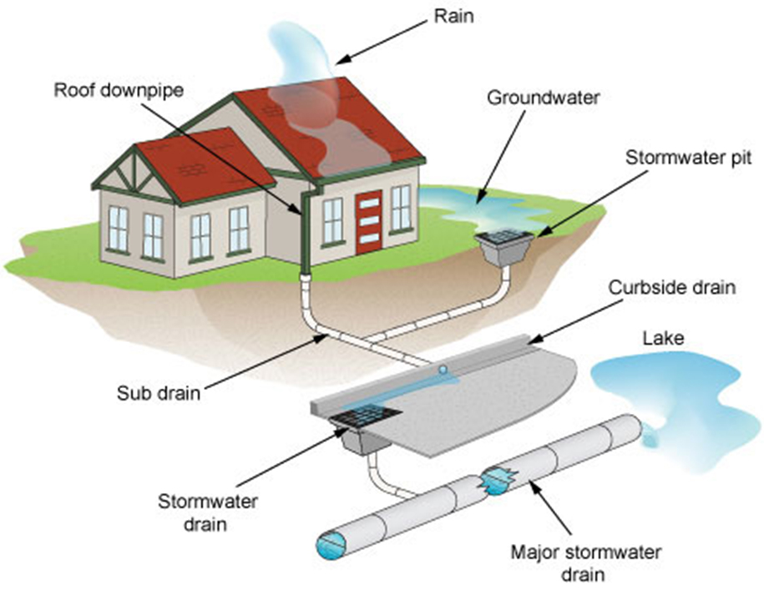
Topographic vs. stormwater system connectivity
Topography affects the hydrological connectivity of surface flows, but in urban areas, the stormwater drainage network also affects connectivity, since the contribution of an impervious patch can change dramatically depending on whether and how its runoff is routed through the stormwater network.
http://www.bmbengineers.com.au
Fig. 4. Scheme of stormwater drainage network.

Slide 7
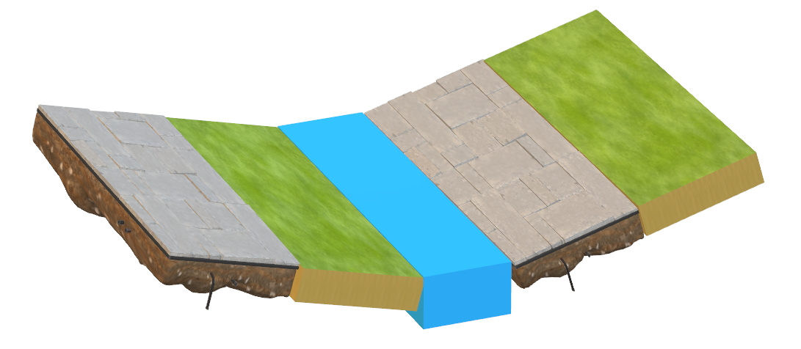
Objectives
a)
We propose a new index UI that is able to capture differences in hydrologic response among basins with the same percentage of impervious area (%UA), but different spatial distributions of such urbanized surfaces
This index is a lumped descriptor of basin-wide hydrologic connectivity that:
Incorporates information about land-use
Better reflects the hydrological effects of urbanization
We test the predictive power of the proposed index against the percentage of impervious area for a regionalization case study
b)
Configuration | a | b | c
$$\%UA$$ | 0.50 | 0.50 | 0.50
$$UI$$ | ?> | ?> | ?
c)

Slide 8
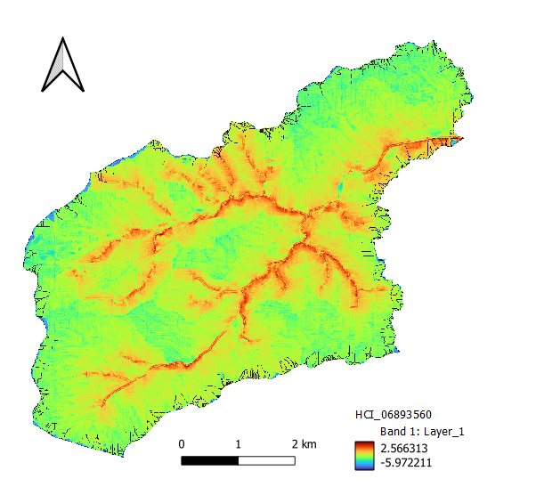
Results – Overview
New Curve Number-based Hydrologic Connectivity Index (CN-HCI) that incorporates information about land-cover (LC)
Inverse distance weighting (IDW) introduced into the definition of the HCI to prevent undue “echo” effects of the impervious surfaces on the hillslope connectivity downstream
New HCI-based index of urbanization (UI) with greater predictive power than the percentage of impervious area in regionalization studies
Fig. 5. CN-based HCI map of watershed 06893560.

Slide 9
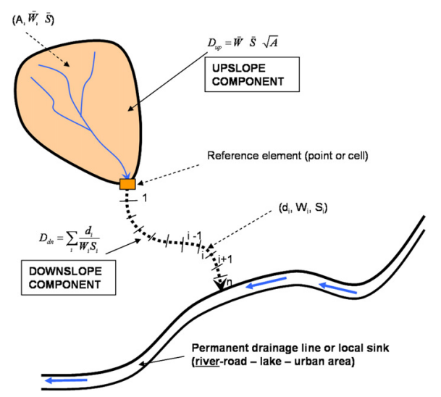
Connectivity indices
$$\left(A,\overline{W},\overline{S}\right)$$
$$D_{up,k}={\overline{W}}_{k}{\overline{S}}_{k}\sqrt{A_{k}}$$
Since Borselli et al. (2008) worked on sediment connectivity, several other indices of connectivity (IC; Hooke et al. 2021) have been proposed, all using the same structure based on an upslope and a downslope component, for each hillslope cell k.
$$Reference cell k$$
$$\left(d_{i},W_{i}, S_{i}\right)$$
$$D_{dn,k}=\sum_{i}{\frac{d_{i}}{W_{i}S_{i}}}$$
A: upstream area draining to cell k
W: weight factor, depends on the formulation
S: slope
$\overline{W}$ , $\overline{S}$ : $W$, $S$averaged over the upstream area
d: distance to the stream along downslope path → closer cells to the stream contribute more.
$$Stream$$
Fig. 6. Scheme for determining the connectivity of generic cell k (from Borselli et al. 2008).

Slide 10
Formulations of connectivity indices
Well established formulations of the connectivity index use one of the following as weight factor W :
RUSLE C-factor, a measure of the potential for erosion (Borselli et al. 2008)
Roughness index RI (Cavalli et al. 2013; Husic & Michalek 2022)
A function of Manning’s roughness coefficient (Persichillo et al. 2018; Zanandrea et al. 2019)
The C-factor formulation is suitable for studying sediment connectivity; the RI-based is only defined from considerations about the topography; the last two incorporate information on land cover (LC).
$$\left(A_{k},\overline{W},\overline{S}\right)$$
$$D_{up,k}=\overline{W}{\overline{S}}_{k}\sqrt{A_{k}}$$
$$Reference cell k$$
$$D_{dn,k}=\sum_{i}{\frac{d_{i}}{W_{i}S_{i}}}$$
$$\left(d_{i},W_{i}, S_{i}\right)$$
$$Stream$$

Slide 11
From connectivity to a new urbanization index
A formulation of the connectivity index is required that somehow incorporates information on the land cover (LC):
Persichillo et al. (2018) and Zanandrea et al. (2019) consider the Manning’s surface roughness coefficient $n$ and define $W=1−n$. In this way, smoother surfaces such as paved areas, are given a greater weight than rougher, e.g., vegetated areas
We propose and test a formulation based on the Curve Number, where $W=CN/100$. This is, in our opinion, a natural choice for the definition of a runoff connectivity index, similar to the use of the C-factor (Renard et al 1997; Borselli et al. 2008) in defining the sediment connectivity index. The latter represents the potential for erosion, while the former the potential for runoff generation, considering both the hydrologic soil type (HST) and land Cover (LC) type.

Slide 12
From connectivity to a new urbanization index
We propose a substantial change in the definition of the HCI, specifically in the way the upslope component is computed
The next example, for a “textbook” basin, shows that current formulations for IC and its upslope component lead to an unwanted effect, particularly when the application is aimed at obtaining an aggregated, lumped descriptor of basin-wide connectivity
For two different spatial configurations of the impervious surfaces (for the same %UA, say, 25%), we observe that when the weighting factor in the upslope component ${\overline{W}}_{k}$ is computed as the arithmetic average of the $W$’s of the cells upstream, hillslope cells located in the headwaters (e.g., close to the basin divide) have an undue effect on the overall watershed connectivity, since their effect is considered at a larger number of cells as compared to the case where the impervious cell are placed closer to the stream network.
vs

Slide 13
From connectivity to a new urbanization index
Impervious upstream
Impervious downstream
Flow Direction
$$Ak$$
100 | 200 | 300 | 400 | 2100 | 400 | 300 | 200 | 100
100 | 200 | 300 | 400 | 4200 | 400 | 300 | 200 | 100
100 | 200 | 300 | 400 | 2100 | 400 | 300 | 200 | 100
100 | 200 | 300 | 400 | 4200 | 400 | 300 | 200 | 100
Slope $S$
0.2 | 0.2 | 0.2 | 0.2 | .005 | 0.2 | 0.2 | 0.2 | 0.2
0.2 | 0.2 | 0.2 | 0.2 | .005 | 0.2 | 0.2 | 0.2 | 0.2
0.2 | 0.2 | 0.2 | 0.2 | .005 | 0.2 | 0.2 | 0.2 | 0.2
0.2 | 0.2 | 0.2 | 0.2 | .005 | 0.2 | 0.2 | 0.2 | 0.2
Impervious surfaces located near the divide can have an undue “echo” effect on the connectivity of the cells downstream.
This results in similar values of the lumped connectivity for both configurations, even though we know that impervious areas closer to the channel should result in larger peaks, with shorter lag times, and therefore should be characterized by higher connectivity values.
Manning’s $n$
0.02 | 0.6 | 0.6 | 0.6 | 0.01 | 0.6 | 0.6 | 0.6 | 0.02
0.02 | 0.6 | 0.6 | 0.6 | 0.01 | 0.6 | 0.6 | 0.6 | 0.02
0.6 | 0.6 | 0.6 | 0.02 | 0.01 | 0.02 | 0.6 | 0.6 | 0.6
0.6 | 0.6 | 0.6 | 0.02 | 0.01 | 0.02 | 0.6 | 0.6 | 0.6
$$\sum_{i}{\frac{d_{i}}{W_{i}S_{i}}}$$
426 | 375 | 250 | 125 | 0 | 125 | 250 | 375 | 426
426 | 375 | 250 | 125 | 0 | 125 | 250 | 375 | 426
426 | 301 | 176 | 51 | 0 | 51 | 176 | 301 | 426
426 | 301 | 176 | 51 | 0 | 51 | 176 | 301 | 426
${\overline{S}}_{k}$ ${\overline{W}}_{k}$
($W=1−n$)
.196 | .138 | .119 | .109 |  | .109 | .119 | .138 | .196
.196 | .138 | .119 | .109 |  | .109 | .119 | .138 | .196
0.08 | 0.08 | 0.08 | .109 |  | .109 | 0.08 | 0.08 | 0.08
0.08 | 0.08 | 0.08 | .109 |  | .109 | 0.08 | 0.08 | 0.08
$$IC_{k}$$
-2.34 | -2.28 | -2.09 | -1.76 |  | -1.76 | -2.09 | -2.28 | -2.34
-2.34 | -2.28 | -2.09 | -1.76 |  | -1.76 | -2.09 | -2.28 | -2.34
-2.73 | -2.42 | -2.1 | -1.37 |  | -1.37 | -2.1 | -2.42 | -2.73
-2.73 | -2.42 | -2.1 | -1.37 |  | -1.37 | -2.1 | -2.42 | -2.73
$$Aggregated IC_{k}$$
$$−33.9$$
$$−34.5$$

Slide 14
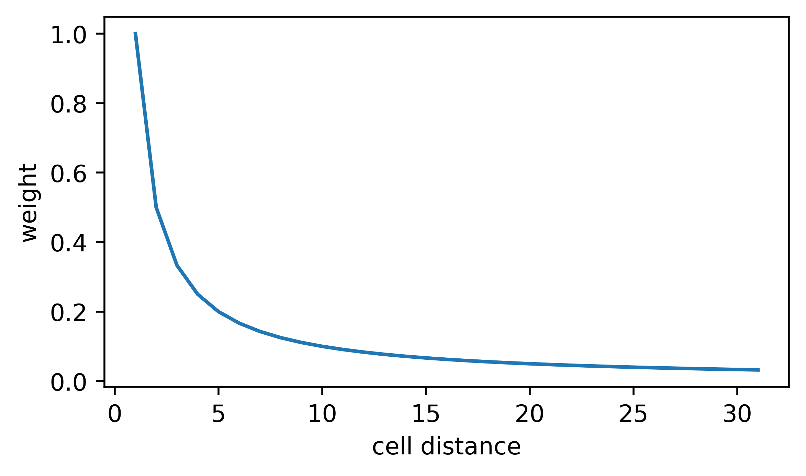
From connectivity to a new urbanization index
To address this issue, we propose computing ${\overline{W}}_{k}$of the upslope component using an inverse distance approach instead of an arithmetic average. This way, the upstream component reflects more closely those characteristics of the neighboring upstream cells, dampening the “echo” effect of cells that are too far away upstream.
This approach reflects the concept that runoff at any specific location of the watershed is more affected by local characteristics, with a decreasing influence for increasing distance.

Slide 15
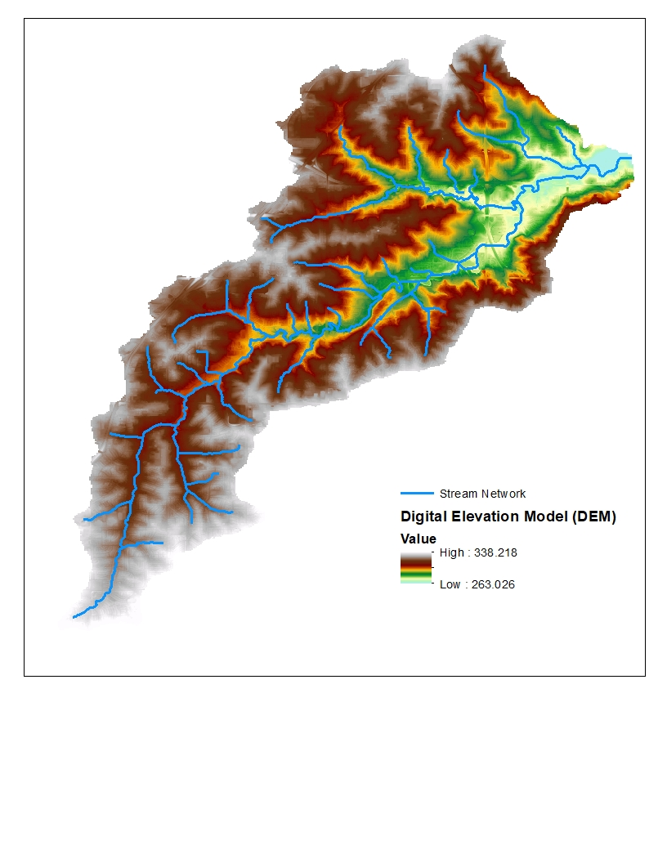
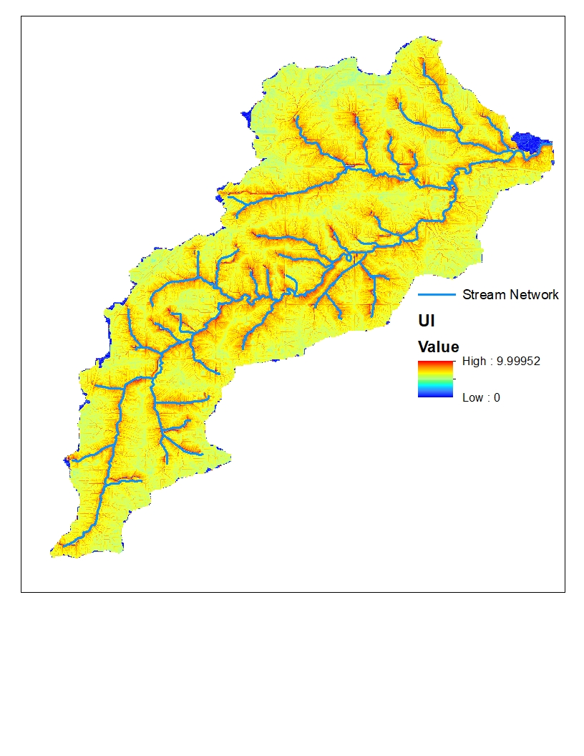
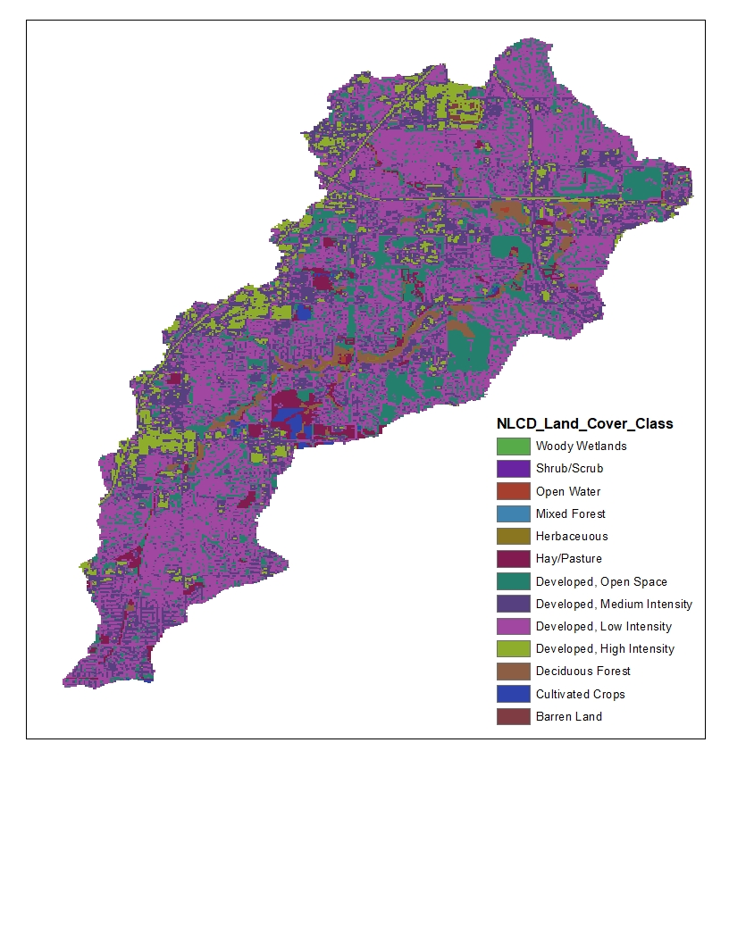
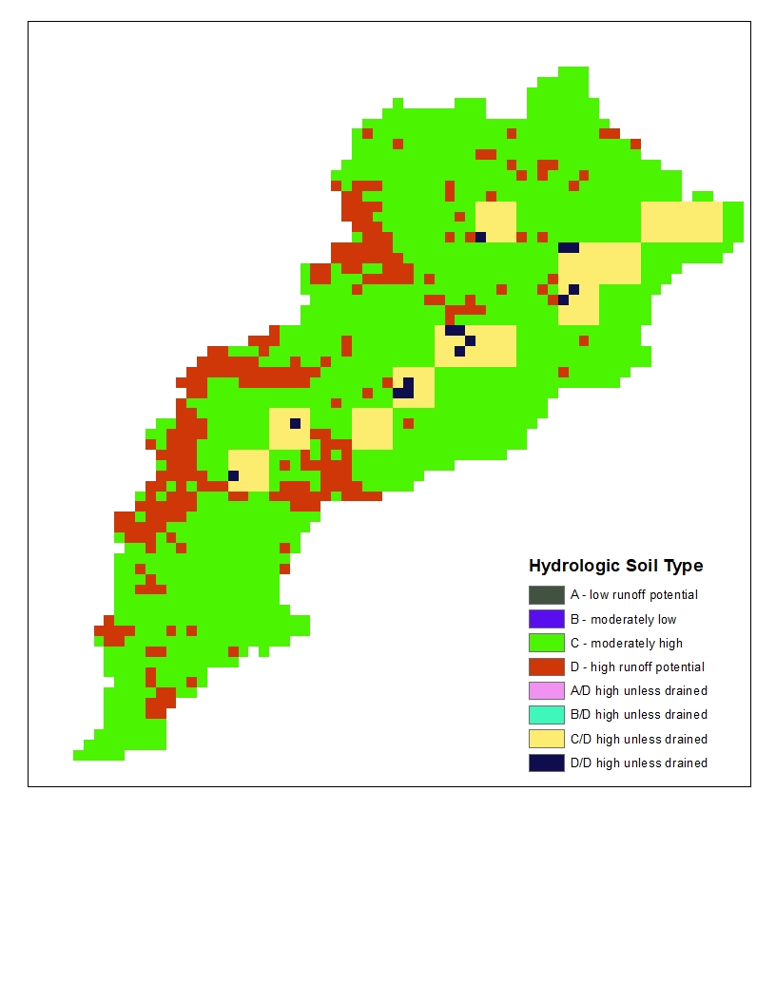
From connectivity to a new urbanization index
DEM
Hydrologic connectivity index
Urbanization Index
Defines flow paths
Weight inversely proportional to the distance to the outlet
HCI
LC
$$UI=\sum_{k}{f_{w,UI}(k)\frac{{HCI}_{k}}{{HCI}_{imp,k}}}$$
Affect runoff travel times and infiltration
HST
Ratio of HCI of the real basin to that of the virtual basin with same topography but totally impervious surfaces, which has the highest potential connectivity for the given topography
$$HCI_{k}$$
Overall scheme to derive an index of urbanization from the connectivity index

Slide 16
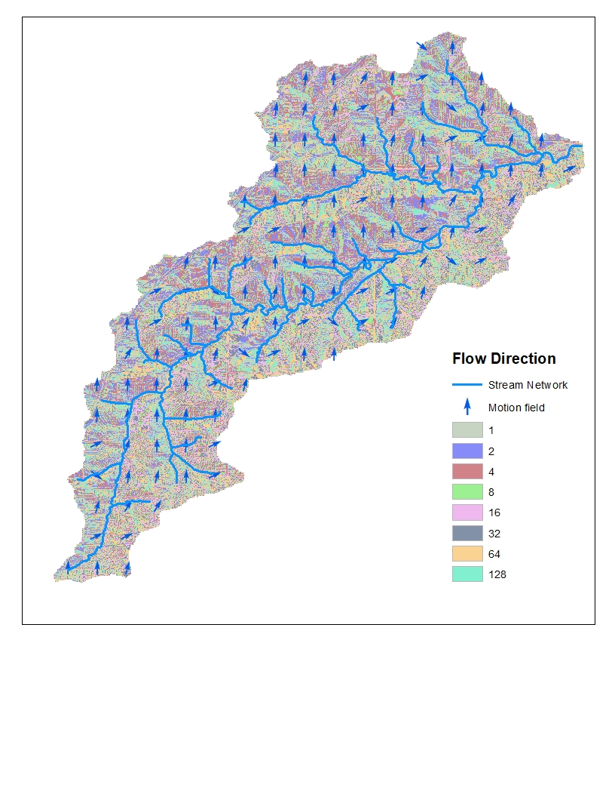
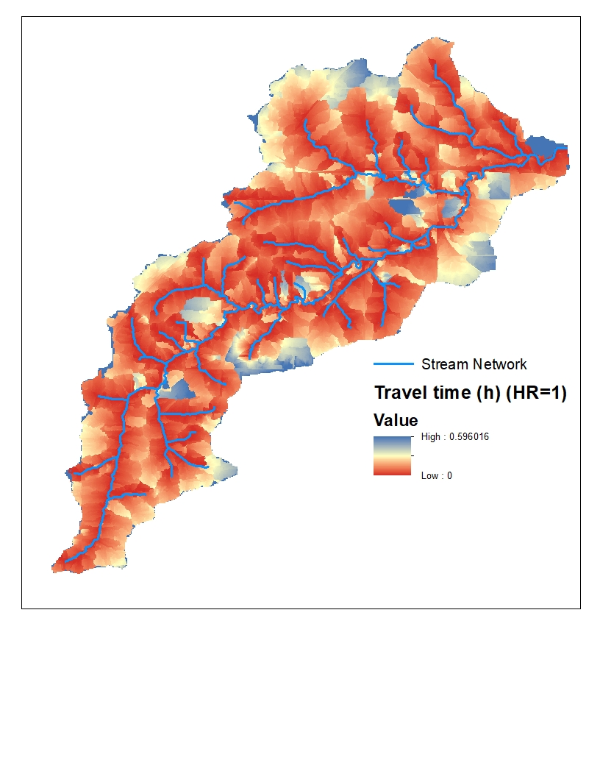
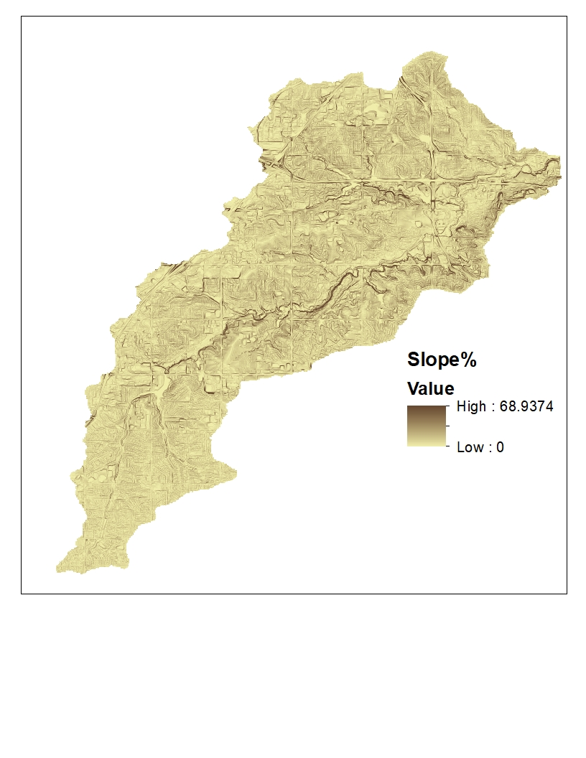
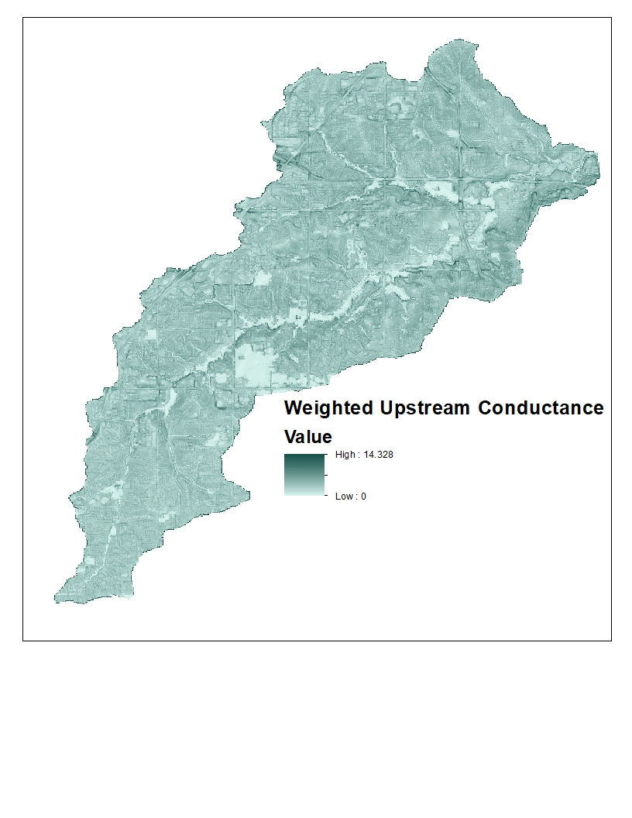
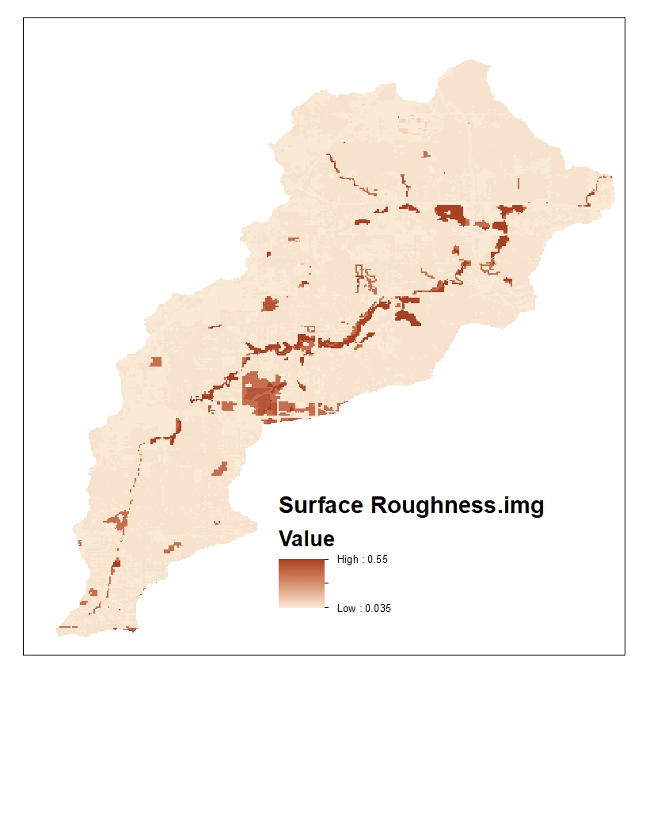
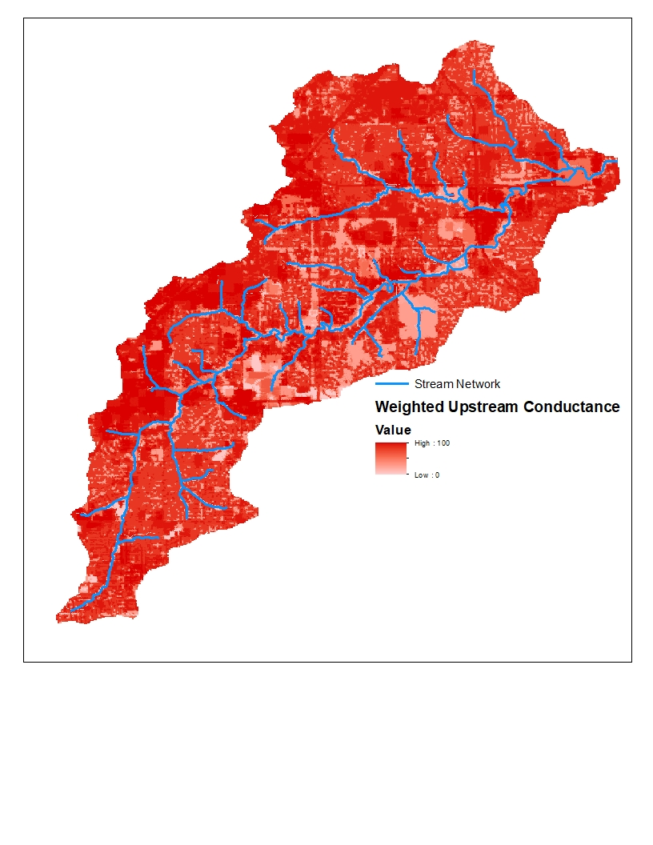
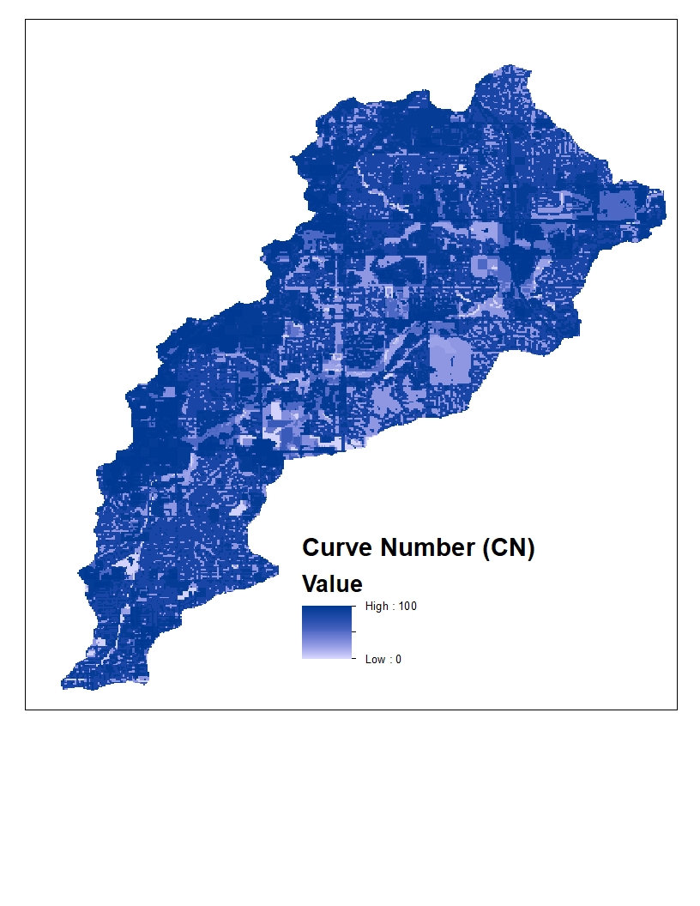
Connectivity index - Overview
Flow
Direction
DEM
$$\sum_{i}{\frac{d_{i}}{W_{i}S_{i}}}$$
Slope S
LC
$$\overline{S}k$$
HCI
Manning’s
Roughness
n
HST
$$\overline{W}k$$
$$HCI_{k}$$
CN
OR

Slide 17
Connectivity index – Step 1
DEM
LC
HST
Classification proposed by the U.S. Department of Agriculture (1986)
D8 flow method (steepest slope)
Surface Hydrology model (Liu & De Smedt 2004)
Flow
Direction
Slope S
Manning’s
Roughness
m
CN
Curve Number (CN) measures the potential for runoff generation.
CN=0: all precipitation infiltrates
CN=100: all precipitation becomes runoff.

Slide 18
Connectivity index – weighting factor W
We tested two alternative weighting criteria:
W=1-n (Persichillo et al. 2018; Zanandrea et al. 2019)
W=CN/100 (our proposed formulation for deriving an index of urbanization)
Manning
Roughness
n
$$W=1−n$$
$$W$$
CN
OR
$$W=CN/100$$

Slide 19
Connectivity index – inverse distance weighting (IDW)
Flow
Direction
Slope S
W
For identifying cells upstream of reference cell $k$
$f_{w}\left(d_{up_k}\right)$: weight is a function of the distance of the upstream cell to reference cell $k$
$\overline{S}$_{k}
$$\overline{W}up$$
$${\overline{S}}_{k}=\sum_{up_k}{f_{w}\left(d_{up_k}\right)S_{up_k}}$$
$${\overline{W}}_{k}=\sum_{up_k}{f\left(d_{up_k}\right)W_{up_k}}$$

Slide 20
Connectivity index
$$\sum_{i}{\frac{d_{i}}{W_{i}S_{i}}}$$
$\overline{S}$_{k}
$$\overline{W}k$$
Sum of weighted distances $d_{i}$ over all the cells downstream of reference cell $k$, up to the point where the stream network is reached (based on Flow Direction)
Every cell gets a rank for its connectivity based on the characteristics of its upstream drainage area (giving more weight to closer cells) and its proximity to the stream network
HCI
$${HCI}_{k}=\log_{10}{\frac{{\overline{W}}_{k}{\overline{S}}_{k}\sqrt{A_{k}}}{\sum_{dn_k}{\left(\frac{d_{dn_{k}}}{{W_{dn_{k}}S}_{dn_{k}}}\right)}}}$$

Slide 21
From HCI to UI
HCI – real basin
HCI – totally impervious basin
$f_{w,UI}\left(k\right)$: If we indicate as $SN_{k}$ the stream network cell where reference cell k drains, the weight $f_{w,UI}$given to $k$ is a function of the distance from $SN_{k}$ to the basin outlet.
$$UI=\sum_{k}{f_{w},UI(k)\frac{{HCI}_{k}}{HCI_{imp,k}}}$$
Urbanization Index

Slide 22
Application to regionalization case study
Homogeneous region with 35 urban watersheds in Missouri (Southard 2010), spanning a size range from < 1km² up to ~500 km². We test the explanatory power of $UI$ against $\%UA$ in predicting the peak flow quantiles Q expected for a range of return periods (from 2 to 500 years). Each linear model is fitted to the basin area A and the descriptor of the level of urbanization $UD$ (either $\%UA$ or the proposed $UI$), following Southard (2010):
$$\log_{10}{Q}=\log_{10}{a}+b\log_{10}{A}+c∙UD (1)$$

Slide 23
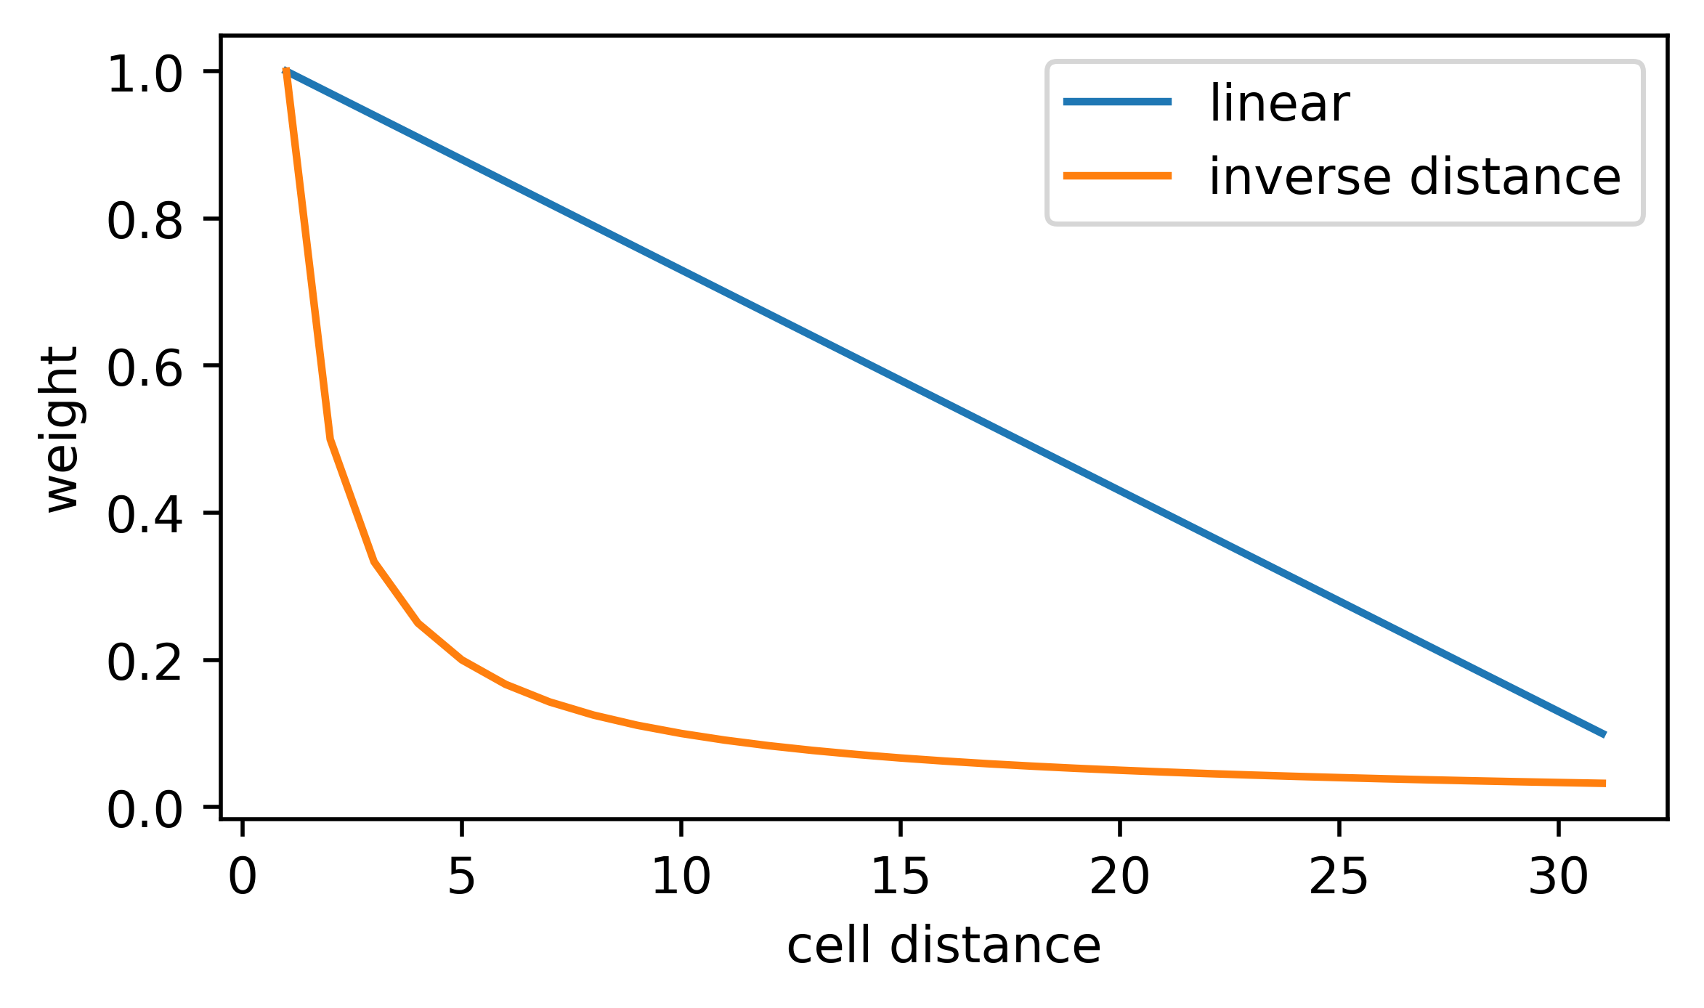
UI from different formulations of the HCI
We tested 4 different formulations of HCI from which the UI was determined, varying $W$ and $f_{w}\left(d_{up_k}\right)$. Each experiment is indicated with a label as reported below.
$$f_{w}\left(d_{up_k}\right)$$
Weight W
$$W=1−n$$
$$W=CN/100$$
linear
WMann_lin
WCN_lin
Weighted average upstream component $f_{w}\left(d_{up_k}\right)$
Weighted average upstream component $f_{w}\left(d_{up_k}\right)$
Inv. Dist.
WMann_inv
WCN_inv
Fig. 6. Two tested weighting functions of the cells upstream for computing the upslope component $D_{up}$. Cells further upstream receive smaller weights.

Slide 24
Performance of UI against %UA
$$\log_{10}{Q}=\log_{10}{a}+b\log_{10}{A}+c∙UD (1)$$
Tab. 1. R² obtained fitting Eq. (1) to $A$ and $\%UA$, and to $A$ and $UI$ using the full dataset. Greatest values are in bold.
MODEL | Q2 | Q5 | Q10 | Q25 | Q50 | Q100 | Q500
A | 0.60 | 0.73 | 0.76 | 0.76 | 0.74 | 0.71 | 0.60
A-%UA | 0.78 | 0.80 | 0.80 | 0.79 | 0.76 | 0.73 | 0.62
A-UI WMann_Inv | 0.81 | 0.83 | 0.83 | 0.80 | 0.77 | 0.73 | 0.60
A-UI WMann_Lin | 0.82 | 0.83 | 0.83 | 0.81 | 0.78 | 0.73 | 0.61
A-UI WCN_Inv | 0.89 | 0.89 | 0.88 | 0.85 | 0.81 | 0.77 | 0.64
A-UI WCN_Lin | 0.89 | 0.89 | 0.88 | 0.85 | 0.81 | 0.77 | 0.64
The UI obtained from the CN-based HCI results in the model with the highest predictive power. There is no sensitivity to the weighting function $f_{w}\left(d_{up_k}\right)$.

Slide 25
5-fold validation for test on “ungaged” basins
Tab. 2. R² obtained by K-fold cross-validation (K=5, test set size 20%). Average R² values.
 | Q2 | Q5 | Q10 | Q25 | Q50 | Q100 | Q500
A-%UA train | 0.78 | 0.80 | 0.80 | 0.79 | 0.76 | 0.73 | 0.62
A-%UA test | 0.44 | 0.56 | 0.59 | 0.59 | 0.55 | 0.49 | 0.31
A-UI WMann_Inv train | 0.80 | 0.80 | 0.81 | 0.79 | 0.76 | 0.72 | 0.60
A-UI WMann_Inv test | 0.69 | 0.32 | 0.42 | 0.45 | 0.57 | 0.45 | 0.58
A-UI WMann_Lin train | 0.81 | 0.81 | 0.81 | 0.79 | 0.76 | 0.71 | 0.60
A-UI WMann_Lin test | 0.51 | 0.39 | 0.47 | 0.50 | 0.33 | 0.56 | 0.53
A-UI WCN_Inv train | 0.88 | 0.89 | 0.87 | 0.85 | 0.81 | 0.77 | 0.64
A-UI WCN_Inv test | 0.83 | 0.83 | 0.79 | 0.72 | 0.64 | 0.54 | 0.29
A-UI WCN_Lin train | 0.88 | 0.89 | 0.87 | 0.85 | 0.81 | 0.77 | 0.64
A-UI WCN_Lin test | 0.83 | 0.82 | 0.79 | 0.71 | 0.64 | 0.54 | 0.29
In the test set, the performance of the Manning-based formulation of the HCI shows some sensitivity to the choice of $f_{w}\left(d_{up_k}\right)$, although there is not a clear “winner”. Overall, the CN-based HCI is the indicator with the greatest predictive power, although its performance decreases for the two greatest quantiles, Q100 and Q500.

Slide 26
Conclusions
Shift in paradigm for the characterization of urban basins
Replace $\%UA$with a new $UI$ that includes information on hydrologic connectivity
A CN-based HCI is generally better than a Manning-based HCI for the definition of the UI
Low sensitivity to the weighting function to aggregate the information from upstream cells in the upslope component of the HCI

Slide 27
Future work
Test over a larger number case studies
Adapt the index to also consider information on the stormwater drainage network

Slide 28
References
Beven, K. J. (2011). Rainfall-runoff modelling: the primer. John Wiley & Sons.
Borselli, L., Cassi, P., Torri, D. 2008. Prolegomena to sediment and flow connectivity in the landscape: A GIS and field numerical assessment. Catena, 75(3), 268-277.
Hooke, J., Souza, J., & Marchamalo, M. (2021). Evaluation of connectivity indices applied to a Mediterranean agricultural catchment. Catena, 207, 105713.
Husic, A., & Michalek, A. (2022). Structural hillslope connectivity is driven by tectonics more than climate and modulates hydrologic extremes and benefits. Geophysical Research Letters, 49(15), e2022GL099898.
Konrad, C. P., 2003. Effects of Urban Development on Floods. Report 076-03 USGS Publication Warehouse (https://doi.org/10.3133/fs07603)
Li, Y., Hu, T., Zheng, G., Shen, L., Fan, J., & Zhang, D. (2019). An improved simplified urban storm inundation model based on urban terrain and catchment modification. Water, 11(11), 2335.
Liu, Y. B. and De Smedt, F., 2004. WetSpa Extension, A GIS-based Hydrologic Model for Flood Prediction and Watershed Management. Documentation and User manual.
Persichillo, M. G., Bordoni, M., Cavalli, M., Crema, S., & Meisina, C. (2018). The role of human activities on sediment connectivity of shallow landslides. Catena, 160, 261-274.
Renard, K., Foster, G.R., Weessies, G.A., Mc Cool, D.K., Yodler, D.C., 1997. Predicting soil erosion by water—a guide to conservation planning with the Revised Universal Soil Loss Equation (RUSLE). U.S. D.A.- A.R.S., Handbook No 703. 384 pp
Southard, R.E., 2010, Estimating the magnitude and frequency of floods in urban basins in Missouri. Scientific Investigations Report 2010-5073 USGS Publication Warehouse (https://doi.org/10.3133/sir20105073 ).
U.S. Department of Agriculture, 1986. Urban Hydrology for Small Watersheds. Technical Report 55.
Zanandrea, F., Michel, G. P., Kobiyama, M., & Cardozo, G. L. (2019). Evaluation of different DTMs in sediment connectivity determination in the Mascarada River Watershed, southern Brazil. Geomorphology, 332, 80-87.

Slide 29
Thank you for attending! Contact: fdllaira@memphis.edu

