Slide 1




Description and validation of a Meteosat based dataset for Surface Radiative Budget
Quentin Bourgeois, Anke Tetzlaff, Reto Stöckli, Nicolas Christen, Viju John, William Moutier, Nicolas Clerbaux, Françoise Gellens-Meulenberghs, Jörg Trentmann and Isabel Trigo

Slide 2

Objective of our CMSAF* project
To jointly retrieve all the components of the Surface Radiative Budget (SRB) for the period 1983-2020:
> Surface Albedo (ALB)
> Surface Incoming Solar radiation (SIS)
> Surface Downwelling Longwave radiation (SDL)
> Surface Outgoing Longwave radiation (SOL)
→ Using the Meteosat Geostationnary satellites and the “GeoSatClim” software from MeteoSwiss.
*CMSAF: Satellite Application Facility on Climate Monitoring

Slide 3
Meteosat Satellites
Meteosat First and Second Generation (MFG & MSG) satellites:
- Different time resolutions: 30 & 15 min for MFG & MSG satellites
- Different spatial resolutions: 2.5 to 5 km (depending on the channels)
- Different spectral channels (e.g., 1 visible channel vs 2 visible channels)
Notes:
6 MFG sat:
VIS - [0.5-0.9] ~0.7 microns ; Spatial resolution: 2.5 km
IR - [10.5-12.5] ~11.5 microns ; Spatial resolution: 5 km
4 MSG sat:
VIS - Spatial resolution: 3 km
IR - [9.8-11.8] ~10.8 microns ; Spatial resolution: 3 km

Slide 4
SRB requirements
Record 38 years of SRB data (+ individual components) for the period 1983-2020 with a spatial coverage 65°N/S-65°W/E.
Spatial resolution: 0.05°x0.05°.
Time scale: hourly, daily and monthly means.
Requirements | Threshold | Target | Optimal
Hourly MAB* | 45 W/m² | 35 W/m² | 6 W/m²
Daily MAB* | 30 W/m² | 25 W/m² | 5 W/m²
Monthly MAB* | 20 W/m² | 15 W/m² | 4 W/m²
Stability | 2 W/m²/dec | 1 W/m²/dec | 0.2 W/m²/dec
*MAB = Mean Absolute Bias
Notes:
Here are the requirements defined by us but by taking into account GCOS recommandations.
GCOS (Global Climate Observing System):
MAB = 1 W/m2
Stability = 0.2 W/m2/dec

Slide 5
Quick description of the SRB algorithm
Shortwave Net Radiation
$$SIS ×\left(1−ALB\right)$$
Shortwave Net Radiation
𝑆𝐼𝑆 ×(1−𝐴𝐿𝐵)
Surface Incoming Solar (SIS) radiation
- MagicSOL algorithm extended to infrared channel
- Cloud Optical Depth calculation with LibRadTran
Albedo (ALB)
- Integration of directional reflectances
- BRDF model inversion adapted from MODIS
Longwave Net Radiation
$$SDL−SOL$$
Longwave Net Radiation
𝑆𝐷𝐿−𝑆𝑂𝐿
Surface Downwelling Longwave (SDL) radiation
- Combination of the GeoSatClim CFC with water vapour content and T2m from ERA5
Surface Outgoing Longwave (SOL) radiation
- Calculated from GeoSatClim SDL and LST (clear sky)
- Use of a Surface Vegetation-Atmosphere Transfer model adapted from H-TESSEL by the RMI (cloudy sky)
SRB
Input data:
CMIP AOD
ERA5 TCWV, TCO3, 2T, 2D, SKT
Emissivity
Processing at ECMWF (Atos/Bologna) for ~2 months on 512 CPUs per job (2 jobs in parallel), total space disk used: ~700TB.
Notes:
BRDF = Bidirectional Reflectance Distribution Function

Slide 6
Validation against stations
Network | Stations | Location (Coordinates) | Period
 | Gobabeb | Namibia (15.04°E, -23.56°N) | 2013-2020
BSRN¹ | Payerne | Switzerland (6.94°E, 46.81°N) | 1993-2020
 | Toravere | Estonia (26.46°E, 58.25°N) | 2007-2020
 | Aadorf-Taenikon | Switzerland (8.90°E, 47.48°N) | 2013-2020
SMN² | Altdorf | Switzerland (8.62°E, 46.89°N) | 2009-2020
 | Magadino-Cadenazzo | Switzerland (8.93°E, 46.16°N) | 2012-2020
¹Baseline Surface Radiation Network
²SwissMetNet
Notes:
Although many ground-based stations measure SIS and SDL radiations, ALB and SOL observations are much more scare and their observation by ground-based stations often started relatively recently. It is therefore difficult to find stations observing the four components of the SRB together over a long time period and in our geographic range of interest.

Slide 7
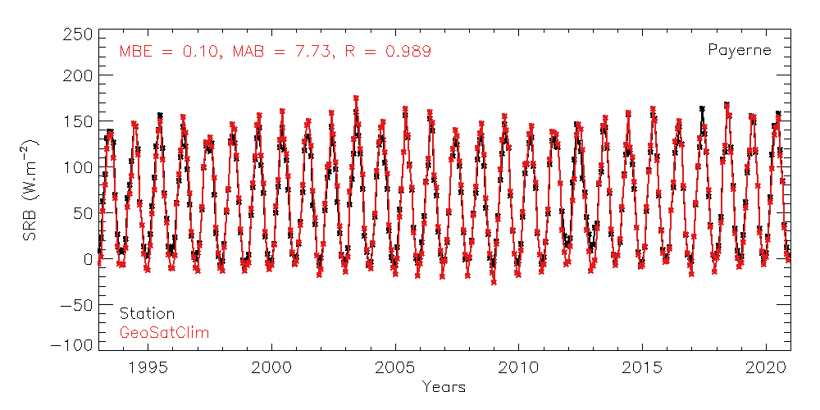
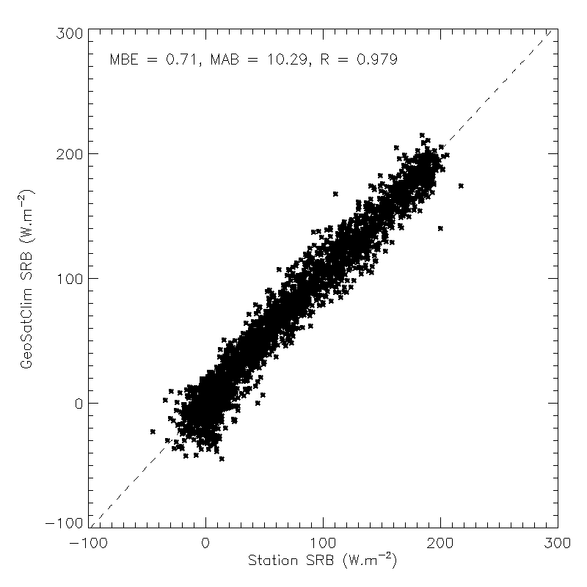
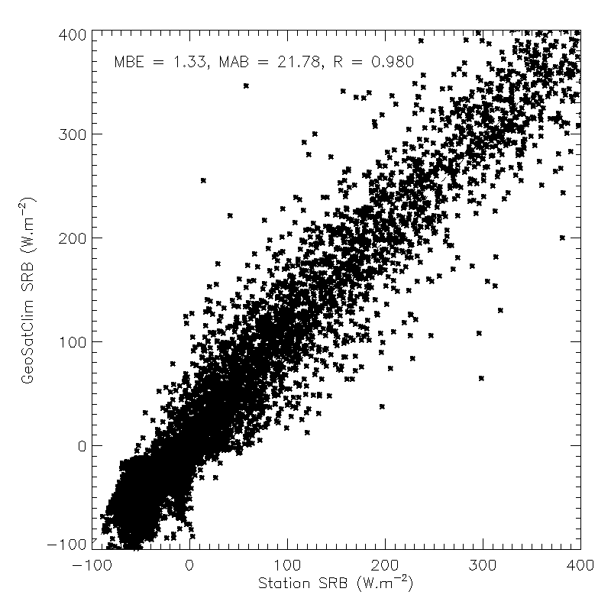
Validation against stations: Payerne
Monthly mean (1993-2020)
Daily mean (2013-2020)
Hourly mean (2015)
SRB (W.m⁻²)
GeoSatClim (W.m⁻²)
Years
Station (W.m⁻²)
Station (W.m⁻²)
MBE = 0.10 W.m⁻²
MAB = 7.73 W.m⁻²
R = 0.989
MBE = 0.71 W.m⁻²
MAB = 10.29 W.m⁻²
R = 0.979
MBE = 1.33 W.m⁻²
MAB = 21.78 W.m⁻²
R = 0.980

Slide 8
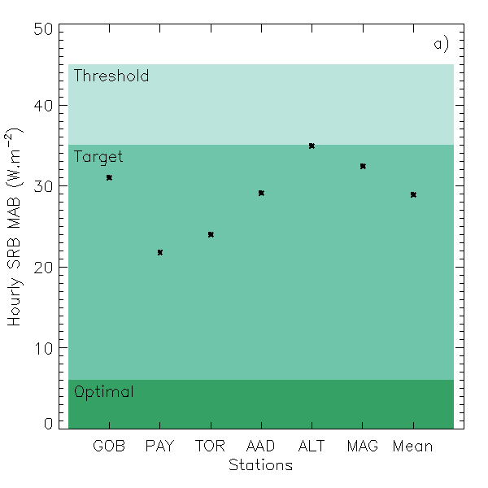
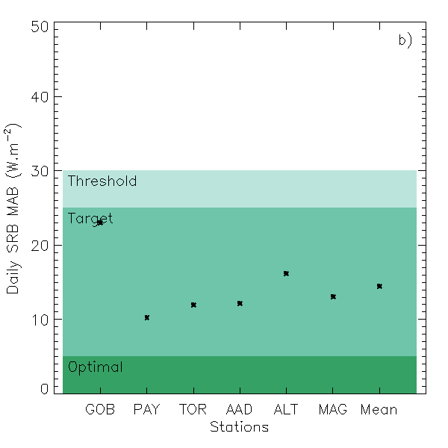
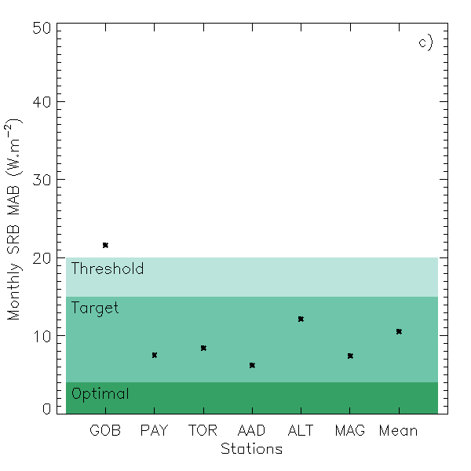
Validation against stations
Threshold
SRB Hourly MAB (W.m⁻²)
SRB Daily MAB (W.m⁻²)
SRB Monthly MAB (W.m⁻²)
Target
Optimal
Stations
Stations
Stations
SRB Stability for Payerne: 0.76 W/m²/dec
Notes:
Hourly MAB average: 28.9
Daily MAB average: 14.4
Monthly MAB average: 10.5

Slide 9
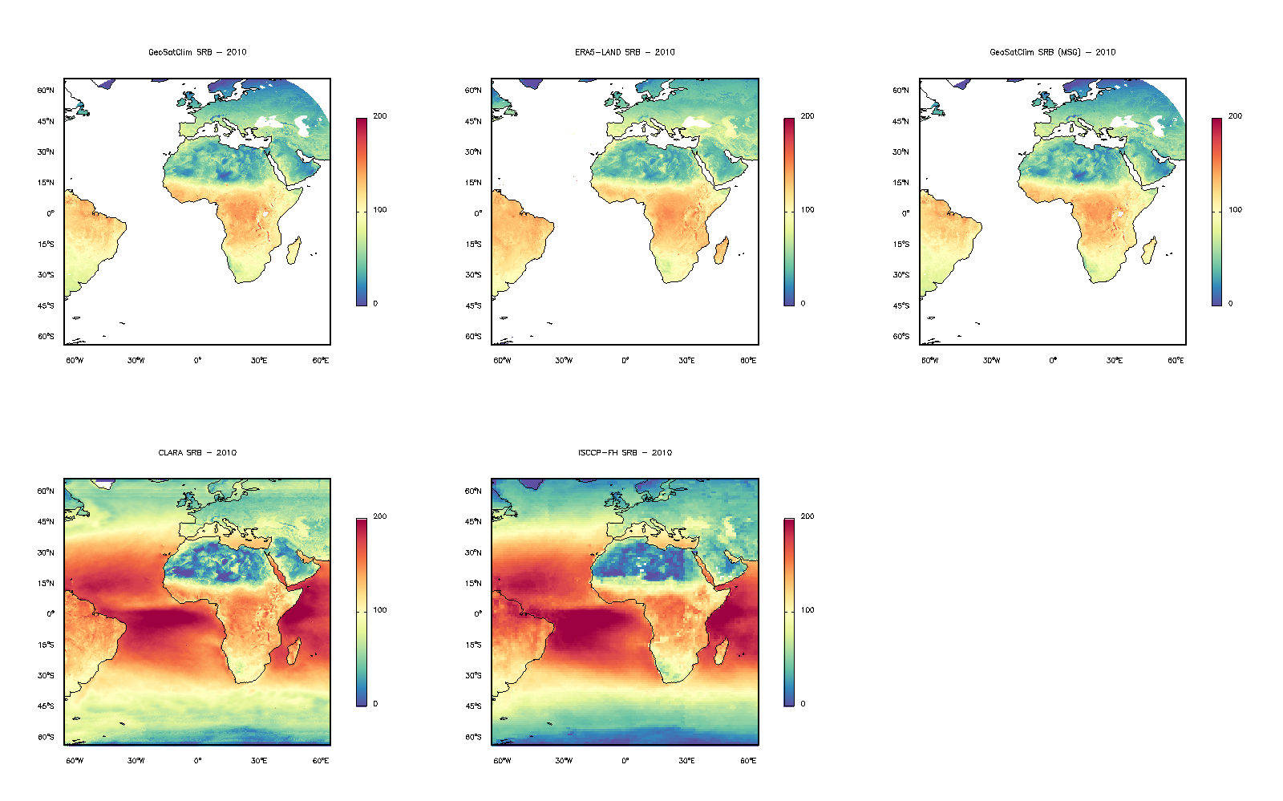
Validation against global products
200
200
100
100
Annual mean SRB (2010)
GeoSatClim
0
ERA5-Land
0
W.m⁻²
200
200
100
100
CLARA-A2
0
ISCCP-FH
0

Slide 10
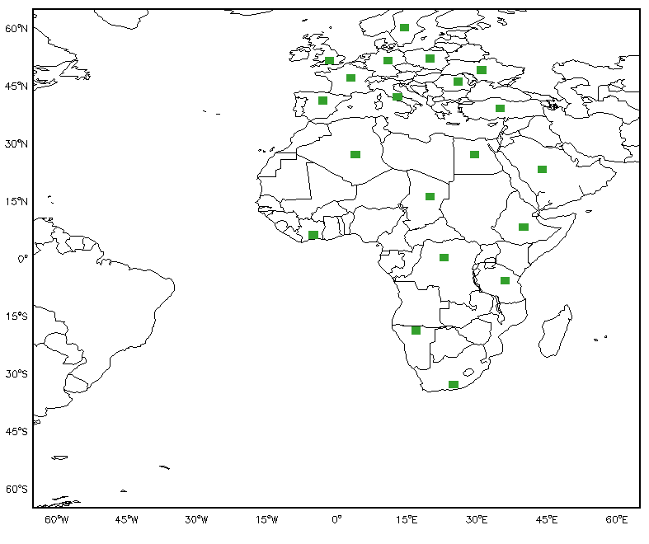
Validation against global products
Locations in Europe (Coordinates) | Locations in Africa (Coordinates)
ENGland (1.5°W, -51.5°N) | ALGeria (4°E, 27°N)
FRAnce (3°E, 47°N) | CHAd (20°E, 16°N)
GERmany (11°E, 51.5°N) | CONgo (23°E, 0°N)
ITAly (13°E, 42°N) | EGYpt (29.5°E, 27°N)
POLand (20°E, 52°N) | ETHiopia (40°E, 8°N)
ROMania (26°E, 46°N) | IVOry Coast (5°W, 6°N)
SPAin (3°W, 41°N) | NAMibia (17°E, 19°S)
SWEden (14.5°E, 60°N) | SAUdi Arabia (44°E, 23°N)
TURkey (35°E, 39°N) | ALGeria (4°E, 27°N)
UKRaine (31°E, 49°N) | CHAd (20°E, 16°N)

Slide 11
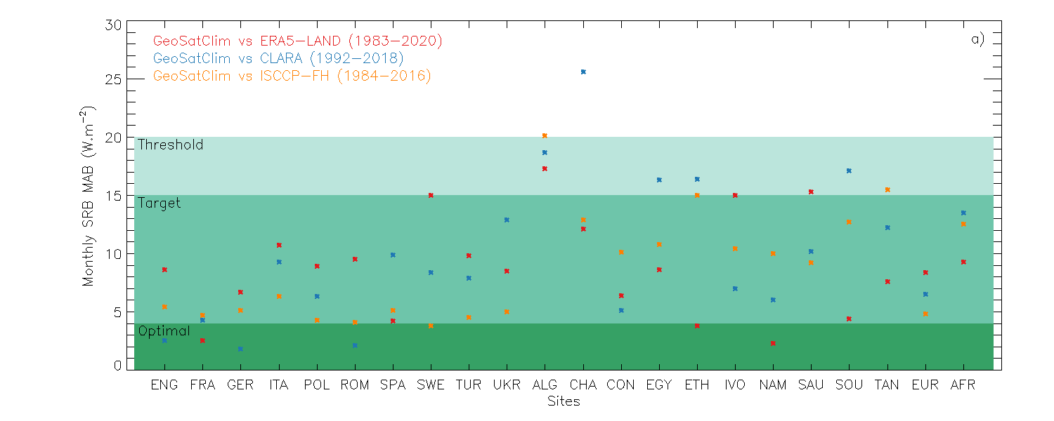
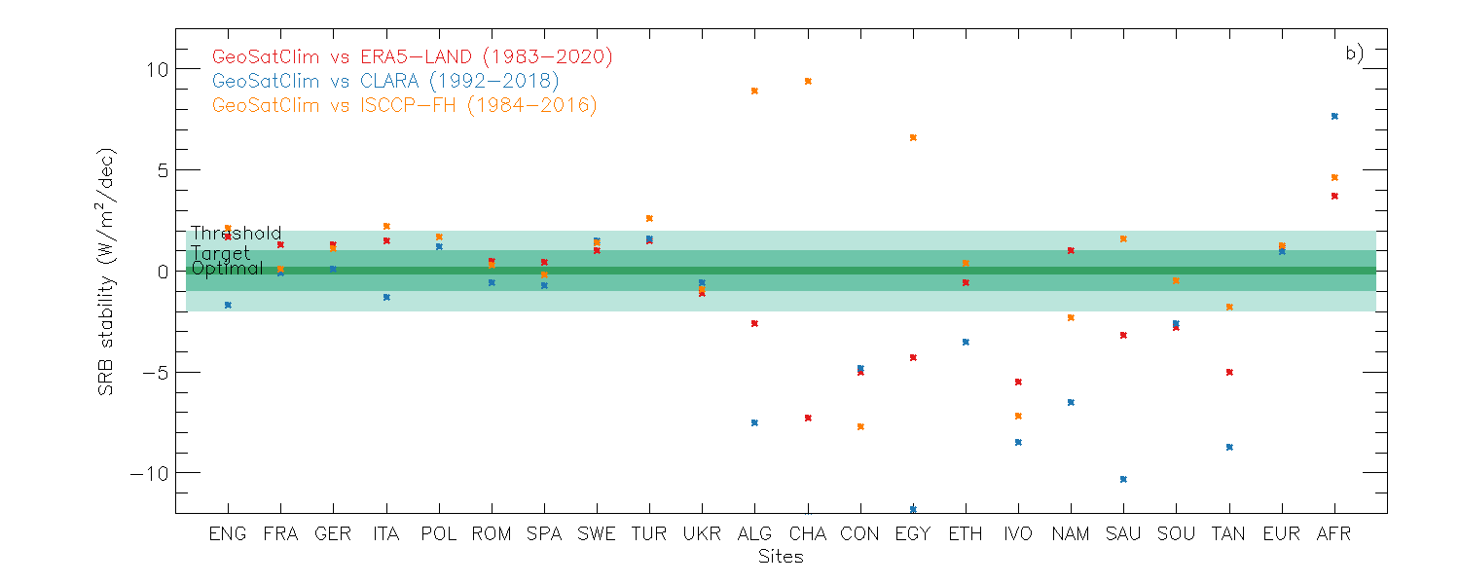
Validation against global products
GeoSatClim vs ERA5-Land
GeoSatClim vs CLARA-A2
GeoSatClim vs ISCCP-FH
SRB Monthly
MAB (W.m⁻²)
 | ERA5-Land | CLARA-A2 | ISCCP-FH
Europe MAB | 8.4 | 6.5 | 4.8
Africa MAB | 9.3 | 13.5 | 12.5
Europe |Stability| | 1.2 | 0.9 | 1.3
Africa |Stability| | 3.7 | 7.6 | 4.6
SRB Stability (W/m²/dec
MAB in W.m⁻²
Stability in W/m²/dec
Sites

Slide 12
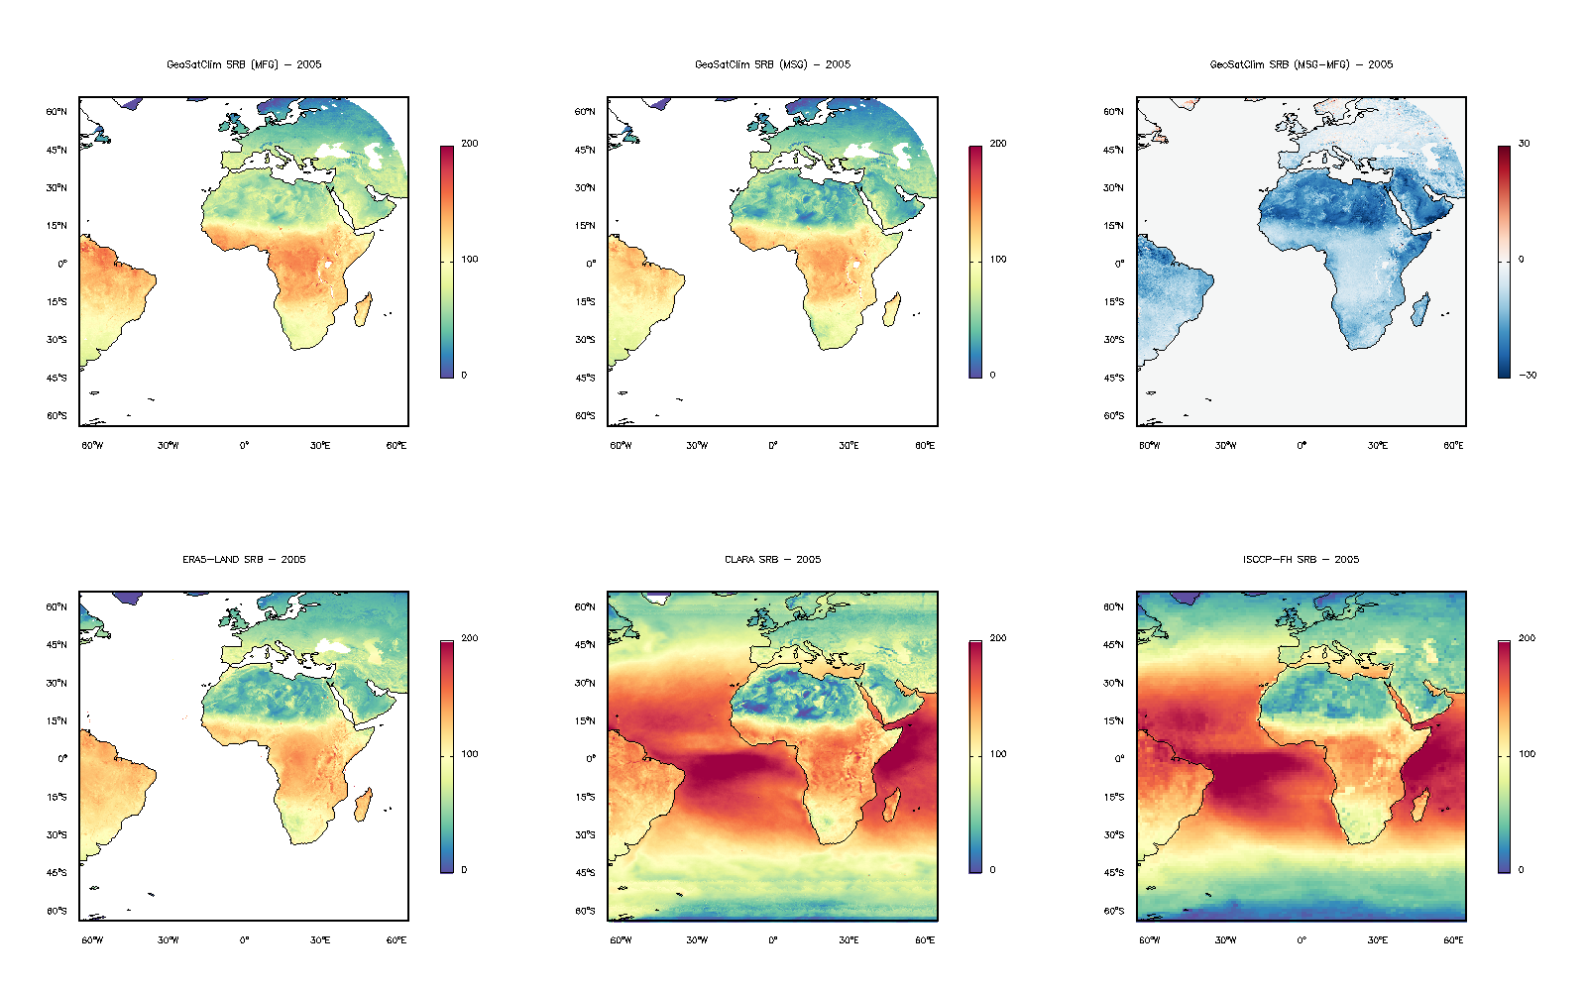
Comparison of MFG and MSG
MFG SRB (2005)
MSG SRB (2005)
MSG - MFG (2005)
W.m⁻²
30
0
-30
Difference in Europe: -3 W.m⁻²
Difference in Africa: -14 W.m⁻²
Difference in the Saharan and Arabian deserts: -20 W.m⁻²

Slide 13
Conclusion
Failed
Threshold
Target
Optimal
Developed a SRB algorithm and produced 38 years of SRB data (+ individual components) from 1983 to 2020 that covers 65°N/S and 65°W/E (0.05°) at hourly, daily and monthly time scales.
According to the stations, the hourly, daily and monthly SRB MAB is 28.9, 14.4 and 10.5 W.m⁻², and the SRB stability is 0.8 W/m²/dec in Payerne.
According to other global products, the monthly MAB is 6.6 W.m⁻² in Europe and 11.8 W.m⁻² in Africa, and the SRB stability is 1.1 W/m²/dec in Europe and 5.3 W/m²/dec in Africa.
What could be the stability problem in Africa?
Mis-correction of the narrow- to broad-band visible channel for warm/dry/reflecting surfaces.
Mis-calibration of the Meteosat channels for these surfaces.

Slide 15
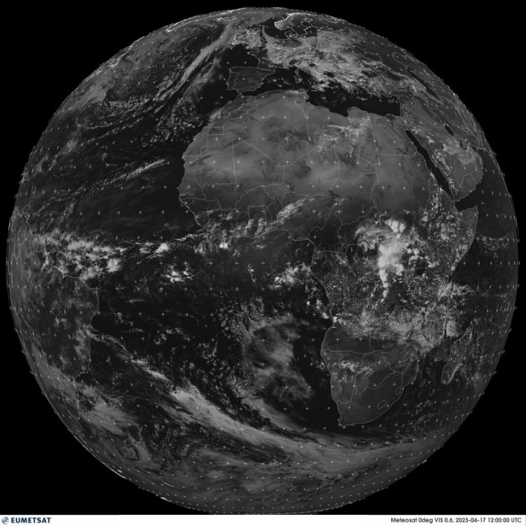
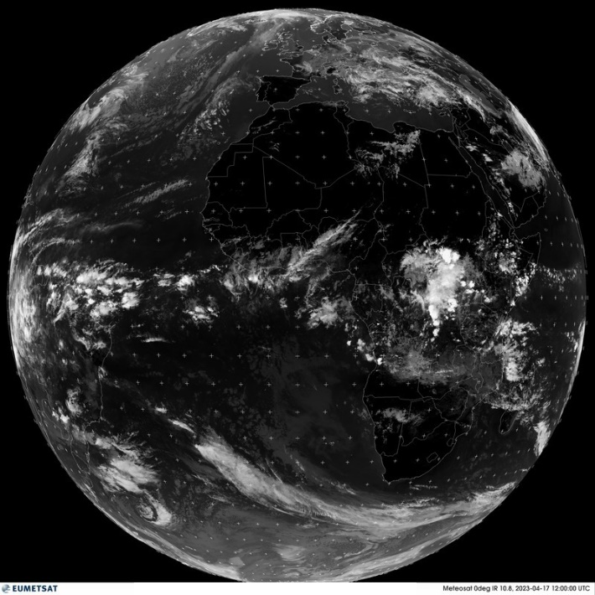
Visible and infrared Meteosat images
Examples of a Meteosat images for visible (left) and infrared (right) channels, taken on 17 April 2023, at 1200 UTC.
Notes:
Increase from black (ocean) to white (clouds/snow).

Slide 16
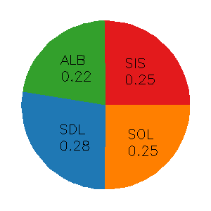
Contribution of the SRB components to the MAB

