Slide 1
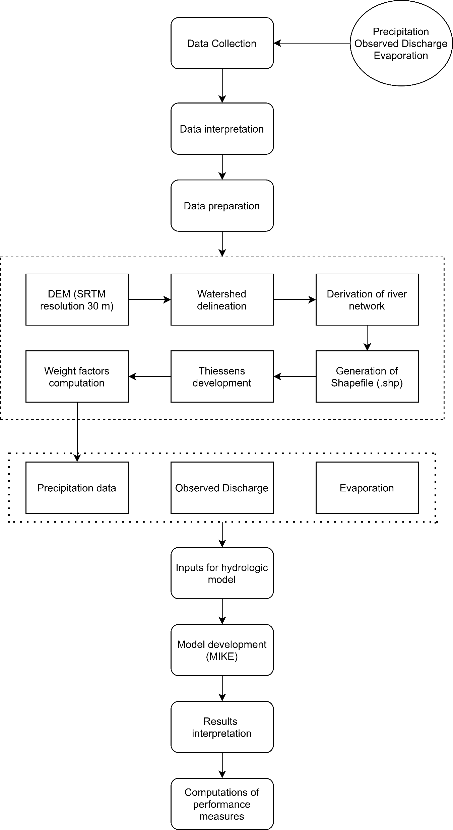
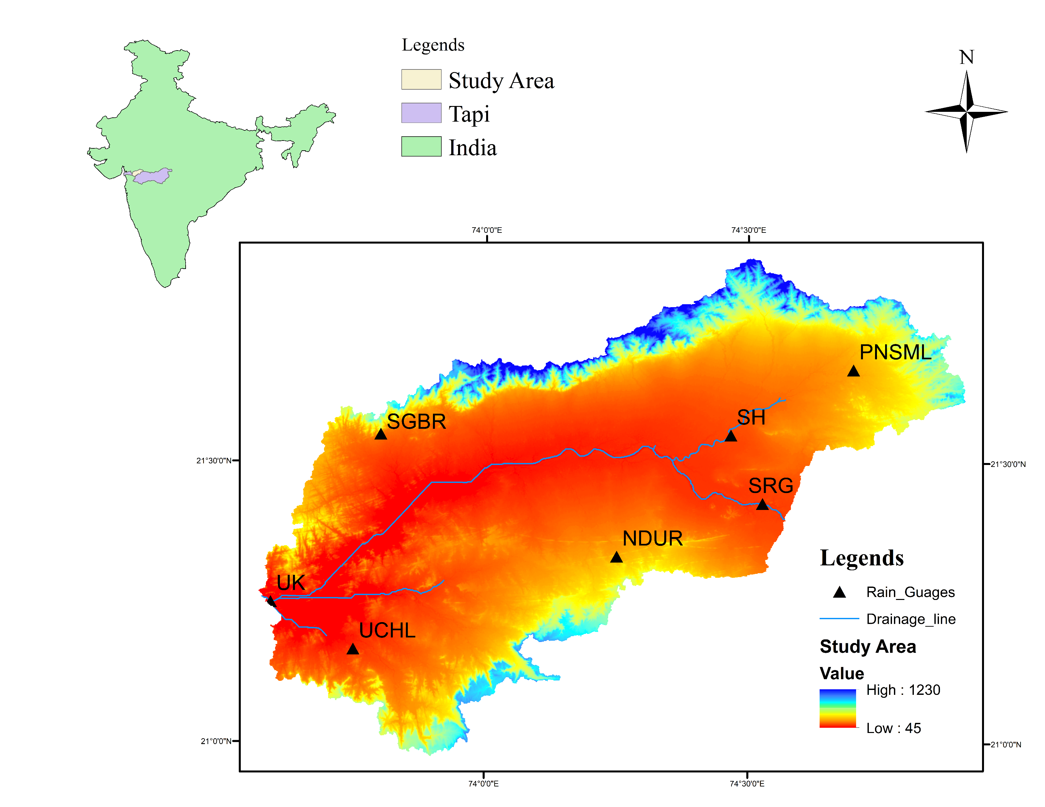
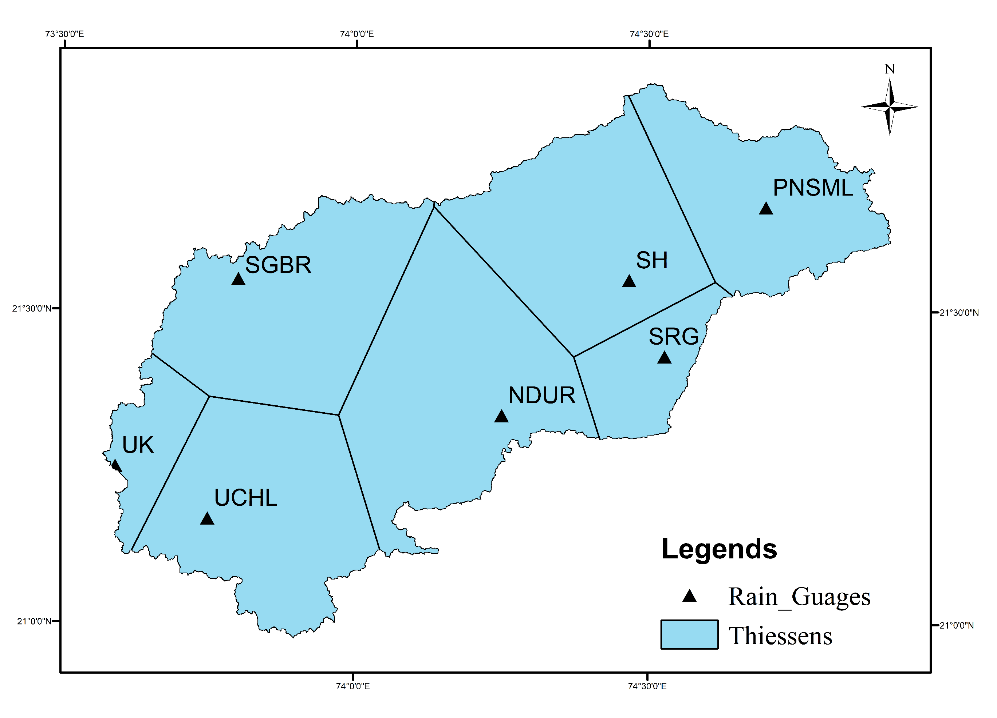
Development of Rainfall Runoff model using MIKE NAM for the flood prone basin of India ¹Ayushi Panchal (ayushipanchal44@gmail.com), ²Sanjaykumar Yadav ¹ Research scholar, Sardar Vallabhbhai National Institute of Technology, Surat ² Professor, Sardar Vallabhbhai National Institute of Technology, Surat
MAP OF THE STUDY AREA
INTRODUCTION
Rainfall-runoff modelling is significantly carried out in order to evaluate the response of different combinations of hydrometeorological and physical characteristics of the basin.
The hydrological models are developed for simulating the rainfall-runoff process. In the present study rainfall-runoff simulation has been carried out to predict the runoff generated at the Ukai reservoir.
The daily data of rainfall, evaporation and river discharge have been given to the model in order to simulate the runoff. The reliability of the developed model has been evaluated based on the statistical performance measures and good agreement has been shown between simulated and observed river discharge and is proven to be enough accurate to predict the discharge.
CONCLUSIONS
The model has performed fairly good after the simulation according to the performance of statistical parameter and the correlation coefficient has been found 0.7 that shows good agreement between observed and simulated runoff.
The model performance could further be improved considering the discharge rate coming from the upstream end of the channel, which is a limitation of MIKE 11 NAM model.
RESULTS
METHODOLOGY

