Slide 1
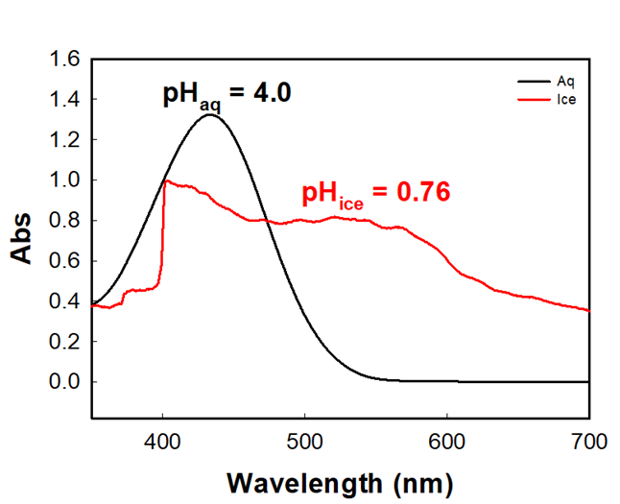
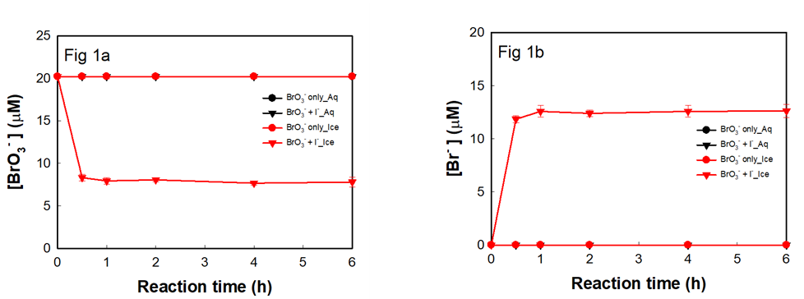
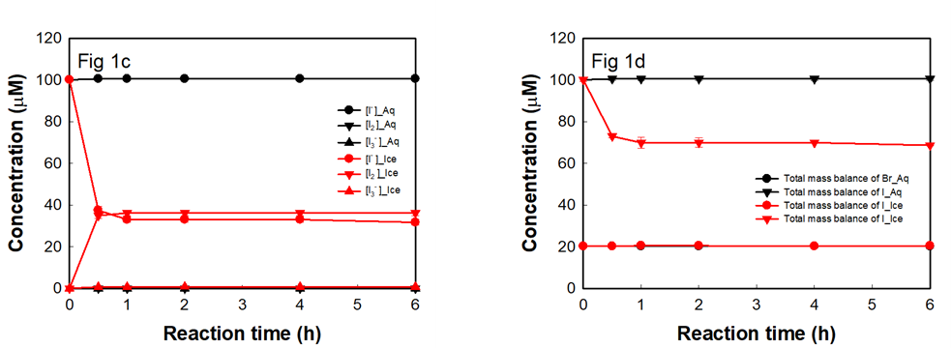
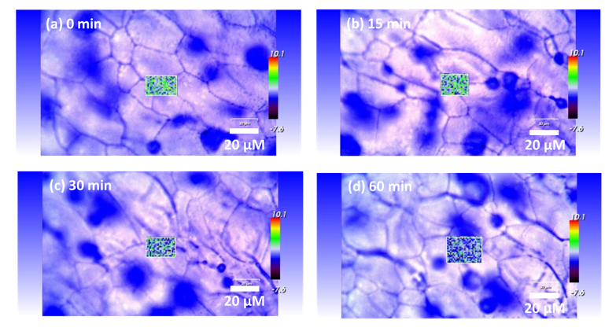
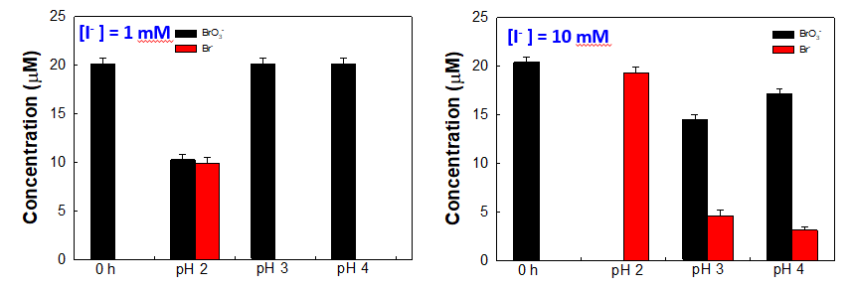
FREEZING-INDUCED BROMATE REDUCTION THROUGH IODIDE AND ITS IMPLICATIONS
Quoc Anh Nguyen ^{a,} ^{b}, Kitae Kim ^{a,} ^{b}
ªKorea Polar Research Institue (KOPRI), Incheon 21990, South Korea
^{b}Department of Polar Sciences, University of Science and Technology (UST), South Korea
Abstract: Freezing, which is the naturally facile process in the cold climate regions, has been extensively investigated as a non-contamination and effective cost method in the environmental treatment. The reactive halogens chemistry has a huge impact on the global environment, especially polar regions. Here, we elucidated the generation of iodine (I₂), tri-iodide (I₃⁻), and bromide (Br⁻) through the bromate (BrO₃⁻) reduction by iodide (I⁻) in the unfrozen solution of ice while it did not take place in aqueous solution. This appreciably enhanced transformation was attributed majorly to the freeze concentration effect of BrO₃⁻, I⁻, and protons (H⁺) in the liquid boundary of ice. The ice grain boundary regions created as well as the consumption of BrO₃⁻ in the BrO₃⁻/I⁻/freezing system in those regions during freezing were visualized with the confocal Raman microscope. pH decrease (the accumulation of H⁺) during freezing was measured quantitatively by the UV-Vis absorption spectra of cresol red (as the acid-base indicator). Also, the freeze concentration effect of I⁻ on the BrO₃⁻ transformation was verified in the differently experimental conditions of pH and/ or I⁻ concentration. The study on the acceleration of BrO₃⁻/I⁻/freezing system provides not only an unknown production pathway of bromine and iodine speciation in the polar environment but also the environmentally friendly insight into BrO₃⁻ treatment (known as the disinfection byproduct during ozonation in water treatment).
Results and discussion
pH change during freezing
Reduction of BrO₃⁻ by I⁻ in water and ice
Experimental conditions: [BrO₃⁻ ] = 20 µM, [I⁻ ] = 100 µM, pH 4.
Reaction temp: water: 25 ºC and ice: -20 ºC.
BrO₃⁻, Br⁻, I⁻ measurement: Ion-chromatography (IC).
I₃⁻, I₂ measurement: UV-Visible spectrophotometry (UV-Vis).
pH of ice grain boundary regions: UV-Vis absorption spectra of cresol-red (CR) as an acid-base indicator.
The distribution and concentration changes of BrO₃⁻ in the ice grain boundary regions: Mapping and measuring the intensity of the characteristic BrO₃⁻ Raman peak (Br – O stretching mode) at 805 cm⁻¹.
Experimental conditions:
[BrO₃⁻ ] = 20 µM, [I⁻ ] = 100 µM, [CR] = 6.7 µM, pH 4.
Reaction temp: water: 25 ºC; ice: -20 ºC.
Reaction time: 1 hour.
Distribution and concentration changes of BrO₃⁻ in the ice grain boundary regions
Verification of the freeze concentration of I⁻ and/or pH on the reduction of BrO₃⁻
Conclusions
The reduction of BrO₃⁻ by I⁻ was demonstrated during freezing owing to the freeze concentration effect.
The freezing process created favorable conditions for the accumulation of all components (BrO₃⁻, I⁻, and protons) in ice grain boundary regions, causing the redox reaction between BrO₃⁻ and I⁻ to occur thermodynamically and kinetically.
The study on the acceleration of BrO₃⁻/I⁻/freezing system provides not only an unknown production pathway of bromine and iodine species in the polar environment but also the environmentally friendly insight into BrO₃⁻ treatment (known as the disinfection byproduct during ozonation in water treatment).
Experimental conditions:
[BrO₃⁻ ] = 1 mM, [I⁻ ] = 1 mM, pH 3.
Reaction temp: -20 ºC.
Proposed mechanisms
BrO₃⁻ + 6H⁺ + 6e⁻ → Br⁻ + 3H₂O E⁰₁ = 1.423V
I₂ + 2e⁻ → 2I⁻ E⁰₂ = 0.5355V
I₃⁻ + 2e⁻ → 3I⁻ E⁰₃ = 0.536V
The net reactions:
BrO₃⁻ + 6I⁻ + 6H⁺ → Br⁻ + 3I₂ + 3H₂O.
E⁰₄ = E⁰₁ – E⁰₂ = 0.8875V.
BrO₃⁻ + 9I⁻ + 6H⁺ → Br⁻ + 3I₃⁻ + 3H₂O.
E⁰₅ = E⁰₁ – E⁰₃ = 0.887V
Experimental conditions: [BrO₃⁻ ] = 20 µM, [I⁻ ] = 1 or 10 mM, pH 2, 3, 4.
Reaction temp: 25 ºC; reaction time: 4 hours.

