Slide 1





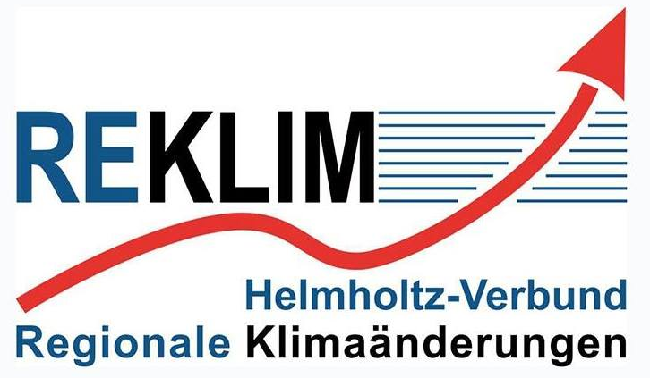
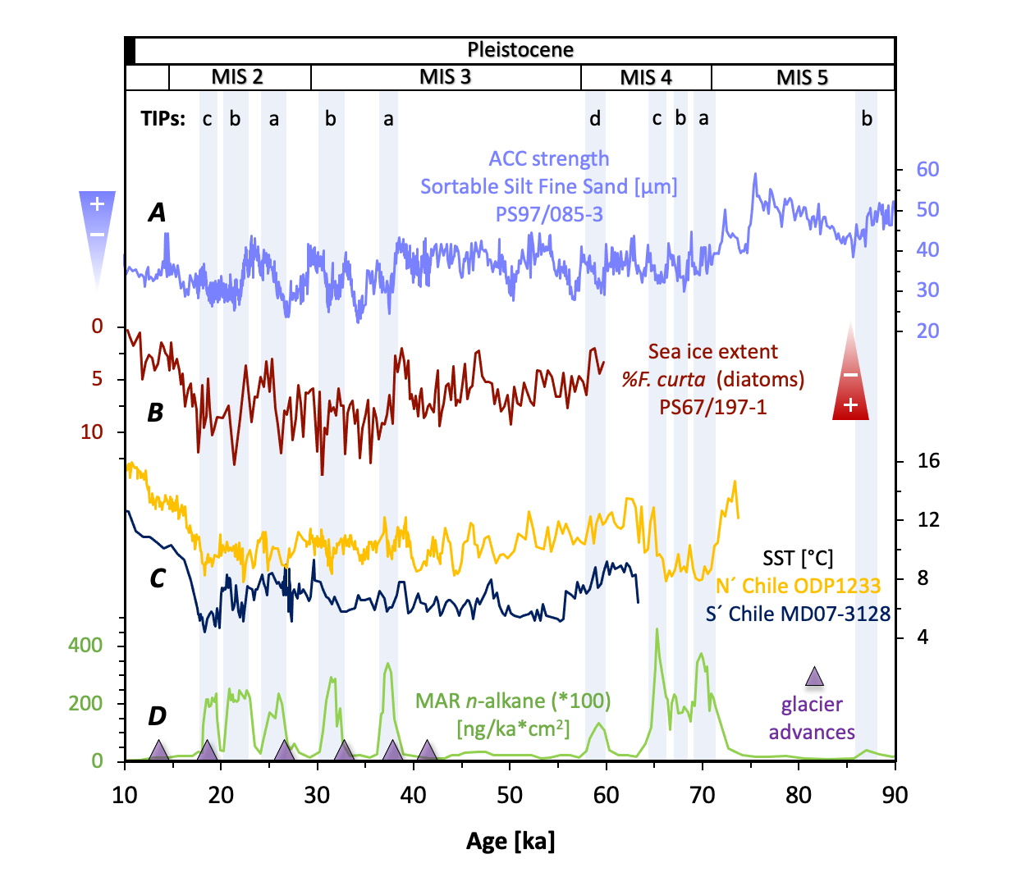
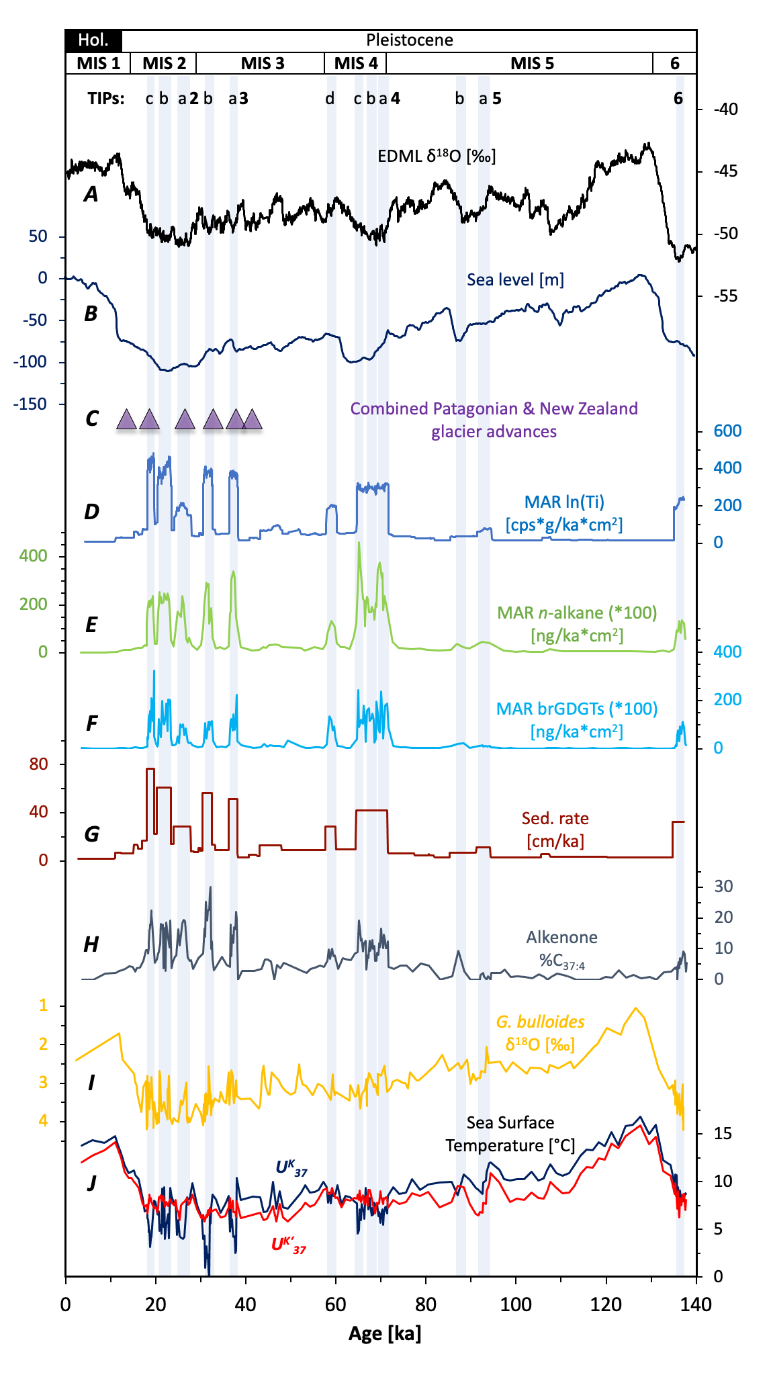
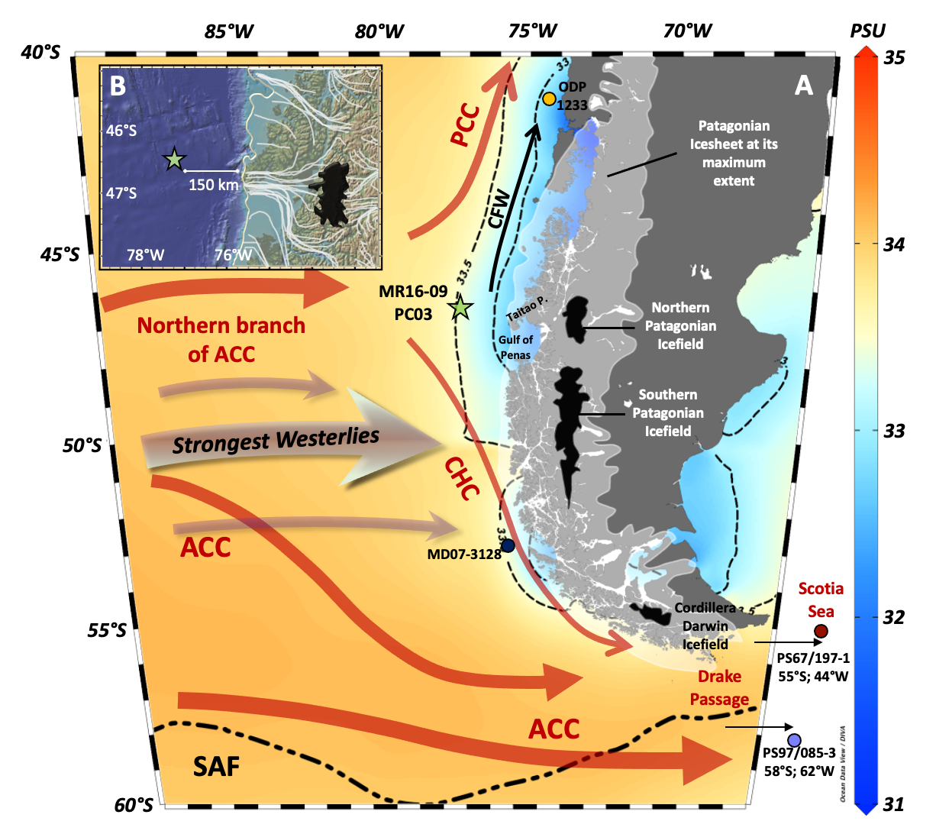
A marine record of Patagonia Ice Sheet changes over the past 140,000 years
Julia R. Hagemann^{1,3}, Frank Lamy¹, Helge W. Arz², Lester Lembke-Jene¹, Alexandra Auderset^{3,4}, Naomi Harada⁵, Sze Ling Ho⁶, Shinya Iwasaki⁷, Jérôme Kaiser², Carina B. Lange^{8,9,10}, Masafumi Murayama¹¹, Kana Nagashima¹², Norbert Nowaczyk¹³, Alfredo Martínez-Garcia³ & Ralf Tiedemann¹
Fig. 2: Ice core EDML (A; 3), Sea level (B; 4) and South Pacific glacier advances (C; 5) together with proxies of core MR16-09 PC03, showing terrigenous (D – G) and freshwater (H, I) input of the PIS over the past 140 ka. (J) Alkenone-derived Sea Surface Temperature (SST). Blue stripes and numbers at the top mark Terrigenous Input Phases (TIPs). MAR: Mass Accumulation Rate.
Background information
Sediment core MR16-09 PC03 of this study is located at the bifurcation of the northern branch of the ACC (~46°S) into the northward flowing PCC and the southward flowing CHC (Fig. 1). The core lies in an ideal position to document changes in the north-south migration of the ACC and its atmospheric counterparts the Westerlies over time. At the same time the core is located ~150 km offshore and therefore in a direct influence of the nearby PIS. The PIS was the largest extrapolar ice sheet of the Southern Hemisphere and contributed ~1.5 m sea level rise during the last termination (1).
Fig. 3: Detailed view of glacial advances be-tween 10 and 90 ka in comparison to other Southern Ocean para-meters. Blue stripes and numbers at the top mark Terrigenous Input Phases (TIP). Purple triangles: com-bined glacier advances of New Zealand and Patagonia (5). Blue curve: Sea Surface Temperature (SST) of core MD07-3128 (6). Yellow curve: Sea Surface Temperature (SST) of core ODP1233 (7). Red curve: Sea ice extent in the Scotia Sea (8). Light blue curve: Strength of (ACC) in the Drake Passage (8).
Results & Conclusion
The PIS was most active and advanced to the shelf edge during the global coldest periods of MIS 6, MIS 4, late MIS 3 and MIS 2. These active intervals are characterized by abrupt changes in sediment (Fig. 2 D – G) and freshwater supply (Fig. 2 H & I), indicating a threshold behaviour. The single high Terrigenous Input Phases (TIP) occur together with sea level low stand and Antarctic cold phases. Furthermore, additional records at the Chilean margin (MD07-3128 (6); ODP1233 (7)), the Scotia Sea (PS67/197-1 (8)) and the Drake Passage (PS97/085-3 (8)) show cold SSTs, equatorward sea ice extension and a reduced throughflow of the ACC into the Atlantic during TIPs. This indicates a northward expansion of the Westerlies (Fig. 3). A northward movement of the Westerlies core (today at ~50°S) increases the precipitation at the study site MR16-09 PC03 during the glacials. In conclusion, the trigger of the threshold behaviour is unclear, but TIPs occur during cold SSTs, Sea level low stand and increased precipitation.
Fig. 1: (A) Map of the southeast Pacific with major ocean currents and sea surface salinity (WOA13; 2). White area: glacial Patagonian Ice Sheet (PIS). Black areas: modern ice coverage. ACC = Antarctic Circumpolar Current; CHC = Cape Horn Current; PCC = Peru-Chile Current; CFW = Chilean Fjord Current; SAF = Subantarctic Front. (B) Insert a map with essential flow lines of the ancient PIS (1). Green star: site MR16-09 PC03 of this study. Red dots: additional cores in the study area.
Address information
⁽¹⁾ Alfred-Wegener-Institute, Geoscience, Bremerhaven, Germany (julia.hagemann@awi.de; Frank.Lamy@awi.de; Lester.Lembke-Jene@awi.de; Ralf.Tiedemann@awi.de)
⁽²⁾ Leibniz Institute for Baltic Sea Research, Warnemünde, Germany (Helge.arz@io-warnemuende.de; jerome.kaiser@io-warnemuende.de)
⁽³⁾ Max Planck Institute for Chemistry, Climate Geochemistry, Mainz, Germany (julia.hagemann@awi.de; a.martinez-garcia@mpic.de; a.auderset@mpic.de)
⁽⁴⁾ Department of Geosciences, Princeton University, Princeton, USA (a.auderset@mpic.de)
⁽⁵⁾ Atmospheric and Ocean Research Institute, The University of Tokyo, Kashiwa, Japan (naomi.harada@aori.u-tokyo.ac.jp)
⁽⁶⁾ Institute of Oceanography, National Taiwan University, Taipei, Taiwan (slingho@ntu.edu.tw)
⁽⁷⁾ MARUM, University Bremen, Bremen, Germany (siwasaki@marum.de)
⁽⁸⁾ Department of Oceanography and Center for Oceanographic Research in the eastern South Pacific, COPAS Coastal, University of Concepción, Concepción, Chile (clange@udec.cl)
⁽⁹⁾ Centro de Investigación Dinámica de Ecosistemas Marinos de Altas Latitudes, Universidad Austral de Chile, Valdivia, Chile (clange@udec.cl)
⁽¹⁰⁾ Scripps Institution of Oceanography, University of California San Diego, La Jolla, USA (clange@udec.cl)
⁽¹¹⁾ Faculty of Agriculture and Marine Science, Kochi University, Kochi, Japane (murayama@kochi-u.ac.jp)
⁽¹²⁾ Research Institute for Global Change, Japan Agency for Marine-Earth Science and Technology, Yokosuka, Japane (nagashimak@jamstec.go.jp)
⁽¹³⁾ Climate Dynamics and Landscape Evolution, Helmholtz Centre Potsdam German Research Centre for Geosciences, Potsdam, Germany (nowa@gfz-potsdam.de)
References
Davies et al. (2020): The evolution of the Patagonian Ice Sheet from 35 ka to the present day (PATICE)
Zweng et al. (2013): World Ocean Atlas 2013 (WOA13), Volume 2: Salinity
Epica Community Members (2006): One-to-one coupling of glacial climate variability in Greenland and Antarctica
Grant et al. (2012): Rapid coupling between ice volume and polar temperature over the past 150,000 years
Darvill et al. (2016): The timing and cause of glacial advances in the southern mid-latitudes during the last glacial cycle based on a synthesis of exposure ages from Patagonia and New Zealand
Caniupán et al. (2011): Millennial-scale sea surface temperature and Patagonian Ice Sheet changes off southernmost Chile (53°S) over the past ~60 kyr
Lamy et al. (2004): Antarctic Timing of Surface Water Changes off Chile and Patagonian Ice Sheet Response; Kaiser et al. (2005): A 70-kyr sea surface temperature record off southern Chile (Ocean Drilling Program Site 1233)
Wu et al. (2021): Orbital- and millennial-scale Antarctic Circumpolar Current variability in Drake Passage over the past 140,000 years

