Slide 1
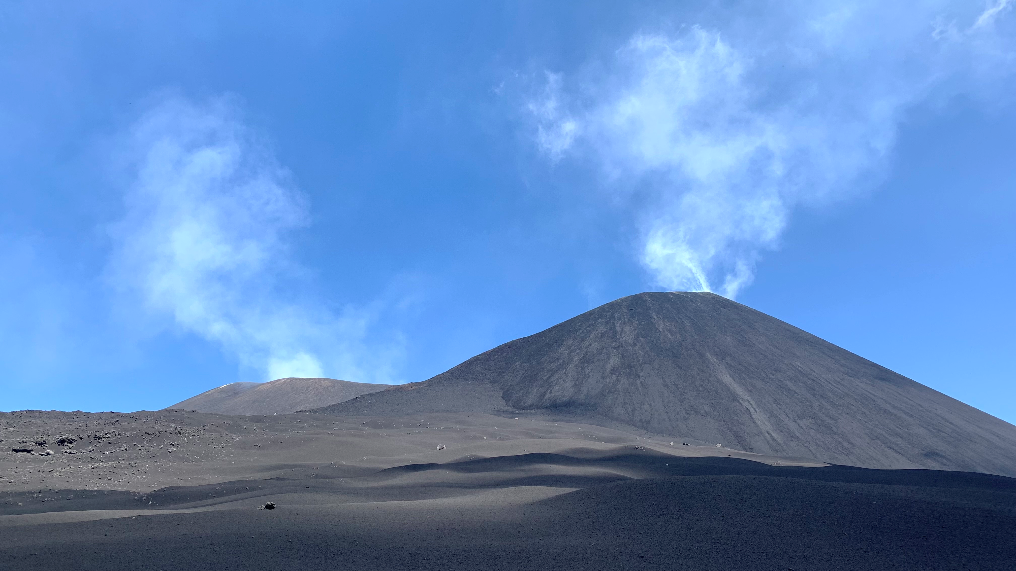
Detection of chlorine, bromine and bromine chloride (BrCl) in volcanic emissions: Studies at Mt. Etna (Italy), 2022
EGU General Assembly 2023
27th April 2023
Bastien Geil¹, Niklas Karbach¹, Nicole Bobrowski^{2,3}, and Thorsten Hoffmann¹
¹Department of Chemistry, Johannes Gutenberg-University Mainz, Germany
²Institute of Environmental Physics, Ruprecht-Karls-University Heidelberg, Germany
³Istituto Nazionale di Geofisica e Vulcanologica – Osservatorio Etneo Catania, Italy
Navigation
return to start
backward forward
1

Slide 2
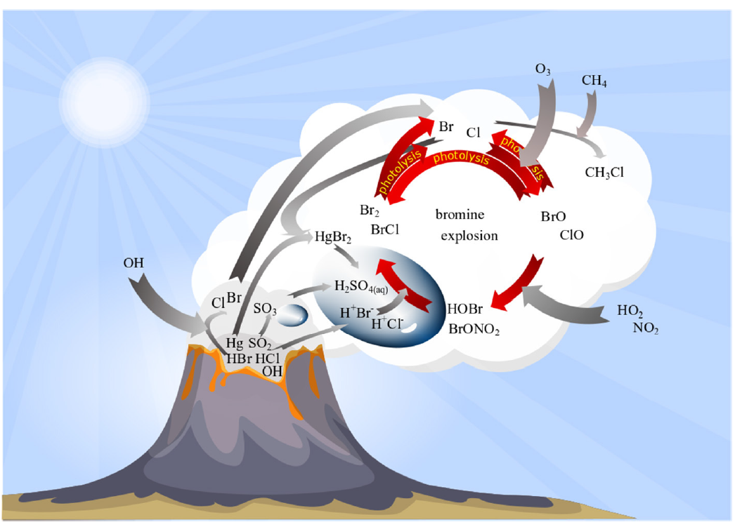
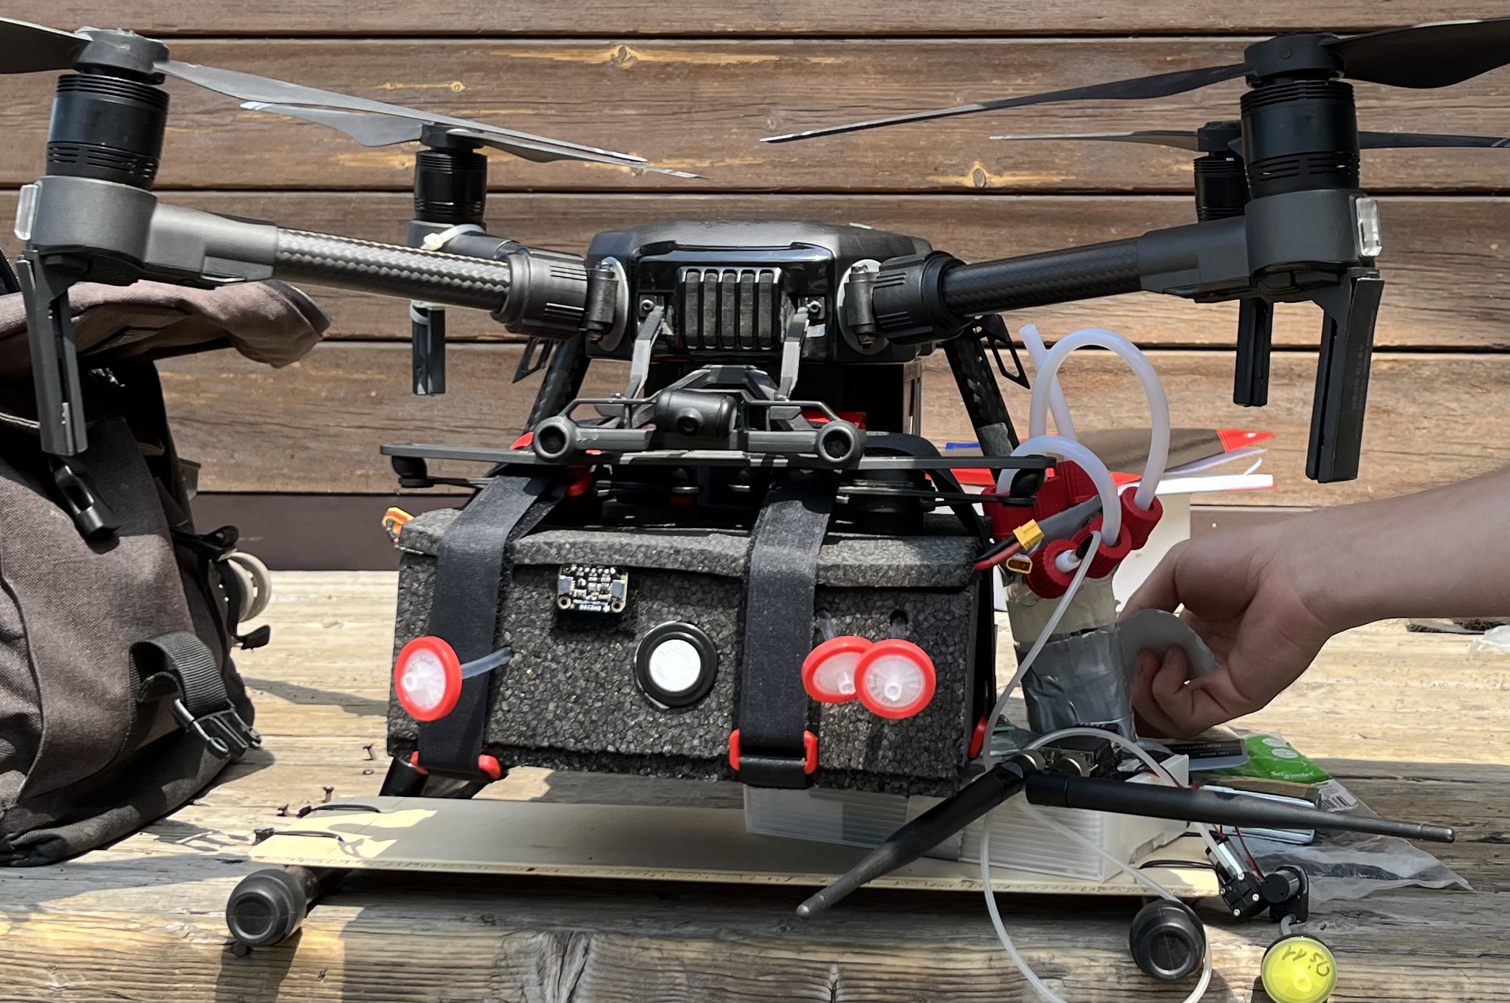
Motivation
satellite
Understanding of physical and chemical processes in volcanic plumes
Link between atmospheric, petrologic and magmatic data
Forecasting volcanic activity
Adapted from Gutmann et al, 2018
This work:
drone based measurements
Adapted from Roberts et al, 2014
DOAS / camera
direct sampling
chemical simulations

Slide 3
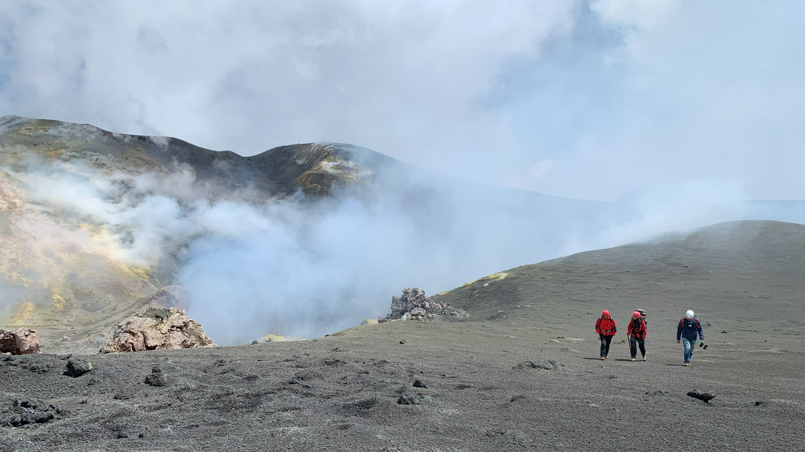
Simultaneous measurements on one drone
Cl₂, Br₂, BrCl
Cl, Br, I in oxidation state 0 and +1
Total halogen species, SO₂ and CO₂
Setup & preliminary results
Setup
Setup

Slide 4
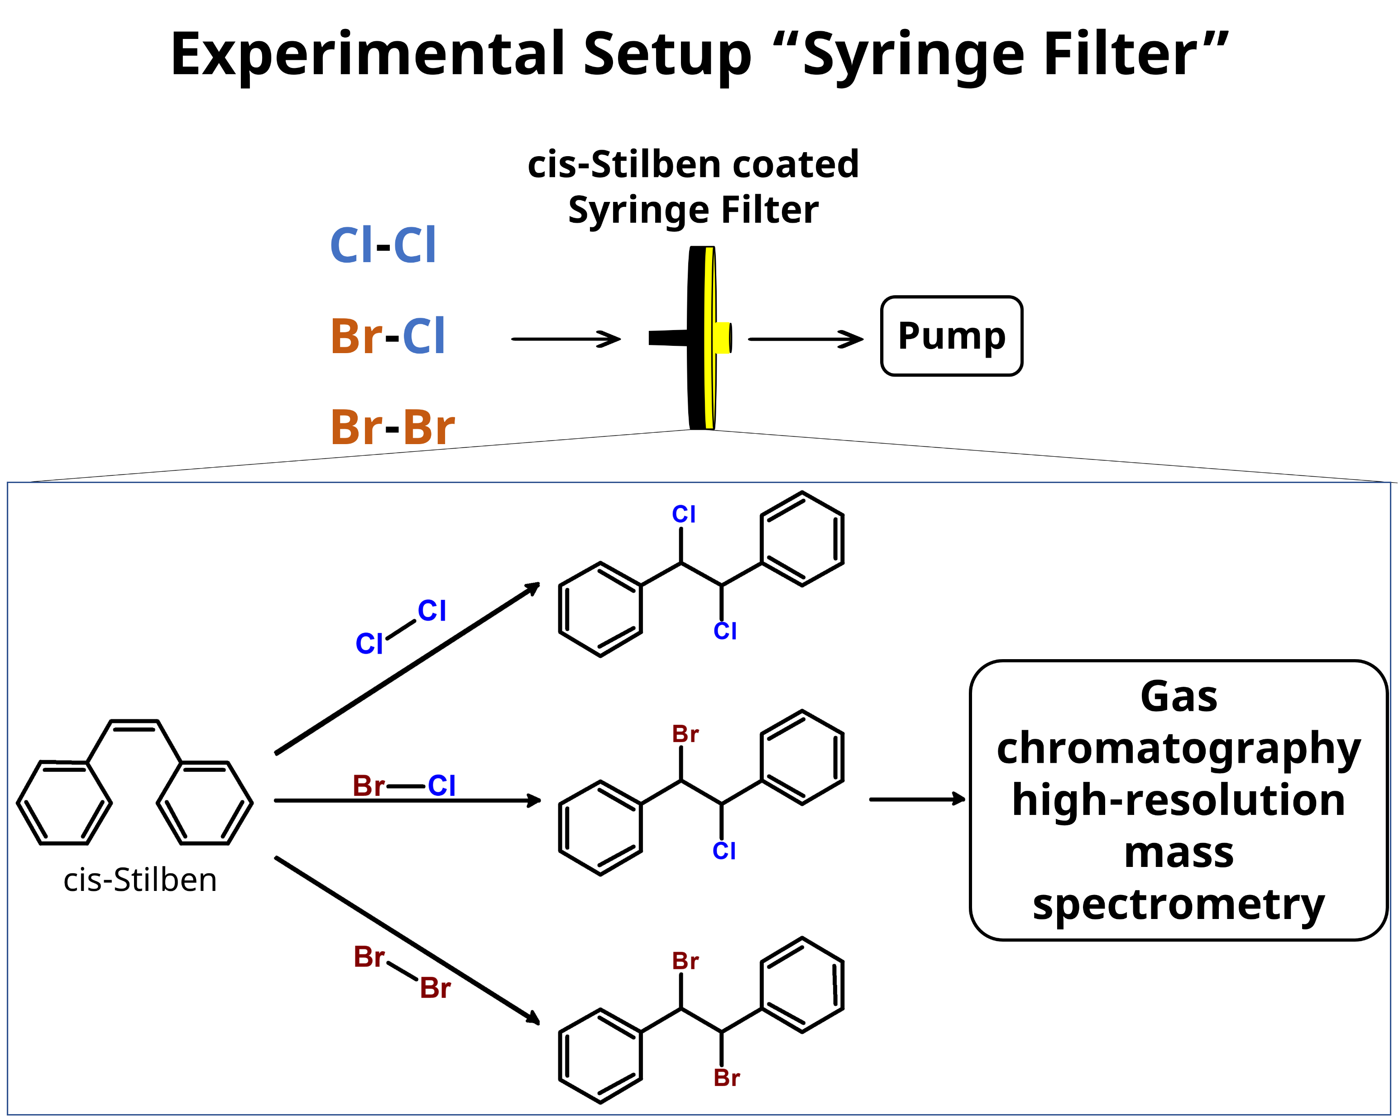
Cl₂, Br₂, BrCl
Fig 1: normalized proportion of Halogens plotted against plume age. Measurements were made at different days during Etna campaign in July 2022.
Sampling time: 5-10 min
Flow: 450 ml/min
Absorption rate: 97 % (Cl₂)
Recoveryrate: 87 % Cl₂
92 % BrCl
97 % Br₂

Slide 5
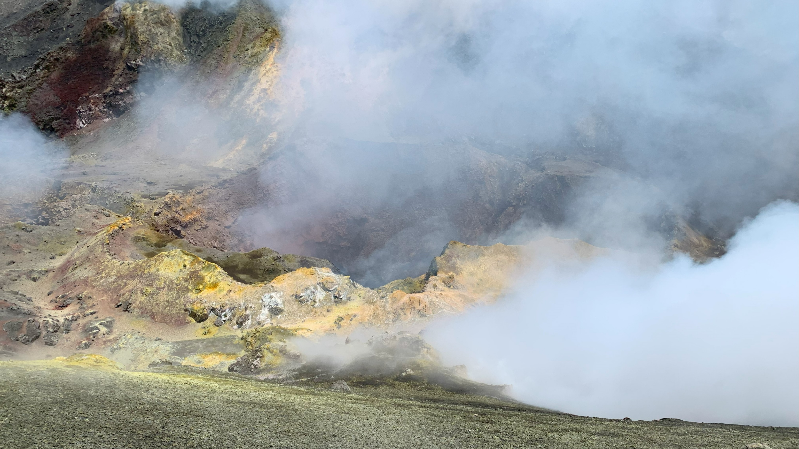
Cl, Br, I in oxidation state 0 and +1
Syringe Filter with TMB-Coating
Quantification via gas chromatography high resolution mass spectrometry
Not analysed at this time
X = Cl, Br, I

Slide 6
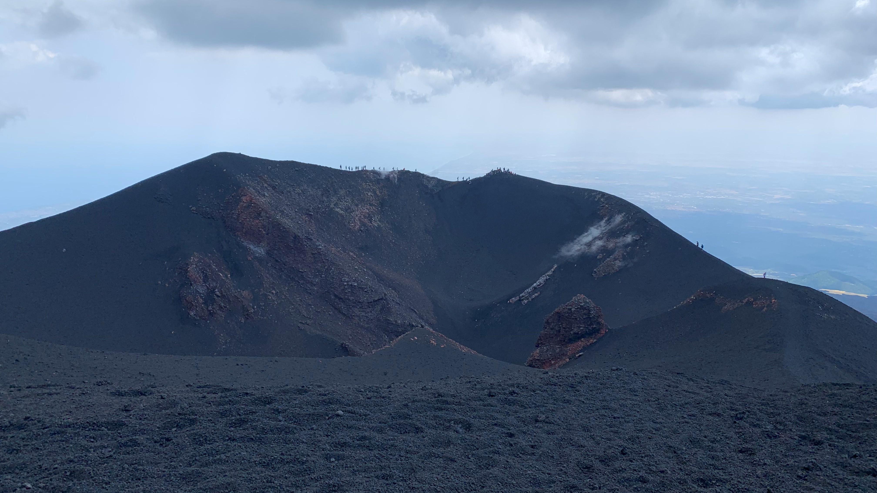
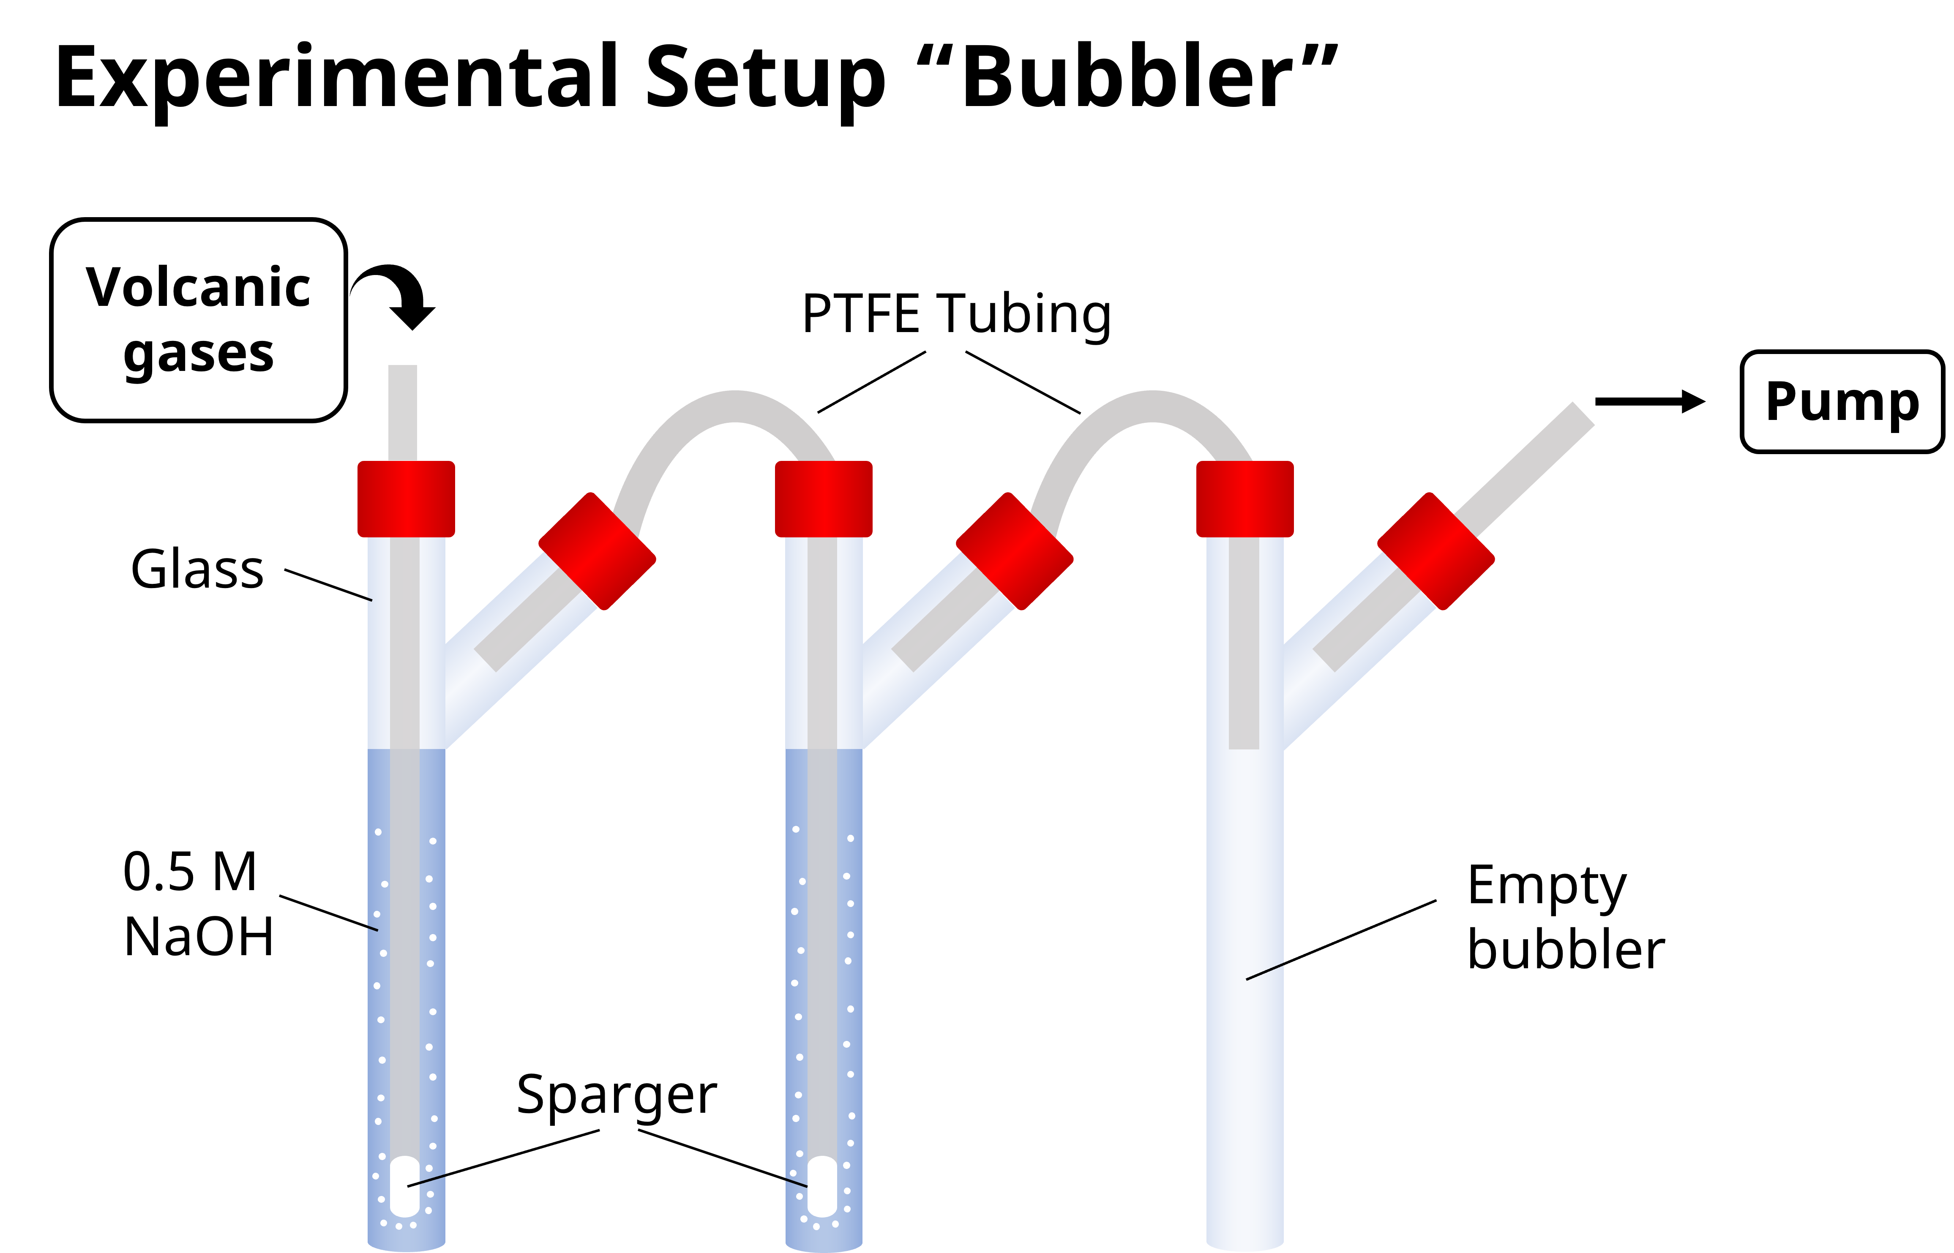
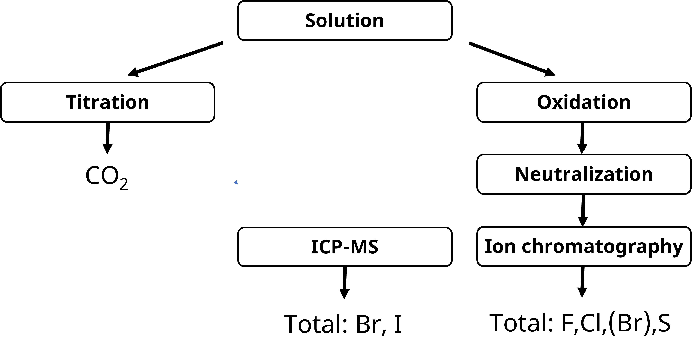
Total halogen species, SO₂ and CO₂
Not analysed at this time

Slide 7
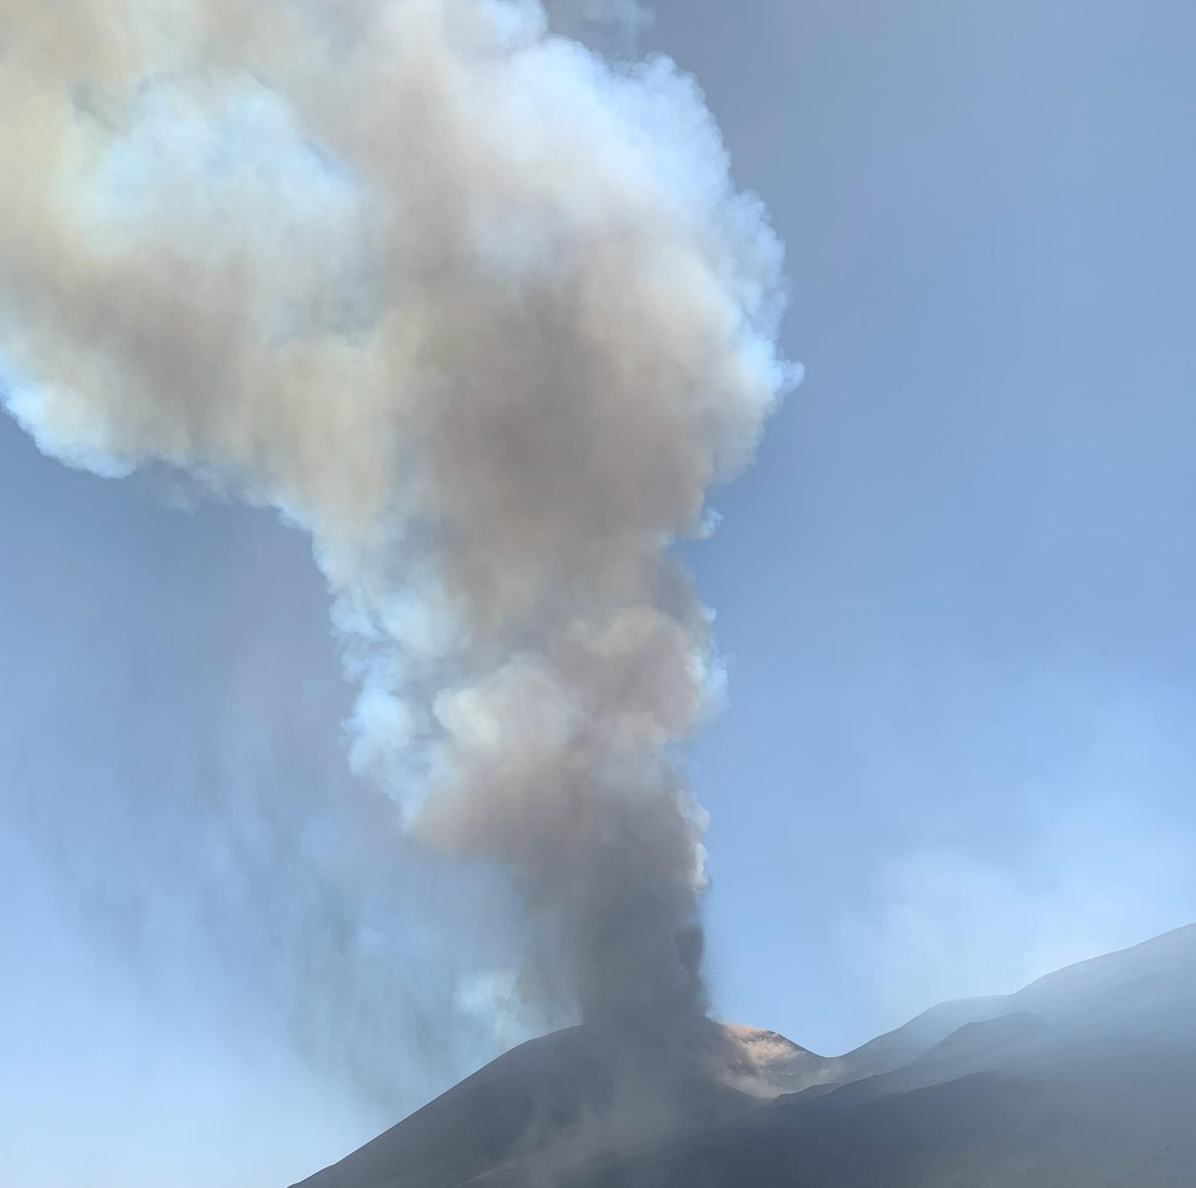
Conclusion and Outlook
With our new method, we are not only able to distinguish the reactive halogen species, but we have also succeeded in developing a very lightweight setup for in situ measurements using drones (UAVs) directly in the volcanic plume. The combination of bubblers and filters allows the simultaneous measurement of the individual halogen species as well as the total halogen concentration.
Next steps:
Quantification of all the halogen species
Detection and quantification of new species with improved coatings for syringe filters
Improvement of chemical simulations for evolution of halogen species in volcanic plumes

