Slide 1


Heavy Metal Contamination in Ganga River Basin Sediments, India
Presented By: Stuti Kushwaha
School of Environmental Sciences, Jawaharlal Nehru University, New Delhi, India

Slide 2
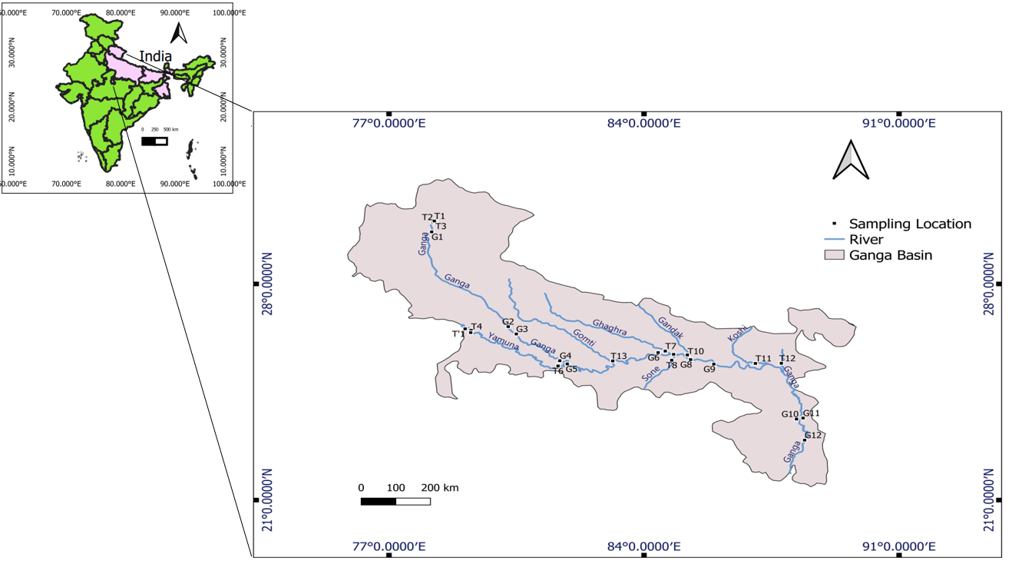
Study Region

Slide 3
Metal | Rainy Season | Dry Season
Co | 14.07 | 11.08
Cr | 49.52 | 61.38
Cu | 29.46 | 45.15
Ni | 28.03 | 23.62
Zn | 123.52 | 69.54
Rainy Season
Dry Season
Average Concentrations in mg/kg

Slide 4
Introduction

Slide 5
Description of Sampling Locations:
Sample id | Co-Ordinates
 | Rishikesh- Haridwar
T1 | N 30°02.248', E 78°14.691'
T2 | N 30°00.045', E 78°12.412'
T3 | N 30°01.920', E 78°16.498'
G1 | N 29°53.591', E 78°10.224'
 | Chambal- Yamuna
T'1 | N 26°32.730', E 79°05.422'
T4 | N 26°30.011', E 79°15.201'
T5 | N 26°25'29'', E 79°14'33''
 | Kanpur
G2 | N 26°37.079', E 80°16.385'
G3 | N 26°22.785', E 80°29.666'
 | Allahabad
G4 | N 25°30.849', E 81°41.179'
T6 | N 25°20.644', E 81°38.374'
G5 | N 25°24.531', E 81°53.584'
Sample id | Co-Ordinates
 | Near Balia
G6 | N 25°46.601', E 84°23.166
 | Ghaghara river
T7 | N 25°49.510', E 84°35.002'
 | After confluence
G7 | N 25°43.229', E 84°48.680'
 | Son River
T8 | N 25°31.744', E 84°45.604'
 | Gandak River
T9 | N 25°41.999', E 85°11.318'
T10 | N 25°41.989', E 85°11.812'
 | After confluence
G8 | N 25°32.963', E 85°16.691'
G9 | N 25°24.161', E 85°54.973'
 | Bhagalpur
T11 | N 25°25.403', E 87°03.579'
T12 | N 25°05.826', E 87°53.401'
 | West Bengal
G10 | N 23°37.455', E 88°11.124'
G11 | N 23°31.946', E 88°21.899'
G12 | 22°56'31''N, 88°24'28''E
 | Gomati
T13 | N 25°30.377', E 83°08.498'

Slide 6
Objectives:
To find the variation in heavy metal concentration in wet and dry season
To find the possible sources of heavy metals
To evaluate the risk imposed by heavy metals

Slide 7
Methodology:
Sample collection
Representative samples were collected in a plastic bag from stainless steel scoop, transferred to laboratory and kept below 4˚C
Pre-processing before digestion
Samples were completely dried and room temp. and sieved from 0.63µm sieve
Samples were completely dried at room temp. and sieved from 0.63µm sieve
Sample Digestion
Using the‘B’ solution method by Shapiro and Brannock (1962)
Using the‘B’ solution method by Shapiro and Brannock (1962)
Sample Analysis
Digested samples analysed in ICP-OES Agilent (5110)
Quality Control: Buffalo river sediment SRM(8704), Blanks, Sample replicates were ran.

Slide 8
Heavy Metals in Rainy and Dry Season
Metal | Rainy Season | Dry Season
Co | 14.07 | 11.08
Cr | 49.52 | 61.38
Cu | 29.46 | 45.15
Ni | 28.03 | 23.62
Zn | 123.52 | 69.54
Co
Average Concentrations in mg/kg
Cr

Slide 9
Heavy Metals in Rainy and Dry Season:
Ni
Ni
Cu
Zn

Slide 10
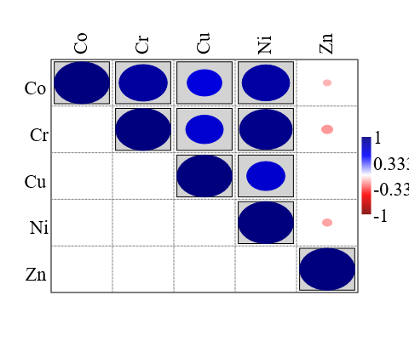
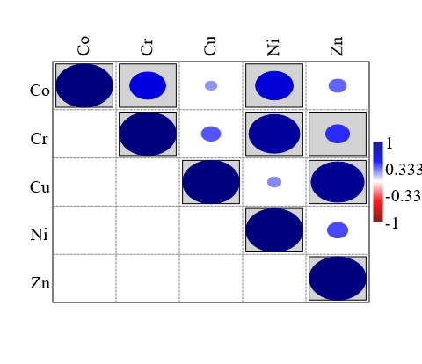
Correlation for Rainy and Dry Season:
Rainy Season
Dry Season
Strong correlation is found between Co-Cr, Co-Ni ,Cr-Ni
Strong correlation is found between Cr-Ni, Cu-Zn
Grey shade indicating, p≤0.05

Slide 11
Contamination Factor:
Cf=Cmetal/Cbackground
Where, C_{metal} - concentration of metal
C_{background} – values adopted from (Singh et al., 2003)
Rainy Season
If: Cf<1 Low Contamination 1<Cf<3 Moderate Contamination 3<Cf<6 Considerable Contamination >6 Very High Contamination
Cf indicates low to moderate contamination in rainy season at some location for Co and Zn.
While moderate contamination of Zn at G5 location in Dry season.

Slide 12
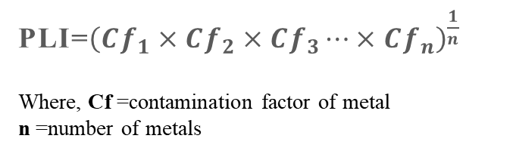
Pollution Load Index:
PLI=${\left(Cf_{1}×Cf_{2}×Cf_{3}⋯×Cf_{n}\right)}^{\frac{1}{n}}$
Where, Cf =contamination factor of metal
n =number of metals
If, PLI=0 perfection
PLI =1 baseline level
PLI>1 polluted
PLI>1 for (G5) in Dry season, indicating polluted sediment

Slide 13
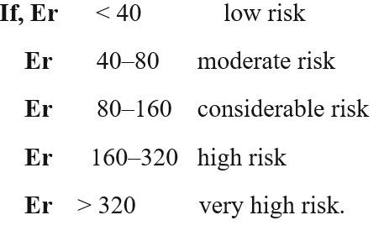

Ecological Risk:
E_{r}^{i}=$T_{r}^{i}×\left(\frac{C_{i}}{C_{0}}\right)$
Rainy Season
Where, Ci = concentration of metal i in sediment
Co= background concentration of metal
Tr =biological toxicity factor for individual metal
Er <40 for both the seasons, showing low risk

Slide 14
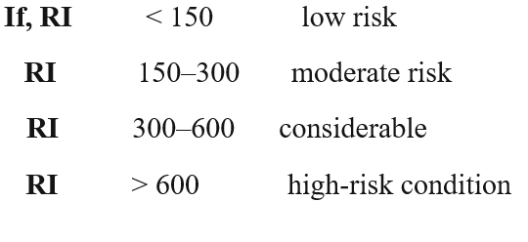
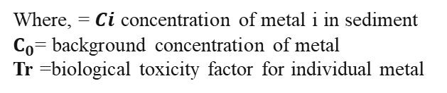
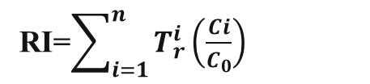
Potential Ecological Risk:
RI=$\sum_{i=1}^{n}{T_{r}^{i}\left(\frac{Ci}{C_{0}}\right)}$
Where, = $Ci$ concentration of metal i in sediment
$C_{0}$= background concentration of metal
Tr =biological toxicity factor for individual metal
RI<150 for both the seasons , indicating low risk

Slide 15
Conclusion:
• High conc. of Cr, Cu in dry season is probably from their natural sources.
• Moderate contamination of Zn indicates its anthropogenic origin.
• Strong correlations between Co-Cr, Co-Ni ,Cr-Ni (RS) and Cu-Zn and Cr-Ni(DS) indicates similar sources and their geochemical behaviour.
• Below Detection values at T10 location probably due to the dilution or washout of the metals or absence of metal in the source rock.
• Low ecological risk found for both seasons. PLI suggests pollution at G5 location.

Slide 16
References:
Rapid analysis of silicate, carbonate, and phosphate rocks. (n.d.). Retrieved April 20, 2023, from https://pubs.er.usgs.gov/publication/b1144A
Frogner-Kockum, P., Göransson, G., & Haeger-Eugensson, M. (2020). Impact of Climate Change on Metal and Suspended Sediment Concentrations in Urban Waters. Frontiers in Environmental Science, 8. https://www.frontiersin.org/articles/10.3389/fenvs.2020.588335
Singh, M., Müller, G., & Singh, I. B. (2003). Geogenic distribution and baseline concentration of heavy metals in sediments of the Ganges River, India. Journal of Geochemical Exploration, 80, 1–17. https://doi.org/10.1016/S0375-6742(03)00016-5

Slide 17
Thank you

