Slide 1
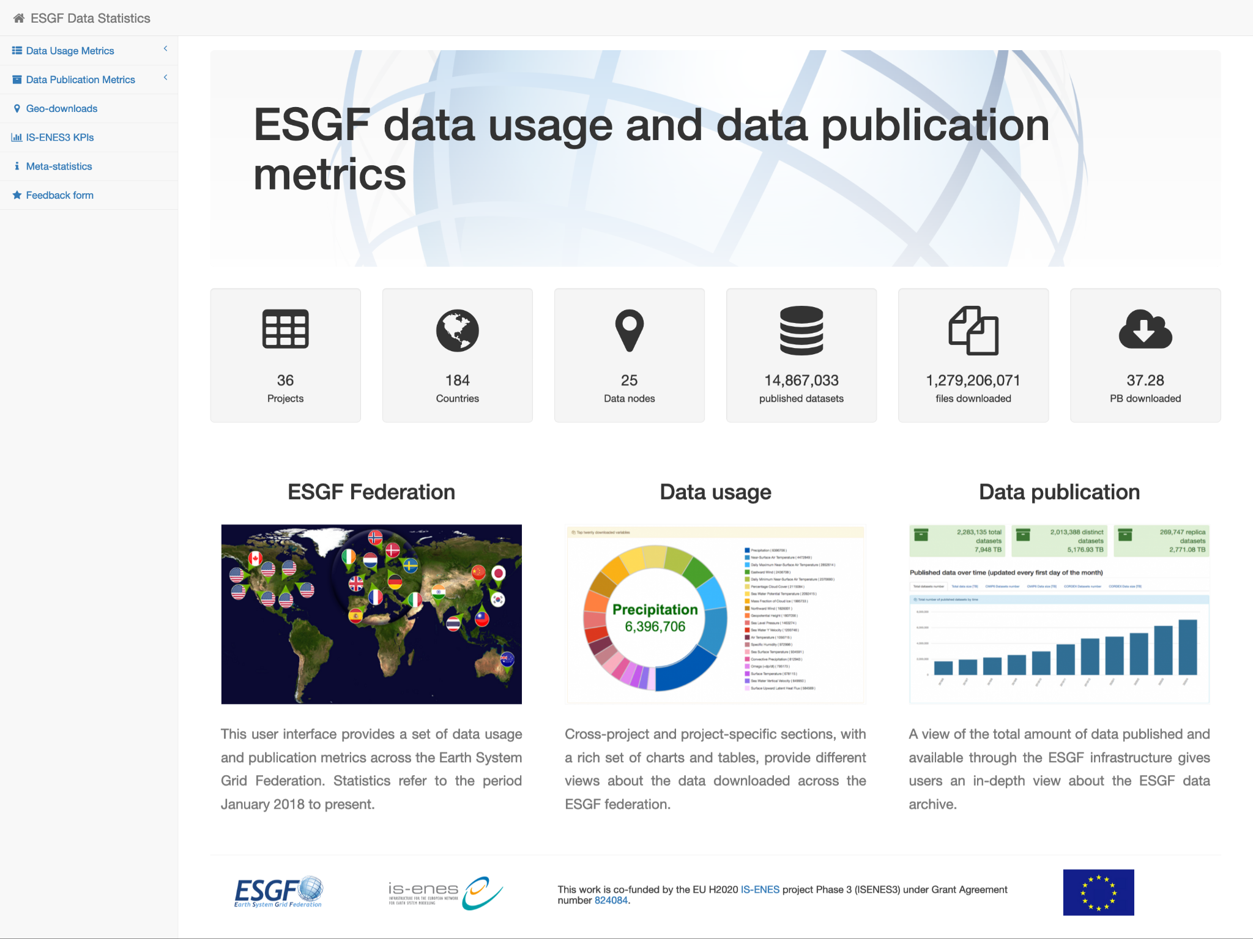
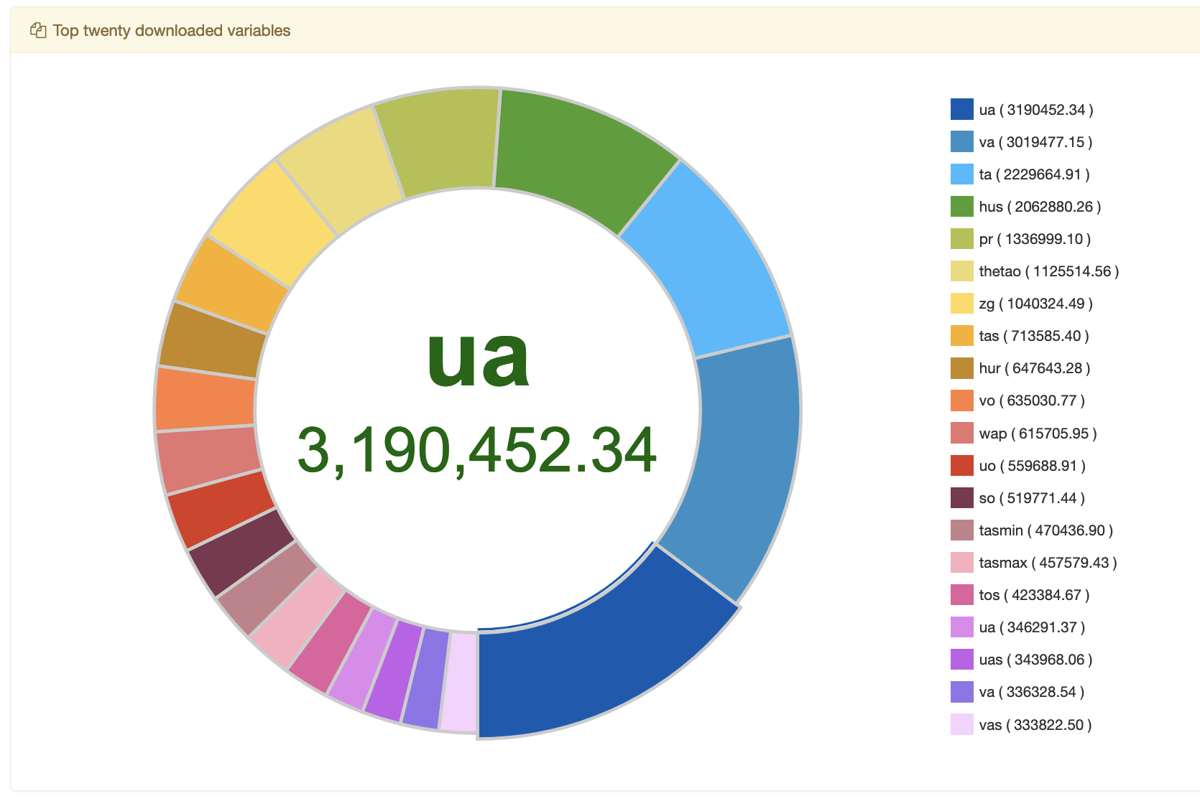
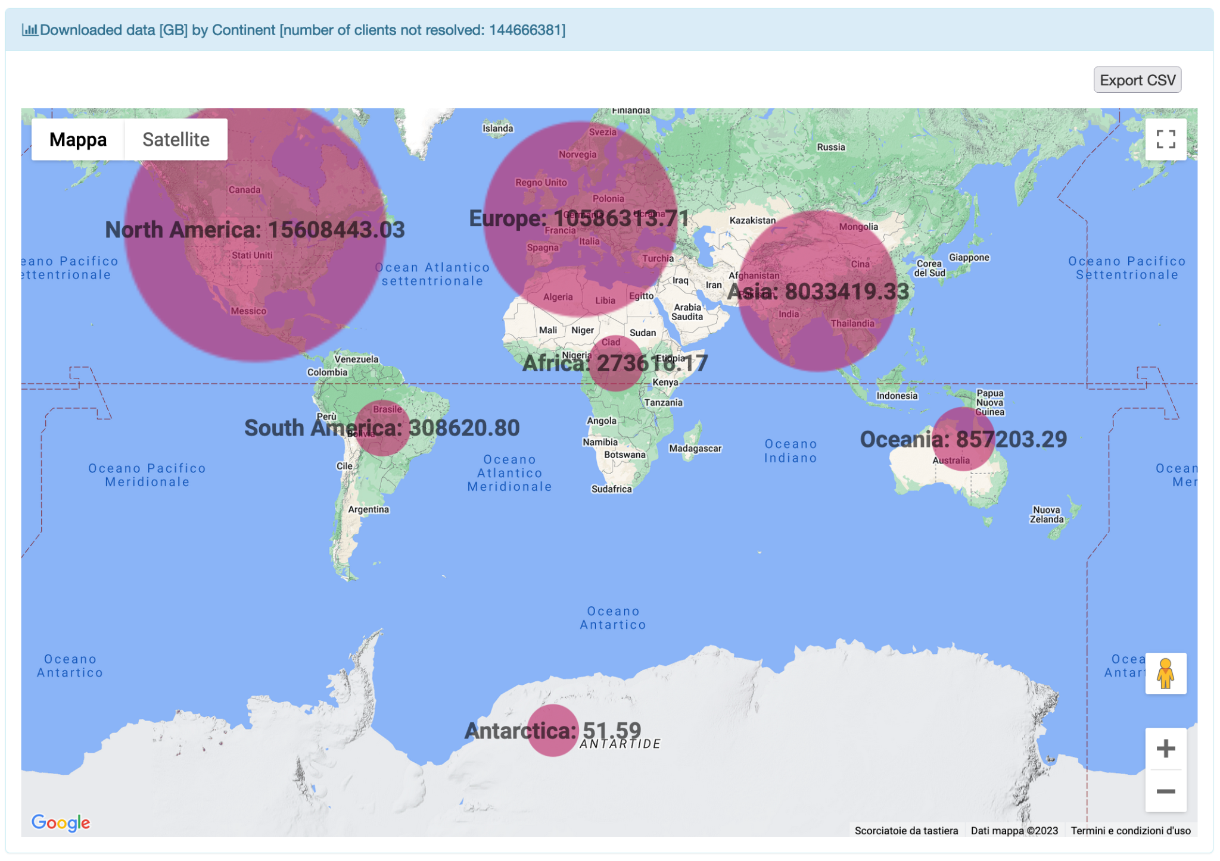
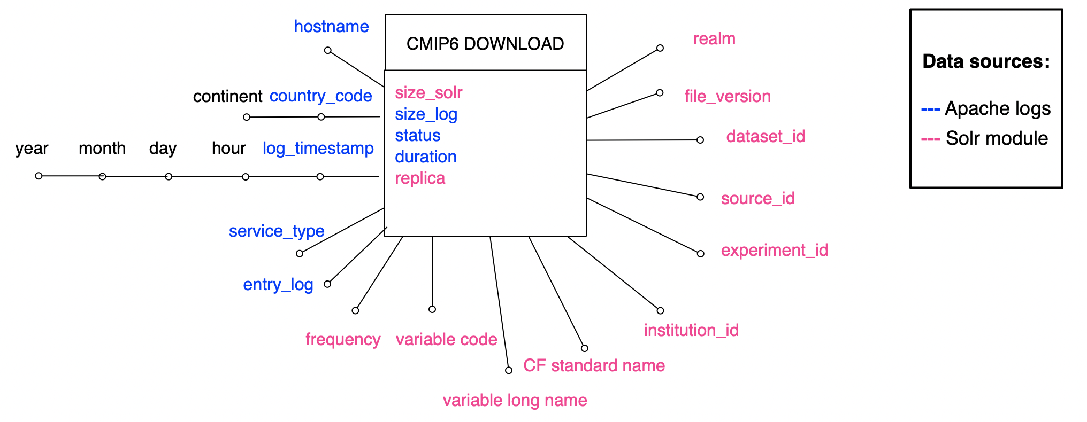
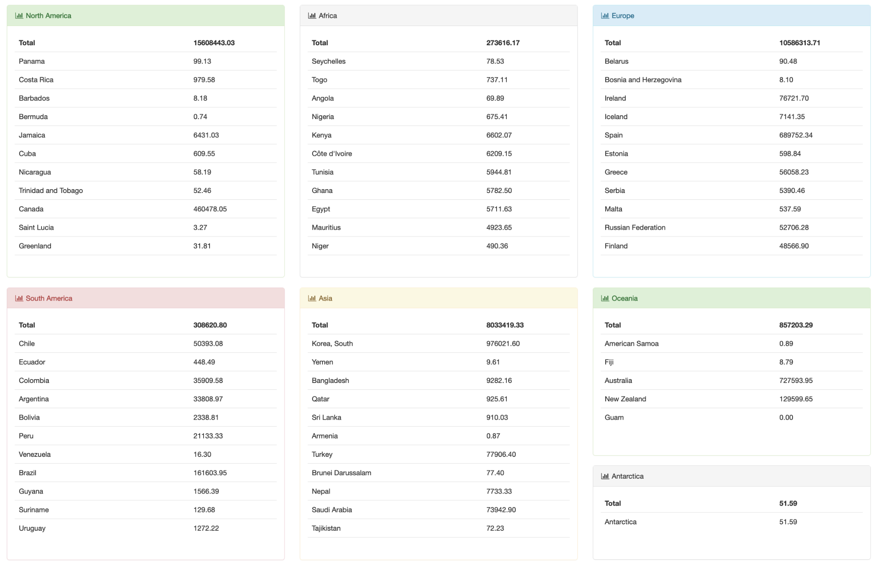
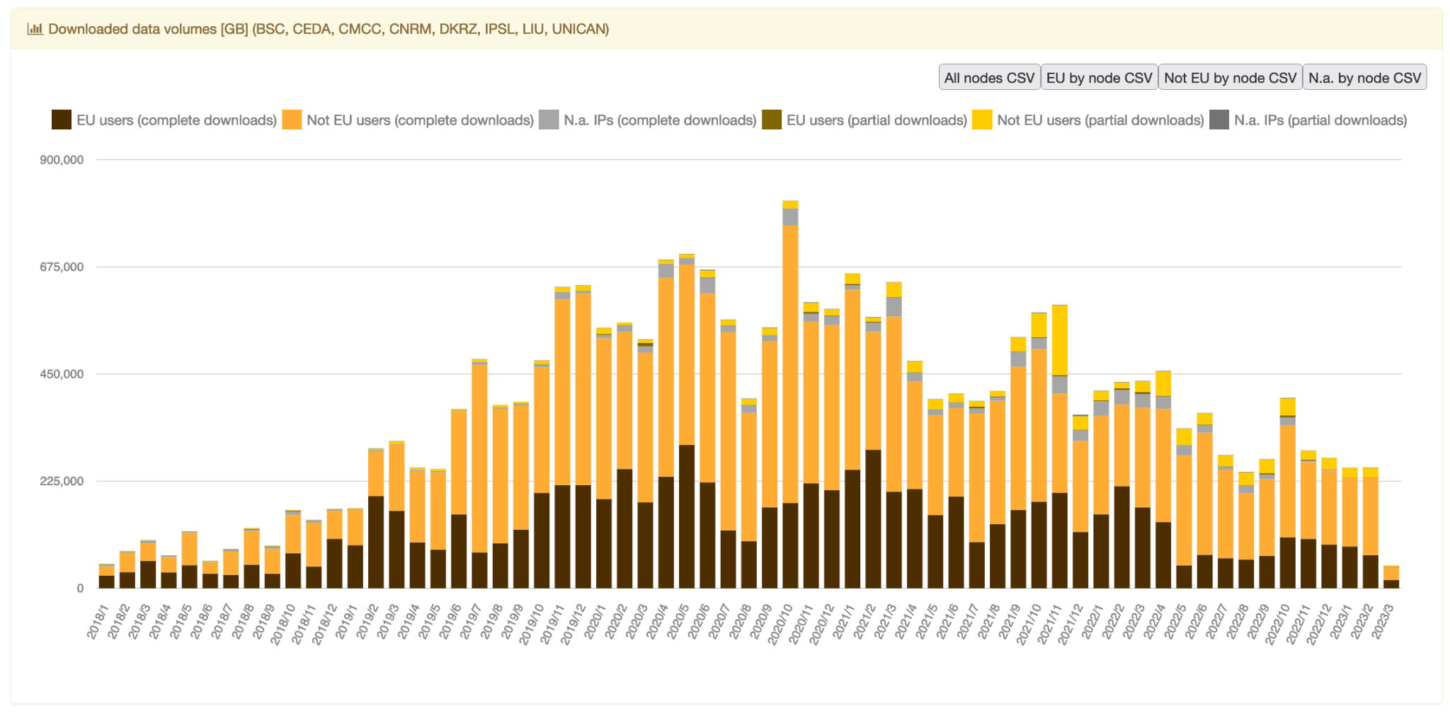
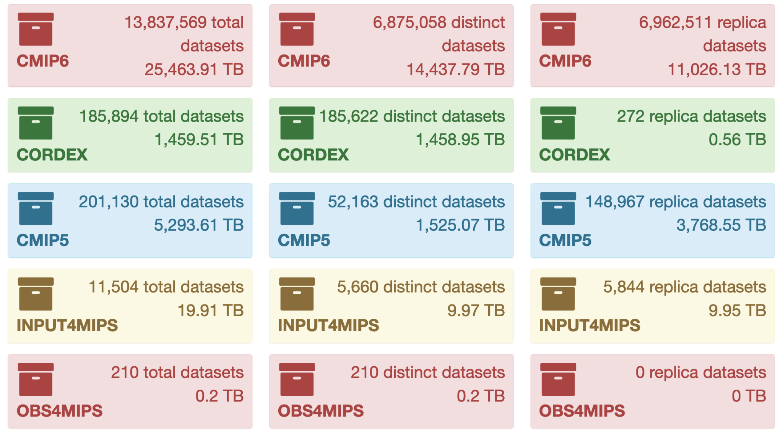
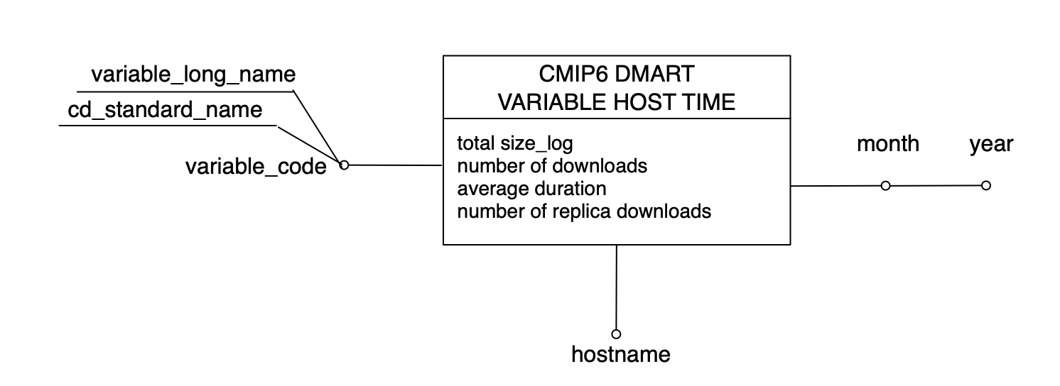
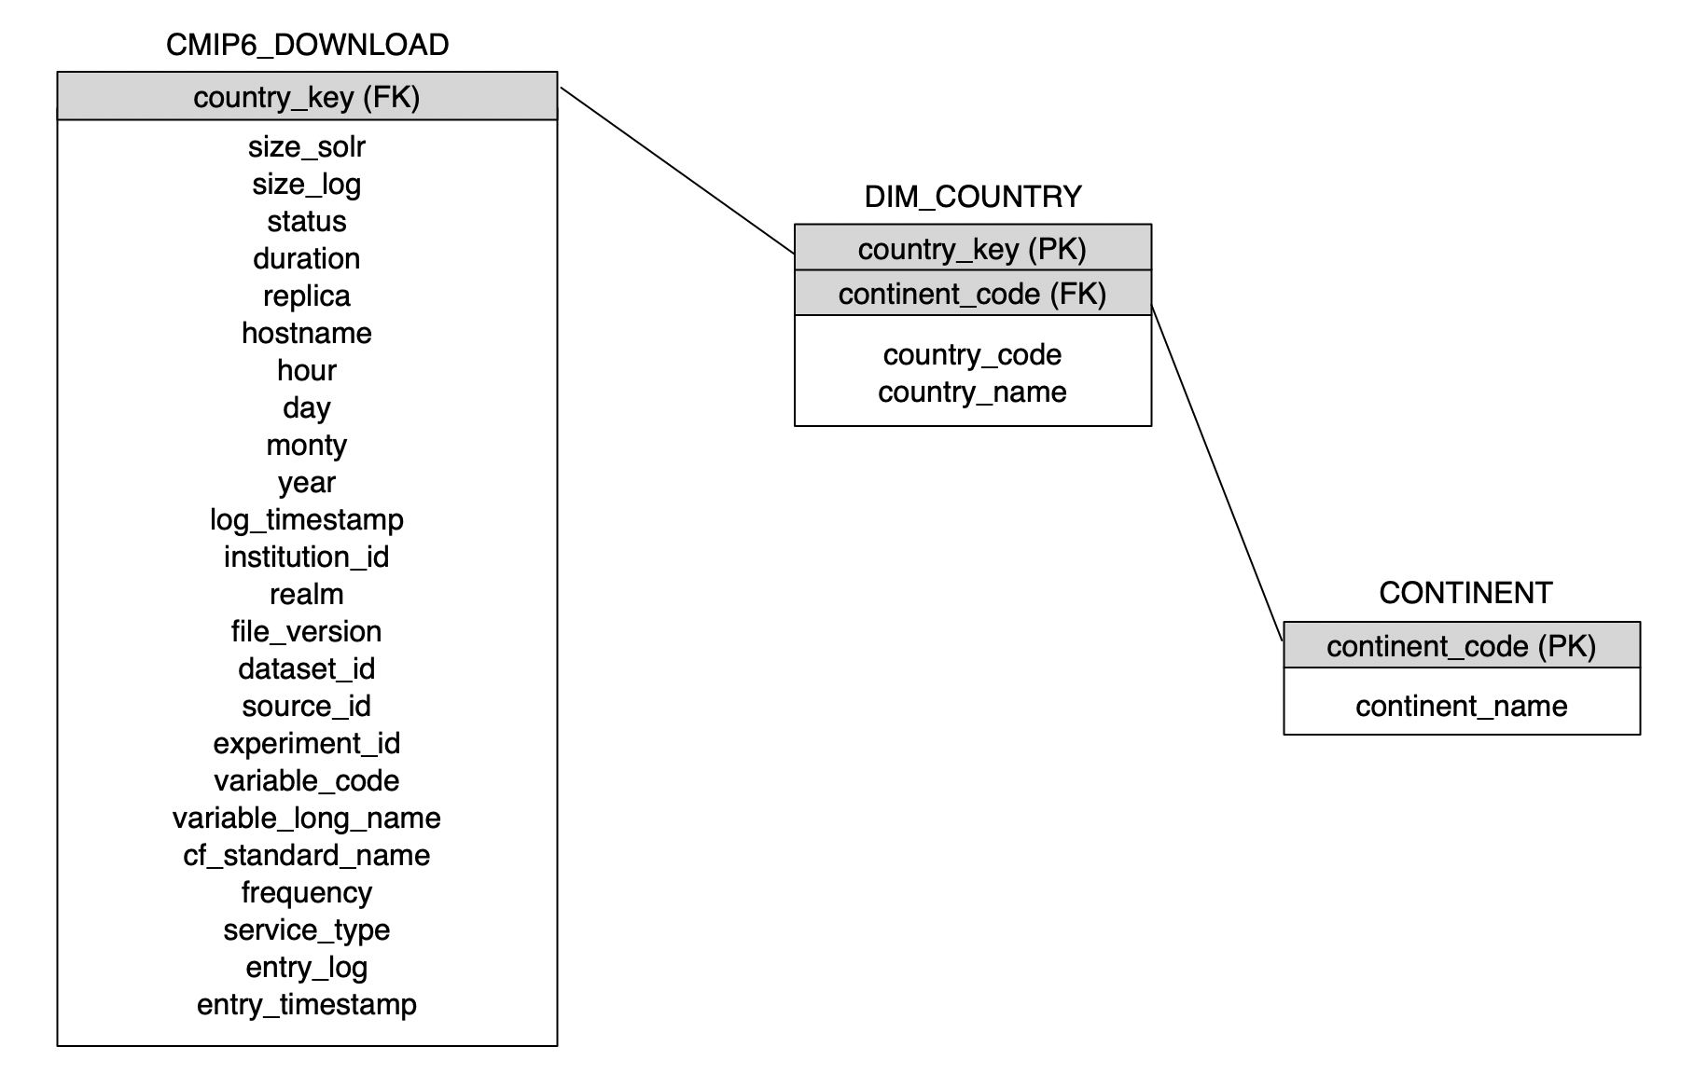
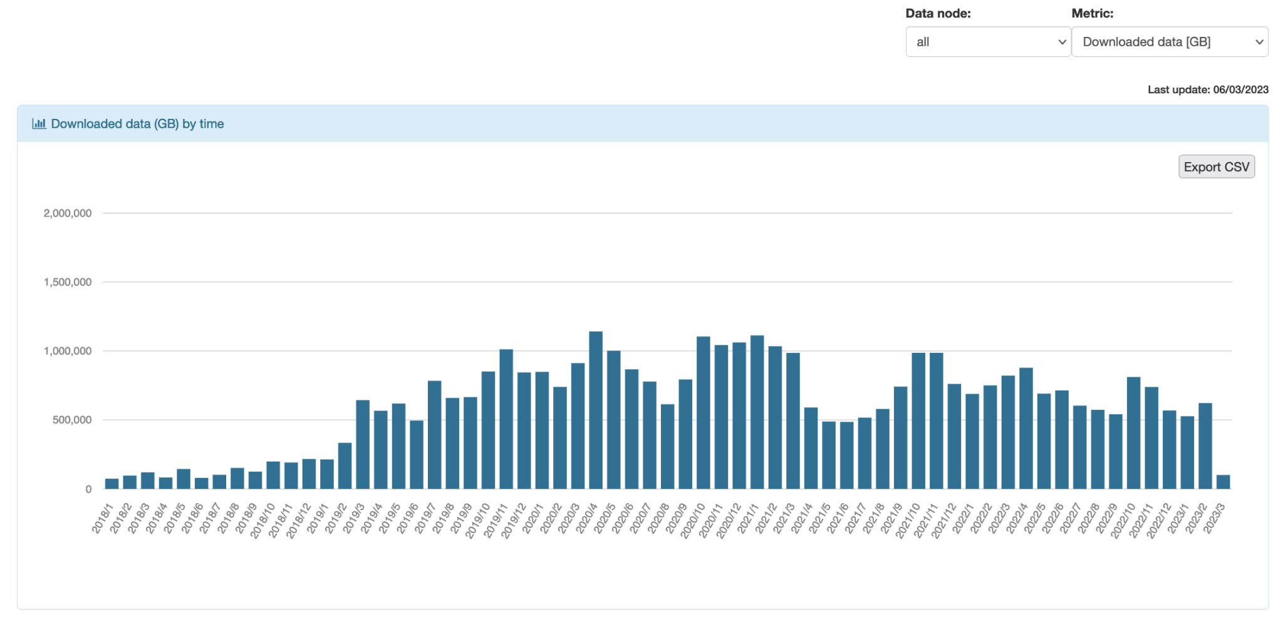
Tracking and reporting peta-scale data exploitation within the
Earth System Grid Federation through the ESGF Data Statistics service
A. Nuzzo¹, F. Antonio¹, M. Mirto¹, P. Nassisi¹, S.Fiore², G. Aloisio¹
¹ Fondazione Centro Euro-Mediterraneo sui Cambiamenti Climatici (CMCC), Lecce, Italy
² Department of Information Engineering and Computer Science, University of Trento, Italy
ESGF Catalog
Apache log
ESGF Data Node
Global Index Node
Analyzer
Logs collector server
Data warehouse system
Collector Node
http://esgf-ui.cmcc.it
IS-ENES3 has received funding from the European Union’s Horizon 2020 research and innovation programme under grant agreement No 824084

Slide 2
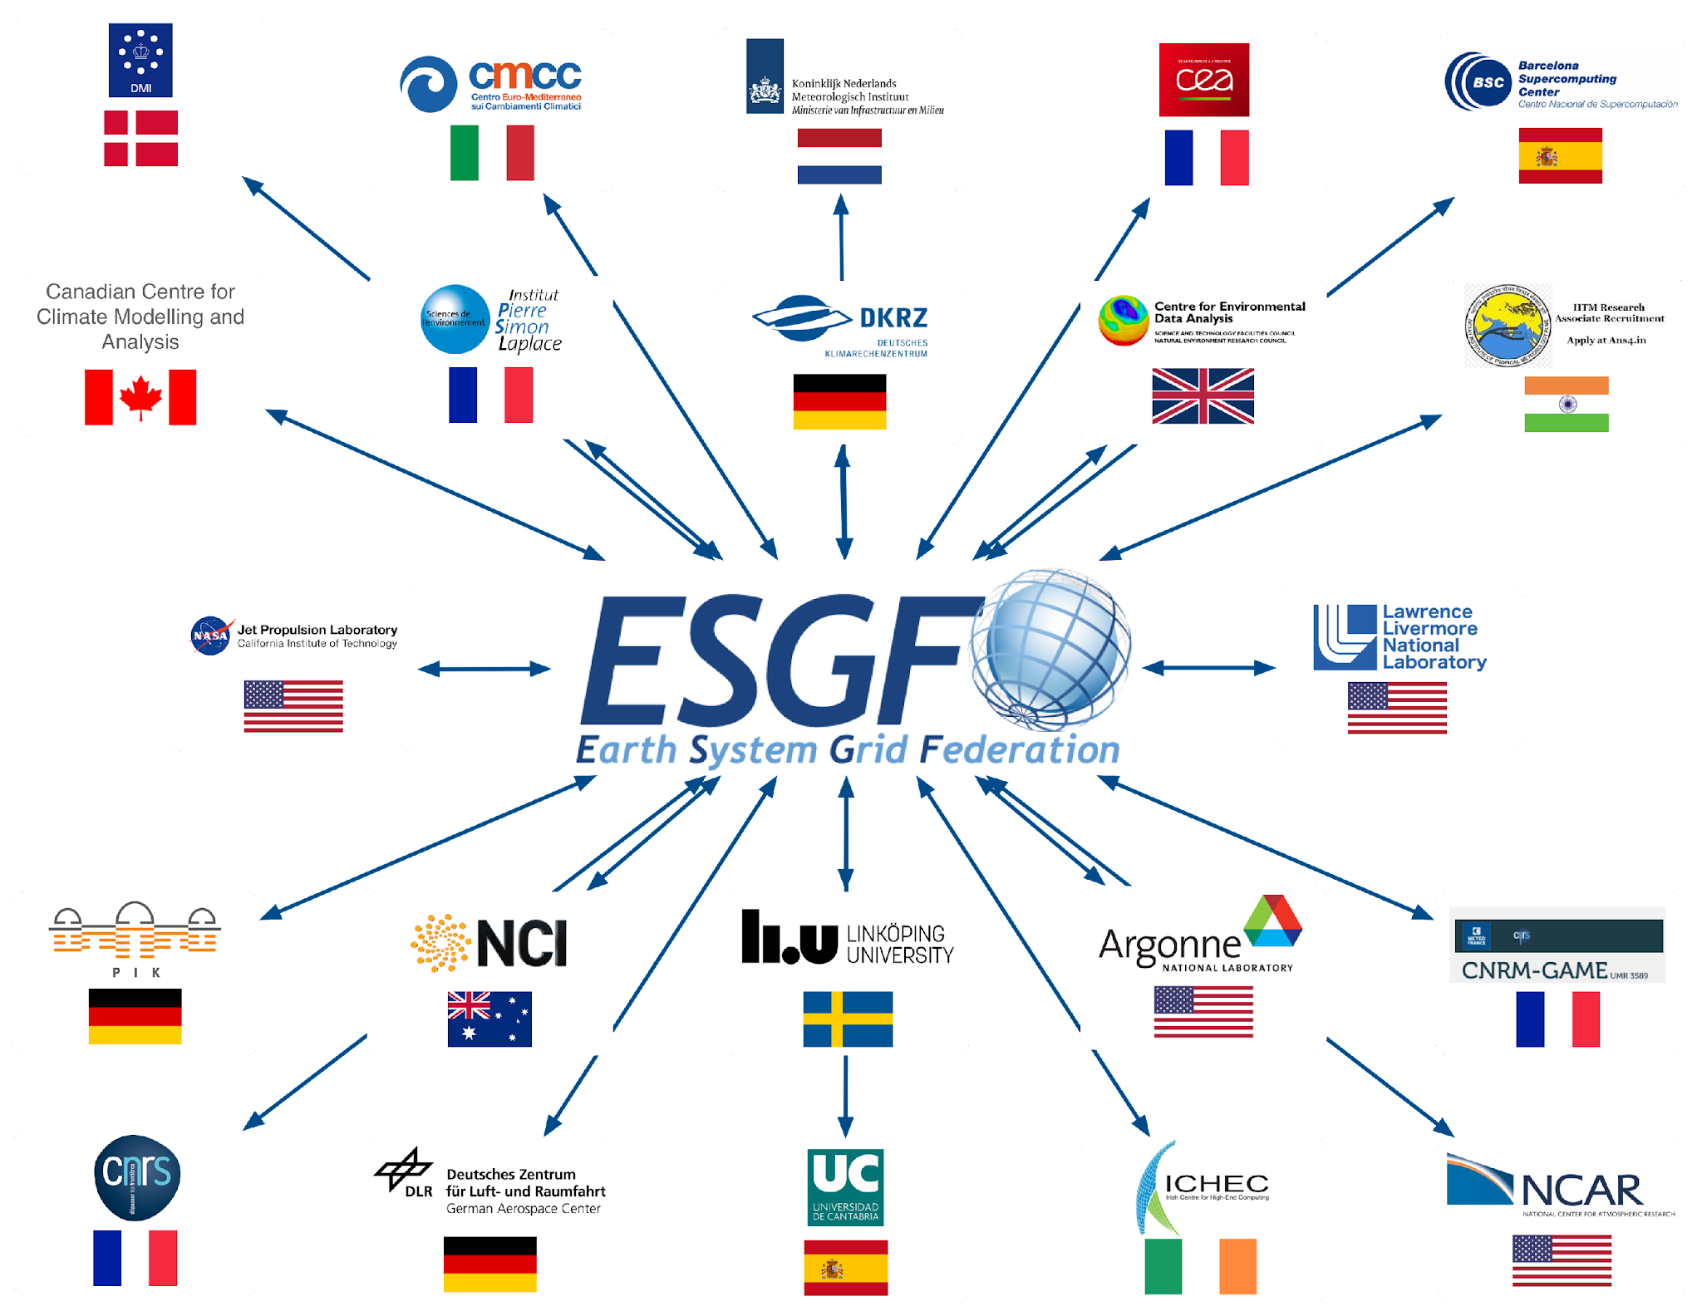
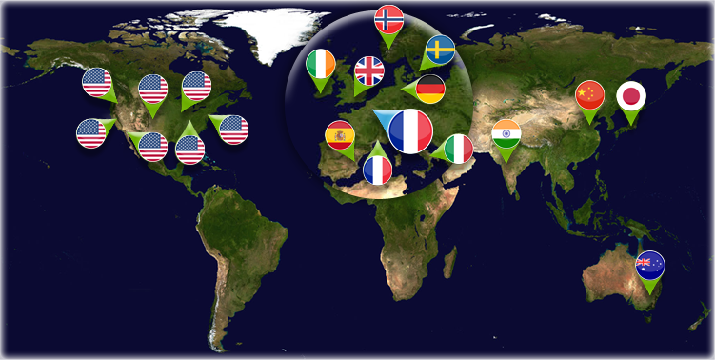
The Earth System Grid Federation (ESGF)
The Earth System Grid Federation (ESGF) is a globally distributed peer-to-peer network of data servers using a common set of protocols and interfaces to archive and distribute Earth system model output.
ESGF is one of the largest-ever collaborative data efforts in Earth system science that develops, deploys and maintains software to facilitate advancements in geophysical science
IS-ENES3 has received funding from the European Union’s Horizon 2020 research and innovation programme under grant agreement No 824084

Slide 3
ESGF main challenges
Some of the challenges that ESGF is committed to address include:
the enormous scale of the data holdings, moving from Peta-bytes to Exa-bytes
support for both model output and a wide variety of observational data
the distributed nature of the data archives, which are geographically distributed and autonomously operated
the need to enable users to access and analyse data with a wide variety of client tools
the need to harmonize and federate multiple local access policies
IS-ENES3 has received funding from the European Union’s Horizon 2020 research and innovation programme under grant agreement No 824084

Slide 4
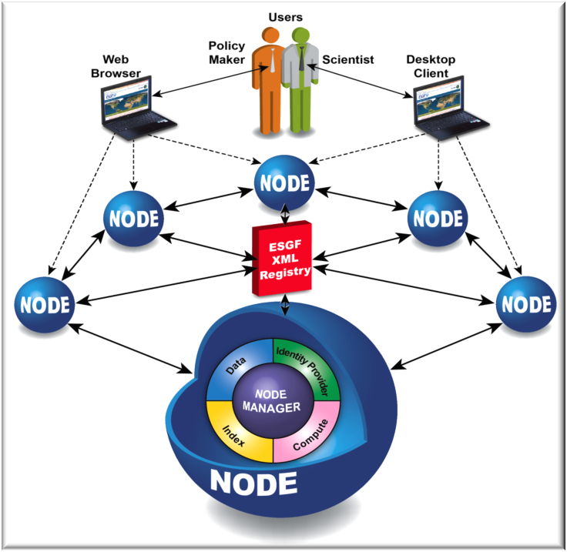
Earth System Grid Federation architecture
Using a system of geographically distributed peer nodes, ESGF holds the premier collection of simulations and observational and reanalysis data for climate change research.
Data node: access to data
Index node: indexing & searching
Identity Provider node: federated user authentication
Compute node: data analysis capabilities
IS-ENES3 has received funding from the European Union’s Horizon 2020 research and innovation programme under grant agreement No 824084

Slide 5
CMCC involvement in ESGF
Design, development, bug fixing and maintenance of a software module for data usage statistics
Leadership of the ESGF Data Statistics Working Group (https://esgf.llnl.gov/working-groups.html) since 2016
Member of the CMIP Data Node Operation Team (CDNOT) since 2017
Hosting and maintenance of two ESGF data nodes for publishing datasets
Research visit at Program for Climate Model Diagnosis and Intercomparison (PCMDI) at the Lawrence Livermore National Laboratory (LLNL) in Livermore (CA) from October 2016 to December 2016
Sandro Fiore
Paola Nassisi
Maria Mirto
Fabrizio Antonio
other CMCC/ASC people
IS-ENES3 has received funding from the European Union’s Horizon 2020 research and innovation programme under grant agreement No 824084

Slide 6
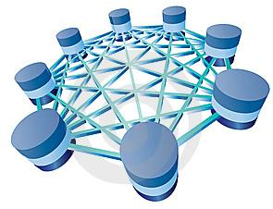
The ESGF Data Statistics service context
Distributed and decentralized database
tens of federated sites
more than 34 Petabytes
about 35 projects
more than 14 millions datasets
How to get statistics from the sites?
IS-ENES3 has received funding from the European Union’s Horizon 2020 research and innovation programme under grant agreement No 824084

Slide 7
The ESGF Data Statistics service
Collects and stores a high volume of heterogeneous metrics, covering data download statistics as well as the status of the federated archive in terms of published datasets, models and istitutes. etc.
How much, how frequently and how intensively the federation is being exploited by the end-users
The amount of downloaded data
The data available through the federation
The most
downloaded data
The less
accessed data
Useful insights on the long tail of research
IS-ENES3 has received funding from the European Union’s Horizon 2020 research and innovation programme under grant agreement No 824084

Slide 8
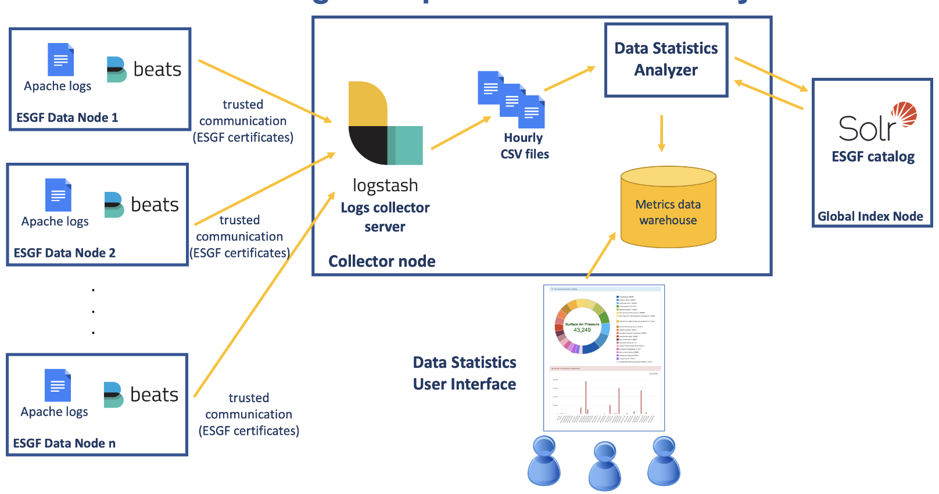
The ESGF Data Statistics architecture
IS-ENES3 has received funding from the European Union’s Horizon 2020 research and innovation programme under grant agreement No 824084

Slide 9
Data node side: HTTPD configuration
IS-ENES3 has received funding from the European Union’s Horizon 2020 research and innovation programme under grant agreement No 824084

Slide 10
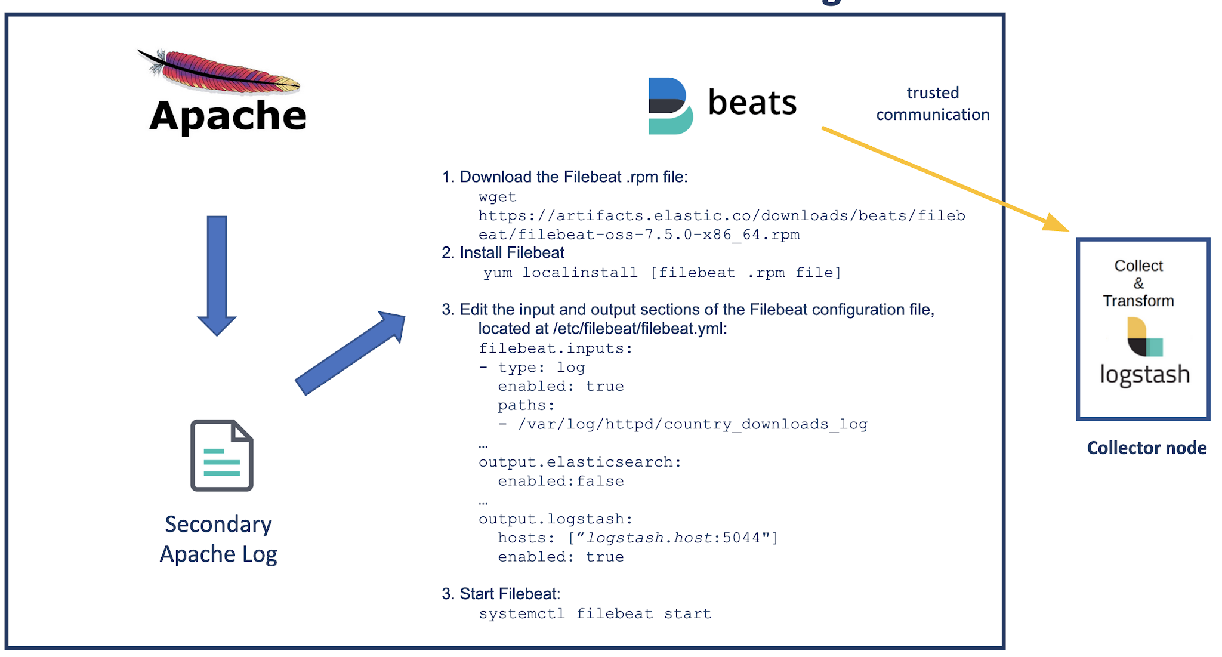
Data node side: Filebeat configuration
IS-ENES3 has received funding from the European Union’s Horizon 2020 research and innovation programme under grant agreement No 824084

Slide 11
Collector node side: Logstash configuration
IS-ENES3 has received funding from the European Union’s Horizon 2020 research and innovation programme under grant agreement No 824084

Slide 12
The data warehouse system – Cross-project
IS-ENES3 has received funding from the European Union’s Horizon 2020 research and innovation programme under grant agreement No 824084

Slide 13
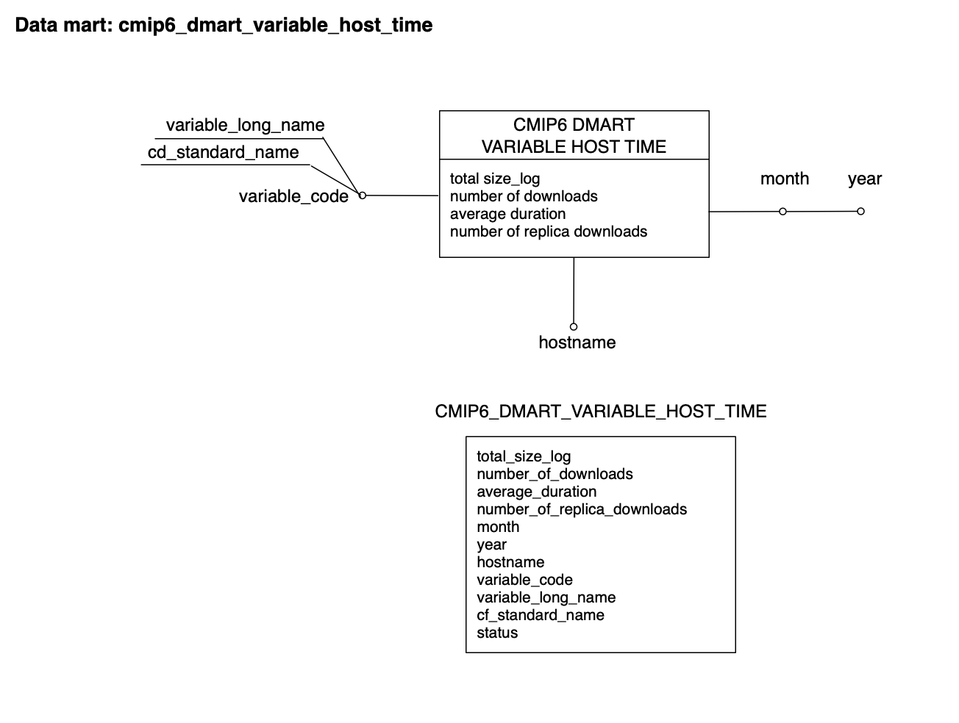
The data warehouse system – CMIP6 project
IS-ENES3 has received funding from the European Union’s Horizon 2020 research and innovation programme under grant agreement No 824084

Slide 14
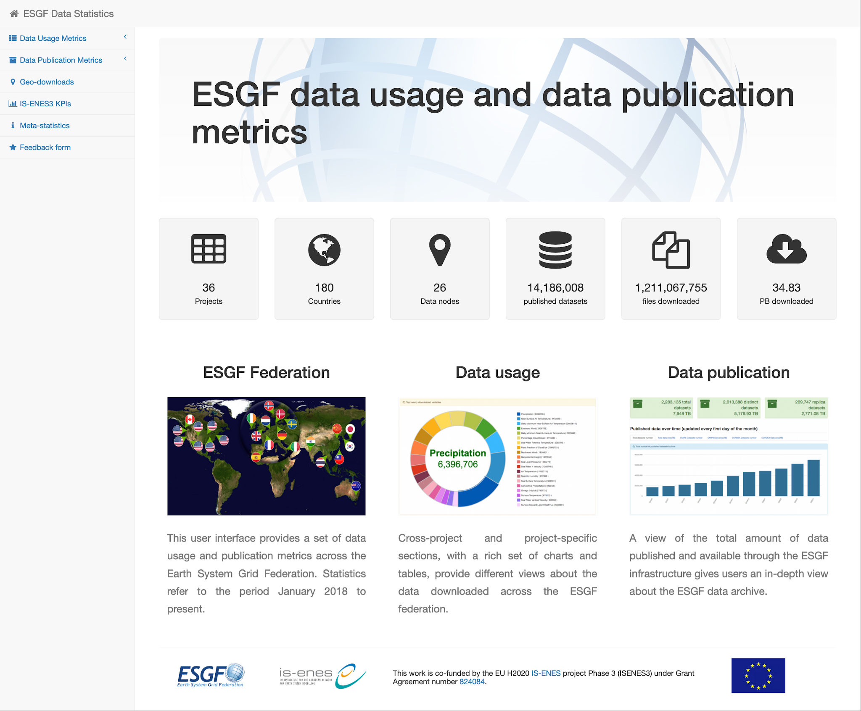
The Community Gateway
ESGF Data Statistics User Interface provides user-friendly access to a comprehensive set of data usage and data archive metrics across the whole ESGF.
http://esgf-ui.cmcc.it
IS-ENES3 has received funding from the European Union’s Horizon 2020 research and innovation programme under grant agreement No 824084

Slide 15
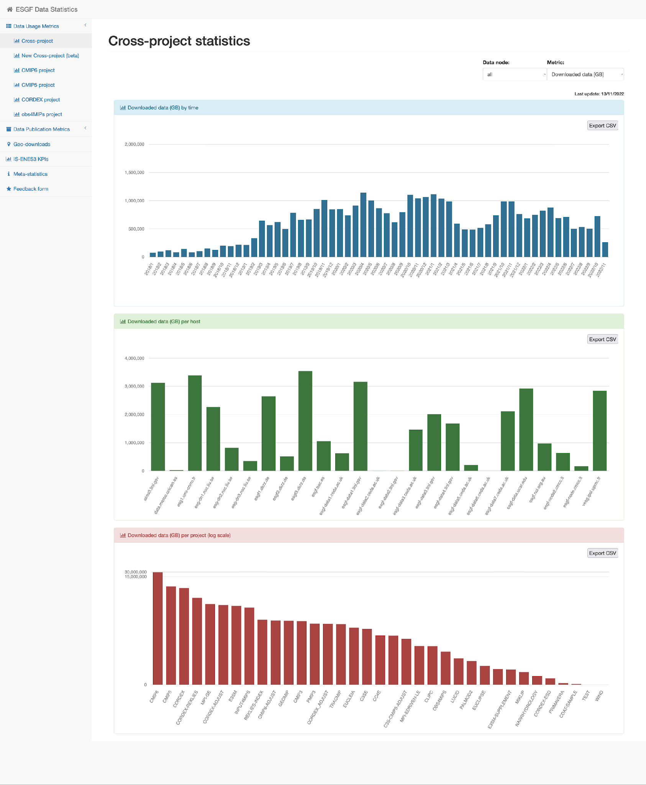
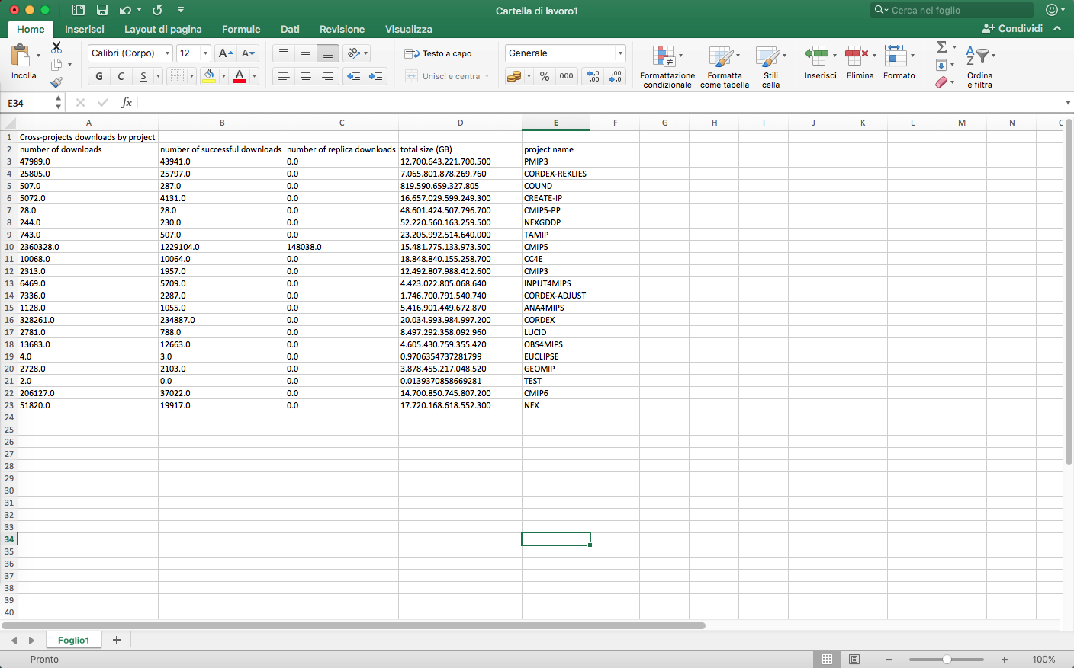
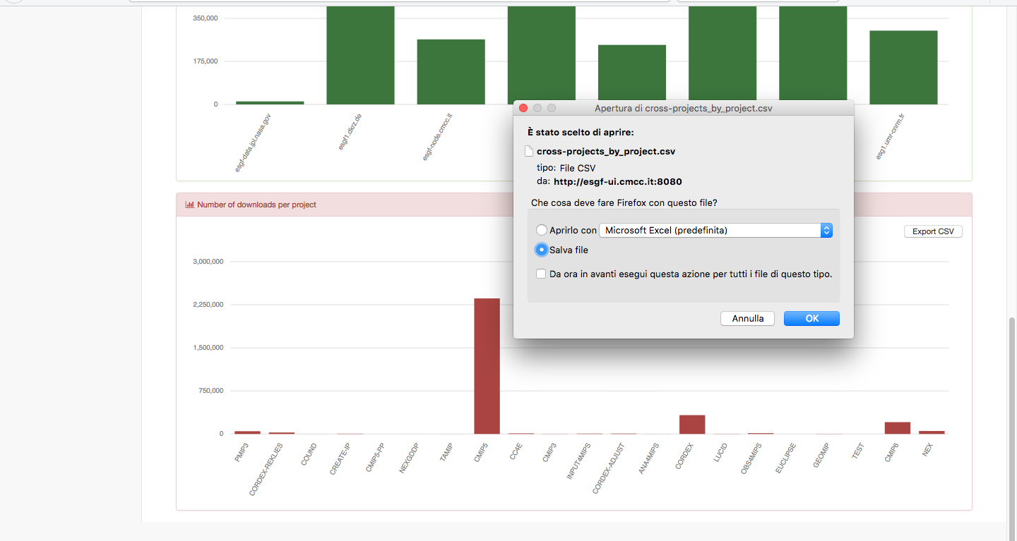
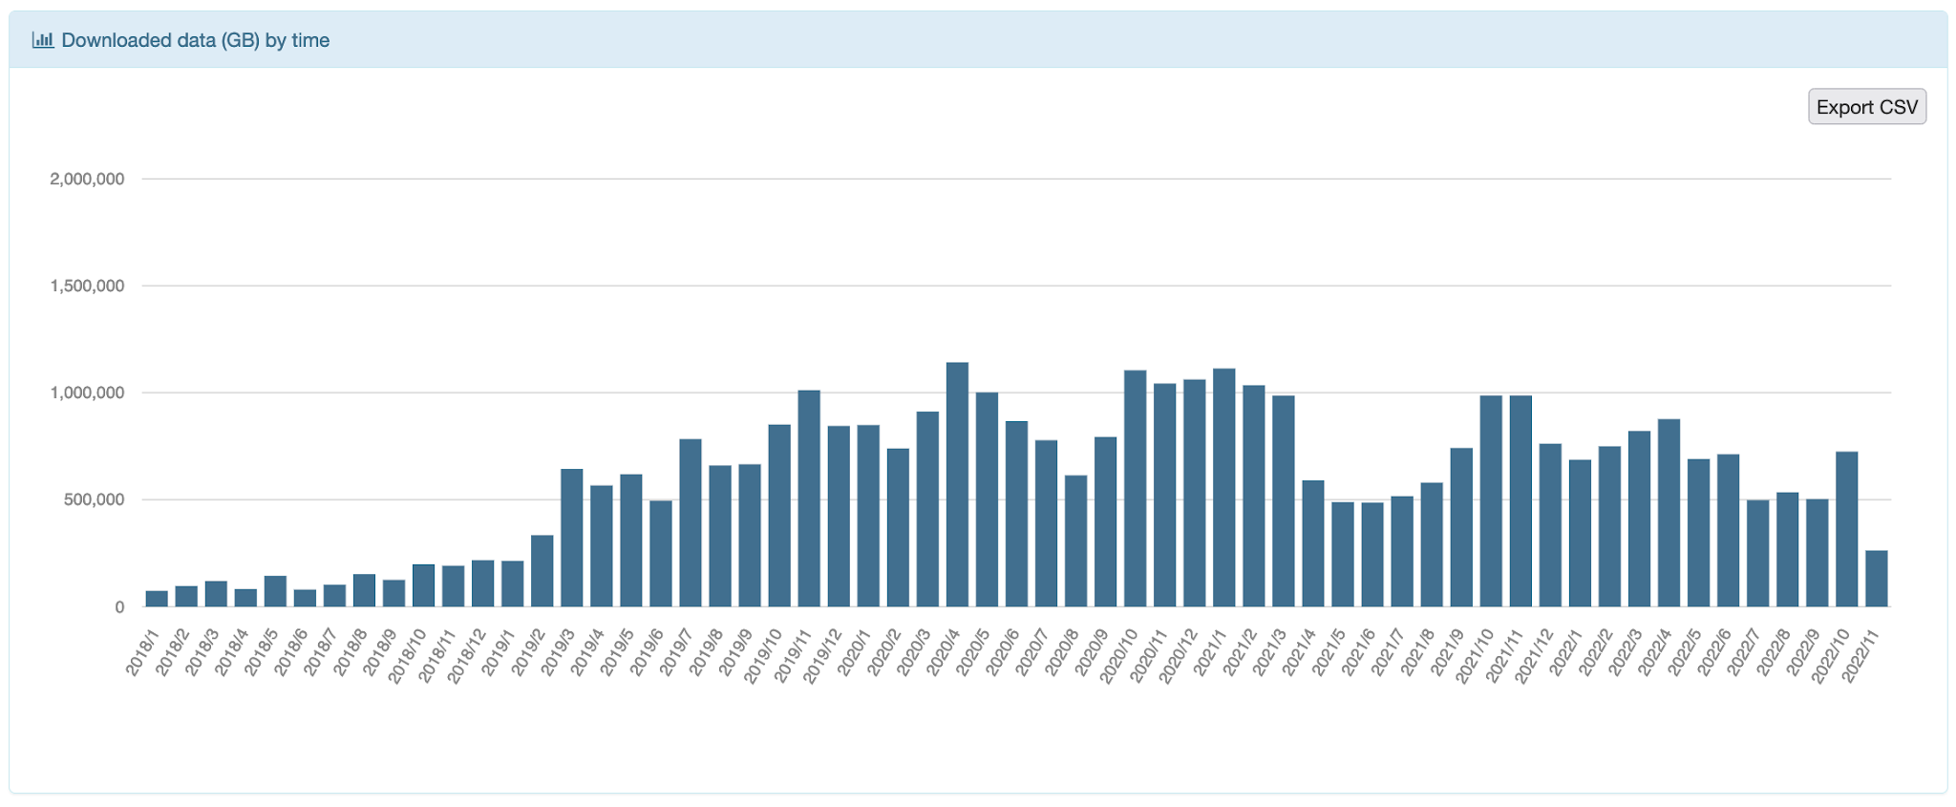
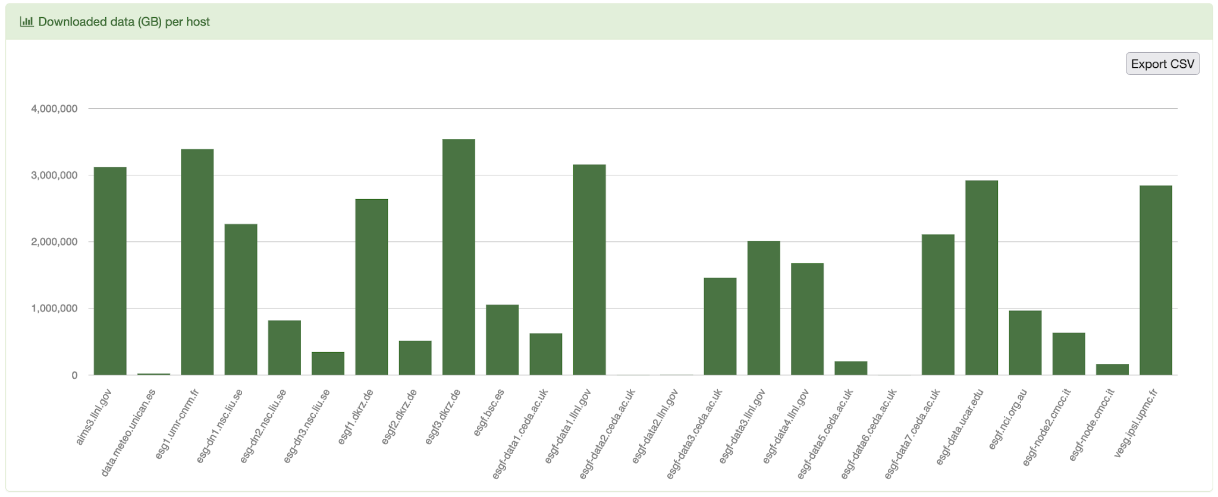
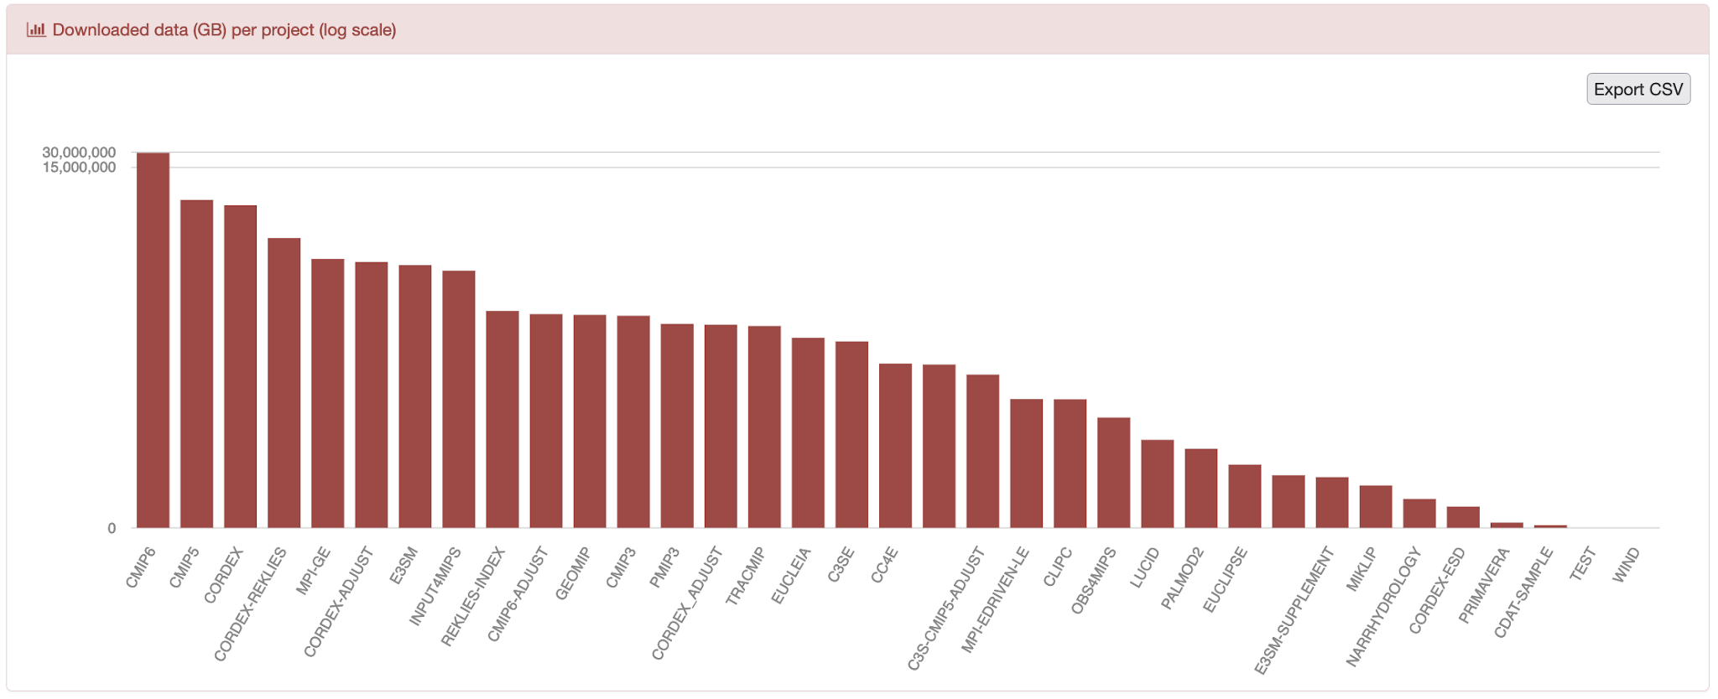
Cross-projects statistics
Metrics such as number of downloads and downloaded data are visualized in several widgets grouping the information by time, by host and by project.
IS-ENES3 has received funding from the European Union’s Horizon 2020 research and innovation programme under grant agreement No 824084

Slide 16
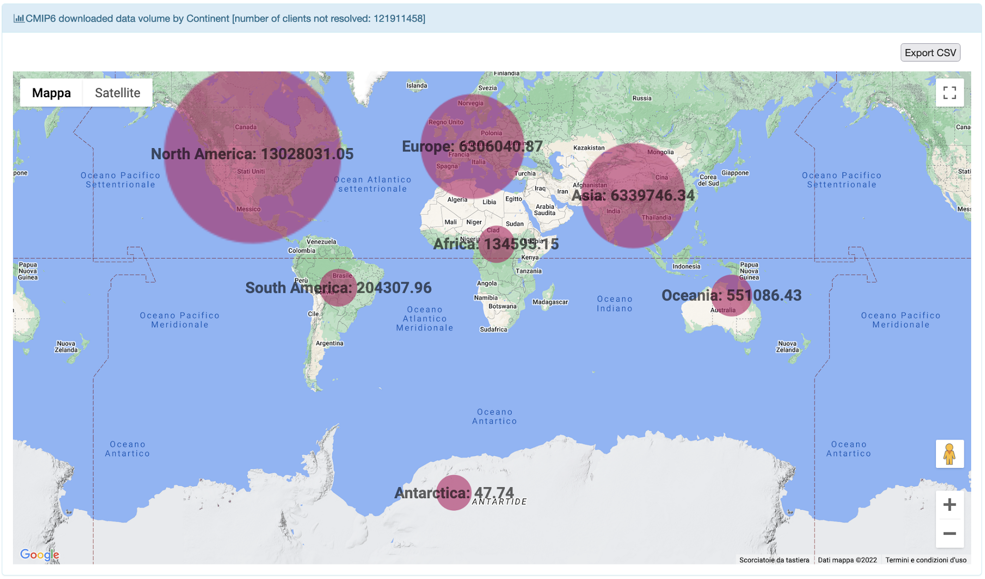
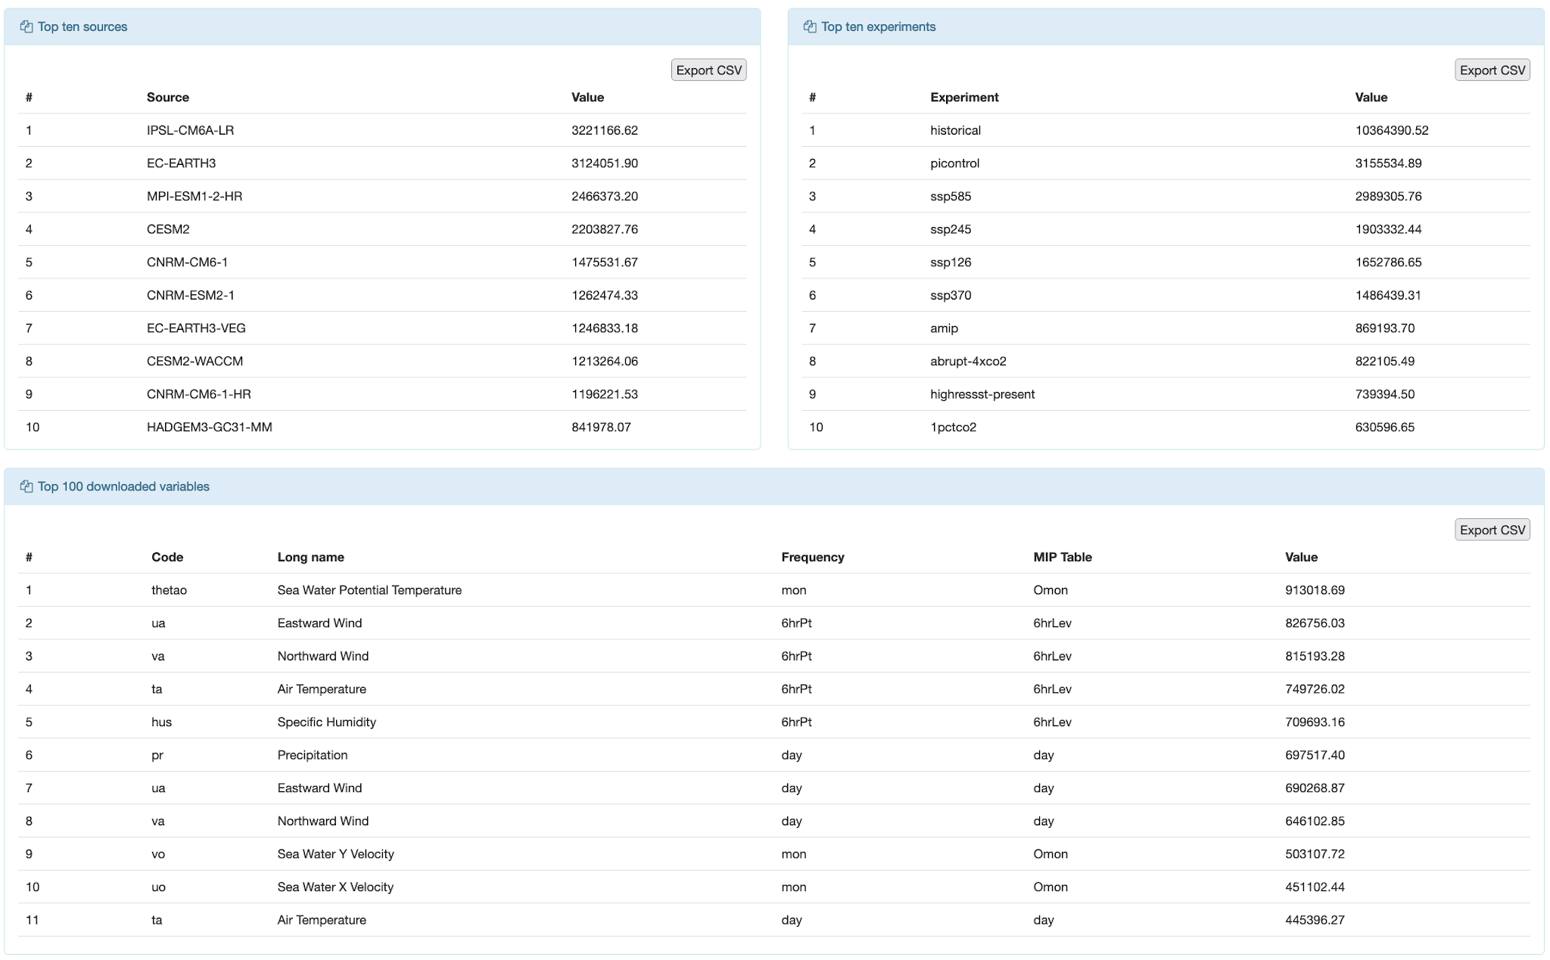
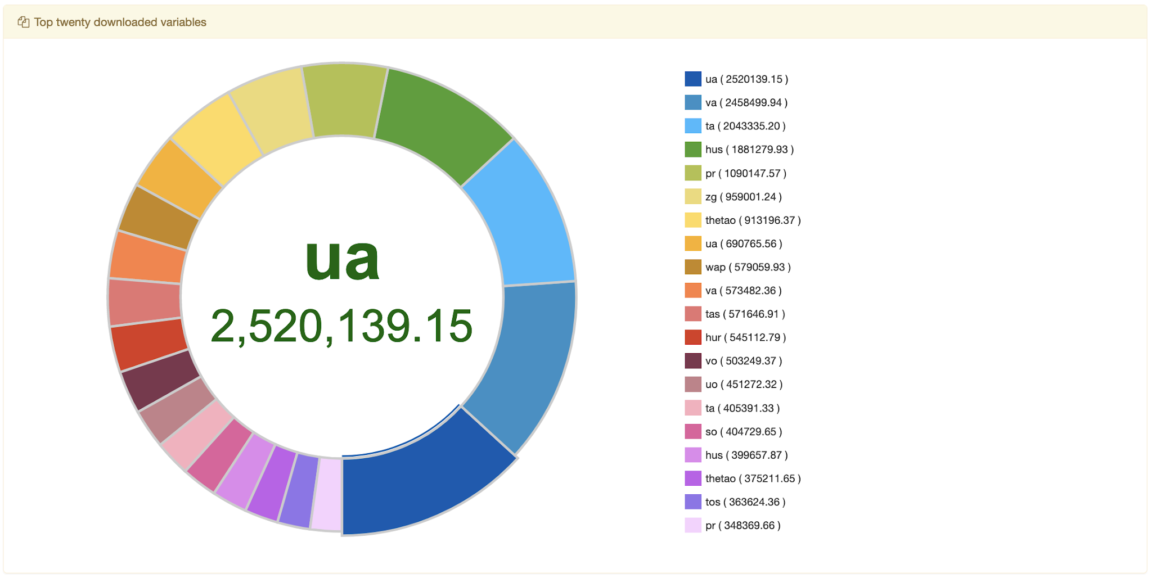
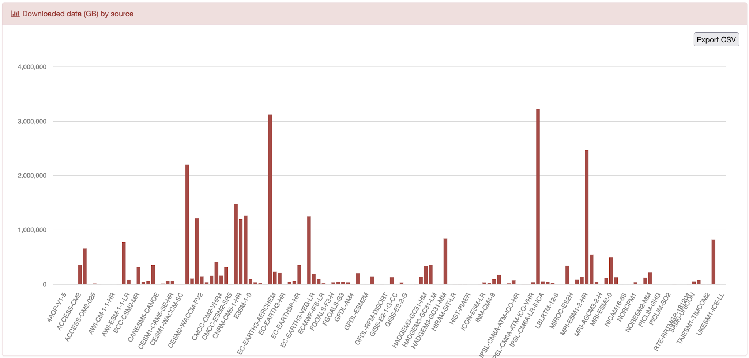
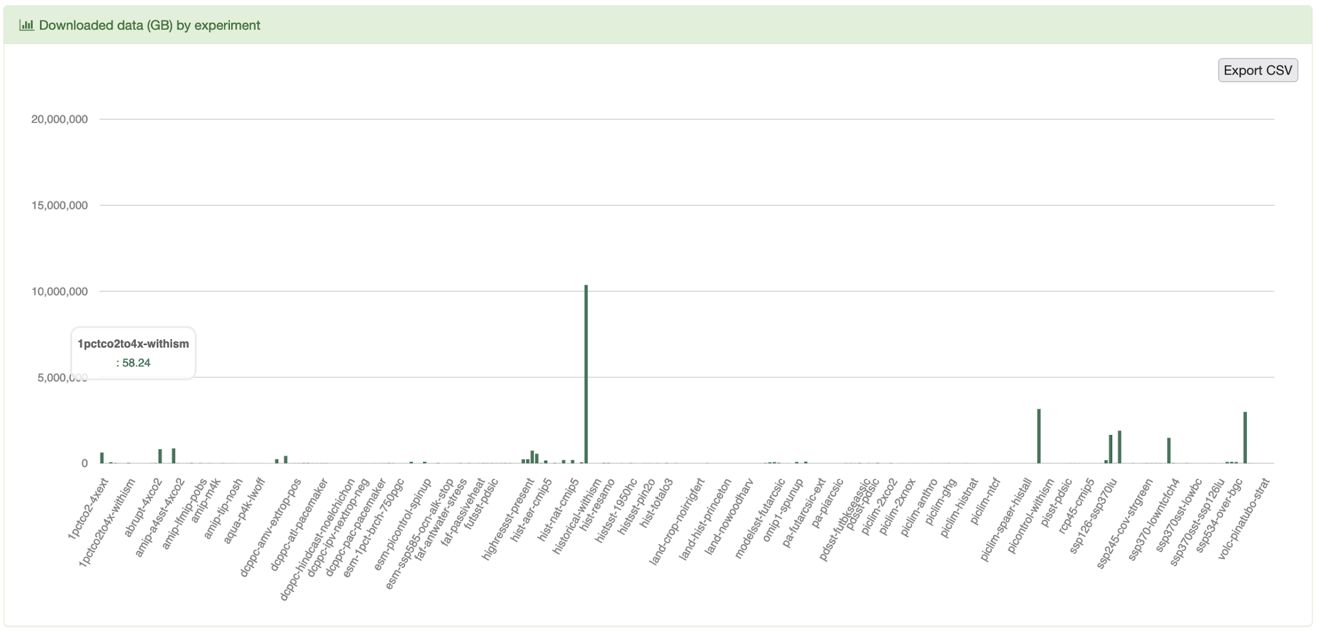
Project-specific statistics (CMIP6)
IS-ENES3 has received funding from the European Union’s Horizon 2020 research and innovation programme under grant agreement No 824084

Slide 17
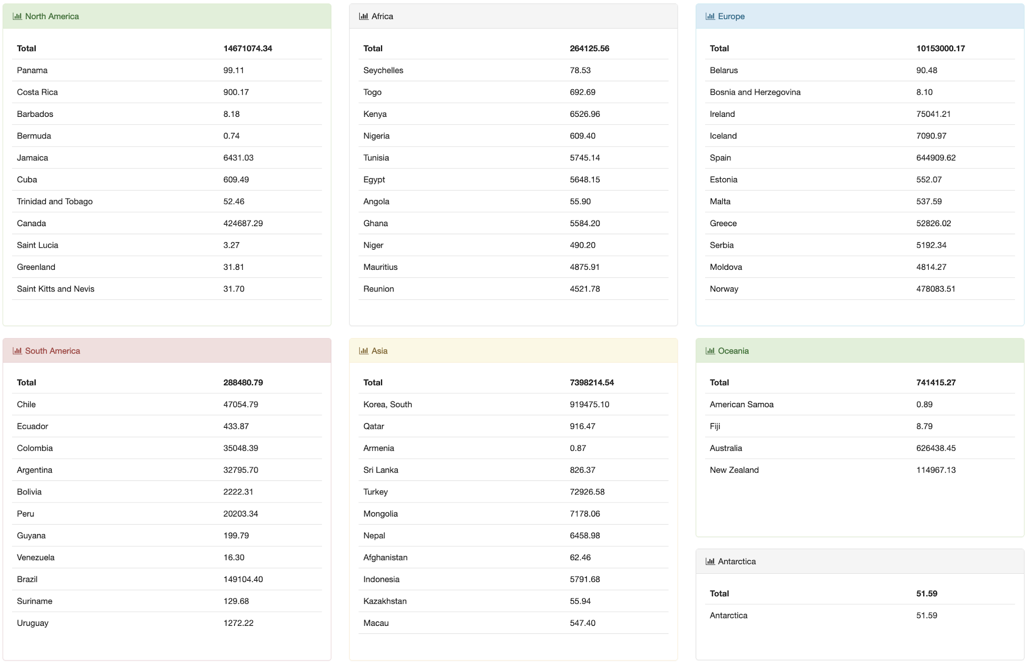
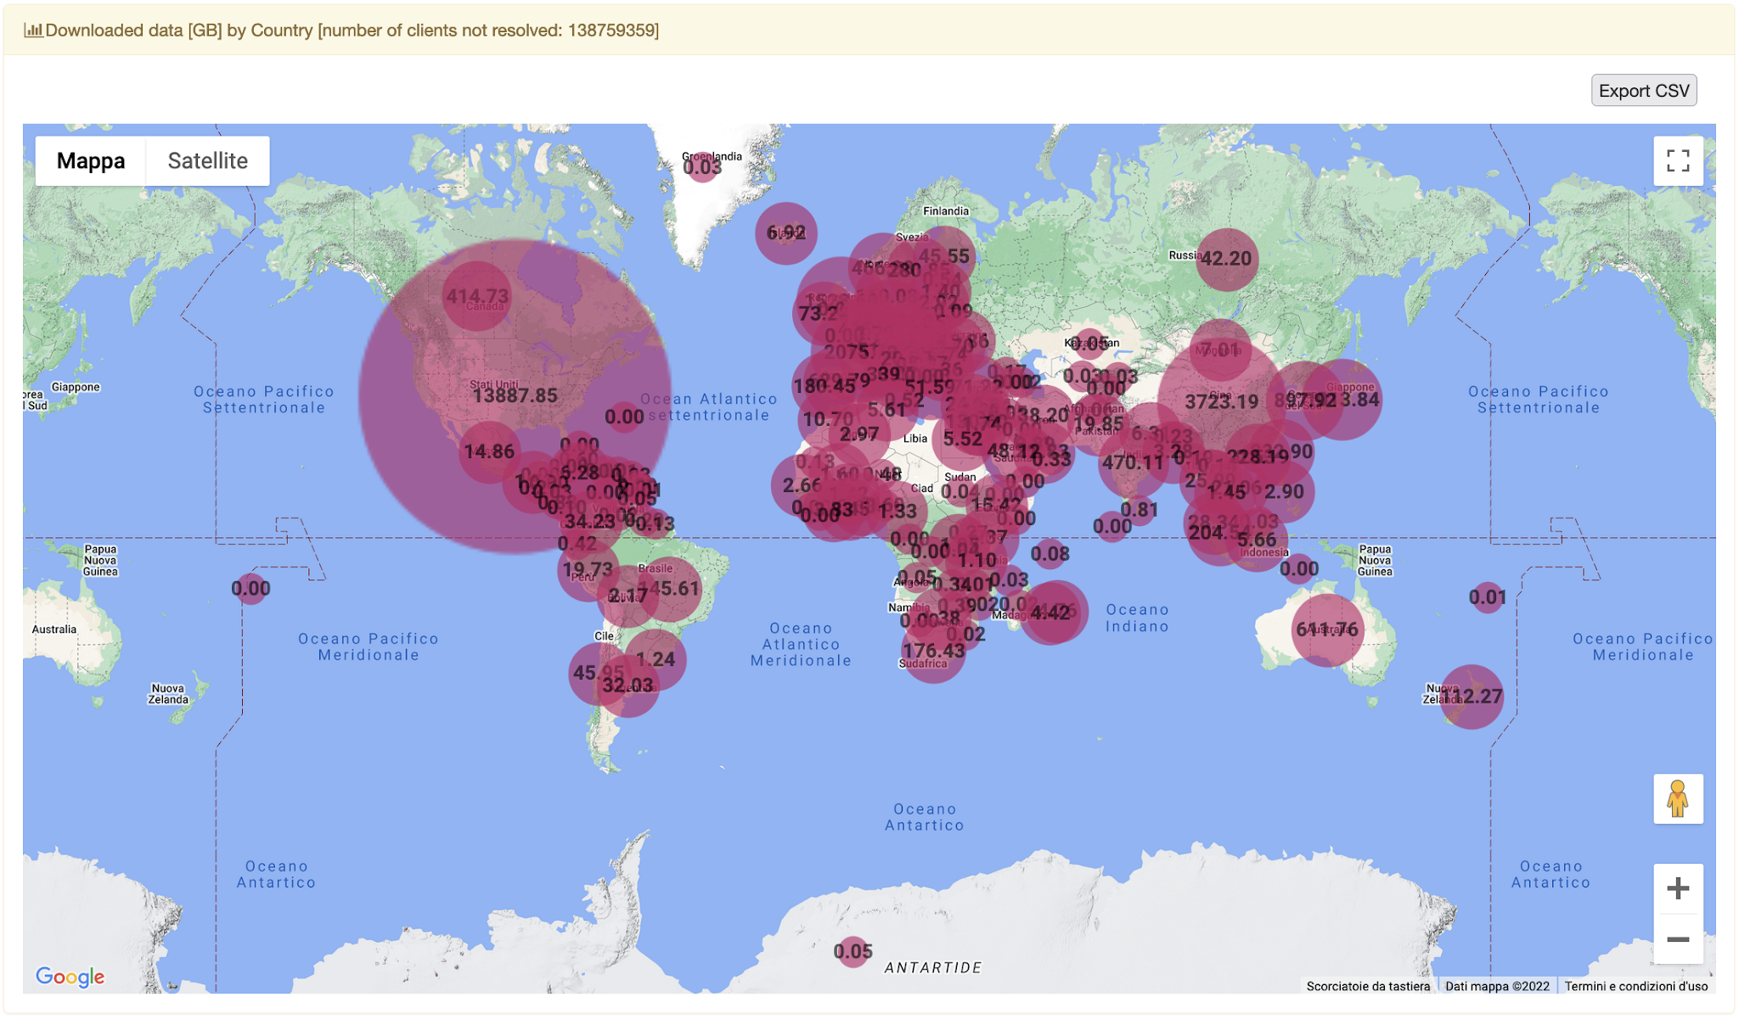
Geo downloads
IS-ENES3 has received funding from the European Union’s Horizon 2020 research and innovation programme under grant agreement No 824084

Slide 18
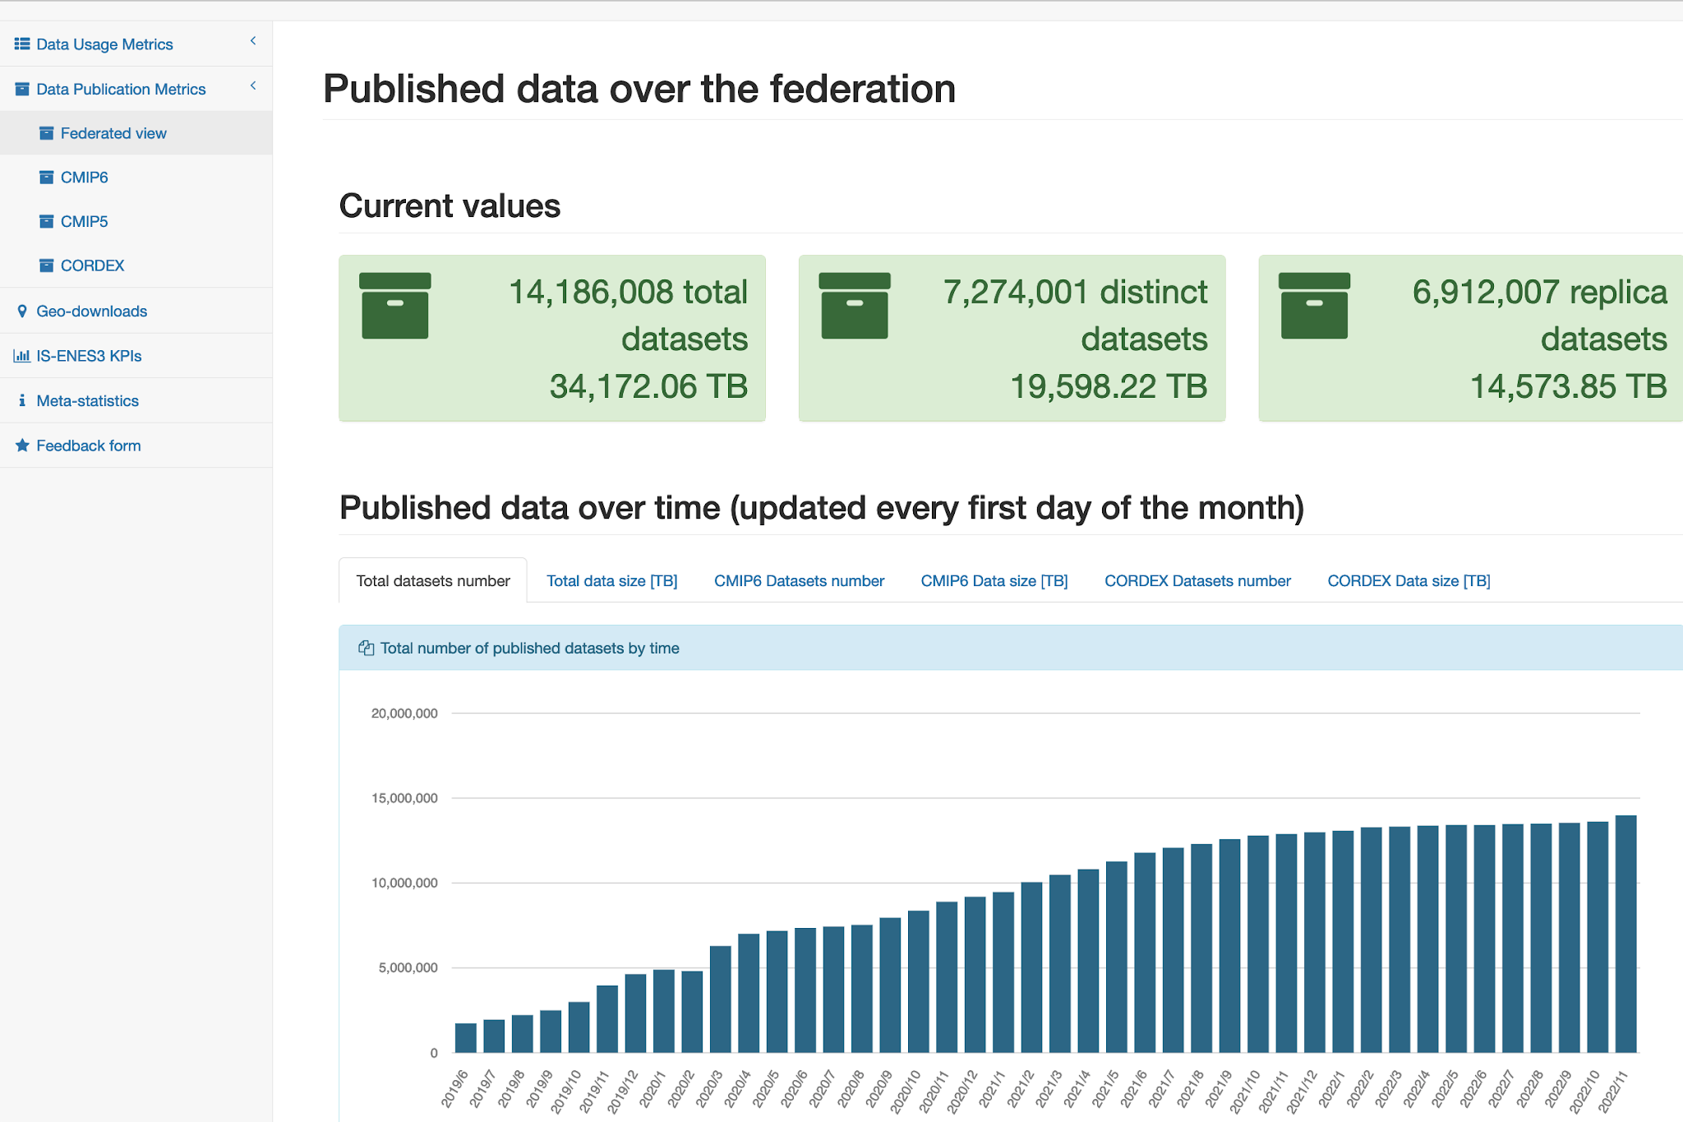
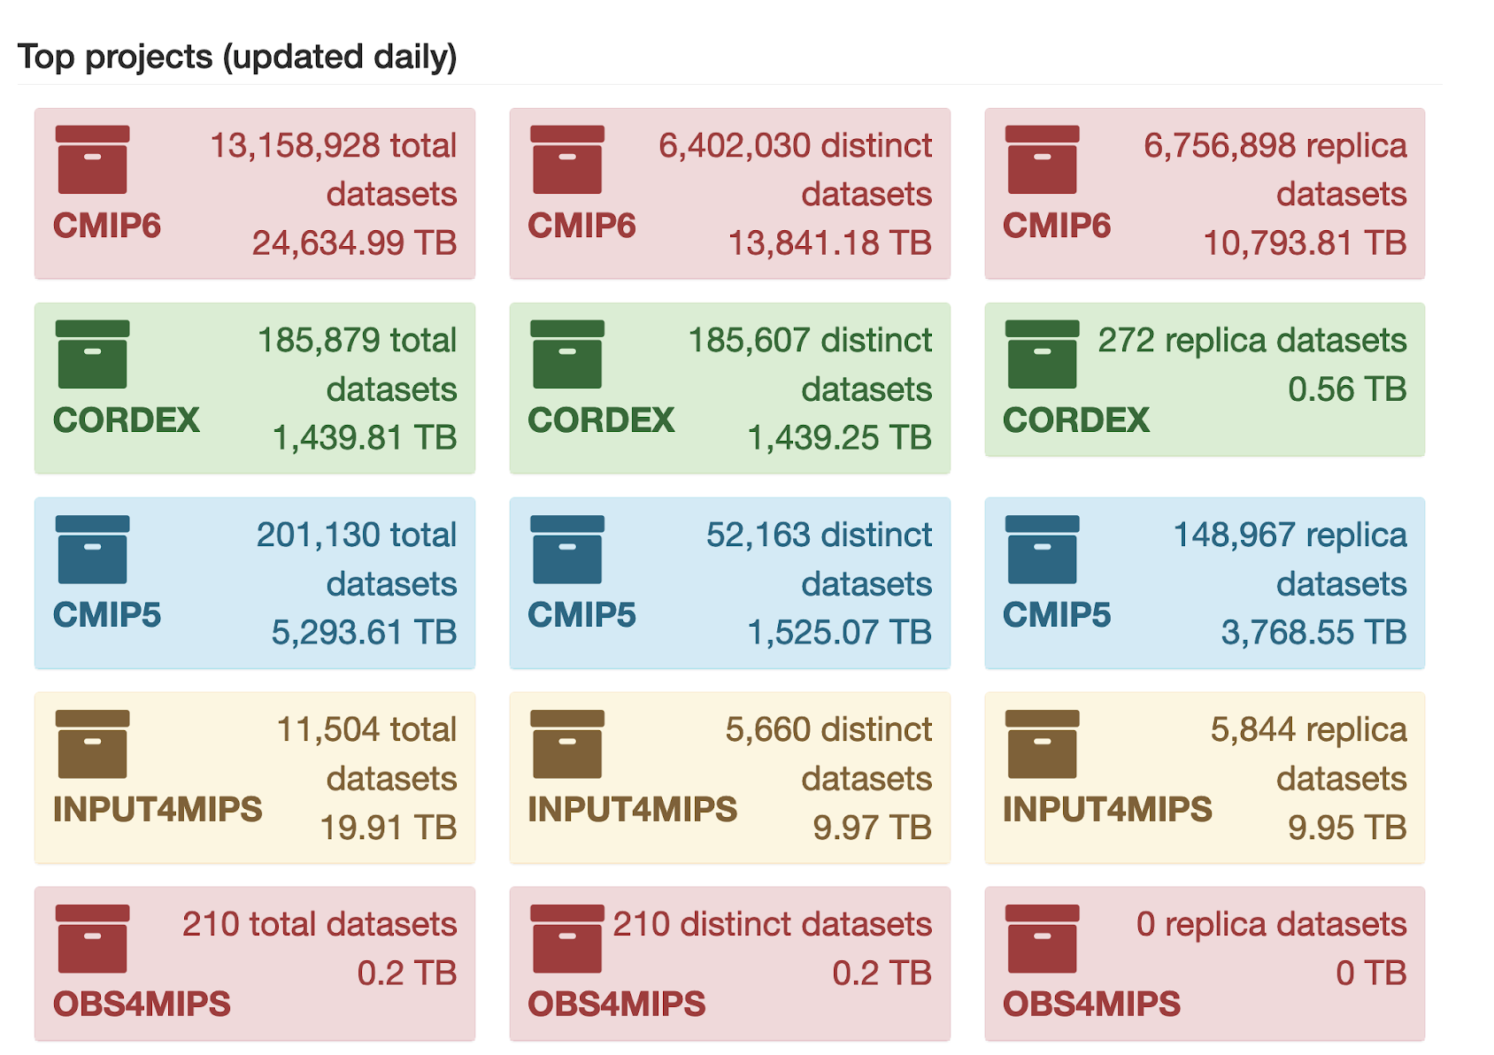
Data Publication Metrics section (Federated view)
Total number of datasets and
data volume (in TB)
Total number of distinct datasets
and data volume (in TB)
Total number of replica datasets
and data volume (in TB)
Total datasets, distinct and replica
datasets and data volume (in TB)
for CMIP6, CMIP5, INPUT4MIPS,
OBS4MIPS, CORDEX projects.
The projects have been considered based on the community’s requests and others can be easily added.
IS-ENES3 has received funding from the European Union’s Horizon 2020 research and innovation programme under grant agreement No 824084

Slide 19
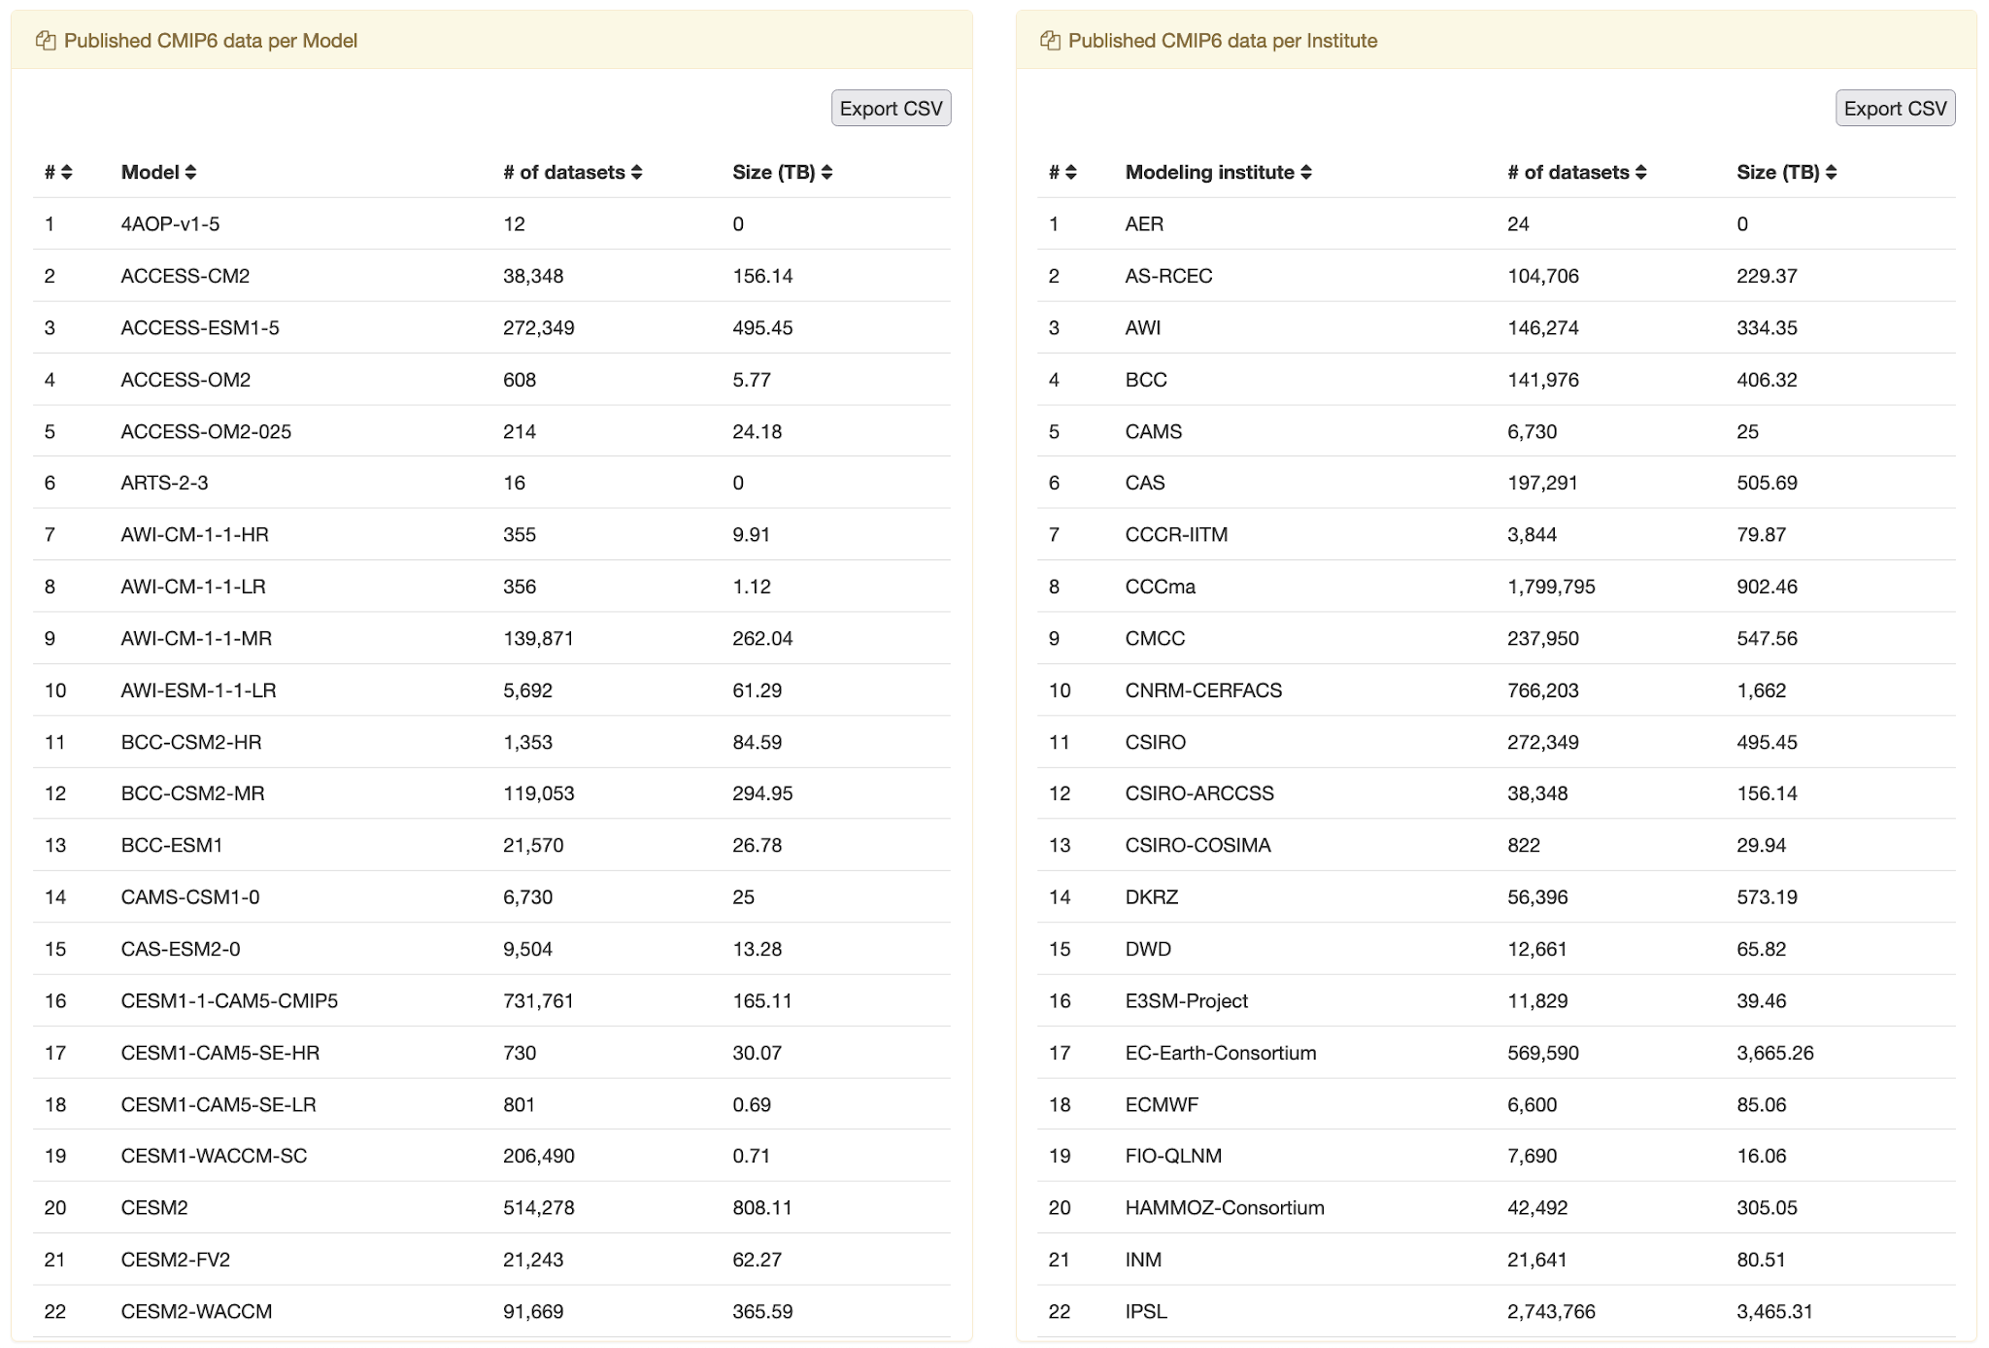
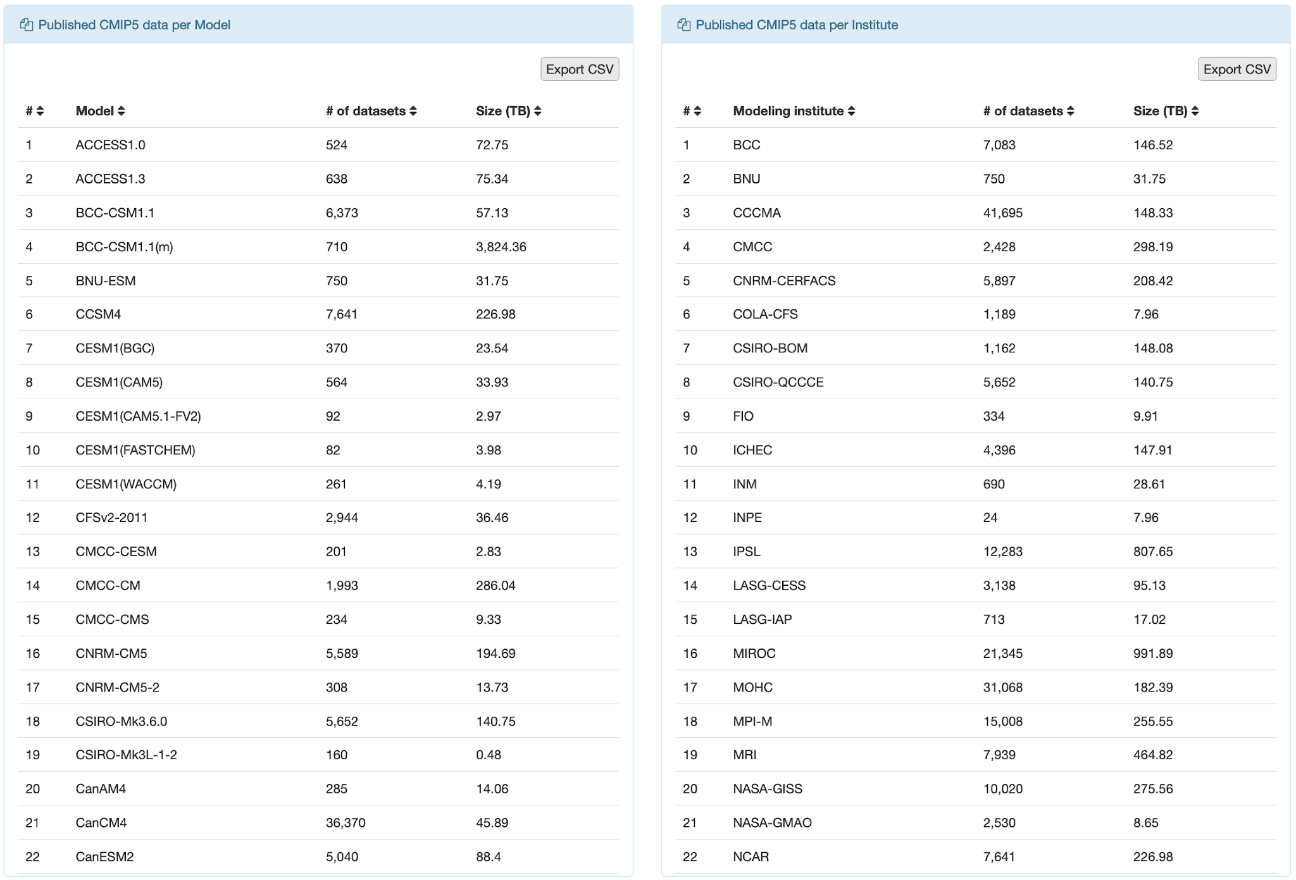
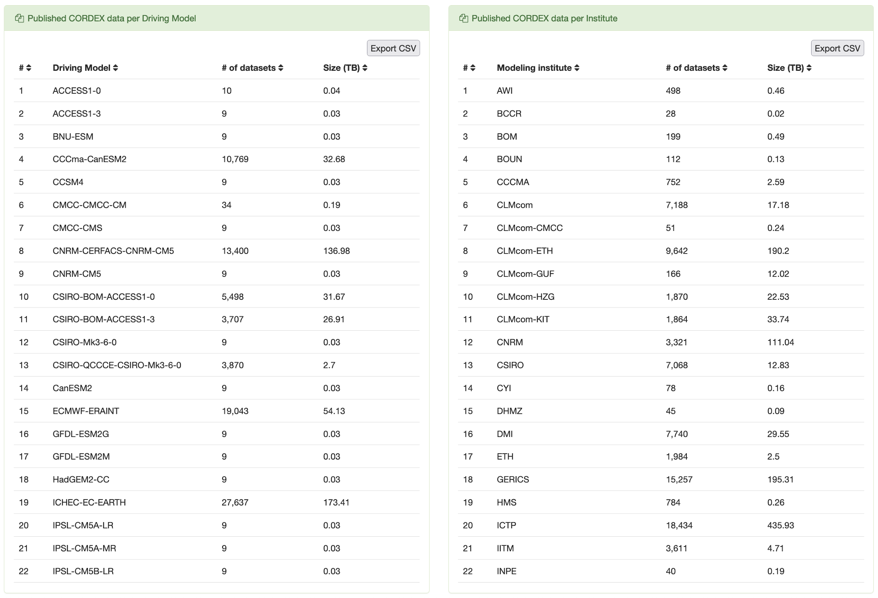
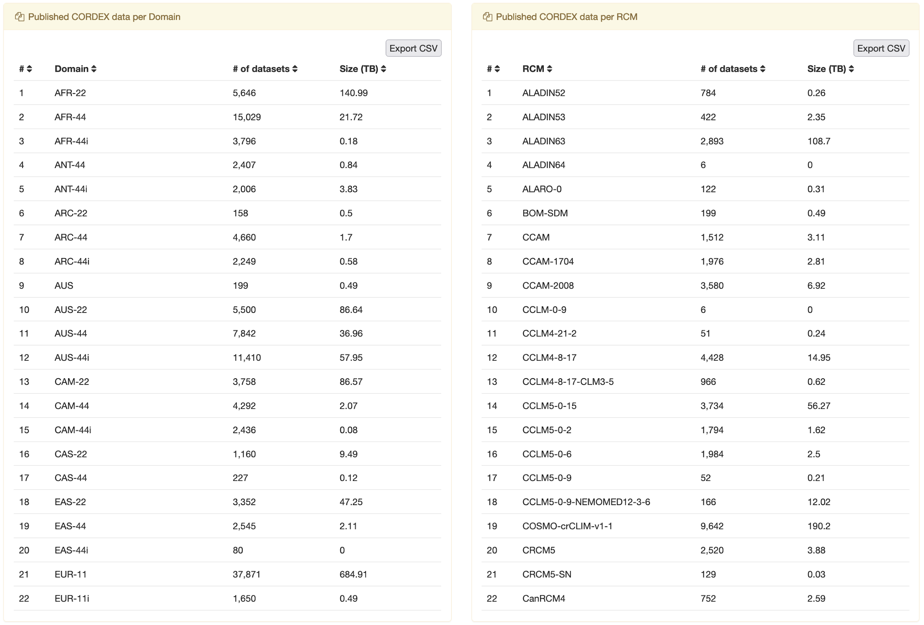
Data Publication Metrics section (projects’ view)
Specific views on the main projects across the entire federation.
IS-ENES3 has received funding from the European Union’s Horizon 2020 research and innovation programme under grant agreement No 824084

Slide 20
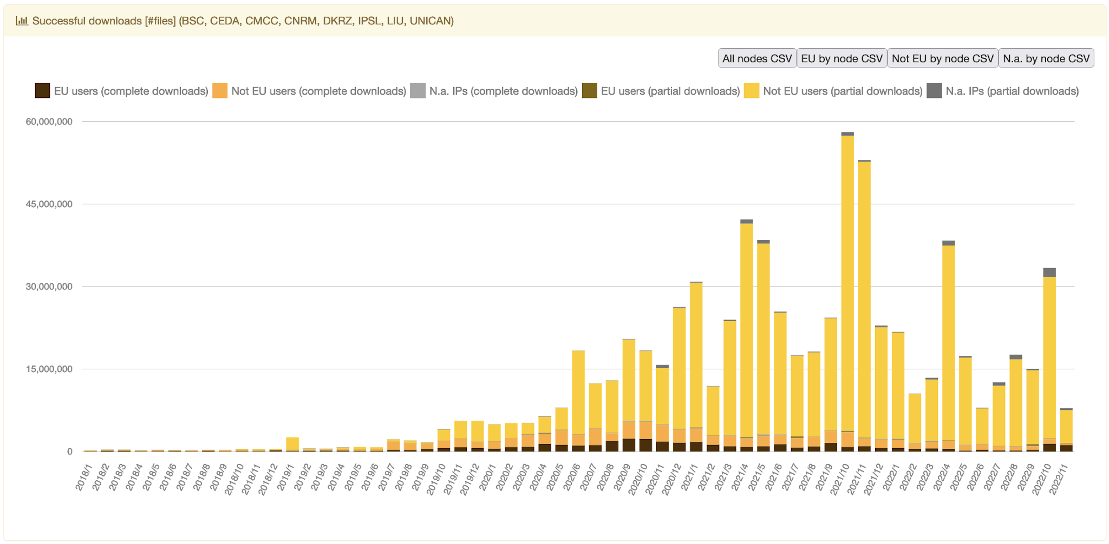
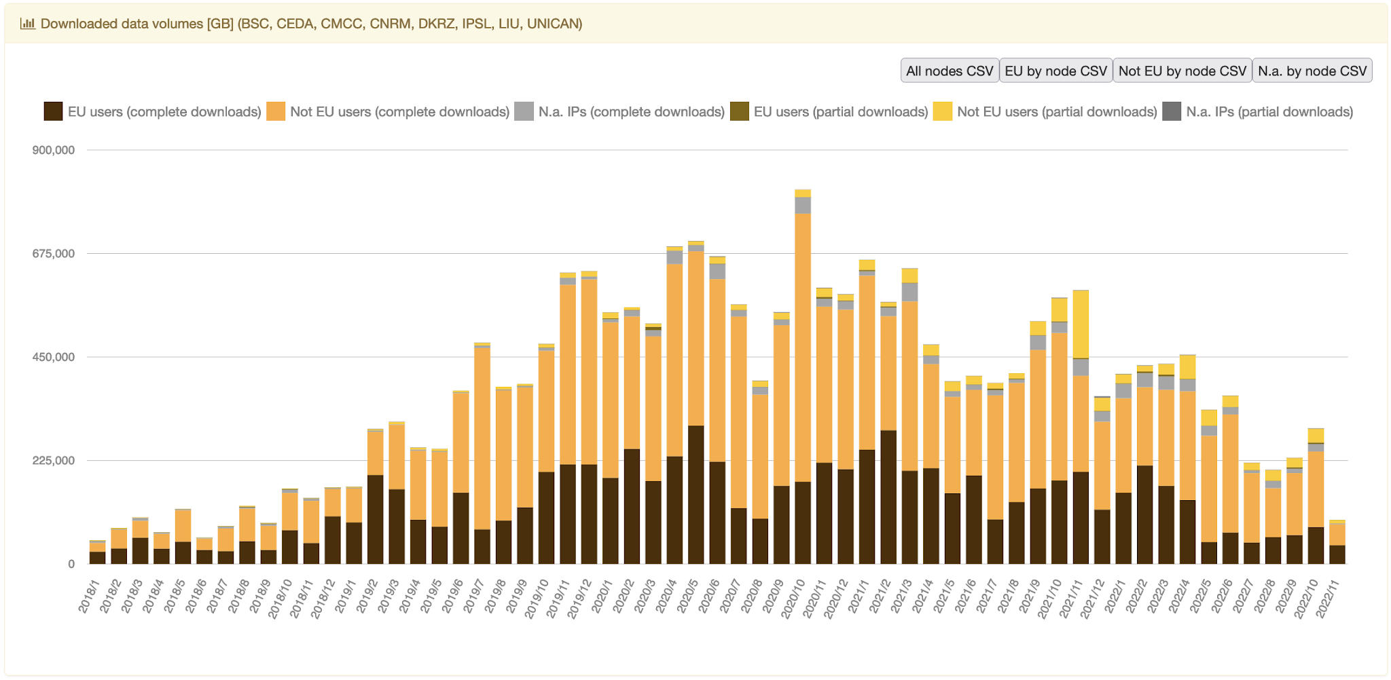
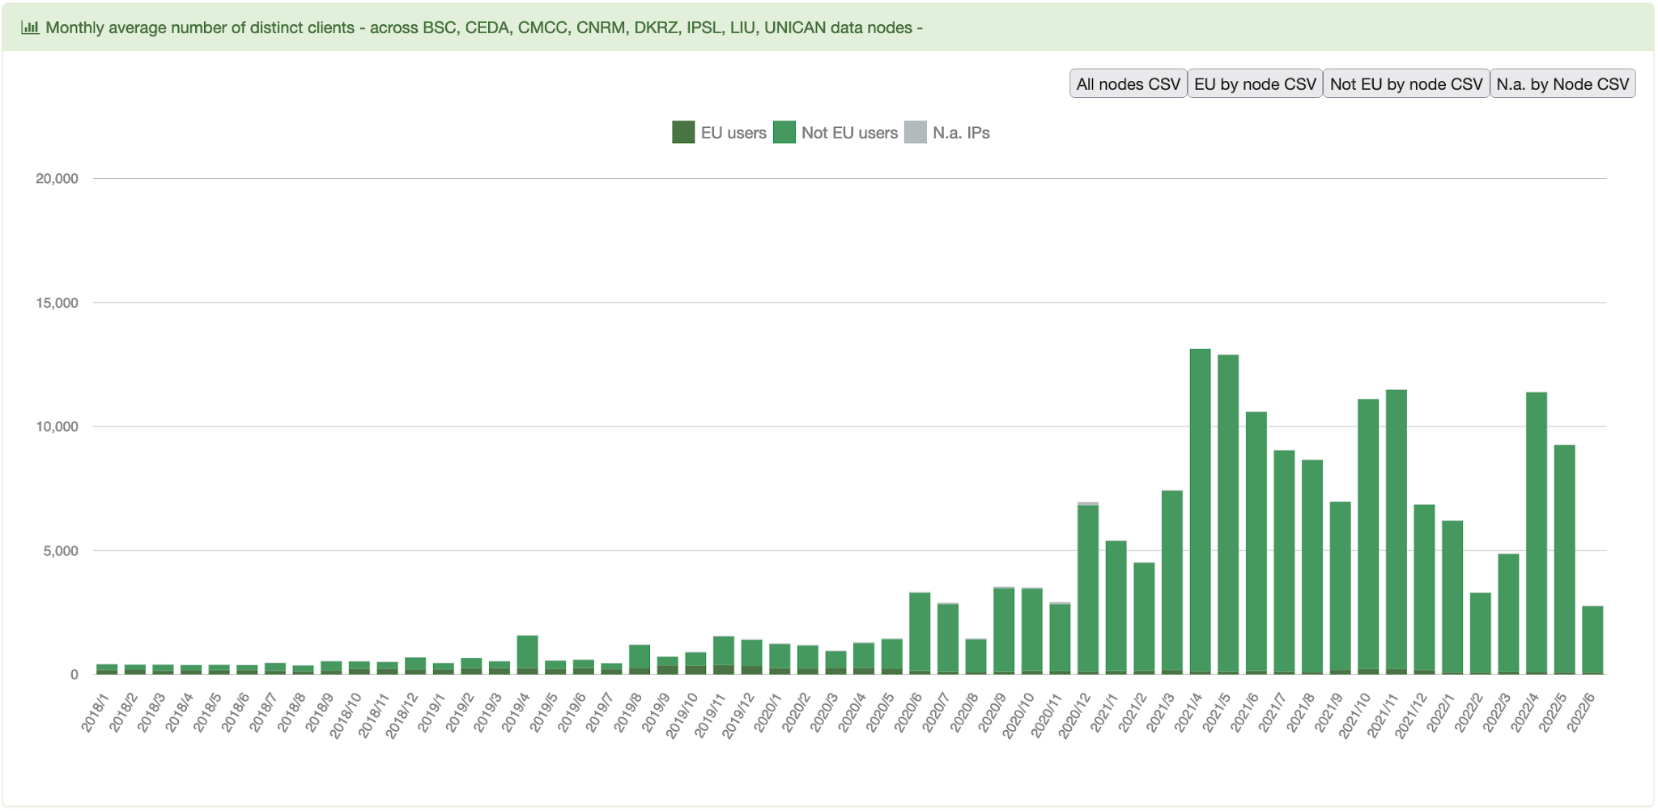
IS-ENES3 KPIs
Successfully downloaded files
Downloaded data volumes
Montly average number of distinct clients
grouped by EU and non-EU users.
IS-ENES3 has received funding from the European Union’s Horizon 2020 research and innovation programme under grant agreement No 824084

Slide 21
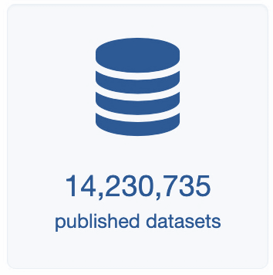
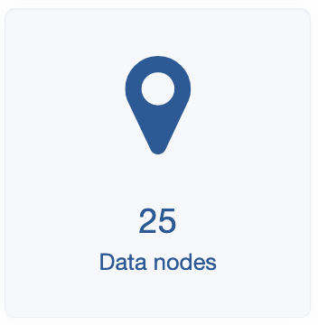
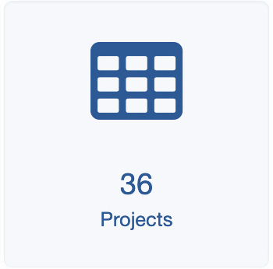
ESGF by the numbers
Data archive information
34 PetaBytes
from
over
around 7 millions
datasets are replicas
As expected, CMIP6 reached 20 PB in June 2021, with about 10 millions and 700 hundred datasets.
IS-ENES3 has received funding from the European Union’s Horizon 2020 research and innovation programme under grant agreement No 824084

Slide 22
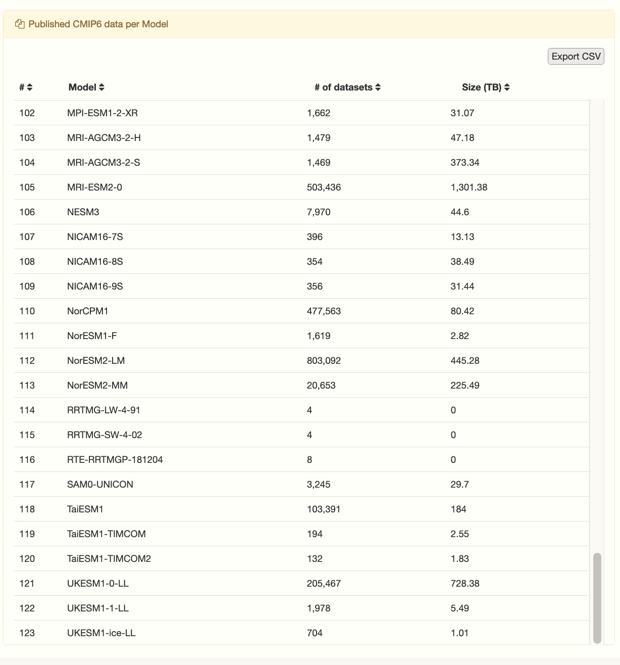
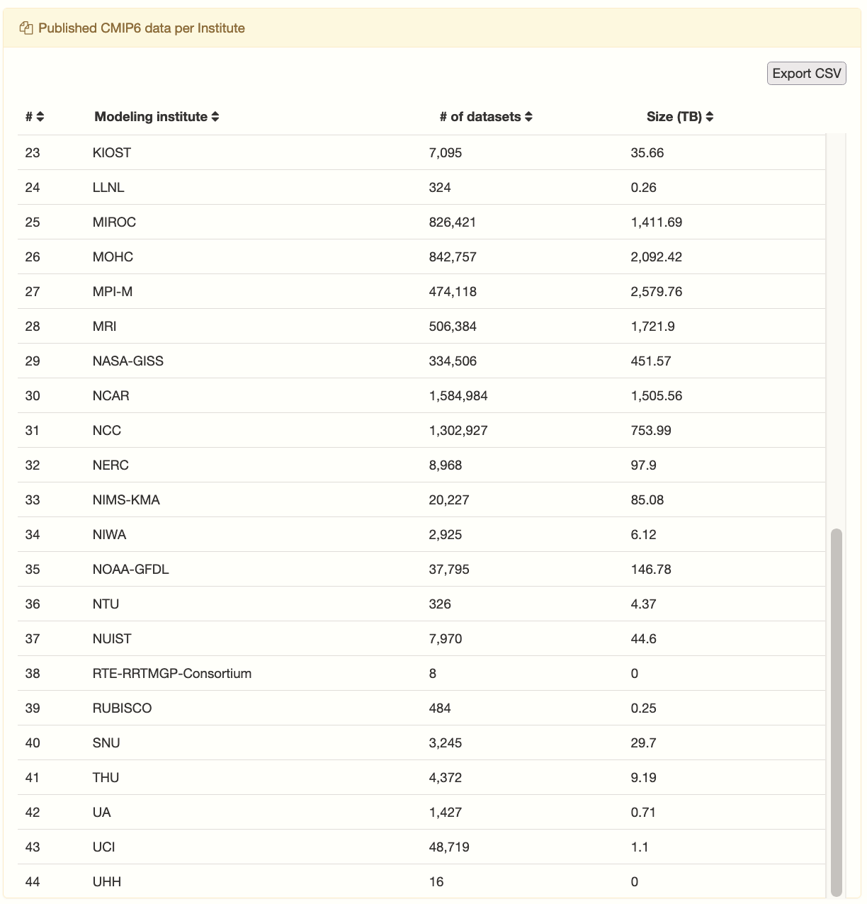
ESGF by the numbers
Data archive information
Currently, CMIP6 counts more that 24 PB and almost 13 millions datasets.
Datasets from about
120 models and
44 different institutions have been published for CMIP6.
IS-ENES3 has received funding from the European Union’s Horizon 2020 research and innovation programme under grant agreement No 824084

Slide 23
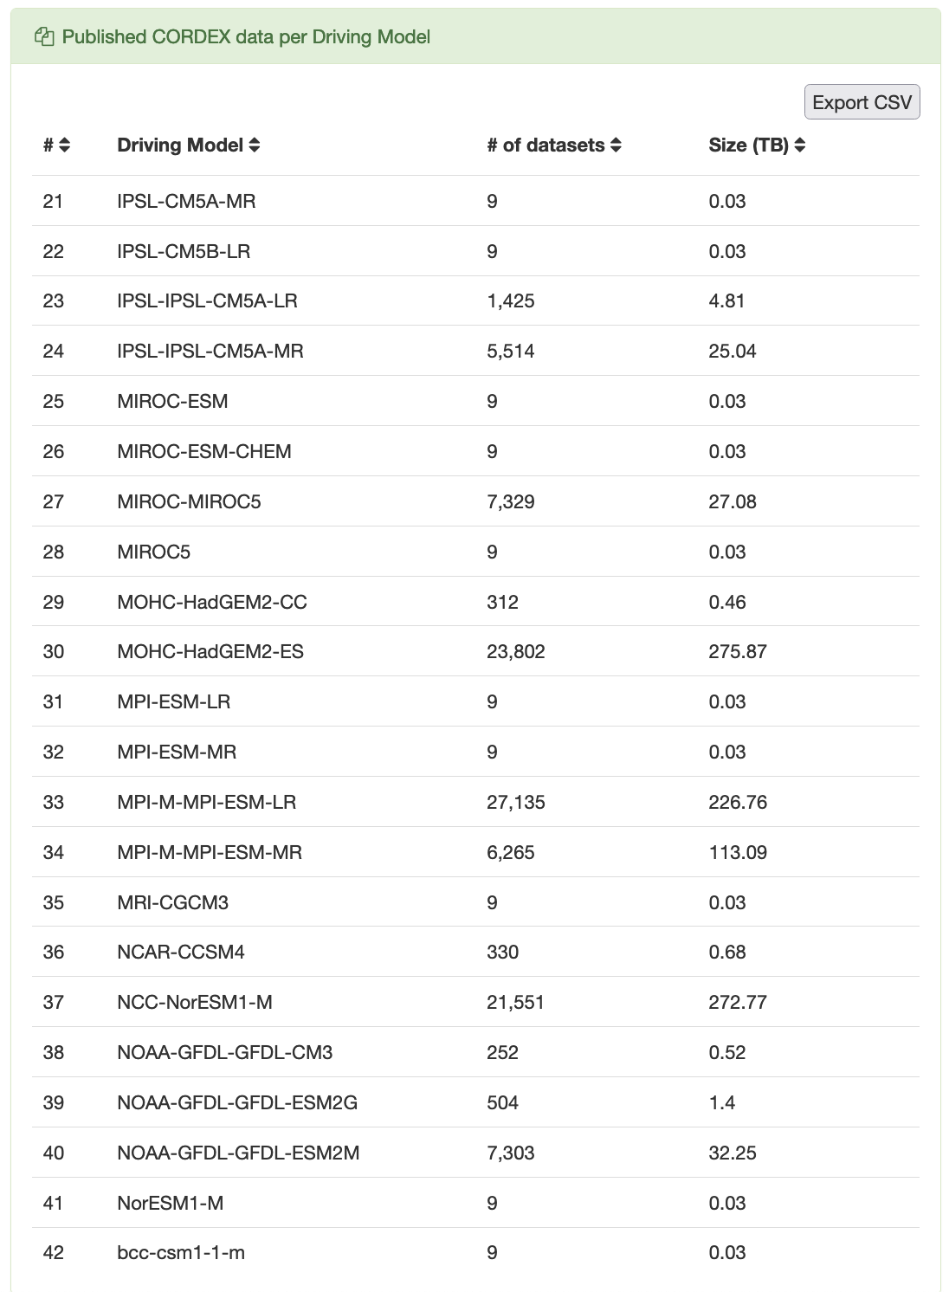
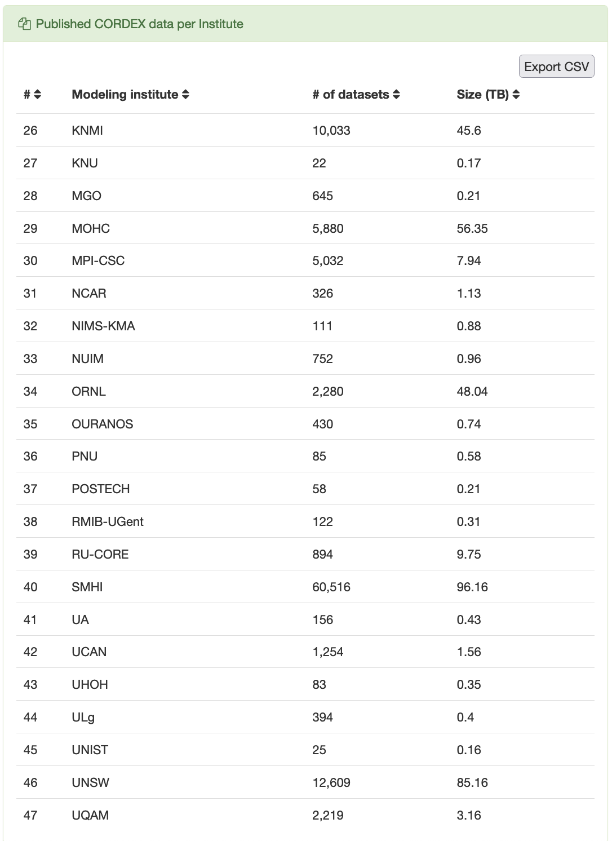
ESGF by the numbers
Data archive information
CORDEX about 1,5 PB and about 186 thousands datasets.
Datasets from about
42 driving models and
47 different institutions have been published for CORDEX.
IS-ENES3 has received funding from the European Union’s Horizon 2020 research and innovation programme under grant agreement No 824084

Slide 24
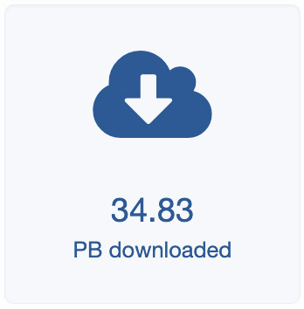
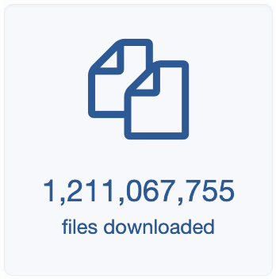
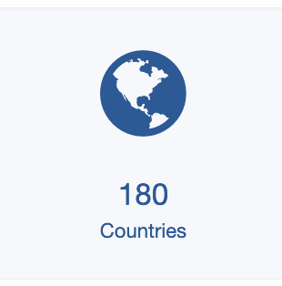
ESGF by the numbers
Data usage information
and
from
IS-ENES3 has received funding from the European Union’s Horizon 2020 research and innovation programme under grant agreement No 824084

Slide 25
ESGF by the numbers
Data usage information
CMIP6 is the most downloaded project with almost 30 PB and over that 1 billion files.
The CMIP6 most downloaded variable is the Eastward Wind (ua) (3 PB), followed by
Northward Wind (va) and Air Temperature (ta)
IS-ENES3 has received funding from the European Union’s Horizon 2020 research and innovation programme under grant agreement No 824084

Slide 26
This project has received funding from the European Union’s Horizon 2020 research and innovation programme under grant agreement N°824084
Our website
https://is.enes.org/
Follow us on Twitter !
@ISENES_RI
Contact us at
is-enes@ipsl.fr
Follow our channel IS-ENES3 H2020

