Slide 1
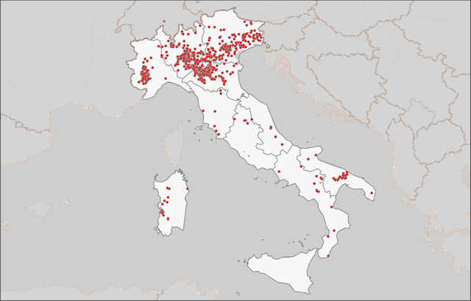
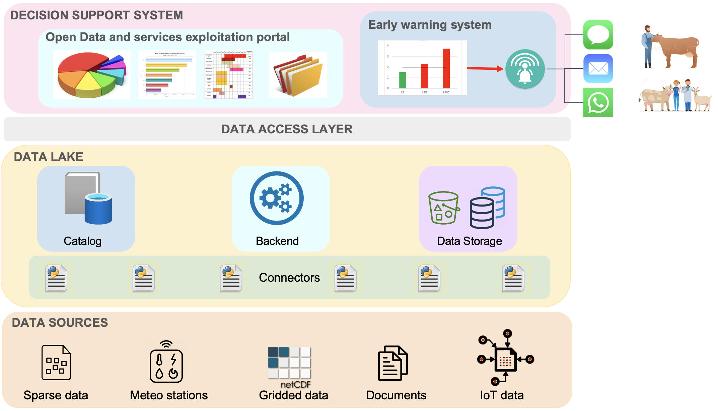
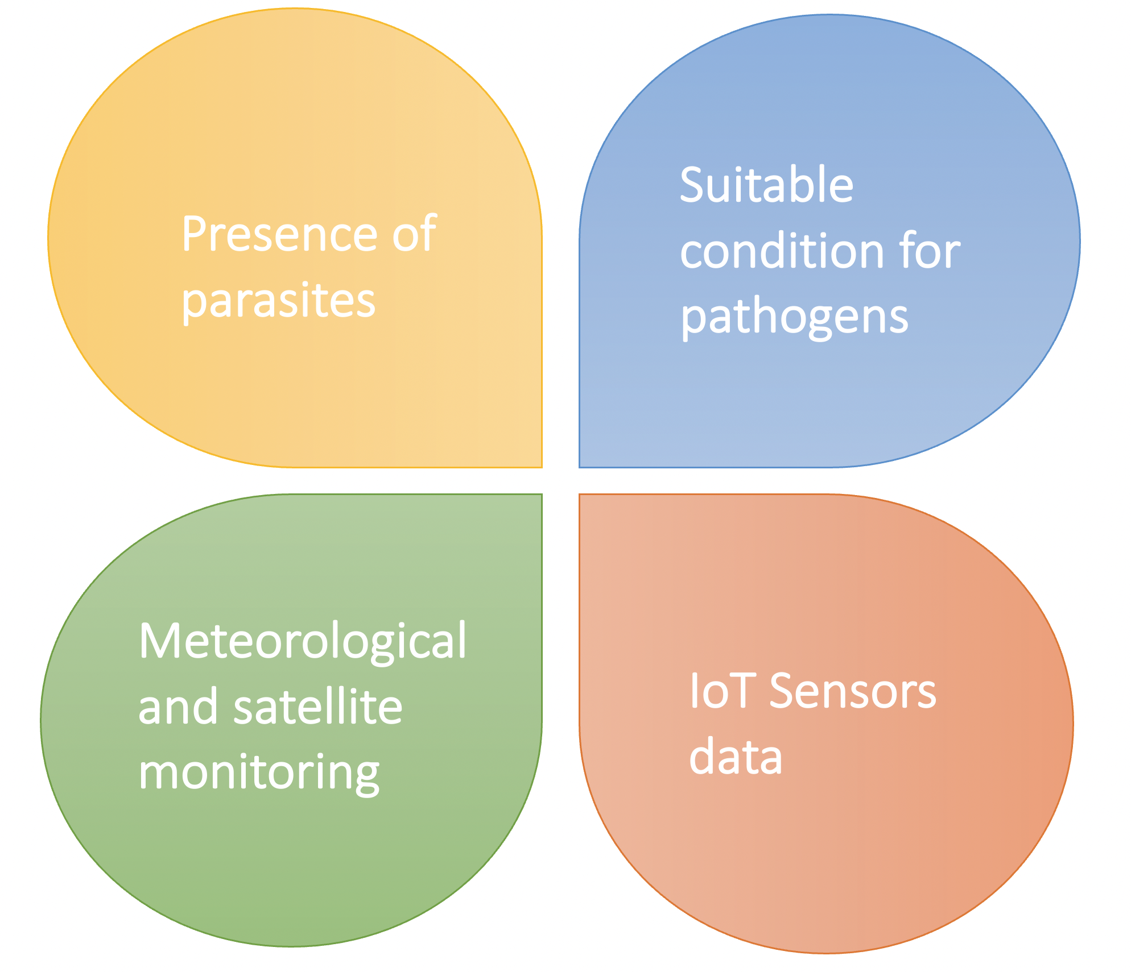
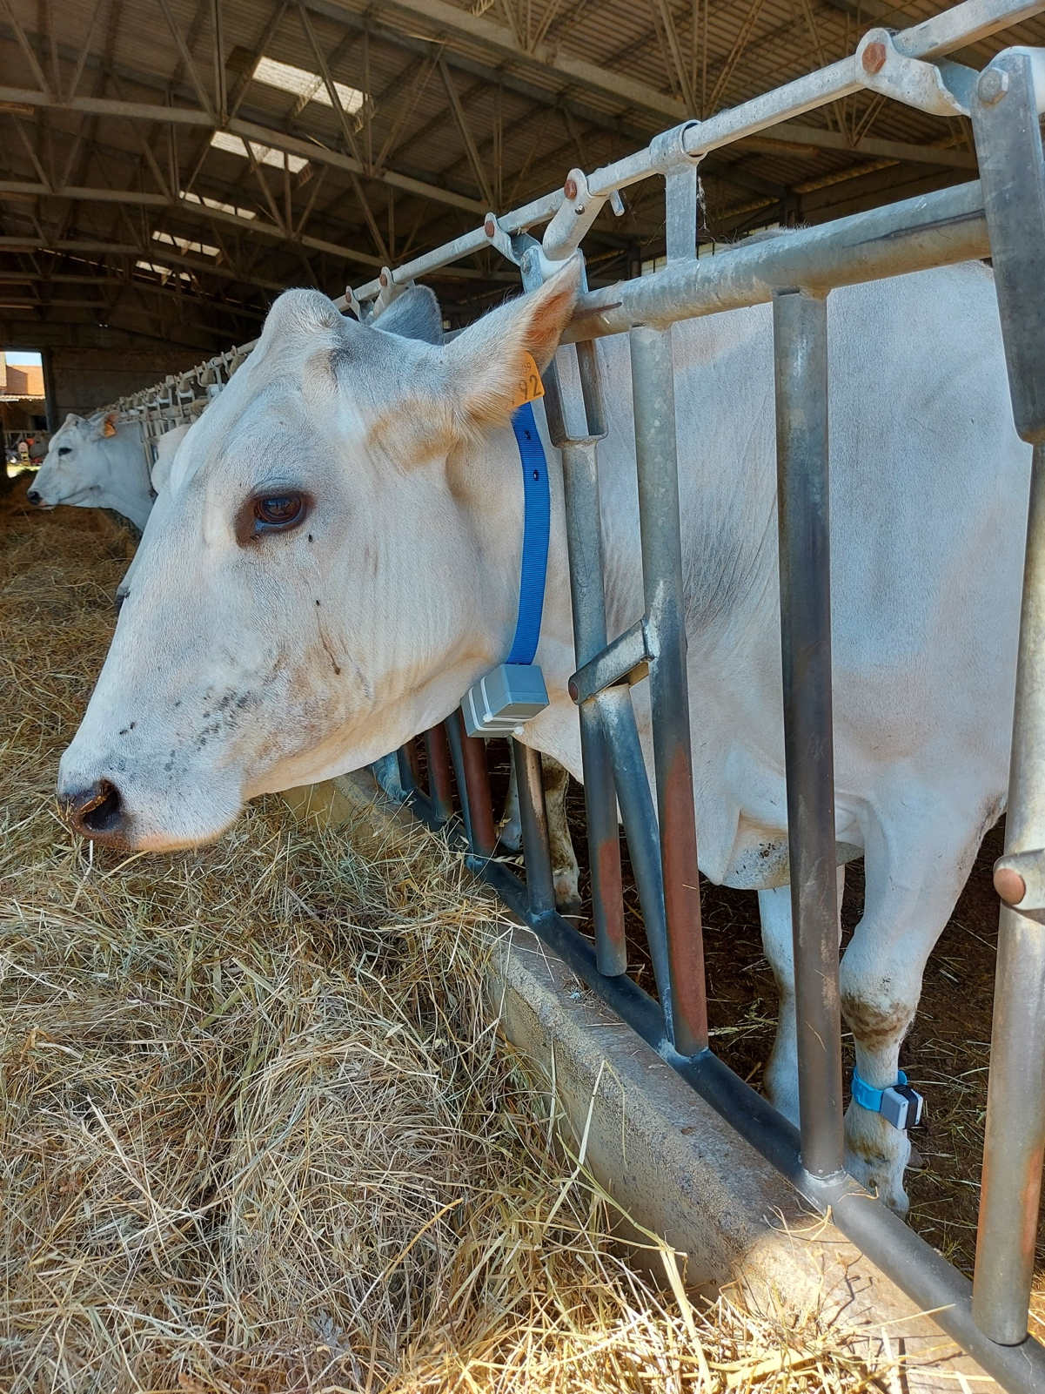
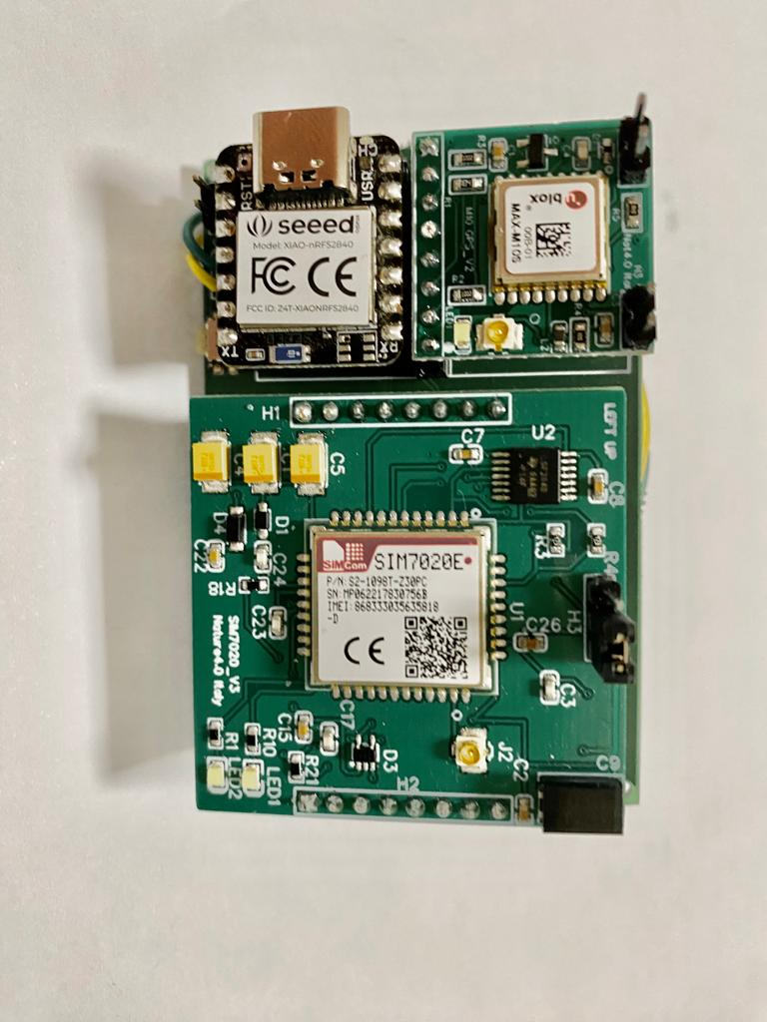
An early warning decision support system for disease outbreaks in the livestock sector
P. Nassisi¹, A. D’Anca¹, M. Mancini¹, M. Santini¹, M. Milanesi², C. Caroli³, G. Aloisio¹, G. Chillemi², R. Valentini², R. Negrini^{4,5}, P. Ajmone Marsan⁵
1. Centro Euro-Mediterraneo sui Cambiamenti Climatici, Lecce, Italy | 2. University of Tuscia, Viterbo, Italy | 3. CINECA, Bologna, Italy
4. Associazione Italiana Allevatori, Rome, Italy | 5. Università Cattolica del Sacro Cuore, Milan, Italy
Environmental temperature
and humidity + GPS + movement

Slide 2
An early warning decision support system for disease outbreaks in the livestock sector
Paola Nassisi, CMCC Foundation
P. Nassisi¹, A. D’Anca¹, M. Mancini¹, M. Santini¹, M. Milanesi², C. Caroli³, G. Aloisio¹, G. Chillemi², R. Valentini², R. Negrini^{4,5}, P. Ajmone Marsan⁵
Centro Euro-Mediterraneo sui Cambiamenti Climatici, Lecce, Italy
University of Tuscia, Viterbo, Italy
CINECA, Bologna, Italy
Associazione Italiana Allevatori, Rome, Italy
Università Cattolica del Sacro Cuore, Milan, Italy

Slide 3
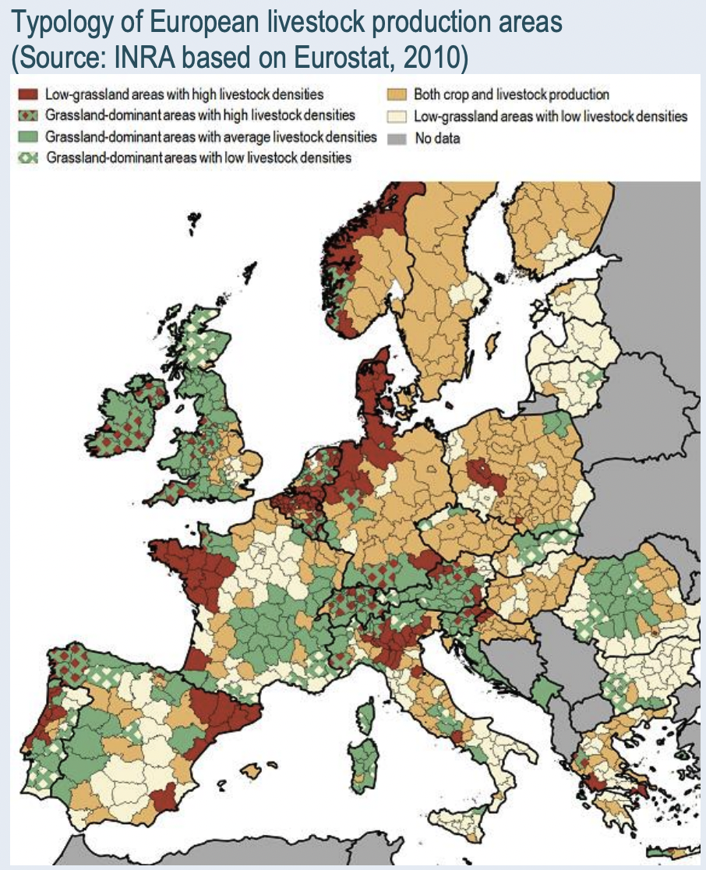
Some figures…
The livestock sector in 2017:
168€ billion annually
45% of the EU agricultural activity
Wide diversity of production system
4 million of employees
400€ billion European industries linked to animal production
Animal Task Force (ATF. 2017a) Why is European animal production important today? Facts and figures

Slide 4
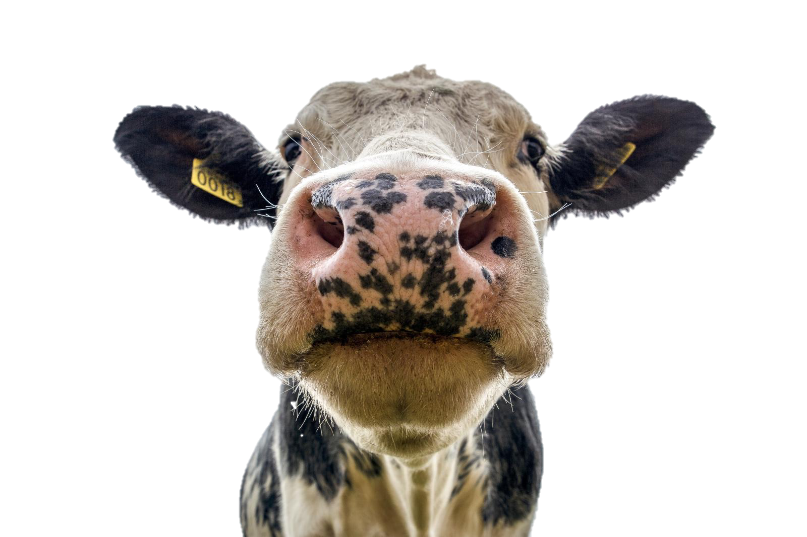
What is stress?
Stress
[stres] noun
!
Biological response elicited by the organism when perceiving a threat (stressor) to its homeostasis.
Moberg and Mench, 2000

Slide 5
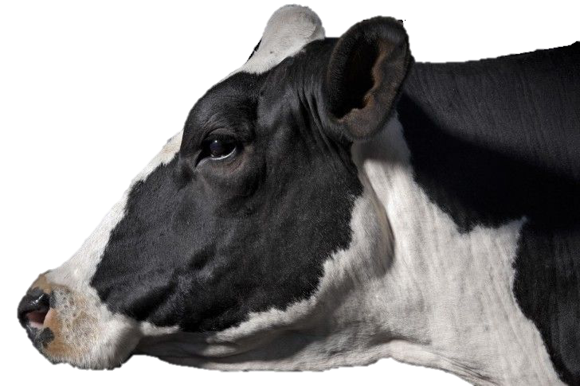
Chronic stress
Environmental
Physiological
Social behaviour
Immunosuppression
Decreased ingestion
STRESS
Animal wellbeing,
production and reproduction, diseases and their spread, food quality and availability
Prevention
Alert

Slide 6
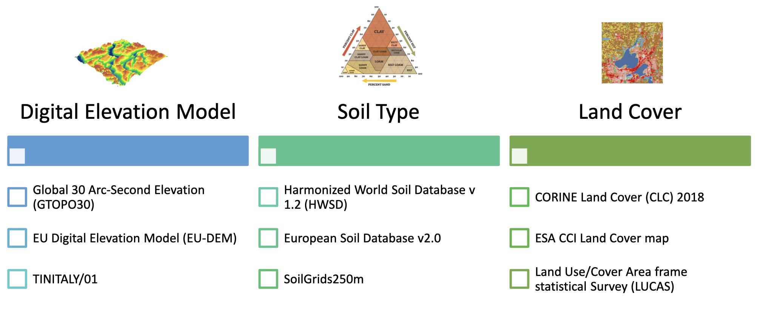
SEBASTIEN Data Sources
Weather and climate datasets
Territorial datasets
Animal welfare indicators

Slide 7
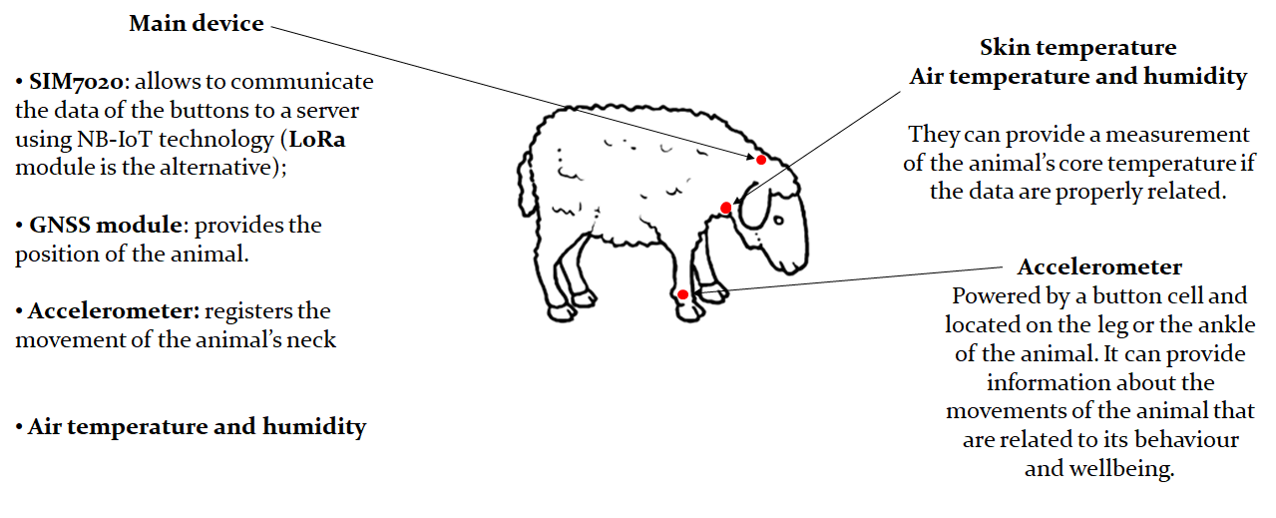
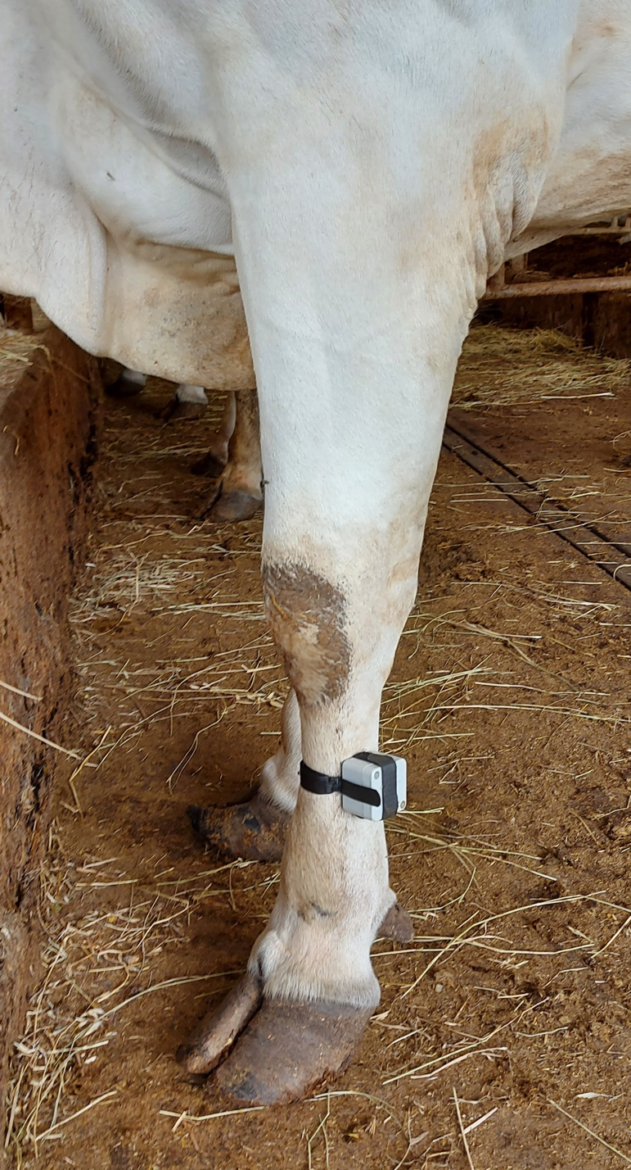
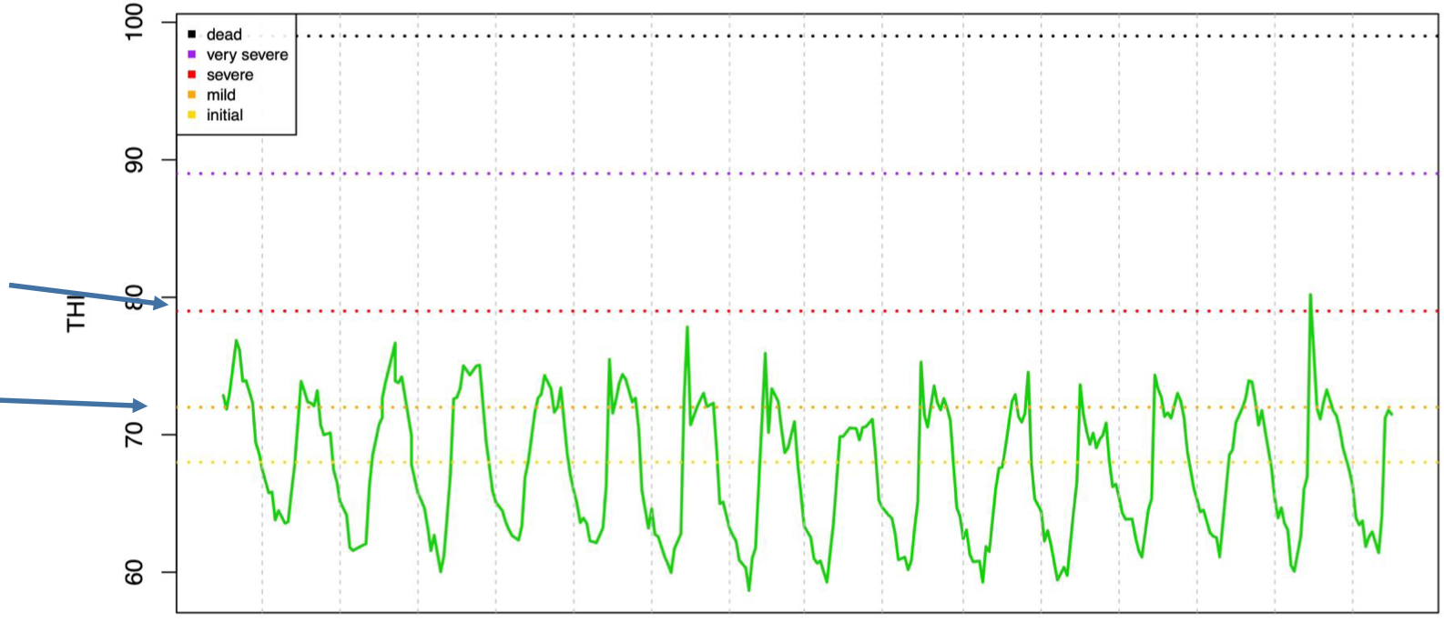
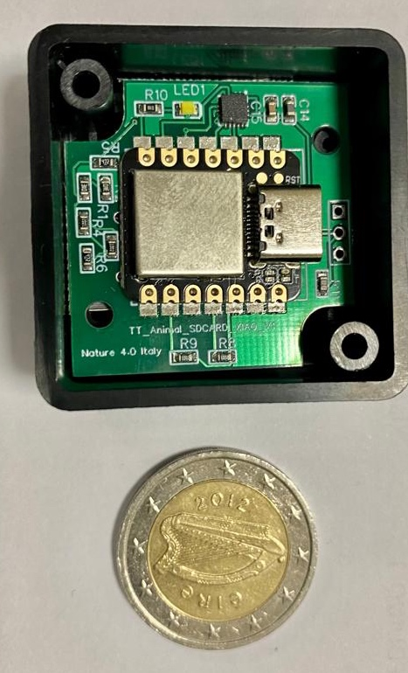
Animal Talker sensors
Environmental temperature
and humidity + GPS + movement
Severe
Mild
Movement

Slide 8
Datasets for animal welfare indicators
Data exchange through LEO project – Livestock Environment Opendata (https://www.leo-italy.eu/)
OUR NUMBERS
Goat Breeds
Sheep Breeds
Cattle Breeds
Buffalo Breed
Monitored Animals
Farms
Acquired Data
Acquired Analysis
Samples Gathered

Slide 9
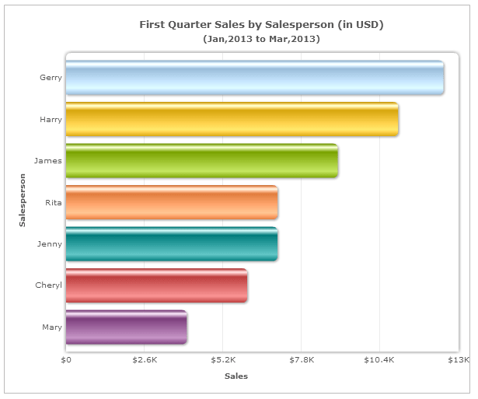
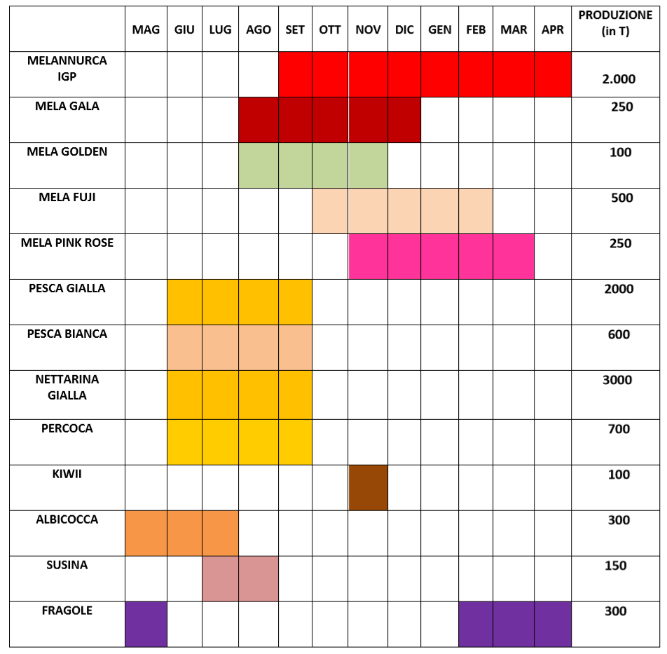
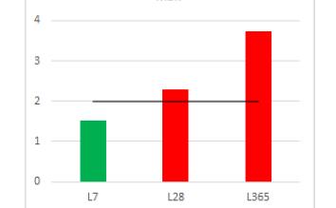
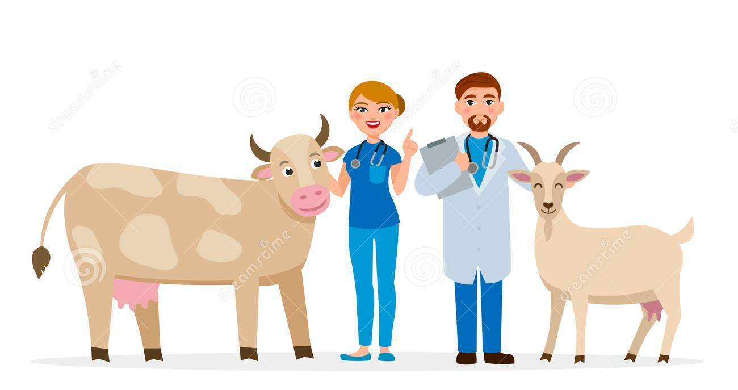
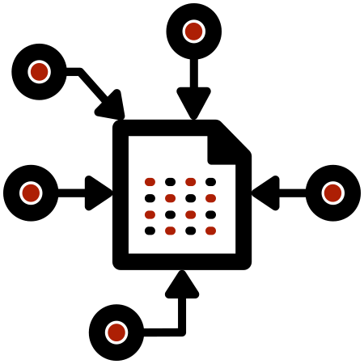
SEBASTIEN architecture
DECISION SUPPORT SYSTEM
Early warning system
Open Data and services exploitation portal
DATA ACCESS LAYER
DATA LAKE
Catalog
Backend
Data Storage
Connectors
DATA SOURCES
Sparse data
Meteo stations
Gridded data
Documents
IoT data

Slide 10
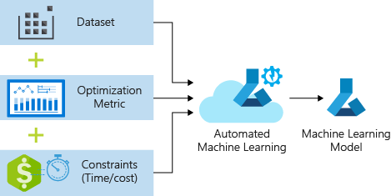
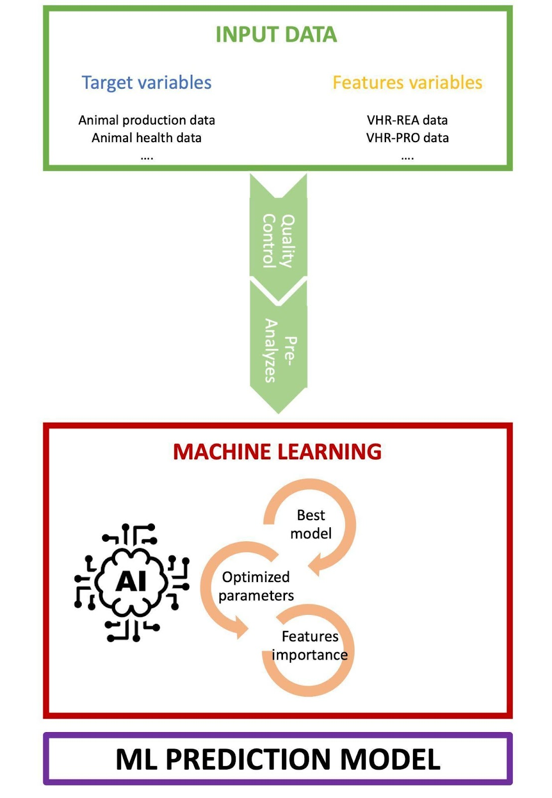
Machine Learning & Artificial Intelligence approaches

Slide 11
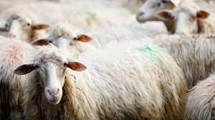
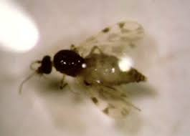
Objectives
Provide early warnings related to data on the risk of infection with transmissible diseases determined on the basis of epidemiological, ecological and climatic data.
Initial targets:
Visna maedi lentivirus in sheep and goats in Sardinia region
Bluetongue RNA virus, transmitted by culicoides insect vectors, for sheep and goats in Sardinia region.
predict the risk of infection to stimulate attention and anticipate prevention actions (e.g., culicoides control, vaccinations, quarantine, reform of animals at the first symptoms)
model transfer to other vector born diseases
Potential extension of the service to monitor West Nile virus distribution in Emilia Romagna region.

Slide 12
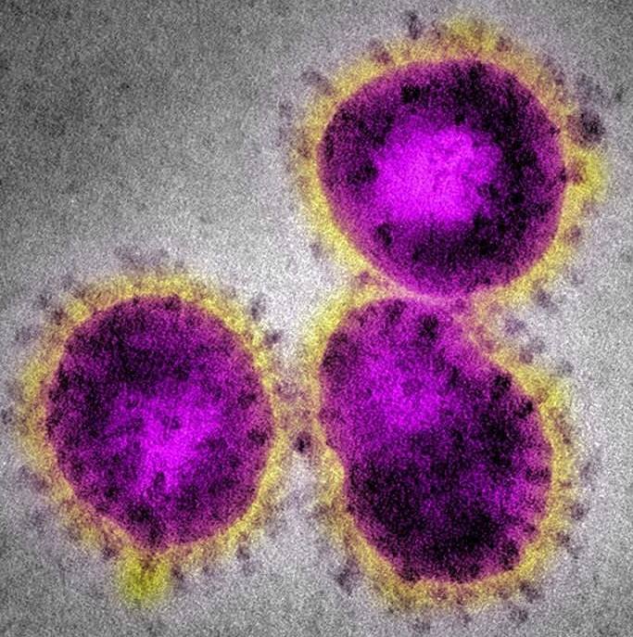
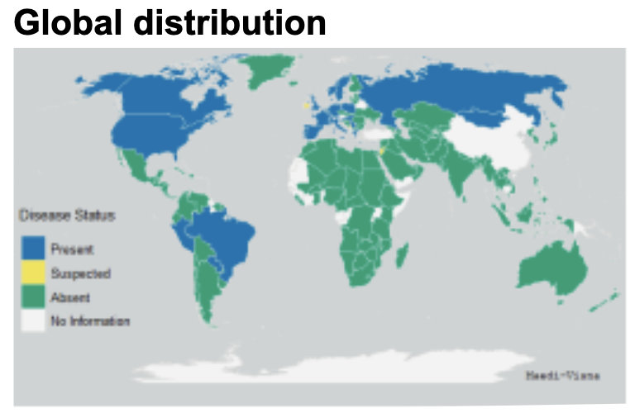
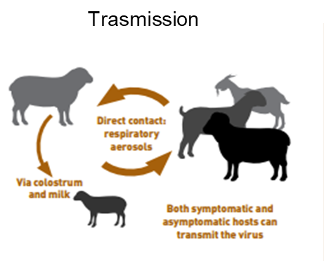
Maedi – Visna (MV)
Maedi-Visna (MV) is a sheep disease characterized by respiratory (Maedi, determined by interstitial pneumonia) and nervous (Visna, progressive inflammatory disease of the central nervous system) clinical signs and occasionally of the joints and/or mastitis.
As Visna Maedi is a disease that requires surveillance, it is subject to notification. Veterinarians and laboratories must notify the cases of epizootic disease and suspicious symptoms.
There are no effective preventative vaccines available against MV.
The Route of Transmission
MV causes a progressive, degenerative inflammatory disease that affects many tissues, leading to economic losses in small ruminant production through culling, reduced birth weight and weight gain, and reduced milk yield.

Slide 13
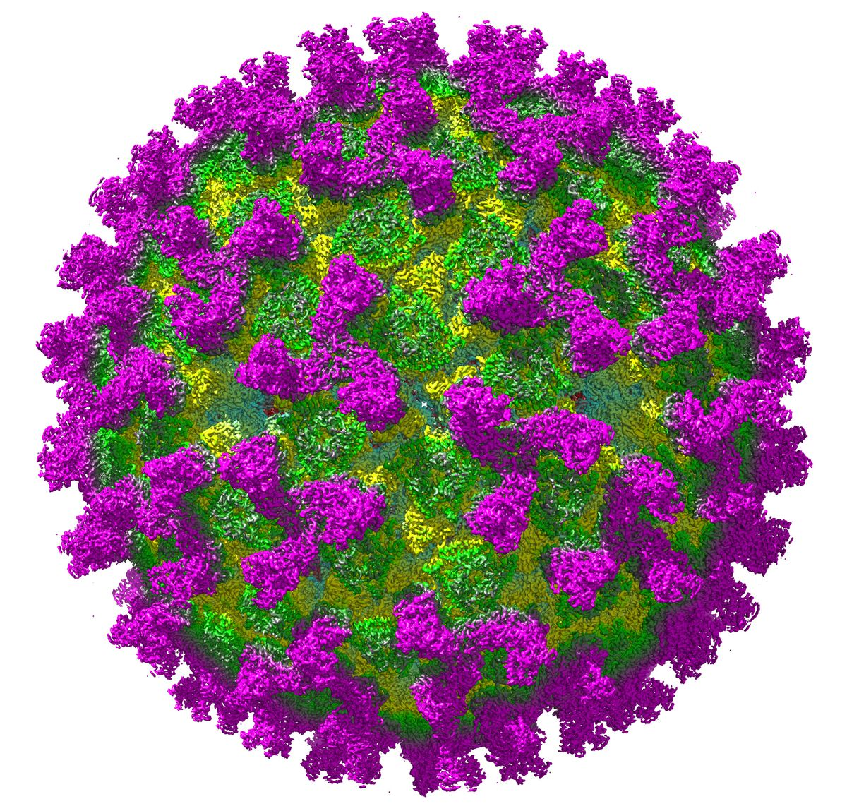
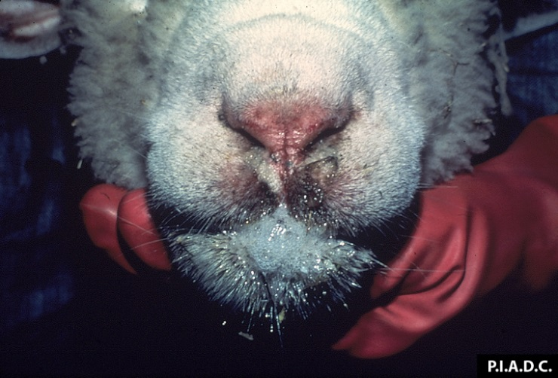
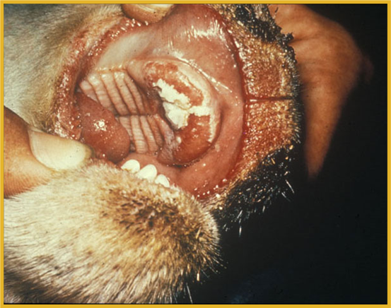
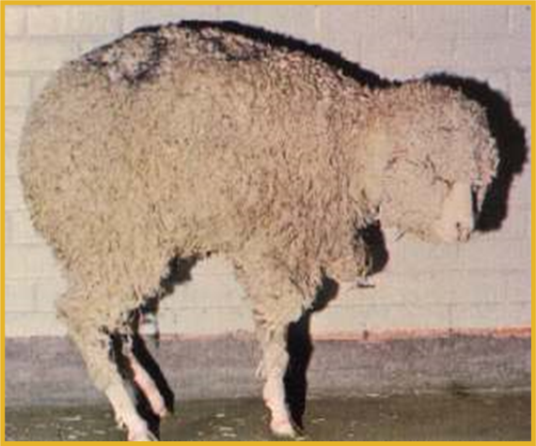
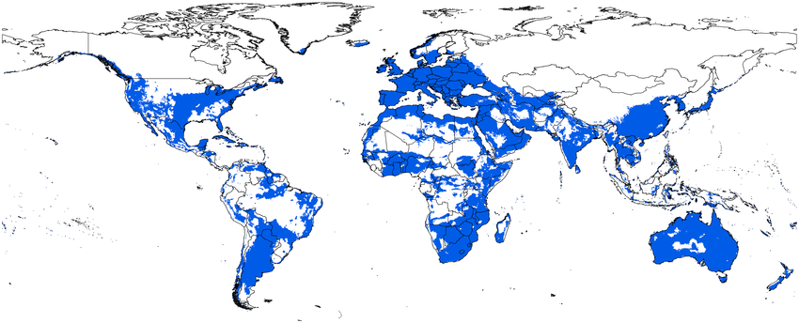
Bluetongue (BTV)
Bluetongue (BTV) is an insect borne viral disease of domestic and wild ruminants, especially sheep.
BTV is the type-species of the genus Orbivirus in the family Reoviridae.
The name refers to the blue discoloration of the tongue and mucous membranes, due to cyanosis.
Clinical signs:
Most asymptomatic
Oral erosions and ulcerations Tongue: Swollen, protruding, Cyanotic = “blue-tongue”
Reproductive failure
Coronitis: Inflammation of coronary band
Lameness: Painful hooves
The route of Transmission
Map of distribution: Infection with bluetongue virus (BTV) is common in a broad band across the world.
The geographic restriction is in part related to the climatic and environmental conditions necessary to support the Culicoides vectors.
There are inactive vaccine available but not live attenuated vaccines.
BTV is classified as an OIE list A disease/multiple species and is therefore notifiable

Slide 14
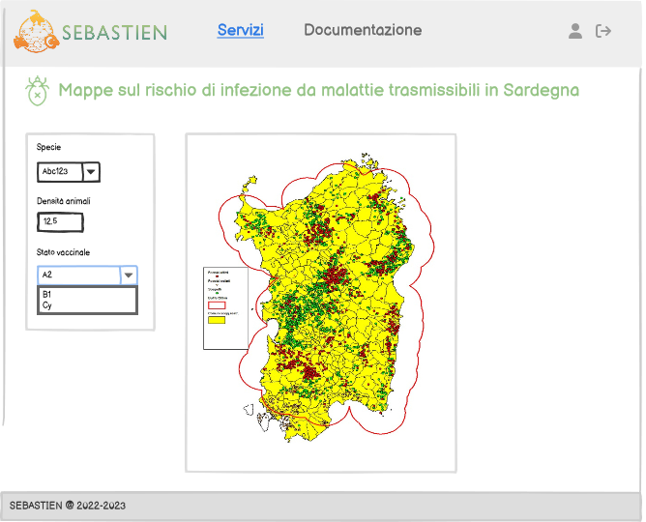
Map on the risk of infection
Parasites and pathogens
Maps on the risk of infection from communicable diseases determined on the basis of epidemiological, ecological and climatic data on Sardinia
Map on the risk of infection
INPUT | 1. User: species, animal density, vaccination status 2. Data lake: climate data
OUTPUT | Short and medium term risk maps in Sardinia
Data to create the model | Epidemiological, ecological and climatic data

Slide 15
Data sources for early warning system
Suitable condition for pathogens
Presence of parasites (outbreaks and spread of related diseases)
Literature information about suitable conditions for pathogens
Meteorological and satellite monitoring of wide areas
AnimalTalker sensors data monitoring the animal wellbeing
Presence of parasites
Meteorological and satellite monitoring
IoT Sensors data

Slide 16
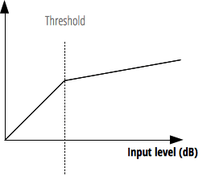
Early warning system workflow

Slide 17
SEBASTIEN in a nutshell
Coordinator: Fondazione Centro Euro-Mediterraneo sui Cambiamenti Climatici (CMCC)
Topic: Public Open Data (POD) – Type of action: CEF-TC-2020-2
Duration: 30 months - Starting date: Jan 2022
Total budget: € 1.338.553,18
Total CEF Contribution: € 1.003.914,89
Follow our social channels
sebastien_project.eu
SEBASTIEN Project
@SEBASTIENproje1
SEBASTIEN website
www.sebastien-project.eu
Sebastien project
SEBASTIEN Project

Slide 18
Thank you!

