Slide 1


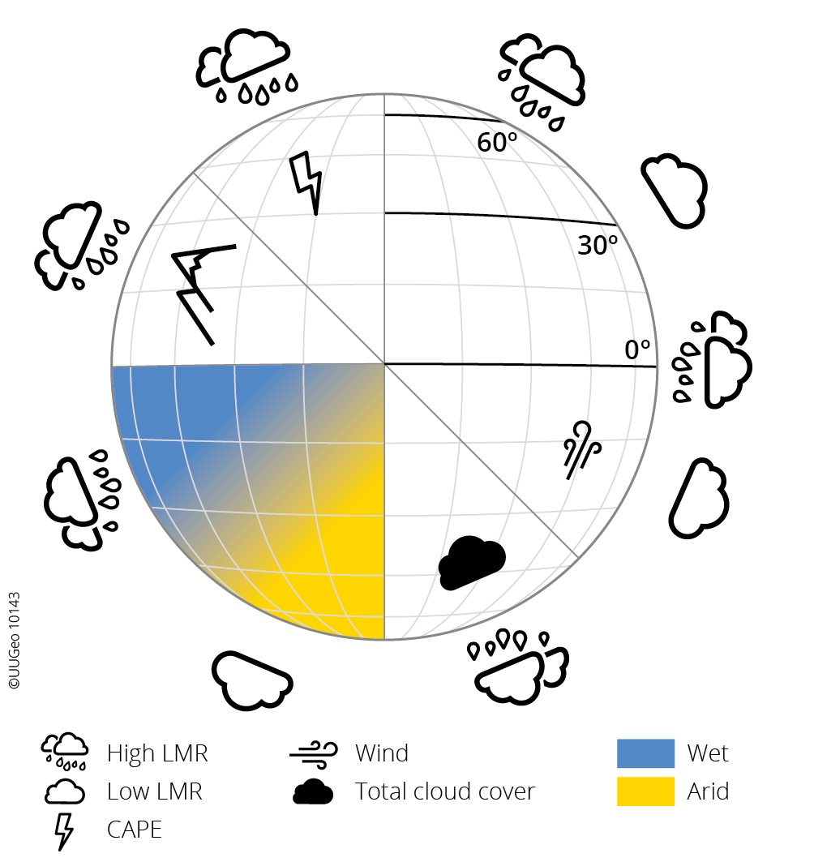
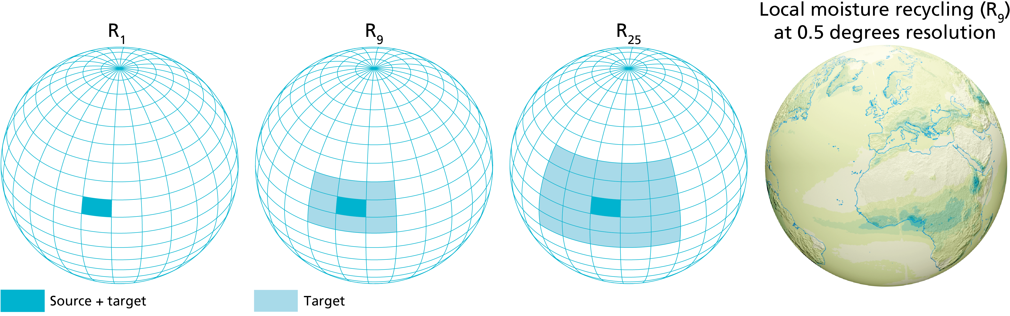
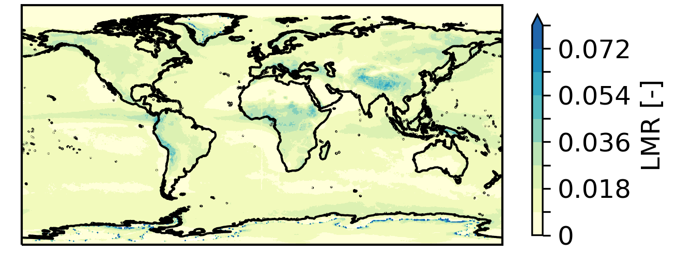













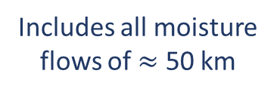
Local moisture recycling across the globe
QR code
Article
Jolanda Theeuwen, Arie Staal, Obbe Tuinenburg, Bert Hamelers, Stefan Dekker
Jolanda.Theeuwen@wetsus.nl
Start
Local moisture recycling can prevent drying due to regreening locally
Article
Methods
Local moisture recycling ratio
Underlying factors
of LMR
Includes all moisture
flows of $≈$ 50 km
Model dependency
Scaling
Variability
Biomes
LMR
Conclusion:
1.7% (std 1.1%)
Peaks in LMR:
LMR
where
Lat.
Theeuwen et al., Hydrol. Earth Syst. Sci. 27 (2023): 1457–1476.
OSPP

Slide 2

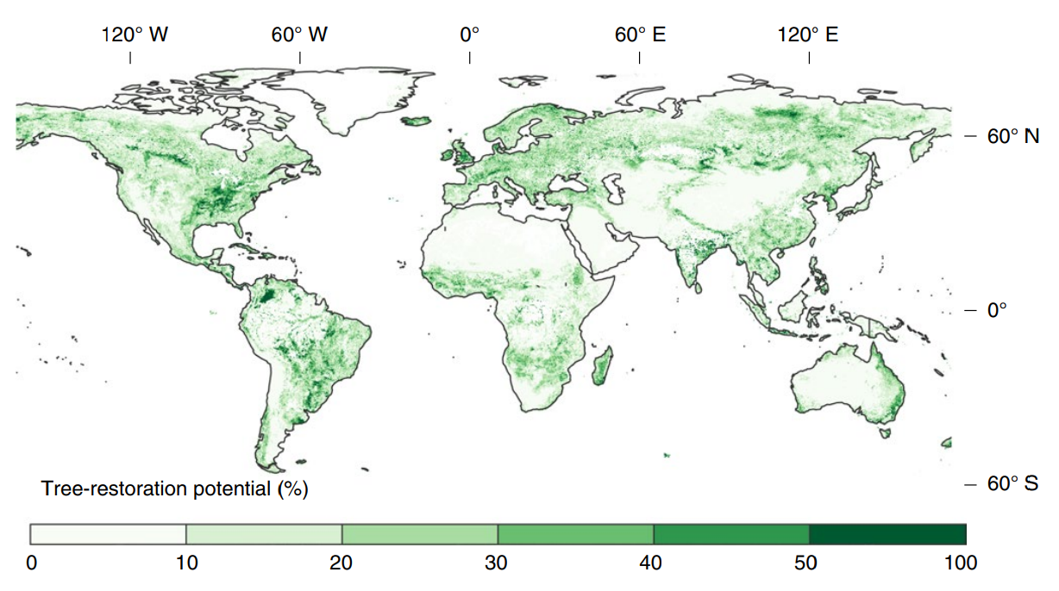
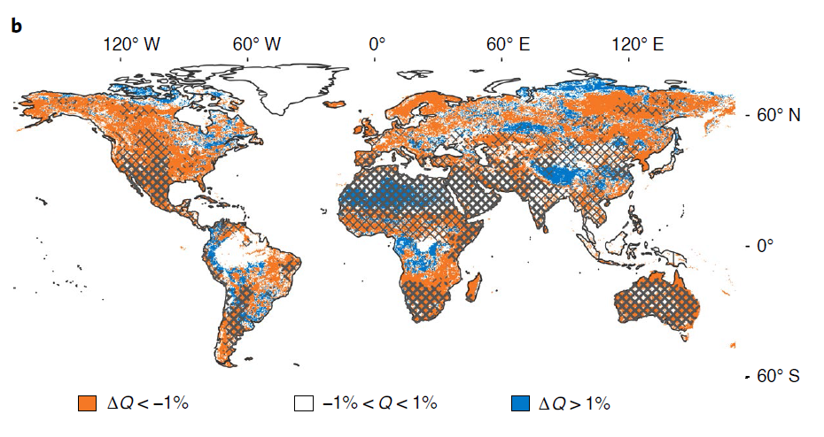
Regreening may enhance local moisture recycling
Local moisture
recycling
+
Regreening
-
-
+
Local drying
Evaporation
-
-
Soil moisture
Bastin, et al. Science 365.6448 (2019): 76-79.
Change in water availability (Q)
Regional recycling reduces drying
To understand how strongly regreening might influence local moisture recycling we need to understand its dependence on atmospheric processes, amongst other processes.
Next
Hoek van Dijke, et al. Nature Geoscience 15.5 (2022): 363-368.

Slide 3
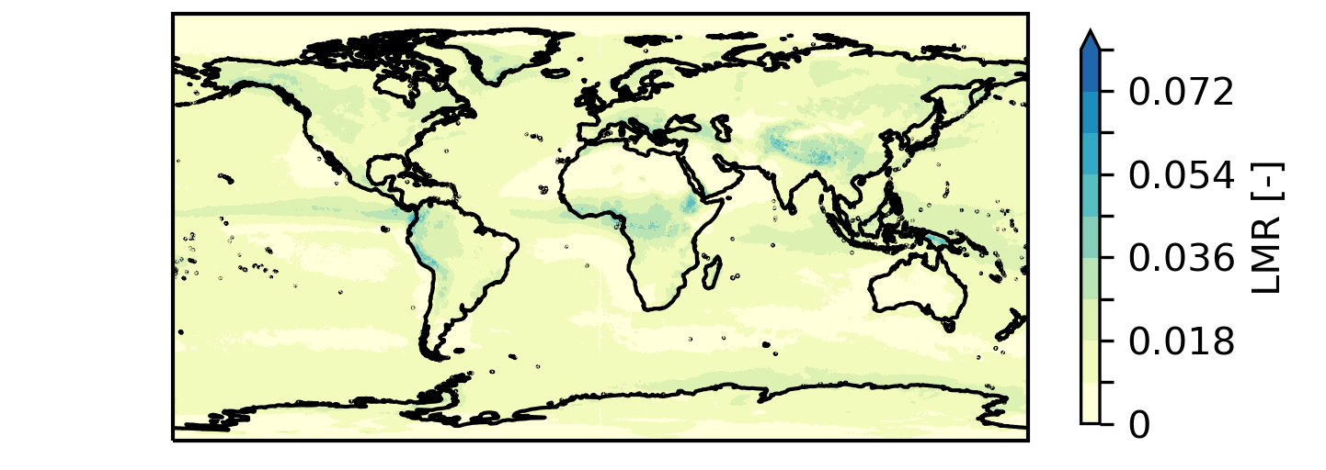
Method - LMR
X
LMR
Local moisture recycling ratio (LMR):
fraction of evaporated moisture that rains out within its
source grid cell and its eight neighboring grid cells.
Calculated using atmospheric moisture connections by Tuinenburg et al. (2020)
Resolution 0.5° ≈ 50 km
Climatological average (2008-2017)
LMR includes al moisture flows of approximately 50 km
Next
Tuinenburg, et al. Earth System Science Data 12.4 (2020): 3177-3188.

Slide 4
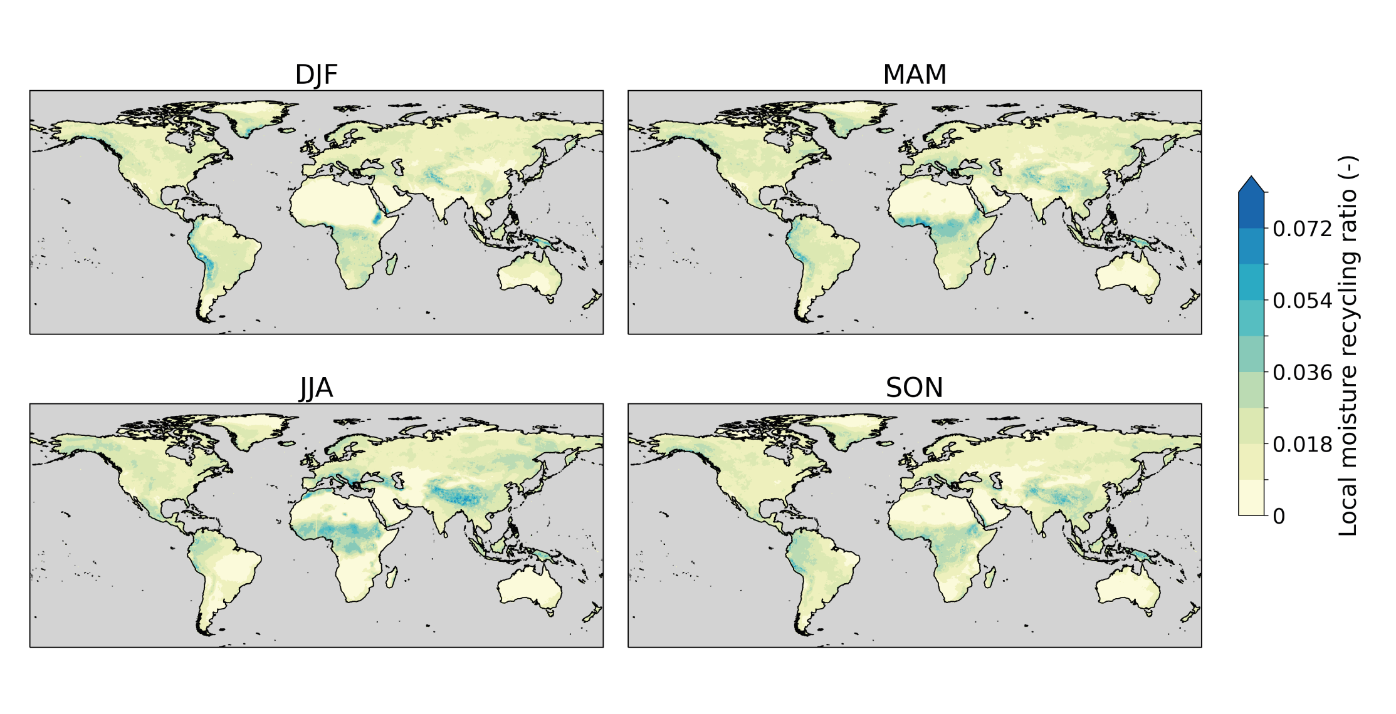
Local moisture recycling ratio (2008-2017)
X
Climatological mean of LMR = 1.7% (std = 1.1%)
Maxima in LMR > 6%
Peaks in LMR for:
Summer*
Wet regions
Elevated regions
Next
*DJF for Southern Hemisphere and JJA for Northern Hemisphere

Slide 5
Underlying factors of LMR
X
Convection related
Wetness
Overview of all correlation coefficients
Next

Slide 6
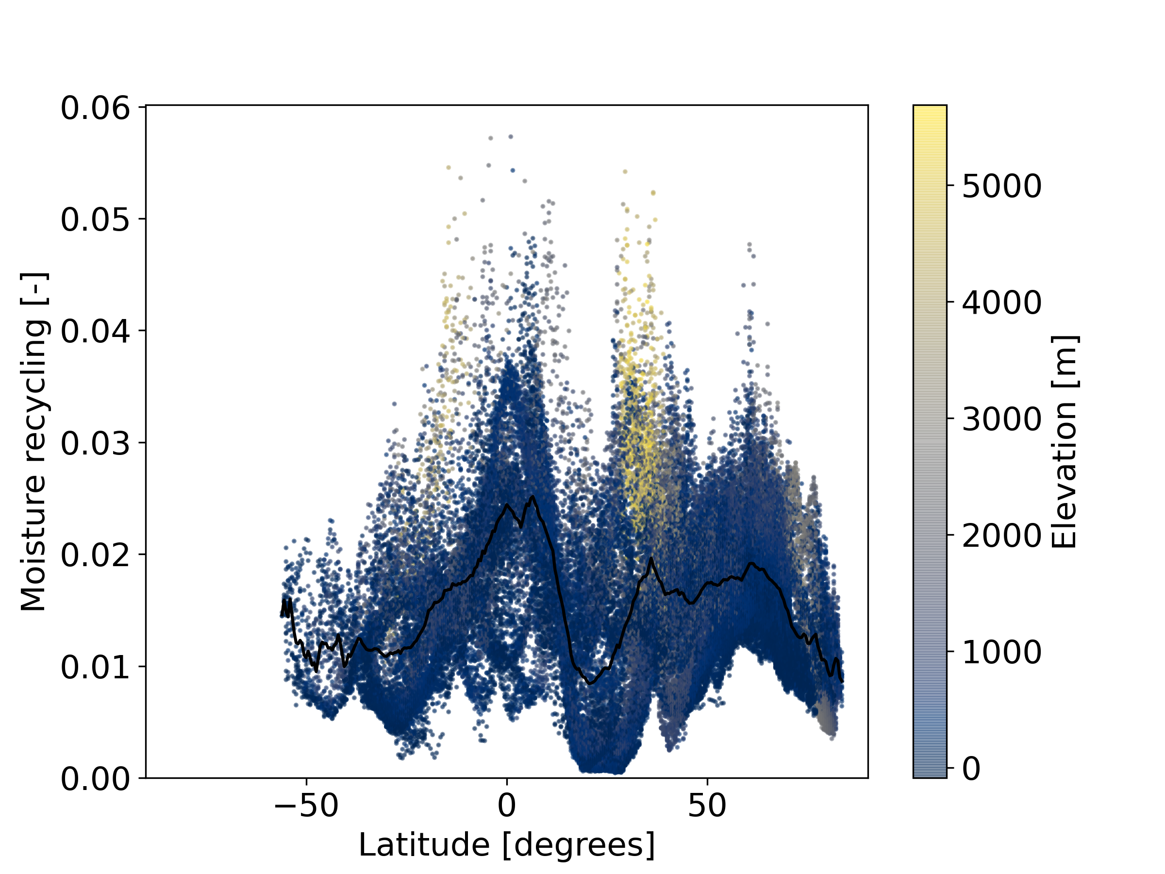
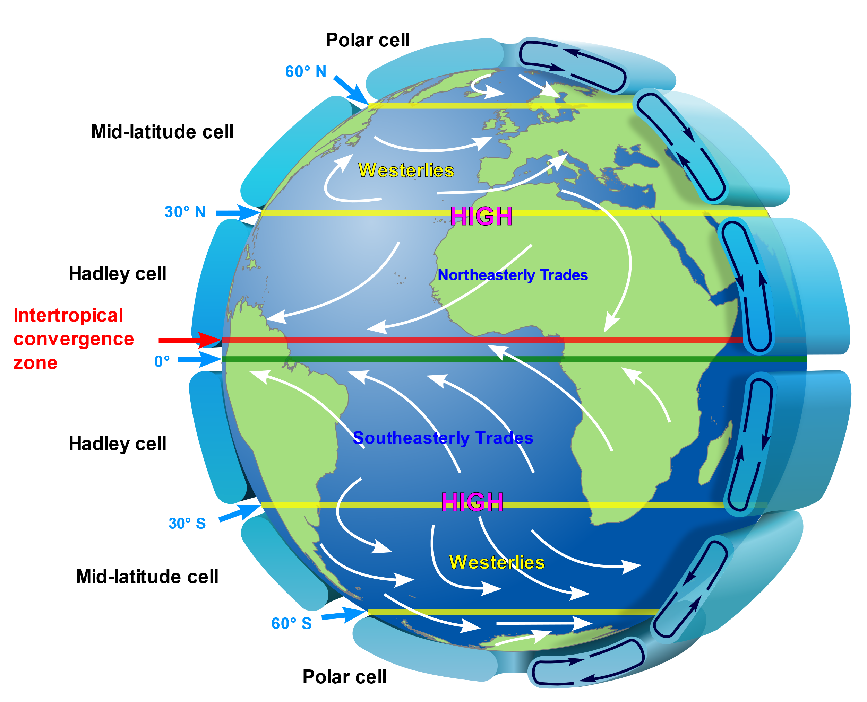
High LMR where air ascends, possibly due to enhanced convection
X
Descending
Ascending
Ascending
Descending
Ascending
Descending
Ascending
Descending
Oscillating pattern overlaps with Hadley Cell circulation. The pattern gets deviated by orography.
Ascending air promotes rainfall through enhanced convection
Previous
Next
https://en.wikipedia.org/wiki/Atmospheric_circulation#/media/File:Earth_Global_Circulation_-_en.svg
By Kaidor, based on File:NASA depiction of earth global atmospheric circulation.jpg

Slide 7
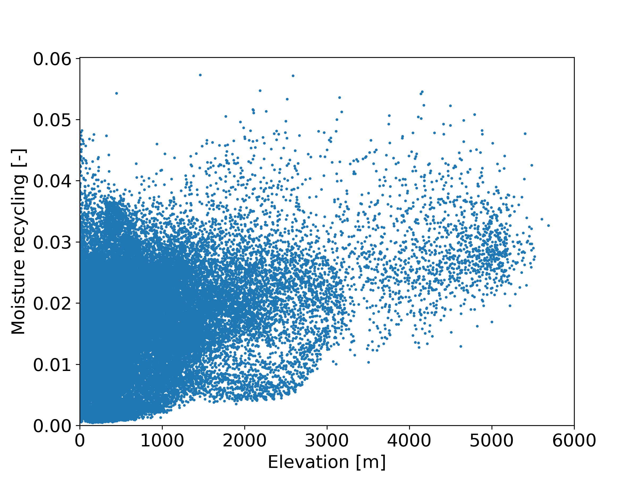
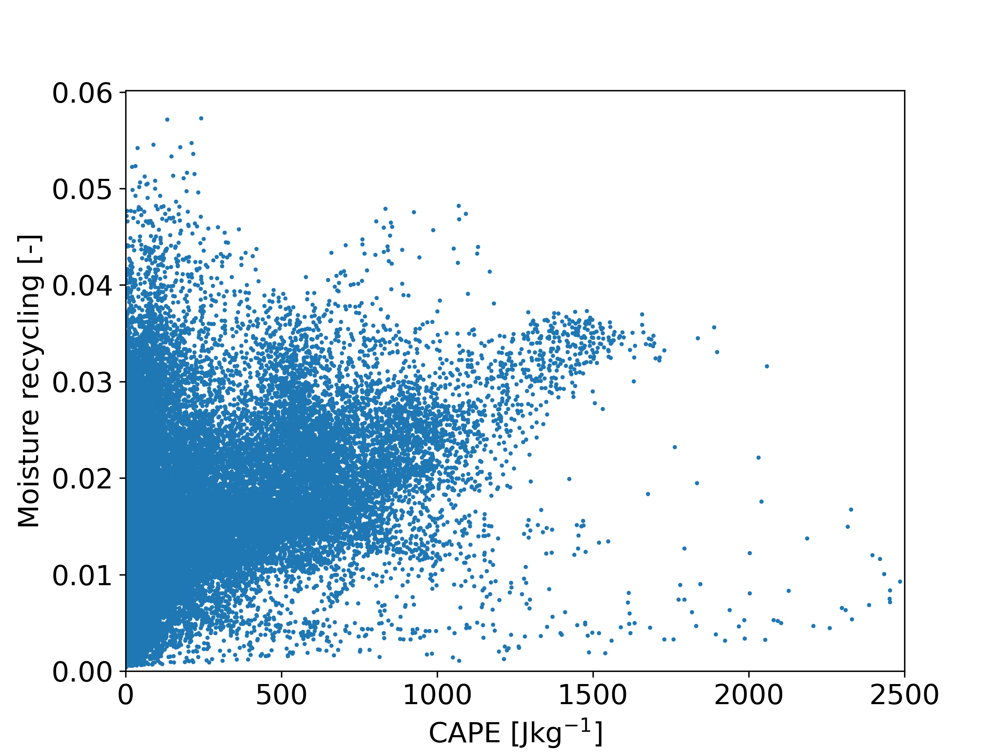
High LMR for large elevation and CAPE*
X
ρ = 0.30
ρ = 0.28
No clear correlation
High LMR for high elevation
Elevation promotes orographic precipitation due to enhanced convection
No clear correlation
Mostly high LMR for high CAPE*
CAPE feeds convection and promotes rainfall
*CAPE: Convective Available Potential Energy
Previous
Next

Slide 8
High LMR for wet regions
X
Tropics are wet enough so variation in wetness seems to no longer affect LMR
Wetness correlates strongest for the lower- and middle-latitudes
Large scale precipitation and convective precipitation have a similar correlation with LMR
Previous
Next

Slide 9
Underlying factors of LMR
X
Variation in wetness does not correlate to LMR for the tropics as there is sufficient moisture available
Orography correlates with LMR between 30° and 75°
Wind speed correlates with LMR between 0° and 45°
Previous
Next
Antarctica is excluded from this analysis

Slide 10
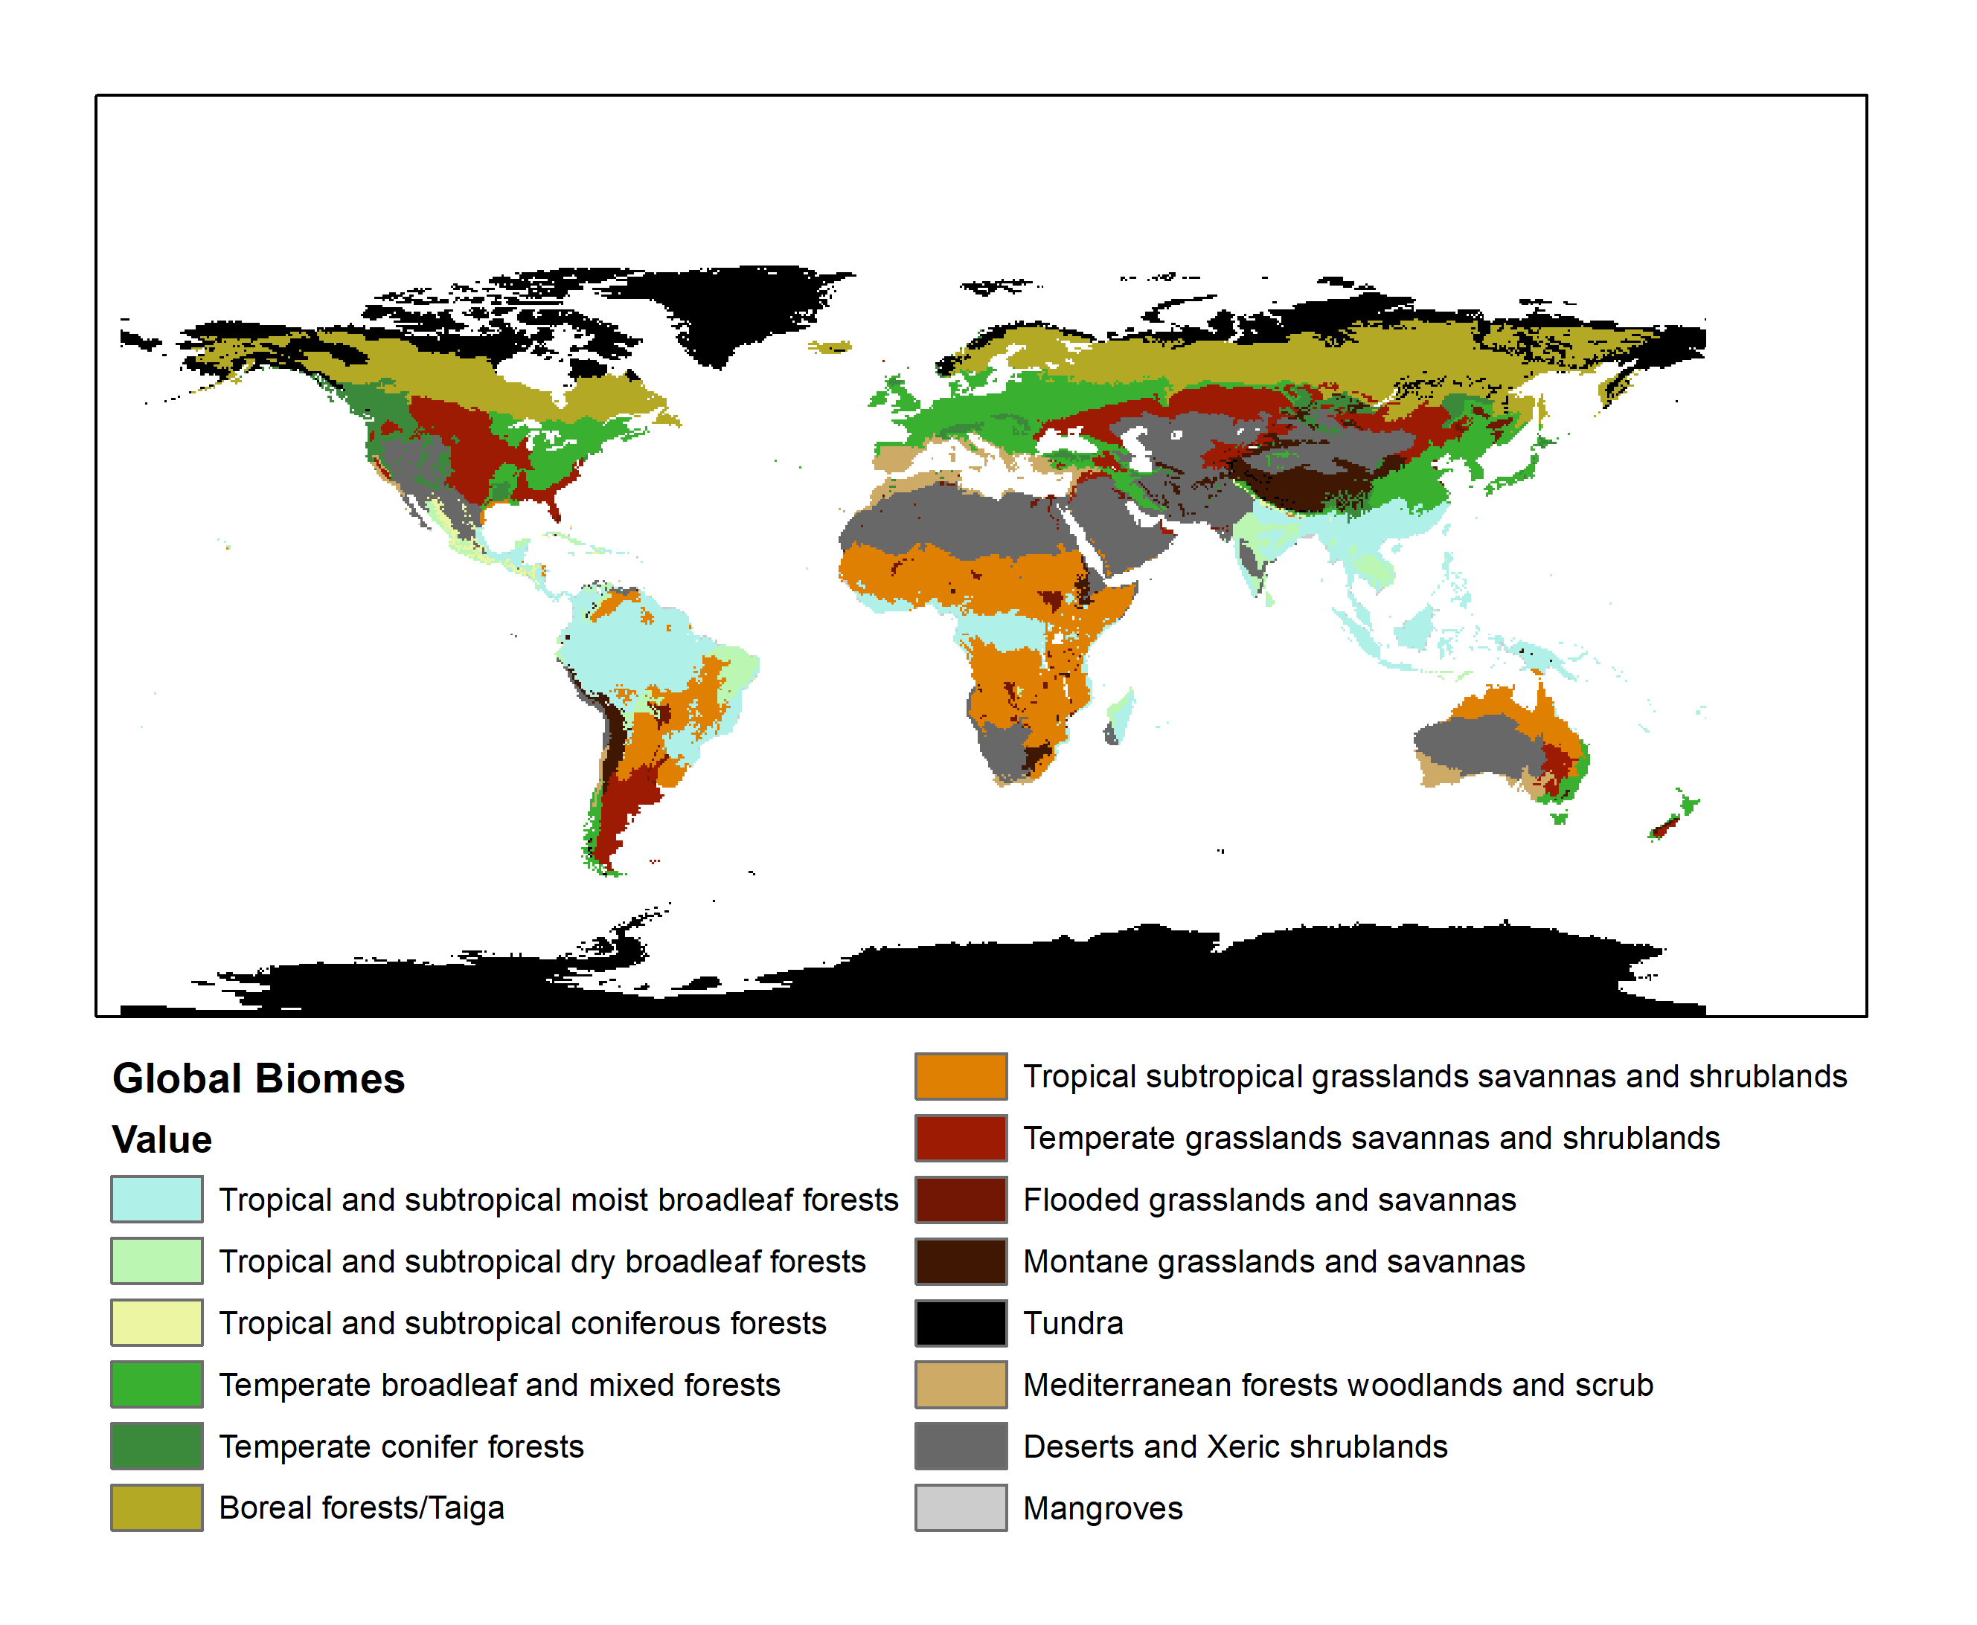
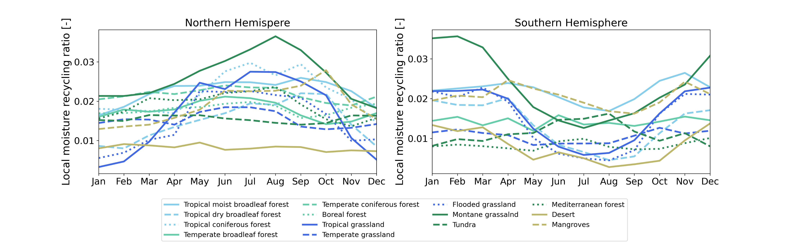
Biomes
X
LMR varies amongst biomes
  Highest over montane grassland
Seasonality varies amongst biomes
  Strongest for grasslands (montane, tropical, flooded)
  Peaks in summer
Differences between northern and southern hemispheres
Next
Notes:
Deze voor de klimatologie omdat je dan eerst alle UTrack laat zien.
De scaling en de model dependency naar achter gooien.

Slide 11
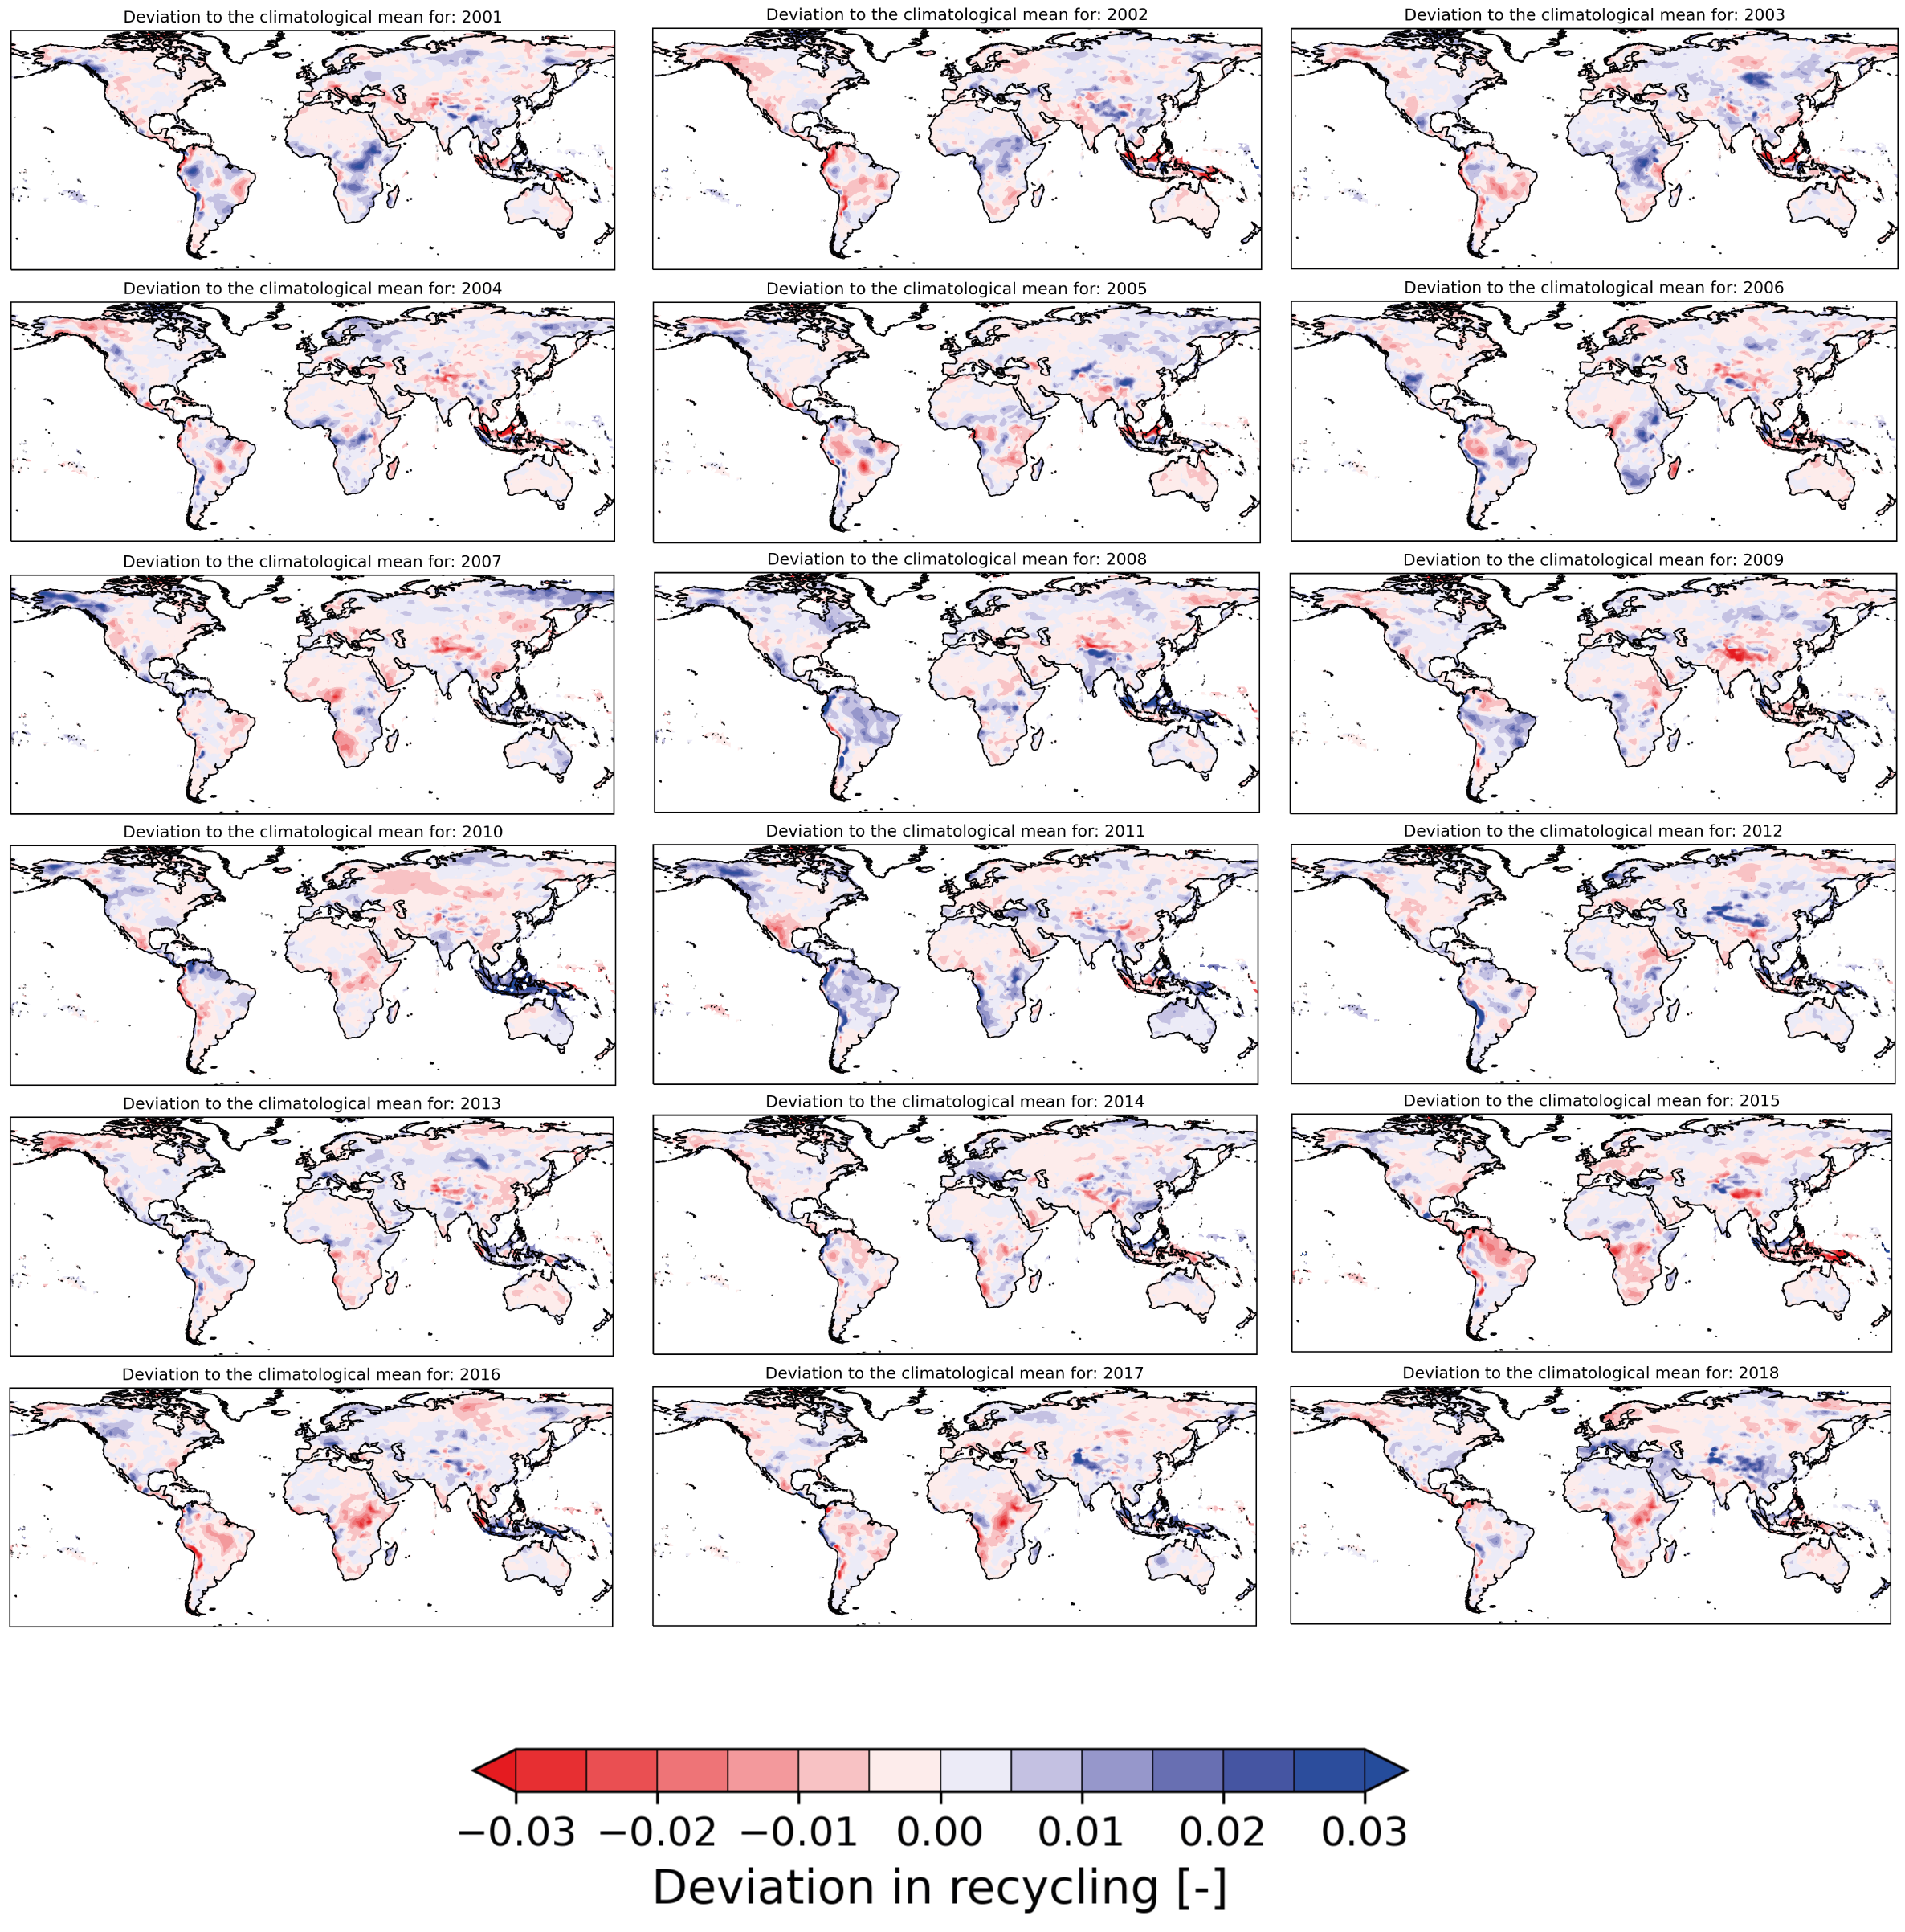

Local recycling between 2001-2018
X
Deviation to the climatological mean (2001-218)
Click here!
Drought conditions → relatively low LMR Wet conditions → relatively high LMR
This data is obtained from Link, et al. Earth System Science Data 12.3 (2020): 1897-1912.
Plots show the recycling of evaporated moisture within a grid cell of 1.5°.
Next
Notes:
Erbij zetten ander model gebruikt
Andere title want het zijn meer events
Meer tekst met uitleg wat de overgang hier is.

Slide 12
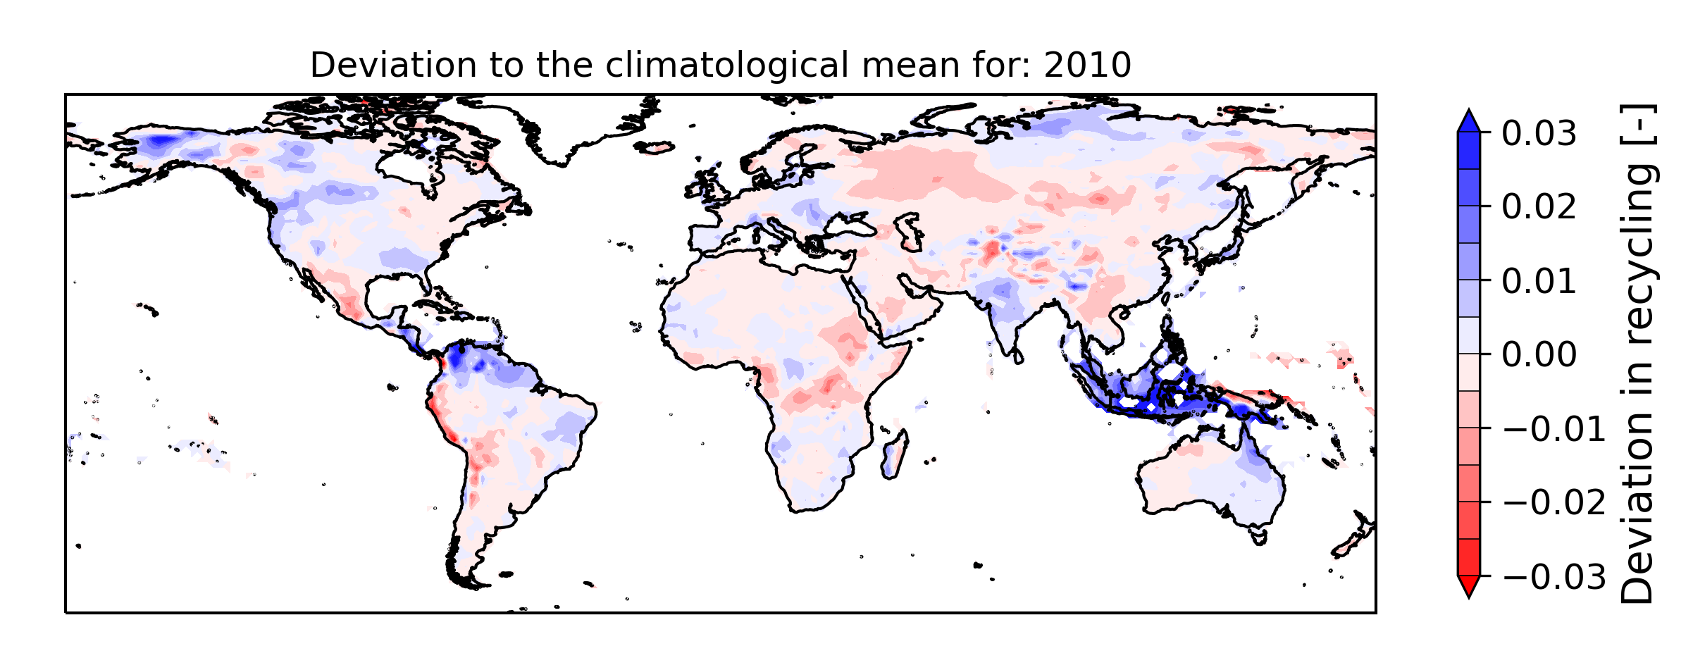
Heatwave reduces local recycling (2010)
X
Heatwave in Eastern Europe and Russia reduced rainfall
Drought conditions reduced LMR
Previous
This data is obtained from Link, et al. Earth System Science Data 12.3 (2020): 1897-1912.
Plots show the recycling of evaporated moisture within a grid cell of 1.5°.
Next

Slide 13
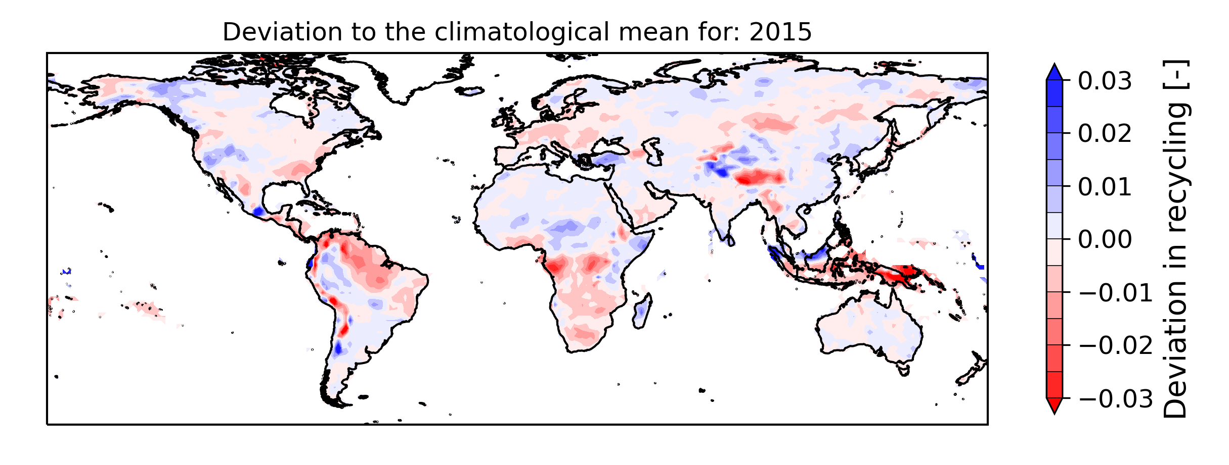
El Niño affects local recycling (2015)
X
El Niño
Reduced rainfall for West Africa and southern Africa and enhanced rainfall for East Africa
Reduced rainfall for South Sumatra and South Bornea and enhanced rainfall for North Sumatra and North Borneo
Reduced (enhanced) rainfall results in lower (higher) than average LMR
Previous
This data is obtained from Link, et al. Earth System Science Data 12.3 (2020): 1897-1912.
Plots show the recycling of evaporated moisture within a grid cell of 1.5°.
Next
Notes:
https://www.nasa.gov/feature/goddard/2016/el-nino-brought-drought-and-fire-to-indonesia

Slide 14



Conclusions
X
Continue for additional information
LMR
1.7% (std 1.1%)
Peaks in LMR:
LMR
where
Lat.
Annually, 1.7% of terrestrial evaporated moisture returns as rainfall within approximately 50 km from its source location
Local moisture recycling peaks during summer
Convection and wetness seem to promote local moisture recycling
Convection is enhanced over mountains, for ascending air and high convective available potential energy
High local moisture recycling reduces local drying due to regreening.
Based on these results we recommend to regreen:
wet regions
close to elevated regions
Jolanda.Theeuwen@wetsus.nl @jtheeu
Theeuwen et al., Hydrol. Earth Syst. Sci. 27 (2023): 1457–1476.
Article
OSPP

Slide 15
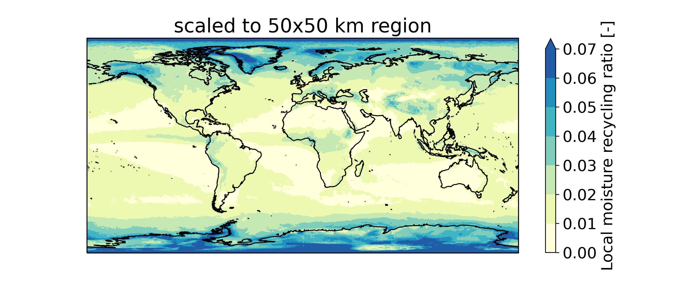
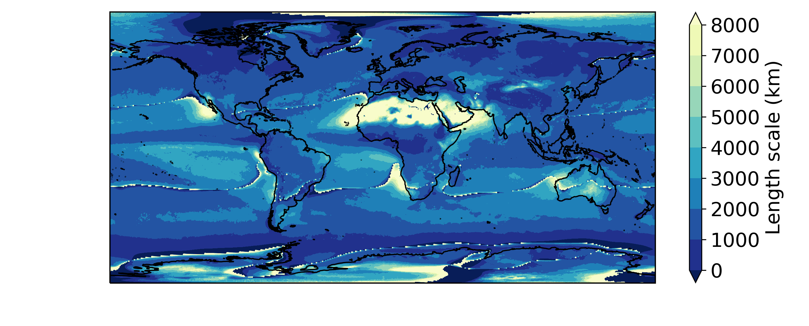
Scaling of LMR
X
Grid cells of 0.5° vary in area with changing latitude
Scaling LMR from a 0.5°x 0.5° grid cell to 2500 km²
Affects pattern for the higher latitudes
Similar pattern for low and middle latitudes
Typical length scale of evaporation allows to compare recycling ratios independent of size of grid cell (Van der Ent & Savenije, 2011)
The local moisture recycling ratio (LMR) allows to quantify changes in local precipitation
Next
Van der Ent and Savenije Atmospheric Chemistry and Physics 11.5 (2011): 1853-1863.

Slide 16
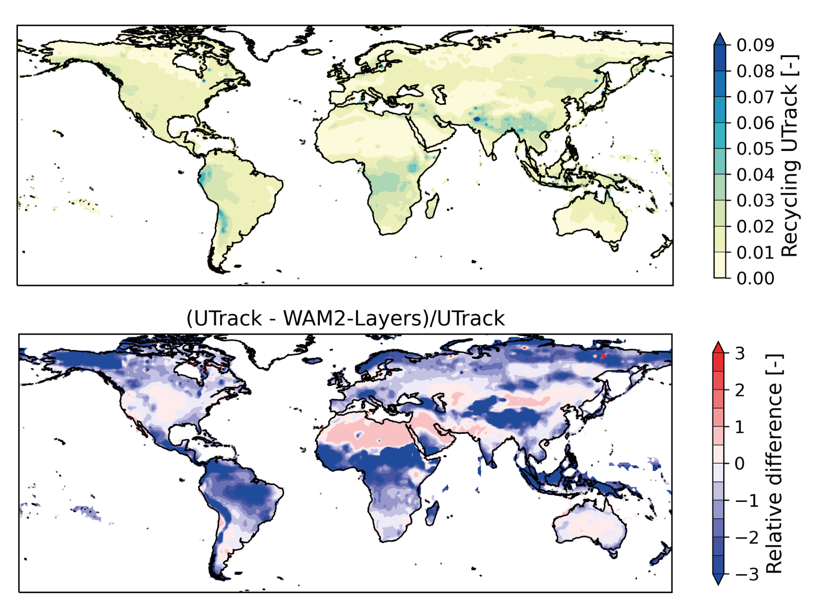
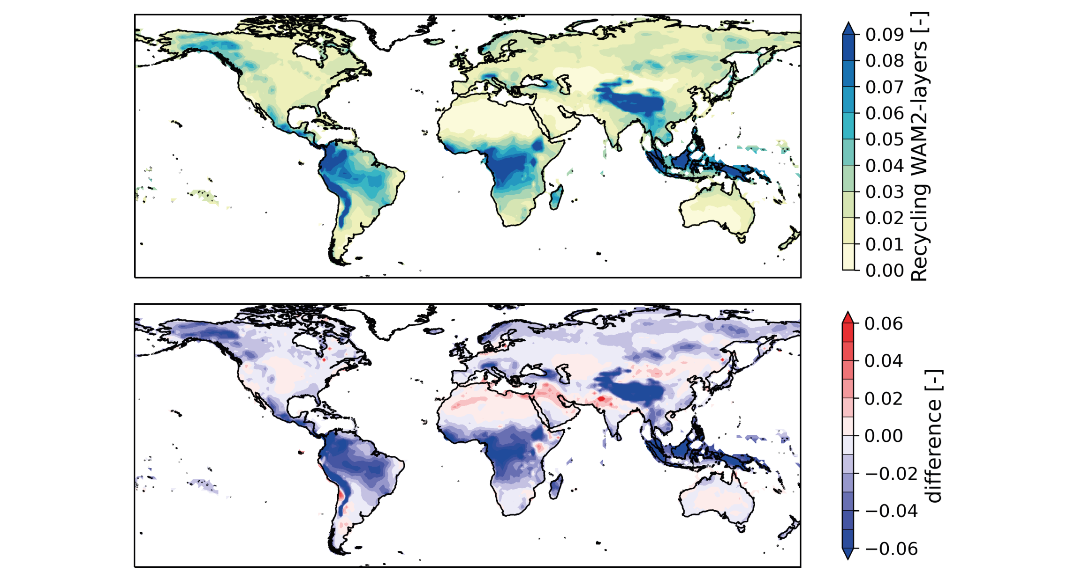
Model dependency of recycling within 1.5°
X
Model | Model type (tracking resolution) | Resolution input data | Recycling within 1.5°
WAM2-Layers | Eulerian model (1.5°) | 1.5° and 6 hourly (ERA-Interim) | Similar spatial pattern but differences in magnitude
UTrack | Lagrangian model (0.25°) | 0.25° and hourly (ERA5)
Link, et al. Earth System Science Data 12.3 (2020): 1897-1912.

