Slide 1
Determining Basal Mass Balance of Ice Shelves Using Simulation-Based Inference
Guy Moss, Vjeran Višnjević, Cornelius Schröder,
Jakob Macke, and Reinhard Drews
28.04.23
EGU 2023 - Session CR2.3
Contents
Next - Highlight

Slide 2
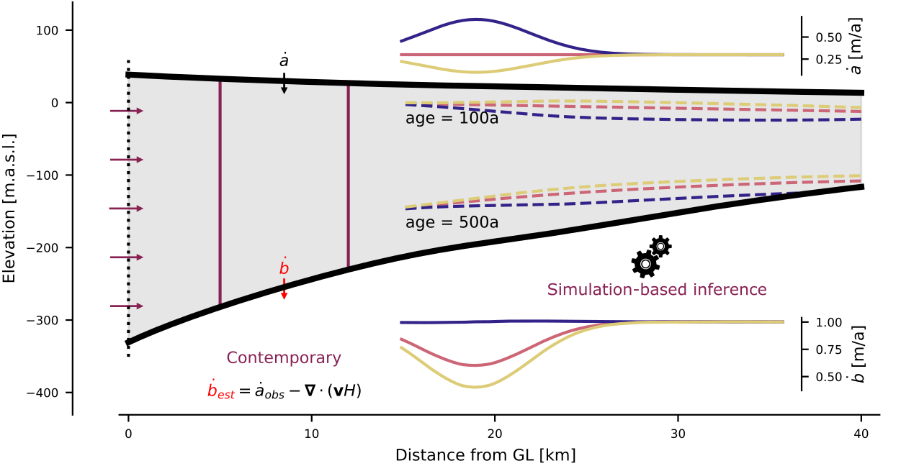
Previous - Title
Next - Highlight
Contents
Mass Balance or Internal Stratigraphy?

Slide 3
Previous - Highlight
Next - Contents
Contents
Come by for a Chat (+Snacks)
guy.moss@uni-tuebingen.de

Slide 4
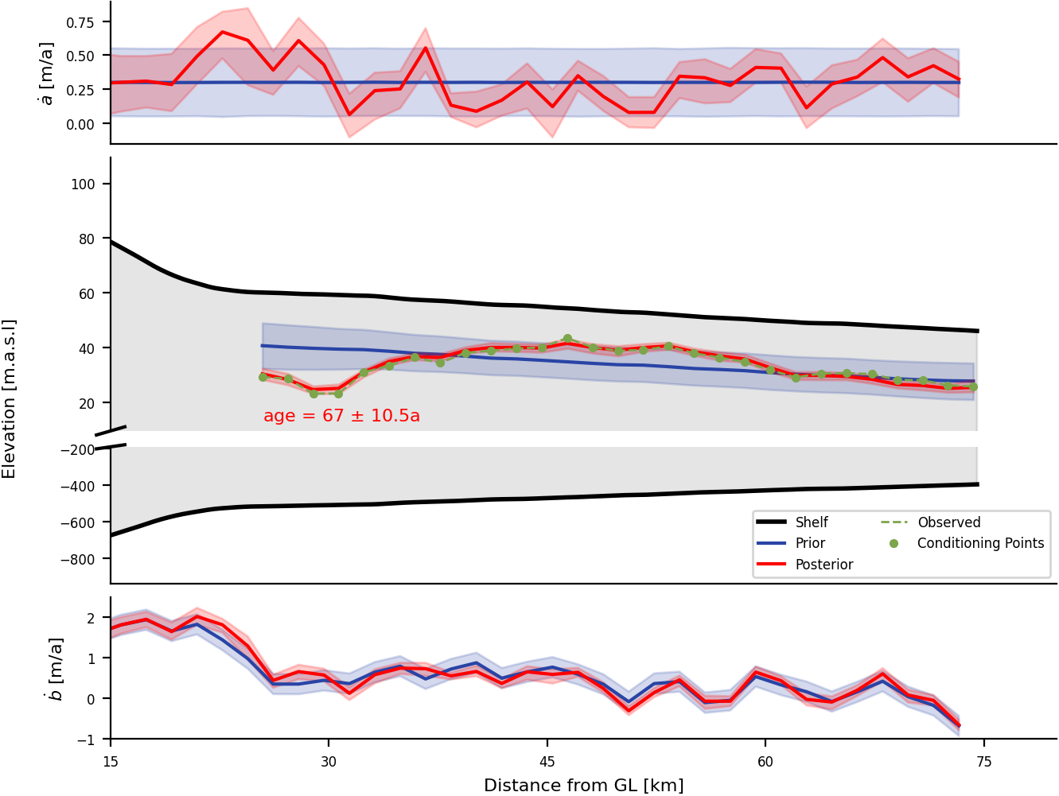
Previous - Highlight
Next - Context
Table of Contents
Spotlight Introduction
Context - Ice Shelves
Key Concepts
Solving Inverse Problems
Simulator Details
Ekström Ice Shelf - Data and Results
Appendix
Acknowledgements
Main Result - using Internal Radar Horizons measurements along a transect in Ekström Ice Shelf, we obtain the posterior probability distribution of the surface and basal mass balance parameters.

Slide 5
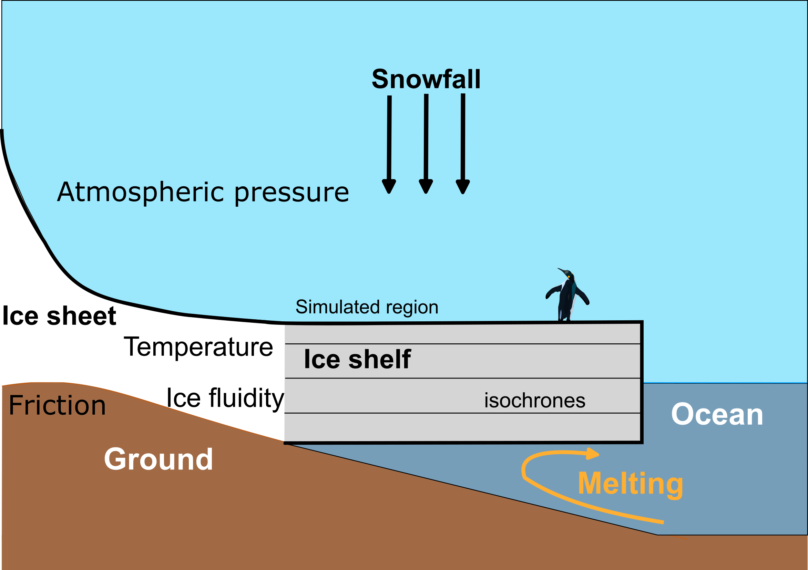
Previous - Contents
Next - Key Concepts
Contents
Ice shelves
Ice shelves are floating masses of ice buttressing ice sheets.
Sub-shelf basal melting is responsible for approximately 50% of all mass loss in Antarctica*.
The internal stratigraphy of the ice shelves contains a spatiotemporal archive of past dynamics.
* M.A. Depoorter et al. (2013), Nature

Slide 6
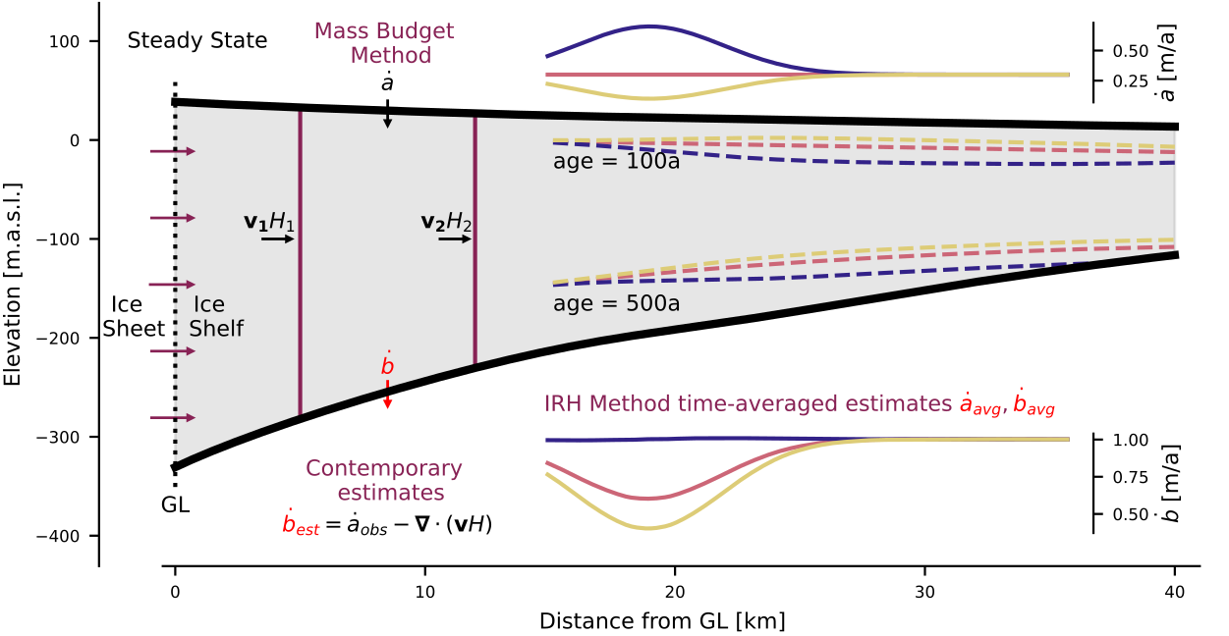
Previous - Context
Next - Inverse Problems
Contents
Key Concepts - Inferring Mass Balance
The total mass balance can be calculated from flux divergence.
Internal stratigraphy decouples total mass balance into accumulation and basal melt.

Slide 7
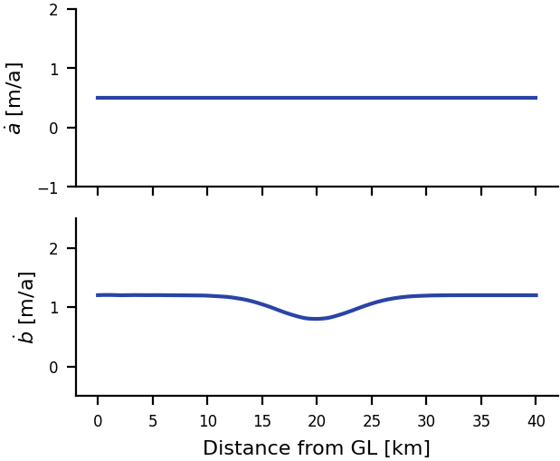
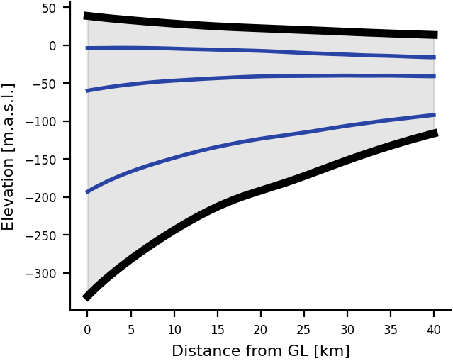
Previous - Key Concepts
Next - Inverse Problems
Contents
Solving Inverse Problems - Deterministic View
Forward Model
Parameter
Predicted
Model Simulation (Full Stokes, SIA, SSA,…)
More about Bayesian Inference

Slide 8
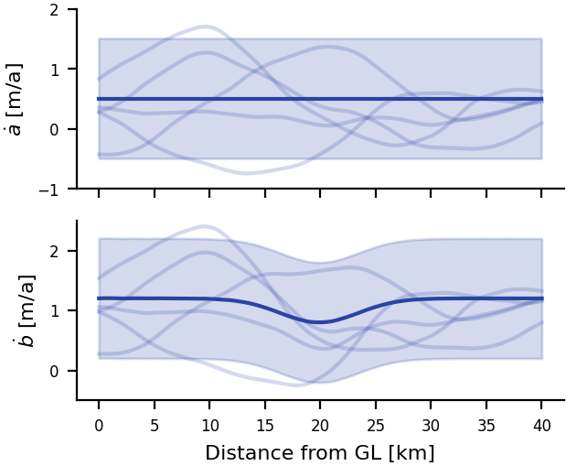
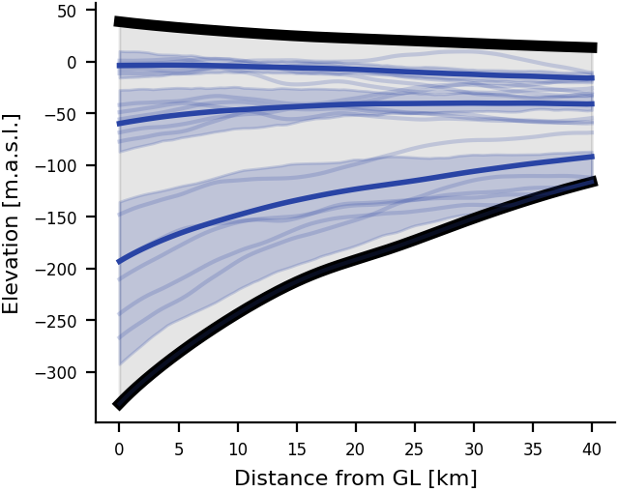
Previous - Inverse Problems
Next - Inverse Problems
Contents
Solving Inverse Problems - Statistical View
Forward Model
Parameter Distribution
Predictive Distribution
Model Simulation (Full Stokes, SIA, SSA,…)
More about Bayesian Inference

Slide 9
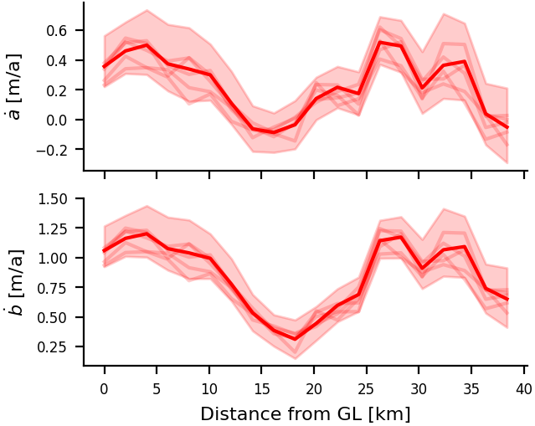
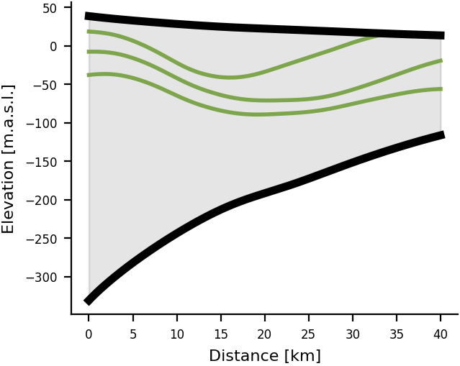
Previous - Inverse Problems
Next - Simulator
Contents
Solving Inverse Problems - Bayesian Inference
Forward Model
Parameter Distribution
Observation
Model Simulation (Full Stokes, SIA, SSA,…)
Inference
Complex models and distributions - Simulation Based Inference (SBI).
More about Bayesian Inference

Slide 10
Previous - Inverse Problems
Next - Ekström Ice Shelf
Contents
Simulator Details
Fix a steady state ice shelf.
Sample surface and basal mass balance from a prior distribution.
Simulate internal layers*.
Repeat for different mass balance parameters.
👆🏿click to play!
*A. Born and A. Robinson (2021), The Cryosphere
What is the age of incoming layers?

Slide 11
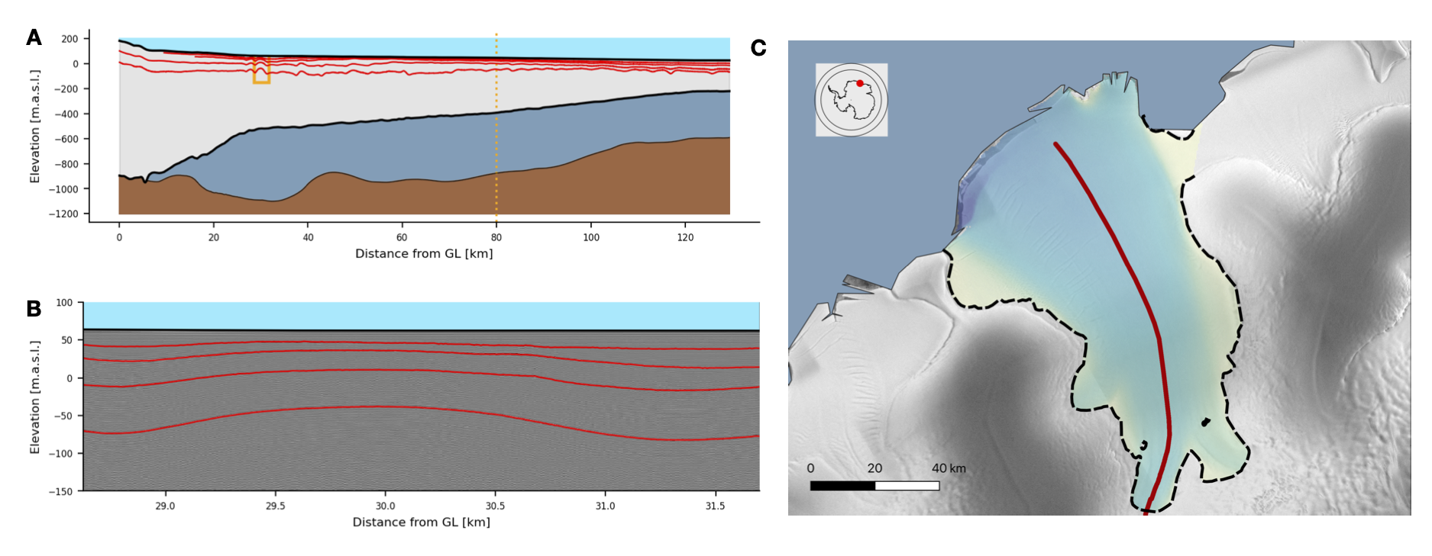
Previous - Simulator
Next - Ekström Ice Shelf
Contents
Ekström Ice Shelf

Slide 12
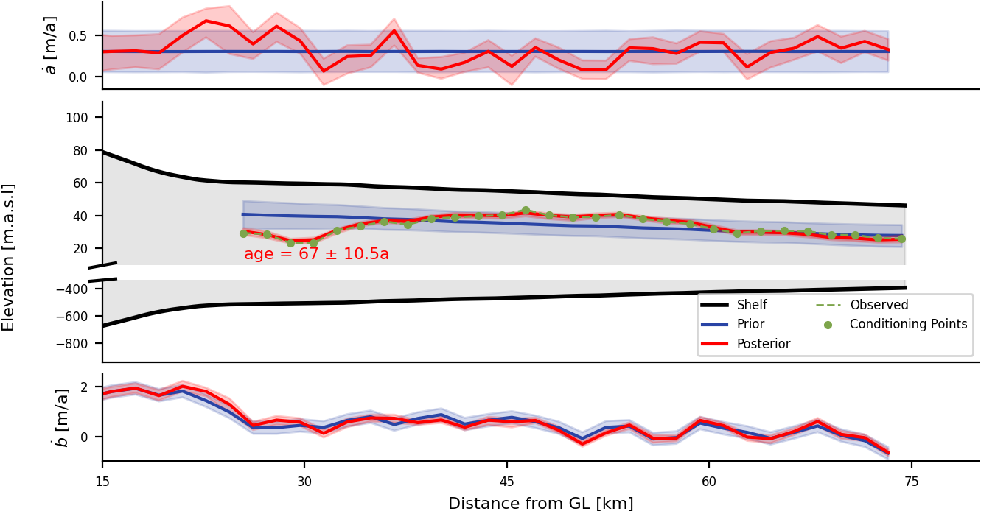
Previous - Ekström Ice Shelf
Next - Appendix
Contents
Results - Ekström
Posterior narrower than prior → reduced uncertainty!
Layer predicted from posterior samples matches observed layer.
How can we trust these results?

Slide 13
Previous - Ekström Ice Shelf
Next - Appendix
Contents
Appendix 1 - Bayesian Inference
$$p(θ|x)=\frac{p(x|θ)p(θ)}{p(x)}$$
$θ$ are your model parameters (what you don’t see), $x$ are your observations.
$p(θ)$ is the prior distribution (what you know about the parameters before you even start?)
$p(x|θ)$ is the likelihood function (if I know my parameter values are $θ$, how likely am I to observe $x$?)
$p(x)=∫p(x|θ)dθ$ is the model evidence (what is the probability that I observe $x$ with this model, no matter what the parameters are?)
$p(θ|x)$ is the posterior distribution (now that I’ve observed x, what is my new knowledge about the parameters?)
Got it - take me back

Slide 14
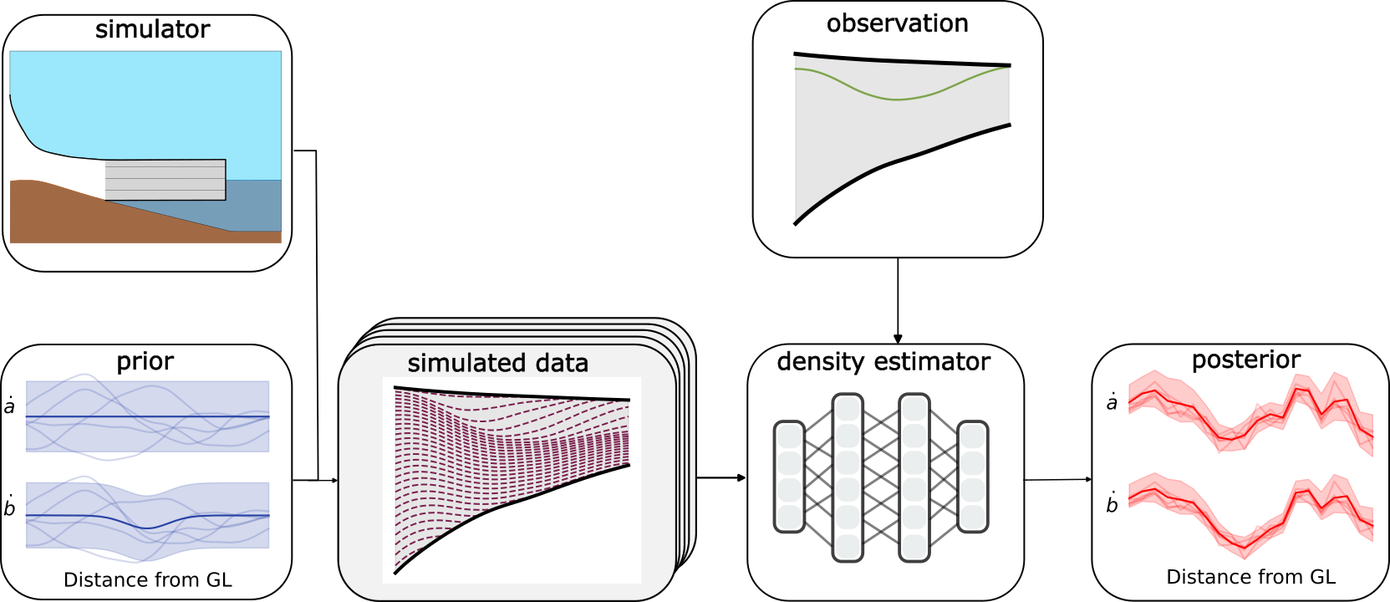
Previous - Appendix
Next - Appendix
Contents
Appendix 2 - SBI Framework
Simulate many samples from the prior distribution to obtain a dataset of parameters and predicted stratigraphies.
Got it - take me back

Slide 15
Previous - Appendix
Next - Appendix
Contents
Appendix 2 - SBI Framework
Train a neural network (typically normalising flows) to approximate the posterior distribution.
Got it - take me back

Slide 16
Previous - Appendix
Next - Appendix
Contents
Appendix 2 - SBI Framework
Evaluate the density estimator with the observed data as input to obtain the posterior distribution.
Got it - take me back

Slide 17
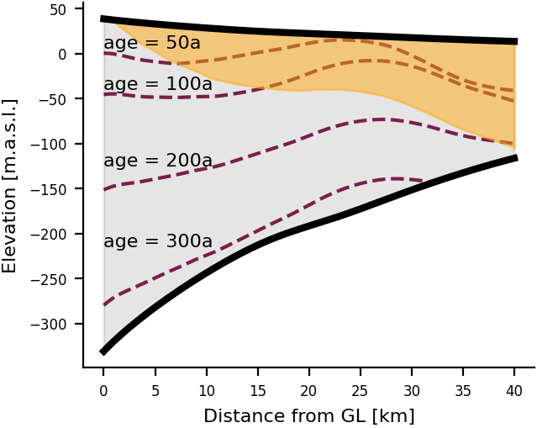
Previous - Appendix
Next - Appendix
Contents
Appendix 3 - Boundary Conditions
The incoming layers from the ice sheet are an unknown boundary condition.
We infer mass balance parameters only from the region that is independent from the boundary condition (orange).
This corresponds to trajectory of particle starting at top left of domain.
Got it - take me back

Slide 18
Previous - Appendix
Next - Appendix
Contents
Appendix 4 - Synthetic Example Definition
Show me the results
Shallow shelf solver implemented using Icepack*
*D.R Shapero, J.A Bageley, A.O. Hoffman and I.R. Joughin(2021) Geosci. Model Dev.
Got it - take me back

Slide 19
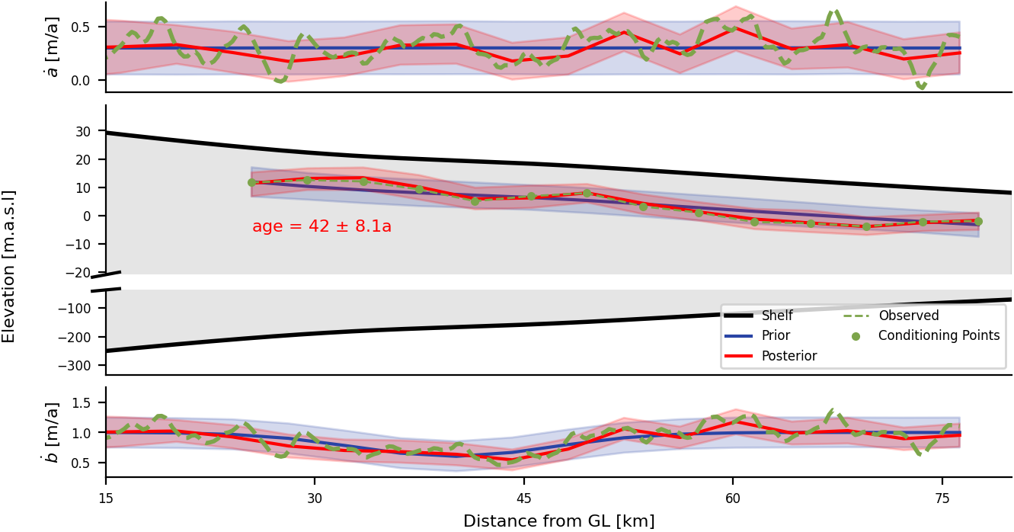
Previous - Appendix
Next - Acknowledgements
Contents
Appendix 4 - Synthetic Example Results
Posterior contains ground truth mass balance parameters, while reducing the prior uncertainty.
Got it - take me back

Slide 20
Contents
Acknowledgements
guy.moss@uni-tuebingen.de
Vjeran Višnjević
Cornelius Schröder
Jakob Macke
Reinhard Drews

