Slide 1
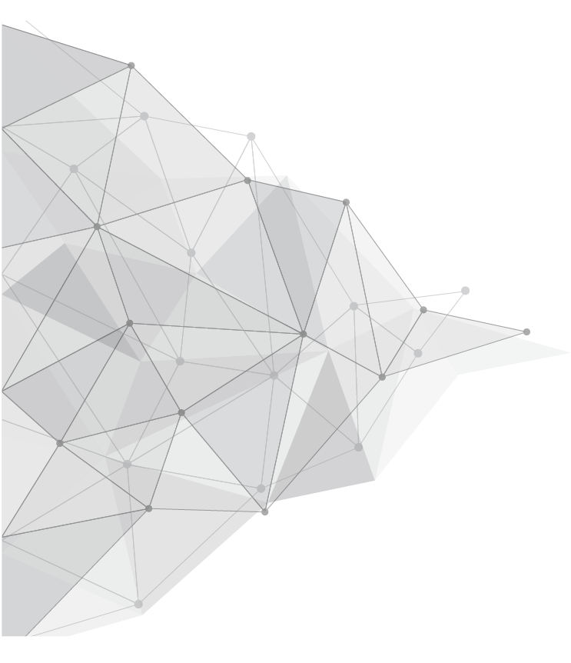
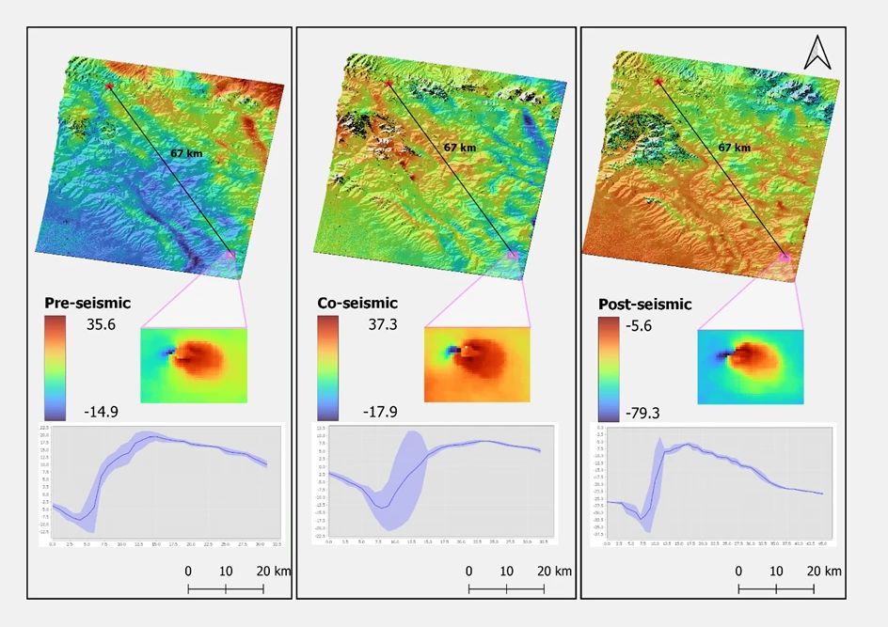
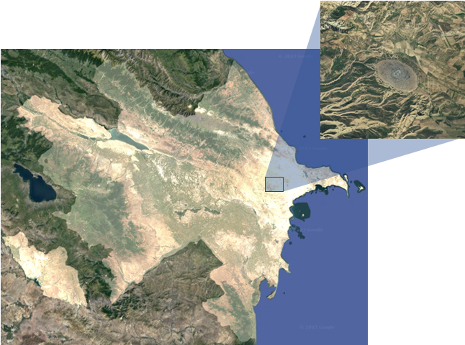
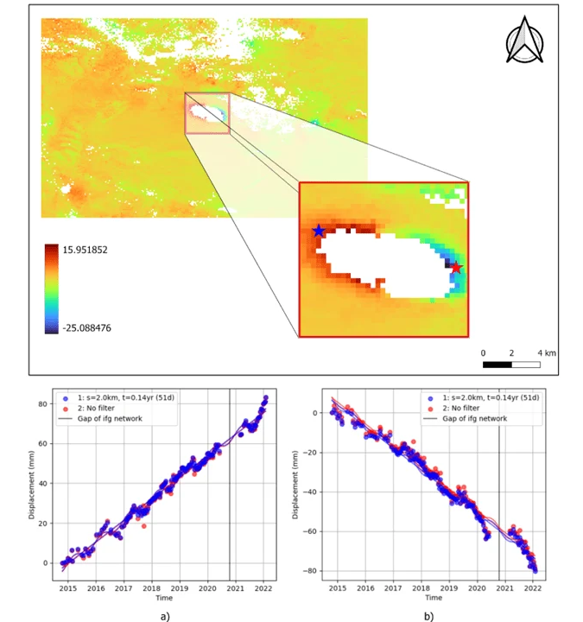
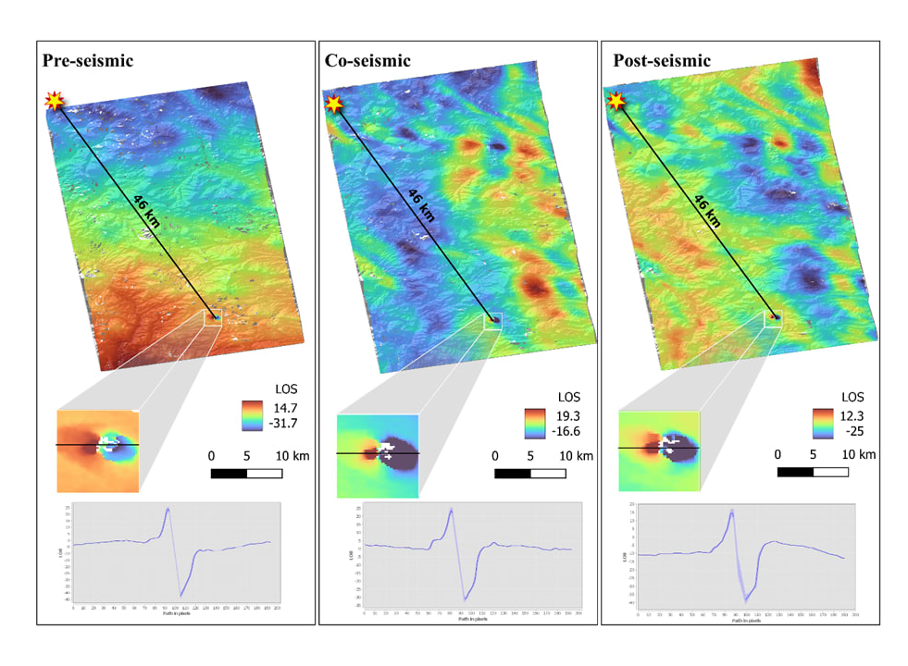
The Relationship Between Moderate Earthquakes and Ayazakhtarma Mud Volcano Using the InSAR Technique in Azerbaijan
Fakhraddin Kadirov and Bahruz Ahadov
EGU General Assembly 2023, Vienna, Austria
Introduction
Data and Method
Results and Discussion
Conclusion
In this study, Interferometric Synthetic Aperture Radar (InSAR) method is used for the first time to evaluate the relationship between moderate earthquakes and volcano dynamics in Azerbaijan. Azerbaijan is located near the eastern edge of the Greater Caucasus and the western edge of the Caspian Sea and is one of the countries with the highest population of mud volcanoes. We assessed pre-, co-, and post-seismic scenarios to investigate potential triggering relationships between moderate earthquakes and the Ayazakhtarma mud volcano. The Ayazakhtarma volcano is located 46 km from the 2021 Shamakhi earthquake and 67 km from the 2019 Basqal earthquake, respectively. The InSAR technique is used to detect changes in the Earth's surface elevation before and after earthquakes, which can provide insight into the mechanisms that trigger mud volcano activity. InSAR provides a robust technique for defining the complexity of earthquakes in spatial dimensions and provides more modern precise information about the effects of earthquakes than traditional methods. Based on our observations of the following earthquakes, our results show that moderate earthquakes (Mw≤5) could not trigger large mud volcano eruptions. In particular, the study of the Ayazakhtarma mud volcano revealed significant Line-Of-Sight (LOS) changes, which were positive and negative in the western half and eastern half of the site, respectively.
We applied the InSAR technique to detect the surface displacement at the Ayazakhtarma mud volcano and related an earthquake using C-band Sentinel 1 SAR data. Sentinel-1 is a satellite radar mission developed by the European Space Agency (ESA) as part of the Copernicus Earth observation program. We assessed pre-, co-, and post-seismic scenarios to find the possible triggering relationship between intermediate earthquakes and the Ayazakhtarma mud volcano. In this research, we obtained spatially and temporally detailed deformation time series and velocities from the LiCSAR (Looking Into Continents from Space with Synthetic Aperture Radar) products using LiCSBAS for the mud volcano from Sentinel-1A/B data between 2014 and 2022. At the same time, radar line-of-sight (LOS) displacement maps were generated based on results from the GMT5SAR for pre-, co-, and post-seismic deformation associated with earthquakes.
Ayazaktarma volcano is located 46 km away from the 2021 Shamakhi and 67 km from the 2019 Basqal earthquakes, respectively.
It is well-known that mud volcanoes frequently erupt as a result of earthquakes. According to earlier studies, an earthquake with a magnitude of M5 or higher that takes place within 20 km can cause a mud volcano to erupt. Our research helps us comprehend how earthquakes impact eruptive processes. No eruption was brought on by the seismic occurrences in this study. In two different situations, the interferograms enable the detection of ground displacement associated with mud volcano activity. Two neighbouring zones of minor subsidence and uplift, which are characteristic of the deformation of the Ayazakhtarma mud volcano, are present. At the Ayazakhtarma, faults also play a fairly important role in the deformation pattern. It’s interesting to note that the observed fault/fracture system primarily exists in the region that divides sectors with various subsidence. New information on the deformation patterns of the mud volcano Ayazakhtarma is provided by the interferometric data that have been studied.
In any case, the study of mud volcanoes and their relationship to earthquakes can provide valuable insights into the geological processes that shape our planet, and may help us better understand and prepare for seismic activity in the future.
Fig. 3. Pre-, co-, and post-seismic deformation of the Basqal earthquake
Results and Discussion
Overall, the use of InSAR data to study the relationship between mud volcanoes and moderate earthquakes has provided valuable insights into the complex and dynamic nature of earth processes. Further research using InSAR and other geophysical techniques can help to improve our understanding of the interaction between earthquakes and other natural phenomena, ultimately contributing to better hazard mitigation and disaster management strategies.
The Ayazakhtarma mud volcano is located 24 km west-northwest of Cheildagh village and is represented in the form of a hill, 3 km long and 2 km wide. We assessed pre-, co-, and post-seismic deformations to find the possible triggering relationship between intermediate earthquakes and the Ayazakhtarma volcano. The Mud volcanoes can sometimes be triggered by moderate earthquakes, although this is not always the case.
Authors
Fakhraddin Kadirov^{1,2} and Bahruz Ahadov ^{1,2},
1 Institute of Geology and Geophysics, Ministry of Science and Education Republic of Azerbaijan, Baku, Azerbaijan (kadirovf@gmail.com)
2 Institute of Oil and Gas, Ministry of Science and Education Republic of Azerbaijan, Baku, Azerbaijan (kadirovf@gmail.com, ahadovshao@gmail.com)
Fig. 1. Study area. Investigating the relationship between earthquakes activity and Ayazakhtarma mud volcano eruptions
Fig. 2. Pre-, co-, and post-seismic deformation of the Shamakhi earthquake
Fig. 4. The Ayazakhtarma mud volcano exhibited significant positive and negative LOS changes in the western and eastern half of the site, respectively/

