Slide 1
Trends and characteristics of warm and dry extreme compound events in South Eastern Europe
Maja Orihan - orihan.maja@gmail.com
Branislav Zivaljevic - branislav.zivaljevic@biosense.rs

Slide 2
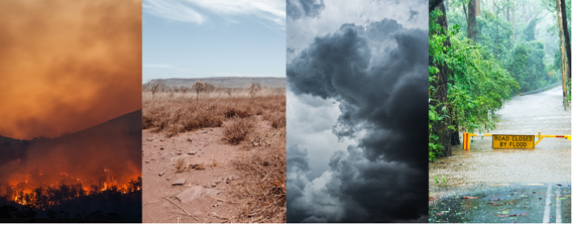
Compound events
Compound events are events that occur at the same time or in sequence and at the same geographic location or at multiple locations within a country or around the world (Zscheischler et al., 2018; Raymond et al., 2020).

Slide 3
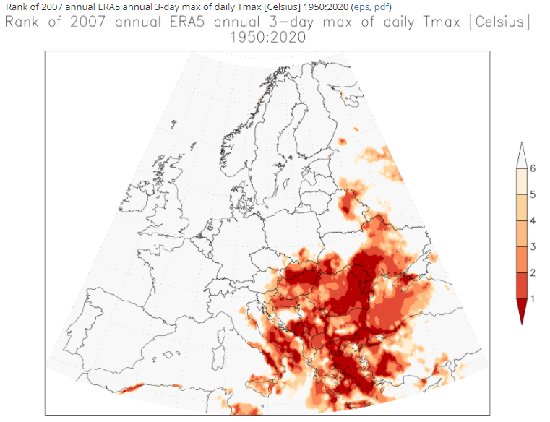
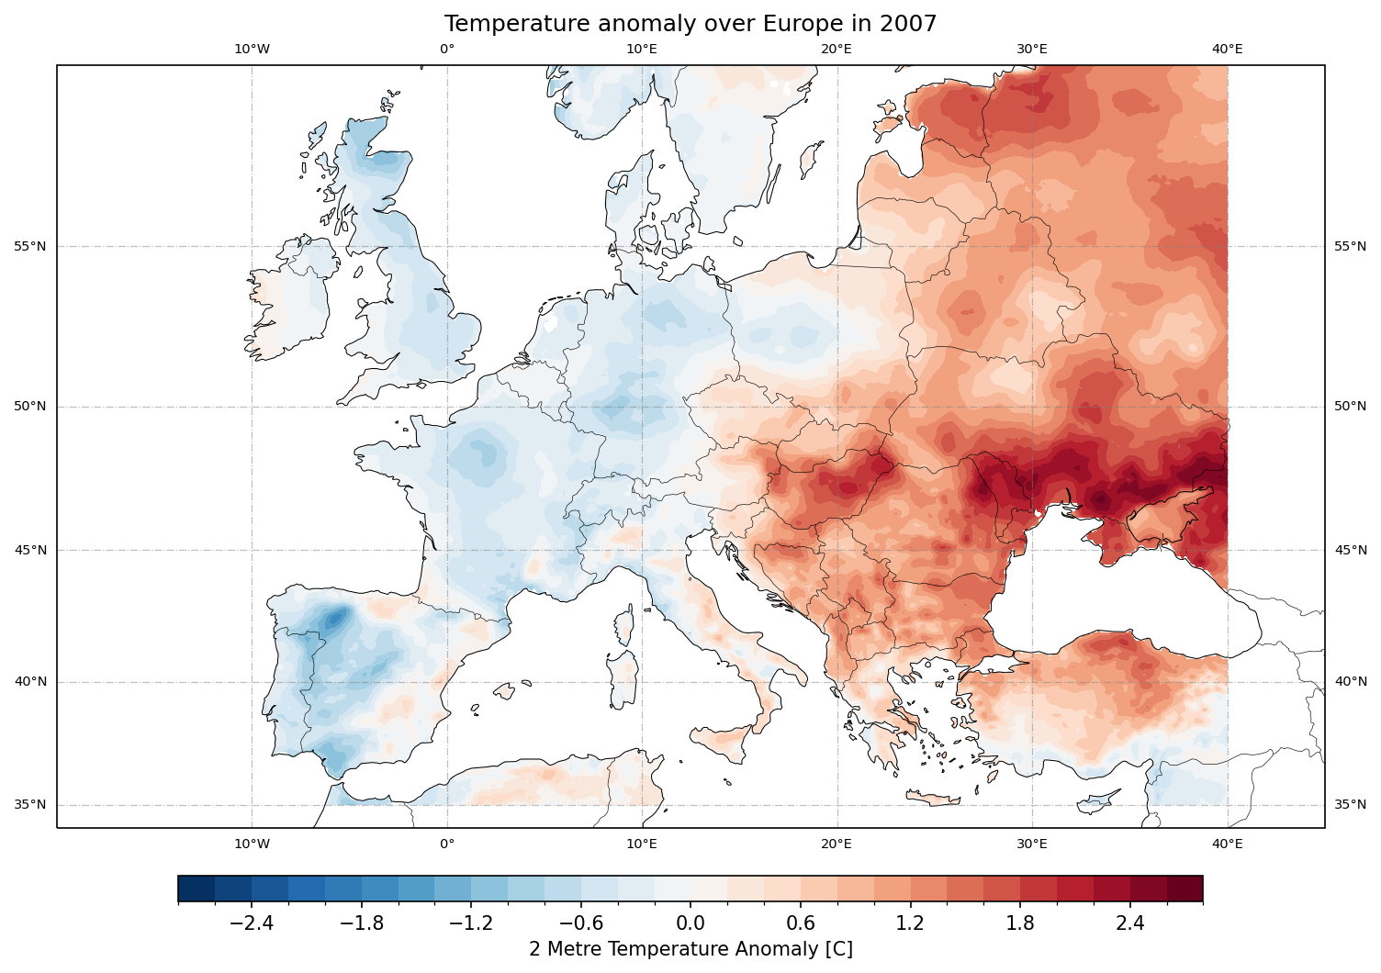
Motivation
Summer 2007

Slide 4
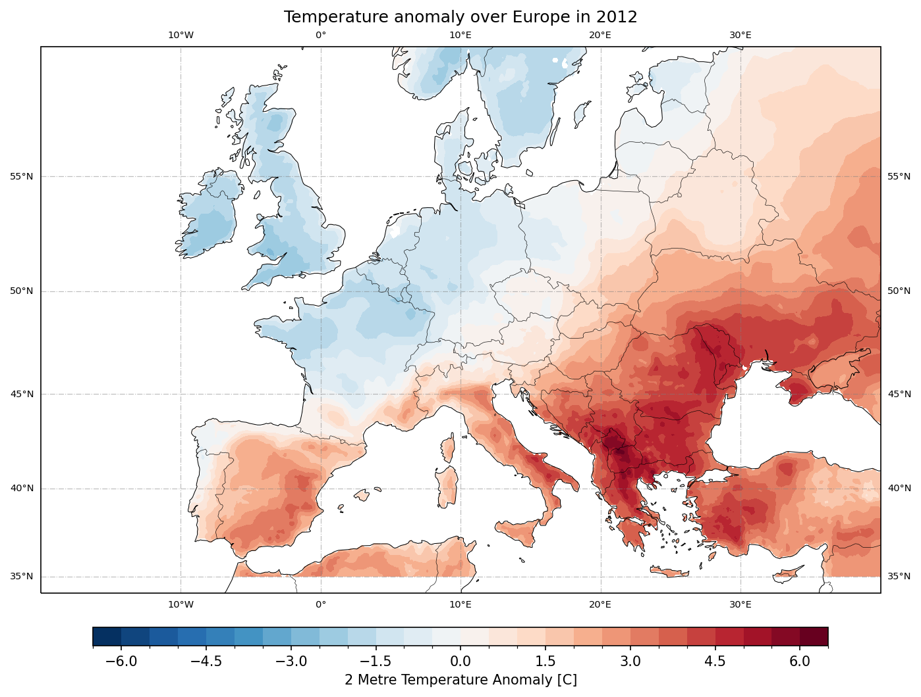
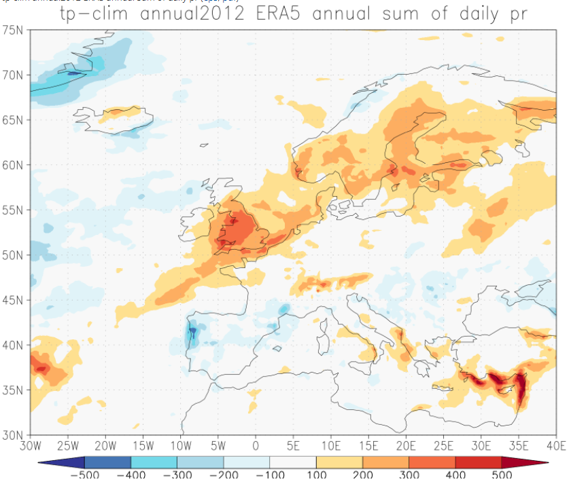
Heat wave and drought 2012

Slide 5
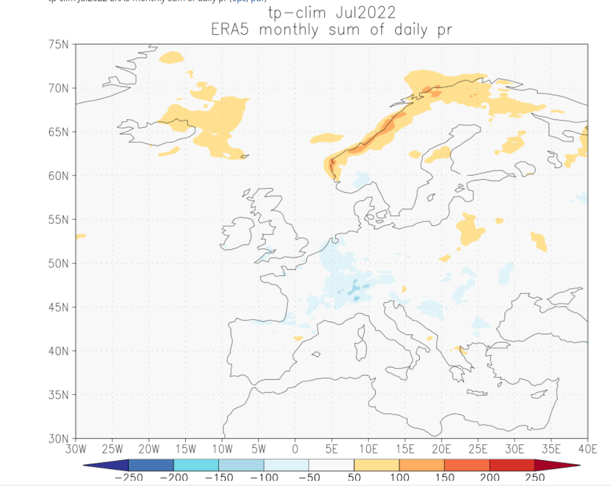
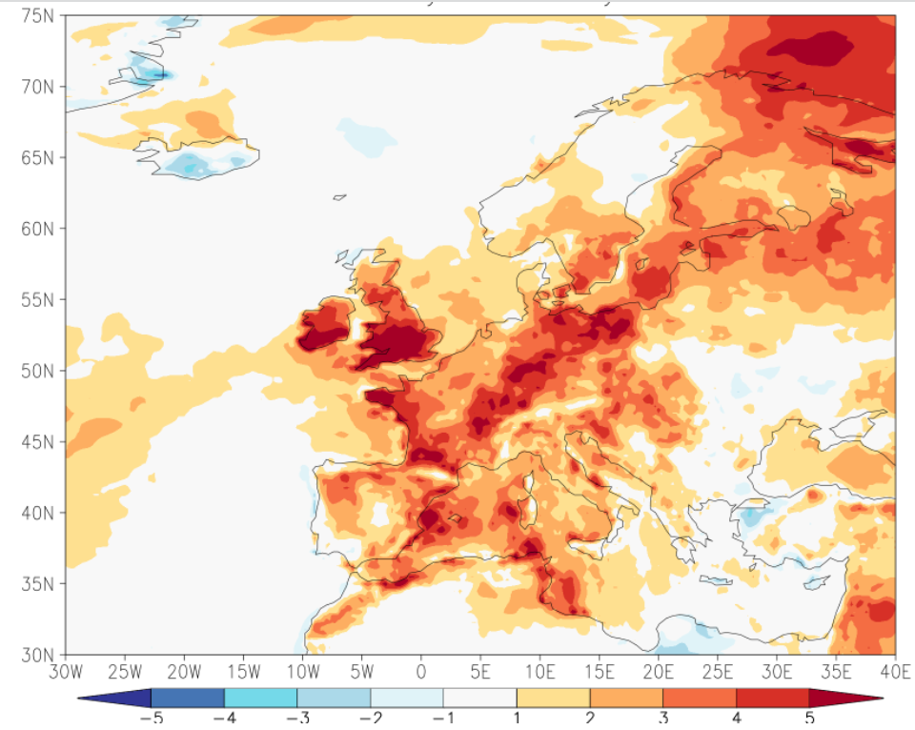
Heat and drought August 2022

Slide 6
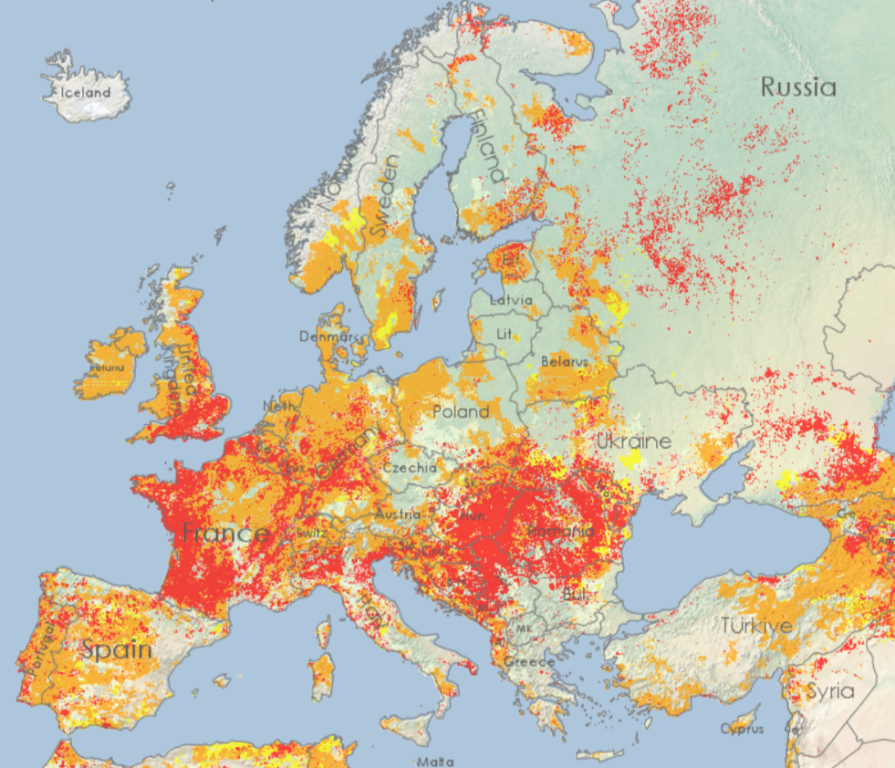
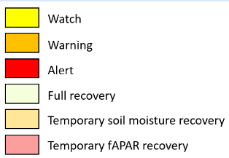
CDI – Combined Drought Indicator
Drought in the first 10 days of August 2022.

Slide 7
Bezak and Mikoš (2020) showed that parts of Western Europe, Italy, the Balkan Peninsula, and Northern and Eastern Europe stand out as hotspots of compound drought and extreme heat events.

Slide 8
Data

Slide 9
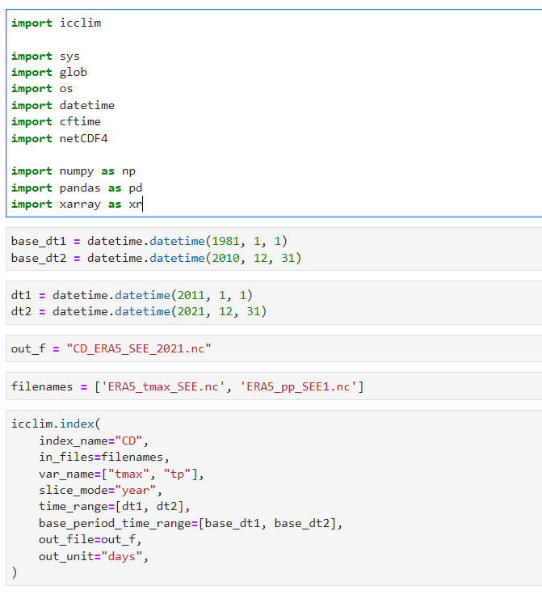
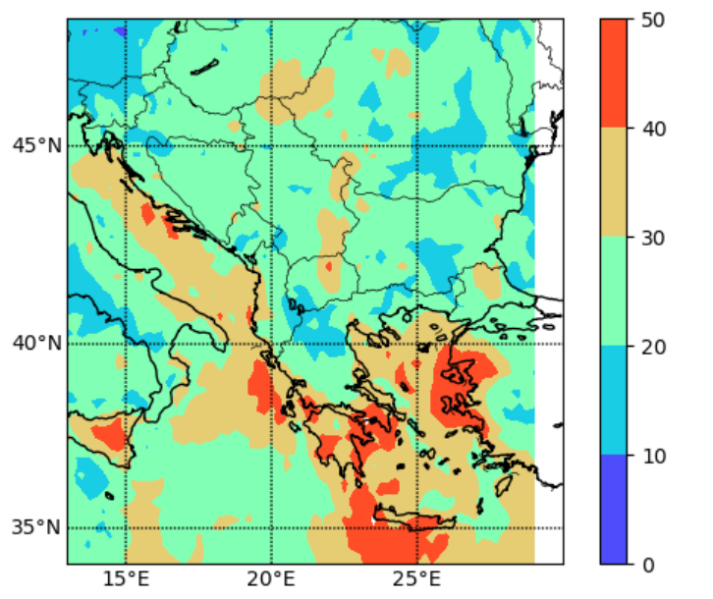
Number of cold and dry events in 2020

Slide 10
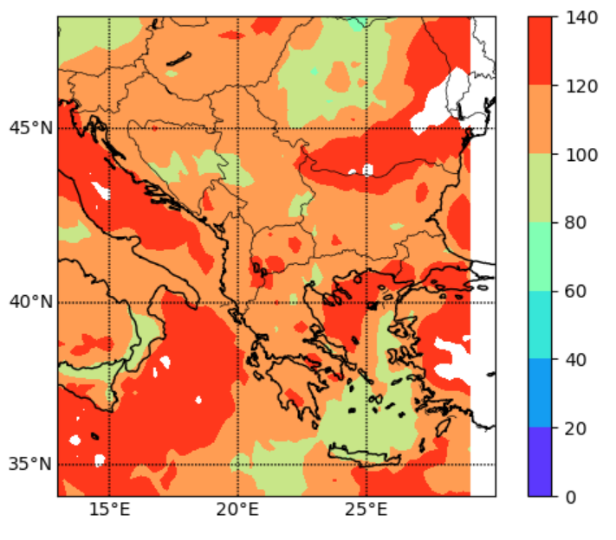
Number of Warm and Dry events in 2007

Slide 11
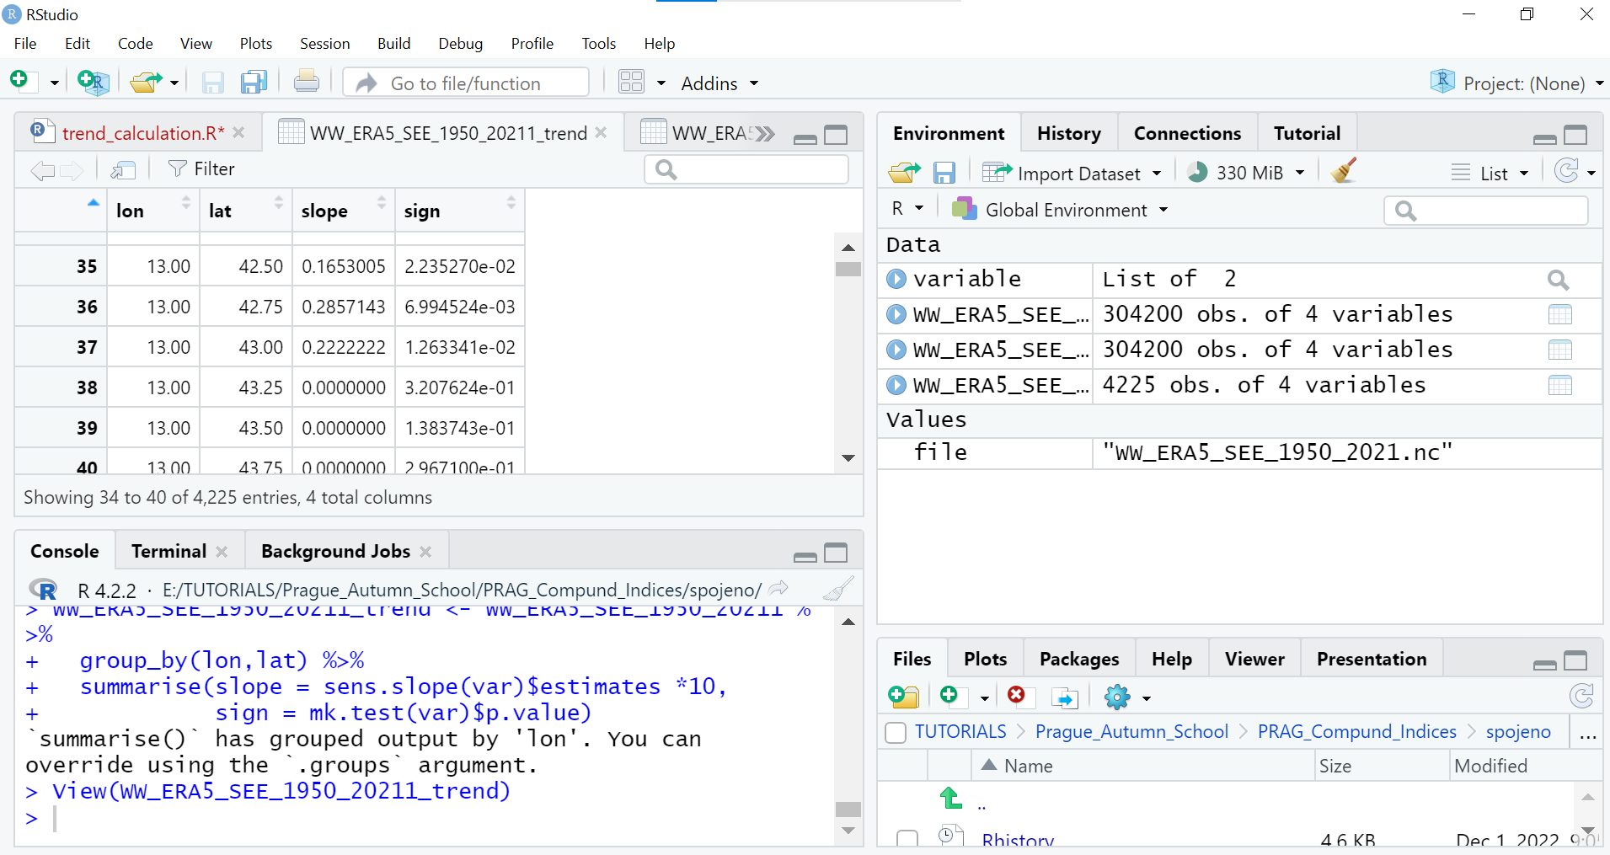
Trends in compound events
Trends were calculated using Mann Kendall trend test in R

Slide 12
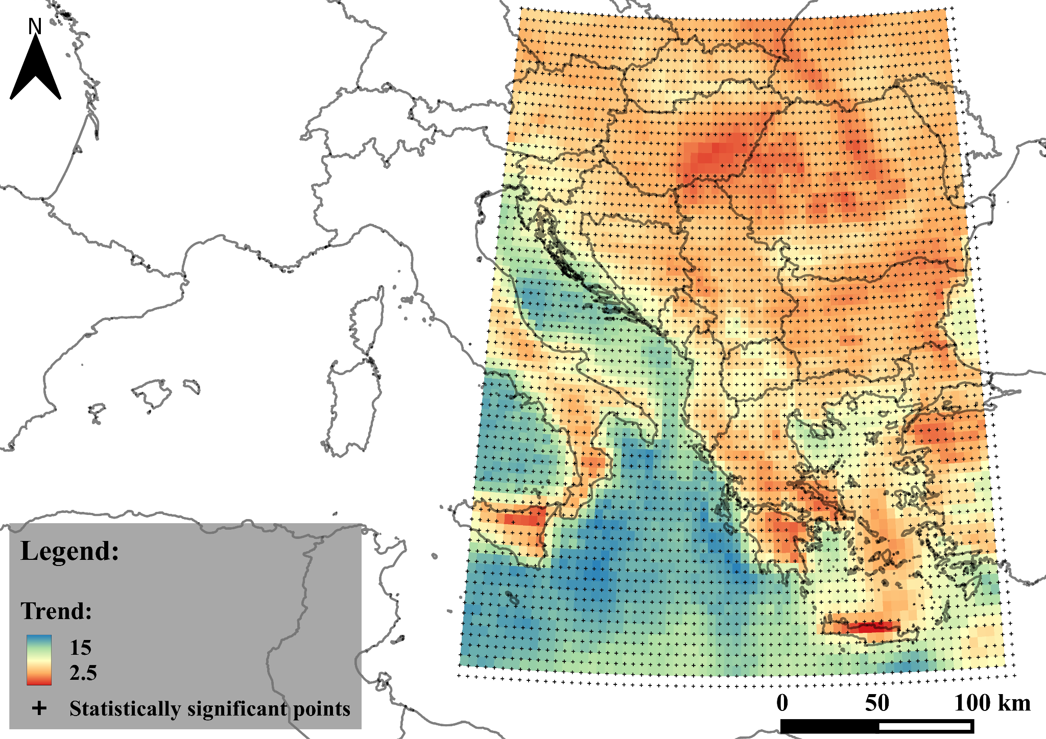
Warm and Dry compound index

Slide 13
Results The results of the analysis reveal a significant positive trend in warm and dry extreme compound events across the SEE region, as illustrated by the map. The highest trend of warming is observed in the blue colored region. The study highlights the increasing trend and severity if warm and dry extreme compound events in SEE and their potential impacts on vulnerable sectors such as agriculture, health, energy and water resources. These extreme events may lead to severe impacts on the region’s socio-economic systems and environment.

Slide 14
Conclusion
The ultimate objective is to raise the awareness of the importance of monitoring compound events in SEE and to offer insights for future research and policy interventions.

Slide 15
Future work
Seasonal indices
Model data
Explore the essential drivers

