Slide 1
Tailoring climate change information to assess the vulnerability of Greek airports and prioritising adaptation
T. van der Schriek, C. Giannakopoulos, N. Roukounakis, A. Karali, G. Kitsara, G. Lemesios & M. Gratsea
The study is executed by the CLimate change IMpacts and ADAPTation (CLIMADAPT) group at the National Observatory of Athens. The head of the CLIMADAPT research group, Dr Giannakopoulos, is the IPCC National focal point for Greece.

Slide 2
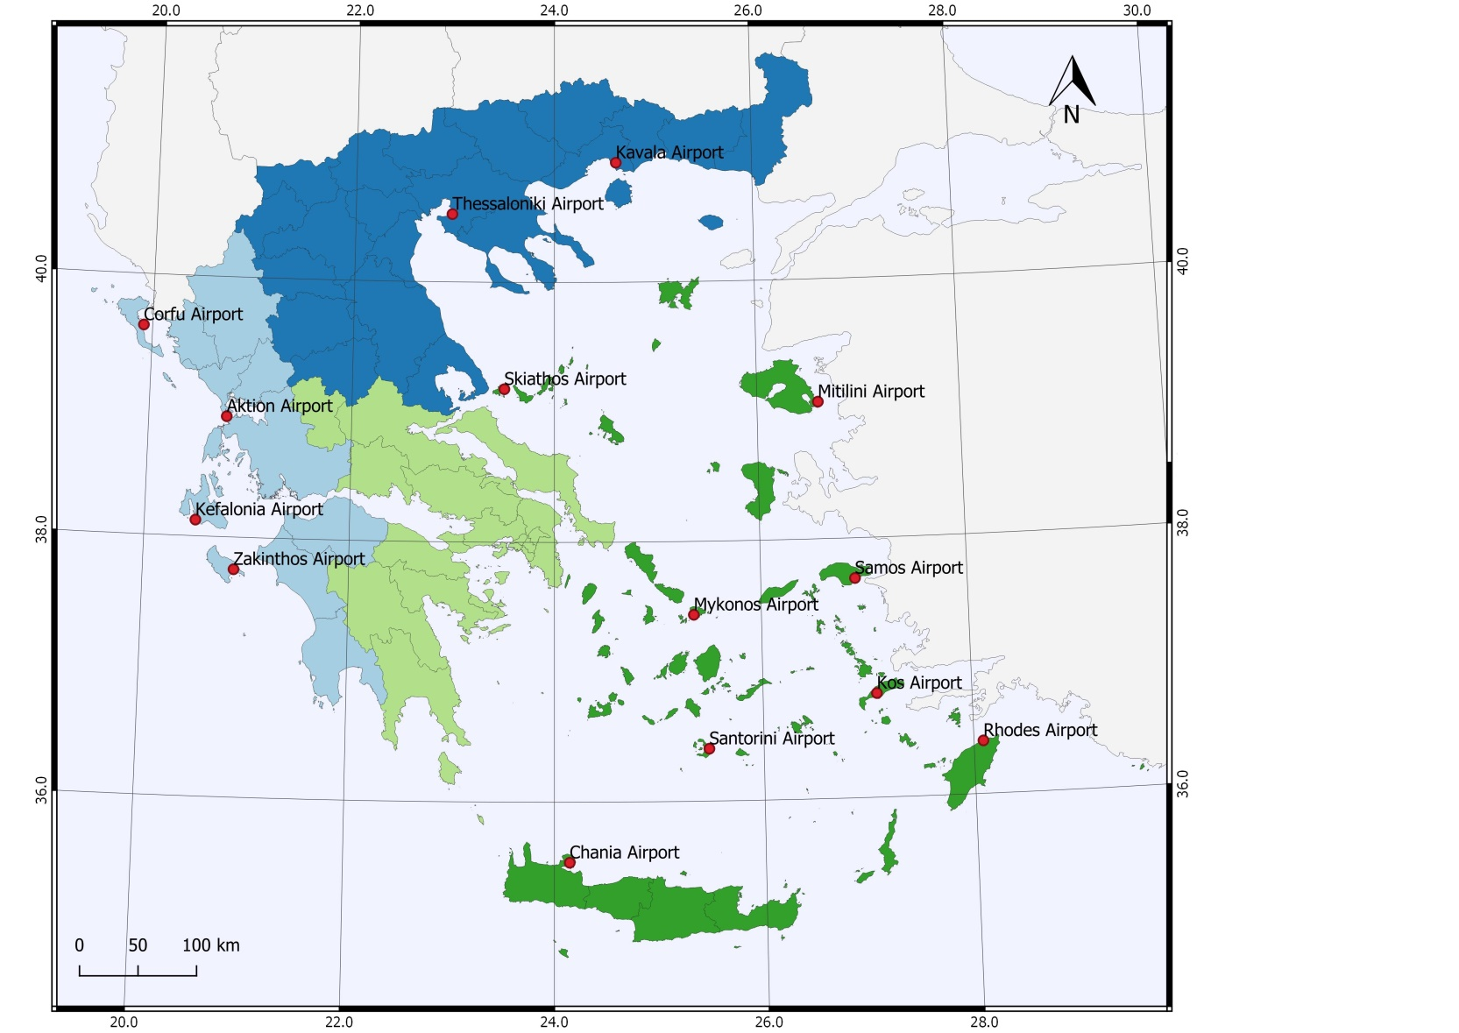
This study focusses on future climate change in the three climatic zones where 14 regional airports are located, as shown on the map. These zones are the following:
• Zone I: Northern Greece
• Zone II: Western Greece
• Zone III: Aegean Islands and Crete
The key risks that climate change poses to Greece are related to changes in temperature and precipitation, extreme weather, increased water stress and flooding, wildfires and sea level rise (MEDECC 2020).

Slide 3
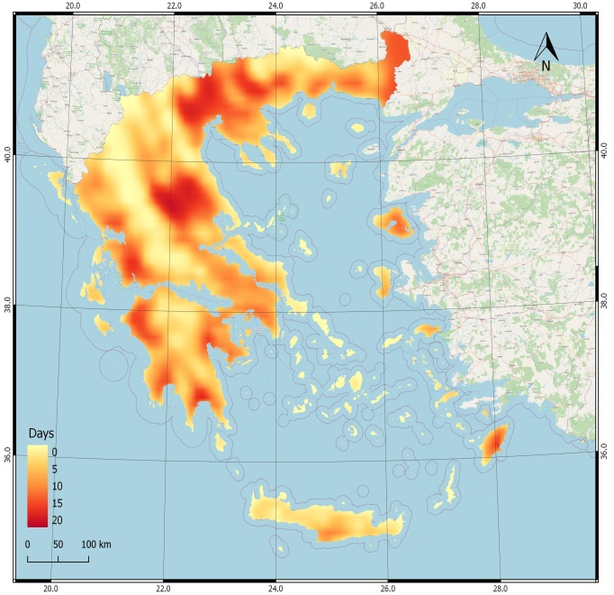
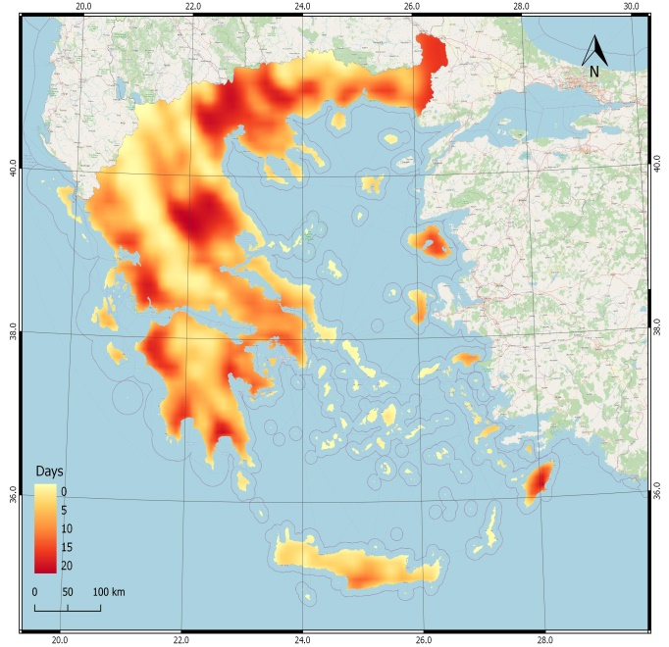
Projections come from state-of-the-art RCM simulations developed within the framework of EURO-CORDEX (Coordinated Regional Climate Downscaling Experiment).
Maps and future climatic information of this report, are developed for the climate services tools (http://climdat.meteo.noa.gr/emblematic/, http://mapsportal.ypen.gr/thema_climatechange), in the frame of the CLIMPACT (https://climpact.gr/) national project and the LIFE-IP AdaptInGR (https://www.adaptivegreece.gr/en-us/) EU project, or are based on the respective Regional Adaptation Action Plans (RAAPs).
Future projections are based on the two IPCC emissions scenarios (AR5; IPCC 2013, https://www.ipcc.ch/report/ar5/wg1/), namely the RCP4.5 and RCP8.5, representing the medium mitigation scenario and the high emission scenario with no climate mitigation policies respectively.
Illustration:
The differences in number of very hot days (> 35ºC) projected under the RCP4.5 climatic scenario for the near future (2021-2050) (left panel) and the RCP8.5 climatic scenario for the near future (2021-2050) (right panel).

Slide 4
Study approach
Assessment framework for the prioritisation of Climate-Change related risks for Greek airports.
Step 1: identification of CC-related risk sources that could affect the airports’ operations and/or infrastructure.
The CC-risk sources, the respective risks, and impacts on operations and/or infrastructure were presented in tables.
Step 2: CC risk sources were assessed under two emission scenarios (i.e., RCP4.5 and RCP8.5) relative to the control period.
Risk ID | Risk source; CC indicator | Risk | Affecting: operations and/or infrastructure
1 | Temperature; T_{max}> 35 ºC | Flashpoint (38°C) of aviation fuel exceeded on very hot days - potential fire hazard. | Both
2 | Fire; FWI & FWI>50 | Increased fire risk due to higher temperatures and increased summer drought potential. | Both
3 | Temperature; T_{max}> 35 ºC | Reduced lift for departing aircraft due to 'thin air' and reduced engine efficiency in very hot weather. | Operations
4 | Fog (warm sea & cold air) | Low visibility due to fog conditions could cause disruption and delays | Operations
5 | Wind changes; Air speed | Wind intensity affects runway utilisation and schedules. Increased risk of wind damage to assets, standing aircraft, vehicles and injuries to staff. | Both
Extract of table listing climate change-related risk sources, risks and how these affect airport functionality and/or operations

Slide 5
Summary of results i
Green | Green means that the risk poses little or no threat to the airport infrastructure and/or operations
Amber | Amber means that the risk can have some impact on the airport infrastructure, functionality, and level of service or operations might be downgraded but still within acceptable/manageable levels
Red | Red means that the risk can have a significant impact on the airport operations and infrastructure which might lead to unacceptable levels of service
Risks are colour-coded and classified into three categories, depending on impact: low risk (green), moderate risk (amber) and high risk (red).
After 2050, sea level rise becomes a “red” risk for coastal airports.
Temperature-related risks (including fire) are classified amber for all airports. Increases in maximum temperatures will affect aircraft takeoff & landing performances; furthermore, energy needs for cooling will increase significantly. Appropriate cooling measures, relying on architectural solutions and green spaces, should be explored as a matter of urgency.
Drought will increase in the future, constraining water availability for all airports. Suitable measures should be sought for this risk (e.g., water recycling, minimizing water use, etc).

Slide 6
Summary of results ii
Green | Green means that the risk poses little or no threat to the airport infrastructure and/or operations
Amber | Amber means that the risk can have some impact on the airport infrastructure, functionality, and level of service or operations might be downgraded but still within acceptable/manageable levels
Red | Red means that the risk can have a significant impact on the airport operations and infrastructure which might lead to unacceptable levels of service
Risks are colour-coded and classified into three categories, depending on impact: low risk (green), moderate risk (amber) and high risk (red).
Amber risks that affect some airports include [1] floods that are mainly related to the local (insufficient) drainage situation, [2] increased future wind speed affecting Ionian and Cycladic Islands, and [3] fog causing disruption in N Greece.

Slide 7
Future assessments: focus
New research has been commissioned to address key issues identified in the presented study.
This research will provide:
[1] new high-resolution airport-specific climate change projections using state-of-the-art regional climate models,
[2] detailed assessments of airport-specific climate risks, and
[3] considerations of whether energy use and design inputs/standards for infrastructure works for individual airports are likely to change in the future.
The main aim is to ensure that airport-specific Climate Change risks & impacts are identified early on and managed effectively, through their integration in the airport’s Master Plans.

Slide 8
IMPROVEMENT ON EXISTING STUDIES
Further studies will go beyond the existing information from the “Climate Change Resilience” study presented here, as they will, for the first time,
create high resolution statistically downscaled climate projections (1km) for each of the 14 airport locations individually, looking at specific time-periods;
provide future projections under three key emission scenarios (RCP 2.6, RCP4.5 and RCP8.5) up to 2100, using the latest model simulations;
estimate the risk category of the high risk items for each of the airports, and the impact of climate change on airport-specific flagged issues regarding heat, drainage, infrastructure and environmental settings;
recommend what new adaptation measures to be included in the master plans of the individual airports.

Slide 9
Issues that will receive particular attention are:
Extreme weather trends (esp. violent winds, heatwaves and heavy rainfall, which tax airport infrastructure and can potentially endanger operations), will be assessed at the local airport level through new model projections.
Fire danger in the wider area around airport sites will be assessed, as smoke from wildfires (e.g. megafires of the 2021 summer) may potentially endanger operations. Also, we will specifically estimate the increase in cooling demand for each airport, which will impact energy costs.

