Slide 1
Normal faulting interaction revealed by out-of-phase Quaternary uplift-rate changes implied by studying deformed marine terraces (EGU23-69)
Marco Meschis^{1,2*}, Gerald Roberts¹, Jennifer Robertson¹, Zoe Mildon³, Diana Sahy⁴, Rajasmita Goswami⁵, Claudia Sgambato^{1,6}, Joanna Faure Walker⁶, Alessandro Maria Michetti^{7,8}, and Francesco Iezzi⁹
¹Department of Earth and Planetary Sciences, Birkbeck, University of London, London, UK,
²Istituto Nazionale di Geofisica e Vulcanologia, Palermo branch, Italy,
³School of Geography, Earth and Environmental Sciences, University of Plymouth, Drake Circus, Plymouth PL4 8AA, UK,
⁴British Geological Survey, Keyworth NG12 5GG, United Kingdom
⁵Royal Dutch Shell, Netherlands
⁶Institute for Risk and Disaster Reduction, University College London, Gower Street, London, WC1E 6BT, UK
⁷Università degli Studi dell'Insubria, Como, Italy
⁸INGV, Osservatorio Vesuviano, Napoli, Italy
⁹DiSTAR-Dipartimento di Scienze della Terra, dell'Ambiente e delle Risorse Universit`a di Napoli “Federico II”, Napoli, Italy
email: marco.meschis@ingv.it
twitter: @marcomeschis

Slide 2
Normal faulting interaction revealed by out-of-phase Quaternary uplift-rate changes implied by studying deformed marine terraces (EGU23-69)
Marco Meschis (Istituto Nazionale di Geofisica e Vulcanologia, Palermo – INGV) et al.
Introduction
The aim of the study is to investigate if a relationship exists between historical seismicity, regional uplift and upper plate faulting activity. The study area is in southern Italy, within a region of the extending and uplifting Calabrian Forearc. In particular, we address the following scientific questions:
Are the Messina-Taormina Fault, the Reggio Calabria Fault and the Armo Fault active? Debated over the last few decades.
If so, is their faulting activity affecting the regional uplift signal as observed in other parts of the uplifting and extending Calabrian Forearc?
Is the uplift varying with time? If so, why?
Is there any relationship between regional uplift, local faulting and historical seismicity?
email: marco.meschis@ingv.it
twitter: @marcomeschis

Slide 3
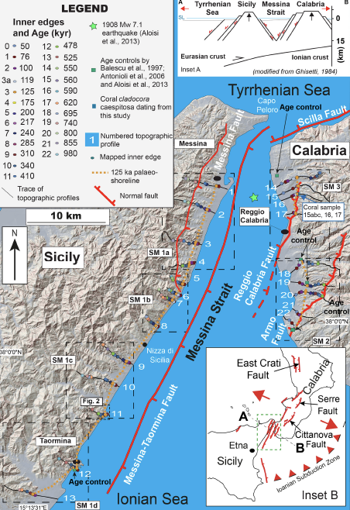
Normal faulting interaction revealed by out-of-phase Quaternary uplift-rate changes implied by studying deformed marine terraces (EGU23-69)
Marco Meschis (Istituto Nazionale di Geofisica e Vulcanologia, Palermo – INGV) et al.
Where are we?
The investigated area lies within the uplifting and seismically extending Calabrian-Peloritani forearc, where the origin of the “regional” signal of uplift, associated with either with the Ionian subduction process (Malinverno and Ryan, 1986) or with mantle upwelling (Gvirtzman and Nur, 1999a, 1999b), is still debated, In particular, the Messina Strait, separating Calabria from Sicily, southern Italy, is a down-faulted graben between inward-dipping Quaternary normal faults, deforming a pre-existing fold and thrust belt made of Palaeozoic, Mesozoic and Cenozoic rock formations interposed during Alpine thrusting (Ghisetti, 1984; Malinverno and Ryan, 1986; Fig. 1). This strait is bounded by active normal faults onshore (Catalano et al., 2003; Monaco and Tortorici, 2000; Stewart et al., 1997) and offshore (De Guidi et al., 2003; Doglioni et al., 2012; Meschis et al., 2019). In particular, the offshore and E-dipping Messina-Taormina Fault offsets pre-Quaternary basement and has propagated upwards to produce a fault-related anticline on its footwall, from Messina town to Taormina town (Catalano et al., 2003; Meschis et al., 2019; Pavano et al., 2016; Stewart et al., 1997; Fig. 1). This fault has deformed the Late Quaternary-Holocene palaeoshorelines outcropping onshore on the Sicilian side of the Messina Strait (Catalano et al., 2003; De Guidi et al., 2003; Pavano et al., 2016; Stewart et al., 1997). Likewise, W-dipping antithetic normal faults, such as the Armo Fault and the Reggio Calabria Fault, control the coastline topography on the Calabrian side of the Messina Strait, deforming the Palaeozoic crystalline thrust sheets and its clastic Cenozoic cover, with the Middle-Late Pleistocene shallow marine deposits, progressively onlapping on fault planes and suggesting persistent faulting (Ghisetti, 1984; Monaco and Tortorici, 2000).
Existing ages of marine terraces mapped in the Messina Strait are briefly summarized here and in Table 1. In particular, along the mapped palaeoshorelines on the footwall of the Messina-Taormina Fault, shallow marine shells have been dated close to Taormina town, identifying the 125 ka (MIS 5e) palaeoshoreline (Antonioli et al., 2006b). By using the Electron Spin Resonance technique on marine mollusc shells such as Patella and Venerupid, shallow marine deposits have been dated (Table 1). Moreover, eolian non-fossiliferous sediments have been dated north of Reggio Calabria (Fig. 1) by applying a thermoluminescence dating technique, identifying the 50 ka palaeoshoreline (Balescu et al., 1997). Thermoluminescence has also been used to date shallow marine deposits from marine terraces, south of Reggio Calabria, identifying the 125 ka (MIS 5e) marine terrace (Balescu et al., 1997). South of Reggio Calabria and within the hangingwall of the Armo Fault, Persististrombus latus a fossil that is commonly used to date marine oxygen isotope stage 5 deposits in the coasts of Italy, have been collected in situ from within shallow sea deposits and used to identify the 125 ka palaeoshoreline (Aloisi et al., 2013; Antonioli et al., 2006a; Antonioli et al., 2006b; Dumas et al., 2005; Ferranti et al., 2006; Miyauchi et al., 1994).
email: marco.meschis@ingv.it
twitter: @marcomeschis

Slide 4
Normal faulting interaction revealed by out-of-phase Quaternary uplift-rate changes implied by studying deformed marine terraces (EGU23-69)
Marco Meschis (Istituto Nazionale di Geofisica e Vulcanologia, Palermo – INGV) et al.
Approach
Detailed GIS-based marine terrace mapping (i) on the uplifting footwall of the Messina-Taormina Fault and (ii) on the hangingwalls of the Reggio Calabria and Armo Faults
Fieldwork to corroborate our GIS analysis
U/Th absolute dating on corals to obtain age controls corroborated by well-known data from literature
Synchronous correlation technique to derive ages for undated marine terraces
email: marco.meschis@ingv.it
twitter: @marcomeschis

Slide 5
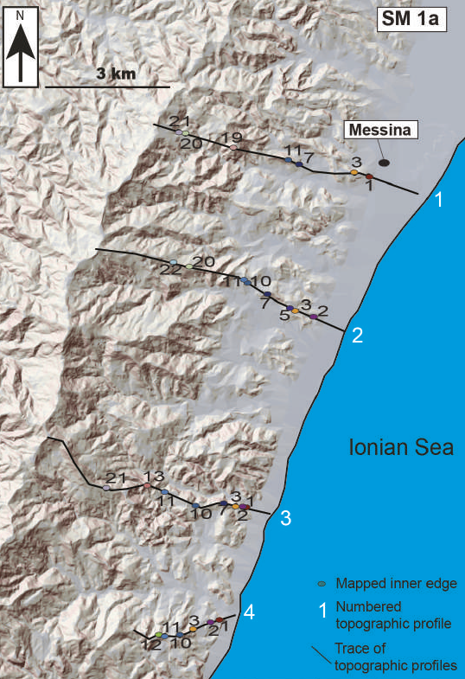
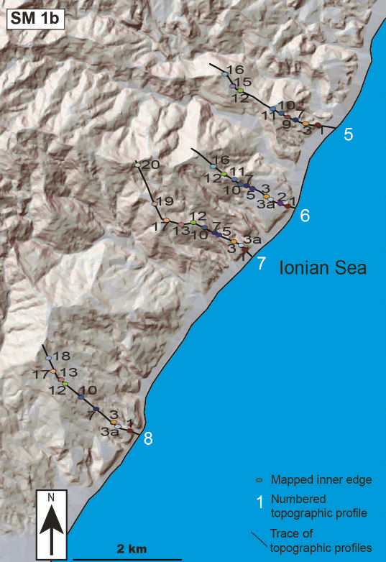
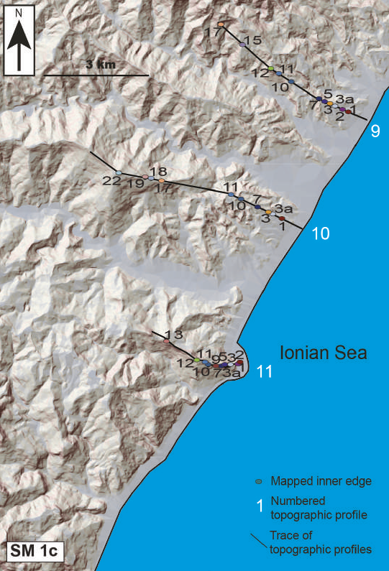
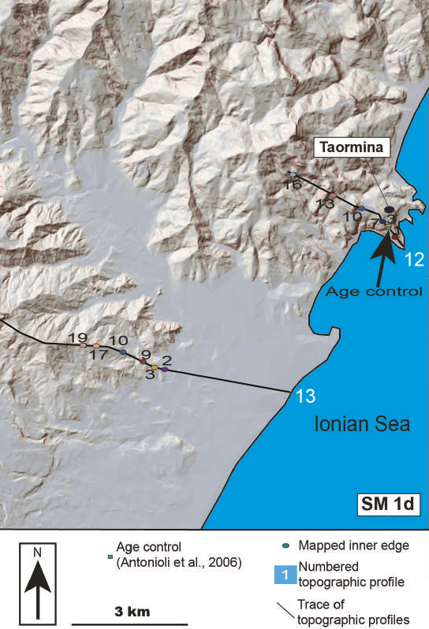
Normal faulting interaction revealed by out-of-phase Quaternary uplift-rate changes implied by studying deformed marine terraces (EGU23-69)
Marco Meschis (Istituto Nazionale di Geofisica e Vulcanologia, Palermo – INGV) et al.
Approach
Detailed GIS-based marine terrace mapping on the uplifting footwall of the Messina-Taormina Fault
email: marco.meschis@ingv.it
twitter: @marcomeschis

Slide 6
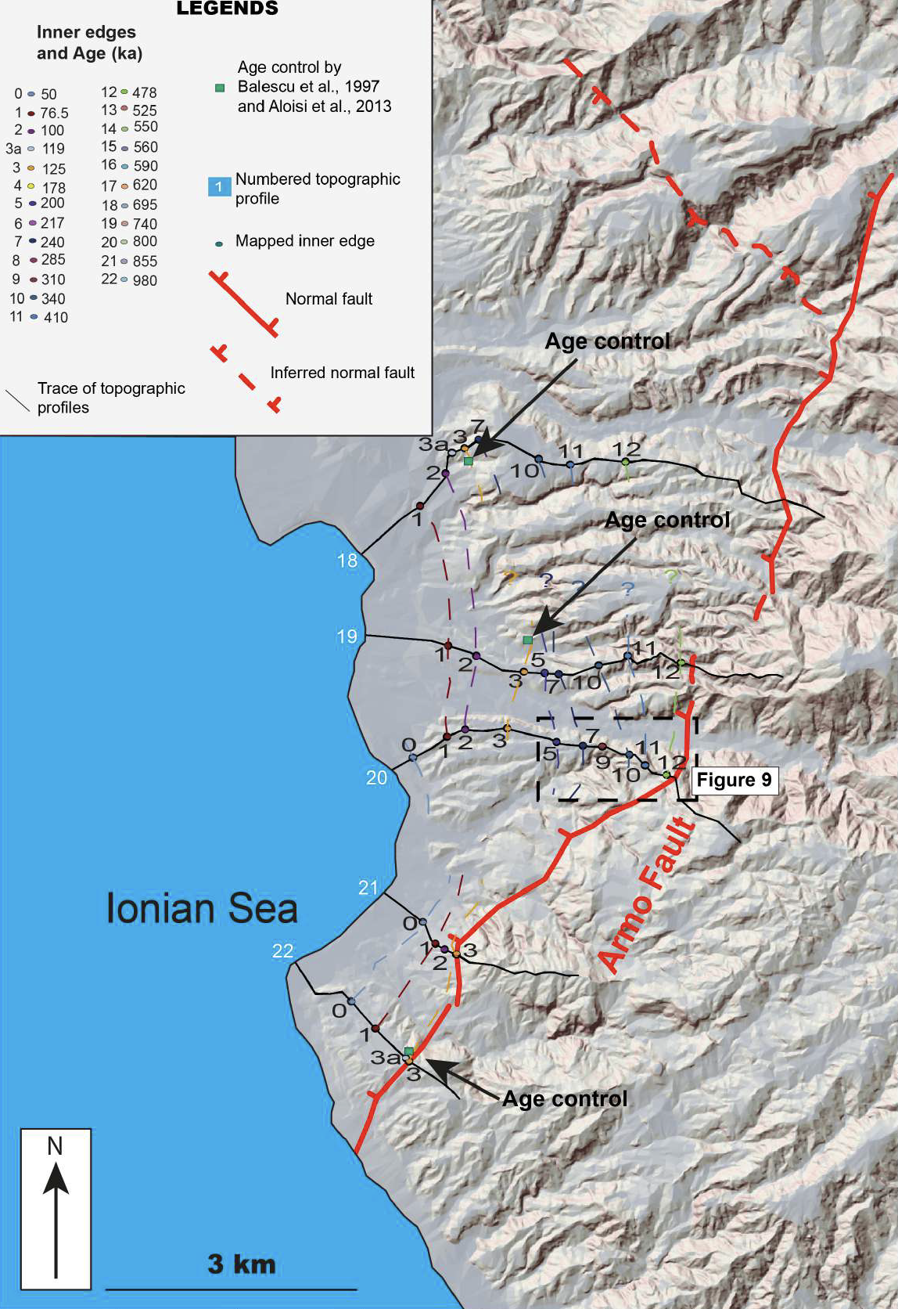
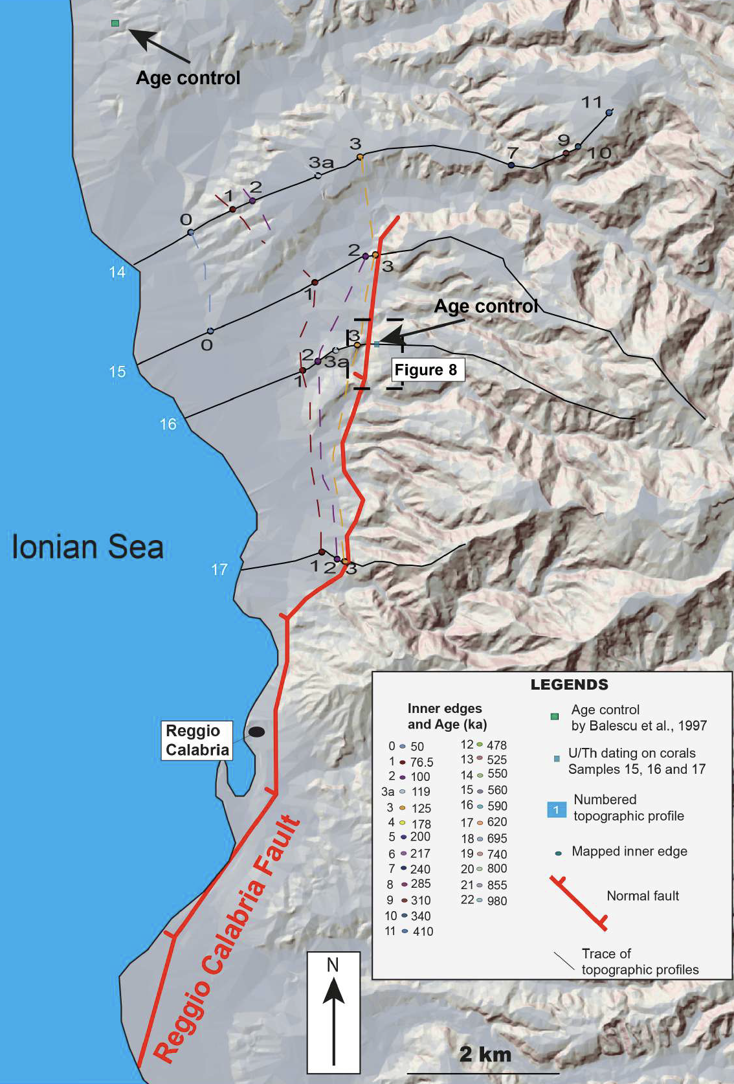
Normal faulting interaction revealed by out-of-phase Quaternary uplift-rate changes implied by studying deformed marine terraces (EGU23-69)
Marco Meschis (Istituto Nazionale di Geofisica e Vulcanologia, Palermo – INGV) et al.
Approach
Detailed GIS-based marine terrace mapping on the uplifting hangingwall of the Armo Fault
Detailed GIS-based marine terrace mapping on the uplifting hangingwall of the Reggio Calabria Fault
email: marco.meschis@ingv.it
twitter: @marcomeschis

Slide 7
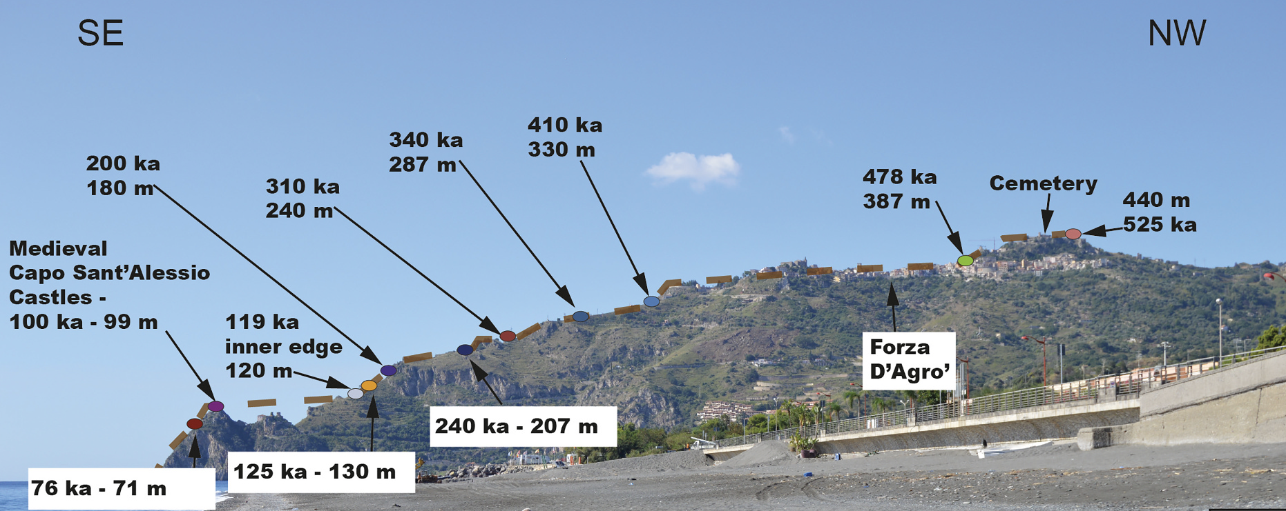
Normal faulting interaction revealed by out-of-phase Quaternary uplift-rate changes implied by studying deformed marine terraces (EGU23-69)
Marco Meschis (Istituto Nazionale di Geofisica e Vulcanologia, Palermo – INGV) et al.
Approach
Fieldwork to corroborate our GIS analysis
email: marco.meschis@ingv.it
twitter: @marcomeschis

Slide 8
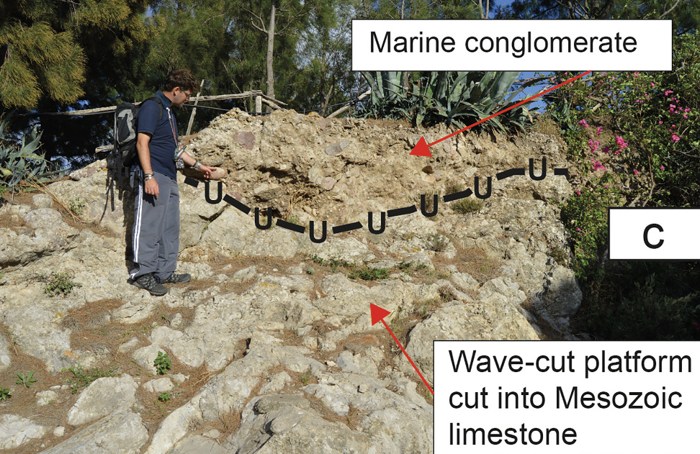
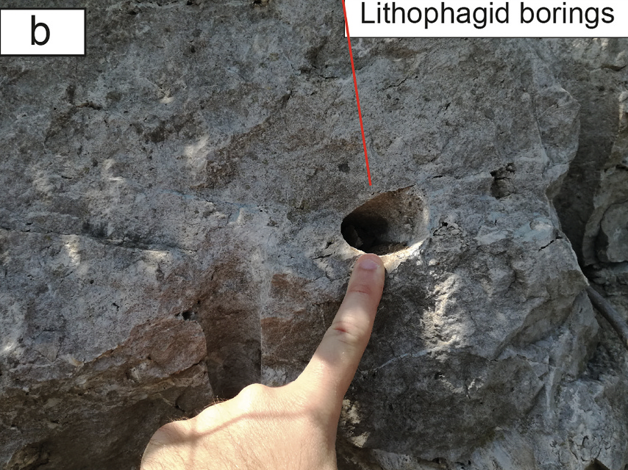
Normal faulting interaction revealed by out-of-phase Quaternary uplift-rate changes implied by studying deformed marine terraces (EGU23-69)
Marco Meschis (Istituto Nazionale di Geofisica e Vulcanologia, Palermo – INGV) et al.
Approach
Fieldwork to corroborate our GIS analysis
email: marco.meschis@ingv.it
twitter: @marcomeschis

Slide 9
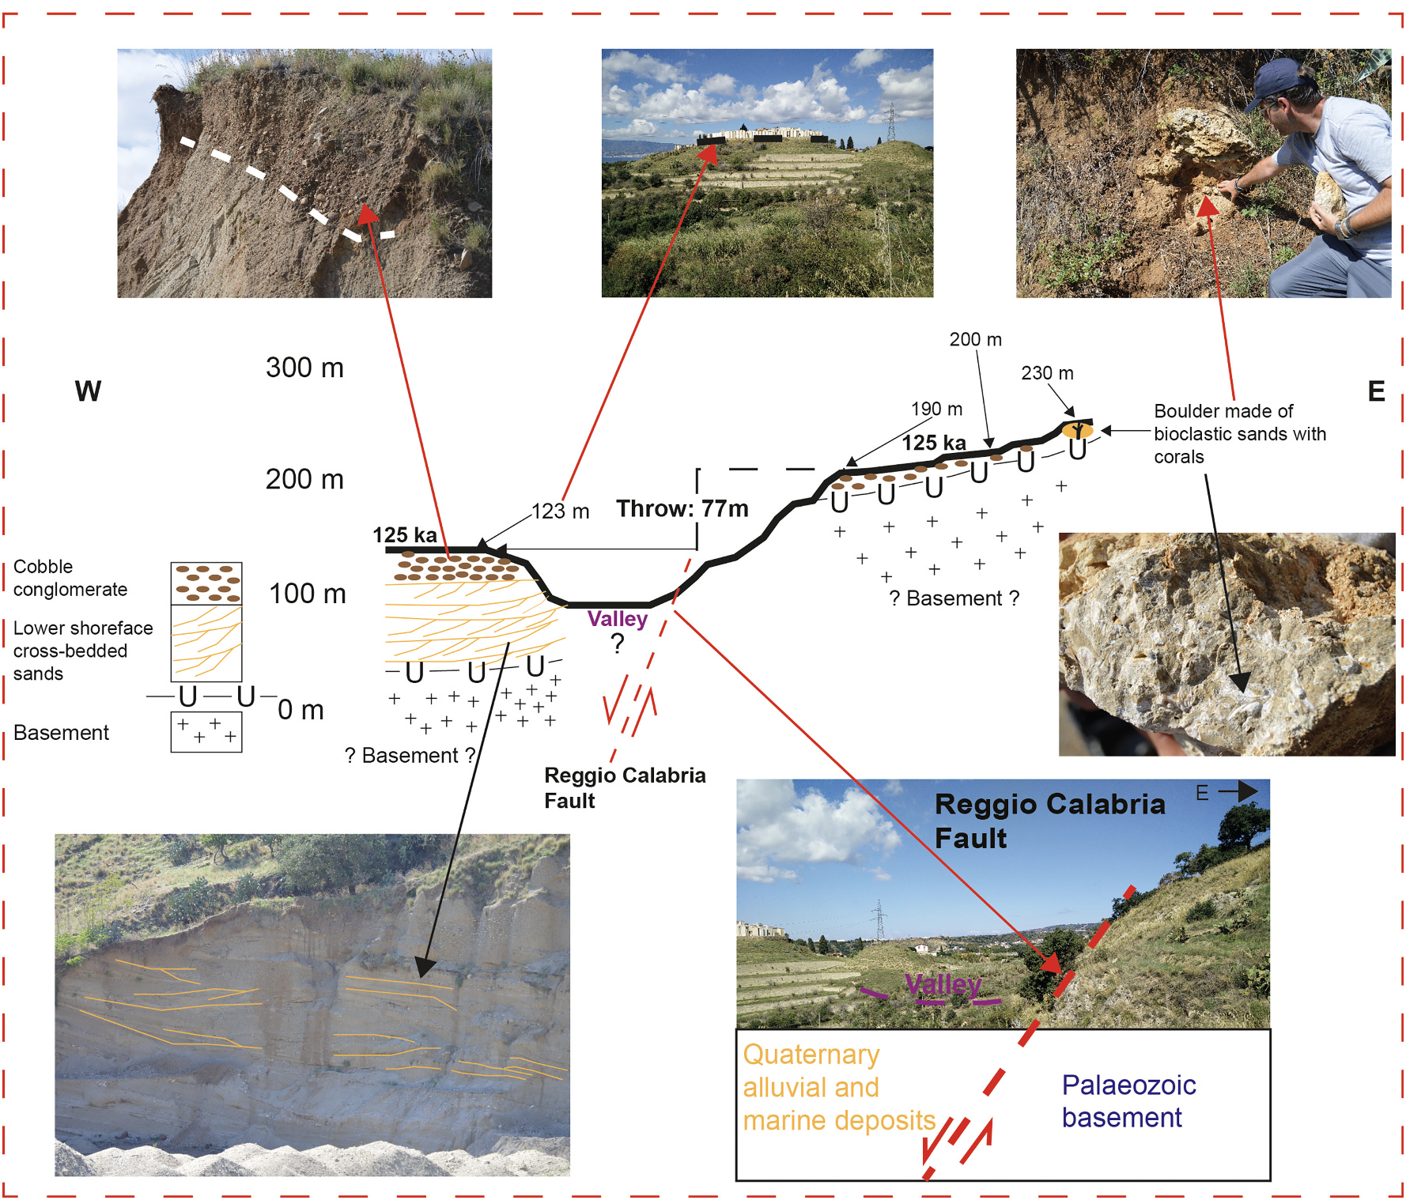
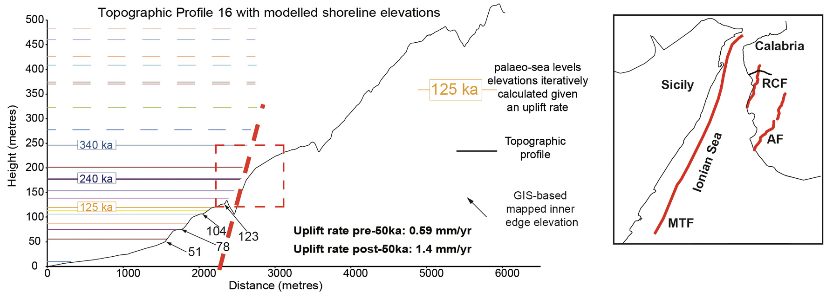
Normal faulting interaction revealed by out-of-phase Quaternary uplift-rate changes implied by studying deformed marine terraces (EGU23-69)
Marco Meschis (Istituto Nazionale di Geofisica e Vulcanologia, Palermo – INGV) et al.
Approach
Fieldwork to corroborate our GIS analysis
Reggio Calabria Fault
email: marco.meschis@ingv.it
twitter: @marcomeschis

Slide 10
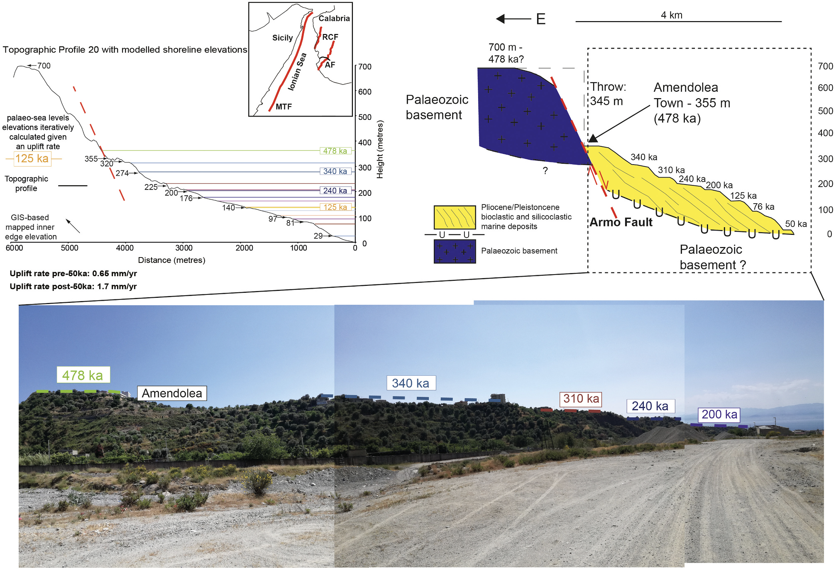
Normal faulting interaction revealed by out-of-phase Quaternary uplift-rate changes implied by studying deformed marine terraces (EGU23-69)
Marco Meschis (Istituto Nazionale di Geofisica e Vulcanologia, Palermo – INGV) et al.
Approach
Fieldwork to corroborate our GIS analysis
Armo Fault
email: marco.meschis@ingv.it
twitter: @marcomeschis

Slide 11
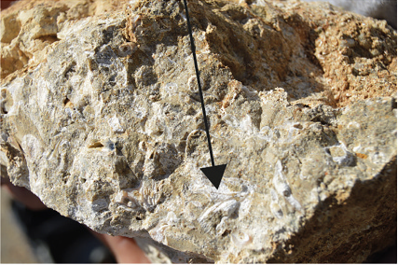
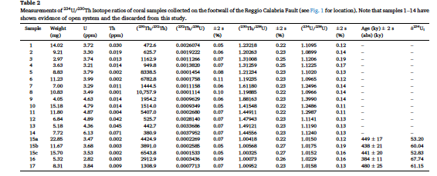
Normal faulting interaction revealed by out-of-phase Quaternary uplift-rate changes implied by studying deformed marine terraces (EGU23-69)
Marco Meschis (Istituto Nazionale di Geofisica e Vulcanologia, Palermo – INGV) et al.
Approach
U/Th absolute dating on corals to obtain age controls corroborated by well-known data from literature
email: marco.meschis@ingv.it
twitter: @marcomeschis

Slide 12
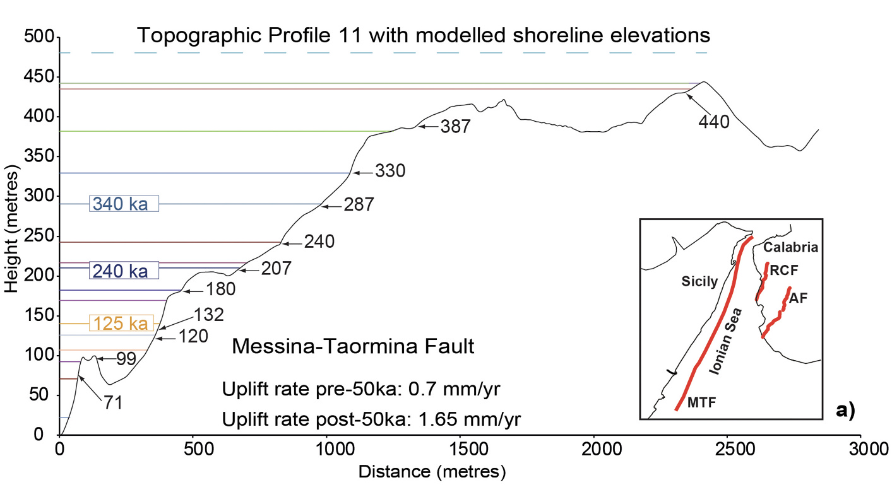
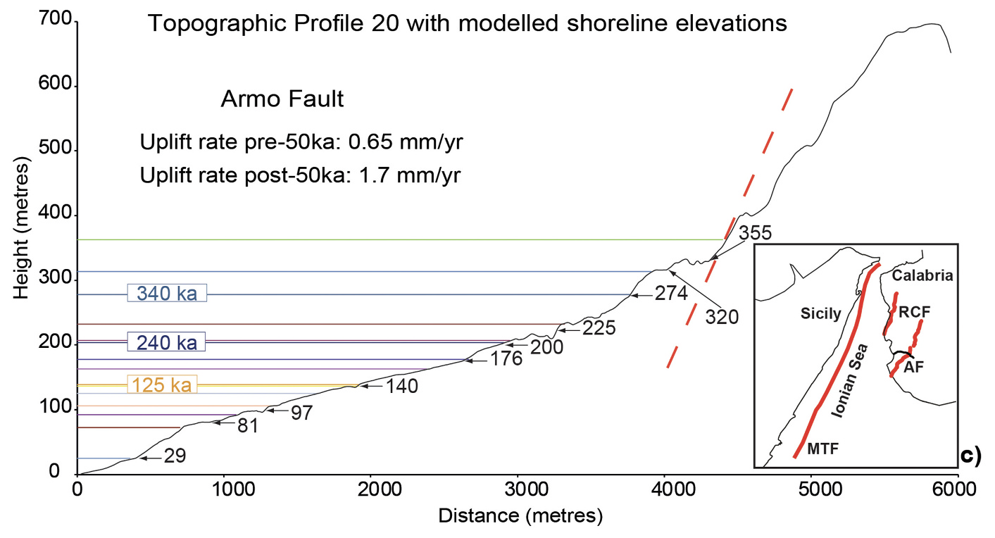
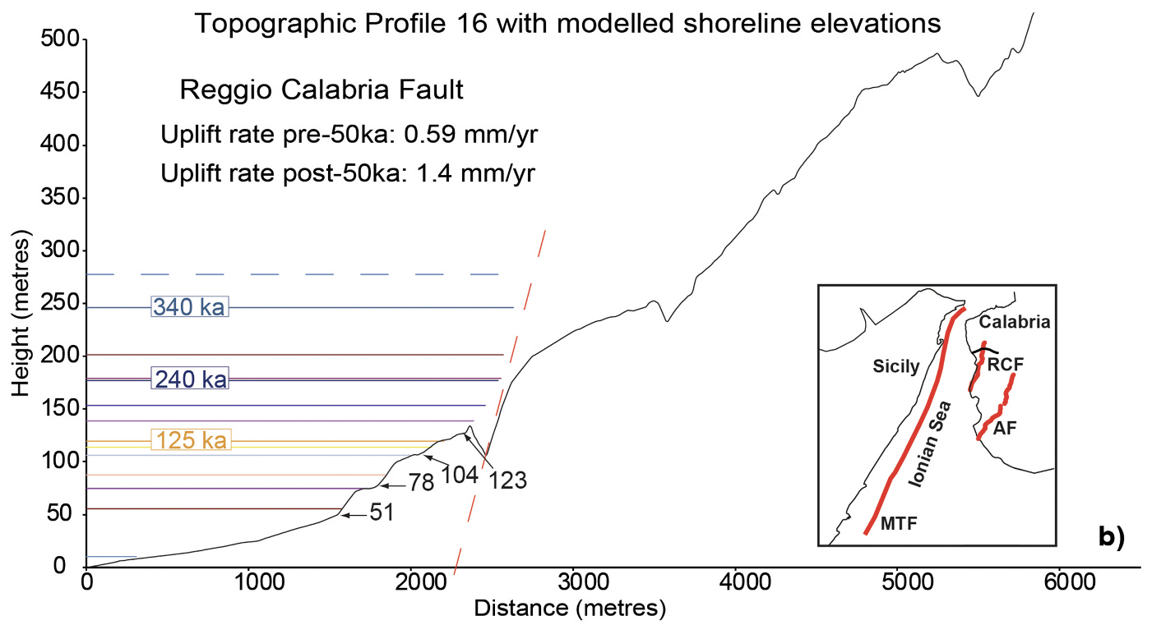
Normal faulting interaction revealed by out-of-phase Quaternary uplift-rate changes implied by studying deformed marine terraces (EGU23-69)
Marco Meschis (Istituto Nazionale di Geofisica e Vulcanologia, Palermo – INGV) et al.
Approach
Synchronous correlation technique to derive ages for undated marine terraces
This modelling has been driven by age controls from new absolutely dating and from well-known literature data
email: marco.meschis@ingv.it
twitter: @marcomeschis

Slide 13
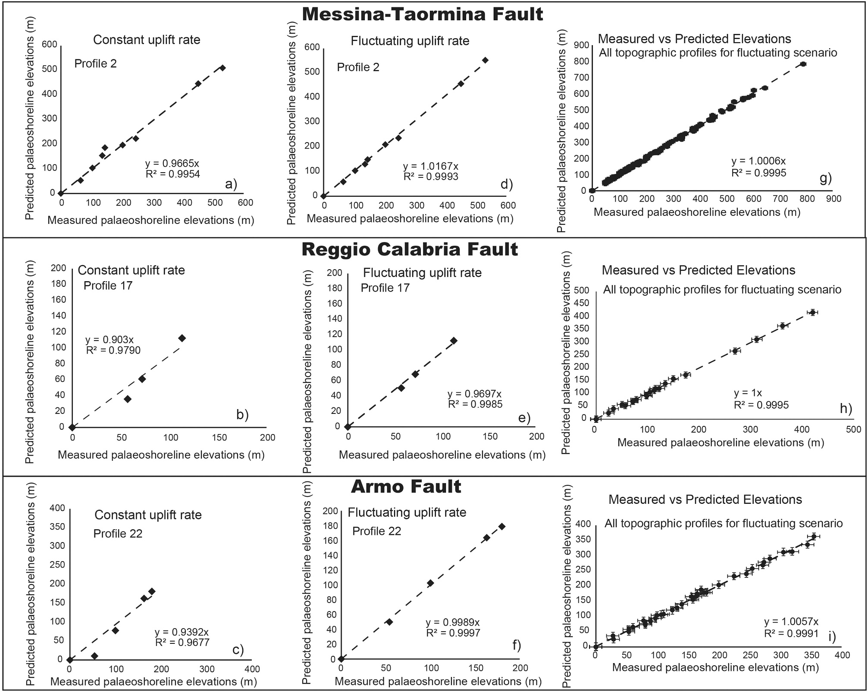
Normal faulting interaction revealed by out-of-phase Quaternary uplift-rate changes implied by studying deformed marine terraces (EGU23-69)
Marco Meschis (Istituto Nazionale di Geofisica e Vulcanologia, Palermo – INGV) et al.
Results
Linear regression analysis for all 3 investigated faults showing that a better and higher R² value is obtained if a changing uplift rate through time is claimed to model multiple mapped palaeoshoreline elevations and multiple synchronously-predicted sea-level highstand elevations. Indeed, constant scenario (a, b and c) vs fluctuating scenario (d, e and f) for one topographic profile for each fault is shown. Linear regression for all topographic profiles (1–22) for the fluctuating scenario are shown in g, h and i. The predicted elevations, representing the synchronously calculated sea-level highstand elevations, indicate a fluctuating uplift rate through time, that has been derived by iterating uplift rates to find the best match to the measured and mapped palaeoshorelines.
Note that “measured” elevations represent palaeoshoreline elevations mapped in the 10 m high resolution DEMs. Coefficient of determination, R² value, has been used between these two datasets to quantify the best fit for all topographic profiles presented in this paper, with a value >0.99.
email: marco.meschis@ingv.it
twitter: @marcomeschis

Slide 14
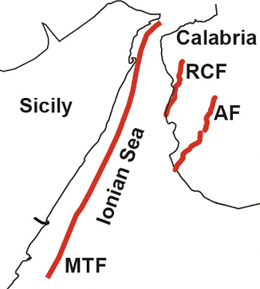
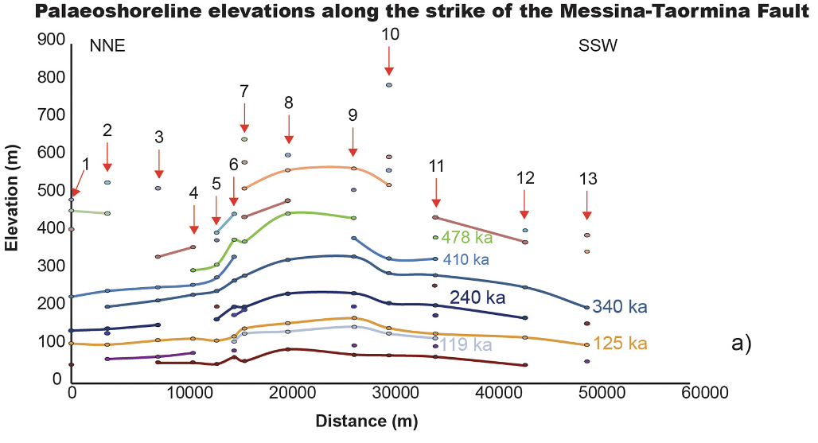
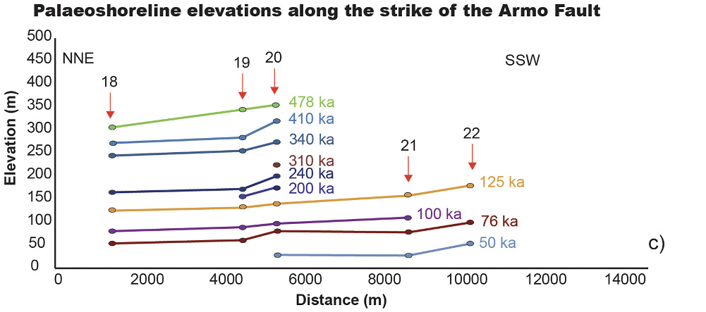
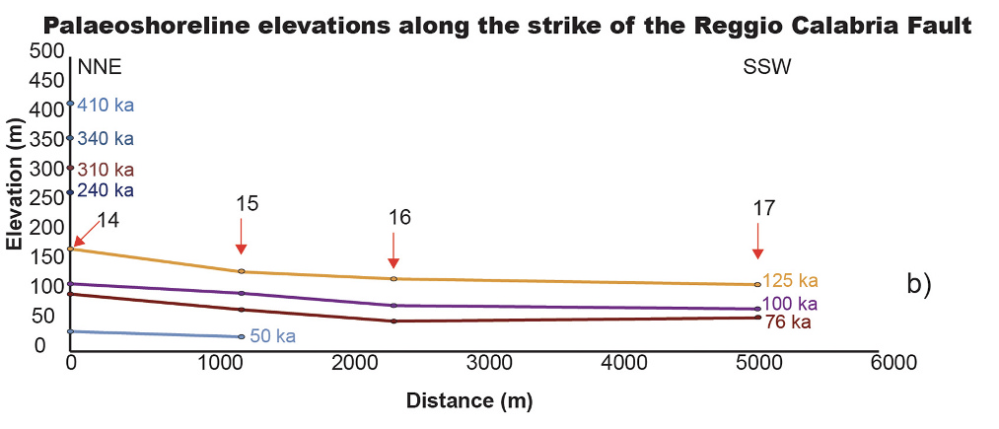
Normal faulting interaction revealed by out-of-phase Quaternary uplift-rate changes implied by studying deformed marine terraces (EGU23-69)
Marco Meschis (Istituto Nazionale di Geofisica e Vulcanologia, Palermo – INGV) et al.
Results
Spatially-changing uplift along-strike faults
Messina-Taormina Fault
Reggio Calabria Fault
Armo Fault
email: marco.meschis@ingv.it
twitter: @marcomeschis

Slide 15
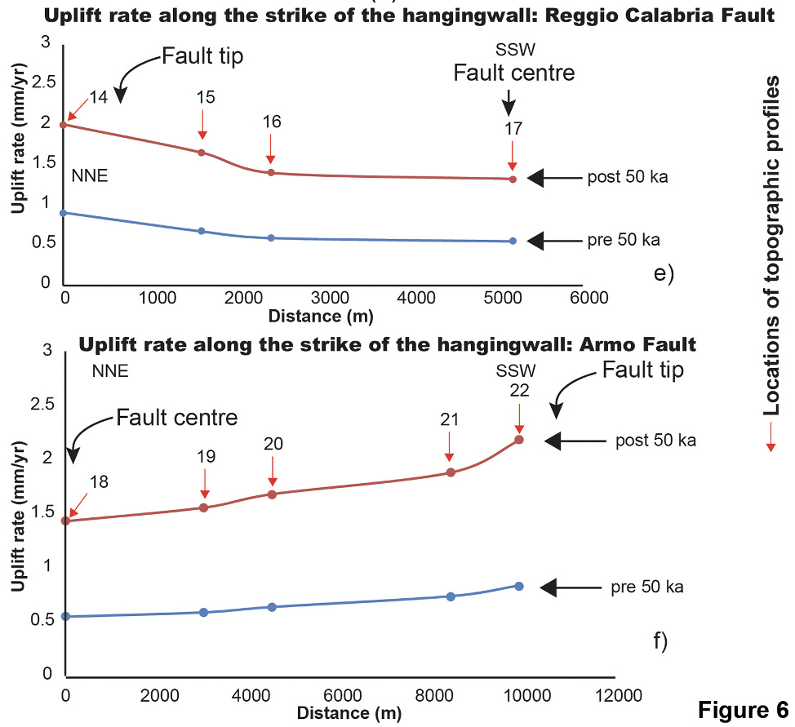
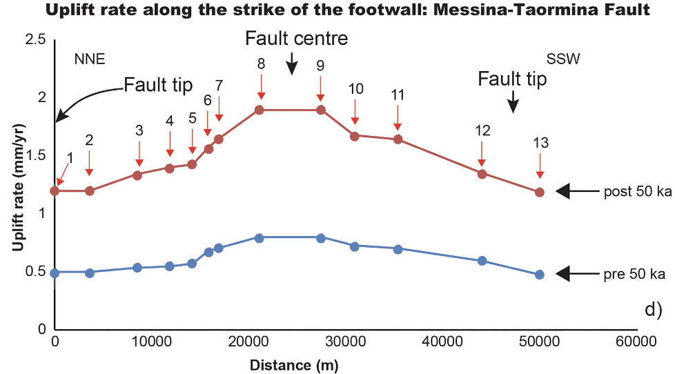
Normal faulting interaction revealed by out-of-phase Quaternary uplift-rate changes implied by studying deformed marine terraces (EGU23-69)
Marco Meschis (Istituto Nazionale di Geofisica e Vulcanologia, Palermo – INGV) et al.
Results
Temporally-changing uplift rates over the Late Pleistocene
Reggio Calabria Fault
Uplift-rate change factor
of ~2.43 at ~50 ka
Messina-Taormina Fault
Armo Fault
email: marco.meschis@ingv.it
twitter: @marcomeschis

Slide 16
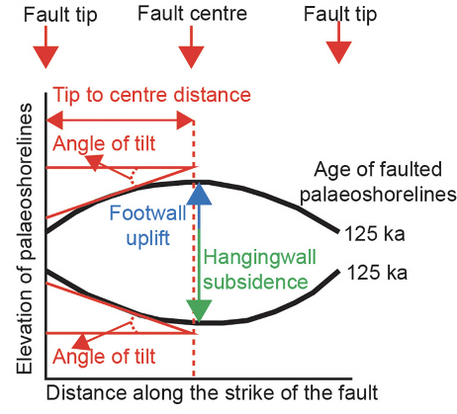
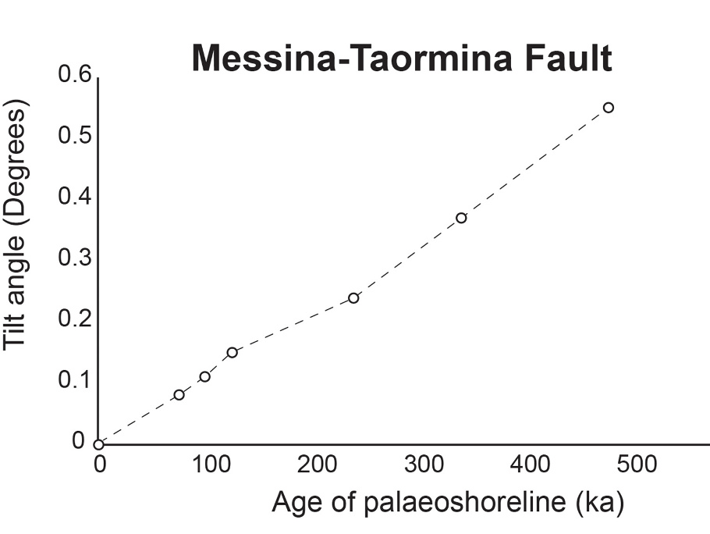
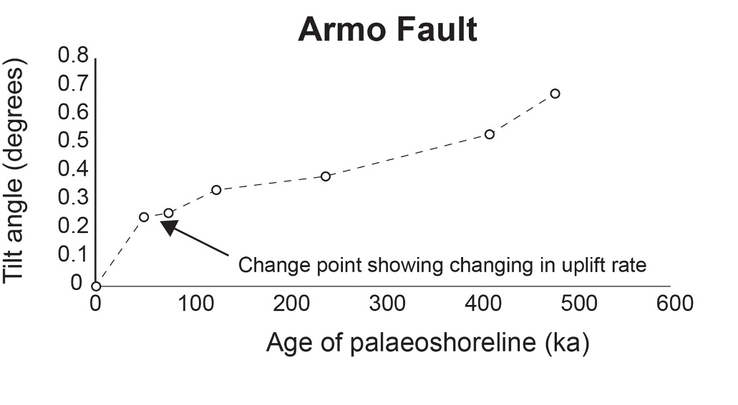
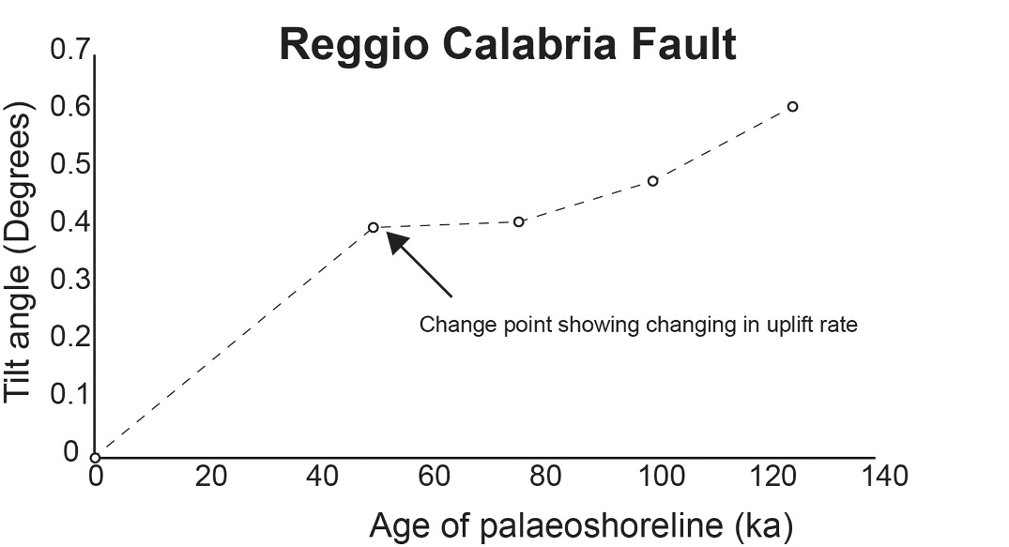
Normal faulting interaction revealed by out-of-phase Quaternary uplift-rate changes implied by studying deformed marine terraces (EGU23-69)
Marco Meschis (Istituto Nazionale di Geofisica e Vulcanologia, Palermo – INGV) et al.
Results
Tilt angle
We calculate how much the mapped palaeoshorelines have been tilted along-strike due to displacement gradients along the fault. This tests the hypothesis that the faults have been active throughout the Late Quaternary, because if this is the case older palaeoshorelines will have experienced a longer history of deformation and hence should exhibit higher tilt angles. Results confirm that the topographically higher and older palaeoshorelines present higher tilt angle values, demonstrating that they have experienced a longer faulting history, with progressive active faulting throughout the Middle-Late Pleistocene
email: marco.meschis@ingv.it
twitter: @marcomeschis

Slide 17
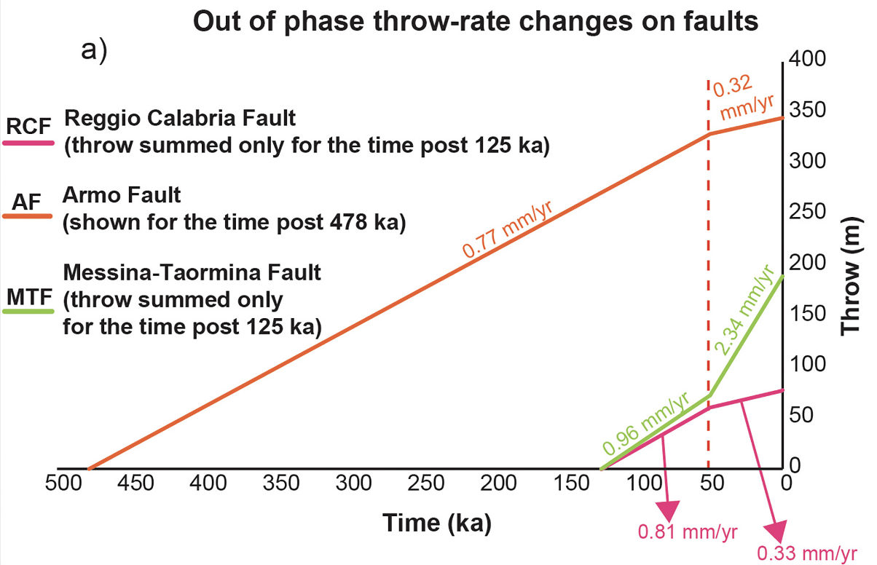
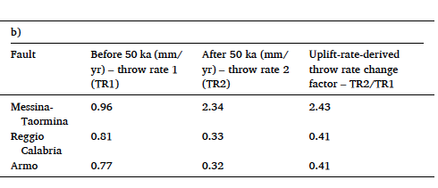
Normal faulting interaction revealed by out-of-phase Quaternary uplift-rate changes implied by studying deformed marine terraces (EGU23-69)
Marco Meschis (Istituto Nazionale di Geofisica e Vulcanologia, Palermo – INGV) et al.
Discussion
To gain information on fault slip-rates from uplift-rates it is important to note that the acceleration in uplift at ~50 ka, measured on (i) hangingwalls of Reggio Calabria Fault and Armo Fault and (ii) footwall of the Messina-Taormina Fault, must reflect the interplay between fault-related vertical motions and vertical motions that are more “regional” in nature either related to the underlying subduction system or mantle upwelling processes through slab window. if the regional uplift stayed constant through time, and affects both the hangingwall and footwalls of the active normal faults, then the following is implied: (i) the footwall uplift on the Messina-Taormina Fault has accelerated at ~50 ka, suggesting that the throw-rate on the fault increased at ~50 ka; (ii) the component of hangingwall subsidence produced by slip on the Reggio Calabria Fault and Armo Fault has decelerated at ~50 ka implying that the throw-rates on these faults decreased at ~50 ka. If our assumption is correct, and regional uplift-rates have remained constant through time, this out-of-phase behaviour, where the slip-rates on some faults accelerate accompanied by a synchronous deceleration of slip on others, implies that some sort of fault interaction may be operating.
email: marco.meschis@ingv.it
twitter: @marcomeschis

Slide 18
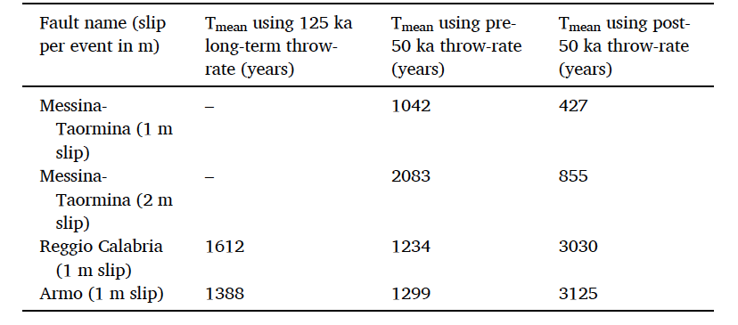
Normal faulting interaction revealed by out-of-phase Quaternary uplift-rate changes implied by studying deformed marine terraces (EGU23-69)
Marco Meschis (Istituto Nazionale di Geofisica e Vulcanologia, Palermo – INGV) et al.
Discussion
T_{mean} is different depending on which throw-rates are used for seismic hazard assessment!!!
email: marco.meschis@ingv.it
twitter: @marcomeschis

Slide 19
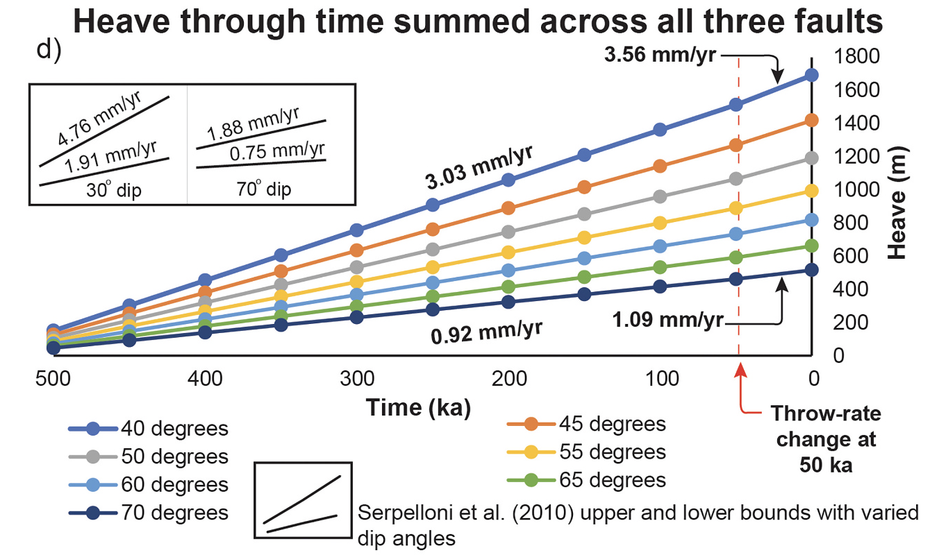
Normal faulting interaction revealed by out-of-phase Quaternary uplift-rate changes implied by studying deformed marine terraces (EGU23-69)
Marco Meschis (Istituto Nazionale di Geofisica e Vulcanologia, Palermo – INGV) et al.
Discussion
In order to compare our results with those from Serpelloni et al. (2010), we have summed the implied throw-rates on the faults through time and converted these into heave-rates (extension rates) by assuming fault dips ranging from 40º to 70º. Although the throw-rates on the faults decrease at 50 ka by a factor of 0.41 on the Reggio Calabria Fault and on the Armo Fault, alongside an increase by a factor of 2.43 at 50 ka on Messina-Taormina Fault, the combined effect of these out-of-phase throw-rate histories is to maintain a relatively constant heave-rate.
This suggests that the slip-rate changes are not related to a change in rate across the whole subduction system, but instead due to a change in the internal organisation of strain of the upper plate of the subduction system.
The contrast of changing throw-rates of individual faults with constant heave-rates when summed all the faults suggests that faults are interacting to maintain the regional extension rate.
email: marco.meschis@ingv.it
twitter: @marcomeschis

Slide 20
Normal faulting interaction revealed by out-of-phase Quaternary uplift-rate changes implied by studying deformed marine terraces (EGU23-69)
Marco Meschis (Istituto Nazionale di Geofisica e Vulcanologia, Palermo – INGV) et al.
Thanks for your attention!!!
This presentation summarises a published paper mentioned below:
Meschis, M., Roberts, G.P., Robertson, J., Mildon, Z.K., Sahy, D., Goswami, R., Sgambato, C., Faure Walker, J., Michetti, A.M. and Iezzi, F. (2022) - Out of Phase Quaternary Uplift-Rate Changes Reveal Normal Fault Interaction, Implied by Deformed Marine Palaeoshorelines, in Southern Italy.
Geomorphology, 416. https://doi.org/10.1016/j.geomorph.2022.108432
email: marco.meschis@ingv.it
twitter: @marcomeschis

