Slide 1
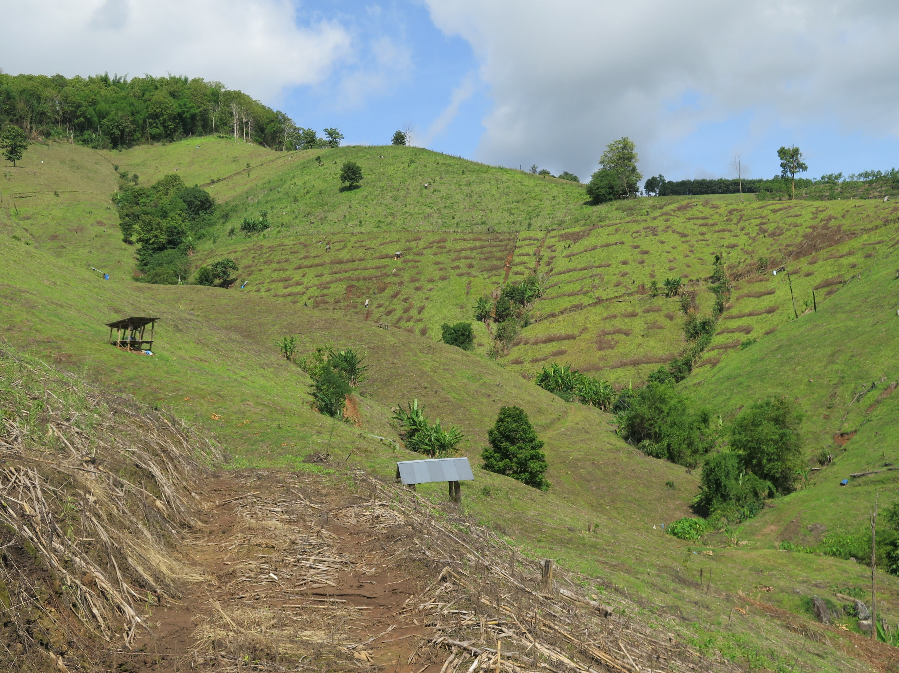
Effect of slope position on hydrochory processes: a natural rainfall study in tropical agroecosystem
Séraphine Grellier¹, Wanwisa Pansak², Suphannika Intanon³, Chanisara Rodprai³, Khwanrawee Anusorn³,Claude Hammecker⁴, Jean-Louis Janeau⁵
1 Department of Spatial planning and Environment Engineering of Polytech Tours, CITERES UMR7324 CNRS, University of Tours, Tours, France
2 Faculty of Environment and Resource Studies, Mahidol University, Salaya, Thailand
3 Department of Agricultural Science, Faculty of Agriculture Natural Resources and Environment, Naresuan University, Phitsanulok, Thailand
4 LISAH, Univ Montpellier, INRA, IRD, Montpellier SupAgro, Montpellier, France
5 iEES-Paris, Institut d’Ecologie et des Sciences de l’Environnement de Paris, (IRD, Sorbonne Université, CNRS, INRA, UPEC, Université Paris Diderot), Paris, France

Slide 2
I
ntroduction
Agricultural activities
→ impacts soil erosion (Boardman, 2006; Guerra et al., 2017; Poesen, 2018; Valentin et al., 2005)
→ loss of biodiversity in lands (Pimentel, 2006)
→ About 35.9 gigatons of soil per year have been eroded (Borrelli et al., 2013)
Hydrochory
the dispersion of seeds by water, is a process linked to water soil erosion
Soil properties
Position along the slope
Biodiversity in agroecosystems
Notes:
The displacement of native plant seeds on the soil surface by runoff may be influenced by soil properties and position along the slope. This may in return affect or modify biodiversity in agroecosystems. There is an urgent need to develop appropriate agricultural practices that promote higher biodiversity and improve soil properties. However, hydrochory processes has not been studied in tropical agroecosystems. This is why we propose to study the processes affecting seed displacement by runoff in steeply sloping maize field affected by rainfall and tillage erosion in Northern Thailand.

Slide 3
I
ntroduction
→ Urgent need to develop appropriate agricultural practices that promote higher biodiversity and improve soil properties
→ Especially in tropical agroecosystems, very few studies
Our main objective is to validate, under natural rainfall, the results obtained under rainfall simulation (Janeau et al., 2022) by following hydrochory processes during two years.
What is the effect of position in the catena and soil properties on seed export, runoff, and soil losses at the 1 m² scale plot in steeply sloping maize field affected by rainfall and tillage erosion in Northern Thailand?
Notes:
The displacement of native plant seeds on the soil surface by runoff may be influenced by soil properties and position along the slope. This may in return affect or modify biodiversity in agroecosystems. There is an urgent need to develop appropriate agricultural practices that promote higher biodiversity and improve soil properties. However, hydrochory processes has not been studied in tropical agroecosystems. This is why we propose to study the processes affecting seed displacement by runoff in steeply sloping maize field affected by rainfall and tillage erosion in Northern Thailand.
Our main objective is to validate, under natural rainfall, the results obtained under rainfall simulation (Janeau et al., 2022) by following hydrochory processes during two years with the following question:
What is the effect of position in the catena and soil properties on seed export, runoff, and soil losses at the 1 m² scale plot?

Slide 4
M
aterials
&
ethods
Study site located at Ban Tub Man (18°19'30.0"N 100°34'17.3"E), Na Noi District, Nan province, Northern Thailand
Collection and measurements of runoff, soil and nutrient losses during two years including 10 rainfall events in 2018 and 14 in 2019.

Slide 5
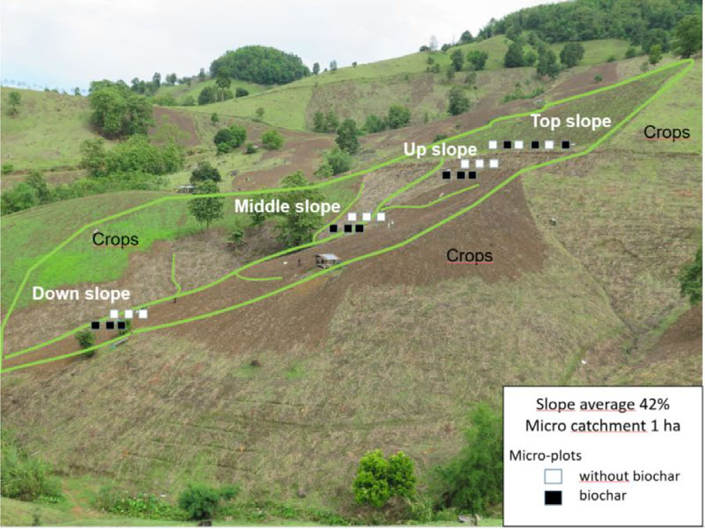
M
aterials
&
ethods
24 plots of 1 m² on four positions along the catena
Cr. Georg Cadisch,
Jean-Louis Janeau

Slide 6
M
aterials
&
ethods
1 m² plot planted with maize (Zea mays L.)
Notes:
1 m² plot planted with maize (Zea mays L.)

Slide 7
M
aterials
&
ethods
Seed extraction and identification method
Notes:
1 m² plot planted with maize (Zea mays L.)

Slide 8
R
esults
In 2018 and in 2019, similar results were found : only the three first rainfall events of the year showed significant amount of exported seeds in runoff.
→ Variability inter-year were high with almost 4 times more exported seeds in 2019 than 2018.
Graph 1. Number of exported seeds per m² measured in 2019 over 14 rainfall events
Notes:
Graph 1. Number of exported seeds per m² measured in 2019 over 14 rainfall events

Slide 9
R
→ Position in the catena influence seed losses. Up position showed higher values than top and down positions.
esults
a
b
ab
Exported seed. m⁻²
b
Position in the catena (from top to bottom)
Graph 2. Number of exported seeds per m² measured in 2019 for the first three rainfall events according to positions in the catena

Slide 10
C
onclusions
In tropical agricultural fields, at the 1m² scale, majority of seeds can be exported by the three first rainfall events.
Effect of the position in the catena: soil characteristics influence hydrochory processes, and there is spatial variation of seed deposition along the catena (more seed rain in the upper part).
No relationship between number of exported seed and types of rainfall, runoff characteristics or soil losses: further analyses to explain the effect of environmental factors on hydrochory processes in agroecosystems of tropical areas.
Notes:
In tropical agricultural fields, at the 1m² scale, the majority of seeds present on the soil surface at the beginning of the rainy season can be exported by the three first rainfall events occurring on bare soils.
This number of exported seeds depends on the position in the catena; meaning either soil characteristics influence hydrochory processes, or there is spatial variation of seed deposition along the catena (to be confirmed with seed rain data not showed here).
We could not show that the number of exported seed depends on types of rainfall, runoff characteristics or soil losses. Deeper analyses shall be running to explain the effect of environmental factors on hydrochory processes in agroecosystems of tropical areas.
Seed population was changing all the time and mostly affected by slope positions.
Amount of seed input was greater than seed output by runoff.
Seed removal under natural rainfall was greatest at upper slope while amount of soil seedbank and species diversity (H’) were greatest at down slope.
Based on seed dynamic data, landscape management should be different between slope positions and place a high priority of conservation in the upper slope.

Slide 11
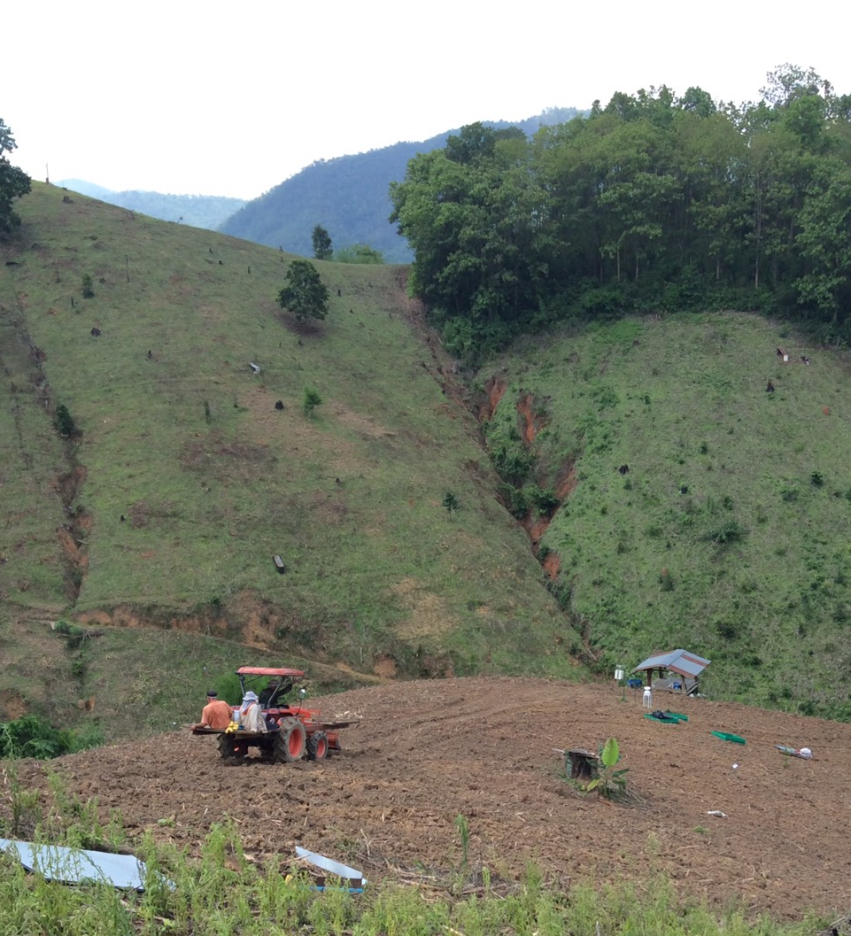
Thank you for your attention

Slide 12
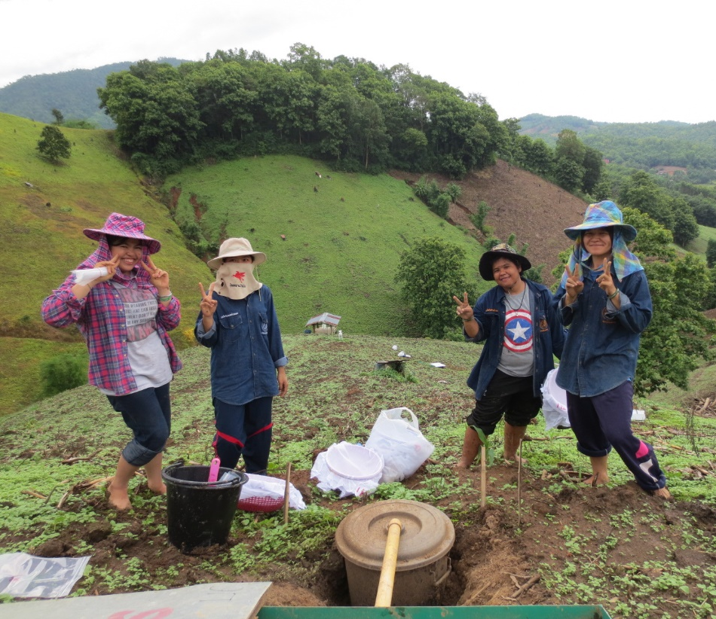
We would like to thank:
B.S. and M.S students from Naresuan University
Miss Sureeporn kheawmuang
Miss Worrada Bunthajan
Miss Tamonwan Thepphakhun
Volunteer helps from a student of University of Tours
Miss Alice Grell
On site support
Mr. Payon Pasom

