Slide 1
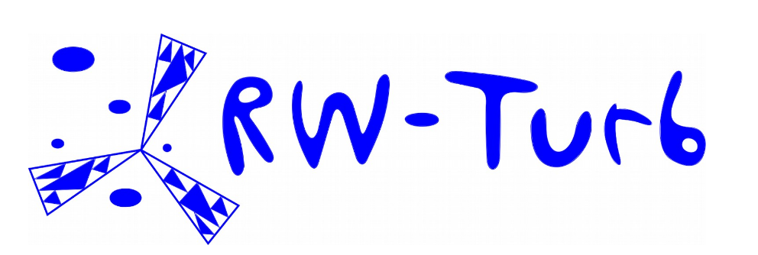
Multi-scale comparison of rainfall measurement with the help of a disdrometer and a mini vertically pointing Doppler radar
Mateus Seppe^{2,1}, Rodrigo Casanova^{2,1}, Jerry Jose¹, Auguste Gires¹, Ioulia Tchiguirinskaia¹, and Daniel Schertzer¹
¹ Hydrologie Météorologie et Complexité (HM&Co), École des Ponts ParisTech (ENPC), France
² Instituto Militar de Engenharia, Rio de Janeiro, Brasil
© Authors. All rights reserved
NP 7.1: Non-linear waves and fracturing and scaling and multi-fractals in hydrology and meteorology
1

Slide 2
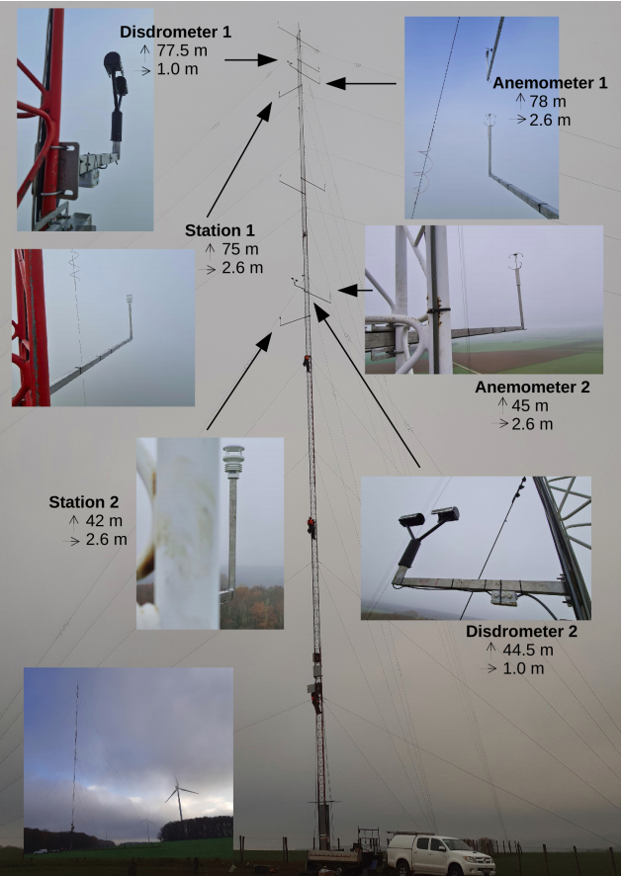
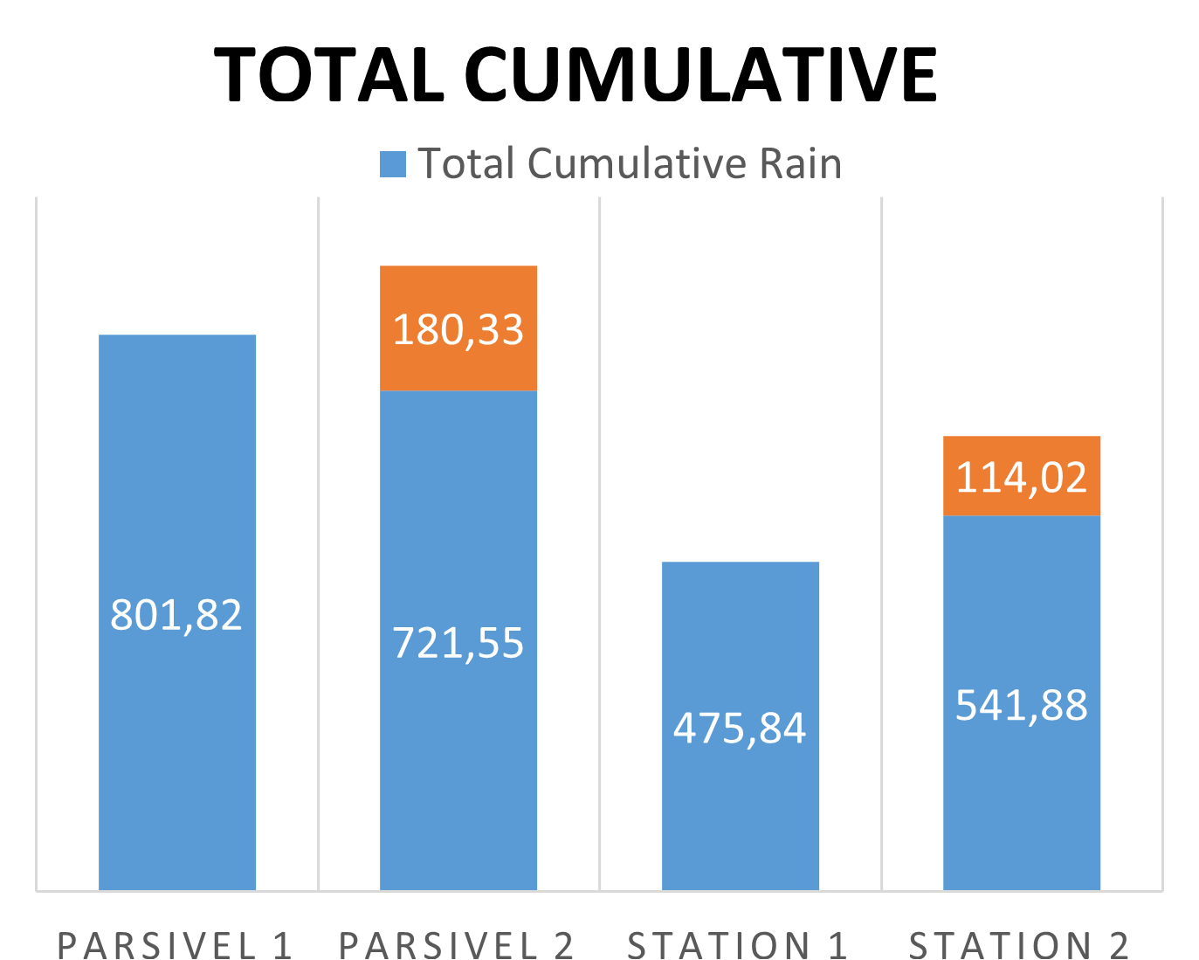
Rain field and Devices
Objective
Compare the performances of two rainfall measuring devices
Disdrometer (Parsivel² , OTT)
mini-Doppler Station (Thies Clima)
The Stations showed an undermeasuring of rain values at Gires et al., 2022, which triggered an investigation.
Methodology:
Universal Multifractal (UM) framework,
Data analysis using rain parameters such as wind, mean diameter and rain rate.
Database:-
1.5 years beginning in December 2020.
Device functioning
The Parsivel operates with an emission of a laser beam from a transmitter to a receiver. When it rains, the raindrops pass between both sides, and it calculates the fall velocity and the equivolumic diameter.
The Clima Sensor uses a signal emitted from a Doppler radar, which is reflected by the raindrops and received by it. The difference in frequency is used to calculate the relative speed of the particle.
at Pays d’Othe, France
2

Slide 3
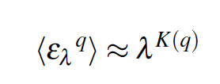
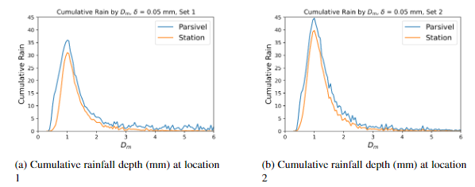
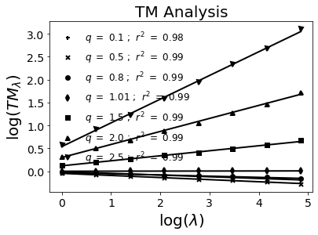
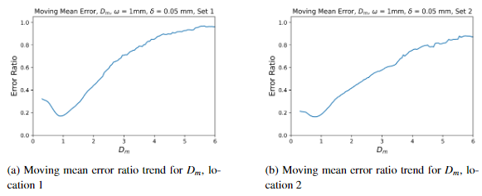
Illustration of results
Scaling analysis
Comparison of measured variability across scales
Influence of various parameters
Influence of rain rate, mean diameter (Dm) and wind on comparison
ε_{λ} normalized conservative field
K(q) moment scaling function
Parsivel
Station
The devices were compared with a resolution beginning at 30s.
The devices presented good scaling, with similar UM parameters.
3

Slide 4
Conclusions
Both devices were able to show good scaling and standard multifractal behavior for rain fields.
The recording frequency of rainfall in the Station isn’t of 1Hz, but 0.5hz.
The Station has a tendency of missing rain points when the Parsivel records it.
The miniDoppler Station undermeasures rain, and presents bad behavior under strong wind and heavier Dm.
The Parsivel also presents a fall on general behavior for wind speeds bigger than 10 km/h.
References:-
Gires, A., Jose, J., Tchiguirinskaia, I., and Schertzer, D.: Three months of combined high resolution rainfall and wind data collected on a wind farm, Earth Syst. Sci. Data Discuss, https://doi.org/10.5194/essd-2021-463, in review, 2022
Friedrich, K., Higgins, S., Masters, F. J., & Lopez, C. R. (2013). Articulating and Stationary PARSIVEL Disdrometer Measurements in Conditions with Strong Winds and Heavy Rainfall. Journal of Atmospheric and Oceanic Technology, https://doi.org/10.1175/jtech-d-12-00254.1
Acknowledgements:-
We greatly acknowledge financial support and data access from CAPES and ANR JCJC RW-Turb project (ANR-19-CE05-0022-01)
4

Slide 5
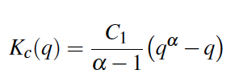
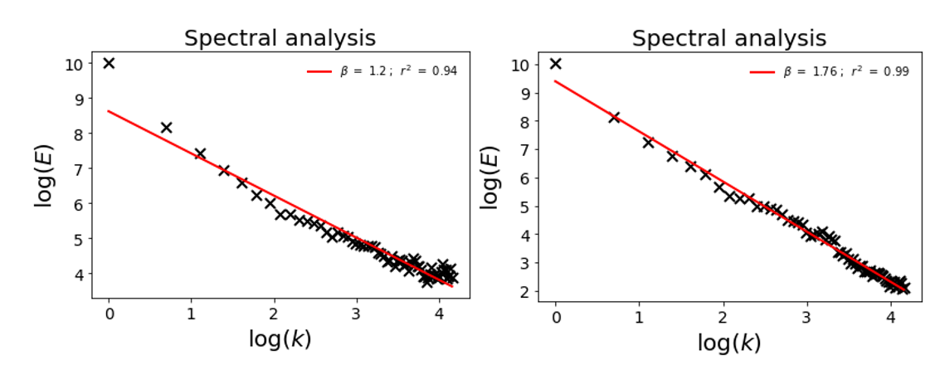
Extra: UM analysis
Universal Multifractal (UM) framework
The UM framework is built around some parameters and equations of physical meaning
Results at 30 seconds
The devices were compared with a resolution beginning at 30 seconds, since this is the Parsivel recording period.
The devices presented good scaling, with different spectral profiles. The α values were close (α = 1.69, 1.65 at set 1 and C₁ = 0.15 and 0.13), but the stations showed a pattern of smaller C₁.
ε_{λ} normalized conservative field
K(q) moment scaling function
λ resolution (outer scale/observational scale)
α multi-fractality index
C₁ mean intermittency codimension
E(k) power spectrum, k frequency, β spectral slope
Analysis at finer scales
It was later seen that the rainfall measurement didn’t have a frequency of 1Hz, but of 0.5Hz. Other measures like wind didn’t present this problem.
A good scaling pattern started to be retrieved at 4s, without apparent repetition.
Parsivel 1 by the left, Station 1 by the right
5

Slide 6
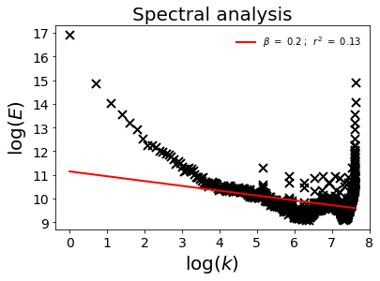
Extra: UM analysis
Methodology in the UM Analysis
Results at 30 seconds
To explore the data, it was used an UM analysis, with ensembles of 4096 seconds for the station and 64 minutes for the Parsivel.
The ensembles were formed by selecting rain events from the Parsivel time series. It was applied a filter to remove the events where the Station had a bad performance in capturing rain (>50% of 0s) or if there was the possibility of snow (Average Temperature < 2 °C).
The devices were compared with a resolution beginning at 30 seconds, since this is the Parsivel recording period (the Station is of 1 second).
The devices presented good scaling, although the spectral profile was slightly different. The alfa values were close, but the stations showed a pattern of smaller C1.
Analysis at finer scales
The ensemble used was the same. The C1 value was smaller for both Stations (0.08, 0.07 for S1, S2) at this resolution, and the alfa didn’t follow a pattern of variation (1.76, 1.65 for S1,S2).
. . ■ . . . . .
6

Slide 7
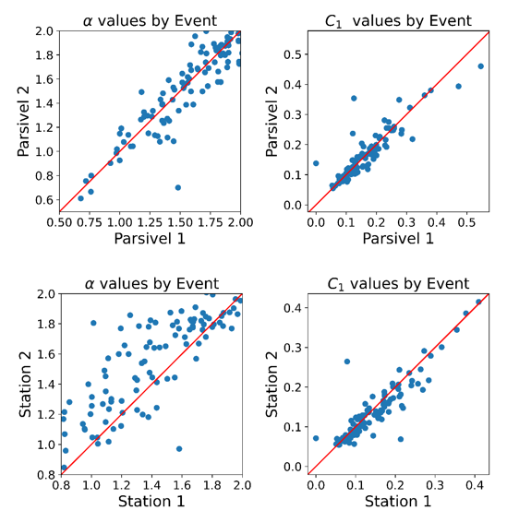
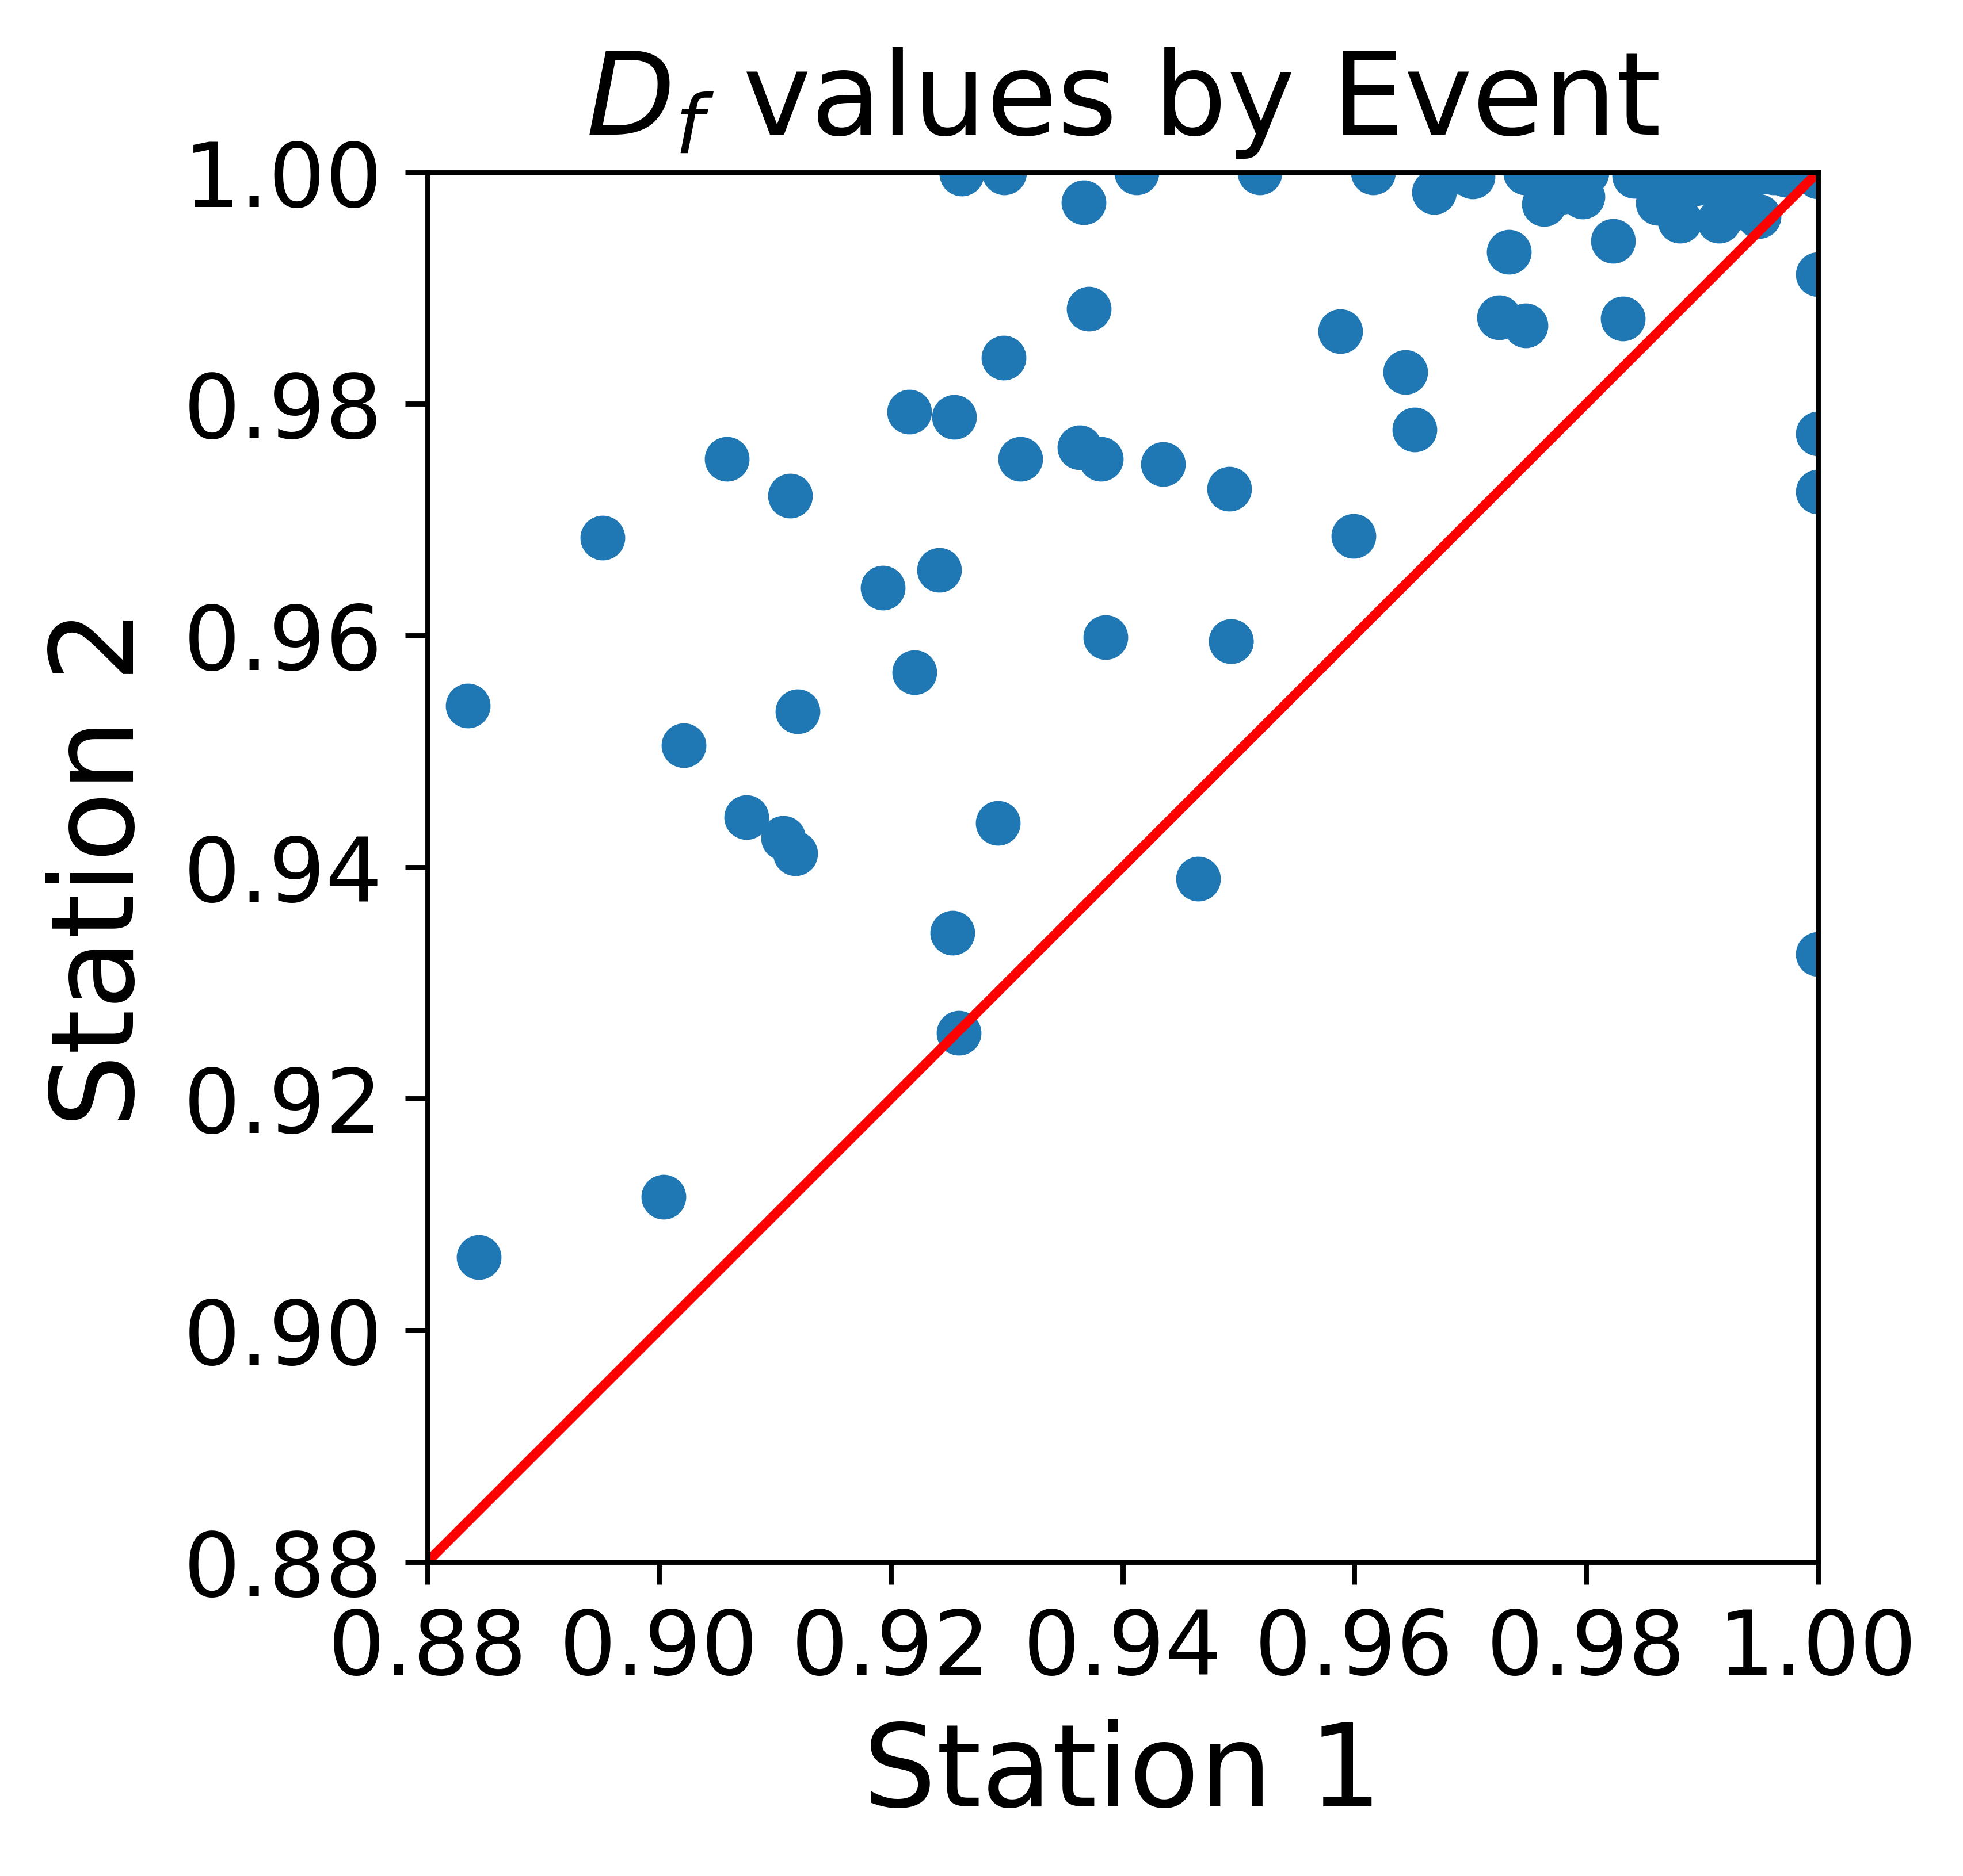
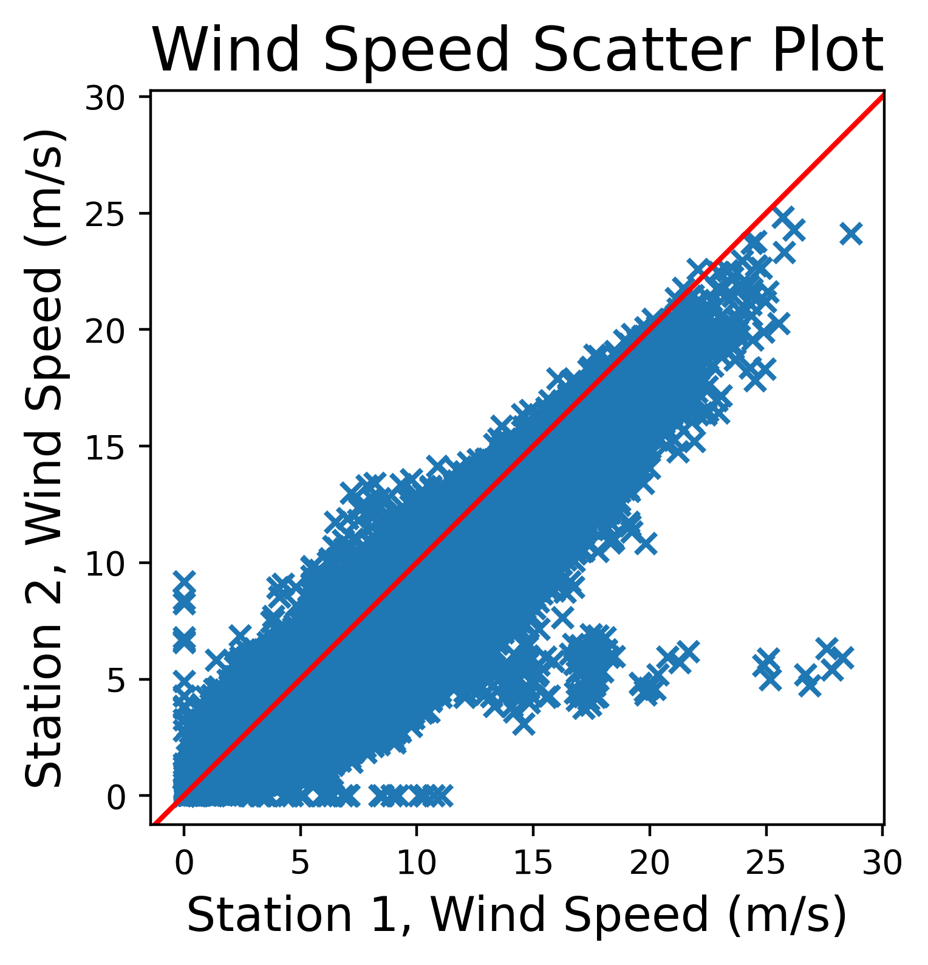
Extra: Zero occurrence
UM Analysis by Event
Zero Occurrence
The events used on the ensemble were analysed individually, computing the UM values for each and comparing among devices of same make.
The parsivels showed a good fit to the bisector in both parameters. The averages were (1.56, 1.55 for alfa in P1, P2) and (0.16, 0.16 for C1 in P1, P2).
For the Stations, the C1 also presented a good alignment to the bisector, but the Alfa showed a large scattering in the Region where Station 2 is bigger. The averages were (1.41, 1.57 for alfa in S1, S2) and (0.145, 0.135 for C1 in P1, P2).
It was perceived that the Station 1 was not recording rain in some time steps where the Parsivel was recording.
It was measured and found a big amount of those time steps, reaching more than 300 hours.
Between both Stations, the difference was of 32 mm. For Parsivels, 8 mm.
It was suspected that the Wind could be having an influence over this effect. When comparing both Stations in Fractal Dimension by events, it is seen that the Station 2 has a bigger FD in 99 events of 106.
7

Slide 8
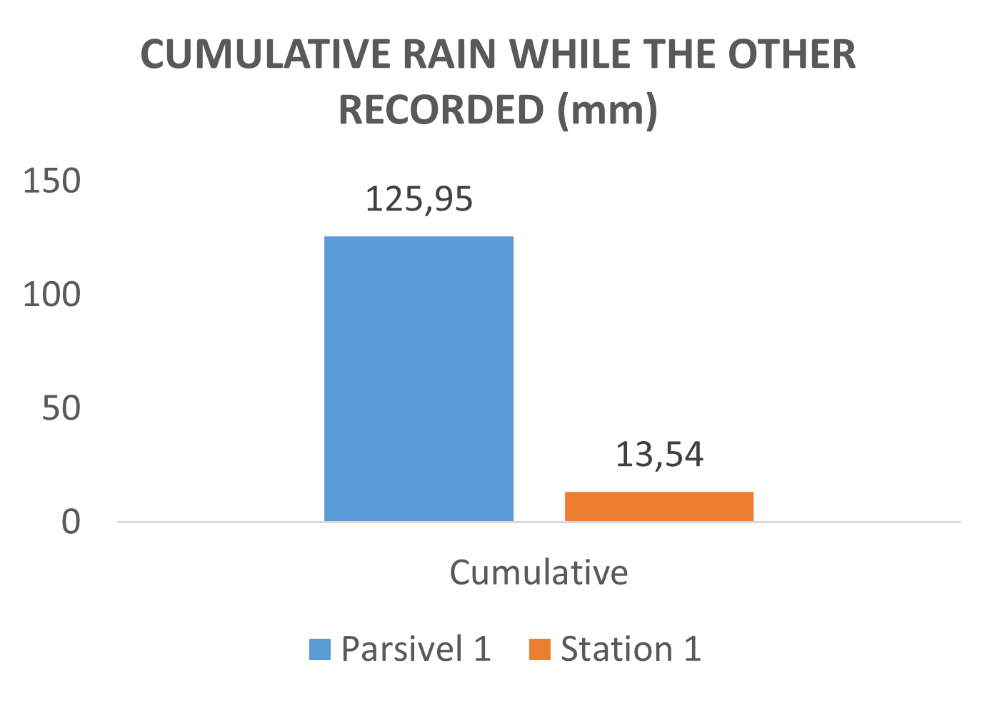
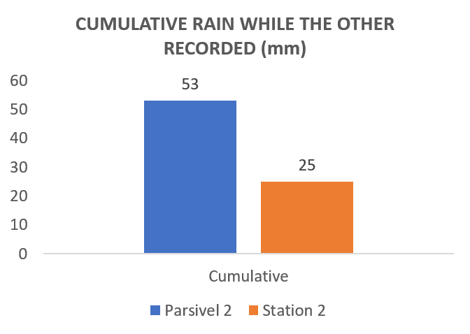
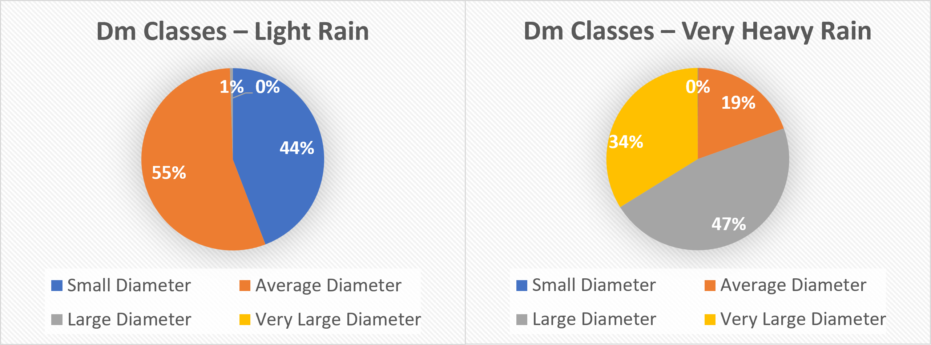
Extra: Rain rate influence
Zero Occurrence
Rain rate influence
It was perceived that the Station 1 was not recording rain in some time steps where the Parsivel 1 was measuring rain. Those added to 125,95 mm measured by the Parsivel while the Station wasn’t recording any rain.
In location 2 this event was happening in a smaller intensity. It was suspected that the Wind could be having an influence. When comparing both Stations in Fractal Dimension by events, it is seen that the Station 2 has a bigger FD in 99 events of 106.
Rain rate (mm/h) was analysed as a influencing parameter as wind speed and D_m.
The general behavior due to rain rate could be traced by its D_m distribution.
Rain Divisions:
Light Rain: < 0.8 mm/h
Moderate Rain: < 4 mm/h
Heavy Rain: < 8 mm/h
Very Heavy Rain: > 8 mm/h
Dm Divisions:
Light Drop: < 0.8 mm
Moderate Drop: < 2 mm
Heavy Drop: < 5 mm
Very Heavy Drop: > 5 mm
8

Slide 9
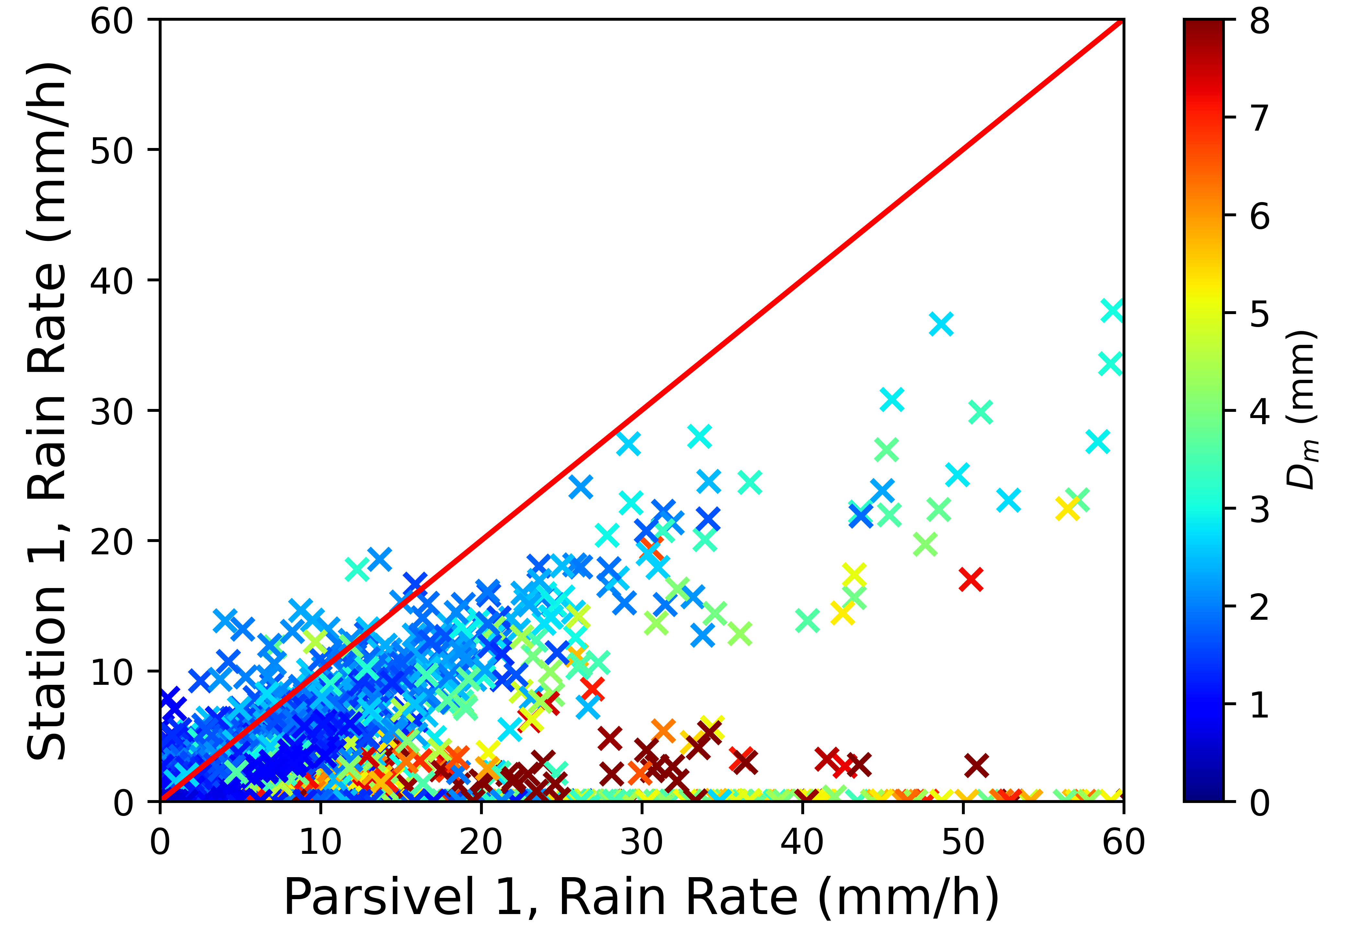
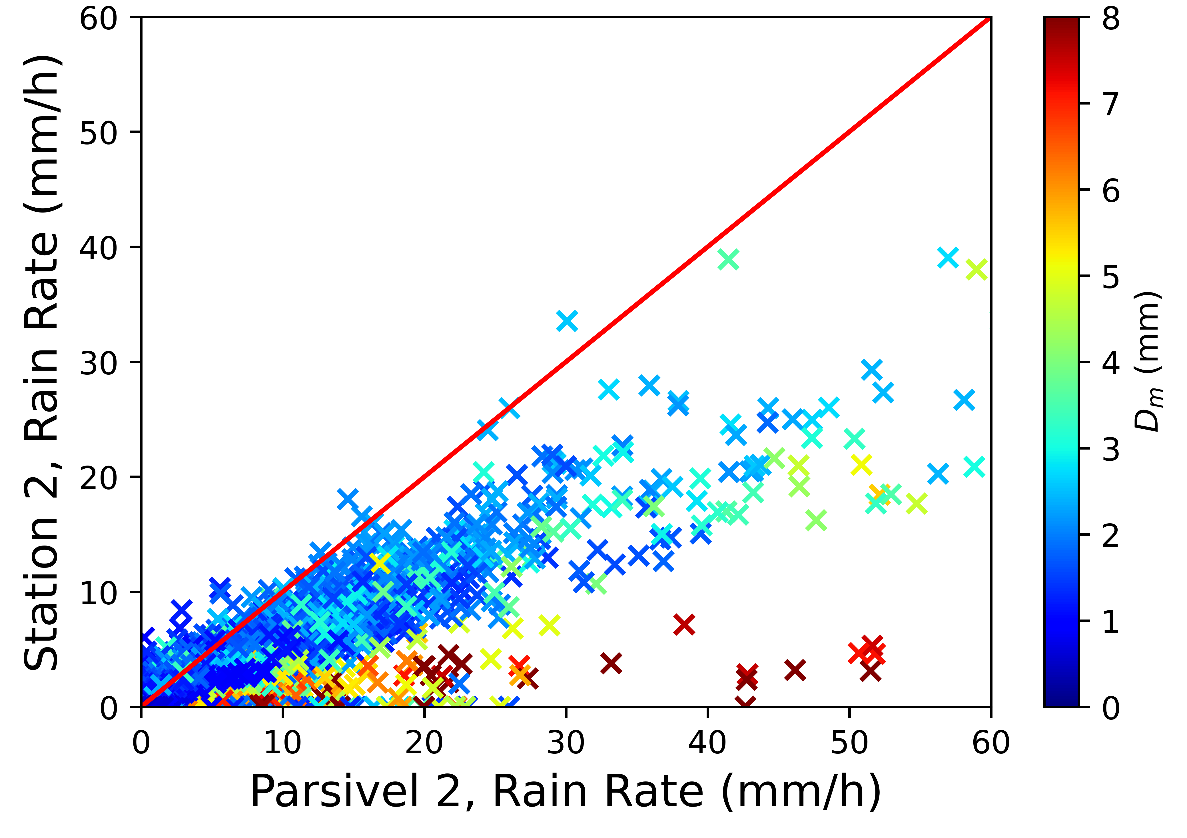
Data analysis: Mean Diameter
D_m Influence
Distribution by D_m
Higher D_m (> 2 mm) were strongly associated with poor performance from the Stations.
Very small Dms were also associated with a poorer performance (< 0.8 mm).
The interval between 0.8 mm and 2 mm was found as an optimal region of performance for the Station. The Ratio Station/Parsivel in 0.9-1.9 was of 0.91.
Very high Dms can cause even a loss in shape of the field, completely losing a peak instead of undervaluating its value.
9

Slide 10
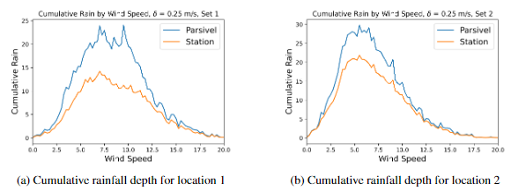
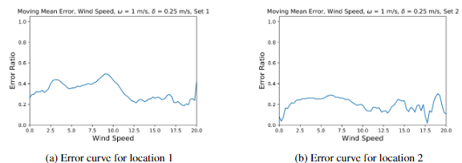
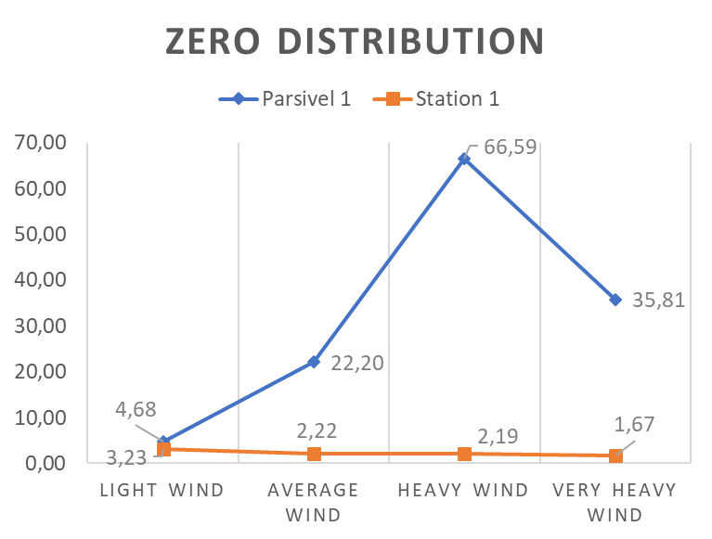
Extra: Wind Speed
Wind Speed Influence
Distribution by Wind
A high occurrence of zero measurement points while the Parsivel was perceiving rain was observed on the Station.
Those points were identified as being light rain and light Dm measurements under heavy wind.
As the Station 2 was submitted to smaller wind velocities, this effect was less observable.
The devices trended to a better correlation with bigger winds, except in the region of light rain and light D_m. This can be asserted to the fact that the Parsivel also loses performance at wind speeds superior to 10 km/h (Friedrich et al., 2013).
Wind Divisions:
Light Wind: < 5.4 m/s
Moderate Wind: < 7.9 m/s
Heavy Wind: < 10.8 m/s
Very Heavy Wind: > 10.8 m/s
Beaufort Wind Table
10

