Slide 1





Hydroacoustic monitoring of Mayotte underwater volcanic eruption
GMPV8.1 - Volcanic processes: tectonics, deformation, geodesy, unrest (20-year anniversary)
Aude Lavayssière
Sara Bazin, Jean-Yves Royer, Pierre-Yves Raumer

Slide 2

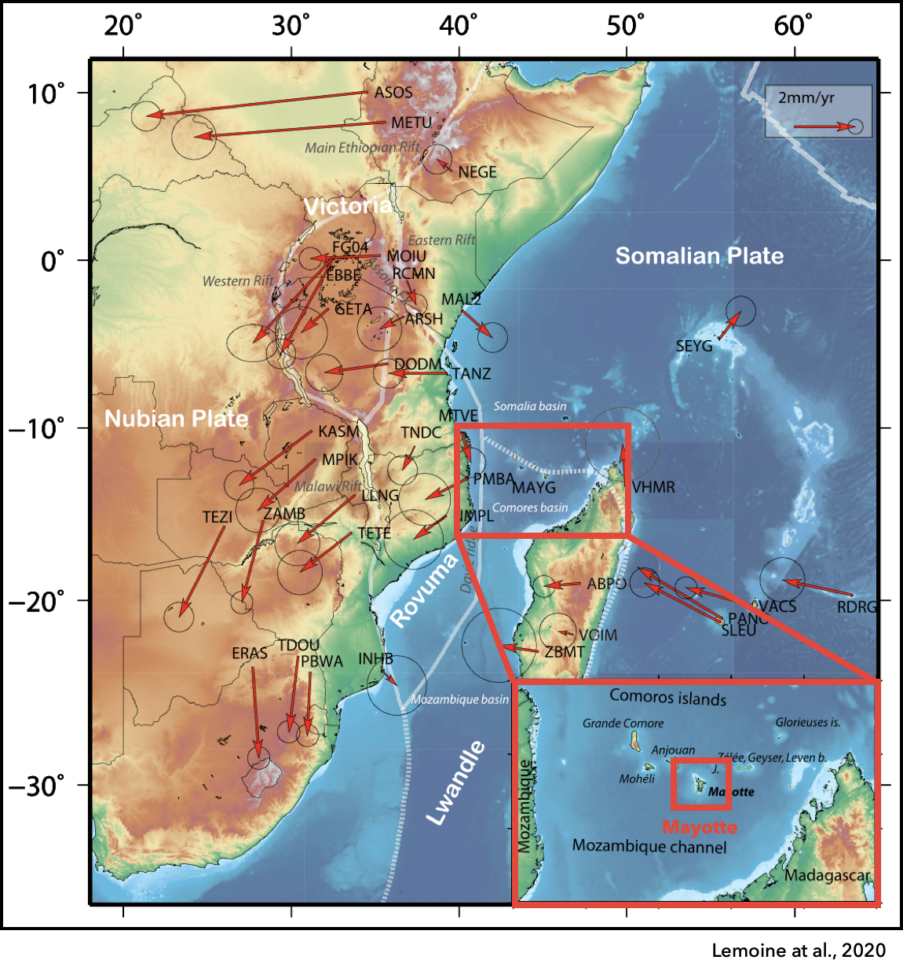
Mayotte
Comoros archipelago, North Mozambique Channel
Origins of the archipelago’s volcanic activity debated
  Partial melting in interaction with mantle plume [Pelleter et al., 2014, Michon, 2016]
  Link between southern part of the East African Rift to Madagascar [Laville et al., 1998, Rufer et al., 2014]
  Plate boundary between the Lwandle and Somalia plates [Famin et al., 2020]
Easternmost and oldest (20 Ma) island of archipelago
Last known volcanic activity 7 ka [Zinke et al., 2003, 2005]
Moderate scattered seismicity before May 2018 [Bertil et al., 2021]

Slide 3
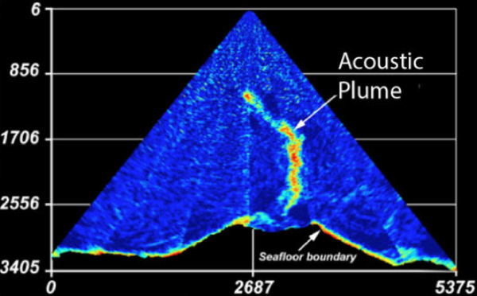
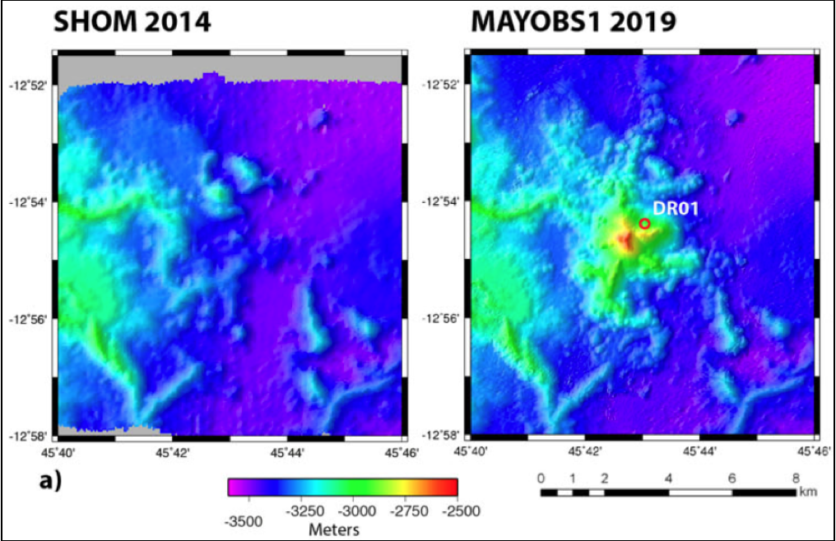
Mayotte’s recent eruption
A seismic « crisis » started in May 2018 with ~130 M_{L} > 4 earthquakes, some felt by Mayotte population and sparked much concerns on the island
Large surface displacements (170 mm/yr subsidence and 240 mm/yr tilting eastward)
MAYOBS1 cruise (May 2019) revealed a new 820 m-tall volcanic edifice, named Fani Maoré, associated with an acoustic plume in the water column
Feuillet at al., 2021
Feuillet at al., 2021

Slide 4
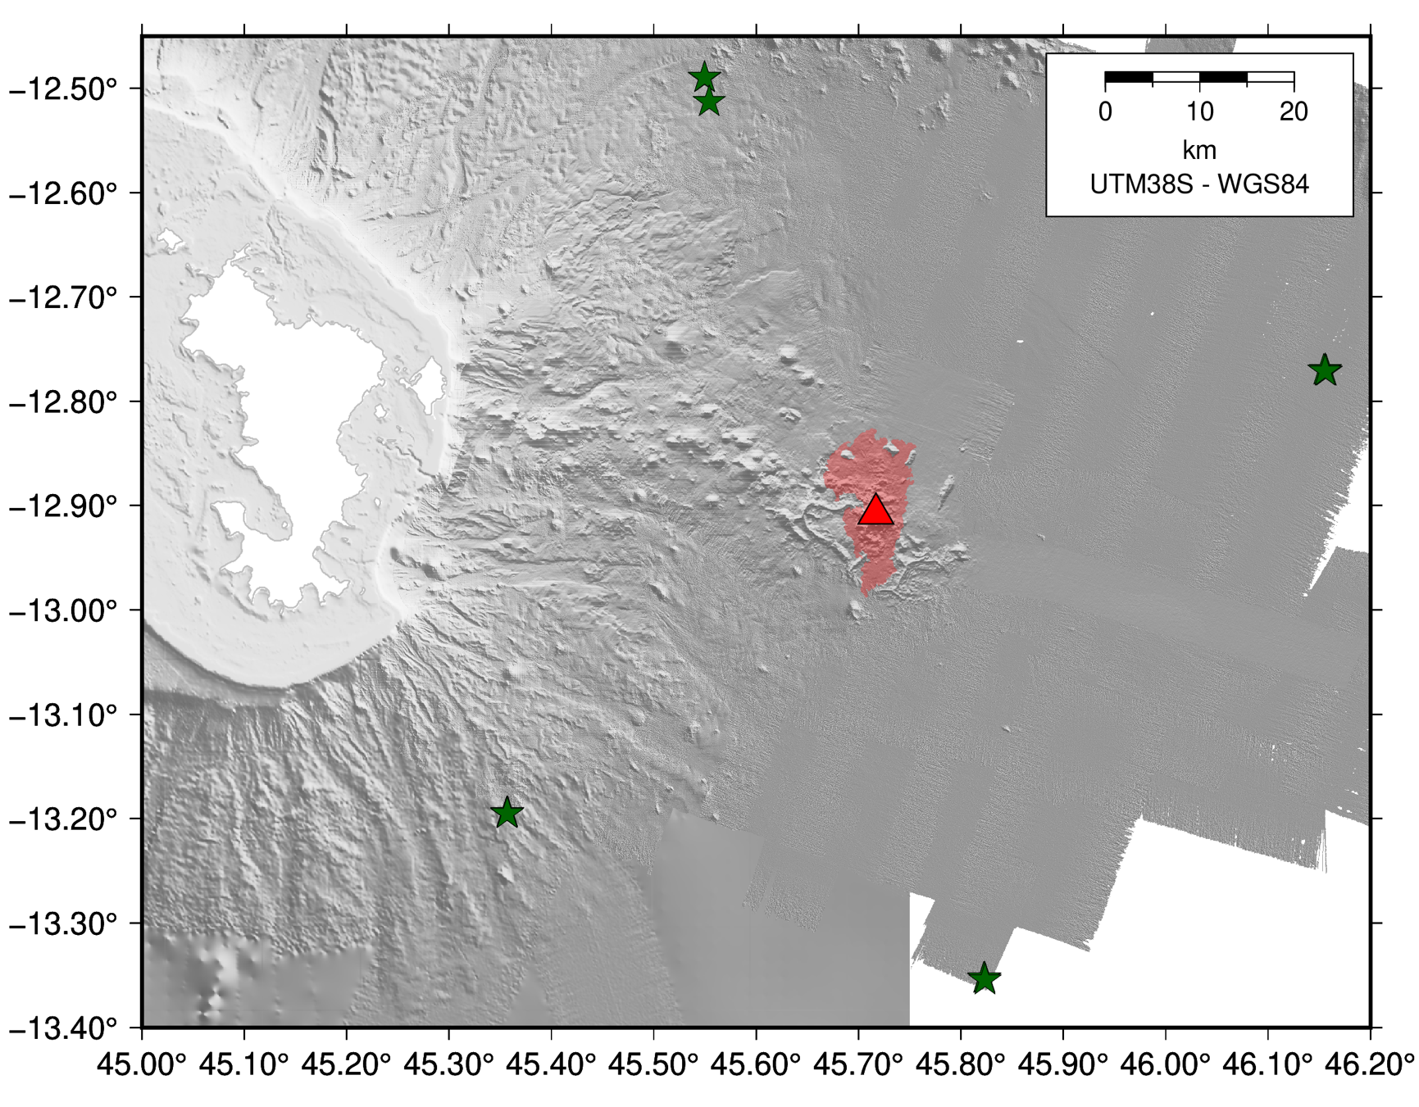


Hydrophone network
4 autonomous hydrophones
50 km from Fani Maoré volcano
Moored at ~1300m depth in the SOFAR channel (SOund Fixing And Ranging channel
The SOFAR acts as an acoustic waveguide carrying sounds over thousands of kilometers
hydrophone
-1300m
1000m vectran
Fani Maoré volcano
1000m pentex
acoustic release
hydrophones
recent lava flows extent
seafloor -3300m

Slide 5

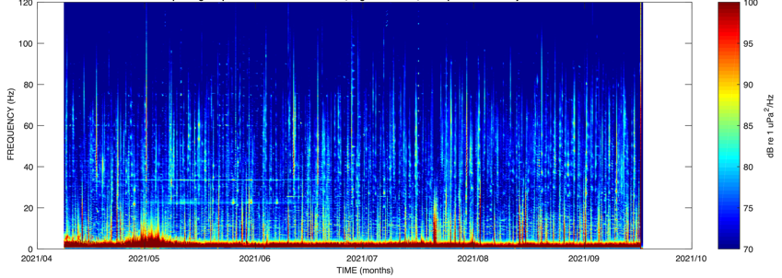
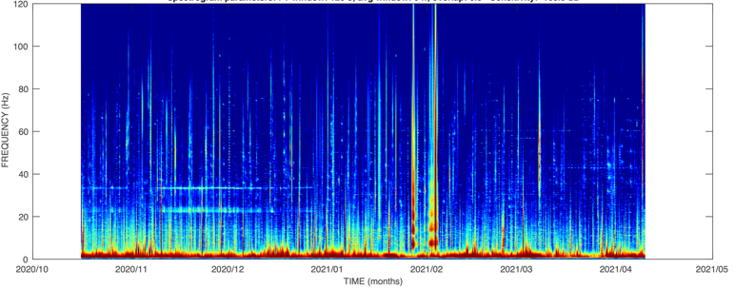
Hydrophone data
Pygmy blue whale - MAHY03 – 14/10/2020
(accelerated 20 times)
From October 2020 to July 2022 (in 3 datasets)
Soundscape detected (0-120Hz) :
  Marine mammals calls
  Active seismic surveys
  Transiting ships
  Seismic events, landslides, …
04/2021 - 09/2021
10/2020 - 04/2021
09/2021 - 07/2022
Bazin et al., 2022

Slide 6
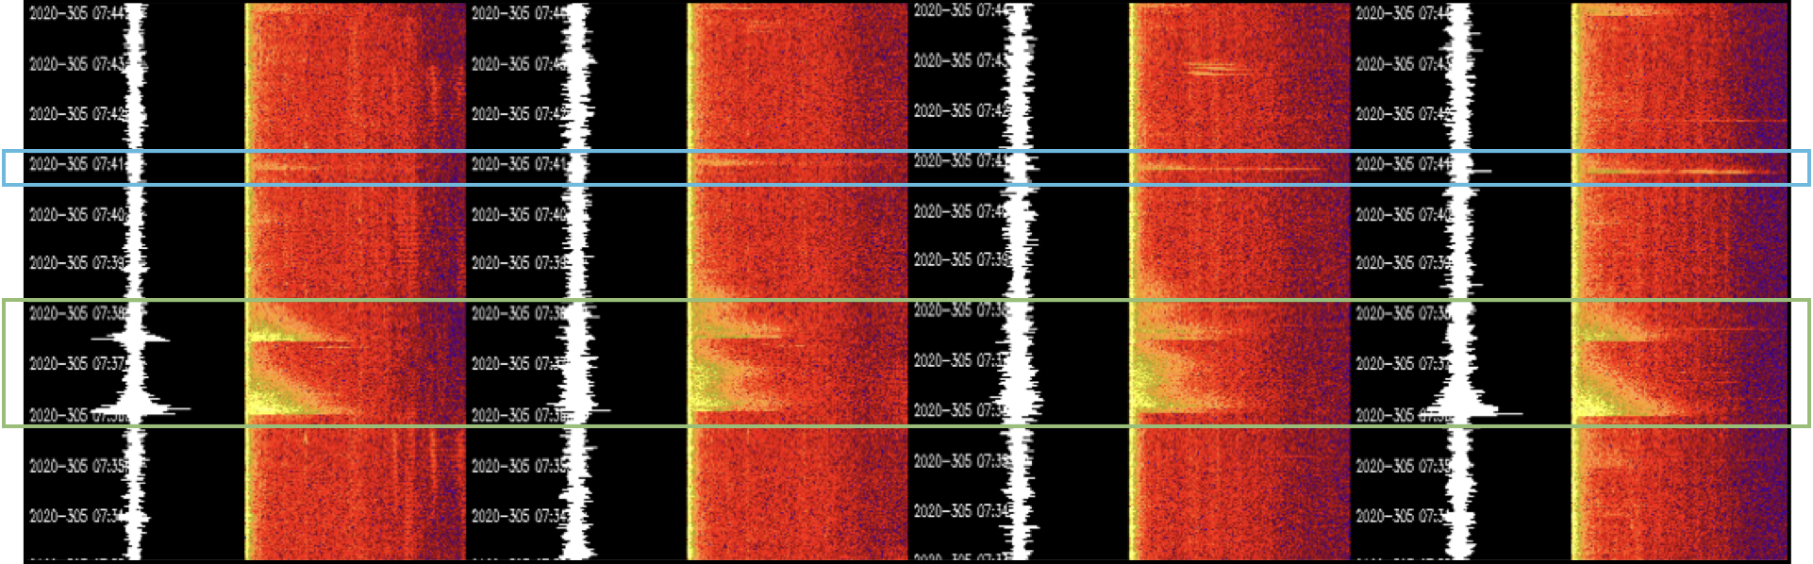
Impulsive events
Mainly observed on spectrograms
Short duration < 5-10 s
Energetic – up to 100 Hz
Also observed at Axial seamount [Le Saout et al., 2020] and South-West Indian ridge [Ingale et al., 2022, 2023]
Impulsive
event
Earthquake
(T-phases)
Bazin et al., 2022

Slide 7
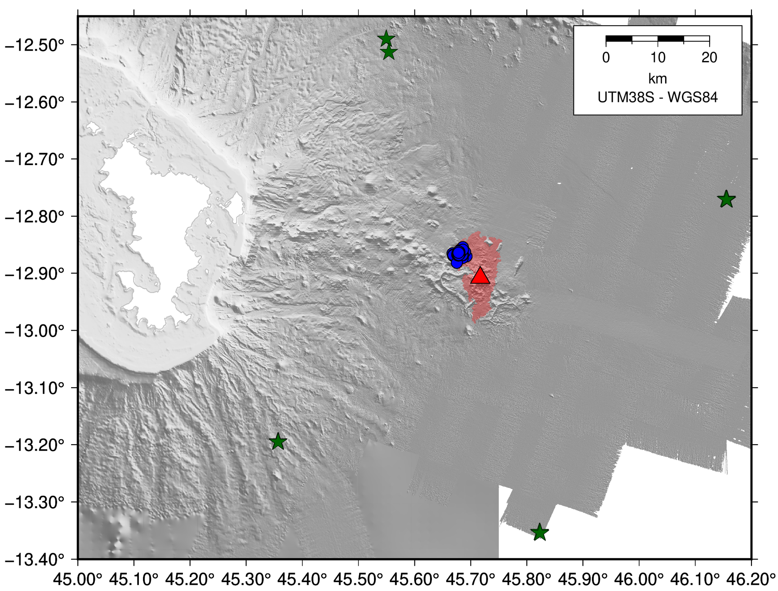

First results
Bazin et al., 2022
Tiktak region
Hand-picking of 24h of data using Seas [Fox et al., 2001]
81 impulsive events
All clustered in the same region NW of Fani Maoré volcano

Slide 8
First results
Bazin et al., 2022
Events location matches region of recent (repeated bathymetric surveys) fresh (red glow from camera) lava flows
Impulsive events :
sounds resulting from lava-water interactions: steam, explosion ?
highlight areas of active flow emplacement

Slide 9
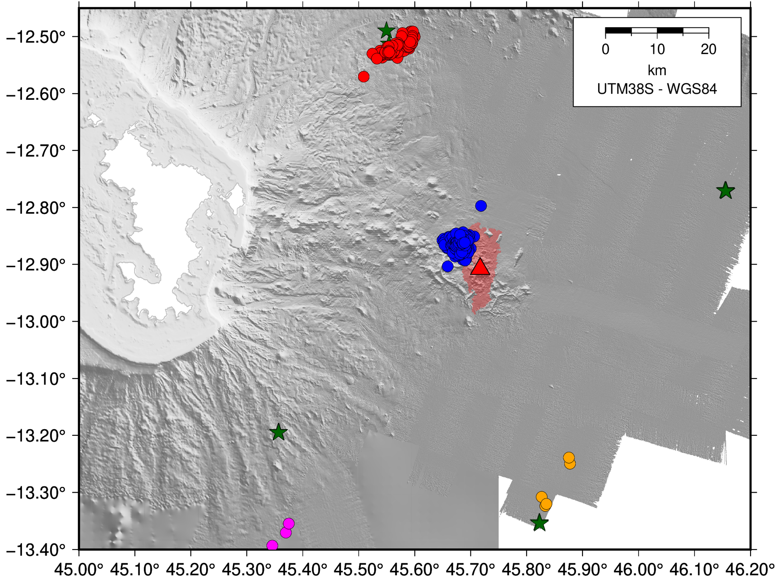
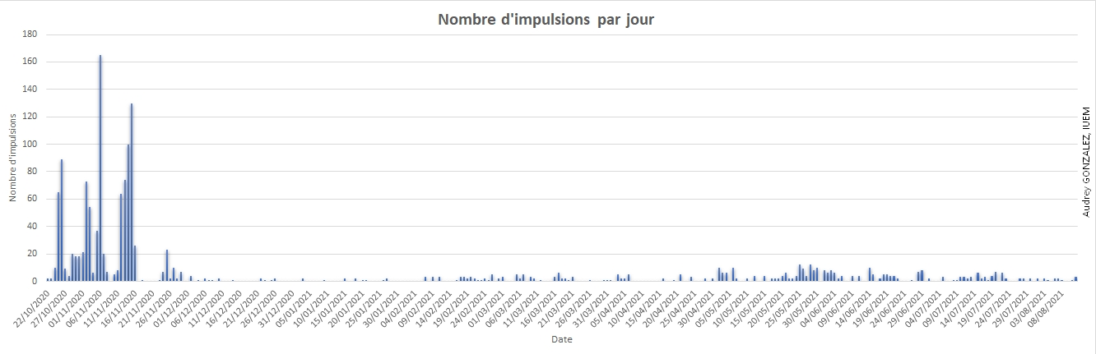
Further results
Manual picking of ~1000 additional impulsive signals detected over 22 months
4 clusters including Tiktak cluster
Tiktak cluster stops on December 4th, 2020 => end of lava flow activity ?
Data in Bazin et al., 2022
04/12/2020
No more events at Tiktak
Number of impulsive events per day
Date
Audrey Gonzalez et al.

Slide 10
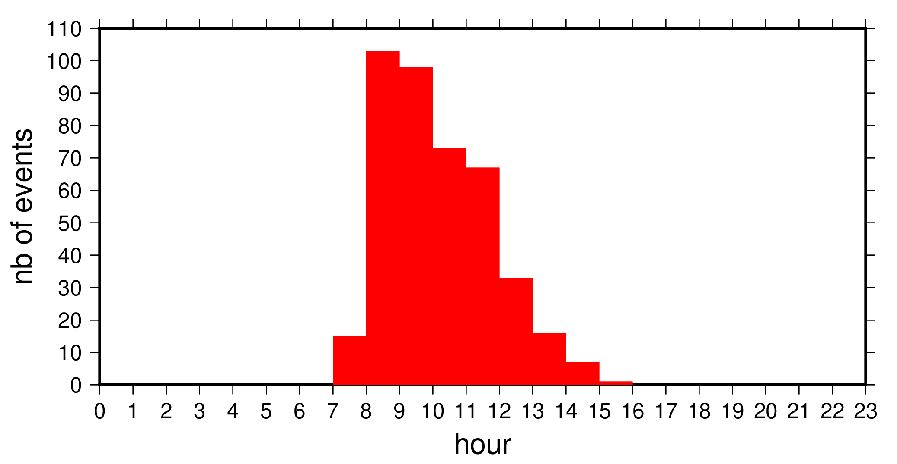
Issues
Manual detection time-consuming
=> Need automatic detection to increase dataset completeness
Northern cluster probably anthropic noise
=> issues with location
Possibly similar problem with other detected clusters
=> Need better location method
Notes:
Dataset coming every 6 months at the moment
Time and people lacking

Slide 11
Automatic detection
Deep Learning technique relies on catalog of well-labeled events for training (PhD Pierre-Yves Raumer)
Impulsive events only visible on spectrograms = i.e., images
=> why not apply image processing techniques
We have a database of picked events
=> method: template matching with OpenCV
Database of impulsive events
Raw data
FFT
FFT
Image
processing
Image
processing
Spectrogram
Spectrogram
Extraction
Template
Matching
Template
Detections
Notes:
Template = image of high signal-to-noise already-detected events
detections = matched features between template and spectrogram of raw data

Slide 12

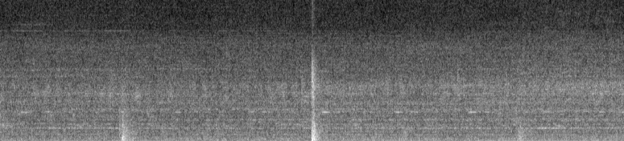
Create template
Database of already-detected
impulsive events
FFT
15 min spectrogram with event in center
Image processing
Normalized spectrogram
Extract ∼10s around event
SNR
High SNR event
Low SNR event
Discard event
Template

Slide 13
Create template
MAHYX1
Template 1
Template 2
Template 256
Average Template 1
MAHYX2
Template 1
Template 2
Template 366
Average Template 2
MAHYX3
Template 1
Template 2
Template 766
Average Template 3
MAHYX4
Template 1
Template 2
Template 832
Average Template 4

Slide 14
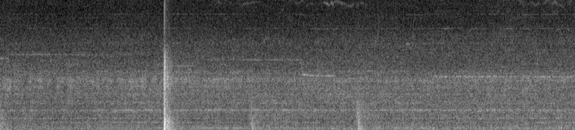
Template matching
Raw data
Template
FFT
15 min spectrogram
Image processing
Template slides pixel by pixel on scanned spectrogram
For each position, a similarity metric (= correlation coefficient) is computed between template and scanned section
Correlation coefficient high enough => object matches the template
SNR threshold before/after event applied to record only impulsive events
Normalized spectrogram
Template
Matching
Template
Matches
Correlation coefficient
threshold
+
SNR threshold
Detections

Slide 15
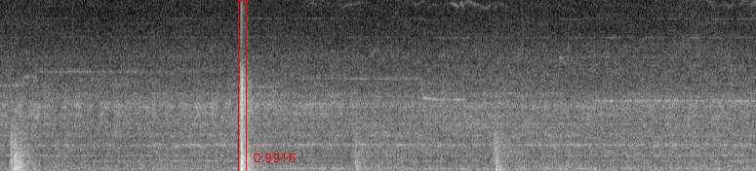
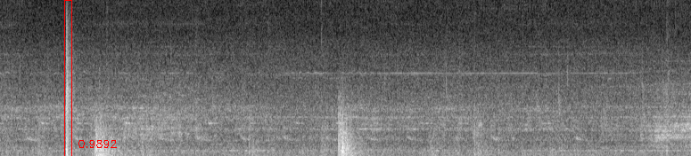
Template matching
Raw data
FFT
High SNR threshold show good results for strong events
15 min spectrogram
Image processing
Normalized spectrogram
Template
Matching
Matches
Correlation coefficient
threshold
+
SNR threshold
but miss smaller ones
Detections
Notes:
But we do miss smaller events

Slide 16
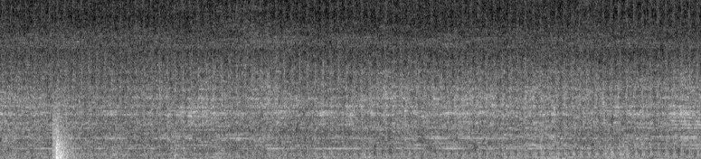
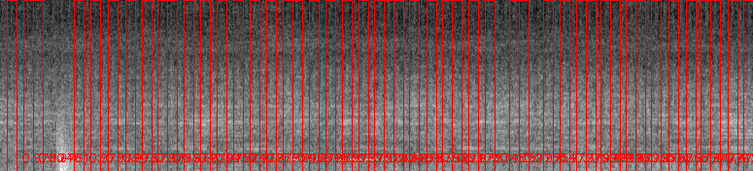
Template matching
Raw data
FFT
Lower SNR threshold detect airgun shots from active seismic surveys
15 min spectrogram
Image processing
Normalized spectrogram
Template
Matching
Matches
Correlation coefficient
threshold
+
SNR threshold
Detections
Notes:
Makes sense as the signals are very similar
BUT seismic surveys events have one characteristic that allow us to remove them: regularity
So every series of events too regular in time are removed

Slide 17
What’s next ?
Match detections then locate using arrival times at each station
Location improvement
=> comprehensive catalog of well-located impulsive events
=> analysis of the spatio-temporal evolution of Mayotte’s lava flows
=> with instrumental development / near real time capabilities, precise underwater lava flow monitoring
=> to be used for other hydrophone networks / other submarine volcano
Notes:
Hopefully next year i’ll be able to show you lava flows emplacements and their evolution

Slide 18


Take-away messages
➤ moored hydrophones record lava-water interactions at the seafloor
➤ automatic detection based on image processing techniques will provide comprehensive catalog for Deep Learning training
➤ new tool for underwater volcano monitoring
Thank you for your attention
Any questions ?
CR Geosciences
Mayotte Special Issue
aude.lavayssiere@univ-brest.fr

Slide 19
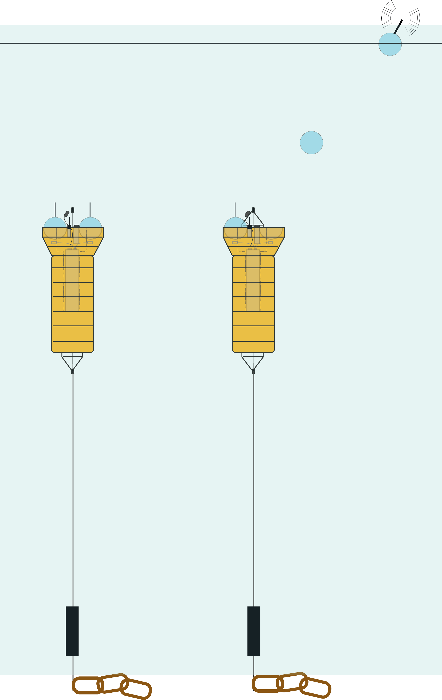


Perspectives
Jean-Yves Royer IUEM, Geo-Ocean
Yann Hello GéoAzur
Jaouen Rozen OSEAN
Moored hydrophones require to recover the mooring line to access data => time consuming
=> HYDROBS : HYDROacoustic OBServatory
=> autonomous mooring with data shuttles releasable on demand
=> Reduce need for large research vessels
Up to 4-year autonomy
Up to 1000 Hz continuous sampling
1 prototype in testing + 2 in construction

Slide 20
