Slide 1
Application of AHP in flood combination calculation of check dam system

Slide 2
01
Overview of Dam System Engineering
CONTENTS
02
Analytical Hierarchy
Process
03
Flood control standards for hazard removal and reinforcement
04
Dam system flood combination calculation

Slide 3
Overview of Dam System Engineering

Slide 4
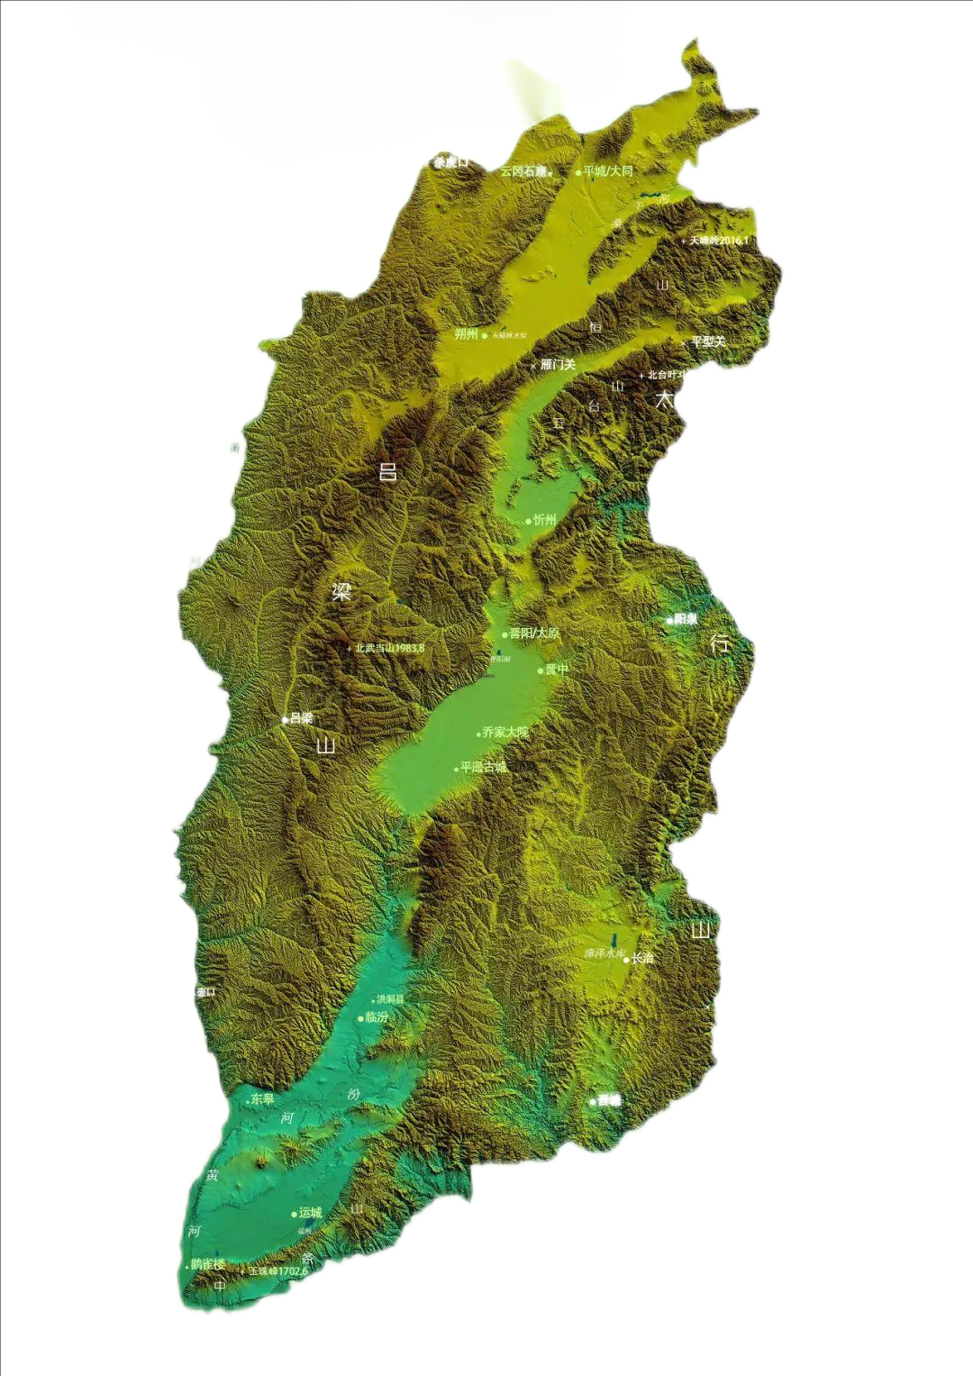
Overview of Dam System Engineering
Located in Linquan Town, Linxian County, Shanxi Province, it is a loess hilly and gully area with a total drainage area of 53 km², including 52.2 km² of soil erosion area and an average soil erosion modulus of 14300 t/(km² · a) over the years。
The construction period of this dam system project was from September 2004 to November 2006, with a total of 30 large and medium-sized silt dams built.
1

Slide 5
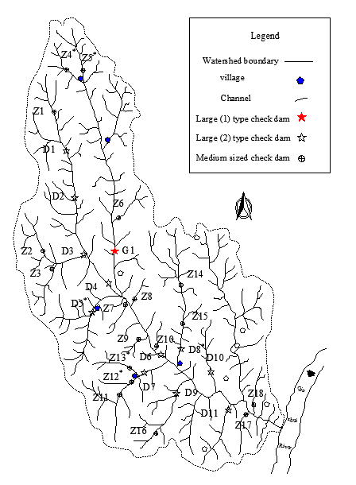
Overview of Dam System Engineering
There are 1 large (1), 11 large (2) and 18 medium-sized warping dams respectively, of which the large (1) warping dam is the "three major pieces", and the rest are the "two major pieces" of the dam and water release project. The main task of danger removal and reinforcement is to add spillway.
。

Slide 6
Overview of Dam System Engineering

Slide 7
Analytical Hierarchy
Process

Slide 8
AHP
Categorize complex problems into interrelationships Construct a hierarchical structure
"Analytic Hierarchy Process", proposed by American operations research scientist Thad in the 1970s, is a decision analysis method combining qualitative and quantitative analysis, which has been widely used in sociology, economics and other fields in China. In recent years, the Analytic Hierarchy Process (AHP) has also been applied in the analysis of the benefits of silt dams and the arrangement of construction schedules.
01
Determine the importance of various factors in the same and different levels through comparative analysis
02
03
A method for making comprehensive decision judgments

Slide 9
AHP
Set the upstream siltation dam of the main and branch ditches in the Wan'angou small watershed of Linxian County as the first layer, set the downstream siltation dam affected by it as the second layer, and then set the downstream siltation dam affected by the second layer as the third layer And so on, until the complete dam system is analyzed。
If there are multiple parallel warping dams upstream of a certain warping dam and they are located at different levels, follow the principle of the lowest level and recursively divide them into the next level in order, so that the large and medium-sized warping dams within the dam system form a hierarchical structural system.

Slide 10
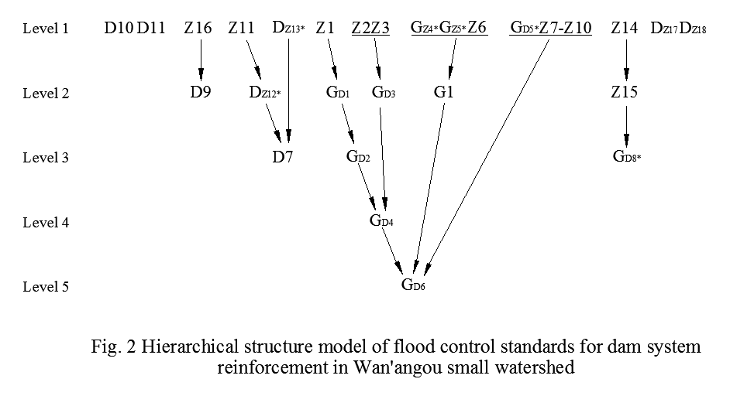
AHP——Dam system hierarchical structure model
通过对比分析确定相同和相异层次中各因素的重要性
做出综合决策判断的一种方法

Slide 11
Flood control standards for hazard removal and reinforcement

Slide 12
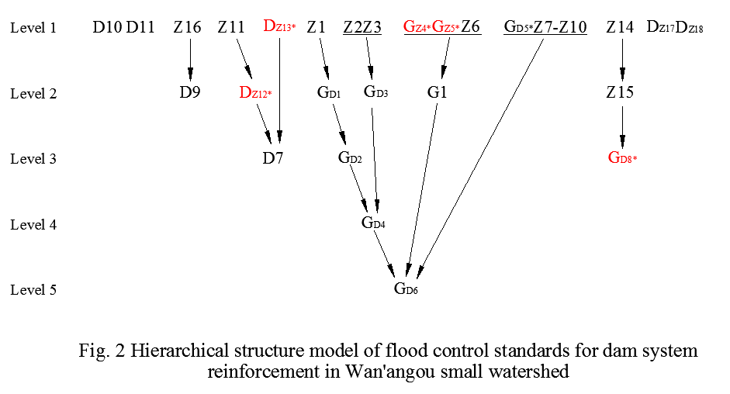
Flood control standards for hazard removal and reinforcement
In Figure 2, it can be intuitively seen that during the design of hazard removal and reinforcement, it is necessary to improve the flood control standards of the silt dam and the reasons for the improvement. For example, there are residential areas within the downstream impact range of the six silt dams located on the first floor, including D5 *, Z4 *, Z5 *, Z13 *, Z12 * on the second floor, and D8 * on the third floor. According to the requirements of the regulations, their flood control standards will be adjusted accordingly

Slide 13
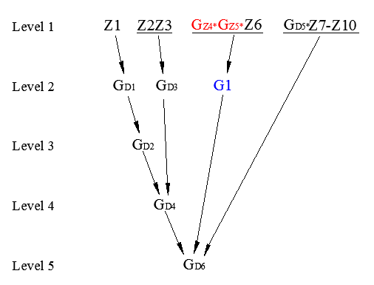
Flood control standards for hazard removal and reinforcement
1
2
Threats
The two large (1) type siltation dams GZ4 * and GZ5 * on the first floor, first of all, have raised their flood control standards to large (2) type siltation dams DZ4 * and DZ5 according to the specifications due to the presence of residential areas within their downstream influence range*。
Secondly, due to its downstream being the second layer of the large (1) type silt dam G1, considering the flood combination, it is elevated to the large (1) type silt dam GZ4 * and GZ5 *.

Slide 14
Dam system flood combination calculation

Slide 15
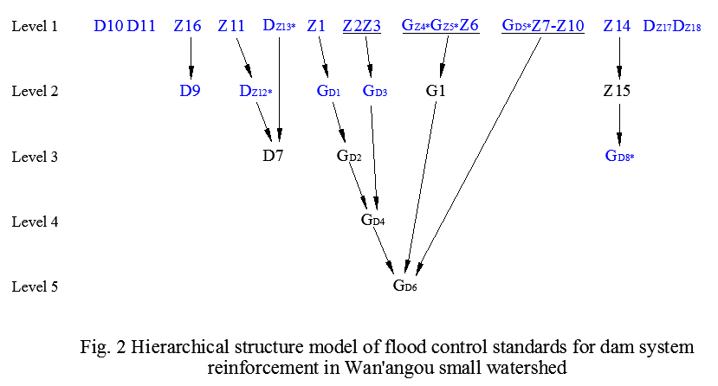
Dam system flood combination calculation - calculated based on a single dam
When calculating the hydrology of large silt dams, the area of runoff production in the interval includes the control area of medium silt dams according to the interval flood control standard. Therefore, the siltation dam calculated based on a single dam refers to all siltation dams located on the first layer, as well as large (1) type siltation dams and large (2) type siltation dams with designed upstream layers of medium sized siltation dams.

Slide 16
Dam system flood combination calculation - calculated based on a single dam
According to the Technical Specification for Warping Dam Engineering (Jin Q834-85),
The formula for calculating peak discharge is
Q_{P}＝C₁H₂₄PF^{2/3}
In the formula:
Q_{P} is the peak flow rate, m³/s;
C₁ is the geographical parameter of the flood peak;
F is the runoff area, km²;
H₂₄ is the 24-hour storm rainfall, mm.
The formula for calculating the total flood volume is W_{P}＝KR_{P}F
In the formula:
W_{P} represents the total flood volume, in 10000 m³; K is the reduction coefficient for small-scale floods;
R_{P} is the primary flood modulus of design rainstorm, 10000 m³/km².

Slide 17
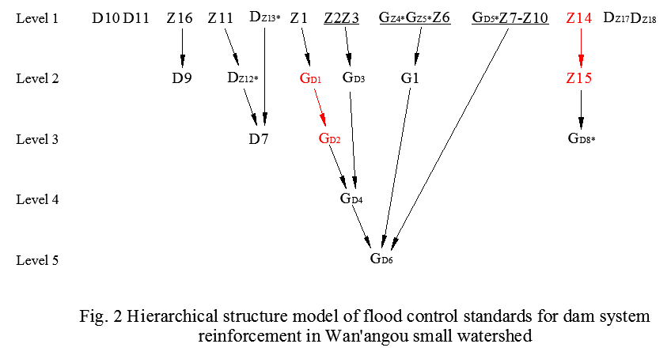
Dam system flood combination calculation - calculated based on a single dam
The silt dam calculated based on a series of dams refers to a silt dam located at two adjacent levels with the same flood control standards and a unique relationship between them. According to the calculation of series dams, there are:
Z₁₅ on the level2
G_{D2} on the level3

Slide 18
Dam system flood combination - calculated based on series dams
The formula for calculating the combined peak discharge is:
Q_{P调}=Q_{P区}+（Q_{P未}-Q_{P区}） q_{1P} /Q_{1P}
Formula for calculating total combined flood volume
W_{P调} =W_{P未}（ f_{区} / F ） +W₁

Slide 19
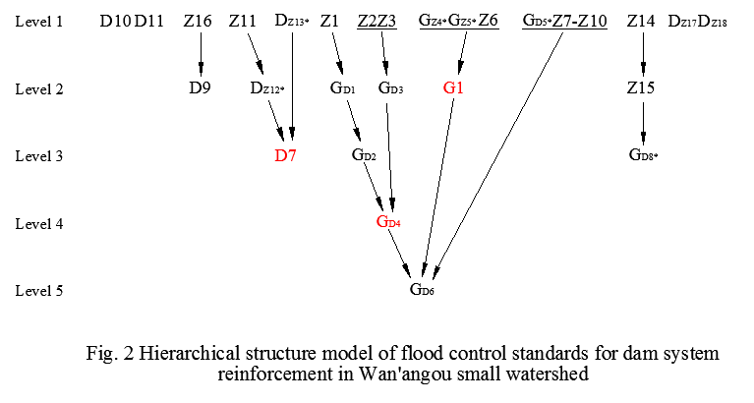
Dam system flood combination - calculated based on parallel dams
The siltation dam calculated by parallel dam refers to a siltation dam located upstream of the design dam with the same flood control standards as the adjacent layer, and with two or more upper level dams.
There are three parallel sedimentation dams, namely G₁on the level 2,
D₇ on the level 3, and G_{D4} on the level 4。

Slide 20
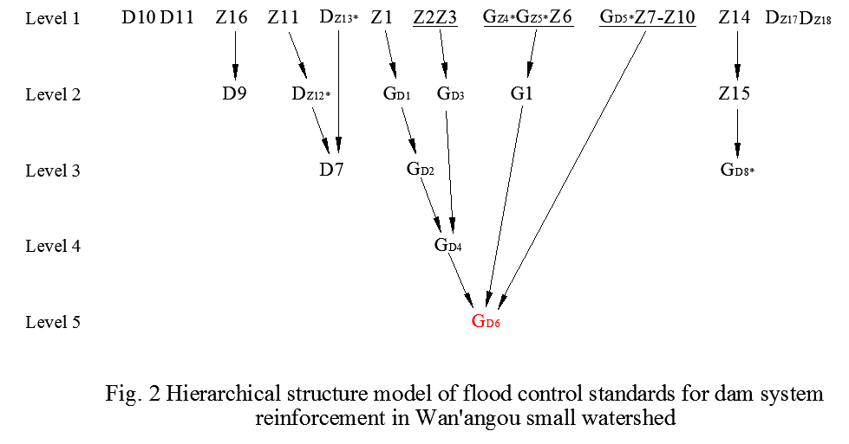
Dam system flood combination - calculated based on parallel dams
There is one large (1) type siltation dam GD6 located on the level 5 , with three parallel siltation dams on the upper layer. The upper layers are GD4 located on the level 4, G1 on level 2, and GD5 on the level 1. These three large (1) type siltation dams, Z7-Z10, are calculated based on the interval area.

Slide 21
Dam system flood combination - calculated based on parallel dams
When designing n parallel sedimentation dams upstream of the dam for flood discharge, the calculation formula for the combined peak flow is:
The formula for calculating the total combined flood volume is:

Slide 22
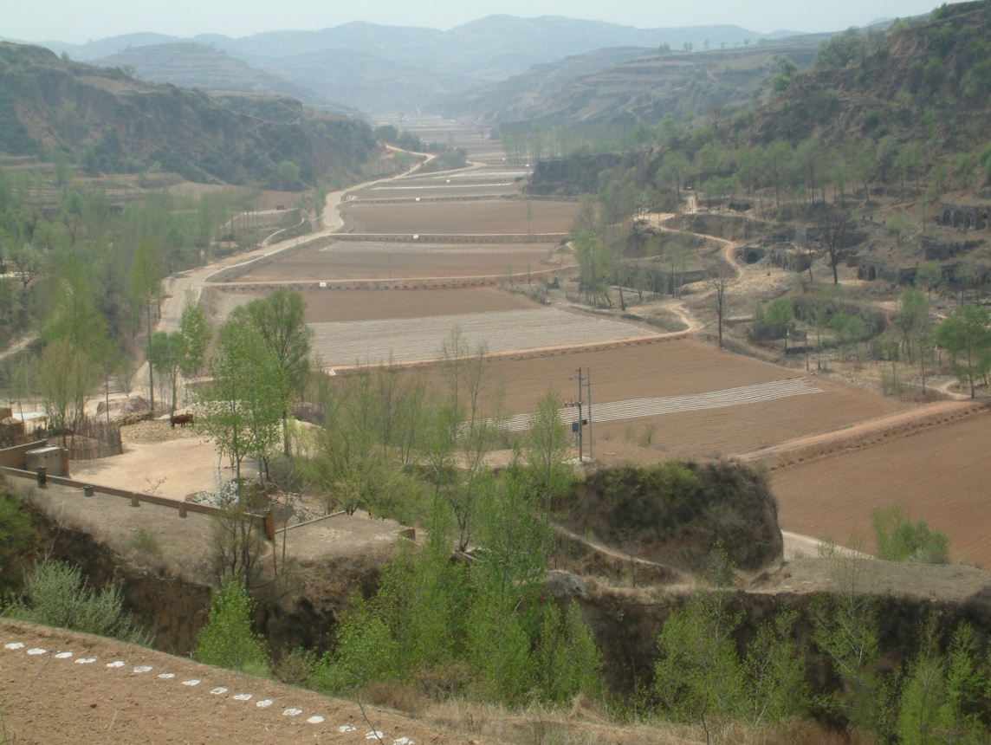
summarize
In the calculation of dam system flood combination, currently only the combination of dam system flood space is considered (based on the principle of similarity), without considering the impact of confluence distance, watershed shape, and channel management on flood confluence time.
For the above problems, it is necessary to establish a dam system hydrodynamic flood routing model, enrich and improve the flood combination theory of computation through model tests, so as to better guide the dam system flood combination calculation.

Slide 23
THANKS YOU

