Slide 1
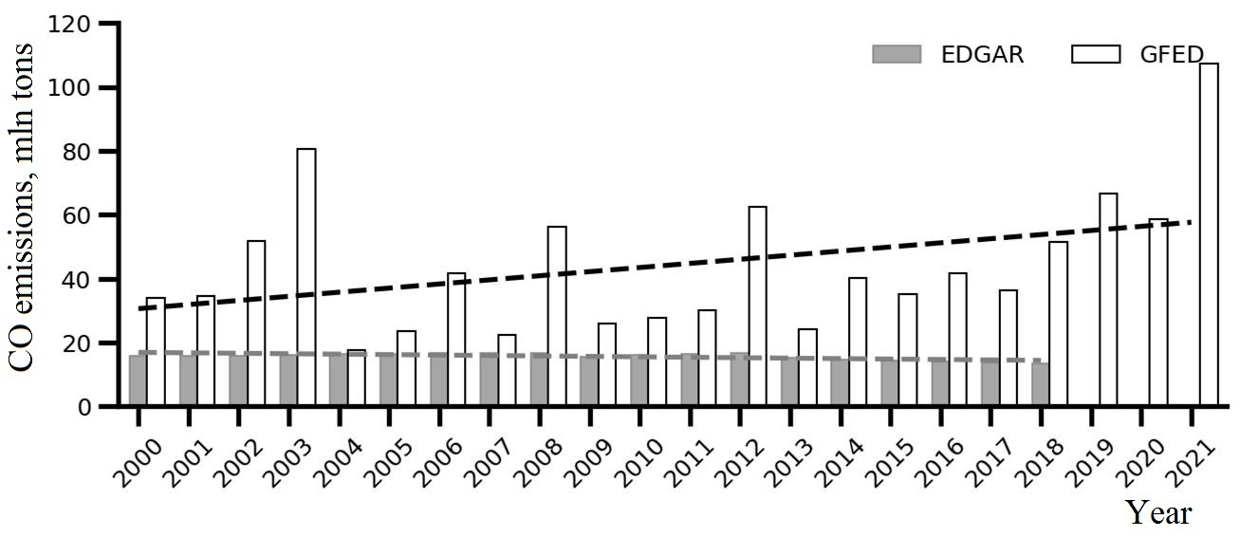
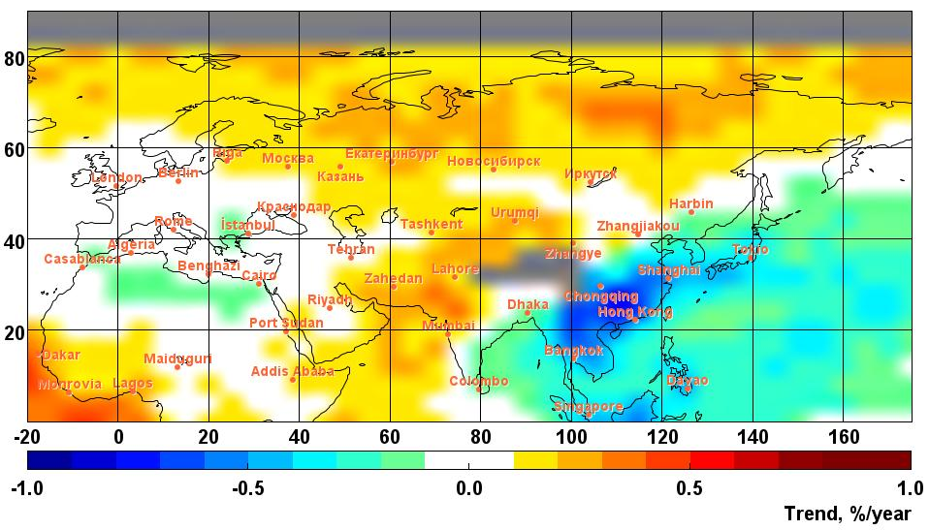
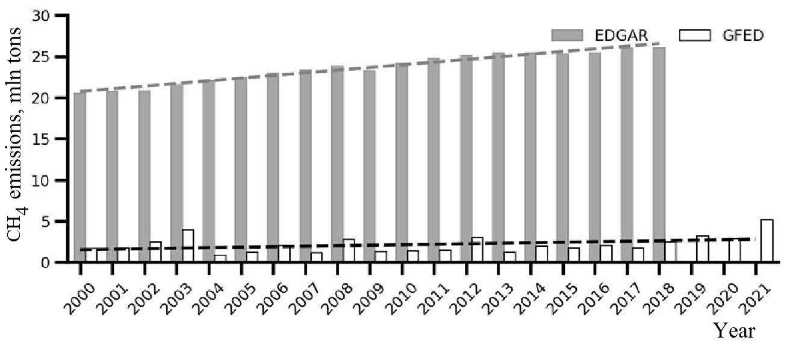
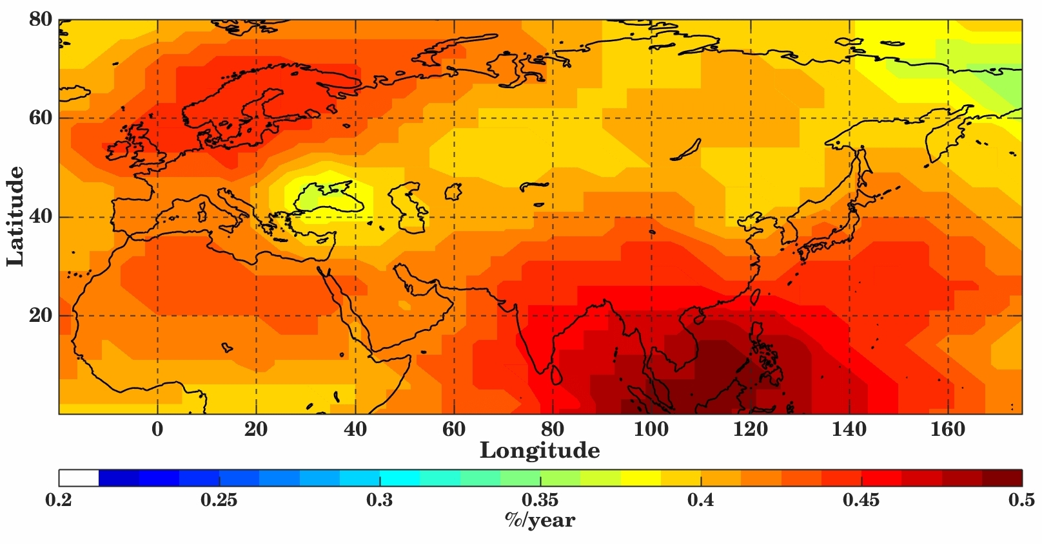
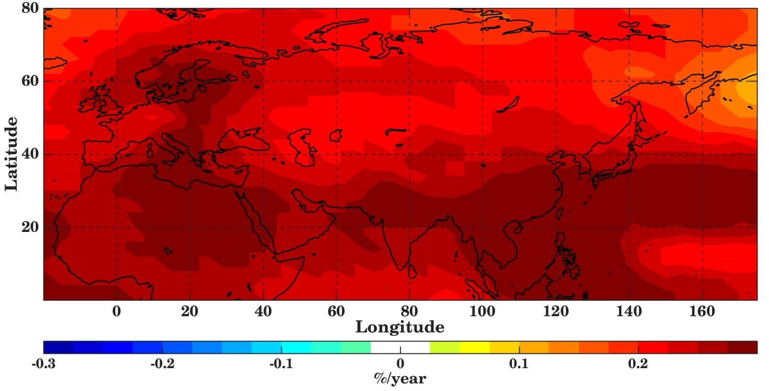
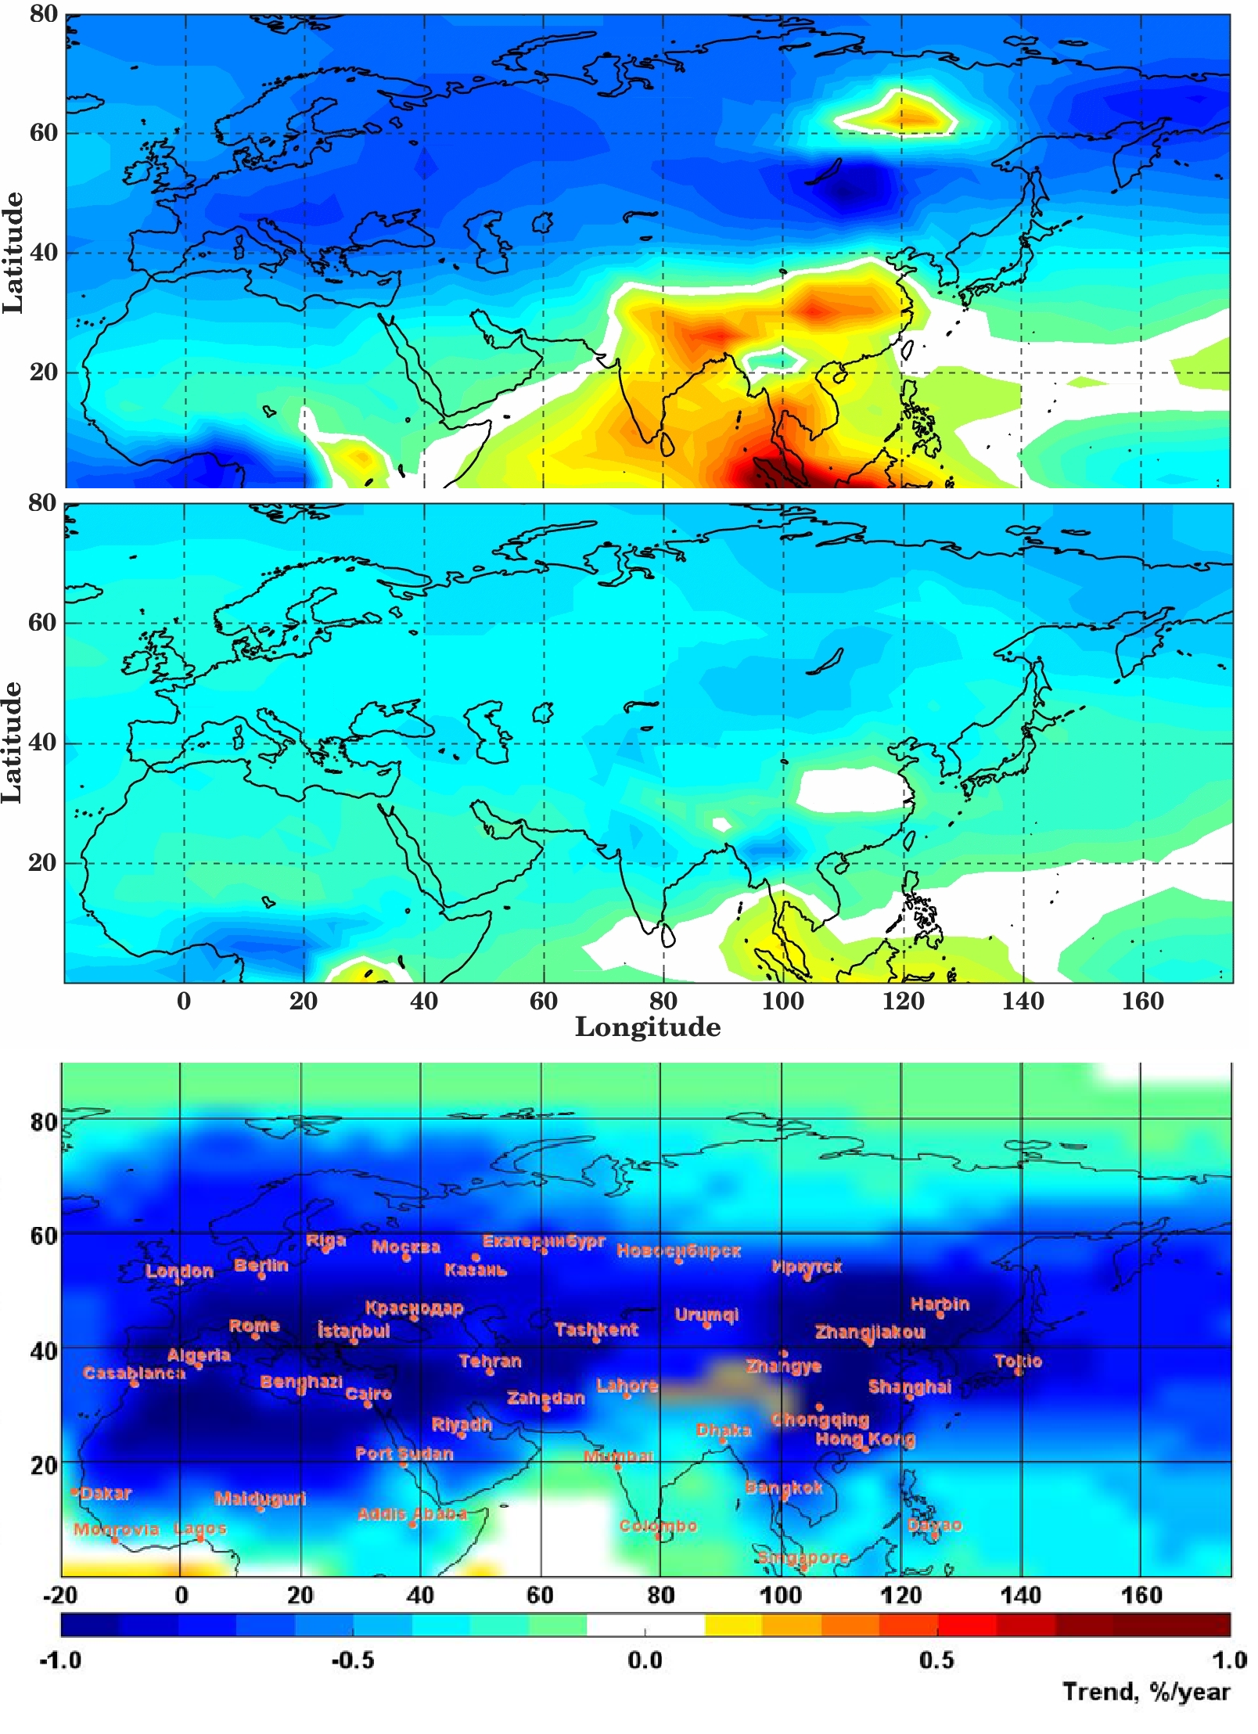
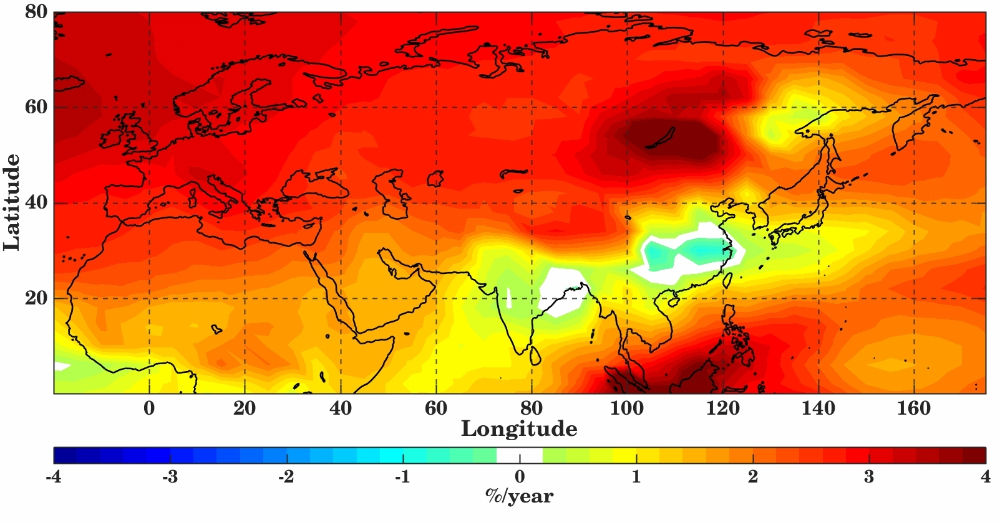
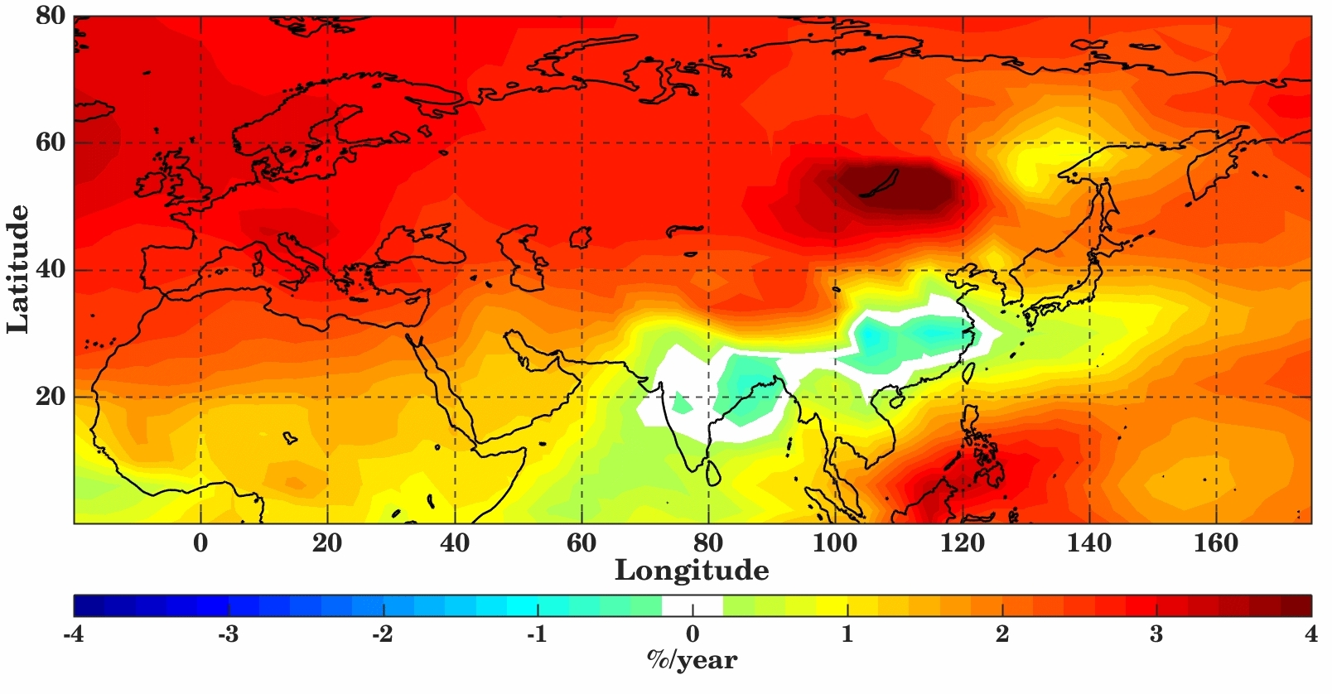
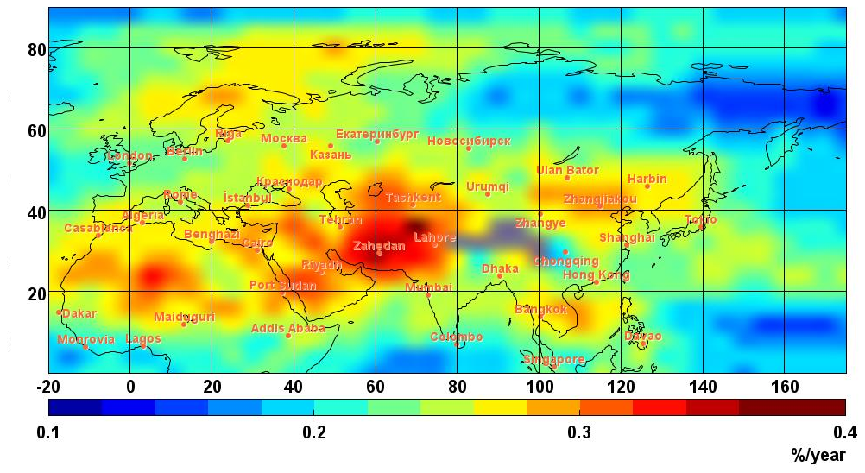
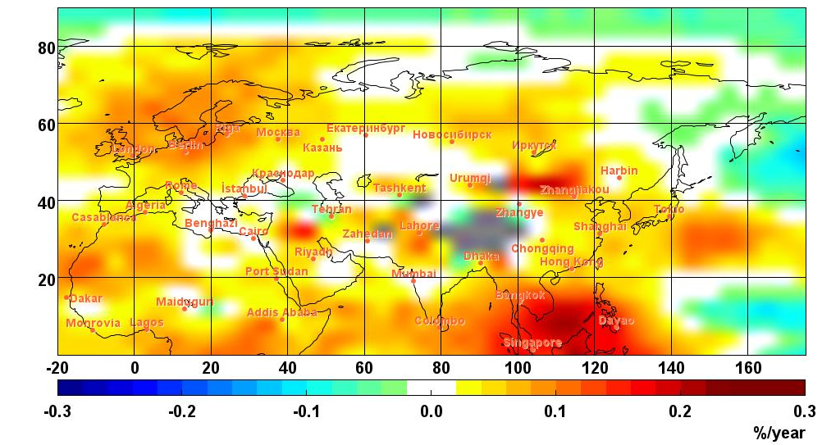
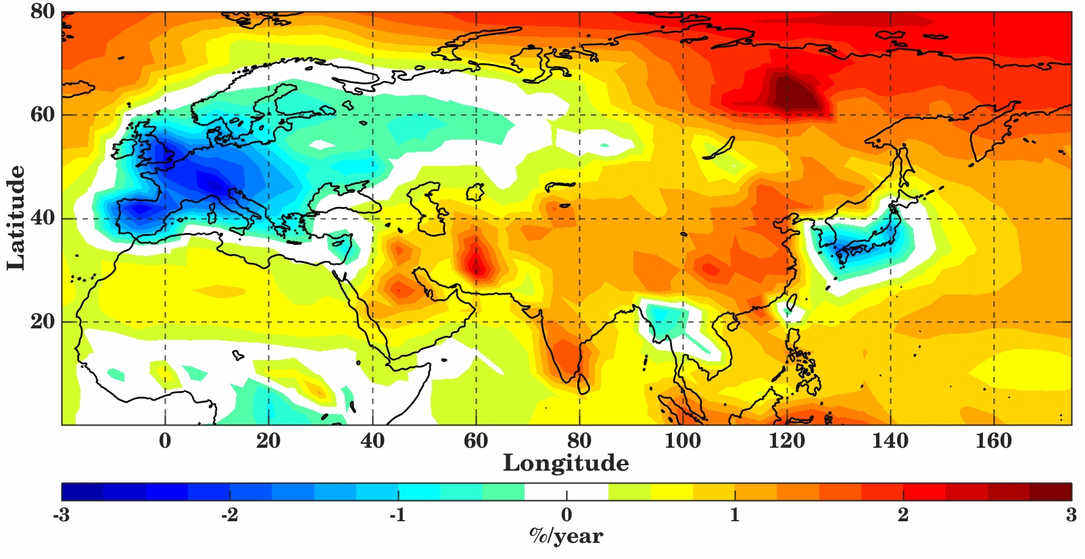
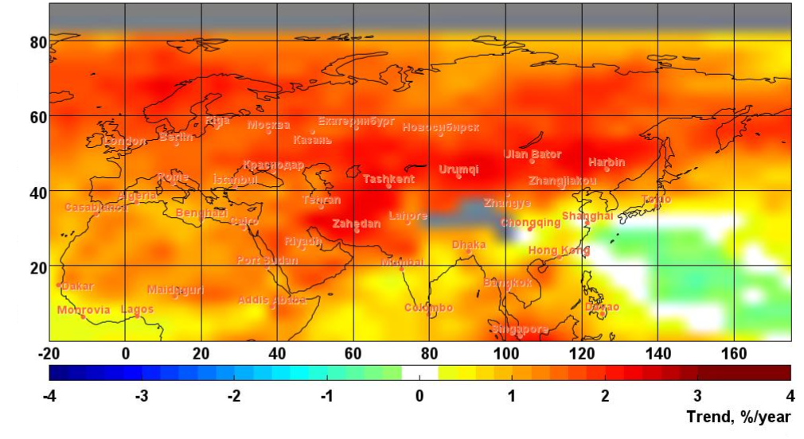
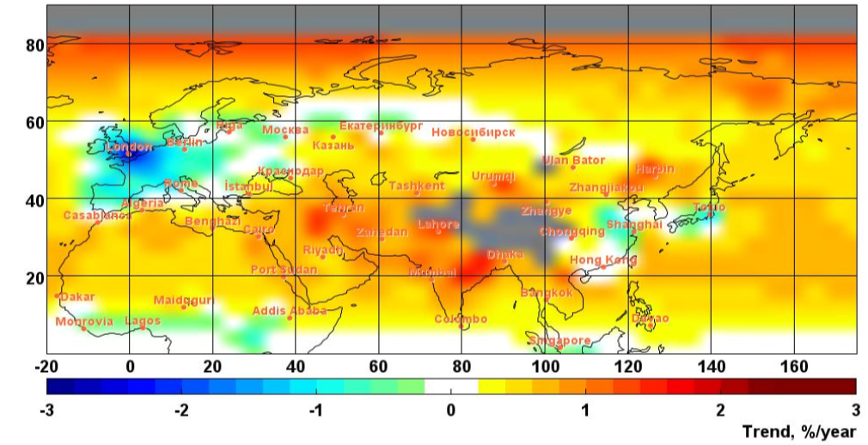
Trends of atmospheric composition over Eurasia and their response on global climate changes
V. S. Rakitin, A. I. Skorokhod, Yu. A. Shtabkin, N. S. Kirillova, E. I. Fedorova
A.M. Obukhov Institute of Atmospheric Physics RAS, Moscow, Russia
Corresponding email: vadim@ifaran.ru
EGU23-7178
Abstract
Introduction
However, after ≈ 2007-2008 CO TC trends have changed, see an example:
CO total column trends for Oct-Nov of 2008-2022 (according AIRS v6)
Based on the analysis of orbital measurements, as well as GEOS-Chem model calculations, a study of trends in the total content of CO, CH₄ and NO₂ in different periods and seasons of 2003-2022 was made for the Eurasia domain, -20°E - 180°E, 0°N - 80°N. Data from the AIRS (v6) and OMI (v3) instruments were used as orbital information.
Based on GEOS-Chem calculations with different scenarios for specifying anthropogenic emissions and emissions from fires, the response of CO trends to climate change was calculated.
Keywords: atmospheric composition, trends, response on global changes, orbital observations, GEOS-Chem modelling
Region “Northern Eurasia”, 27–180° E, 45–70° N.
What we know about modern tendencies in CO and СH₄ concentration trends and emissions?
Concentrations:
Decrease in CO after ≈ 2000
Growth in СH₄ after ≈ 2007
Anthropogenic emissions (EDGAR):
Reduction in CO
Increase in СH₄
Emissions from wild fires (both gases):
- Increase in Eastern Eurasia, decrease in Western Eurasia (include Europe)
What is the reason of such changes?
GEOS-Chem experiments were carried out and their results were compared with experimental estimates of the trend (according to data from orbital AIRS and OMI).
Model experiments (retrieves of trends in the total content of CO, CH₄ and NO₂)
Emissions: CEDS (anthropogenic), GFED4 (wild-fires), MEGAN (natural)
Meteorology: MERRA-2
Exp_0 – CO, CH₄ and NO₂ anthropogenic emissions and emissions from wild-fires were “default” (as is)
Exp_1 - CO anthropogenic and emissions from wild-fires were fixed on 2005 year level (the year with low activity of wild fires). CH₄ and NO₂ emissions were “default”
CO TC trend dynamics (changes) after 2008:
the difference between yearly trend (2008-2019) and trend (2003-2008) according AIRS v6
CH₄ TC trends for autumn months of 2008-2019:
Model overestimates the trend values
CH₄ TC trend dynamics (changes) after 2008:
the difference between yearly trend (2008-2019) and trend (2003-2008) according AIRS v6
CO TC yearly trends for 2003-2019 according model retrievals and orbital observations
GEOS-Chem, exp_0 (emissions ‘default”)
GEOS-Chem, exp_0 (emissions ‘default”)
GEOS-Chem, exp_0 (emissions “default”)
GEOS-Chem, exp_0 (emissions “default”)
GEOS-Chem, exp_1 (fixed emissions): response of climate changes
GEOS-Chem, exp_1 (fixed emissions): response of climate changes
AIRS
AIRS
NO₂ TC yearly trends, 2004-2019: model and experimental estimates are in agreement
GEOS-Chem, exp_0 (emissions ‘default”)
AIRS v6 observations
AIRS v6 observations
OMI
References:
1. IPCC, 2021: Climate Change 2021: The Physical Science Basis. Contribution of Working Group I to the Sixth Assessment Report of the Intergovernmental Panel on Climate Change. Cambridge University Press, Cambridge, United Kingdom and New York, NY, USA, In press, doi:10.1017/9781009157896.
2. Rakitin V.S., Skorokhod A.I., Pankratova N.V., et al. Recent changes of atmospheric composition in background and urban Eurasian regions in XXI-th century // 2020 IOP Conf. Ser.: Earth Environ. Sci. 606 012048 doi:10.1088/1755-1315/606/1/012048
3. Rakitin V.S, Elansky N.F., Wang P., et al. Changes In Trends Of Atmospheric Composition Over Urban And Background Regions Of Eurasia: Estimates Based On Spectroscopic Observations // Geography, Environment, Sustainability. 2018. V.11. № 2. P. 84−96.
4. Bey I., Jacob D.J., Yantosca R.M., Logan J.A., et al. Global modeling of tropospheric chemistry with assimilated meteorology: Model description and evaluation // J. Geophys. Res., 106, 23073–23095, doi:10.1029/2001JD000807. 2001.
5. Zhang L., Jacob D.J., Downey N.V., et al. Improved estimate of the policy–relevant background ozone in the United States using the GEOS–Chem global model with 1/2o x 2/3o horizontal resolution over North America // Atmospheric Environment. V. 45. I. 37. PP. 6769–6776. 2011.
6. Hoesly R.M., Smith S.J., Feng L., et al. Historical (1750–2014) anthropogenic emissions of reactive gases and aerosols from the Community Emissions Data System (CEDS) // Geosci. Model Dev., 11, 369–408, 2018.
7. van der Werf G.R., Randerson J.T., Giglio L., et al. Global fire emissions and the contribution of deforestation, savanna, forest, agricultural, and peat fires (1997–2009) // Atmos. Chem. Phys. 2010. V. 10. P. 11707 11735. doi:10.5194/acp1011707 2010.
8. Ed. by E.T. Olsen. AIRS/AMSU/HSB Version 6 Data Release User Guide. Version 1.2.1.
URL: https://docserver.gesdisc.eosdis.nasa.gov/repository/Mission/AIRS/3.3_ScienceDataProductDocumentation/3.3.4_ProductGenerationAlgorithms/V6_Data_Release_User_Guide.pdf
9. Krotkov N.A., Lamsal L.N., Celarier E.A., et al. The version 3 OMI NO2 standard product. Atmos. Meas. Tech. 2017, 10, 3133–3149.
Summary:
GEOS-Chem satisfactorily reproduced the trends of CO, CH₄ and NO₂
The response of CO trends on climate changes was estimated.
After ≈2007-2008 CO and CH₄ trends in uncontaminated areas of Eurasia have changed. In summer and autumn months, an increase in CO TC in most mid-and high-latitude regions of Europe and Asia, including the Arctic regions was obtained, as well as an increase in the growth rate of CH₄ in Northern Europe and in tropical and subtropical Eurasian regions.
One of possible reasons of positive dynamic in CO TC trends could be changes in the global photochemical system occurring against the global climate change, in particular, changes in the source/sink ratio for trace atmospheric gases and formation additional natural CO from CH₄ and NMHCs.
Acknowledgements
Contacts:
Dr. Vadim Rakitin,
Senior Researcher
e-mail: vadim@ifaran.ru
This work was supported by Russian Science Foundation under grant No 21-17- 00210

