Slide 1
Un-pinning of Antarctic Ice Shelves over the past 5 decades
Bertie Miles and Rob Bingham
Berite.miles@ed.ac.uk
Pine Island Ice Shelf
1973
1989
2000
2022
George VI Ice Shelf

Slide 2
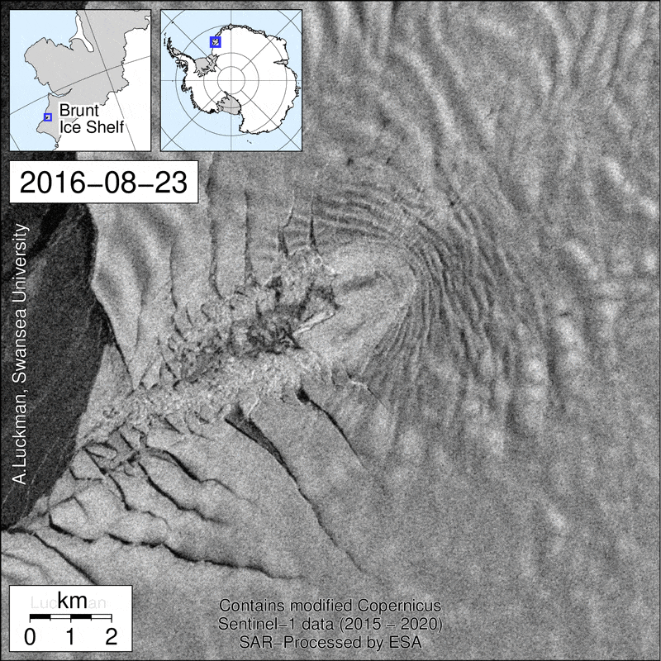
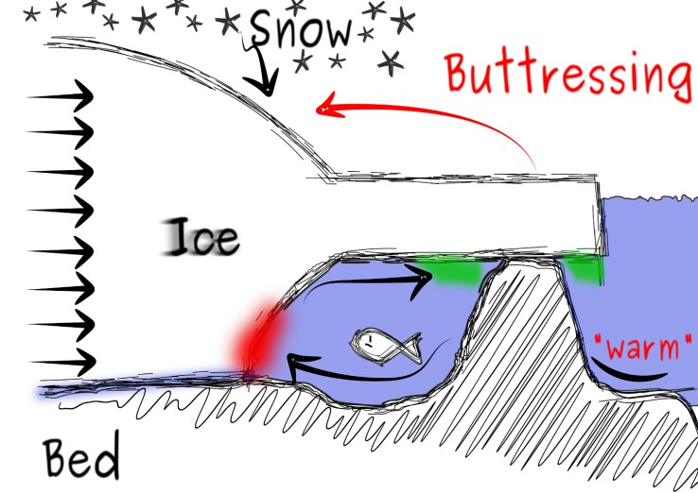
Pinning Points
Why are pinning points important?
Buttressing
Rifting/calving
Ocean circulation beneath ice shelves
Parts of the ice shelves that matter the most
Source: David Docquier - EGU Blog post
Pinning points form when ice shelves locally reground on bathymetric highs

Slide 3
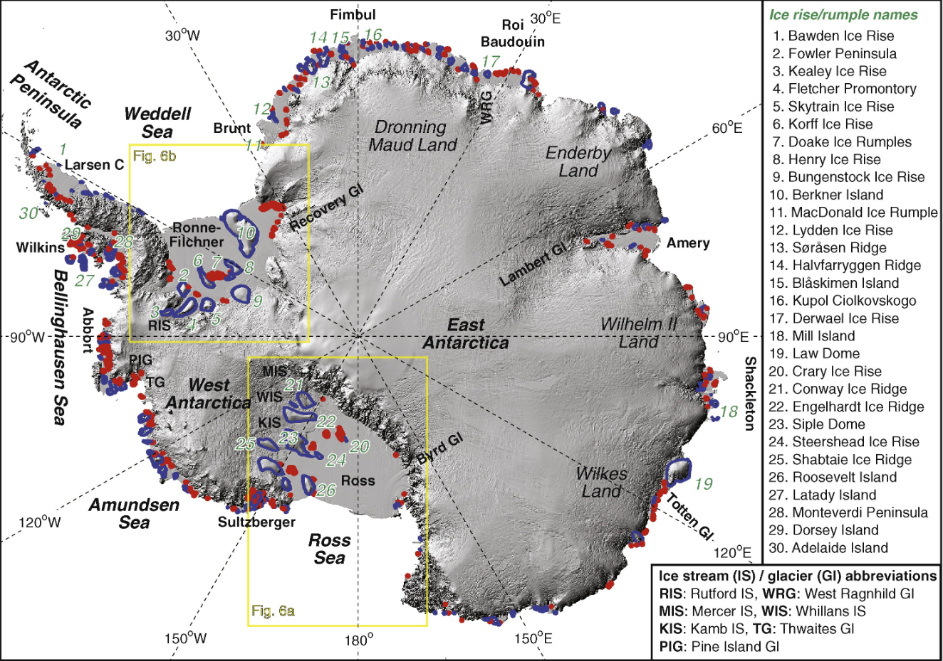
Hundreds of pinning points
Multiple pinning points on most ice shelves. Many not mapped.
But how is their interaction with ice shelves changing through time?
Matsuoka et al. (2015)

Slide 4
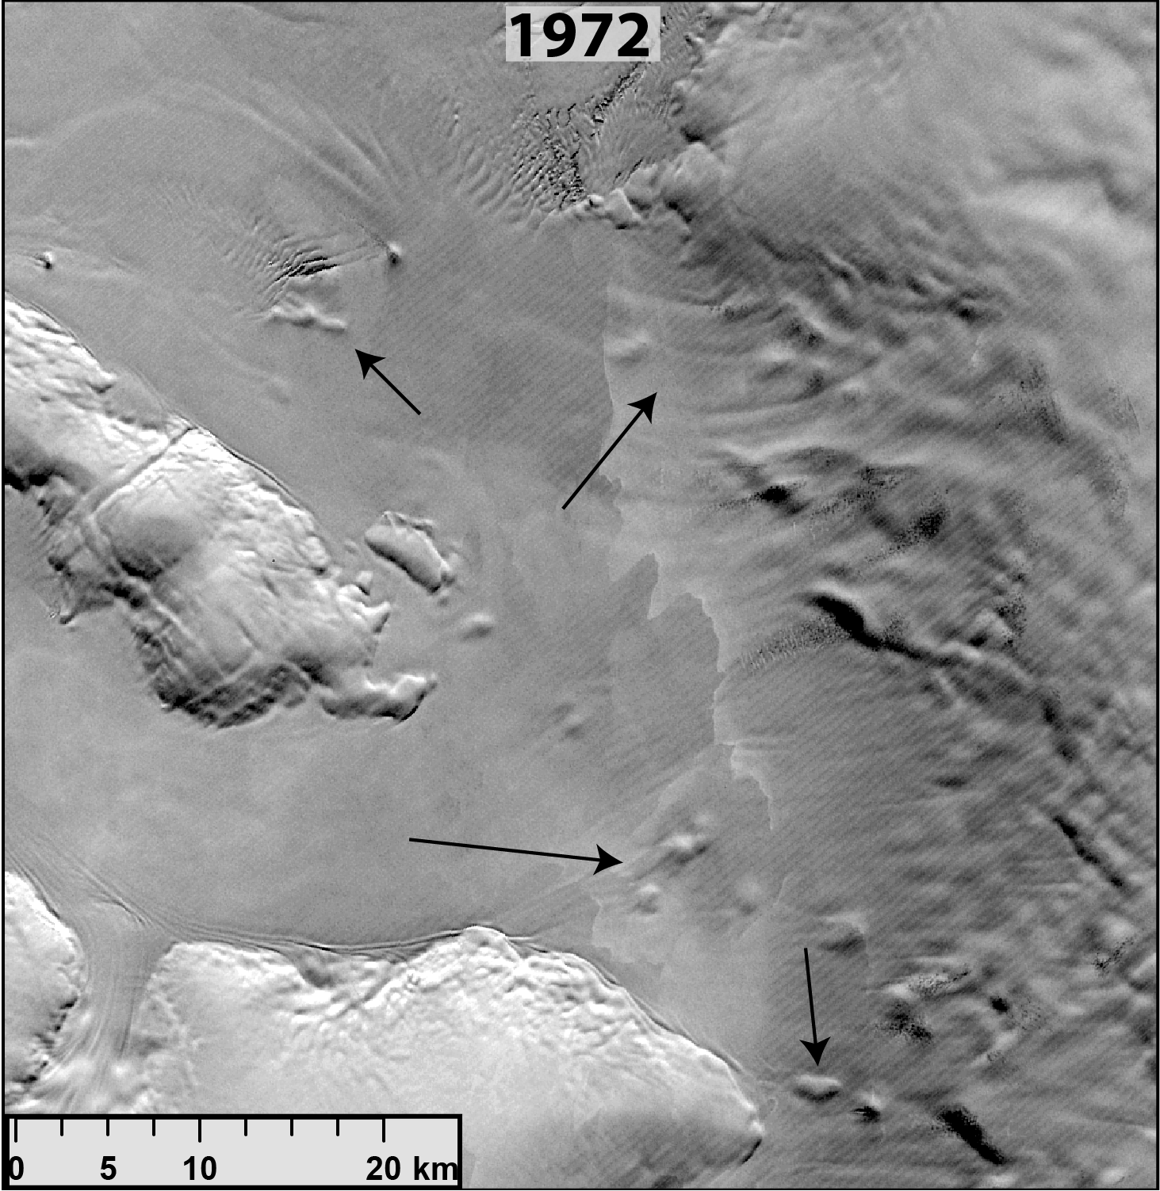
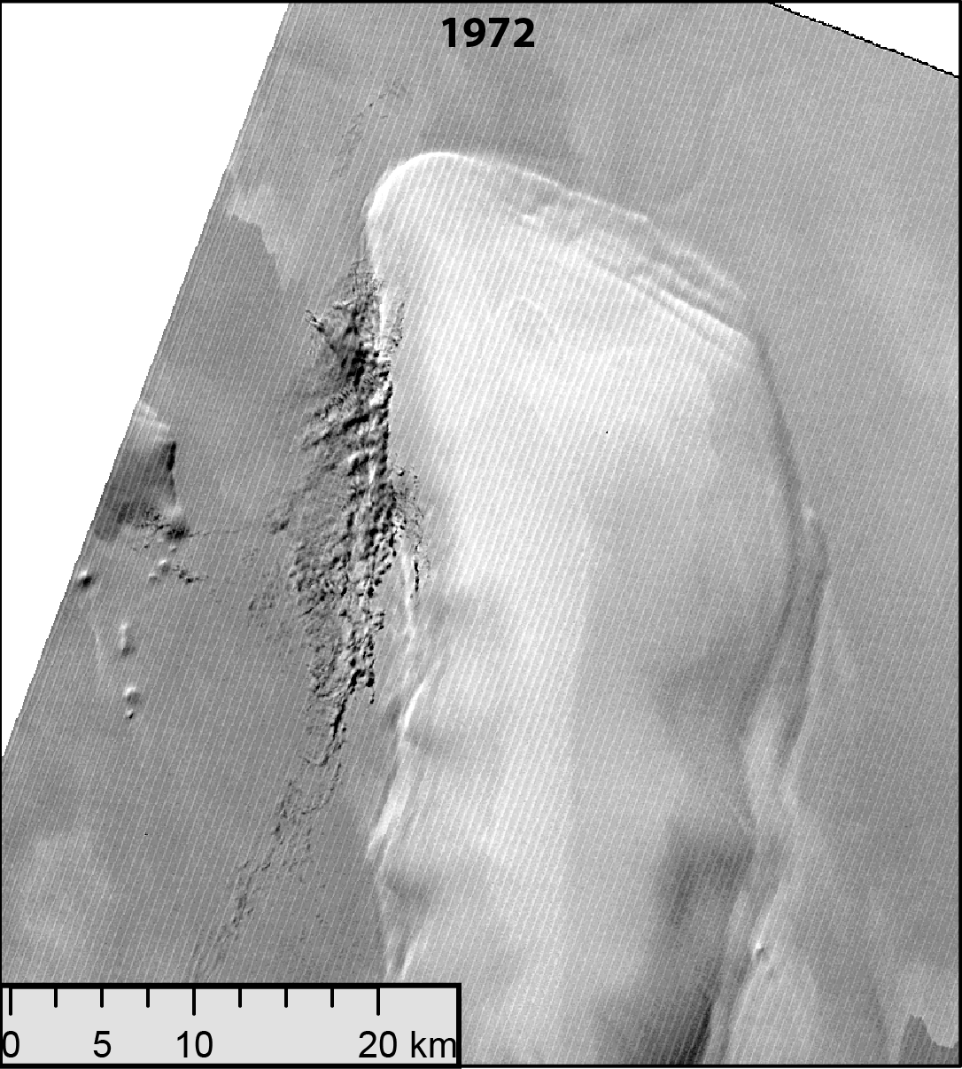
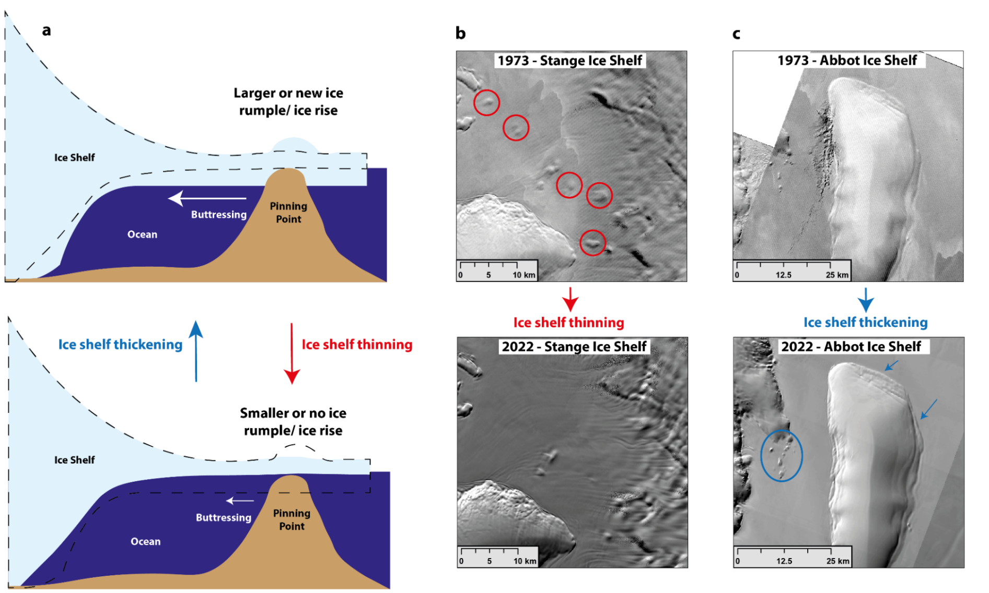
Pinning point change from optical imagery
Change in ice shelf thickness = change in surface expression of pinning point

Slide 5
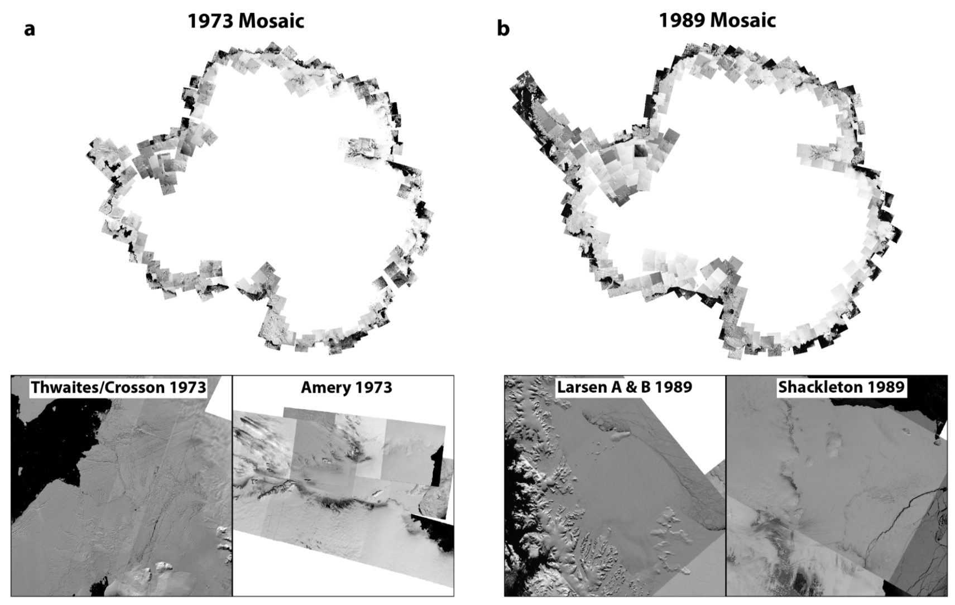
Landsat archive – extending the record change
1973 – New Landsat-1 mosaic
1989 – New Landsat-4/5 mosaic
2000 – LIMA mosaic
2021/2022 – Landsat 8/9
Pre-satellite altimetry
Satellite altimetry era
We use the entire Landsat archive to map change in surface expression of all pinning points

Slide 6
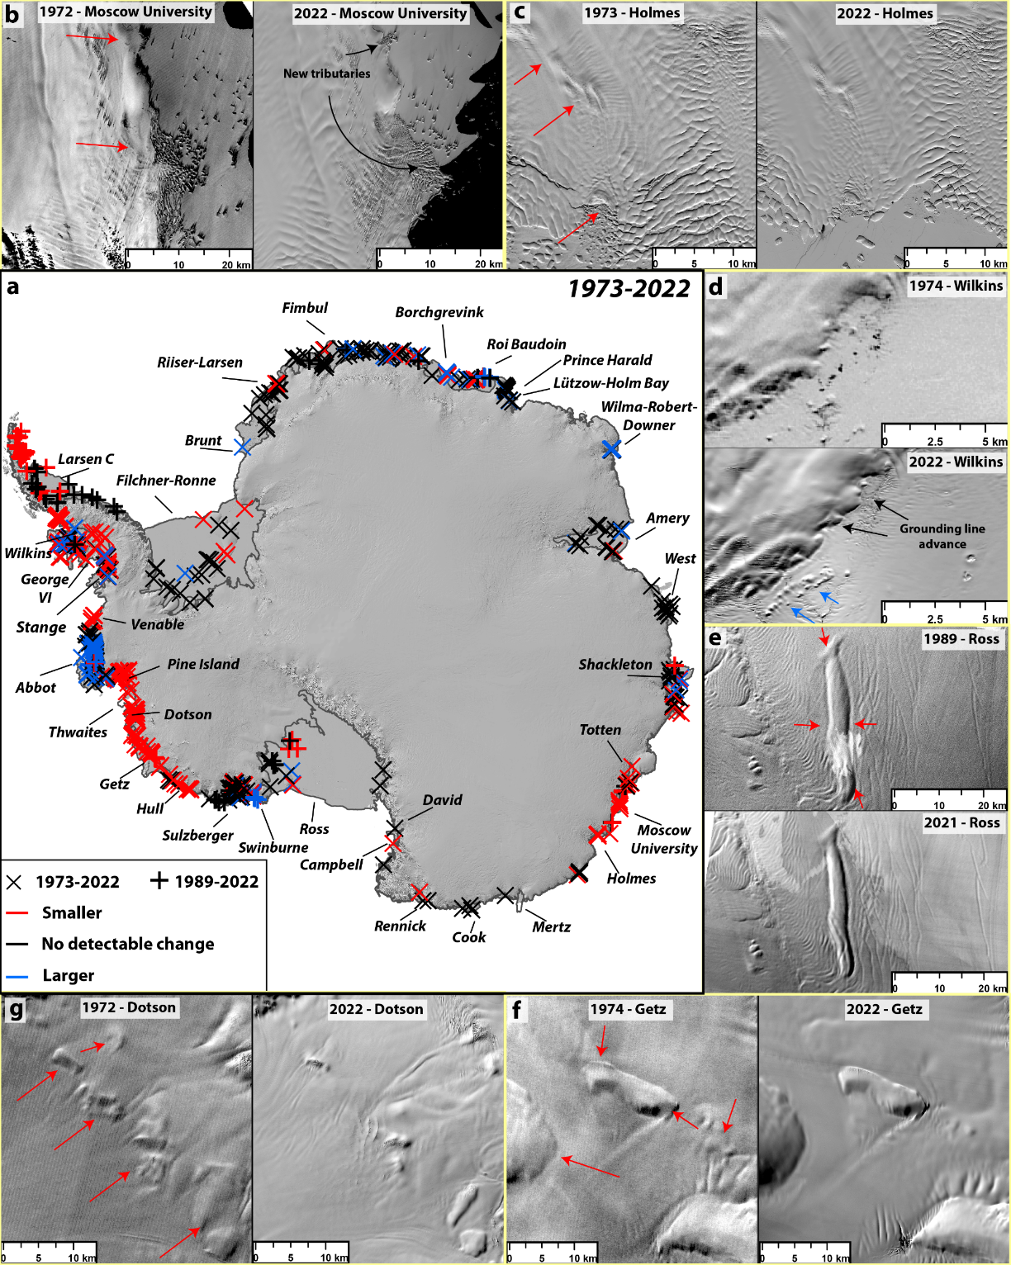
Pinning point change
Pattern of change largely reflects satellite altimetry trends, but there are some exceptions (e.g. Abbott)
Many pinning points have completely disappeared
But some regions of thickening and pinning point growth
Regions of limited change are important as well e.g. Dronning Maud Land

Slide 7
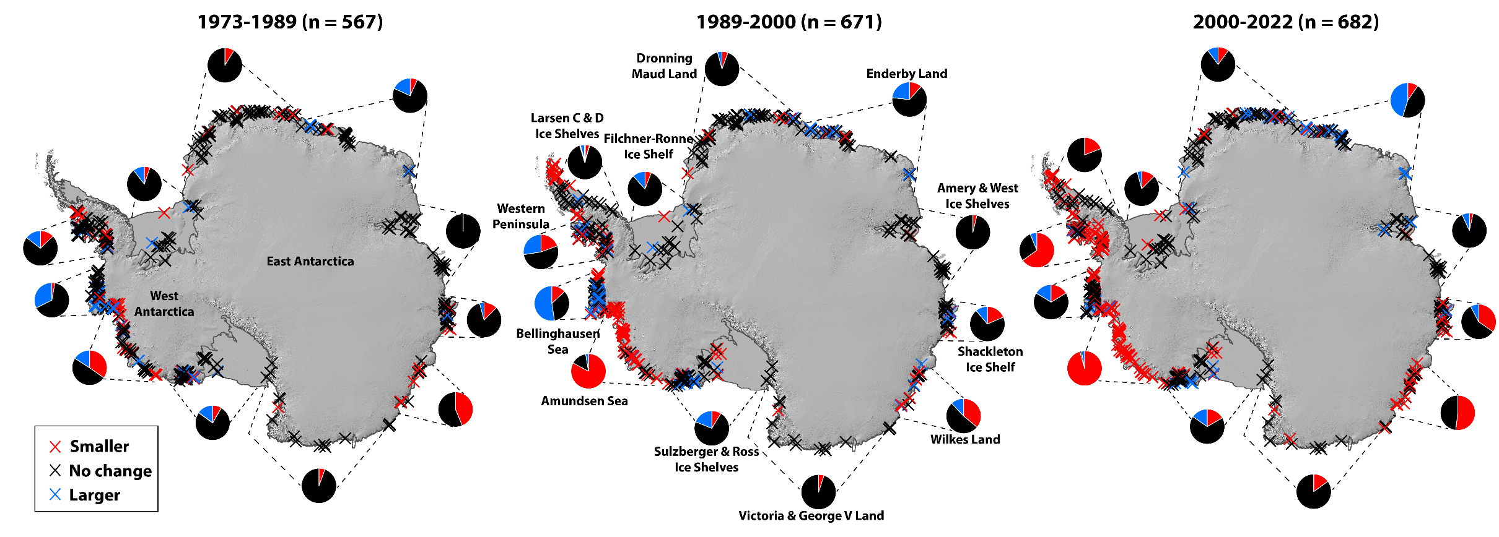
Pinning point change
15% reducing in size
25% reducing in size
37% reducing in size
Acceleration of pinning point loss →

Slide 8
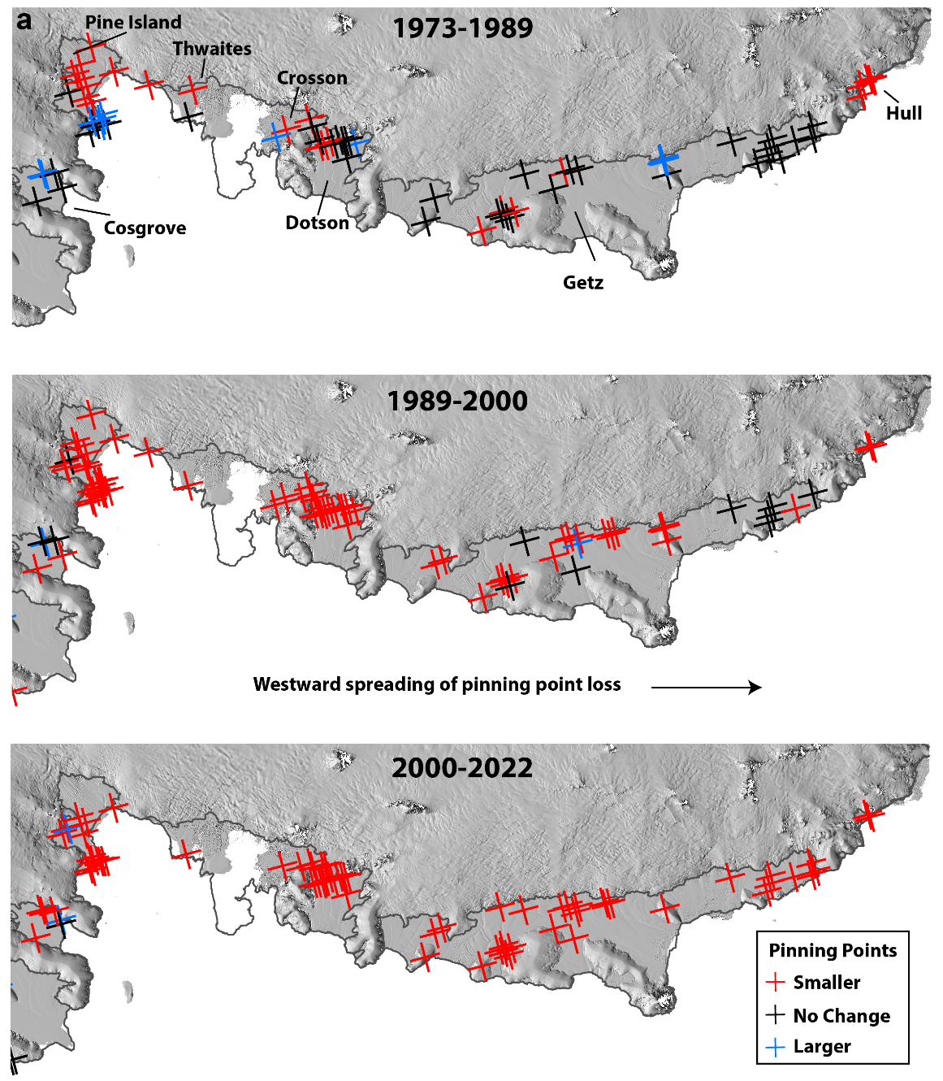
Amundsen Sea
Resolving timeline of change very important (modelling, ocean feedbacks, anthropogenic influence)
Relatively limited change in the 1970s and 1980s.
Has this been driven more by ocean variability, or other feedbacks (e.g. meltwater input)?
Data from Jenkins et al. (2018)

Slide 9
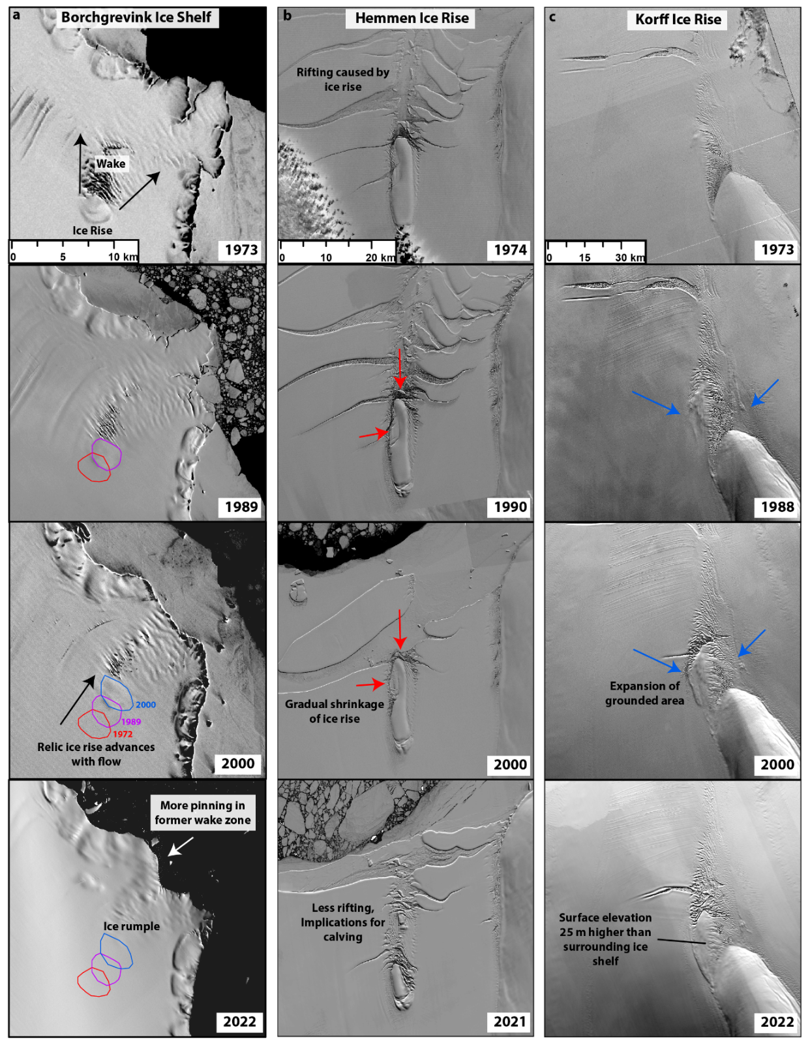
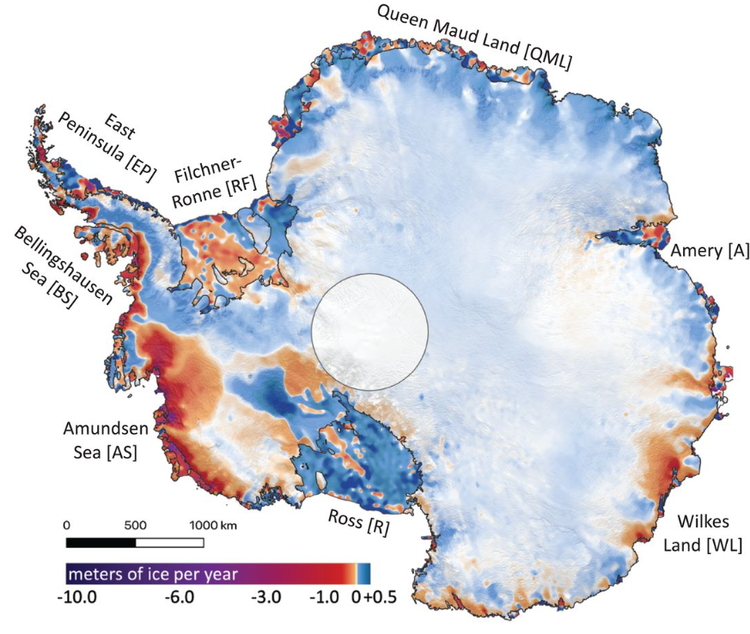
Rapidly changing Ice Rises
Hemmen
Borchgrevink
Korff
2003-2019 (Smith et al., 2020)
Large ice rises can evolve over short decadal timescales, even in regions with limited modern change in ice shelf thickness

Slide 10
Conclusion
There has been an acceleration in pinning point loss over the past 50 years
Relatively limited change in the 1970s and 1980s
Widespread pinning point loss in Amundsen sector, Western Peninsula and Wilkes Land
Evidence of rapidly changing ice rises (growth and decay)

