Slide 1
Session GMPV8.1 - Volcanic processes: tectonics, deformation, geodesy, unrest
Dike-arrest vs dike-propagation and associated surface stress: an example from the Younger Stampar eruption (13th century), Reykjanes Peninsula, SW Iceland
Noemi Corti¹, Fabio L. Bonali^{1,2}, Elena Russo^{1,2}, Federico Pasquaré Mariotto³, Agust Gudmundsson⁴, Kyriaki Drymoni¹, Alessandro Tibaldi^{1,2}, Rosario Esposito¹, Alessandro Cavallo¹
1. Department of Earth and Environmental Sciences, University of Milan-Bicocca, 20126 Milan, Italy;
2. CRUST-Interuniversity Center for 3D Seismotectonics with Territorial Applications, 66100 Chieti Scalo, Italy;
3. Department of Human and Innovation Sciences, Insubria University, Como, Italy;
4. Department of Earth Sciences, Queen's Building, Royal Holloway University of London, Egham TW20 0EX, UK.
Abstract QR code
1

Slide 2
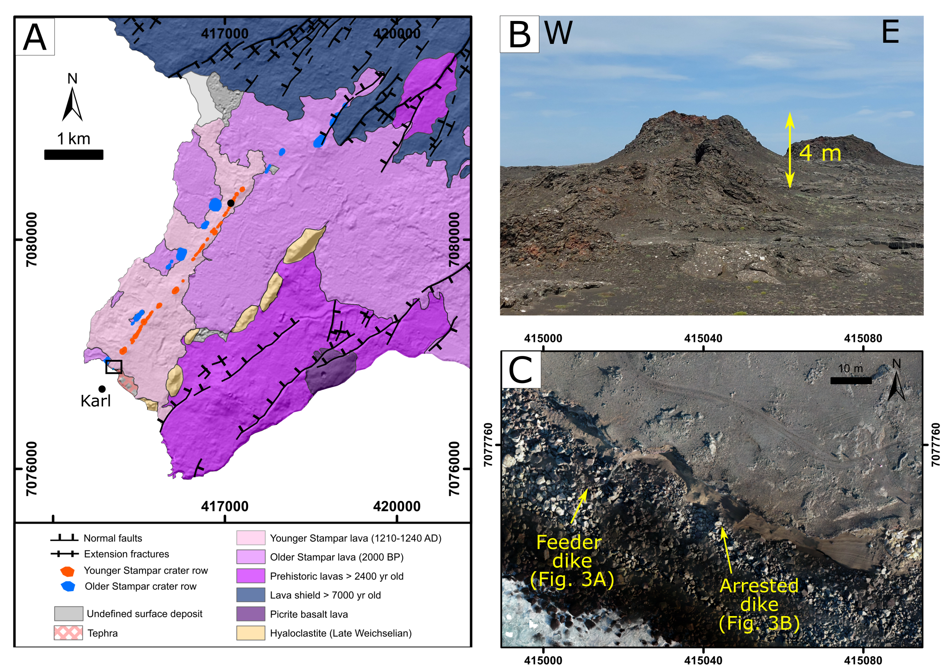
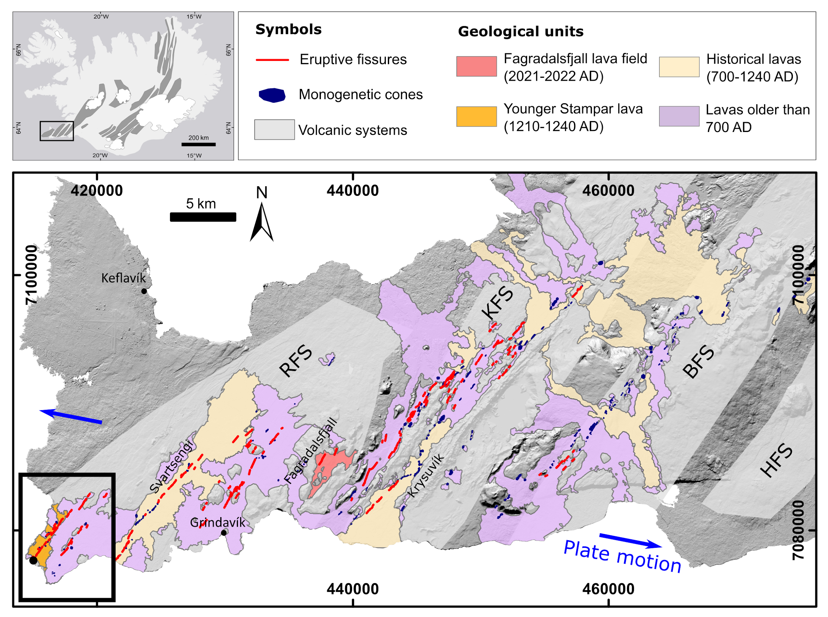
Geological Setting
Reykjanes Peninsula (SW Iceland)
Younger Stampar eruption,
1210-1240 AD (Saemundsson et al., 2016)
Before the volcanic activity in 2021 and 2022 at Fagradalsfjall, the latest volcanic episode took place between 700 and 1240 AD (Saemundsson et al., 2016, 2020).
2

Slide 3
Research Goals and Methodology
Feeder dike
Goals
Understanding what caused the arrest of one dike, located 30 m away from a feeder dike;
Understanding the absence of faults or tension fractures at the surface, even if the dike arrested at a very shallow depth (5 m below the surface).
Methodology
Remote sensing from aerial photos (source: National Land Survey of Iceland https://www.lmi.is/), to collect structural data along the Stampar crater rows;
UAV-SfM to reconstruct the 3D model of the dikes outcrop (1120 drone-collected pictures, Model resolution: 8 mm/pixel);
Field analysis;
Finite Element Method (FEM) modelling through COMSOL Multiphysics®.
Arrested dike
3

Slide 4
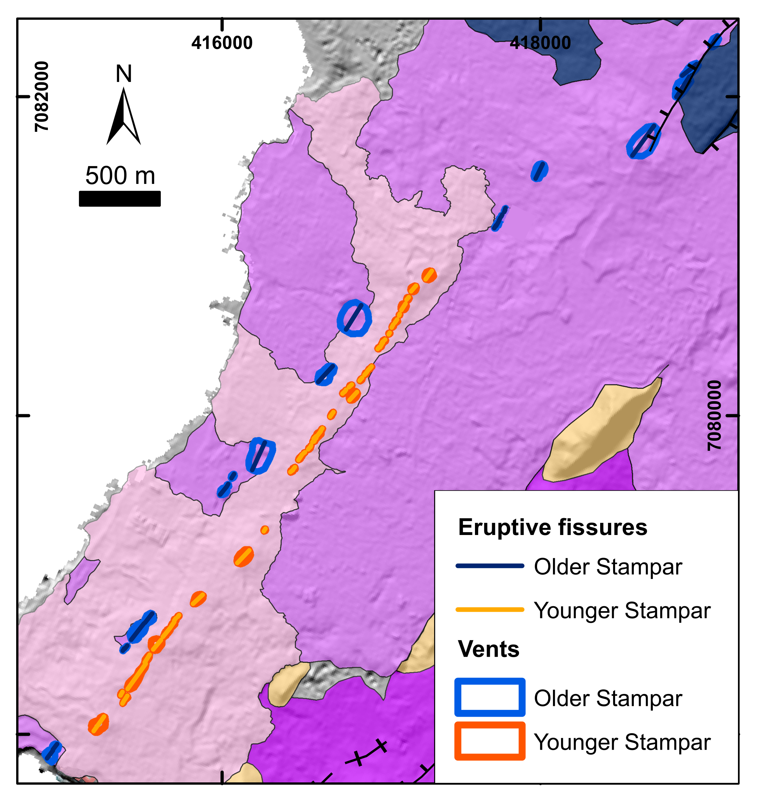
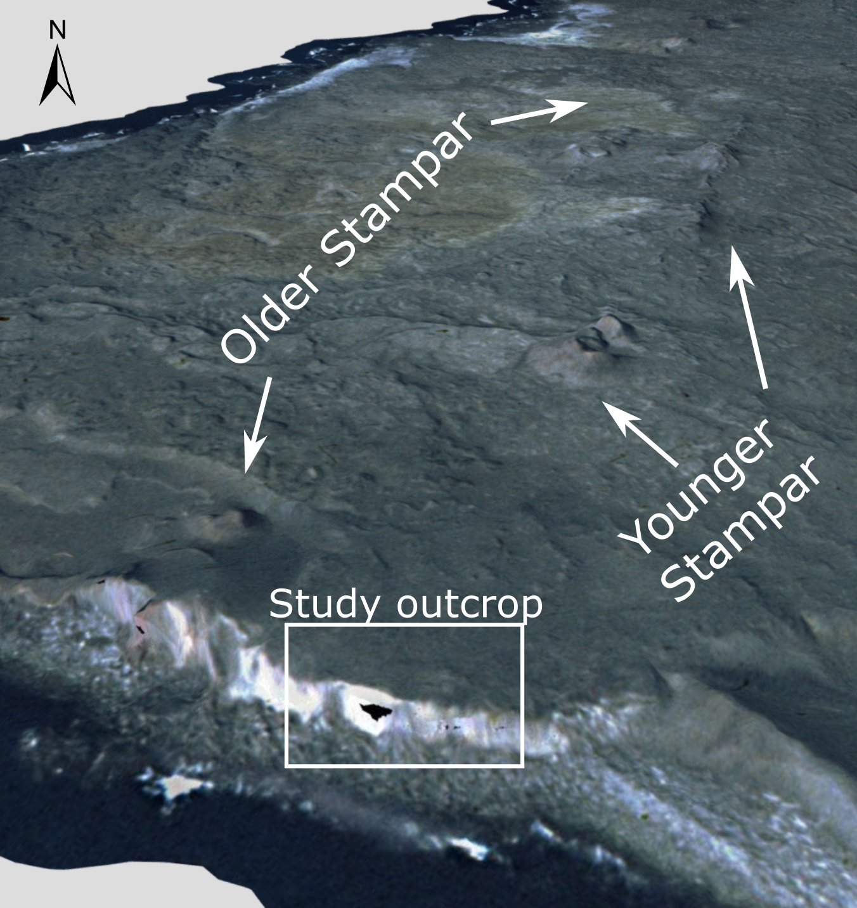
Results: structural data
Stampar crater rows
All vents belonging to the Older and the Younger Stampar crater rows were identified;
Based on the elongation of the cones (Tibaldi et al., 2013), 23 eruptive fissures were identified for the Older Stampar, and 49 for the Younger Stampar crater row;
Both crater rows present a general NE-trending alignment;
Apart from the eruptive fissure itself, no tension fractures or normal faults are visible at the surface, as can be observed in the 3D model.
Range: N21°E -N51°E
Av. strike: N33.2°E
Range: N23°E -N50°E
Av. strike: N38.8°E
4

Slide 5
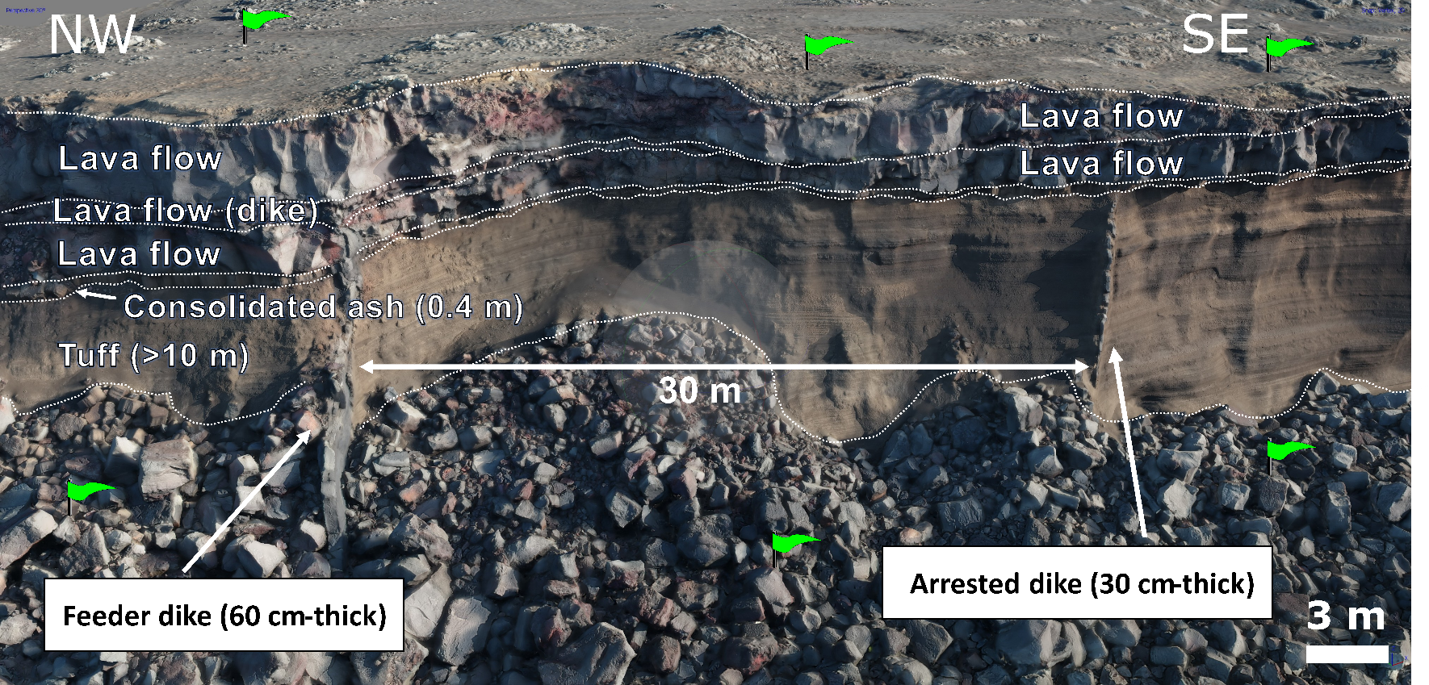
Results: structural data
Studied outcrop and dikes
Feeder dike
Max. thickness: 0.6 m (at the base);
Thickness decreases approaching the tip;
The segment is always vertical or subvertical.
Arrested dike
Max. thickness: 0.3 m (at the base);
The dike is vertical up to the last 2 m at the top, where it starts deflecting, up to 70° at the tip.
Range: N27°E –N47°E
Av. strike: N36.2°E
Range: N18°E –N47°E
Av. strike: N32.2°E
5

Slide 6
Methodology: numerical models
We ran numerical models using FEM software COMSOL Multiphysics ® (v. 5.6);
We discretized model by a very fine triangular meshing, with a minimum element quality of 0.4534 m and 1100 boundary triangular elements;
We modeled a basaltic dike as a cavity with an internal overpressure (P₀) in an elastic layered medium, based on our observations in the field:
Poisson’s ratio (ν) = 0.25
Density (ρ): Lavas=2600 kg m⁻³, and Tuff=2000 kg m⁻³
Young’s modulus (E) based on typical values from the literature (Gudmundsson et al., 2011, 2020);
We fastened all models in the two bottom corners to avoid rigid-body rotation and translation;
We plotted the tensile stress values (σ₃), the shear stress (τ), and we produced 1D graphs of tensile and von Mises stresses at the surface.
2 m
2.6 m
0.4 m
10 m
6

Slide 7
Methodology: numerical models
We conducted sensitivity analyses to investigate how the subsequent parameters could affect the arrest of the dike and the brittle deformation at the surface
Setting I
Investigating dike propagation in the tuff layer
three depths within the tuff
P₀=2-4 MPa
extensional stress field (1 MPa)
Setting II
Exploring the mechanical properties (stiffness) of the lava and tuff layers
E of tuff = 1-3 GPa
E of lava layers = 7-15 GPa
Setting III
Evaluating the influence of compression caused by the previous dike intrusion (feeder) (Gudmundsson, 2017)
P₀=2-4 MPa
compressional stress field (2-4 MPa)
2 m
2.6 m
0.4 m
10 m
7

Slide 8
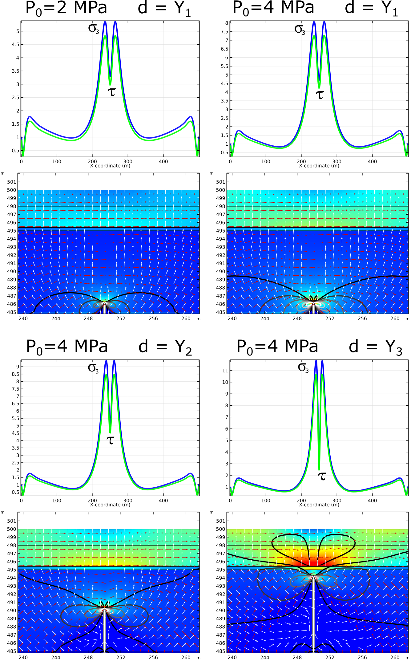
Results: numerical models
All the models are subject to an extensional stress field of 1 MPa
Regardless of dike overpressure, σ₁ is vertical and σ₃ is horizontal at the dike tip: no stress rotation occurs;
While increasing the overpressure, the magnitude of stresses at the tip of the dike and at the surface increases;
While the dike moves closer to the lava/tuff contact, the concentration of tensile stress decreases at the dike tip and increases in the stiffer lava layers.
8

Slide 9
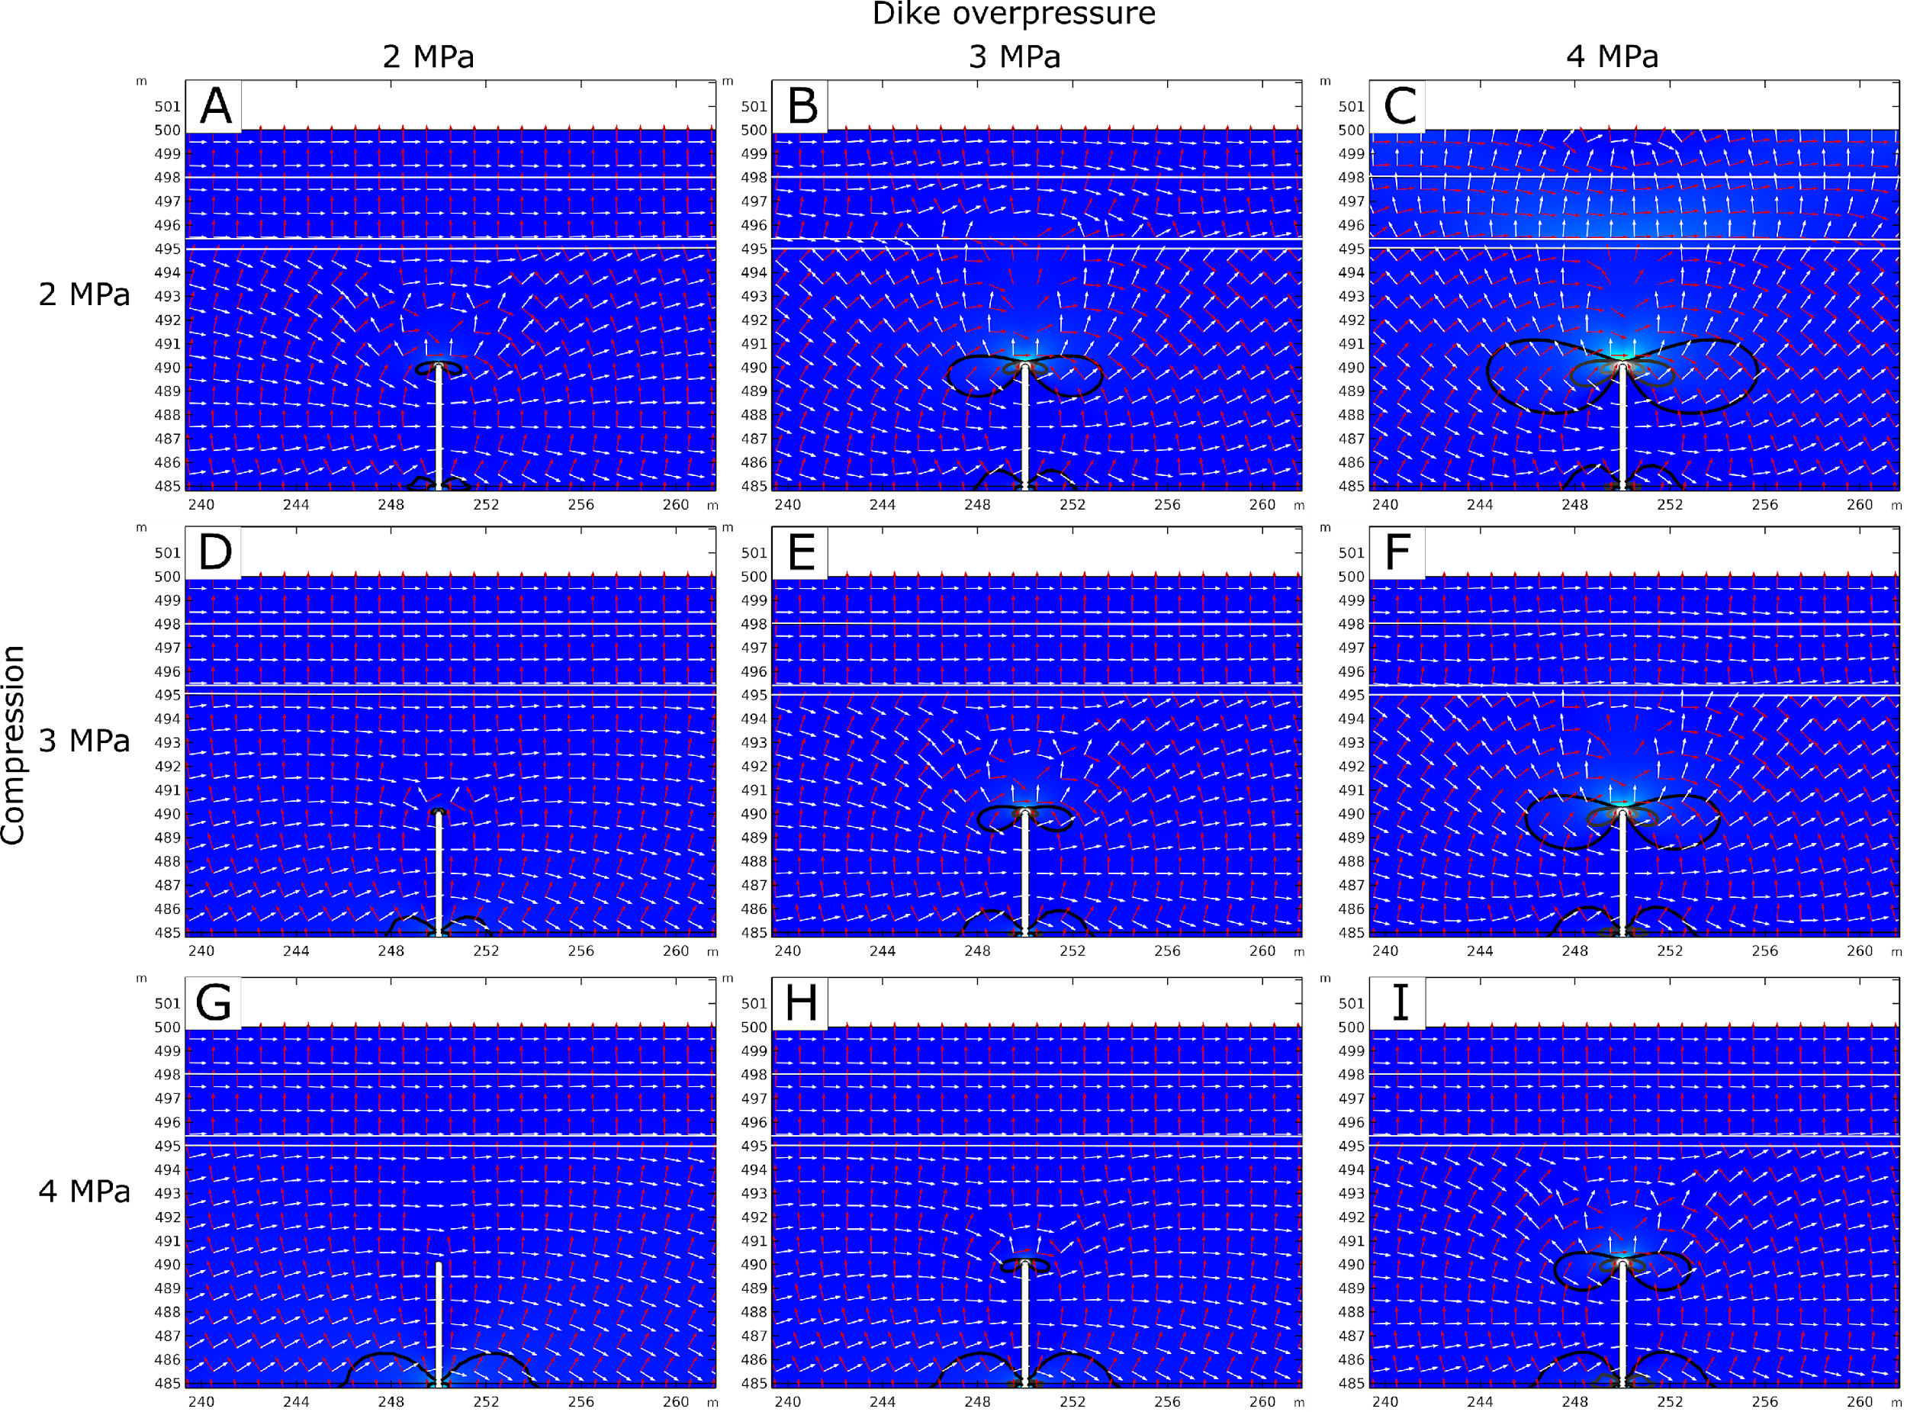
Results: numerical models
Evaluating the influence of compression caused by the previous dike intrusion (feeder) (Gudmundsson, 2017).
A decrease of tensile stress at the tip of the dike is observed;
Whenever compression is equal to or greater than the dike overpressure, the dike is likely to be arrested also because of a 90° rotation of σ₁ and σ₃.
9

Slide 10
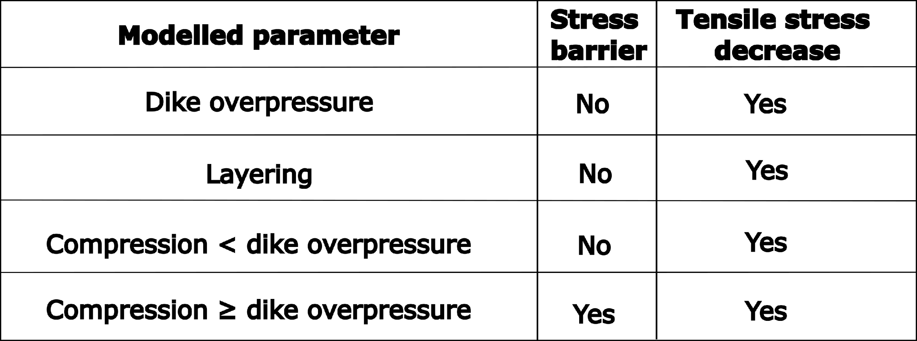
Discussion
The average orientation of the Younger Stampar eruptive fissure is consistent with that of the Older Stampar crater row, and with the average orientation of the eruptive fissures associated with other historical and prehistoric eruptions (e.g. N40°E)(Clifton and Schlische, 2003), like the 2021-2022 Fagradalsfjall event (Barsotti et al., 2022; Flòvenz et al., 2022; Sigmundsson et al., 2022);
Dike arrest may be caused by stress barriers, which consist of a local stress field that is unfavorable to fractures propagation, or by a tensile stress decrease at the tip of the dike, which inhibits propagation , and could also explain the absence of brittle deformation at the surface.
In our numerical models, we have investigated the influence of the following factors on dike arrest and the associated absence of brittle deformation:
10

Slide 11
Conclusions
By integrating fieldwork and UAV surveys, we have been able to study the crater rows associated to the Stampar eruptions (SW Iceland) as well as two dikes cropping out along the cliff. One of these dikes was arrested at a depth of only 5 meters without causing any kind of brittle deformation at the surface.
Our structural analyses indicate that the orientation of the Stampar crater rows is consistent in strike with that of the volcanic system of the Reykjanes Peninsula, as well as with other historic and prehistoric eruptive fissures in the area.
Our numerical models indicate that the layering and the dissimilar mechanical properties of the host rock could explain the arrest of the dike and the absence of brittle deformation at and above its tip. Specifically, the presence of a stiffer layer above a softer one may lead to a decrease in tensile stress concentration at the dike tip, and an increase in the upper layer, once the dike gets closer to the stiff/soft contact.
The horizontal compressive stress caused by the previous intrusion of the nearby feeder dike, in turn, could be a contributing factor for the very low overpressure of the arrested as it approached the tuff-lava contact, ultimately leading to its arrest at the contact. When the stiffer lava layer is dissected by the feeder dike, compression concentrates in the lava due to its high stiffness, favoring the arrest of the dike at the contact.
Our findings may have significant implications to other volcanic areas in Iceland and across the globe.
11

Slide 12
References
Barsotti, S., Parks, M. M., Pfeffer, M. A., Óladóttir, B. A., Barnie, T., Titos, M. M., et al. (2022). The Eruption in Fagradalsfjall (2021, Iceland): How the Operational Monitoring and The Volcanic Hazard Assessment Contributed to Its Safe Access. Research Square, DOI: 10.21203/rs.3.rs-1453832/v1
Clifton, A. E., & Schlische, R. W. (2003). Fracture populations on the Reykjanes Peninsula, Iceland: Comparison with experimental clay models of oblique rifting. Journal of Geophysical Research: Solid Earth, 108(B2).
Flóvenz, Ó. G., Wang, R., Hersir, G. P., Dahm, T., Hainzl, S., Vassileva, M., et al. (2022). Cyclical geothermal unrest as a precursor to Iceland’s 2021 Fagradalsfjall eruption. Nature Geoscience, 15(5), 397-404.
Gudmundsson, A. (2011). Rock fractures in geological processes. Cambridge University Press.
Gudmundsson, A. (2017). The glorious geology of Iceland's golden circle (p. 334). Cham, Switzerland: Springer International Publishing.
Gudmundsson, A. (2020). Volcanotectonics: Understanding the structure, deformation and dynamics of volcanoes. Cambridge University Press.
Saemundsson, K.; Sigurgeirsson, M. Á., Hjartarson, A.; Kaldal, I.; Kristinsson, S.G. (2016) Geological Map of Southwest Iceland, 1:100 000 (2nd ed.). Reykjavík: Iceland GeoSurvey.
Sæmundsson, K., Sigurgeirsson, M. Á., & Friðleifsson, G. Ó. (2020). Geology and structure of the Reykjanes volcanic system, Iceland. Journal of Volcanology and Geothermal Research, 391, 106501.
Sigmundsson, F., Parks, M., Hooper, A., Geirsson, H., Vogfjörd, K. S., Drouin, V., ... & Ágústsdóttir, T. (2022). Deformation and seismicity decline before the 2021 Fagradalsfjall eruption. Nature, 609(7927), 523-528.
Tibaldi, A., Bonali, F. L., Pasquaré, F. A., Rust, D., Cavallo, A., & D’urso, A. (2013). Structure of regional dykes and local cone sheets in the Midhyrna-Lysuskard area, Snaefellsnes Peninsula (NW Iceland). Bulletin of volcanology, 75(11), 1-16.
THANK YOU FOR YOUR ATTENTION!
12

