Slide 1
Global climate simulations of boundary-layer winds with a higher order parametrization scheme
Emanuele S. Gentile*, Ming Zhao*,
Vince Larson**, Colin Zarzycki***
Princeton University GFDL/NOAA*, University of Wisconsin–Milwaukee**, Penn State University ***
26 April 2023, Vienna, EGU23

Slide 2
Background: the GFDL climate model
Zhao et al. (2022)
Operational GFDL atmospheric climate model AM4 is a robust model
Typical General Circulation Model biases such as equatorward displacement of midlatitude westerlies does not occur
Annual mean stress is in good agreement with CMIP5 spread and reanalysis but seasonal biases exist in AM4
Part of AM4 biases are likely linked to modelling of momentum transport in boundary layer
Zonal wind-speed
AM4 annual mean
stress well constrained also
in tropics, equator and southern ocean

Slide 3
Research question
What is the impact of parametrizing the boundary-layer and cloud turbulence with a higher order scheme in global climate model GFDL-AM4 simulations of boundary-layer winds?
Cloud Layers Unified By Binormals (CLUBB) has been selected as the higher-order parametrization scheme

Slide 4
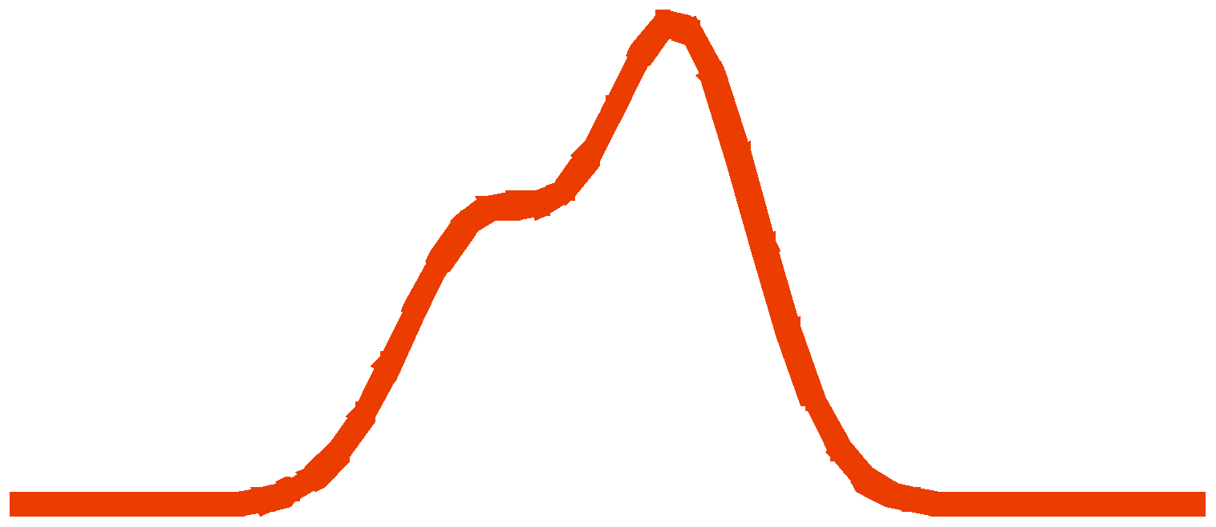
CLUBB Parametrization
Primary grid-mean equations
red = host prognosed;
blue = CLUBB prognosed
green = CLUBB integrated
CLUBB
Advance 10 prognostic equations
Close dissipation, pressure terms
Use PDF to close higher-order moments, buoyancy terms
Select PDF from given functional form
to match 10
moments
Golaz et al. (2002)

Slide 5
The GFDL-AM4 model
with CLUBB
ATMOSPHERIC DYNAMICS
CLUBB
CLOUD MICROPHYSICS
CLUBB_DM DIAGNOSTIC MOMENTUM
RADIATION
CLUBB
CLOUD MACROPHYSICS
CLUBB_PM PROGNOSTIC MOMENTUM
Set eddy diffusivities to zero
SHALLOW AND DEEP CONVECTION
VERTICAL DIFFUSION OF MOMENTUM, HEAT, MOISTURE, AND TRACERS BASED ON LOCK SCHEME
VERTICAL DIFFUSION OF MOMENTUM, HEAT, MOISTURE, AND TRACERS BASED ON LOCK SCHEME
UPWARD DIFFUSION OF HEAT AND MOISTURE
UPWARD DIFFUSION OF HEAT AND MOISTURE
Prognostic momentum offers more flexibility in tuning the parameters compared to diagnostic momentum
Only for first model
level
COUPLING WITH THE SURFACE

Slide 6
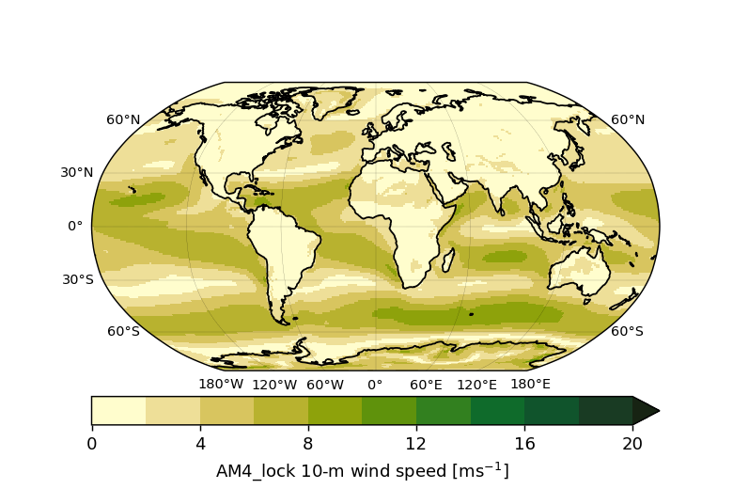
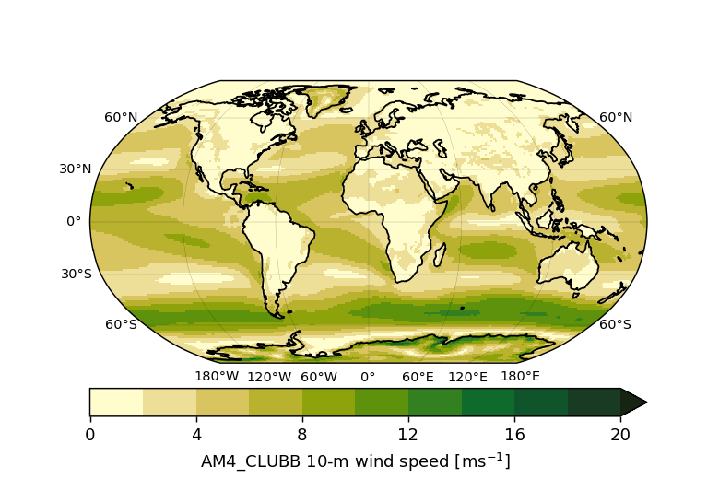
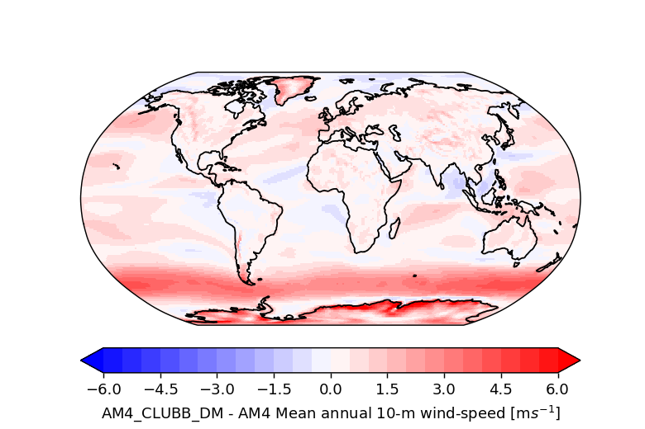
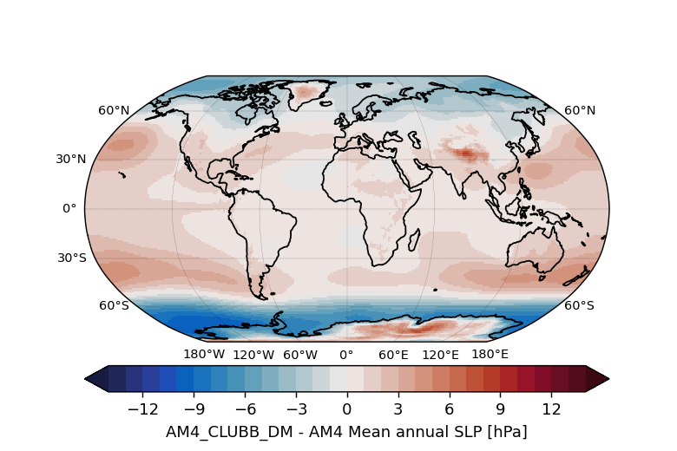
AM4 VS AM4_CLUBB_DM
AM4
AM4-CLUBB_DM
10-m Wind speed [m/s]
10-m Wind speed [m/s]
AM4-CLUBB_DM – AM4
AM4-CLUBB_DM – AM4
10-m Wind speed [m/s]
MSLP [hPa]
CLUBB_DM mostly leads to more intense 10-m wind speeds over the globe
Largest increases, by up to 4m/s, in the Southern Ocean and between 1 and 2m/s intensification in the midlatitudes and tropics
CLUBB_DM impact on MSLP consistent with impact on 10-m wind speeds – explained by thermal wind relationship

Slide 7
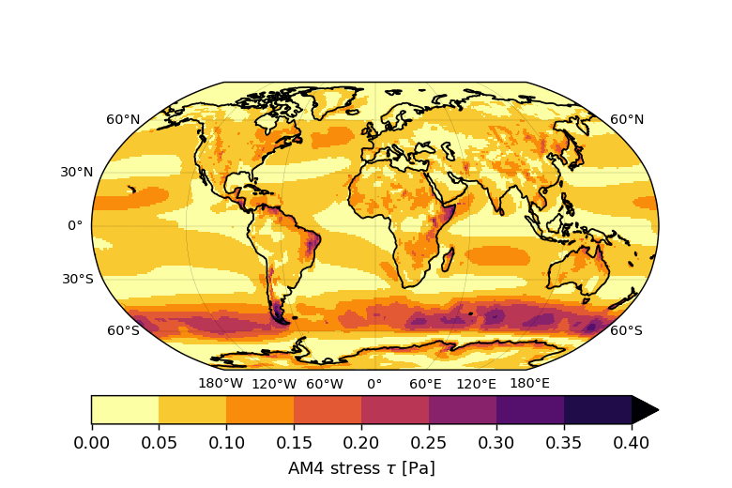
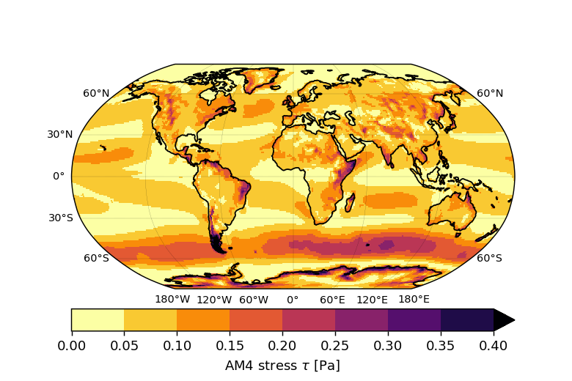
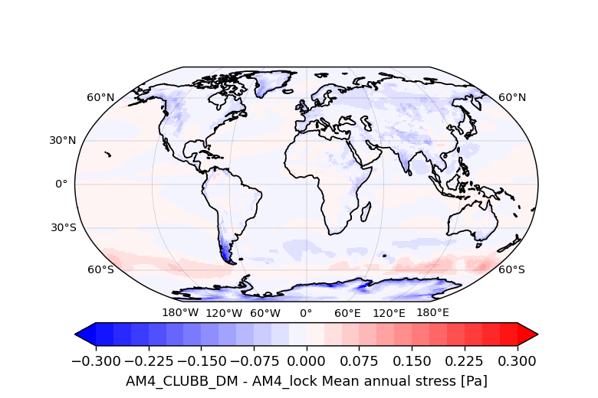
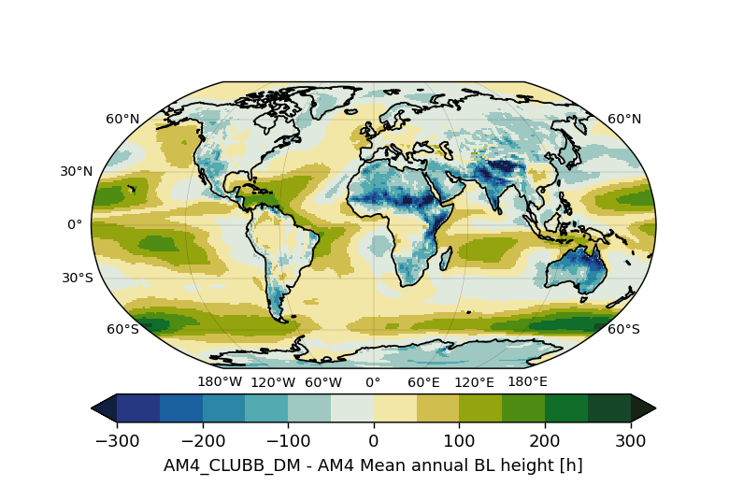
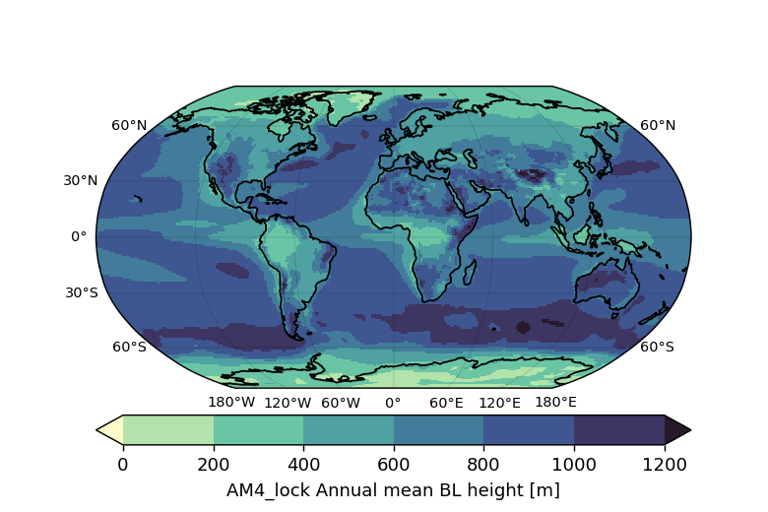
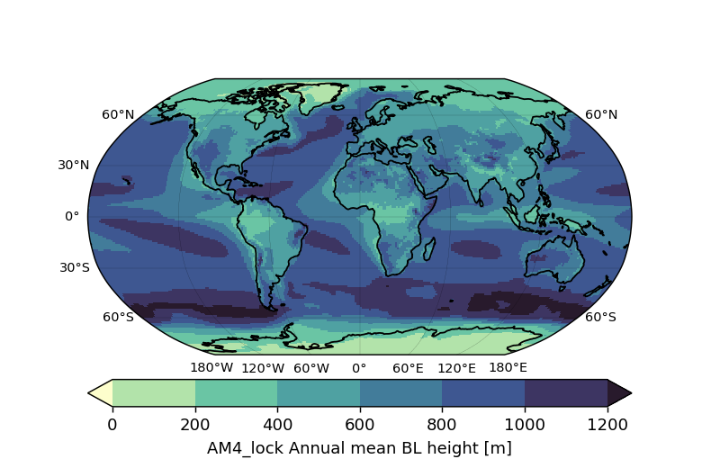
AM4 VS AM4_CLUBB_DM
AM4
AM4-CLUBB_DM
AM4-CLUBB_DM – AM4
Surface stress [Pa]
Surface stress [Pa]
Surface stress [Pa]
BL height [m]
BL height [m]
BL height [m]
Largest increase of BL height correlate with increases in surface stress suggesting CLUBB BL is more turbulent and diffusive thus leading stronger wind speed at the surface

Slide 8
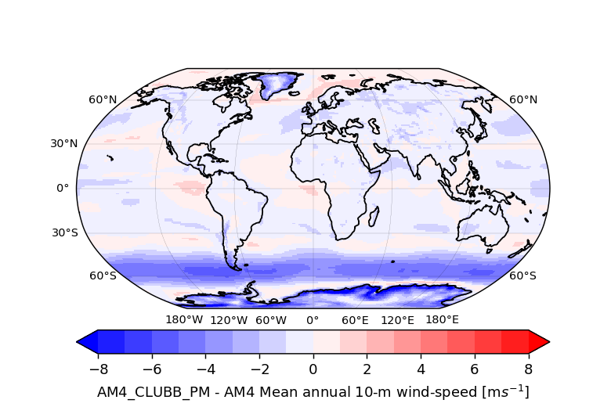
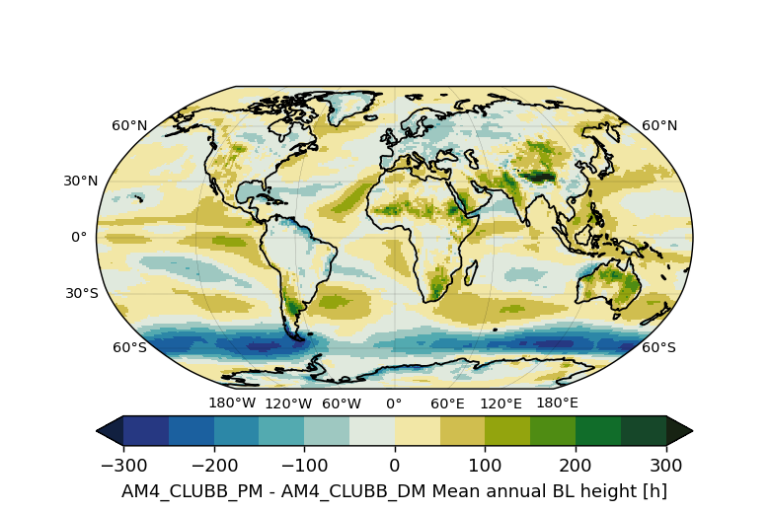
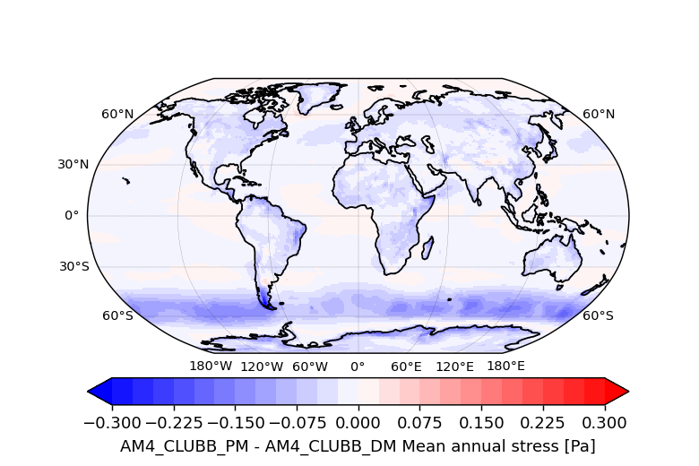
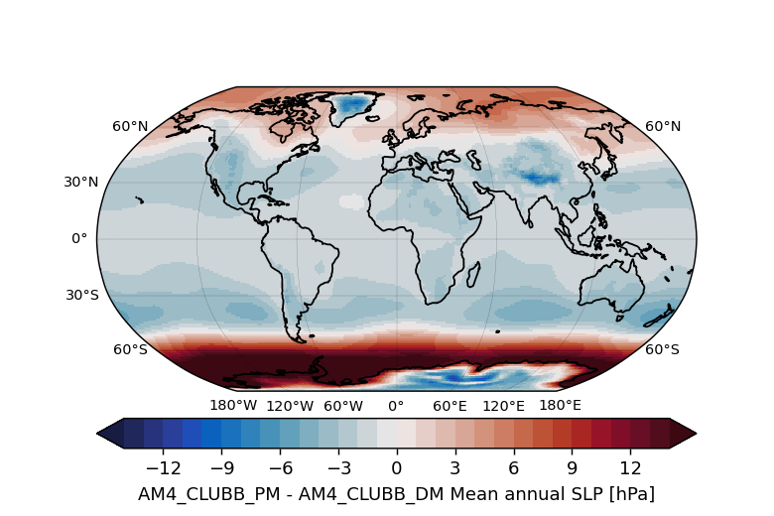
AM4_CLUBB_DM VS AM4_CLUBB_PM
AM4-CLUBB_PM – AM4-CLUBB_DM
10-m wind speed [m/s]
BL height [m]
Stress [Pa]
MSLP [Pa]
CLUBB with prognostic momentum decreases 10-m wind speeds, e.g. up to 6m/s in the Southern Ocean
Changes in 10-m wind speeds due to prognostic momentum flux correlate with impact on BL height, suggesting reduced BL diffusivity leading to reduced 10-m winds
MSLP increases around the poles and decreases in the midlatitudes

Slide 9
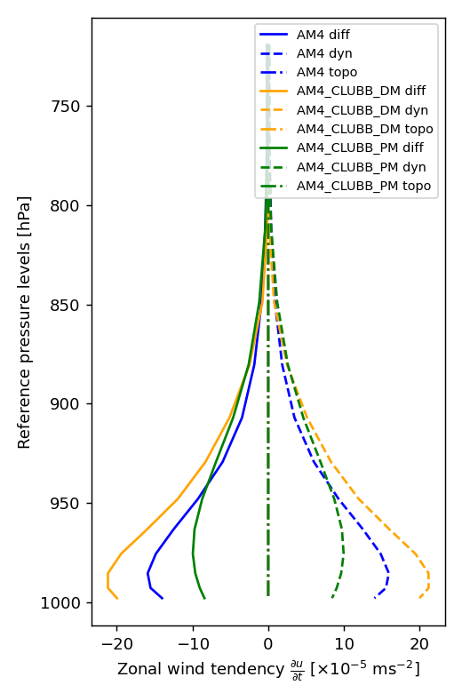
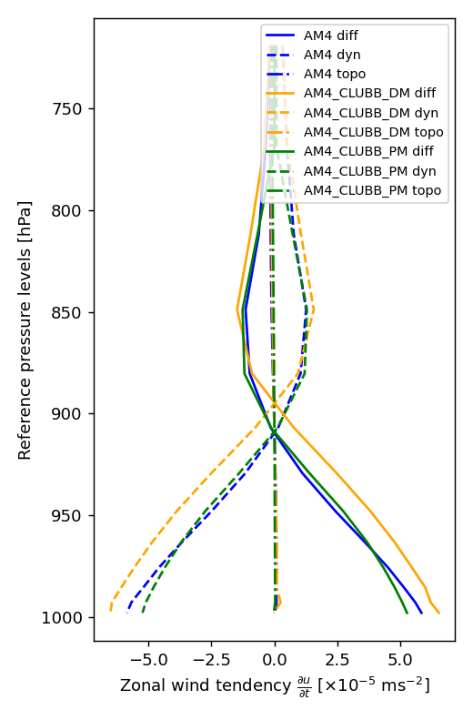
WIND TENDENCIES COMPARISON
AM4_CLUBB_DM presents larger momentum sink (through diffusion) but also larger source (through dynamics) than AM4
The adding of CLUBB_DM to AM4 produces initially a small drag after the dynamics tendencies are computed (no lock).
According to the bulk transfer formula, over time CLUBB_DM drag catch up with AM4 values
Because CLUBB_PM is not as diffusive as CLUBB_DM, drag does not reach AM4 values
Southern Ocean 60S
Tropics 30N

Slide 10
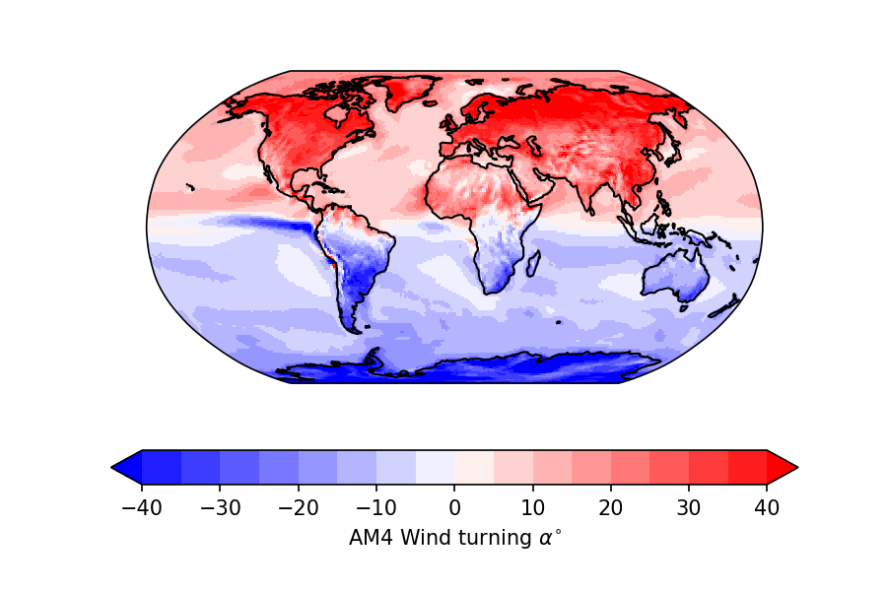
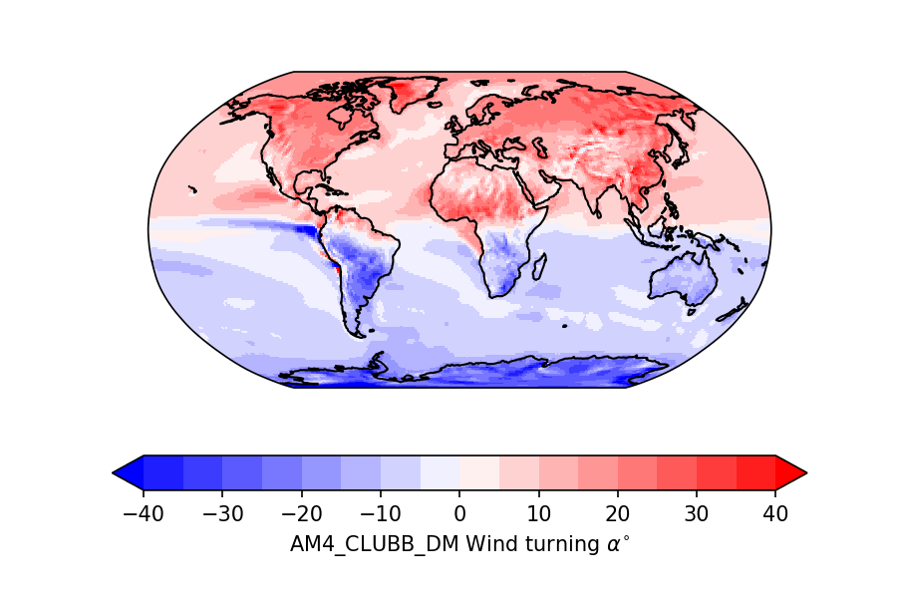
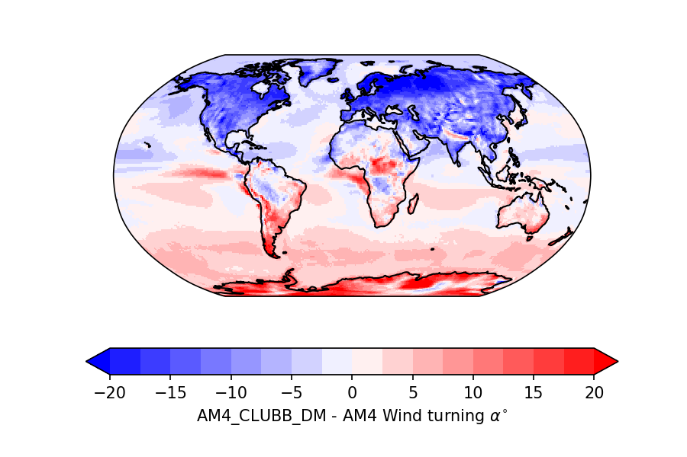
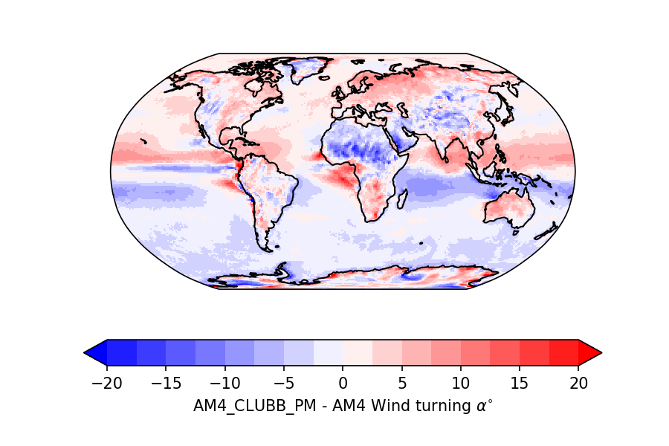
WIND TURNING ANGLE AS METRIC
CLUBB_DM reduces the AM4 wind turning angle $α$
CLUBB_PM enhances $α$, though not as much as to yield back original AM4 values
Simple model for wind turning $α= \cos^{−1}\left(\frac{fh\left\langle \overline{v}\right\rangle }{{u_{∗}}^{2}}\right)$ consistent with results
Smaller $α$ in CLUBB_DM suggests deeper BL, and cross-isobaric flow, given larger $τ$ and likely leads to stronger mass flux, explaining the MSLP biases
Similar reasoning for CLUBB_PM
AM4
AM4-CLUBB
AM4-CLUBB – AM4
AM4-CLUBB_DM – AM4-CLUBB_PM

Slide 11
CONCLUSIONS
CLUBB_DM overestimates 10-m wind speed simulating an overly-diffusive boundary-layer.
CLUBB_PM reduces the 10-m wind speed of CLUBB_DM, simulating a shallower and less turbulent boundary layer, and flips the impact on MSLP.
Wind turning turns out a more representative metric than surface stress to assess the friction felt by the boundary-layer flow on change of parametrization.
Thanks to its higher number of tunable parameters, CLUBB_PM seems more promising than CLUBB_DM to "decouple" the momentum processes that control the surface stress and those throughout the boundary layer, which also control the wind turning angle, thus decoupling wind-speed and MSLP bias.
Notes:
11

Slide 12
THANKS!
Emanuele.Gentile@noaa.gov

Slide 13
ANGLE OF WIND TURNING
Wind turning angle α relates with a single scalar value the boundary-layer turbulence to cross-isobaric flow, the latter being important for cyclone development and the large-scale flow
Simple theoretical model for α derived by Svensson and Holtslag (2009) :
$α= \cos^{−1}\left(\frac{fh\left\langle \overline{v}\right\rangle }{{u_{∗}}^{2}}\right)$
Larger (smaller) Coriolis parameter $f$, boundary layer height $h$, or cross-isobaric flow $\left\langle \overline{v}\right\rangle$ decrease (increase) $α$
Larger (smaller) surface stress ${u_{∗}}^{2}$ increases (decreases) $α$
Generally positive in NH, and negative in the SH
BL top
Bl TOP WIND
Surface
SURF. WIND
Angle of wind turning

