Slide 1
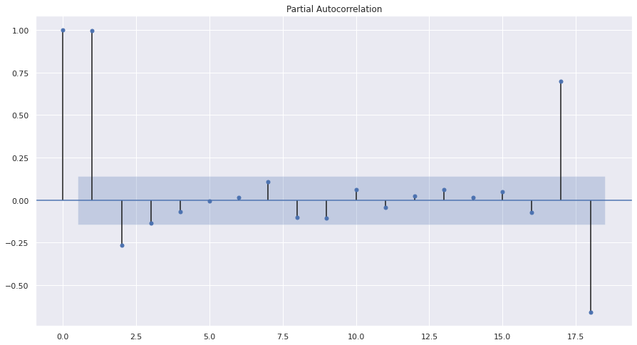
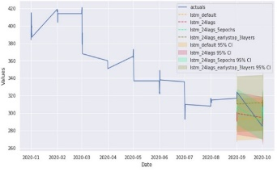
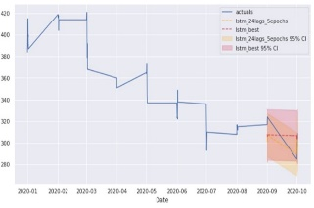
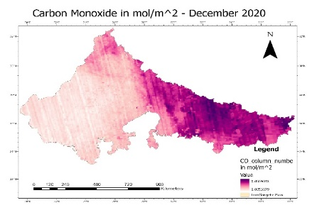
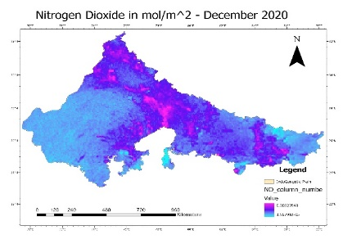
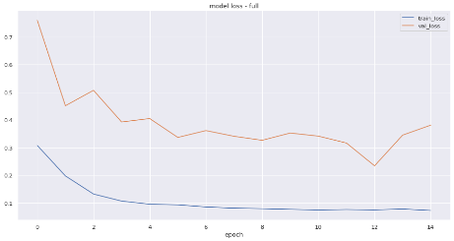
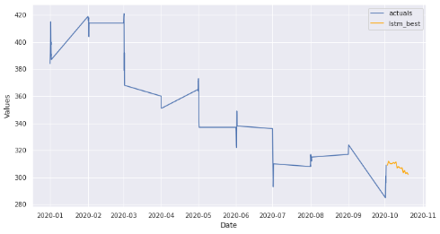
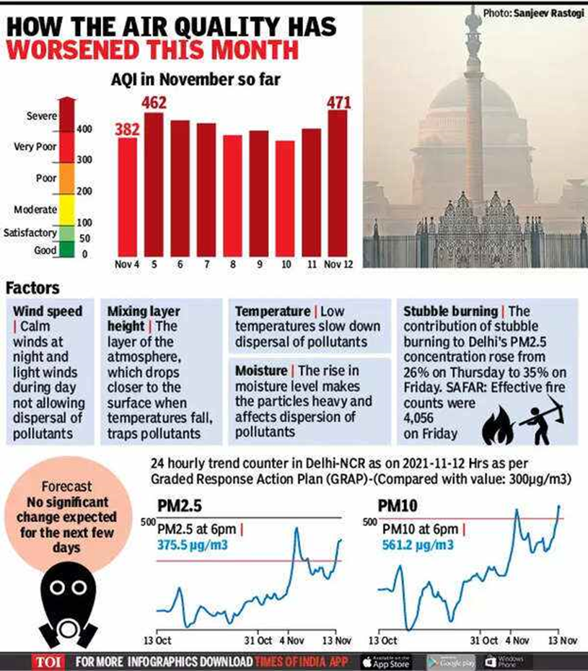
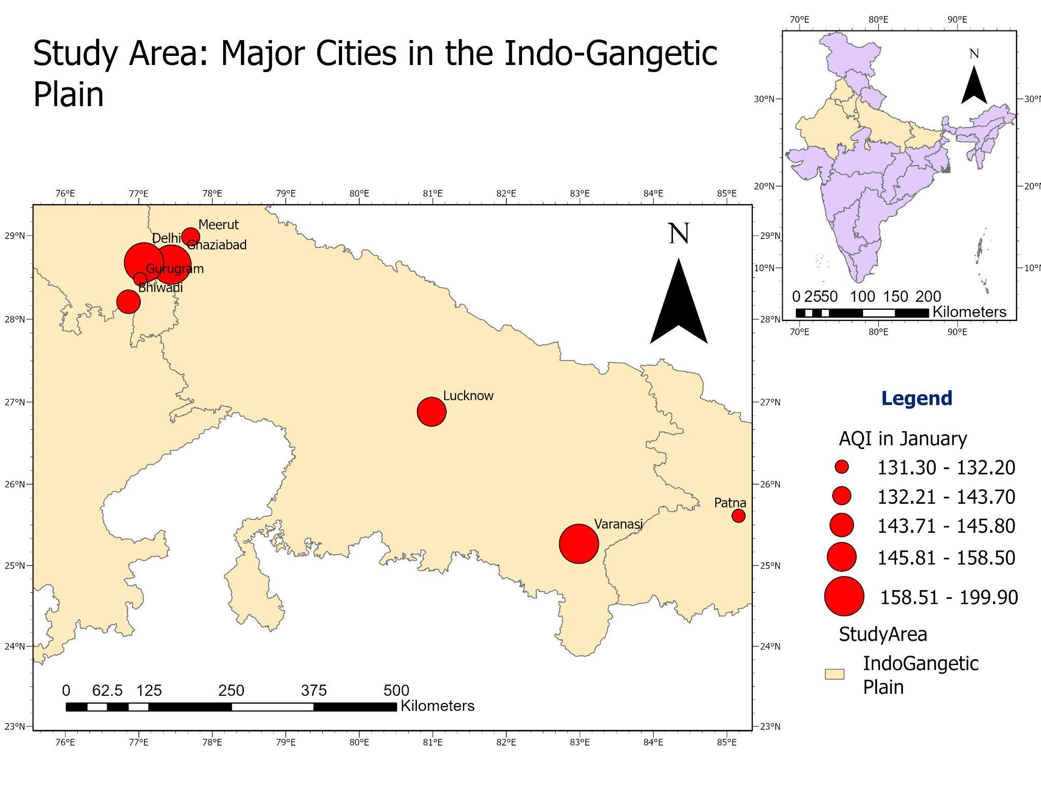
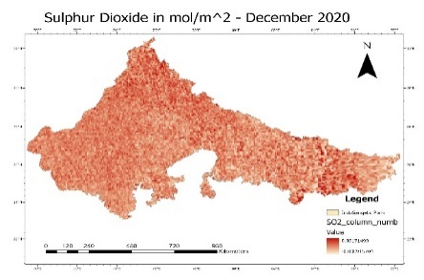
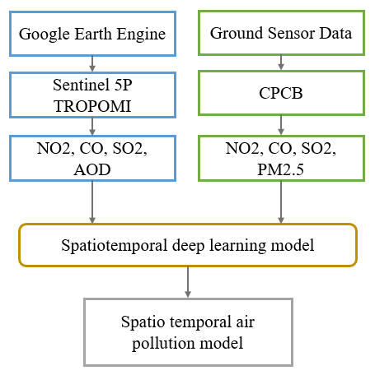
ASSESSMENT OF IMPACT OF AIR POLLUTION USING DEEP LEARNING-BASED AIR QUALITY DATA MODEL
Remya Ravikumar^{1,2}, Nagesh Subbana¹, Alka Singh¹, Raian Vargas Maretto²
¹Center for Wireless Networks & Applications (WNA)Amrita Vishwa Vidyapeetham, Amritapuri, India
²Geo-Information Science and Earth Observation, ITC, University of Twente, Netherlands
Objective and Motivation
Primary Objective:
Create a deep learning model for a precise air quality prediction
Motivation:
India is ranked 5th and 21/30 most polluted cities are located in India (WHO 2019)
1.24 million premature deaths (Nair et al, 2021) were reported in the country just in the year 2017 alone.
The ground sensor data is obtained from Central pollution control board (CPCB) for the same pollutants and was also used as input of our model
a
b
c
a
b
d
e
c
d
Fig4 cyclic from left: a) PAC of NO2, b) LSTM estimator with different combination of parameters, c) Best LSTM, d) Model loss e) Prediction of NO2 conc. for the next 24 hours
Conclusion:
In this study, we developed a Long short term memory based neural network based air quality model. The model was able to correctly predict the pollutant concentration for the next 24 hours and the prediction was validated using the Convolution neural network (CNN) as well as with the previous observations.
Fig2 cyclic from left: a) CO concentration, b) NO2 concentration, c) SO2 concentration obtained from sentinel 5P, d) methodology flow chart
Fig1 : a)Newspaper (Times of India November 13, 2021) clipping showing the air pollution levels effecting India, b) Study area considered in this project
Future Directions:
Incorporating meteorological parameters to increase accuracy.
Introducing a graph neural network to get a better correlation between satellite and ground sensor data.
Analyse the impact on health of the population due to air pollution.
Result:
The input for our LSTM model was the previous 24 hours pollutant concentration level of NO2, SO2, PM2.5 and CO and the output was the predicted sequence of the pollutants contents in the next 24 hours.
The model was validated by to fitting it within the preceding 24 hours data
Figure 4d shows the model loss as we can observe that the model has relatively less validation loss and training loss which implies that our model is correct
Figure 4f shows the prediction for the next 24 hours, it follows the trend which has been observed in the previous dates
Study Area:
The Study area is taken as the major cities in the indo-gangetic belt as shown in fig1b. All of these cities falls under the top 15 polluted cities of the world.
Methodology:
The satellite data was taken is obtained from Sentinel 5P TROPOMI and with the help of google earth engine. Fig2a-c shows the images obtained for CO, NO2, SO2 pollutant contents.
The pixel values corresponding to desired locations were extracted and used as input for our LSTM model.
Reference:
WHO, “Ambient (outdoor) air pollution,” Dec. 19, 2022. [Online]. Available: https://www.who.int/news-room/fact-sheets/detail/ambient-(outdoor)-air-quality-and-health
M. Nair, “Valuing burden of premature mortality attributable to air pollution in major million-plus non-attainment cities of India,” Sci. Rep., p. 15, 2021.
Times of India Nov13,2022,https://timesofindia.indiatimes.com/india/declare-two-day-lockdown-if-need-be-sc-to-centre-on-delhi-air-pollution/articleshow/87679619.cms

