Slide 1
Lag in vegetation productivity response to water availability and atmospheric dryness at catchment scale
Guta Wakbulcho Abeshu & Hong-Yi Li
University of Houston
April 27-2023

Slide 2
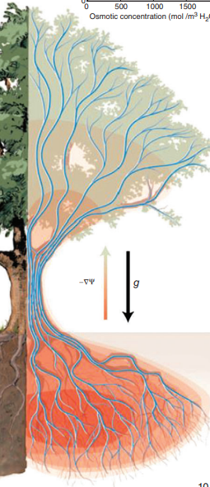
Introduction
Soil water storage fluctuations have defining impact on the ecosystem structure and function (Porporato & Rodriguez-Iturbe, 2013).
Atmospheric dryness (vapor pressure deficit) and soil water storage are connected by plant hydraulic transport systems.
VPD at leaf surface
Plant hydraulic transport system
Soil water storage
From Fatichi et al., 2016

Slide 3
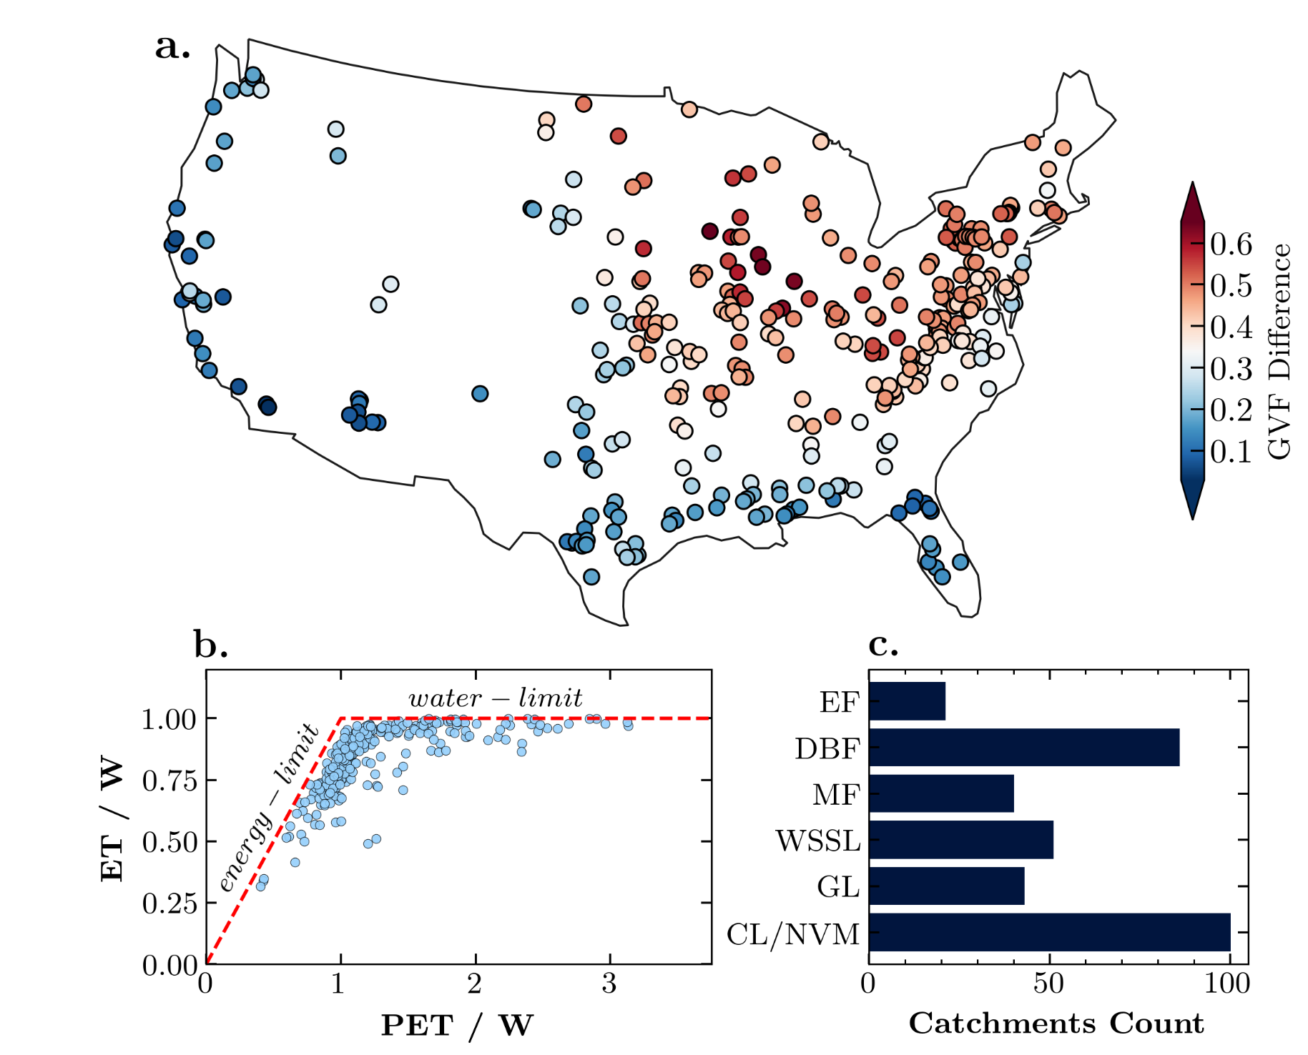
Data – Hydrometreological data from CAMELS
341 Catchments
Notes:
The vegetation productivity, known as gross primary productivity (GPP) data is from Landsat satellite observation
It has 30m spatial resolution and 16-day temporal resolution which we converted to monthly.

Slide 4
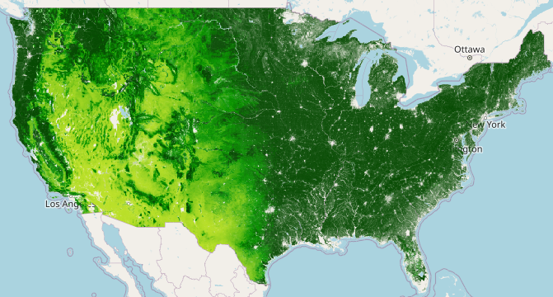
Data - GPP
Vegetation productivity (Gross Primary Productivity, GPP) is from Landsat (1986-2014)
16-days interval and 30m spatial resolution
Notes:
The vegetation productivity, known as gross primary productivity (GPP) data is from Landsat satellite observation
It has 30m spatial resolution and 16-day temporal resolution which we converted to monthly.

Slide 5
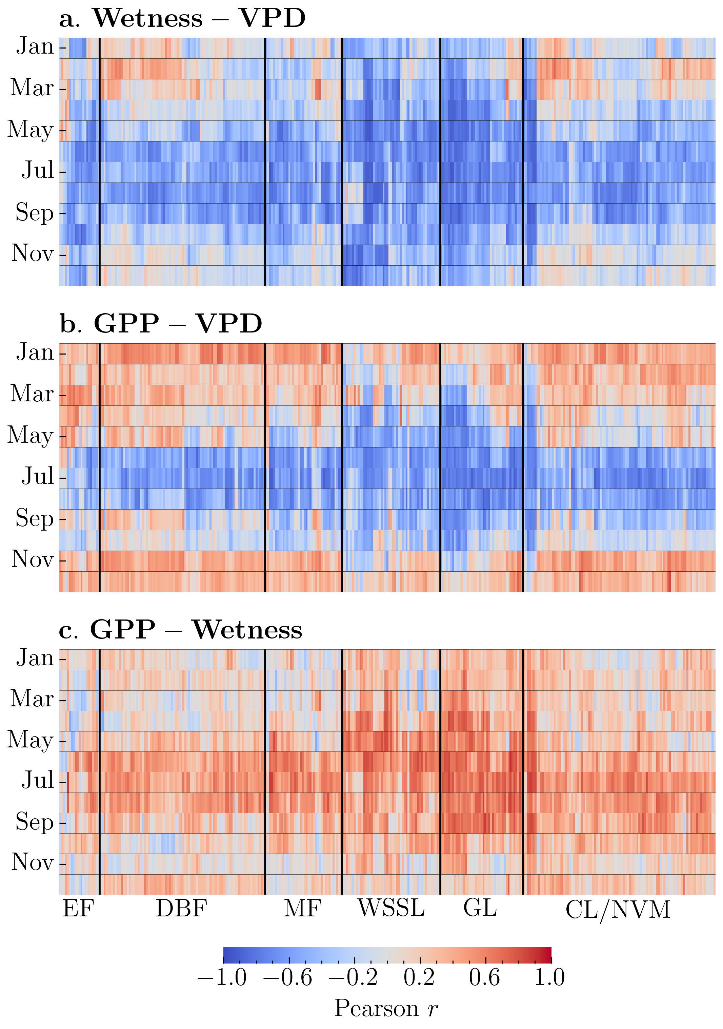
GPP-VPD, GPP-Wetness and Wetness-VPD relationships
Within-Catchments : relationship for a given catchment on a monthly basis
Wetness-VPD : For months with relatively high water demand (June-August), ~80% of the catchments showed a moderate to strong negative correlation. This was also true for ~73% of the catchments in September.
GPP-Wetness: more than 60% of the catchments, there was a moderate to strong positive correlation between Wetness and GPP during the peak growing months (June-August).
GPP and VPD : June - September, more than 66% of the catchments showed a moderate to strong negative correlation.
Cross-Correlation & Granger Causality test
-GPP-Wetness : 0/1-lag for 94% of catchments
-GPP-VPD: 0/1-lag for 87.5% of catchments
-Granger causality test statistically significant for both Wetness and VPD

Slide 6
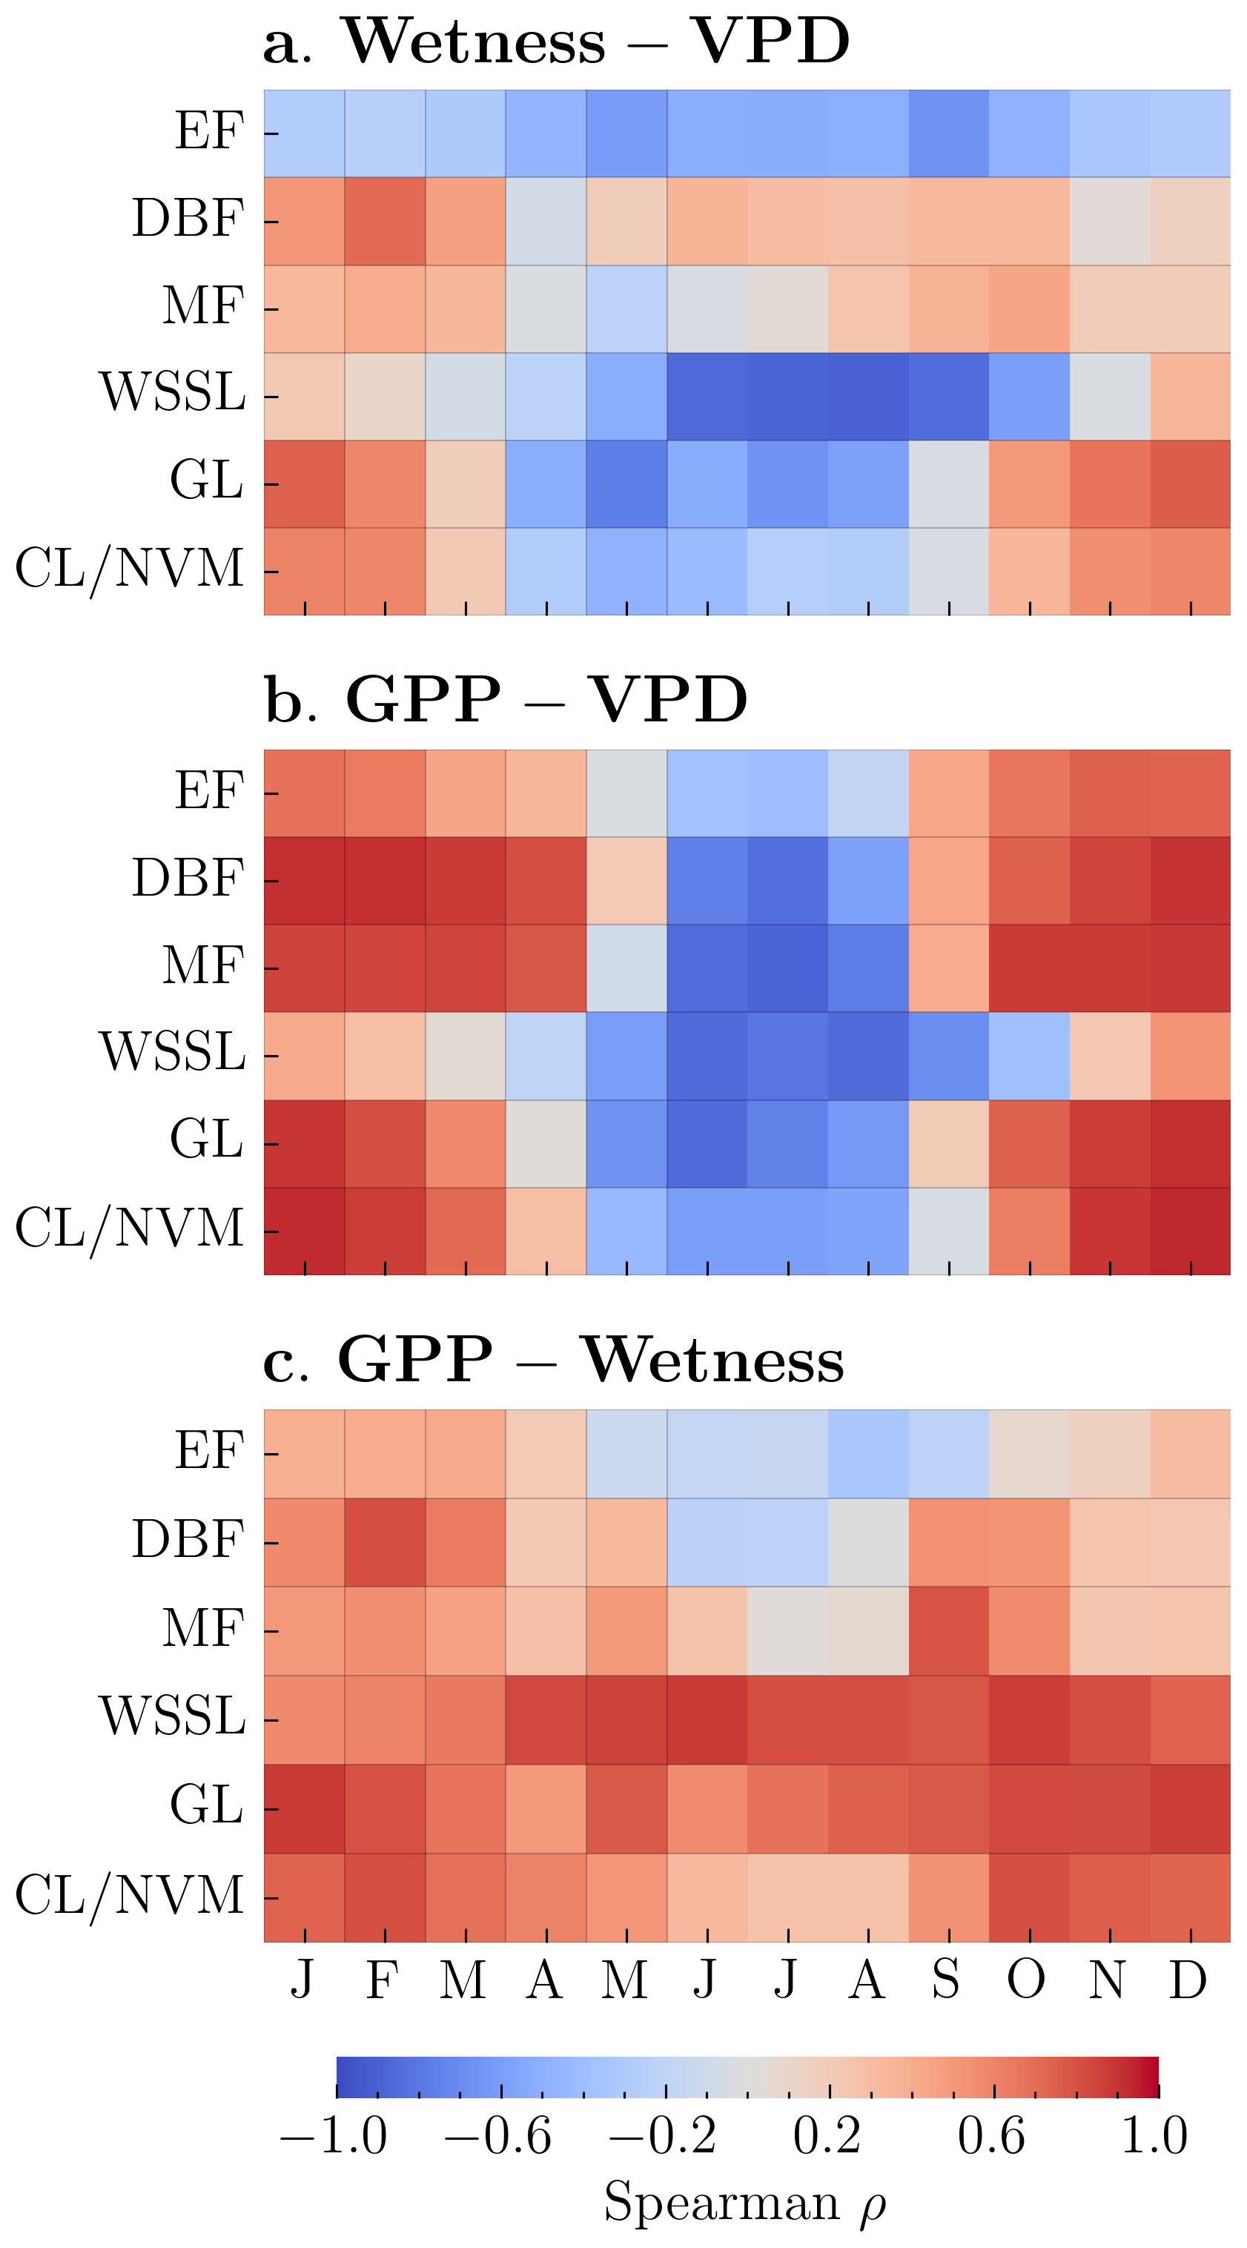
GPP-VPD, GPP-Wetness and Wetness-VPD relationships
Between-Catchments : for a given vegetation type and a given month, GPP-Wetness, GPP-VPD and Wetness-VPD relationship
GPP-Wetness: A strong positive association between GPP and Wetness was found in WSSL and GL catchments. The relationship is moderate to strong and positive for CL/NVM and DBF, except during the summer months (June-August). Only during the dormant months (October-March) was a moderate relationship detected for EF (4 months) and MF (5 months)
GPP-VPD: showed a moderate to strong positive relationship during the dormant months (typically October – March) for all vegetation types except WSSL. On the contrary, the relationship is moderate to strong and negative during the peak growing season (June-August).

Slide 7
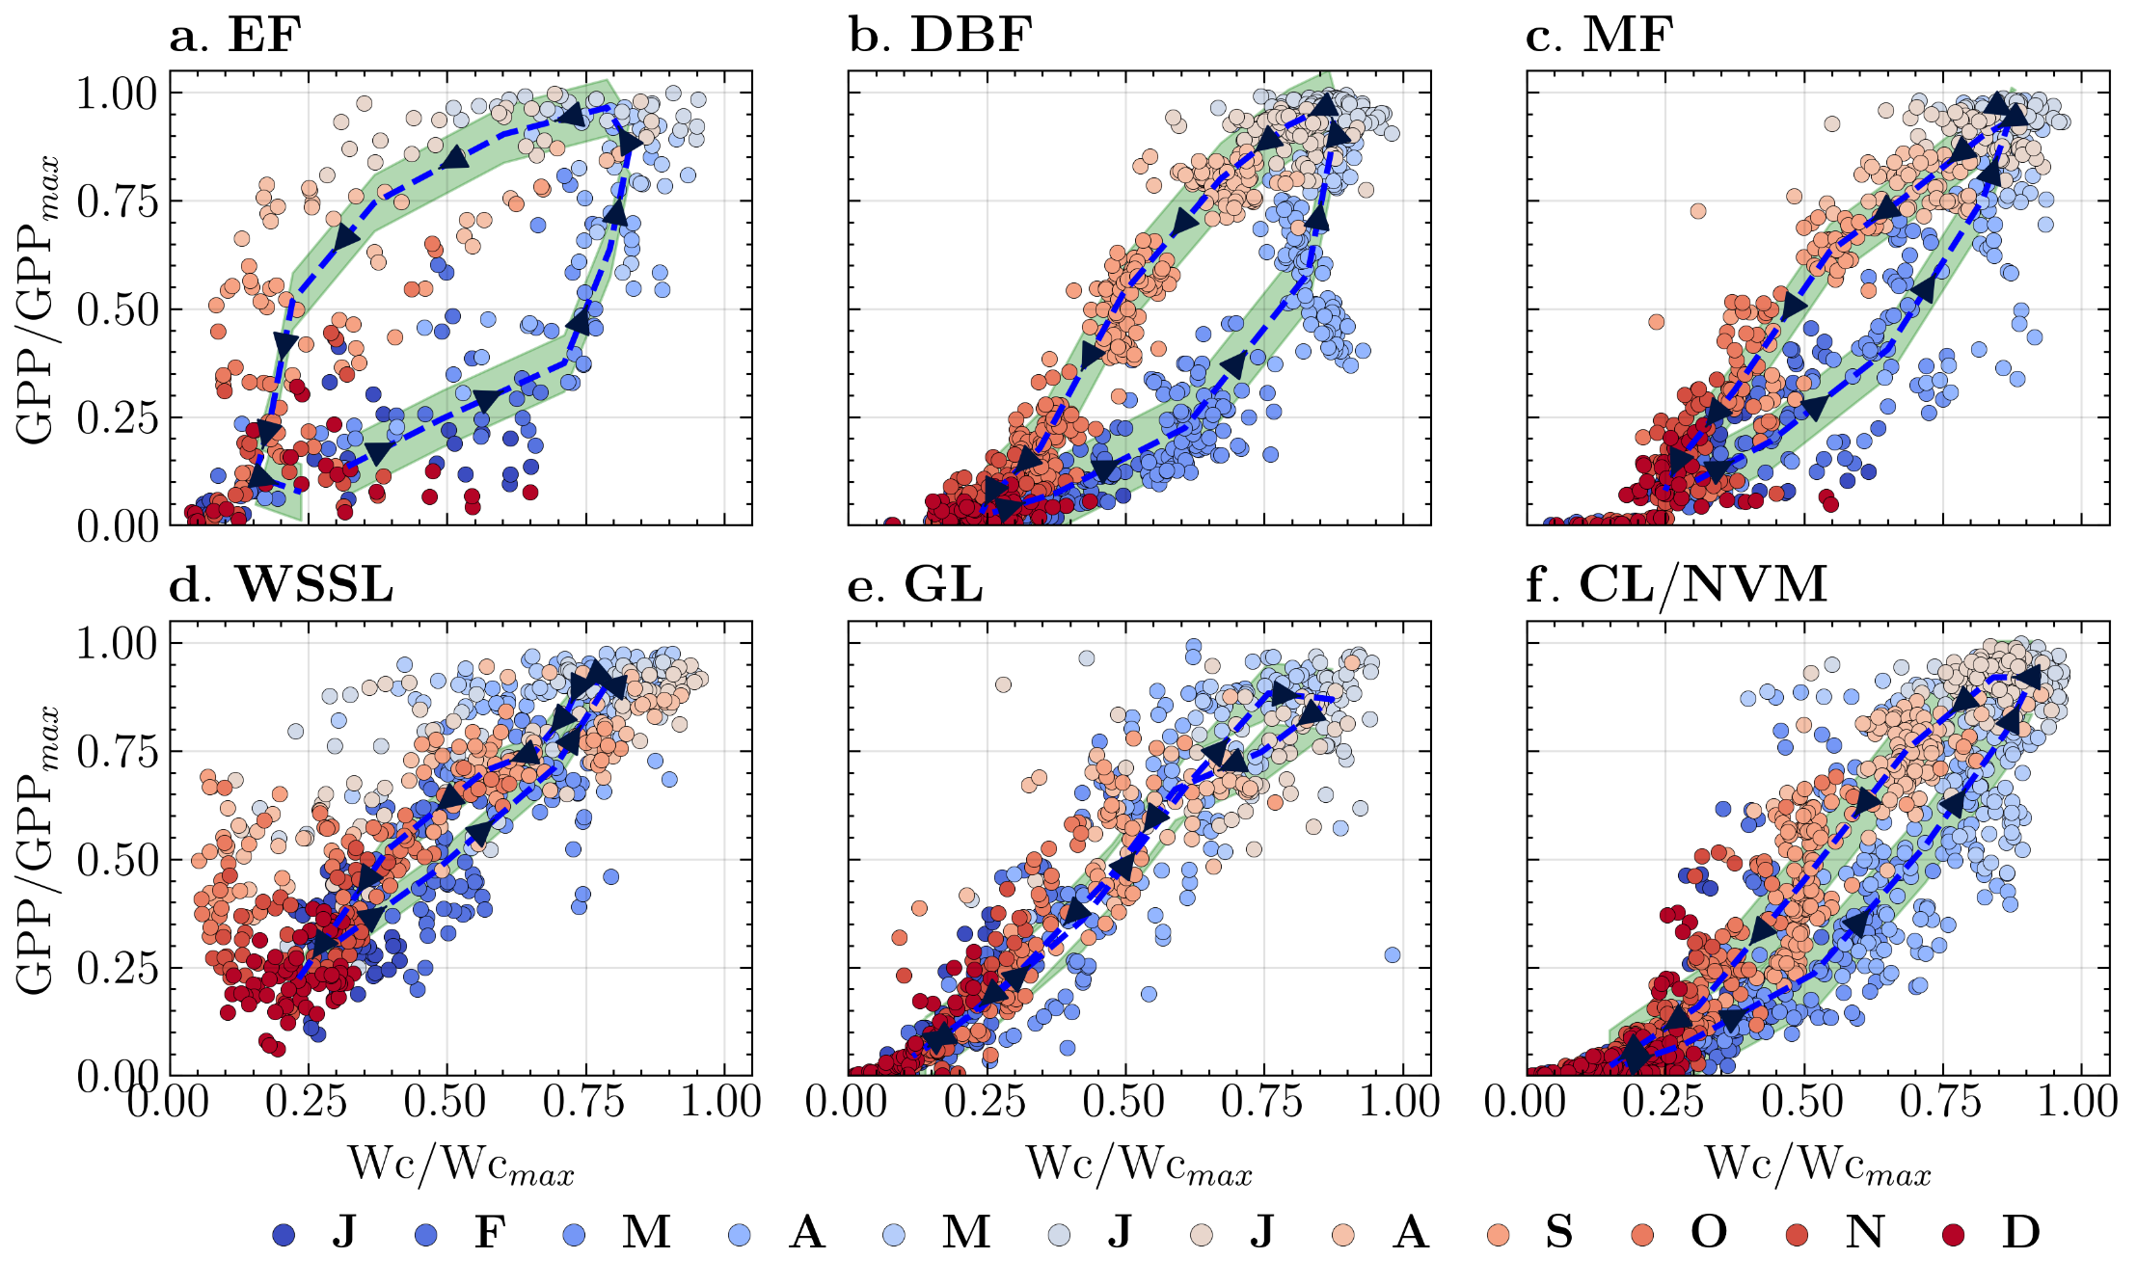
Plant response to Water available lag by 0-2 month

Slide 8
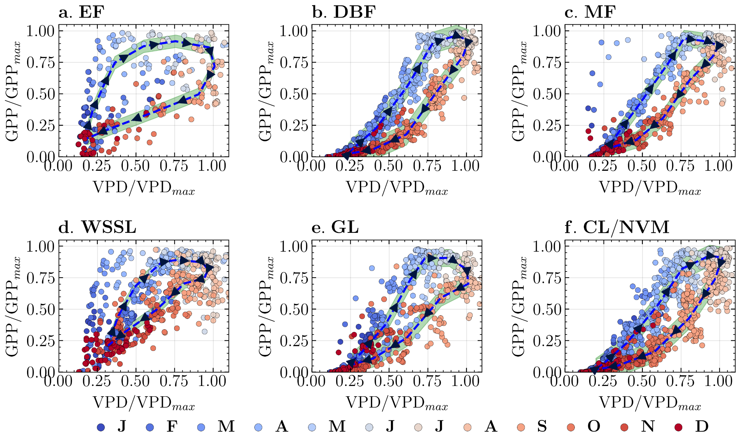
Plant response to VPD

Slide 9
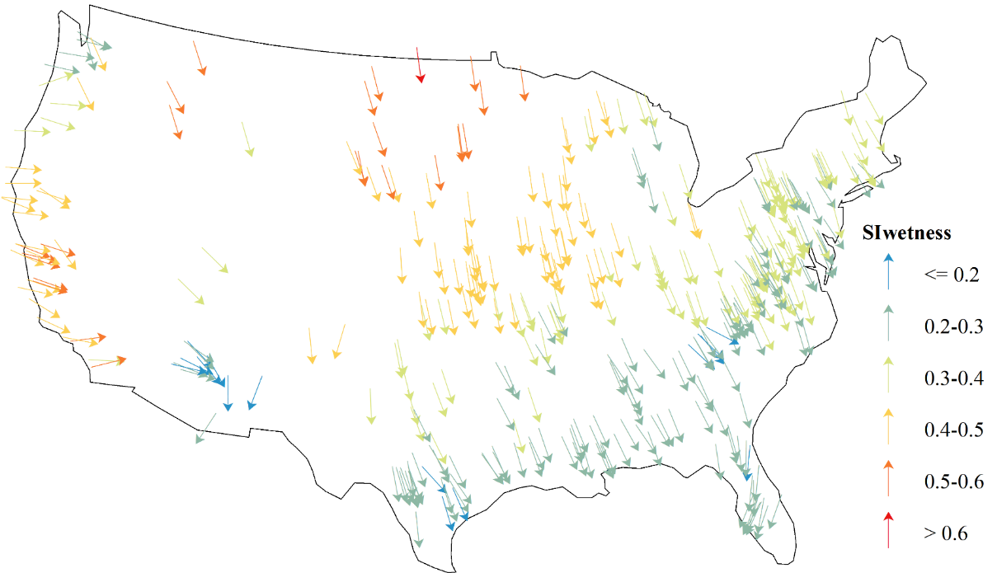
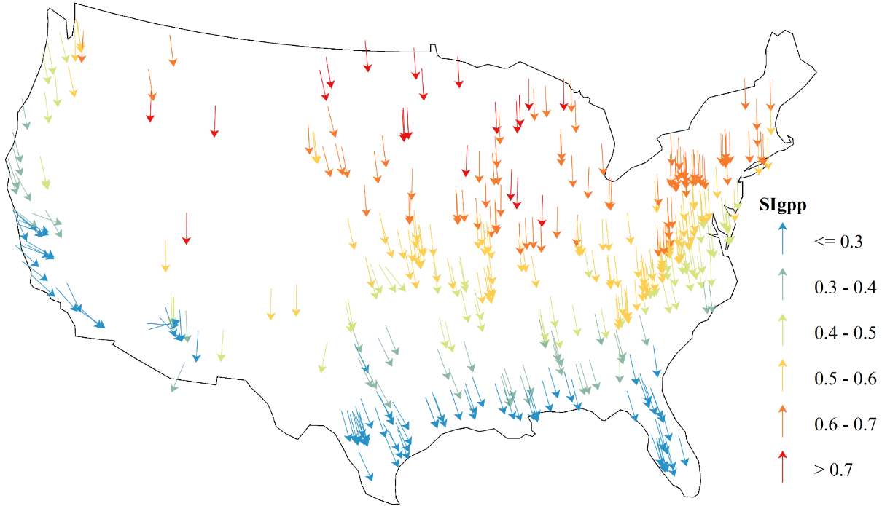
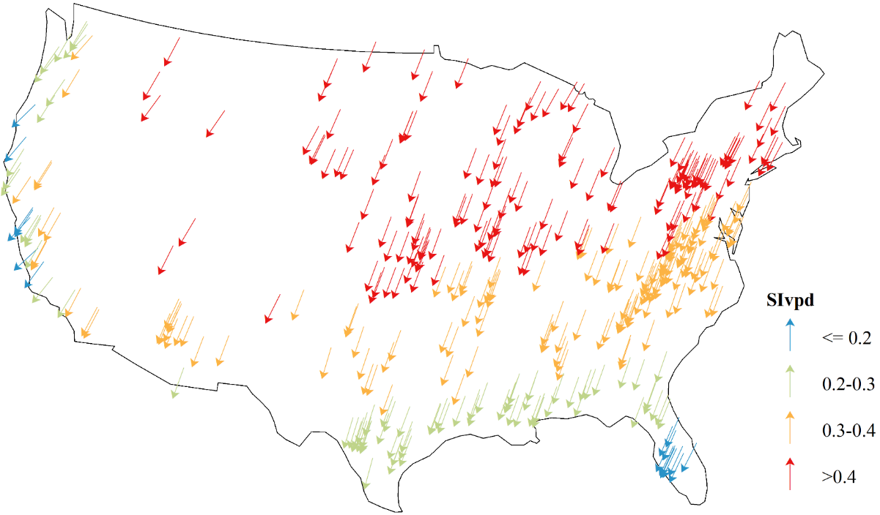
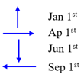
Seasonality Strength and direction

Slide 10
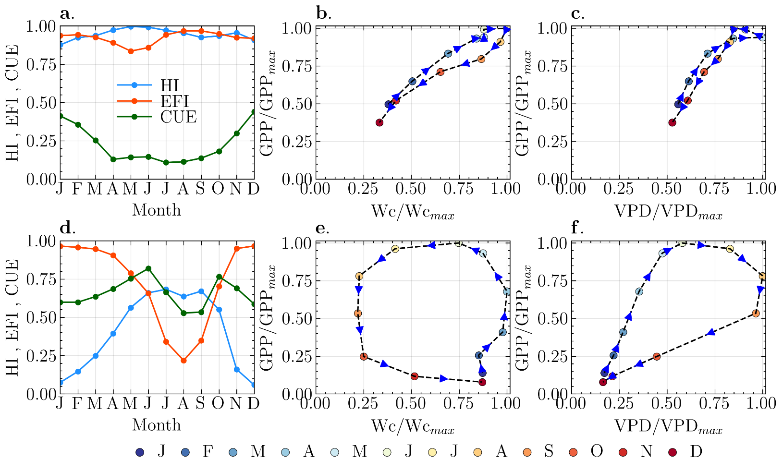
Narrow vs Wide GPP-Wetness and GPP-VPD Hysteresis

Slide 11
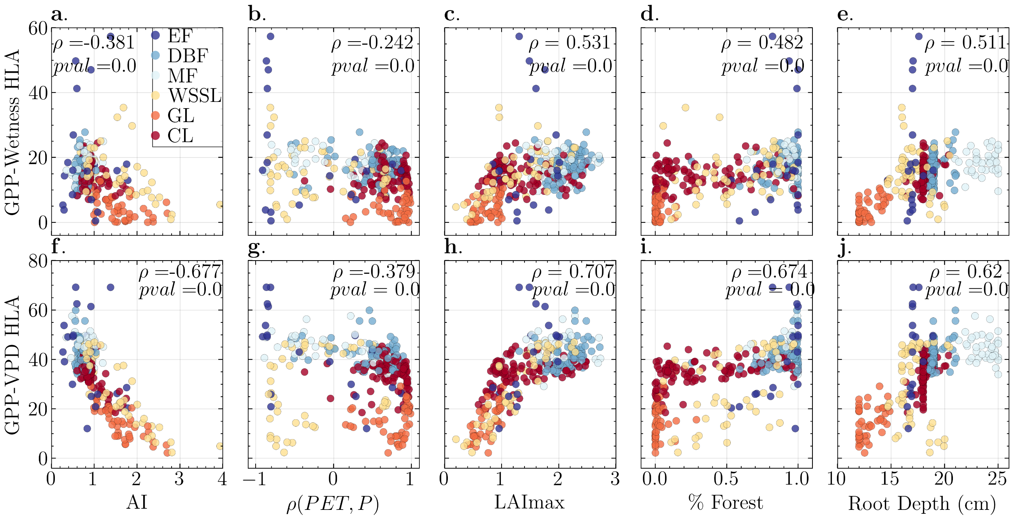
Factors controlling the Hysteresis size
HLA : Hysteresis Loop Area

Slide 12
Conclusions
The annual scale relationships of GPP-Wetness and GPP-VPD and Wetness-VPD are likely driven by a few dominant months.
Catchment long-term properties are responsible for the narrow/wide hysteresis
Catchment water supply-productivity and water demand-productivity cause-effect relations occur within a maximum span of two months (i.e., ±1 month from GPP).

