Slide 1
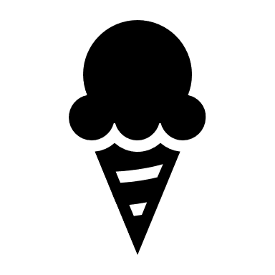
Streamflow-based snow mass reconstruction using spatial melt patterns from synthetic snow cover maps
Pau Wiersma (pau.wiersma@unil.ch), Fatemeh Zakeri & Grégoire Mariéthoz
Graphical abstract
Introduction
Models & Data
Methods
Results
Conclusion & Outlook

Slide 2
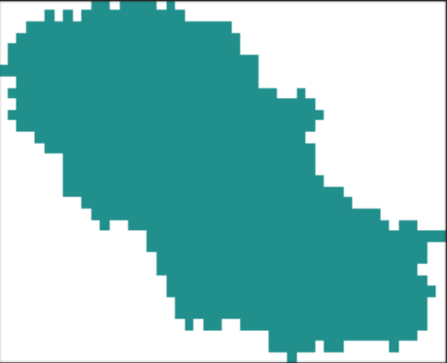
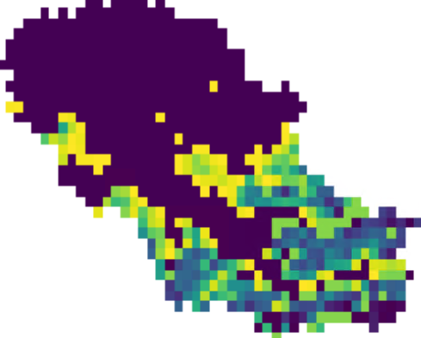
Hydrological Model
Snowfall correction
2D melt factor
Streamflow-based snow mass reconstruction using spatial melt patterns from synthetic snow cover maps
Pau Wiersma (pau.wiersma@unil.ch), Fatemeh Zakeri & Grégoire Mariéthoz
Temperature + Precipitation
Setting | Accumulation | Melt factor
S1
S2
S3
S4
Daily 30m snow cover maps
Snowfall correction
10.000x
+
Hydrological Model
(1km resolution)
No snowfall correction
Constant, uniform
2D melt factor adjustment
Snowfall correction
Constant, uniform
10.000 prior daily snow mass maps
Streamflow observations
Snowfall correction
Constant, seasonal
100 posterior daily snow mass maps
Evaluation against snow observations
Snowfall correction
Distributed, seasonal

Slide 3
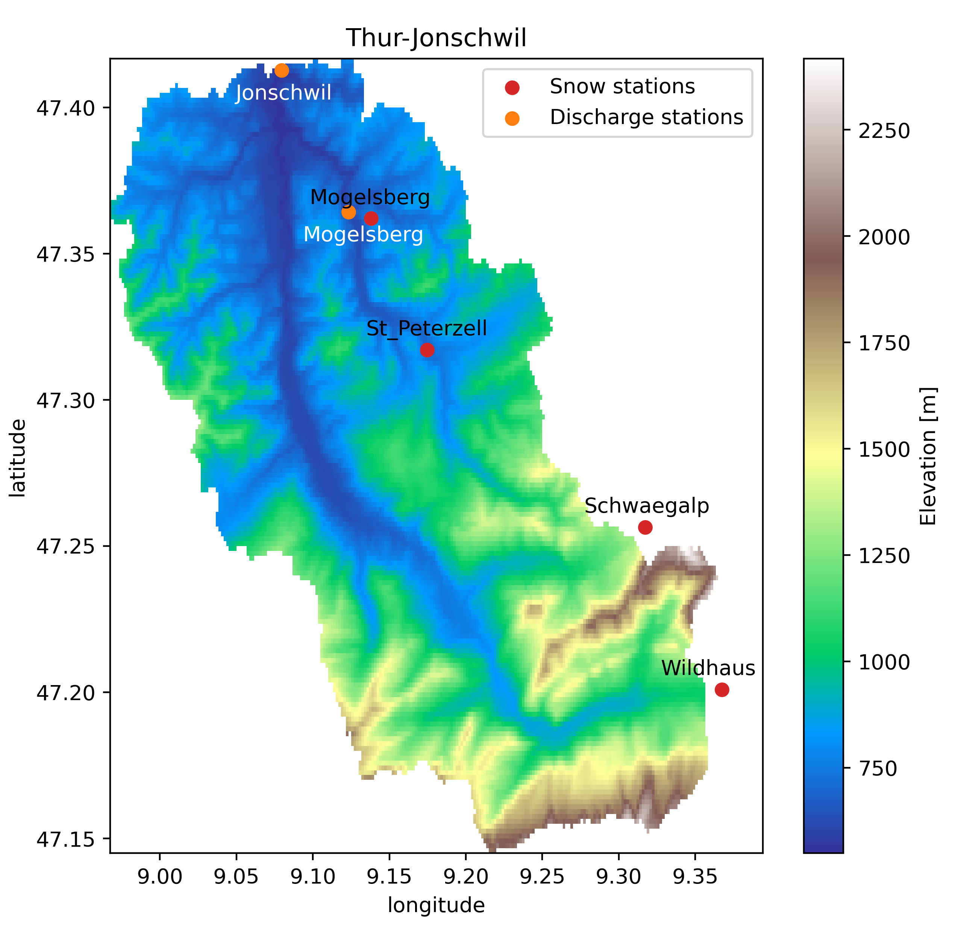
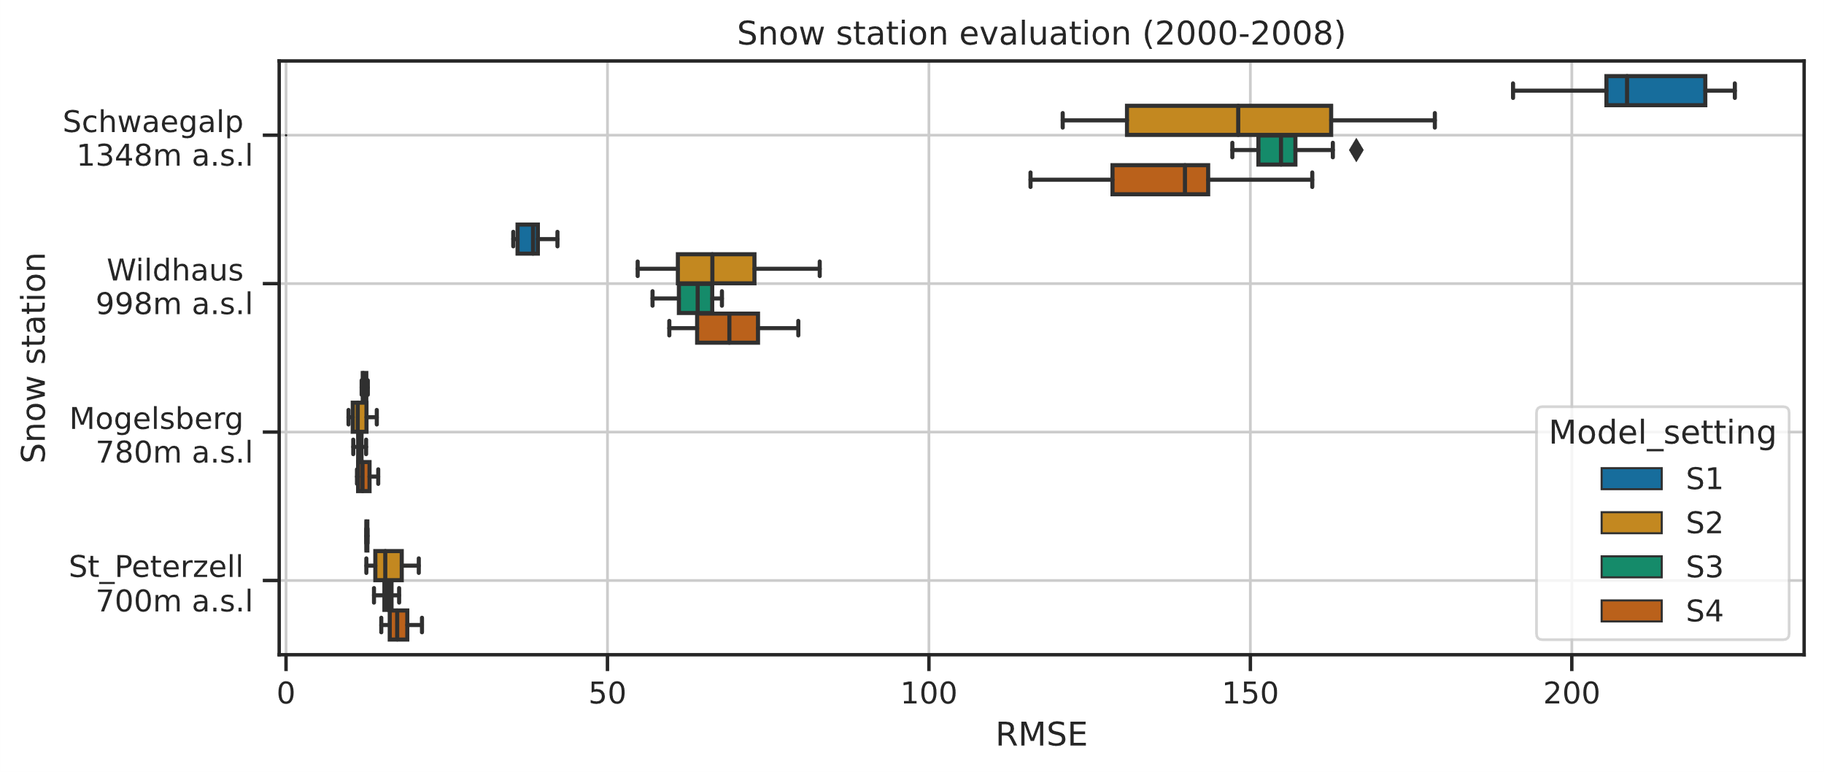
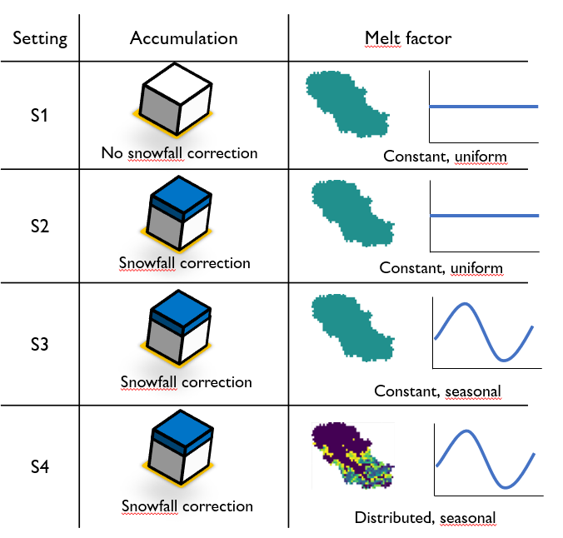
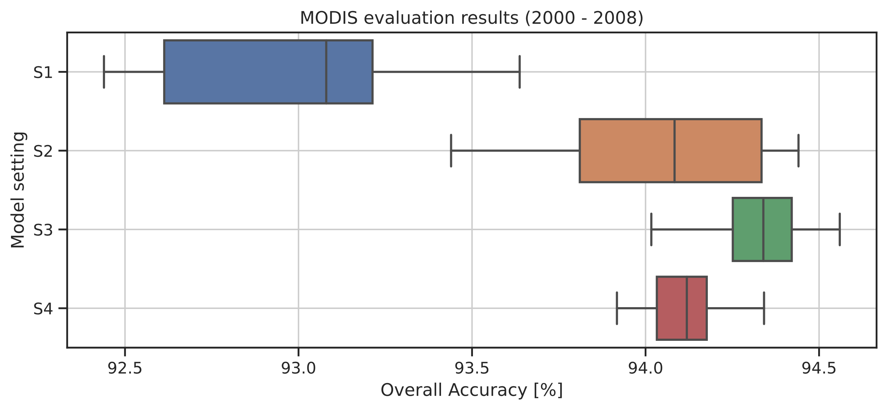
Hydrological Model
Snowfall correction
2D melt factor
Streamflow-based snow mass reconstruction using spatial melt patterns from synthetic snow cover maps
Pau Wiersma (pau.wiersma@unil.ch), Fatemeh Zakeri & Grégoire Mariéthoz
Model & Data:
Wflow_sbm hydrological model
Resampled Landsat daily synthetic snow cover maps
Thur-Jonschwil catchment in Eastern Switzerland
(493 km²) with 2 discharge and 4 snow depth stations
Methodology:
Per setting 500 calibration runs using only streamflow observations at Jonschwil
10 best runs are kept for evaluation on
Mogelsberg streamflow
In-situ gap-filled snow depth to snow mass observations
MODIS snow cover (500m)
Setting 4:
Distributed melt factor =
uniform melt factor * 1km gridded snow cover fraction
Results:
Snowfall correction improves all results
Replacing uniform with distributed melt factor leads to:
Slightly improved streamflow
Similar snow mass performance
Reduced spatial snow cover performance, except in early winter

Slide 4
Streamflow-based snow mass reconstruction using spatial melt patterns from synthetic snow cover maps
Pau Wiersma (pau.wiersma@unil.ch), Fatemeh Zakeri & Grégoire Mariéthoz
Motivation
By tweaking the snow accumulation and melt configurations of a distributed hydrological model, we can simulate an infinite number of spatio-temporal snow water equivalent (SWE) distributions
All these SWE distributions lead to a different streamflow response after having been melted and routed by the hydrological model
Comparison against streamflow observations allows us determine which SWE distributions were realistic and which ones should be discarded
This finally gives us a posterior ensemble of catchment-wide SWE evolutions over each winter
However, these hydrological models often use simplifications that prevent a realistic representation of spatial melt patterns, which leads to difficulties in the SWE-streamflow translation
Temperature + Precipitation
Snowfall correction
10.000x
+
Hydrological Model
(1km resolution)
2D melt factor adjustment
10.000 prior daily snow mass maps
Streamflow observations
100 posterior daily snow mass maps

Slide 5
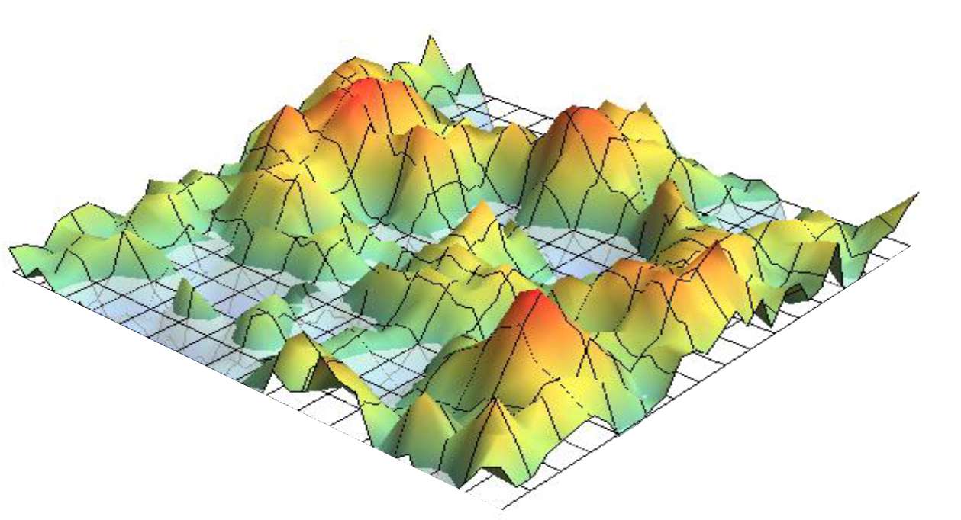
Streamflow-based snow mass reconstruction using spatial melt patterns from synthetic snow cover maps
Pau Wiersma (pau.wiersma@unil.ch), Fatemeh Zakeri & Grégoire Mariéthoz
Problem statement
In reality, the lower the snow cover fractions, the less area contributes to the snow melt and therefore the smoother the melt response will be
In hydrological models, a grid cell can often only be either fully snow covered or fully snow depleted
Since the entire grid cell area is contributing to the snow melt until all the snow has disappeared, the simulated melt is likely too abrupt
To prevent this behaviour, remotely sensed snow cover can inform the model on the subgrid snow cover fraction and help to smooth out the simulated melt
But what about days without remotely sensed snow cover observations?
 | Snow water equivalent | Snow melt response
Reality
Hydrological Model
Hydrological model + Remotely sensed snow cover fraction
+

Slide 6
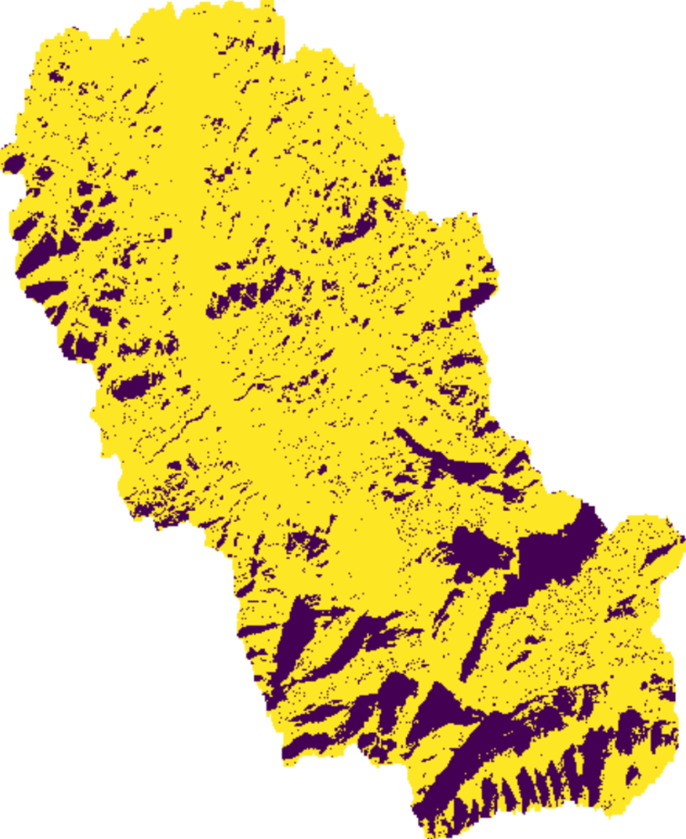
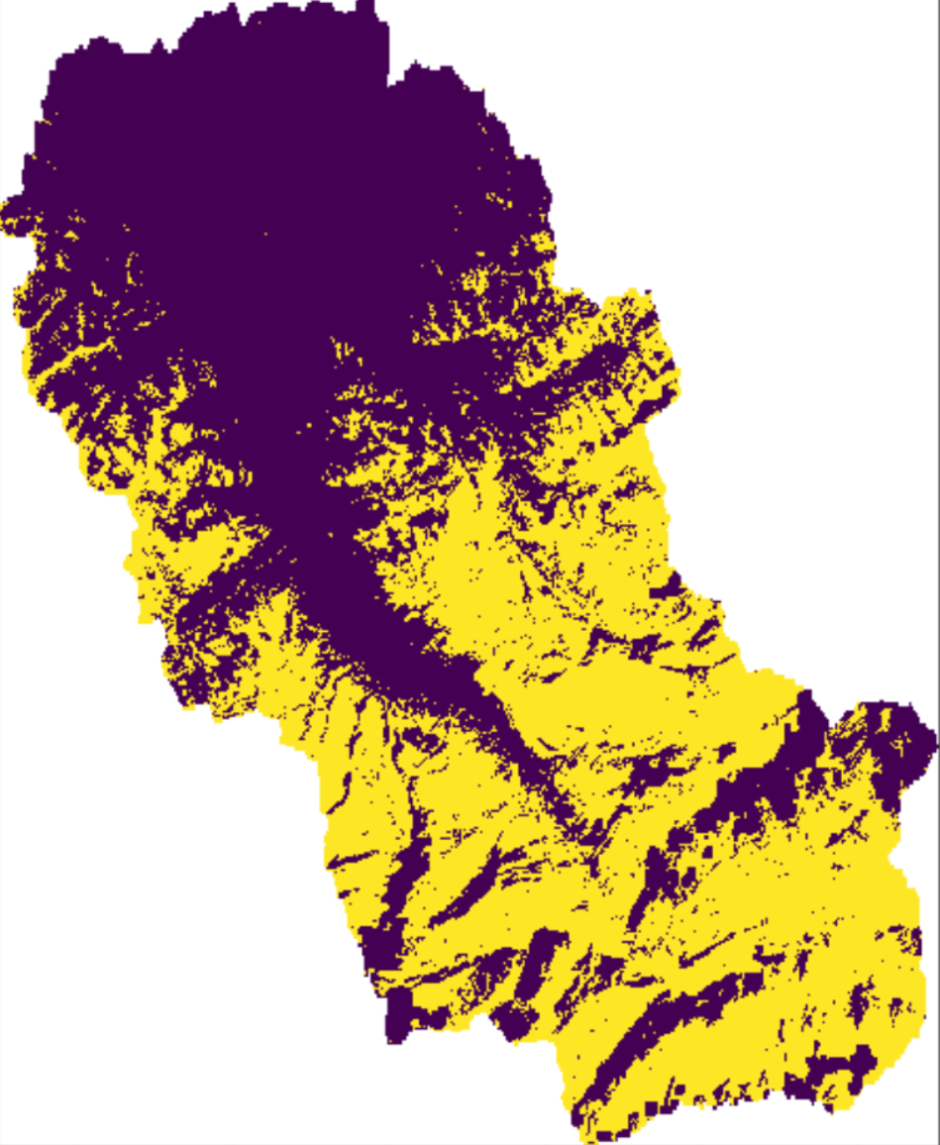
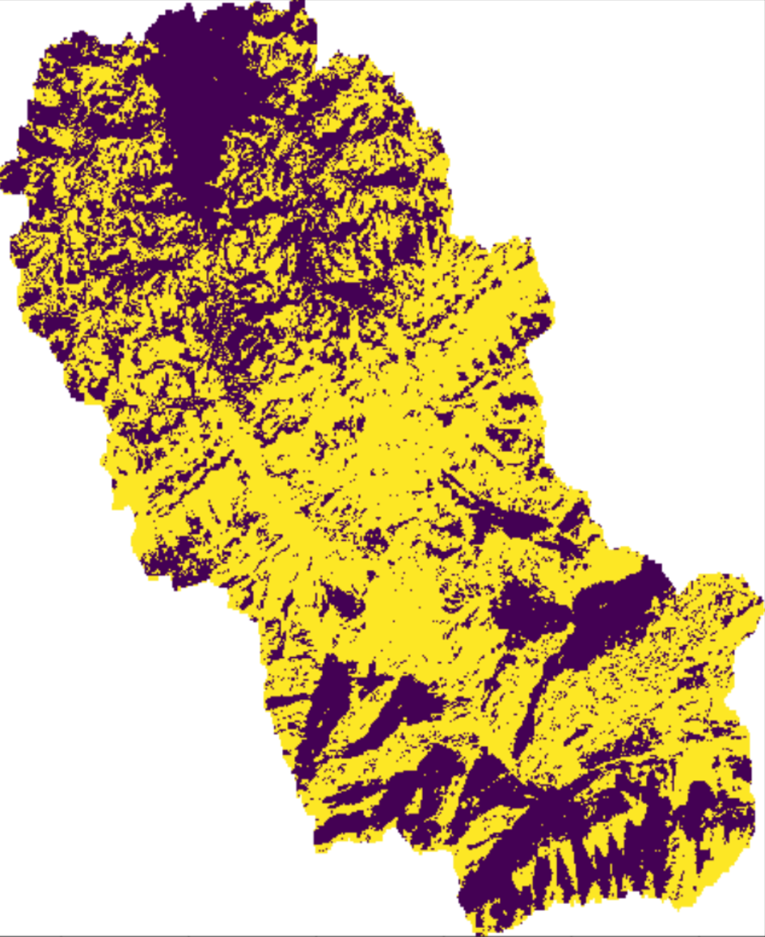
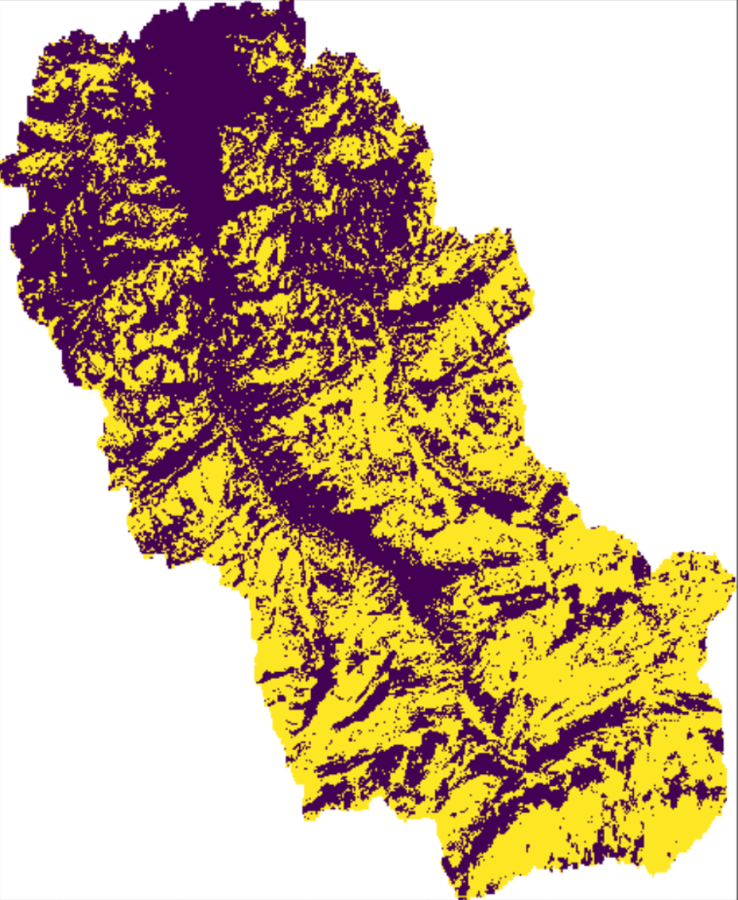
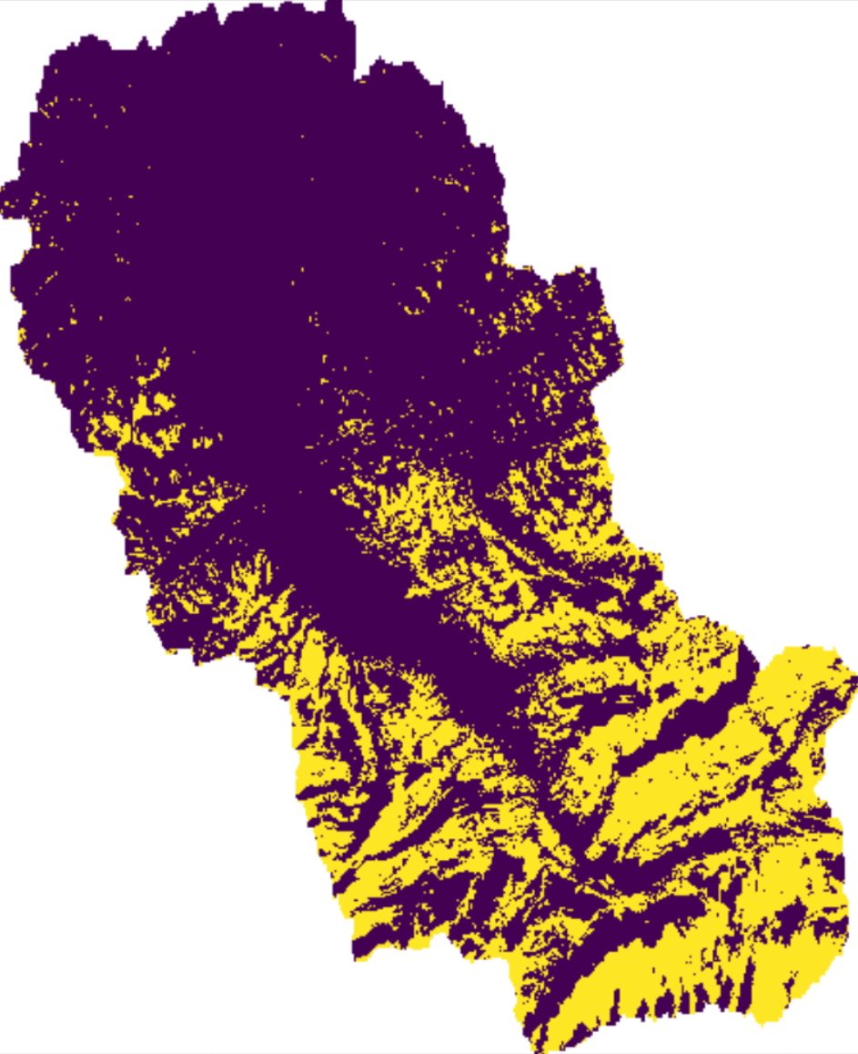
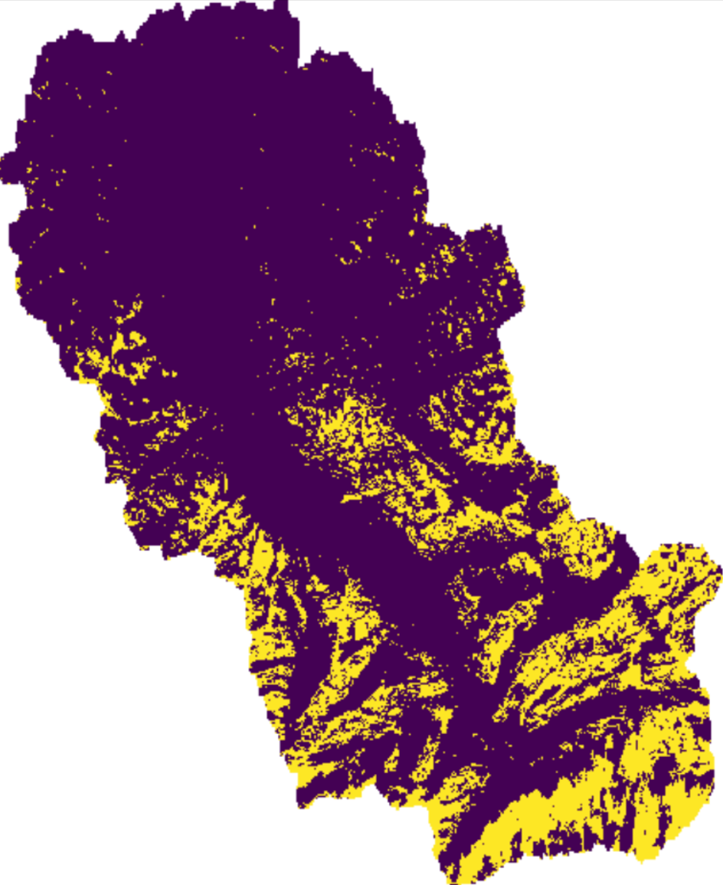
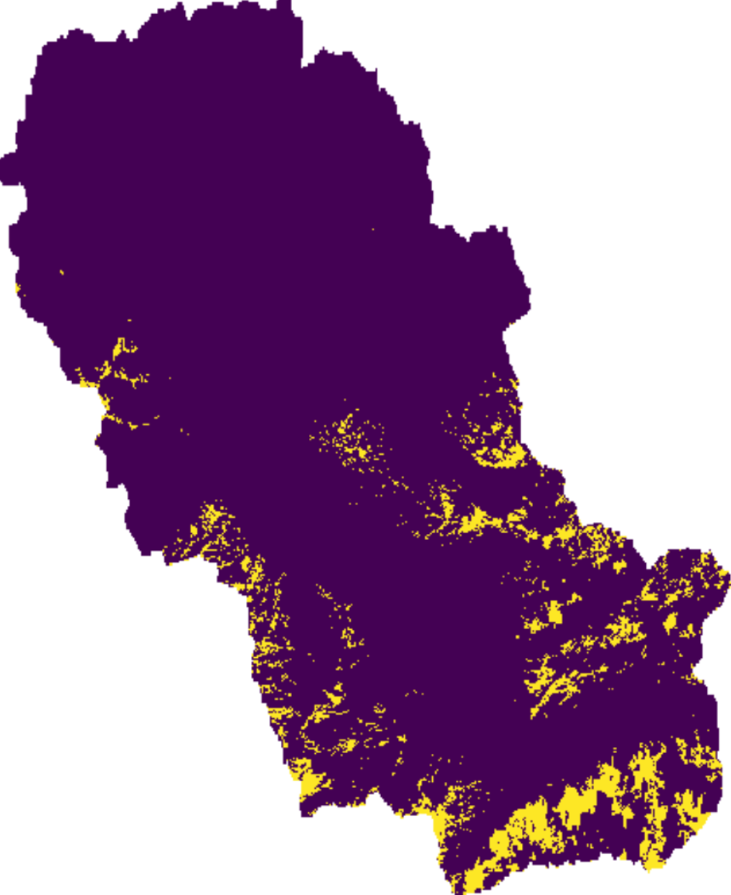
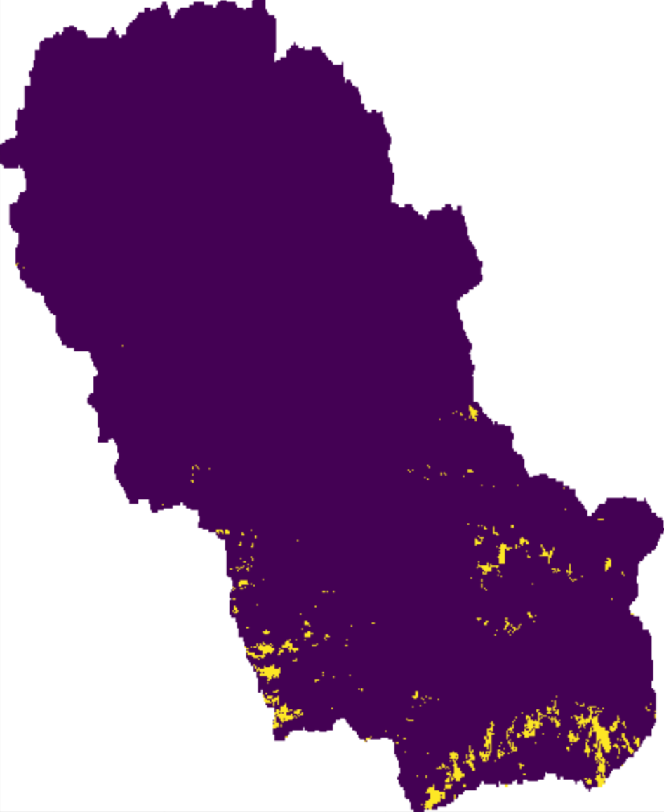
Streamflow-based snow mass reconstruction using spatial melt patterns from synthetic snow cover maps
Pau Wiersma (pau.wiersma@unil.ch), Fatemeh Zakeri & Grégoire Mariéthoz
Proposal
Recently, multiple studies have attempted to create a daily time series of high-resolution snow cover maps by downscaling MODIS or resampling Landsat/Sentinel-2 imagery
Zakeri & Mariéthoz (in preparation), have developed a methodology that can run independently from MODIS imagery and has the potential to synthetize snow cover maps before 2000 and into the future
In this study, we assess the added benefit of using these synthetic snow cover maps to inform the hydrological model on the per pixel snow cover fraction and consequently the per pixel melt factor reduction
We do this by running the streamflow-based SWE reconstruction with and without the synthetic snow cover maps and consequently evaluating the results using in-situ observations and MODIS snow cover maps
The study is carried out between 1999-2008 in the Thur-Jonschwil catchment in eastern Switzerland using the wflow_sbm hydrological model
Real snow cover maps
2100
1950
Synthetic snow cover maps

Slide 7
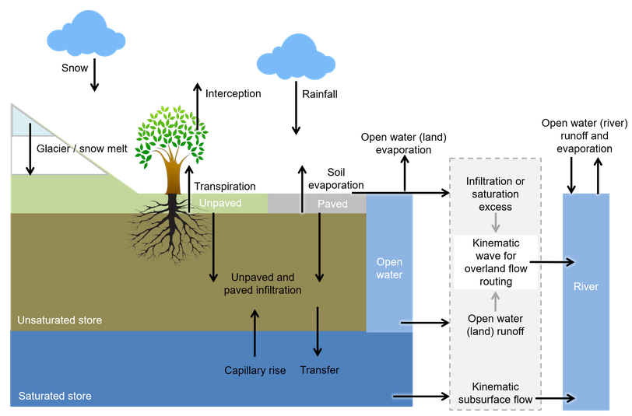
Streamflow-based snow mass reconstruction using spatial melt patterns from synthetic snow cover maps
Pau Wiersma (pau.wiersma@unil.ch), Fatemeh Zakeri & Grégoire Mariéthoz
Hydrological Model
Wflow_sbm (van Verseveld et al., in review)
Snow module:
Gridded version of HBV-96
Constant and uniform degree day melt factor
Liquid water content + refreezing
Partial rain/snowfall around 0° C
Lateral gravitational transport
Julia source code run within the python wrapper pywflow (Schilperoort, B. (2023). github.com/eWaterCycle/pywflow)
1km resolution
We use the station-based gridded daily TabsD (temperature) and RhiresD (precipitation) products of MeteoSwiss as forcing (2km resolution)

Slide 8
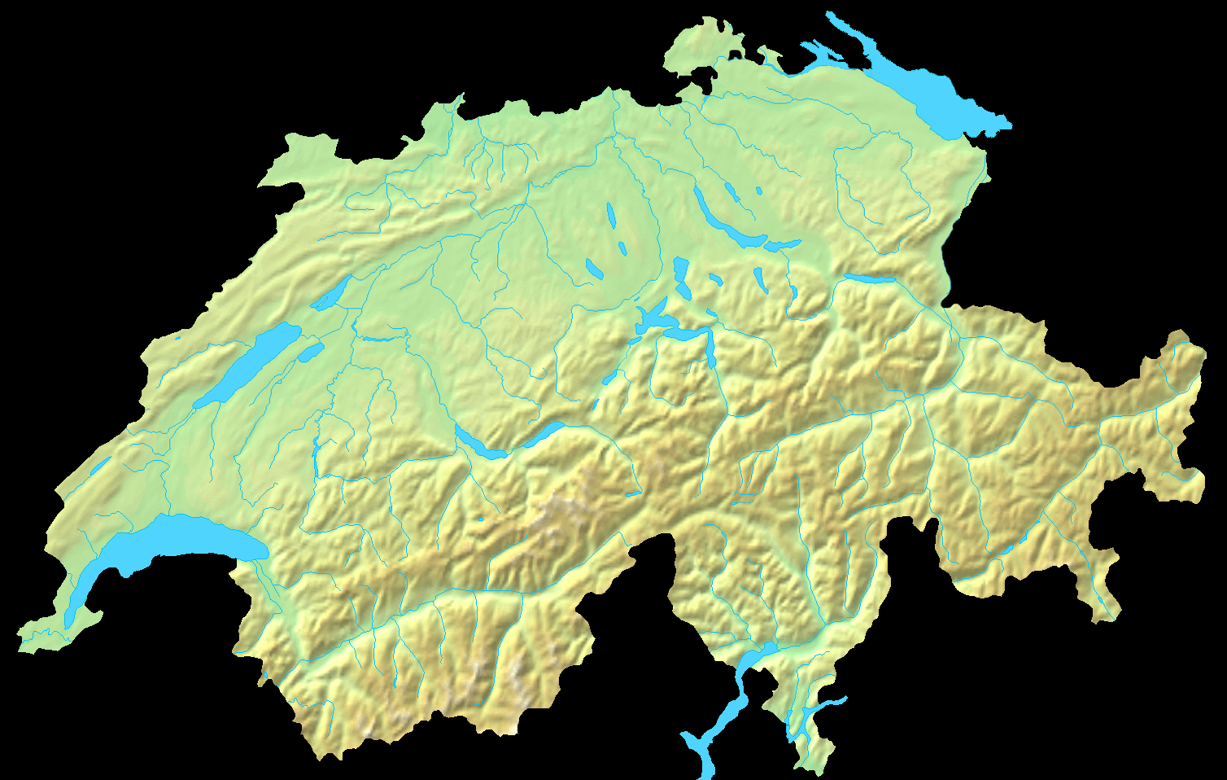
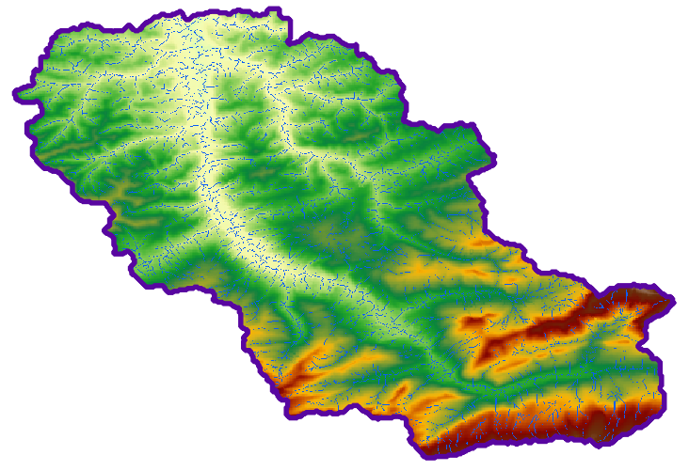
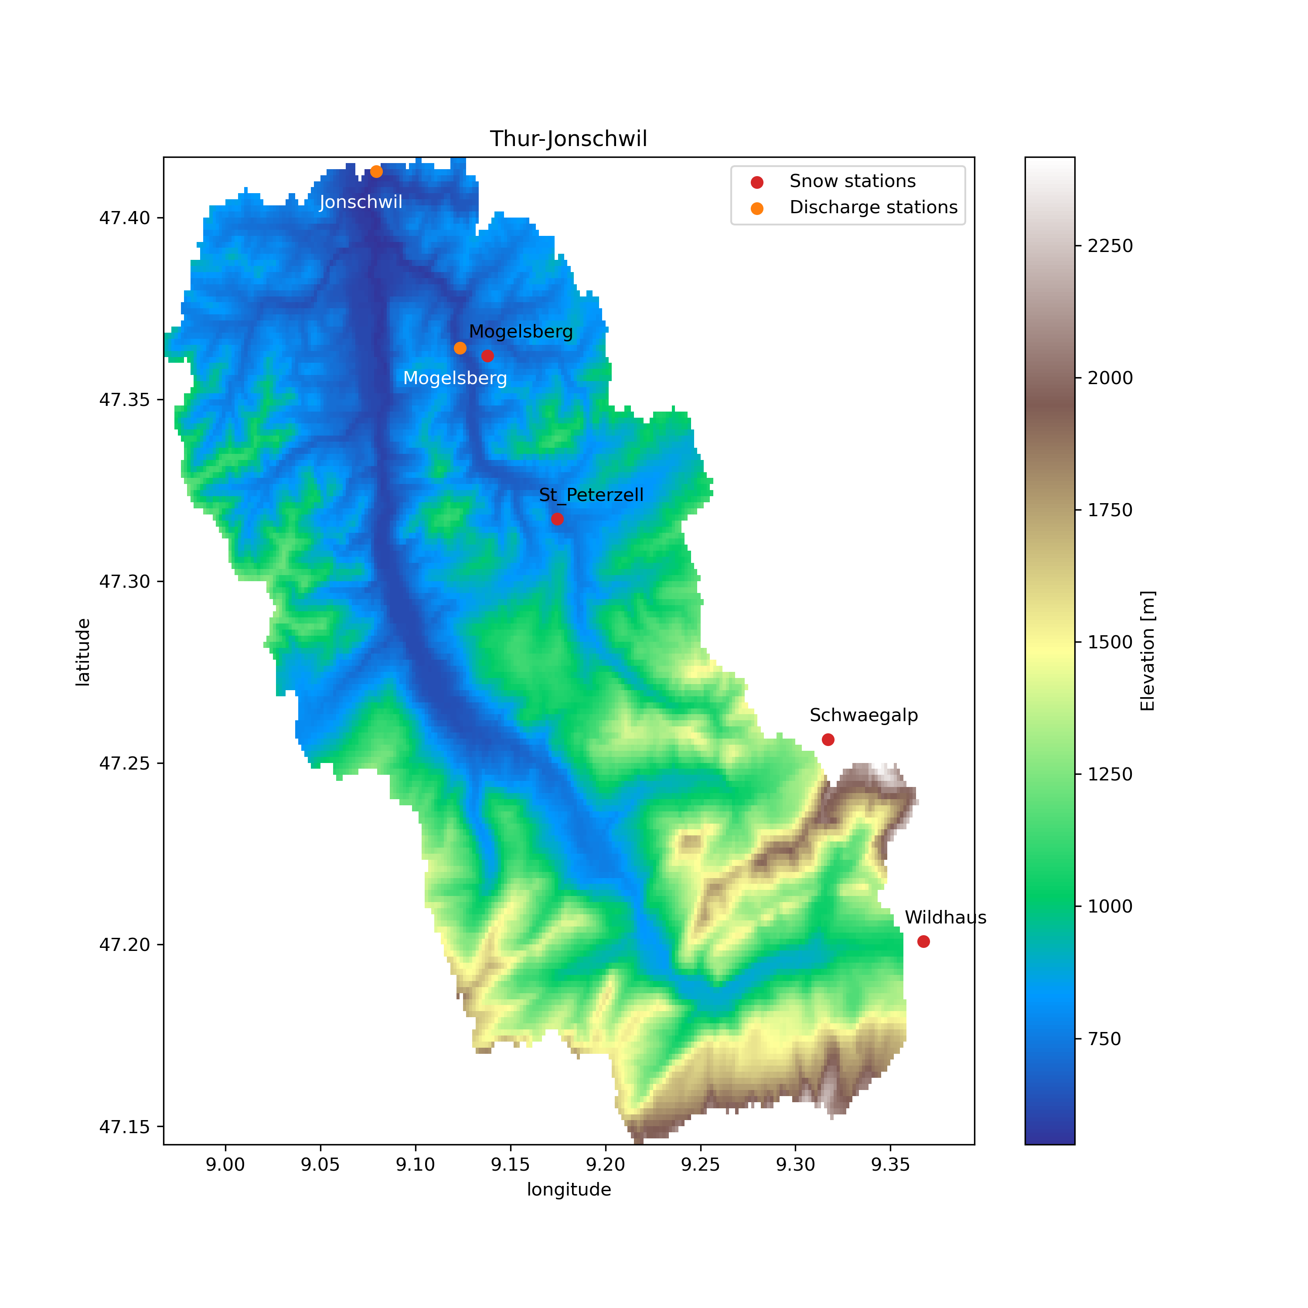
Streamflow-based snow mass reconstruction using spatial melt patterns from synthetic snow cover maps
Pau Wiersma (pau.wiersma@unil.ch), Fatemeh Zakeri & Grégoire Mariéthoz
Test catchment
Thur-Jonschwil in Eastern Switzerland (493 km²)
Intermittent snow cover at lower elevations
Mean peak SWE of 650mm at Säntis (2502m)
Discharge measurements (BAFU)
Jonschwil (1966-2023)
Mogelsberg (88 km², 1972 – 2023)
Snow depth measurements
Schwägalp (SLF, 1348m)
Wildhaus (MeteoSwiss, 998m)
Mogelsberg (MeteoSwiss, 780m)
St Peterzell (MeteoSwiss, 700m)
The snow depth data have been gap-filled and converted to SWE by SLF
Notes:
Size + webcam image

Slide 9
Streamflow-based snow mass reconstruction using spatial melt patterns from synthetic snow cover maps
Pau Wiersma (pau.wiersma@unil.ch), Fatemeh Zakeri & Grégoire Mariéthoz
Methods (1/2)
4 model settings of increasing complexity
In S4, the snow cover fraction is calculated for each 1km grid cell using the fraction of 30m synthetic binary snow cover maps
This snow cover fraction is consequently multiplied by the basin-wide melt factor to obtain the distributed melt factor
Whenever there is still SWE in the hydrological model but the 1km snow cover fraction is zero it is converted to 100% to accelerate the meltout and prevent SWE persistance
Setting | Accumulation | Ablation
S1
S2
S3
S4
No snowfall correction
Constant, uniform
Snowfall correction
Constant, uniform
Snowfall correction
Constant, seasonal
Snowfall correction
Distributed, seasonal
Notes:
S1 serves as the benchmark
The snowfall correction should correct for gauge undercatch and forcing biases
The seasonally varying melt factor should account for changes in solar radiation
The distributed melt factor should account for spatial snow cover fraction variations

Slide 10
Streamflow-based snow mass reconstruction using spatial melt patterns from synthetic snow cover maps
Pau Wiersma (pau.wiersma@unil.ch), Fatemeh Zakeri & Grégoire Mariéthoz
Methods (2/2)
For each model setting:
500 calibration runs using the ROPE optimization algorithm (Bardossy et al., 2008) within SPOTPY (Houska et al., 2015) over the period 1999-2008
Keep the 10 runs with the highest KGE for evaluation
For calibration we use only the streamflow at Jonschwil For evaluation we use:
Streamflow at Mogelsberg
Modeled SWE at snow stations
MODIS snow cover upscaled to 1km
For all setting two sensitive soil parameters are included in the calibration
For S1+2 we calibrate the static melt factor, while for S3+4 we calibrate both the minimum and maximum between which the melt factor fluctuates
Setting | Accumulation | Ablation
S1
S2
S3
S4
No snowfall correction
Constant, uniform
Snowfall correction
Constant, uniform
Snowfall correction
Constant, seasonal
Snowfall correction
Distributed, seasonal
Notes:
S1 serves as the benchmark
The snowfall correction should correct for gauge undercatch and forcing biases
The seasonally varying melt factor should account for changes in solar radiation
The distributed melt factor should account for spatial snow cover fraction variations

Slide 11
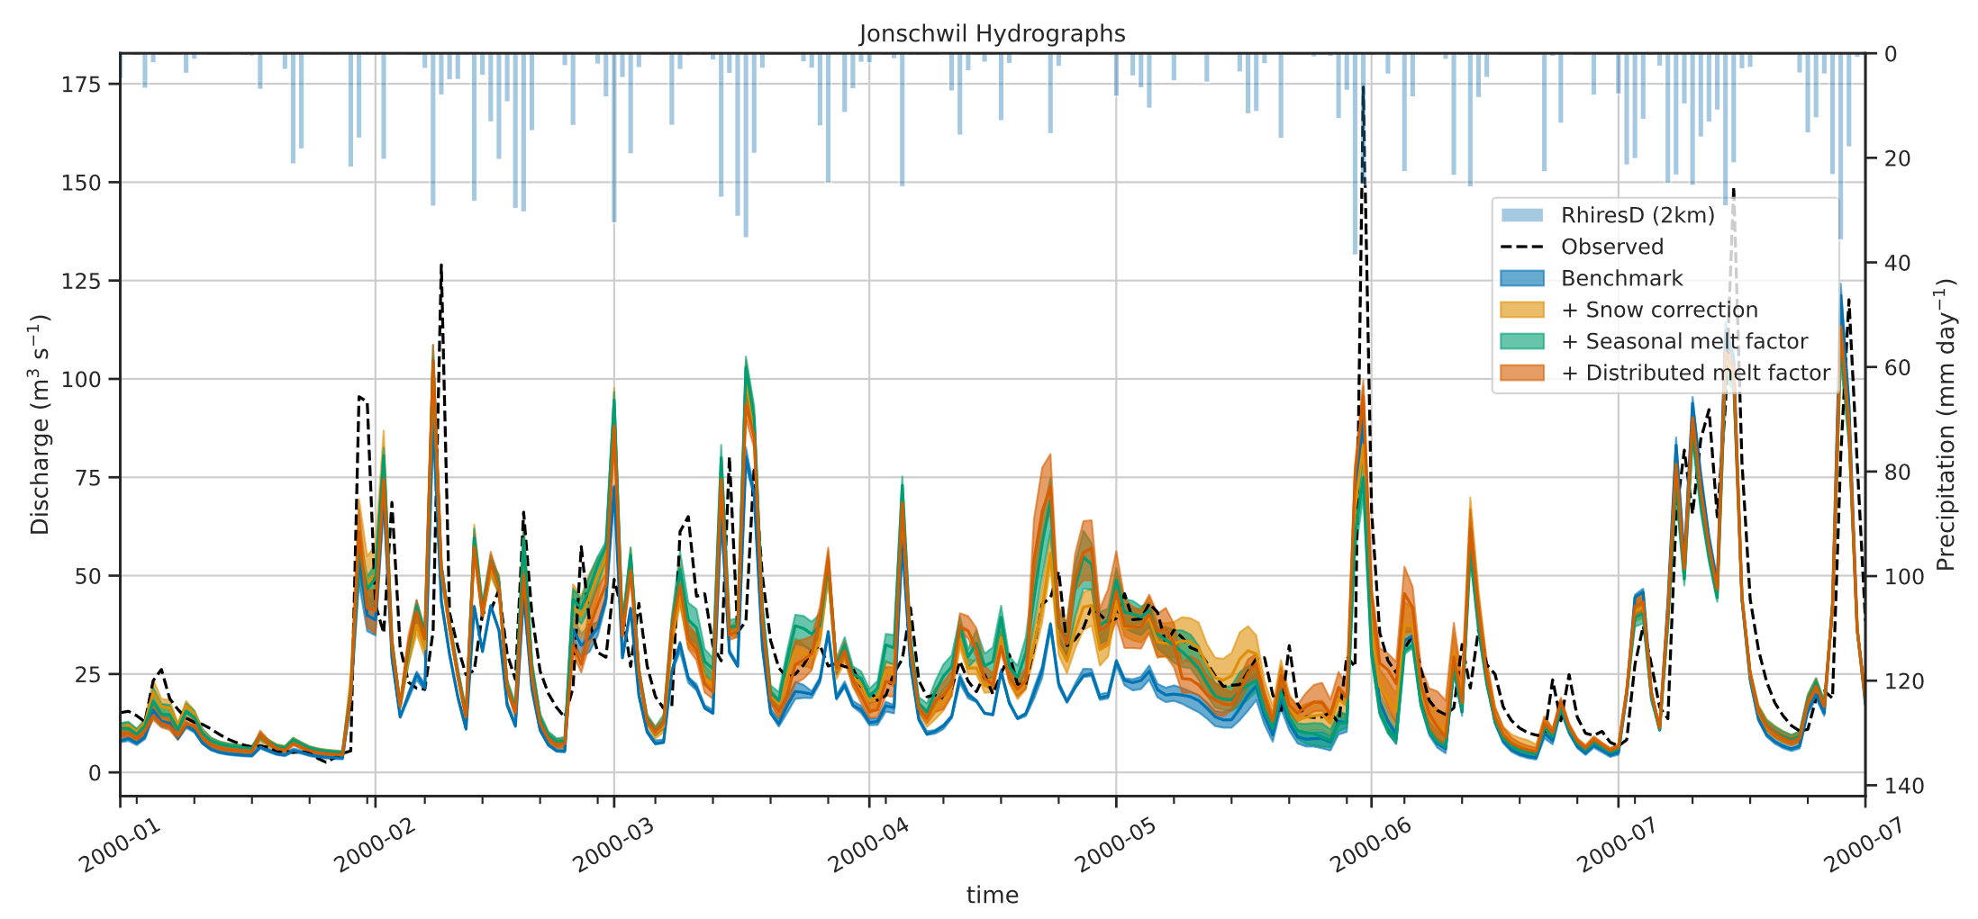
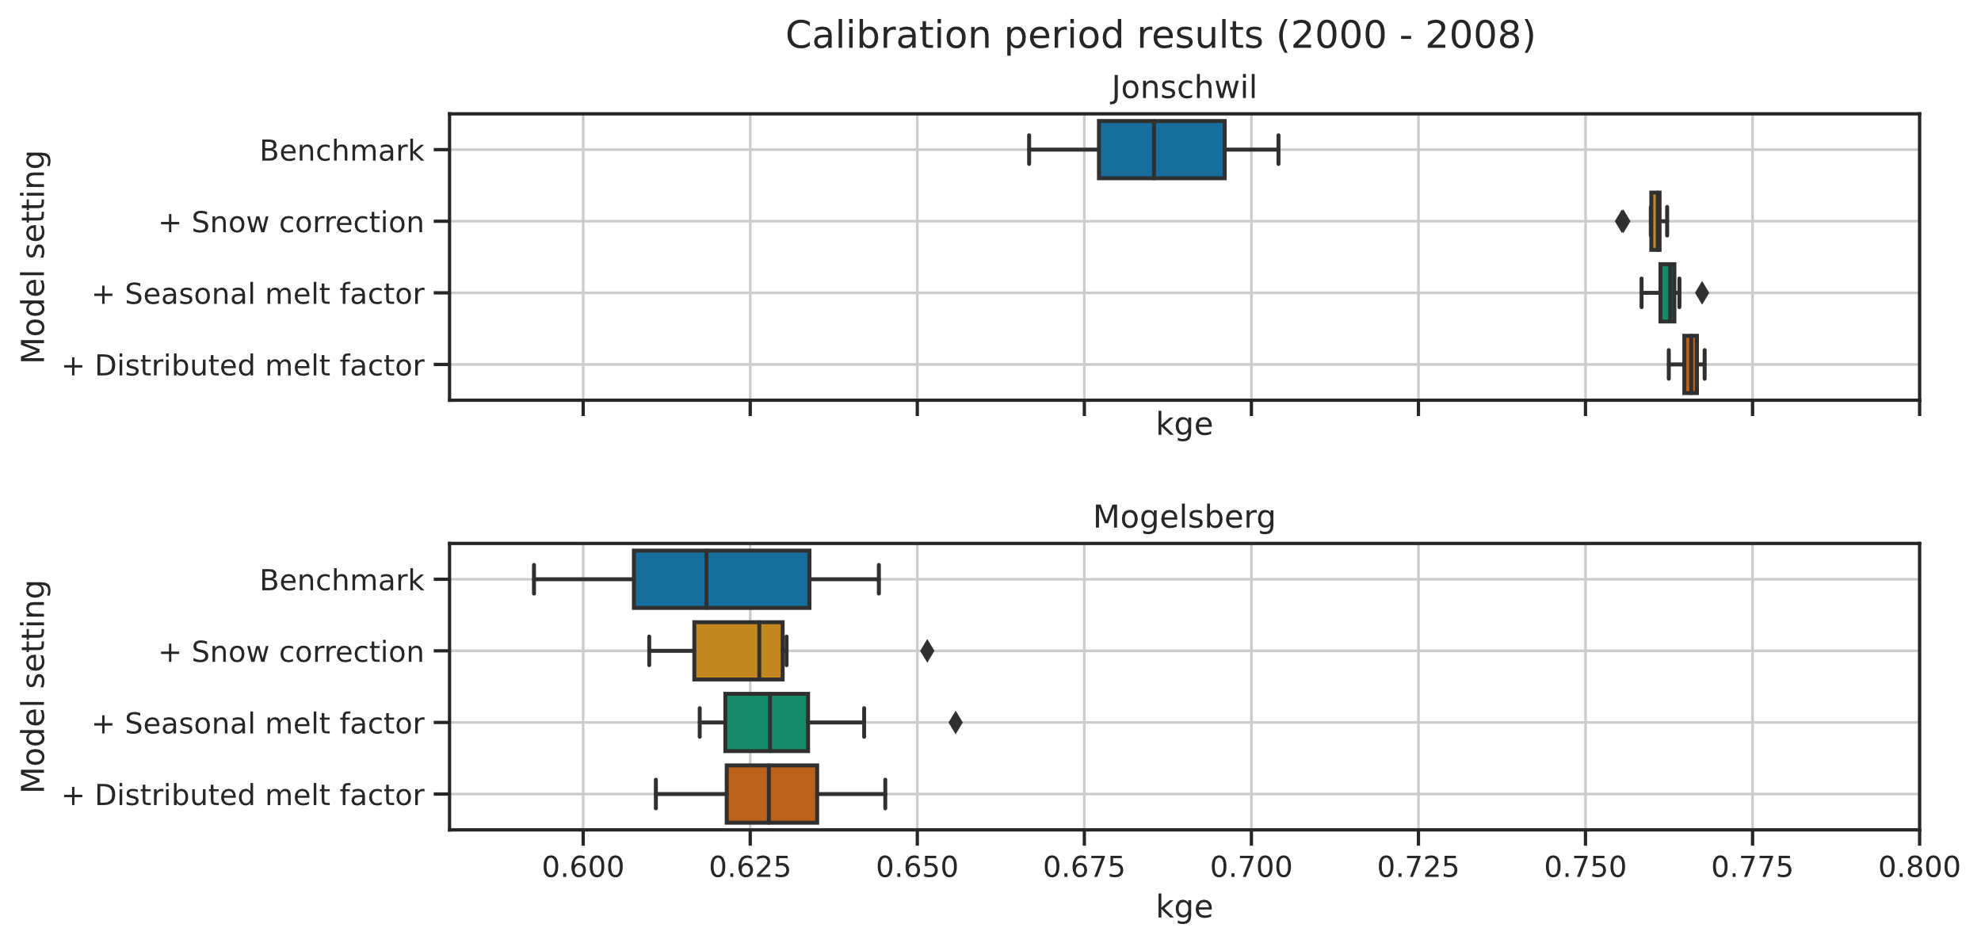
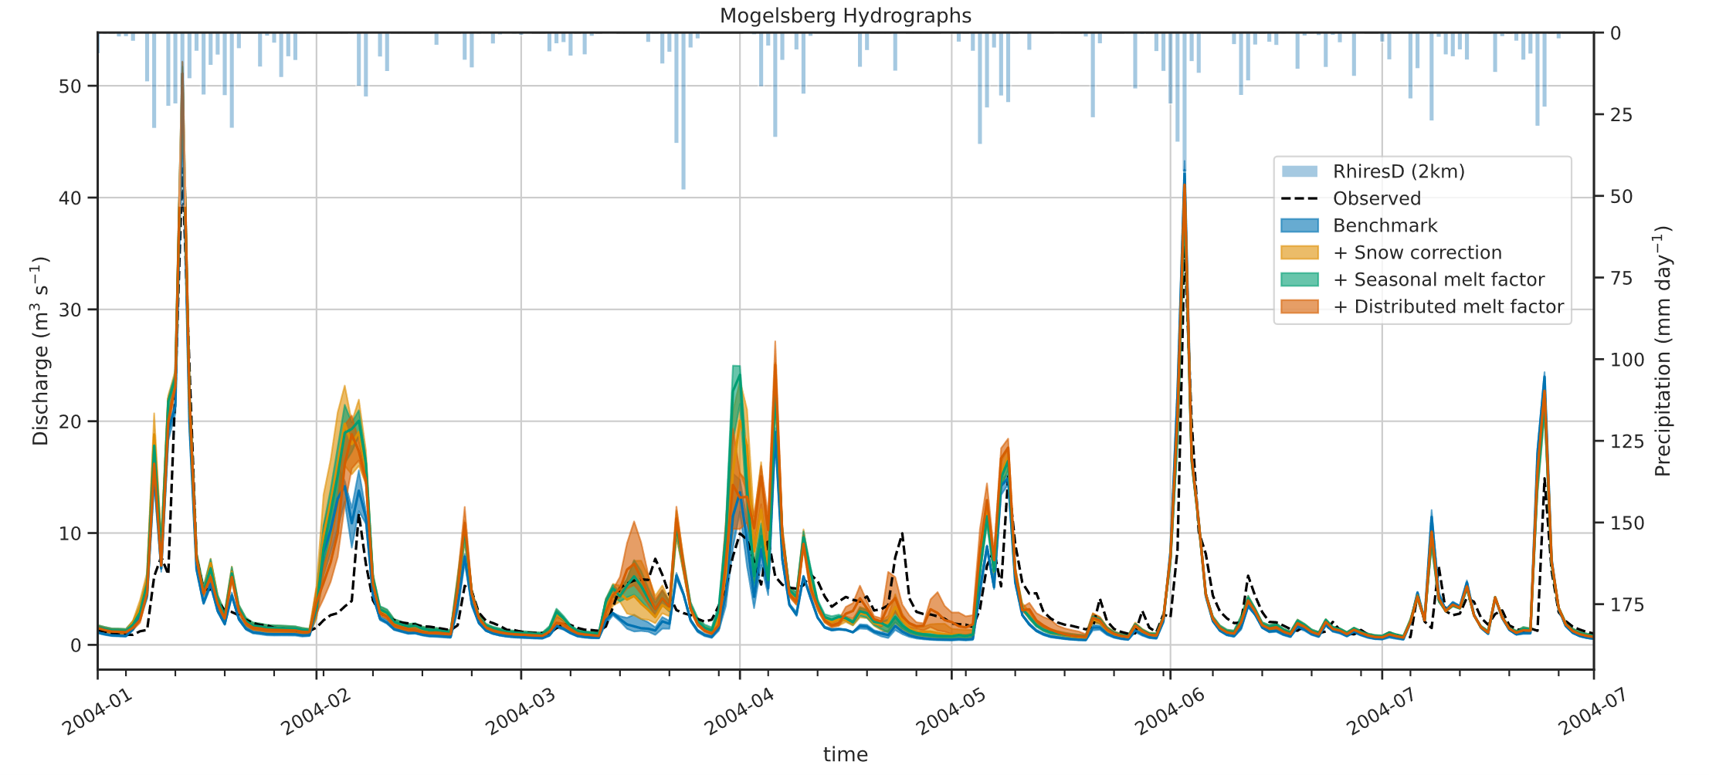
Streamflow-based snow mass reconstruction using spatial melt patterns from synthetic snow cover maps
Pau Wiersma (pau.wiersma@unil.ch), Fatemeh Zakeri & Grégoire Mariéthoz
Results - streamflow evaluation
Applying the snowfall increases KGE performance
No significant improvement from making the melt factor vary in time or space
Notes:
S1 serves as the benchmark
The snowfall correction should correct for gauge undercatch and forcing biases
The seasonally varying melt factor should account for changes in solar radiation
The distributed melt factor should account for spatial snow cover fraction variations

Slide 12
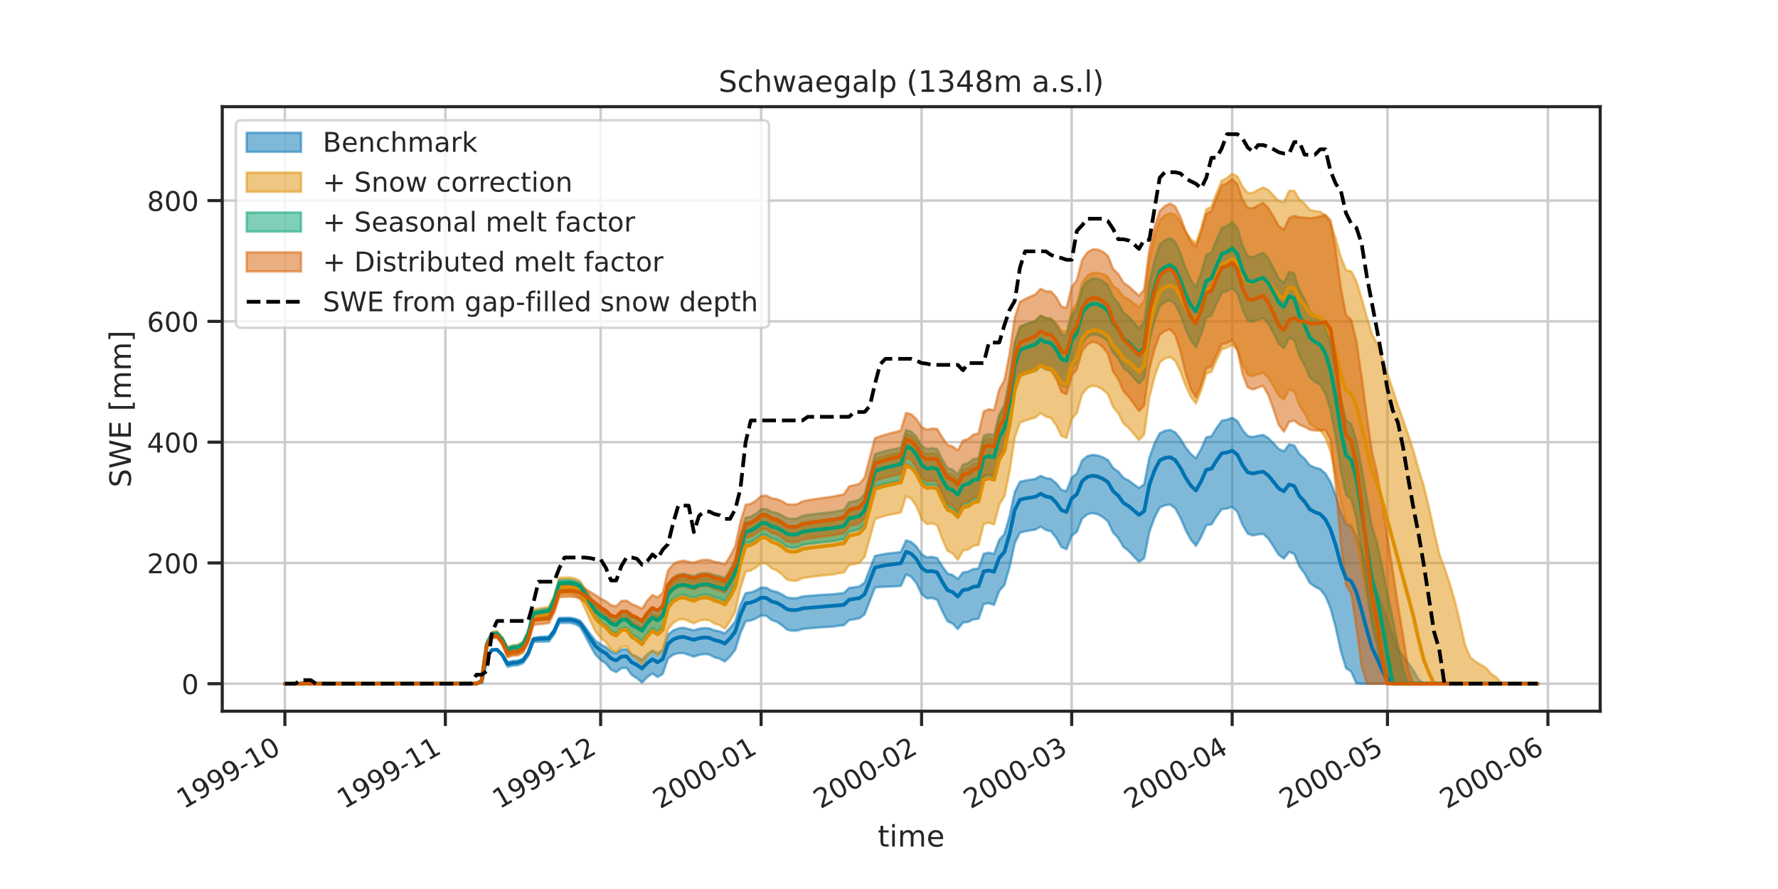
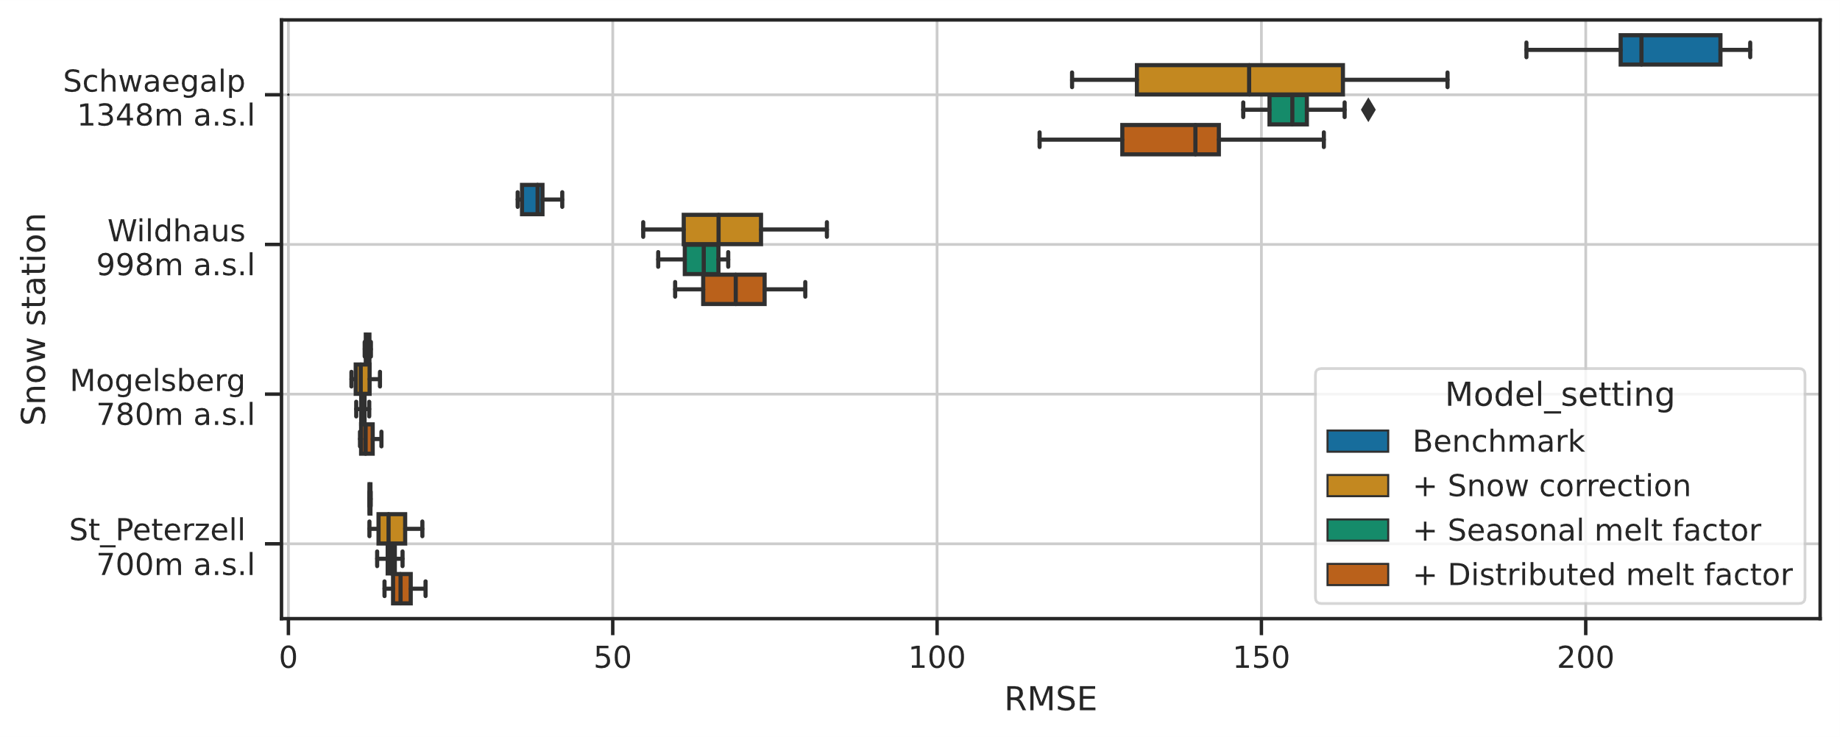
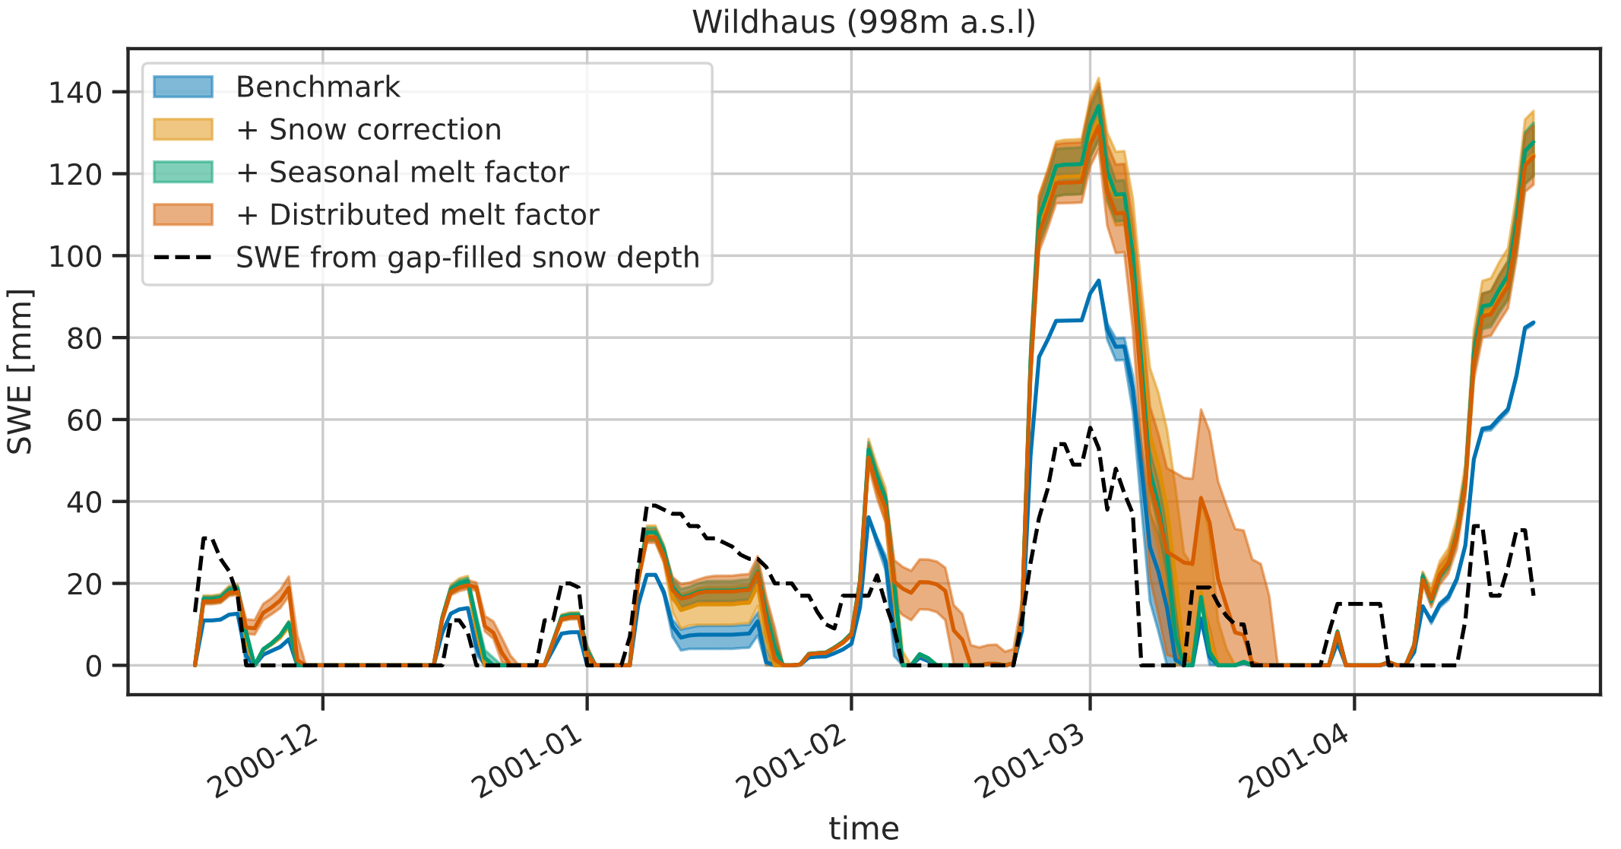
Streamflow-based snow mass reconstruction using spatial melt patterns from synthetic snow cover maps
Pau Wiersma (pau.wiersma@unil.ch), Fatemeh Zakeri & Grégoire Mariéthoz
Results - Snow station evaluation
Reduced underestimation with the distributed melt factor (S4) at the highest station (Schwägalp)
Frequent overestimation and reduced performance at other stations
Notes:
S1 serves as the benchmark
The snowfall correction should correct for gauge undercatch and forcing biases
The seasonally varying melt factor should account for changes in solar radiation
The distributed melt factor should account for spatial snow cover fraction variations

Slide 13
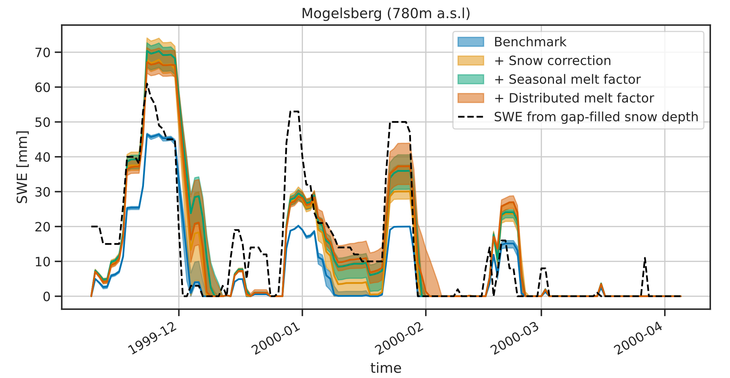
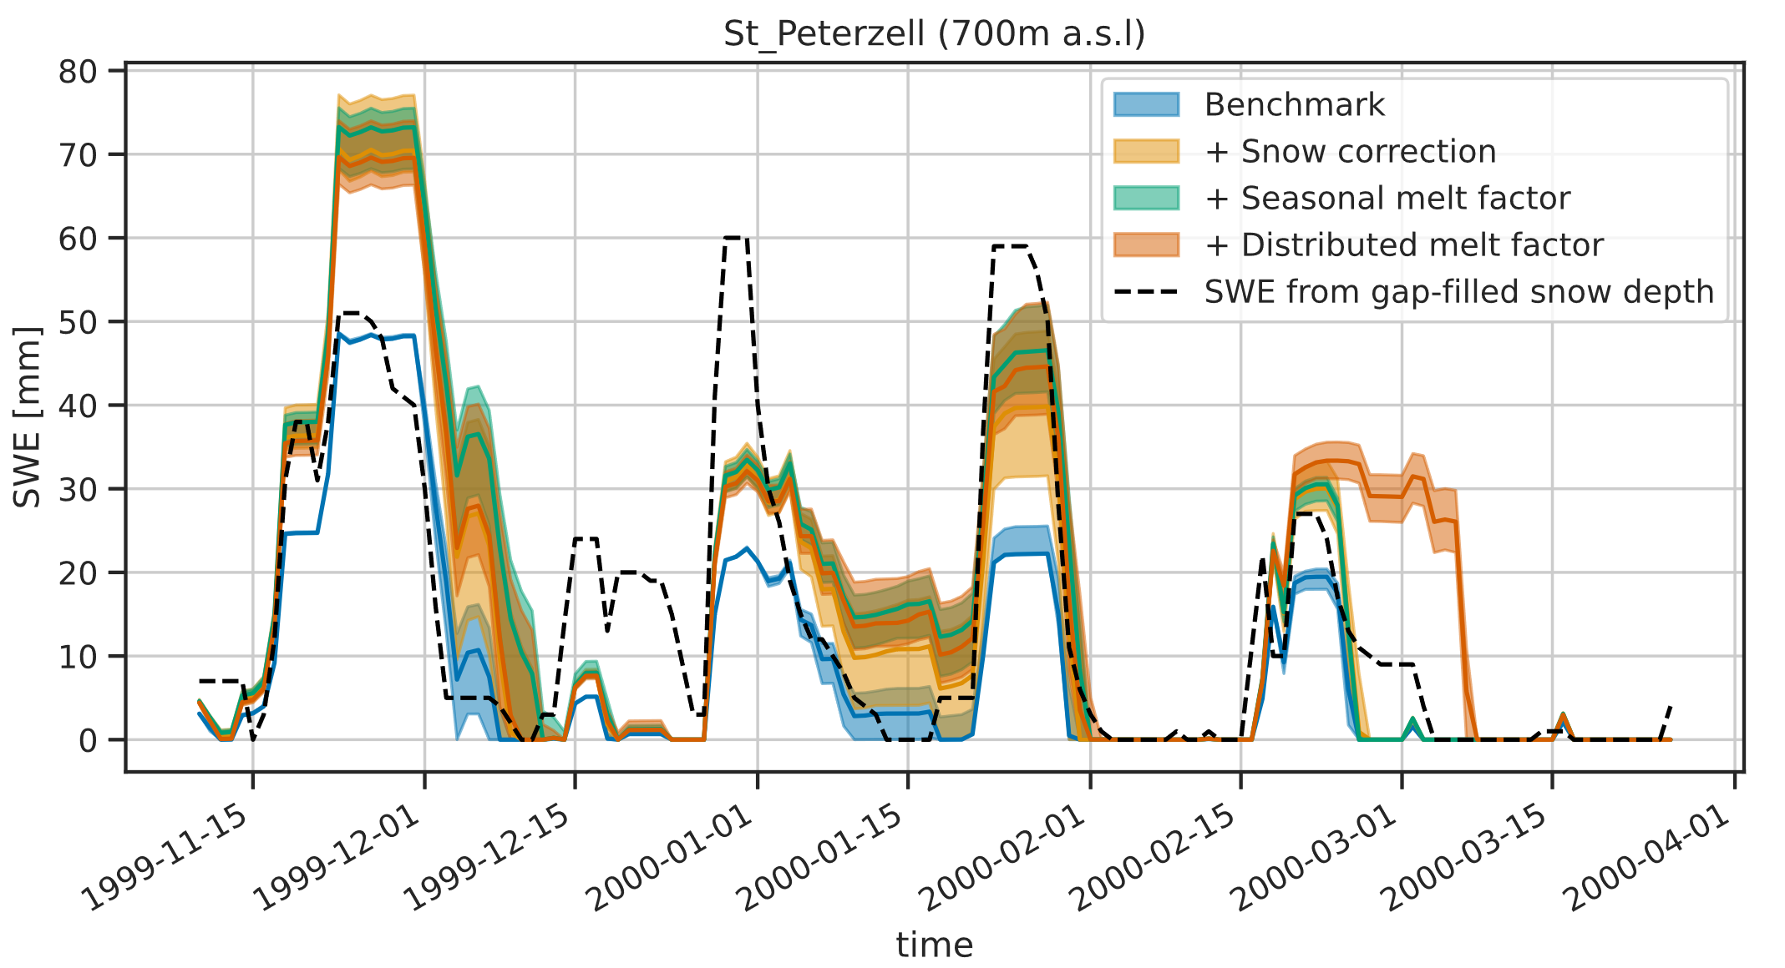
Streamflow-based snow mass reconstruction using spatial melt patterns from synthetic snow cover maps
Pau Wiersma (pau.wiersma@unil.ch), Fatemeh Zakeri & Grégoire Mariéthoz
Results - Snow station evaluation
Reduced underestimation with the distributed melt factor (S4) at the highest station (Schwägalp)
Frequent overestimation and reduced performance at other stations
Notes:
S1 serves as the benchmark
The snowfall correction should correct for gauge undercatch and forcing biases
The seasonally varying melt factor should account for changes in solar radiation
The distributed melt factor should account for spatial snow cover fraction variations

Slide 14
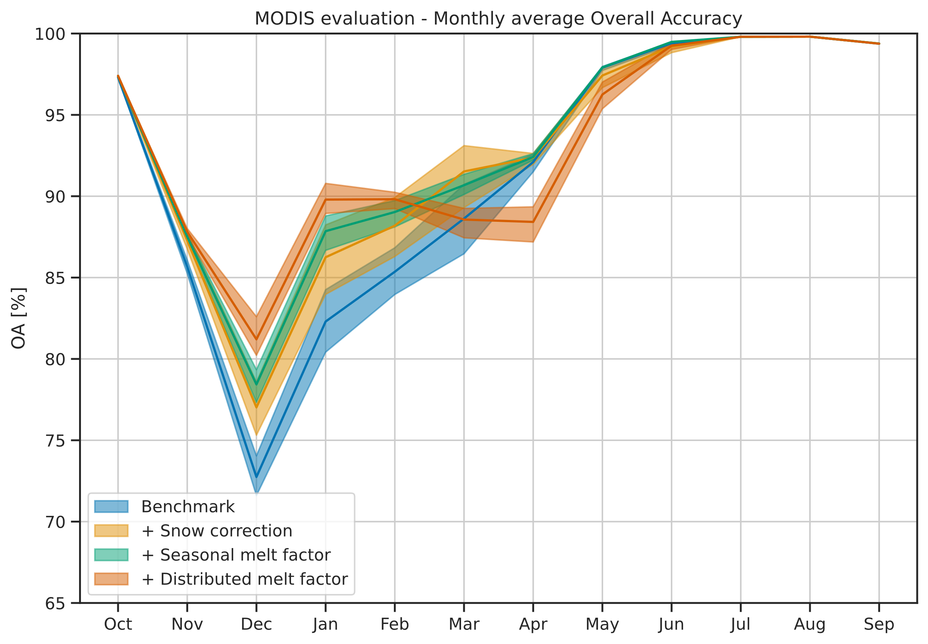
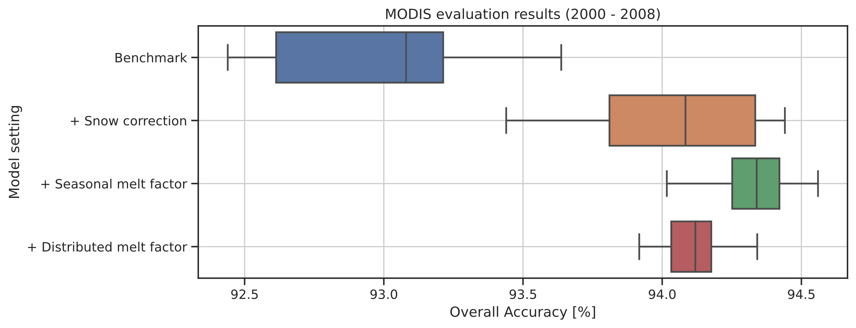
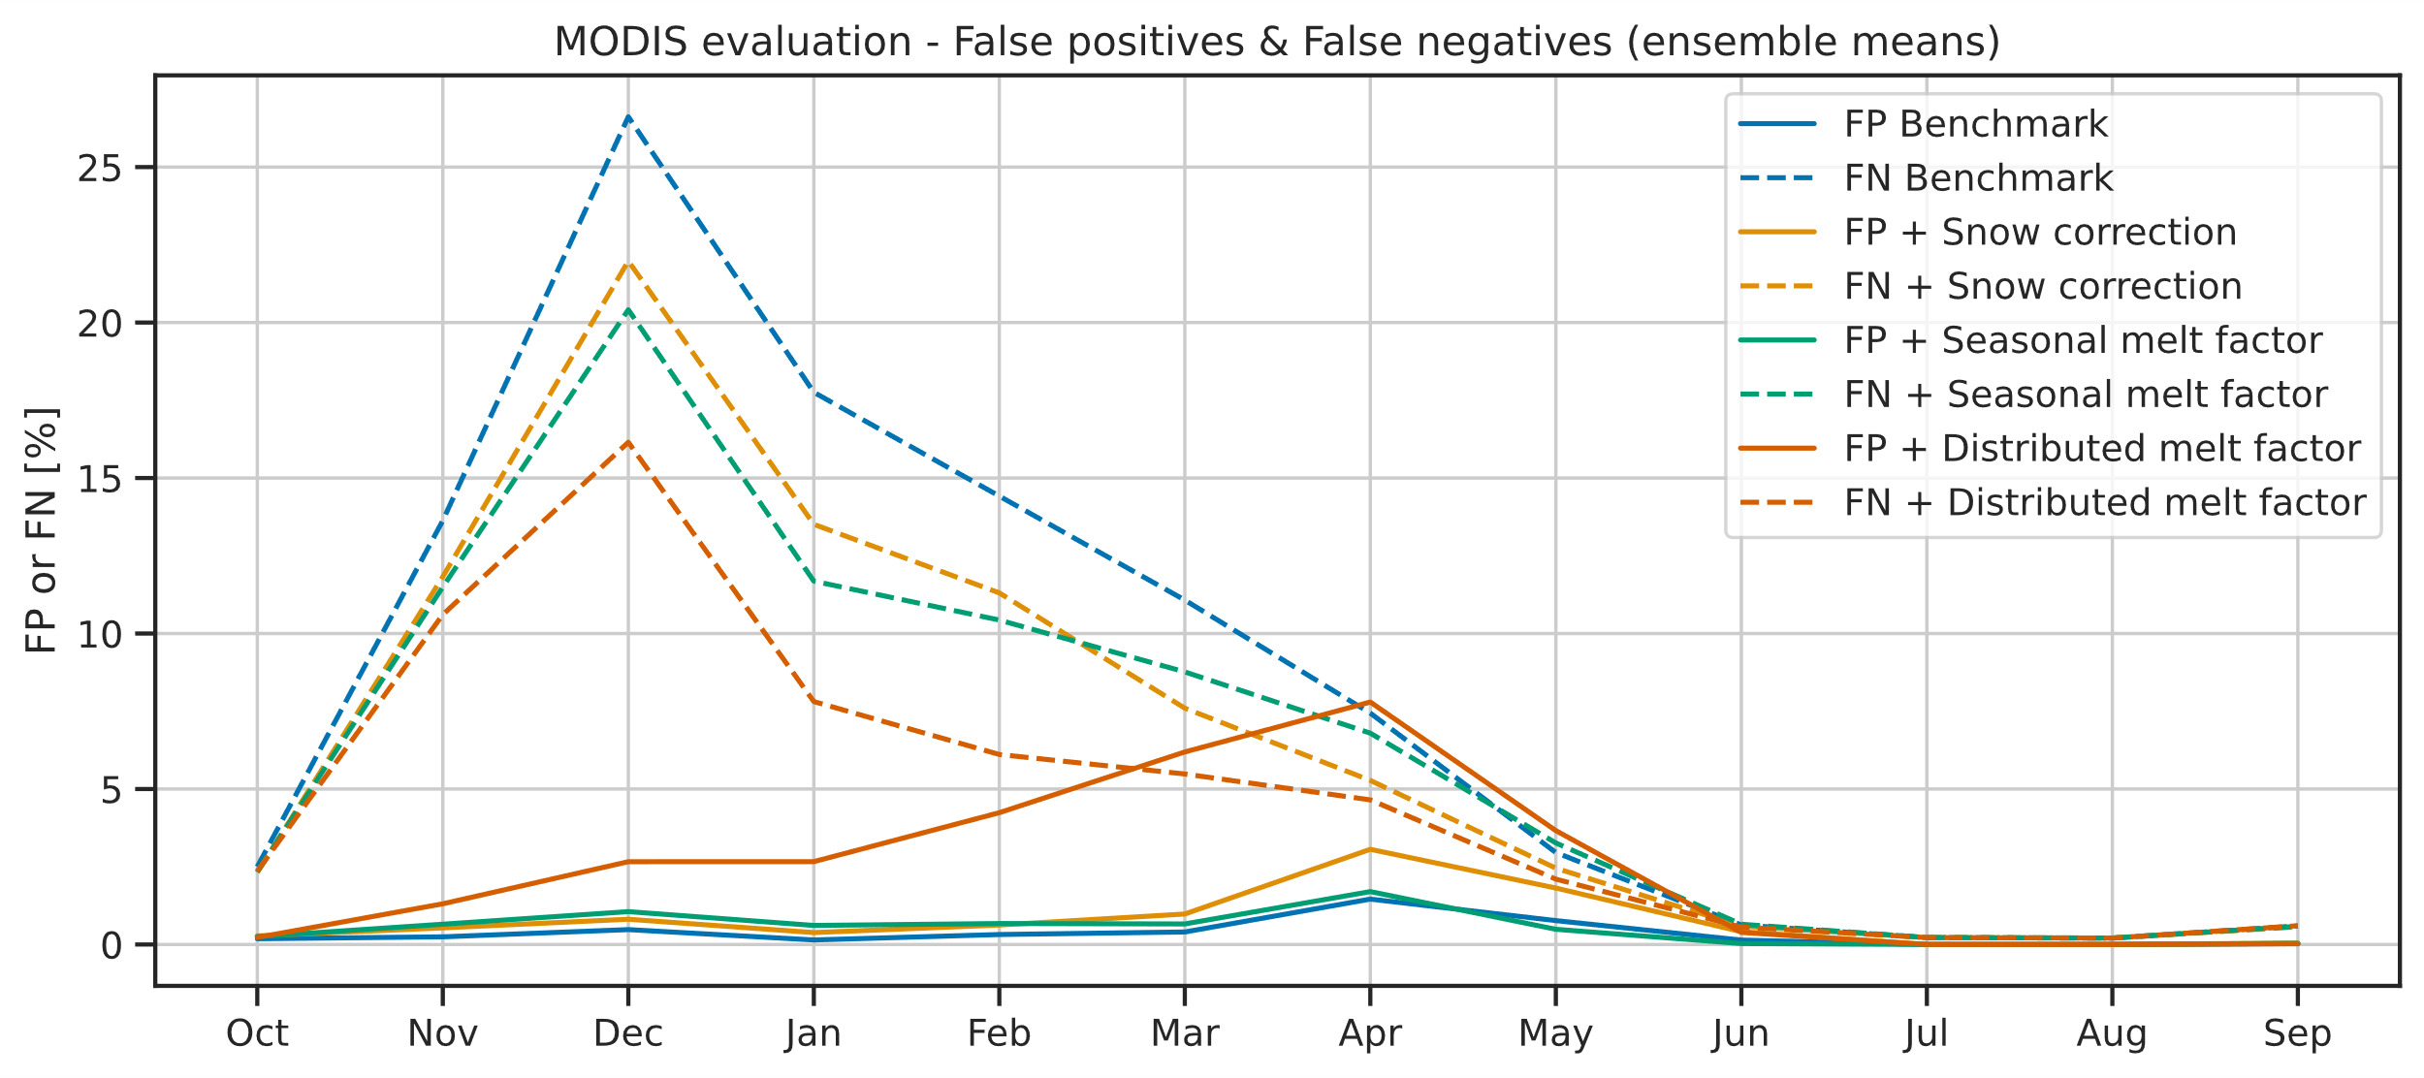
Streamflow-based snow mass reconstruction using spatial melt patterns from synthetic snow cover maps
Pau Wiersma (pau.wiersma@unil.ch), Fatemeh Zakeri & Grégoire Mariéthoz
Results - MODIS snow cover evaluation
Despite the added information by the synthetic snow cover maps, the overall performance of S4 is reduced compared to S3
Particularly in late spring S4 contains many false positives (i.e. simulated meltout date is too late)
The opposite is the case in early winter, when S4 performs better due to less false negatives (i.e. early winter meltouts are correctly prevented)
Notes:
S1 serves as the benchmark
The snowfall correction should correct for gauge undercatch and forcing biases
The seasonally varying melt factor should account for changes in solar radiation
The distributed melt factor should account for spatial snow cover fraction variations

Slide 15
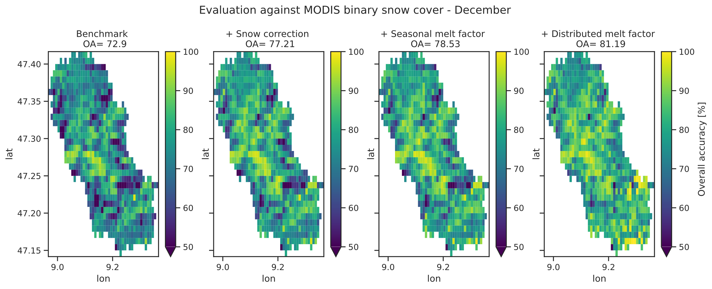
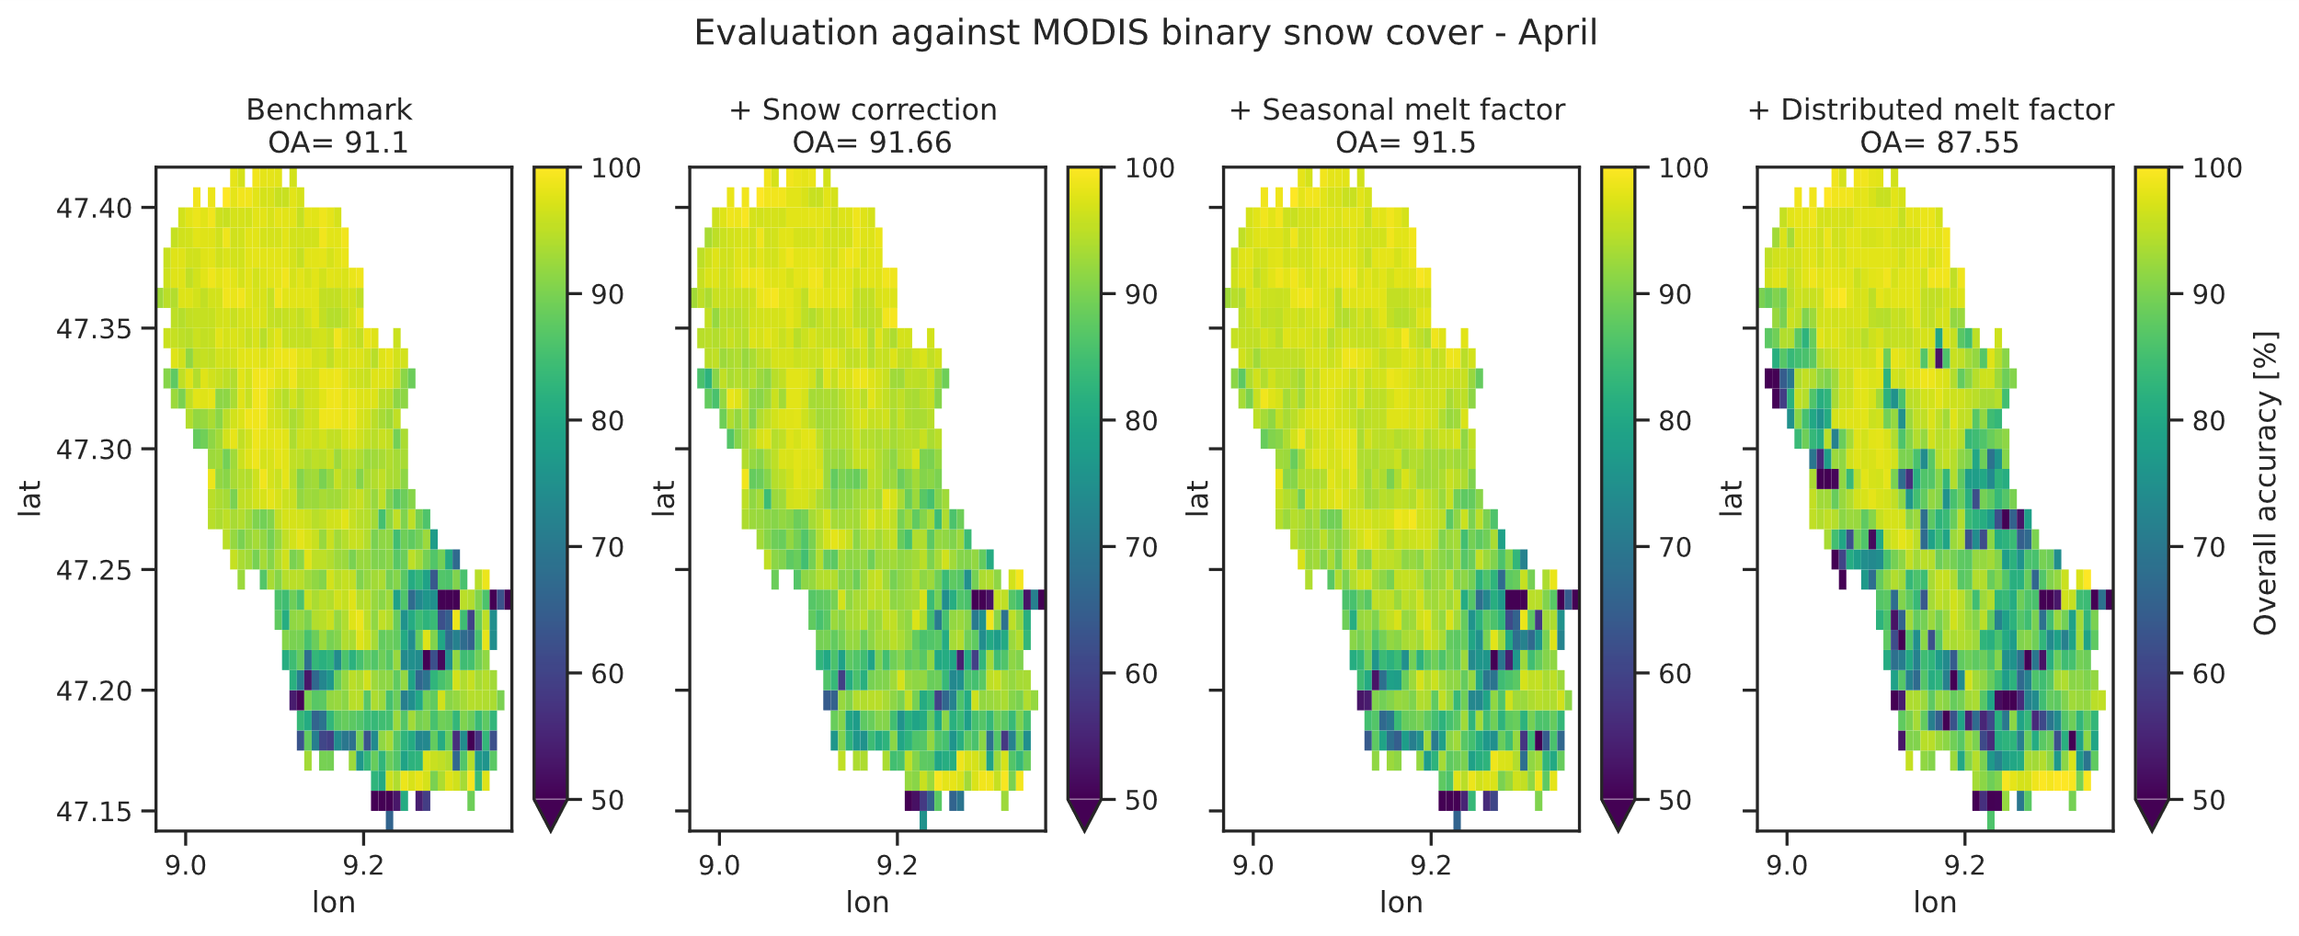
Streamflow-based snow mass reconstruction using spatial melt patterns from synthetic snow cover maps
Pau Wiersma (pau.wiersma@unil.ch), Fatemeh Zakeri & Grégoire Mariéthoz
Results - MODIS snow cover evaluation
Despite the added information by the synthetic snow cover maps, the overall performance of S4 is reduced compared to S3
Particularly in late spring S4 contains many false positives (i.e. simulated meltout date is too late)
The opposite is the case in early winter, when S4 performs better due to less false negatives (i.e. early winter meltouts are correctly prevented)
Notes:
S1 serves as the benchmark
The snowfall correction should correct for gauge undercatch and forcing biases
The seasonally varying melt factor should account for changes in solar radiation
The distributed melt factor should account for spatial snow cover fraction variations

Slide 16
Streamflow-based snow mass reconstruction using spatial melt patterns from synthetic snow cover maps
Pau Wiersma (pau.wiersma@unil.ch), Fatemeh Zakeri & Grégoire Mariéthoz
Preliminary conclusions
We performed streamflow-based snow mass reconstruction using 4 configurations of increasing complexity
Applying a snow cover correction (S1-2) improved streamflow, SWE and spatial snow cover results in nearly all cases
Going from a temporally constant to a seasonal melt factor (S2-3) only lead to a significant improvement in spatial snow cover results
Including synthetic spatial snow cover fraction maps to go from a spatially uniform to a spatially distributed melt factor (S3-4) surprisingly lead to reduced spatial snow cover performance, except in early winter. Streamflow and SWE modeling performance did not change significantly
Next steps
Assess the sensivity to the synthetic snow cover maps
Repeat setting 4 with MODIS snow cover fraction
Include more snow-dominated catchments
Compare multi-winter vs single winter reconstruction
Explore other ways of translating the snow cover fraction information to a distributed melt factor in the hydrological model to include:
Vegetation
Snowpack age
Shadow
Notes:
S1 serves as the benchmark
The snowfall correction should correct for gauge undercatch and forcing biases
The seasonally varying melt factor should account for changes in solar radiation
The distributed melt factor should account for spatial snow cover fraction variations

Slide 17
Streamflow-based snow mass reconstruction using spatial melt patterns from synthetic snow cover maps
Pau Wiersma (pau.wiersma@unil.ch), Fatemeh Zakeri & Grégoire Mariéthoz
References
Bárdossy, A. and S. K. Singh. 2008. Robust estimation of hydrological model parameters. Hydrology and Earth System Sciences 12, Nr. 6: 1273–1283. doi:10.5194/hess-12-1273-2008, .
Houska, Tobias, Philipp Kraft, Alejandro Chamorro-Chavez and Lutz Breuer. 2015. SPOTting Model Parameters Using a Ready-Made Python Package. PLoS ONE 10, Nr. 12: e0145180. doi:10.1371/journal.pone.0145180, .
Schilperoort, B. (2023). pywflow (Version 0.1.0) github.com/eWaterCycle/pywflow
Verseveld, Willem J. van, Albrecht H. Weerts, Martijn Visser, Joost Buitink, Ruben O. Imhoff, Hélène Boisgontier, Laurène Bouaziz, et al. 2022. Wflow_sbm v0.6.1, a spatially distributed hydrologic model: from global data to local applications. Geoscientific Model Development Discussions 2022: 1–52. doi:10.5194/gmd-2022-182, .
Thanks to Tobias Jonas from SLF for providing the SWE data at the four snow stations.
Notes:
S1 serves as the benchmark
The snowfall correction should correct for gauge undercatch and forcing biases
The seasonally varying melt factor should account for changes in solar radiation
The distributed melt factor should account for spatial snow cover fraction variations

Slide 18
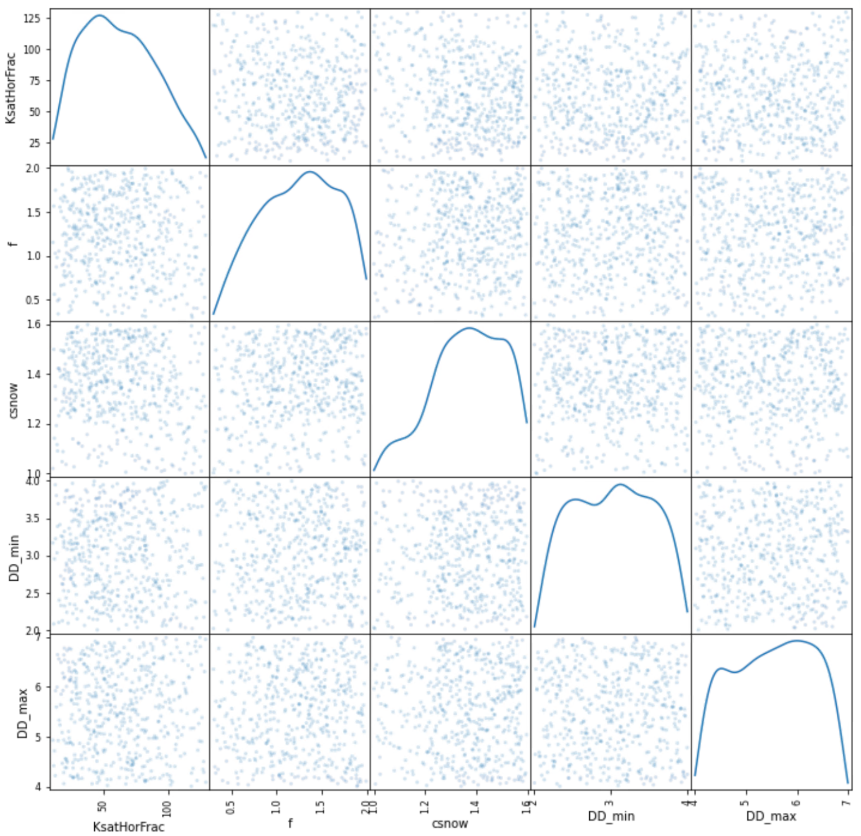
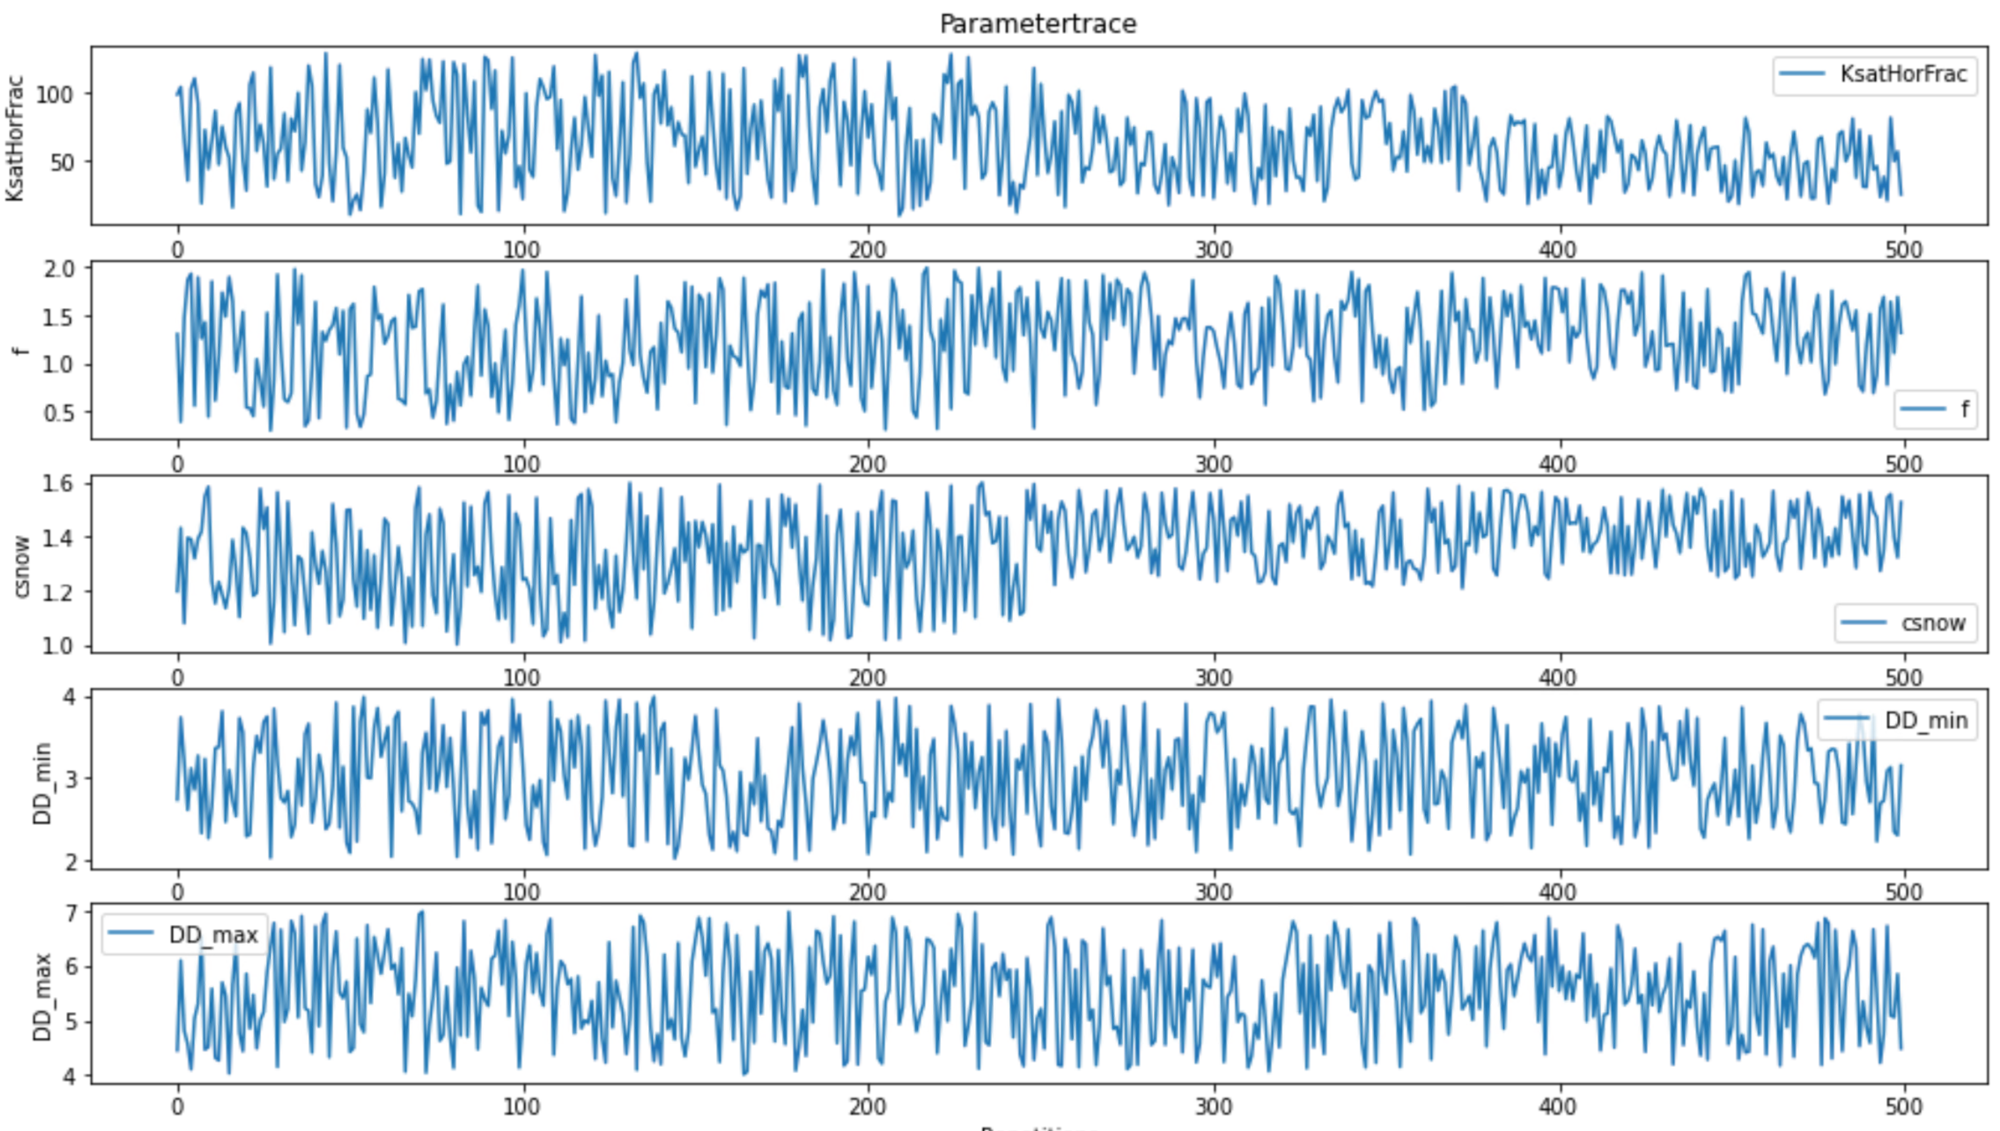
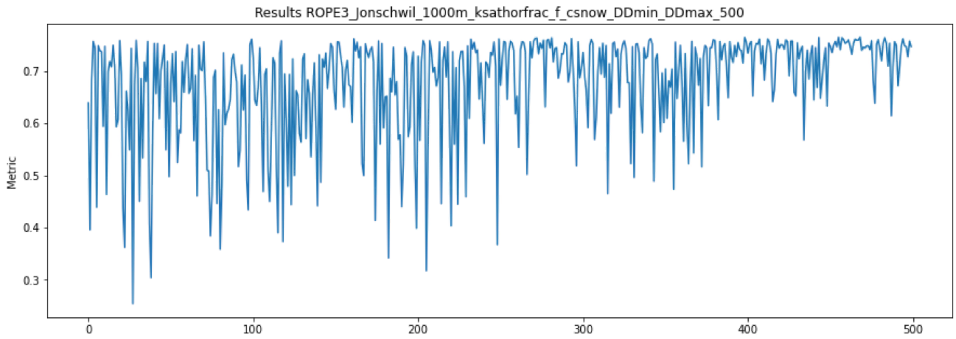
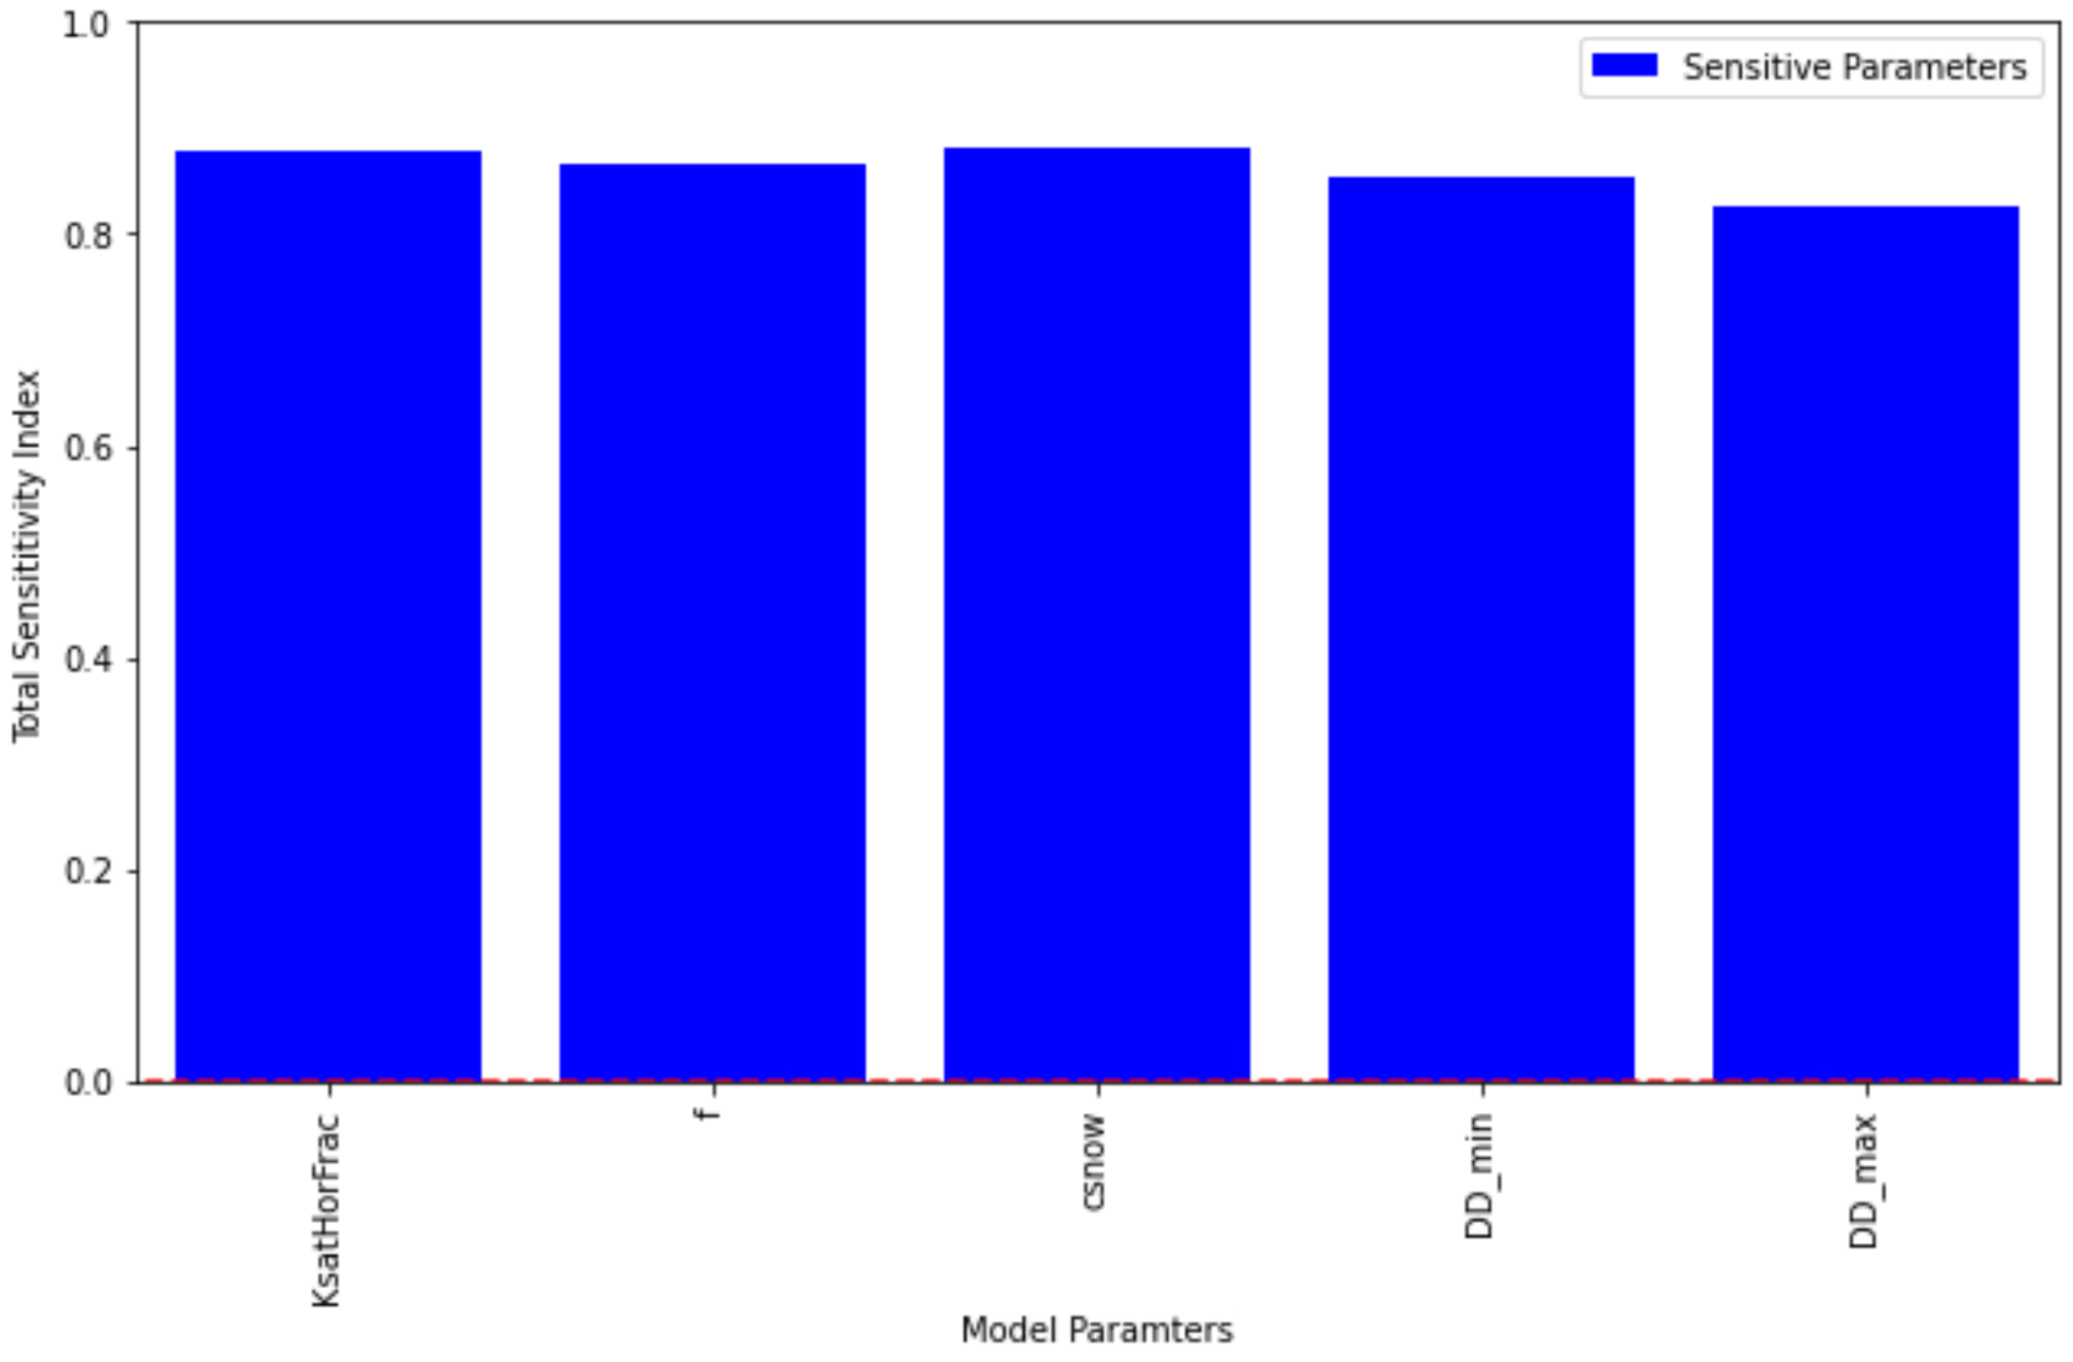
Streamflow-based snow mass reconstruction using spatial melt patterns from synthetic snow cover maps
Pau Wiersma (pau.wiersma@unil.ch), Fatemeh Zakeri & Grégoire Mariéthoz
ROPE optimization algorithm (Bardossy et al., 2008)
Latin hypercube for the first half of runs
Keep 20% best results and start latin hypercube for next 1/6
Repeat twice for a total of 3 resampling subsets
Notes:
S1 serves as the benchmark
The snowfall correction should correct for gauge undercatch and forcing biases
The seasonally varying melt factor should account for changes in solar radiation
The distributed melt factor should account for spatial snow cover fraction variations

Slide 19
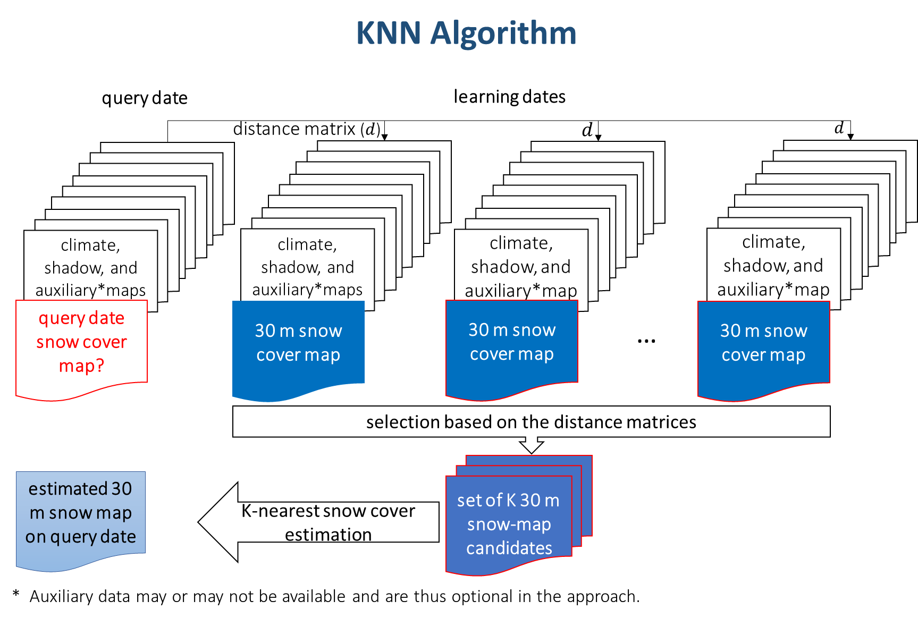
Streamflow-based snow mass reconstruction using spatial melt patterns from synthetic snow cover maps
Pau Wiersma (pau.wiersma@unil.ch), Fatemeh Zakeri & Grégoire Mariéthoz

