Slide 1
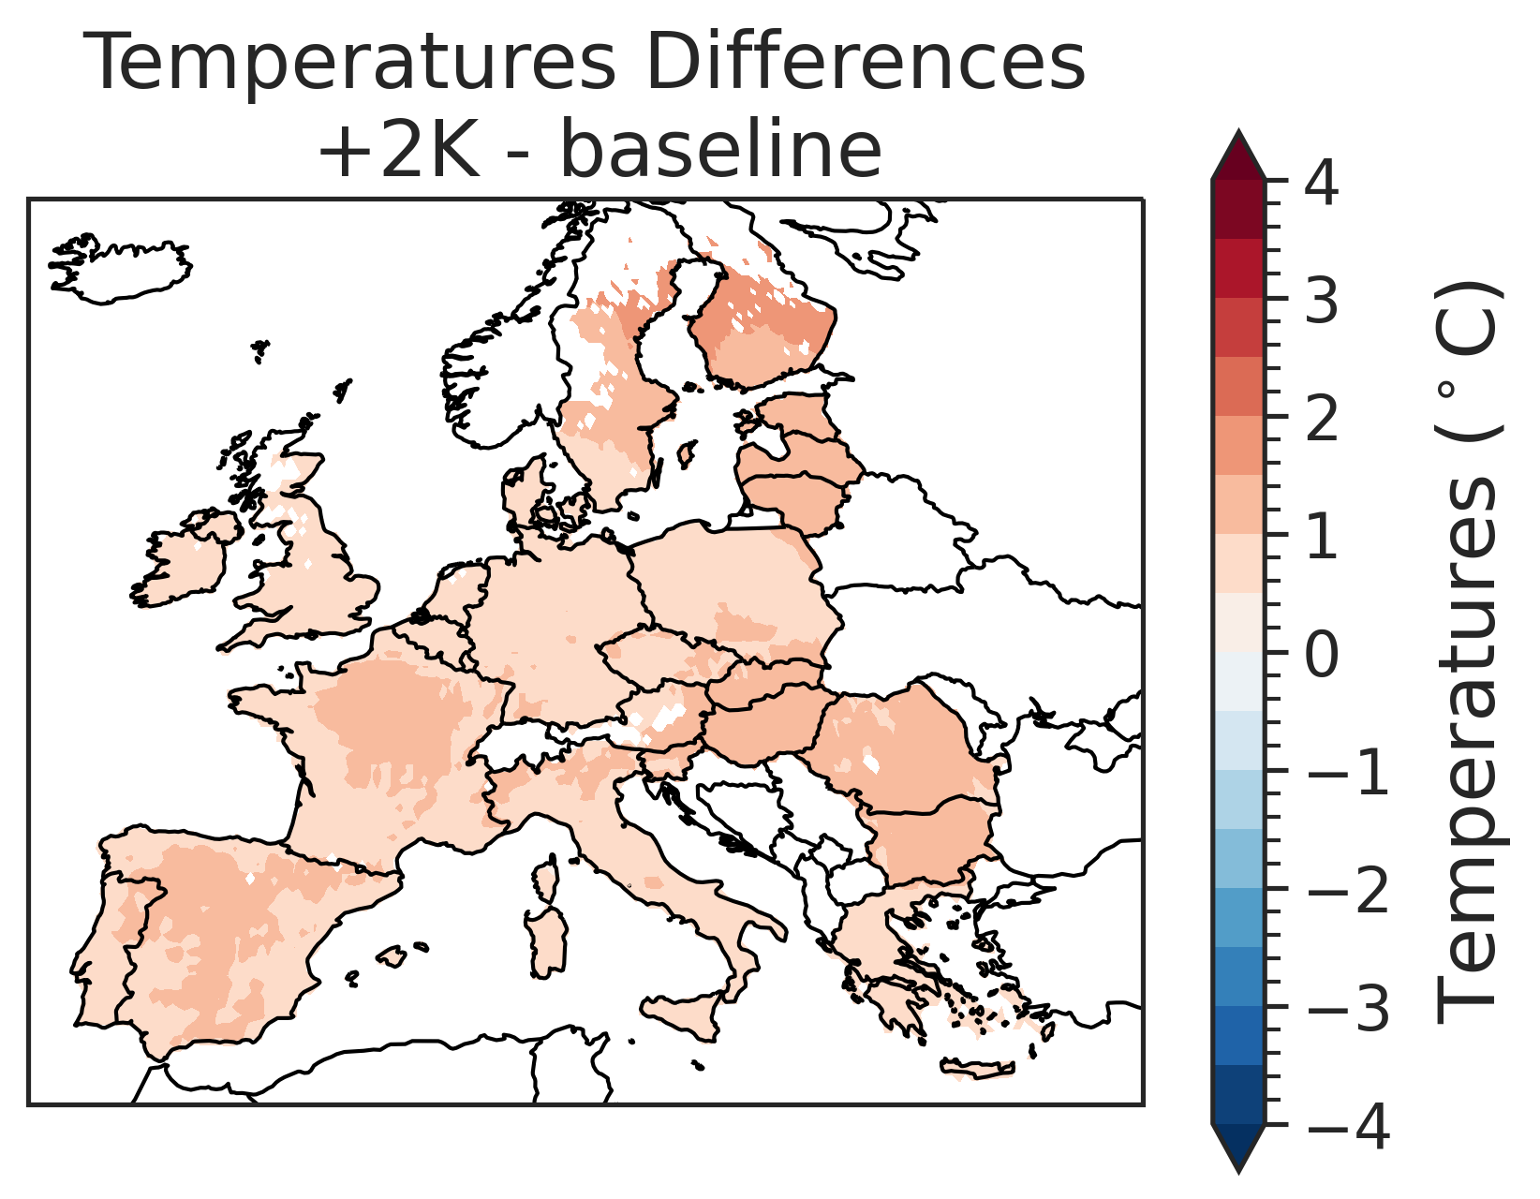
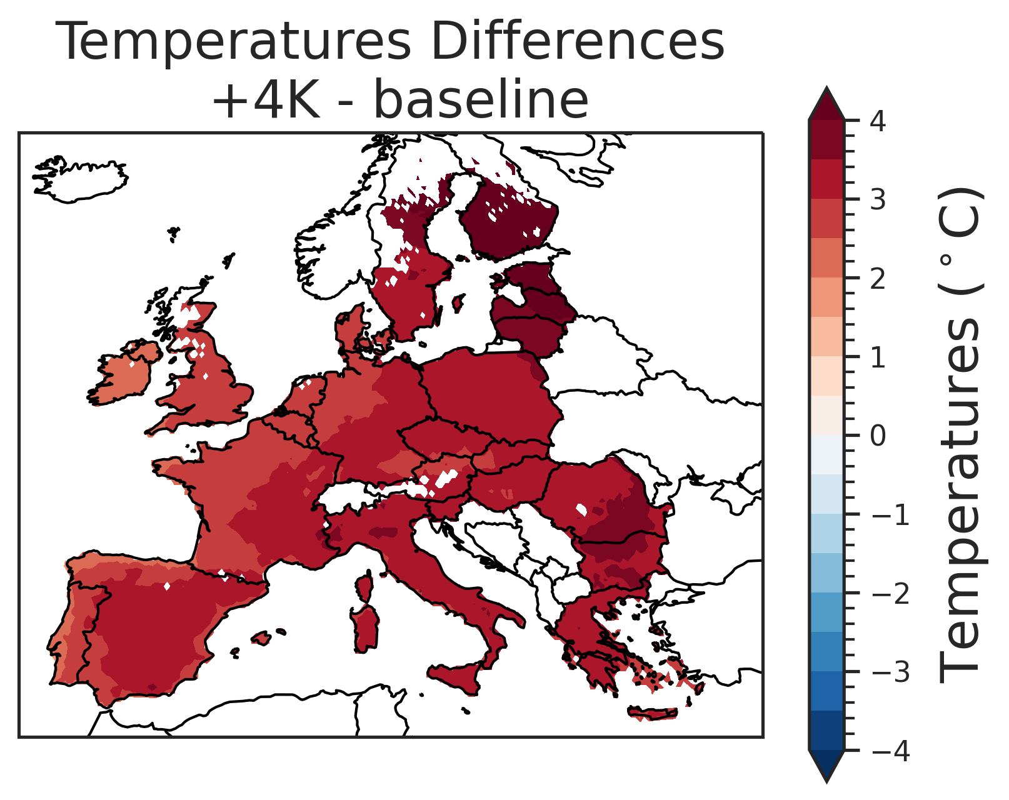
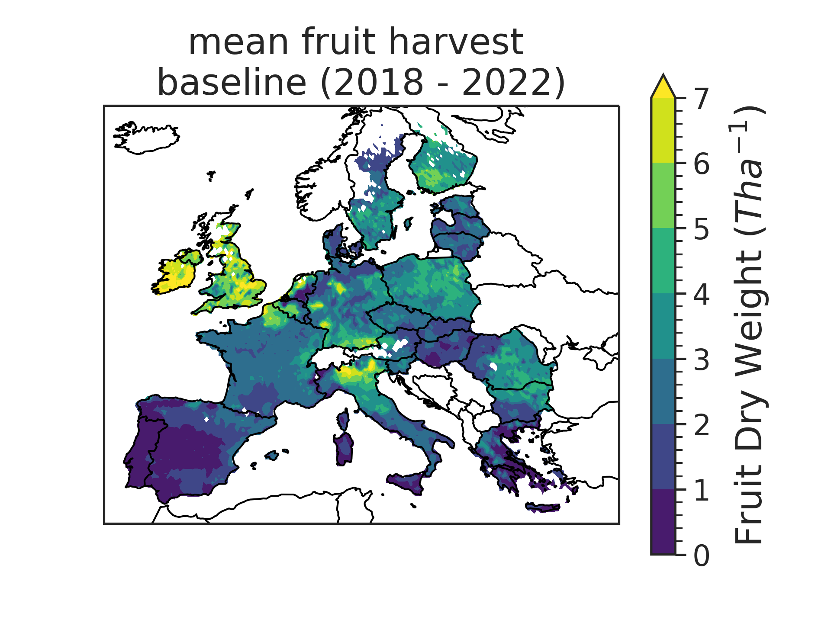
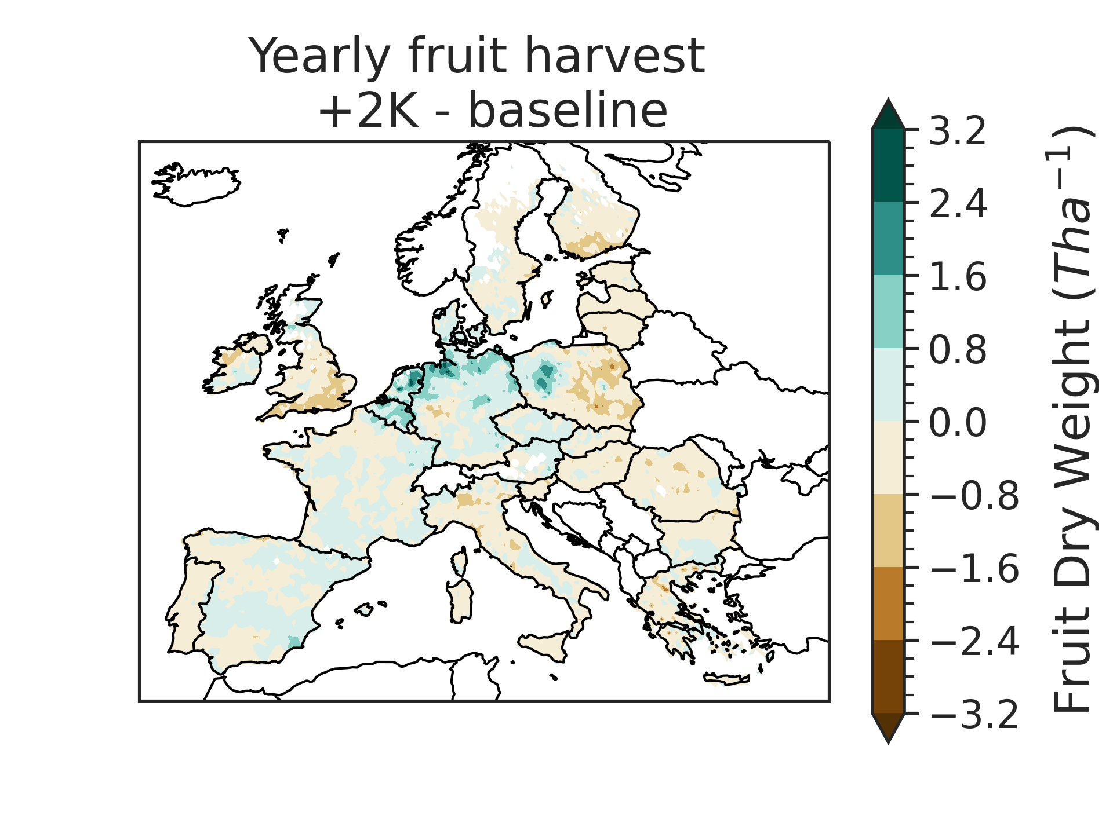
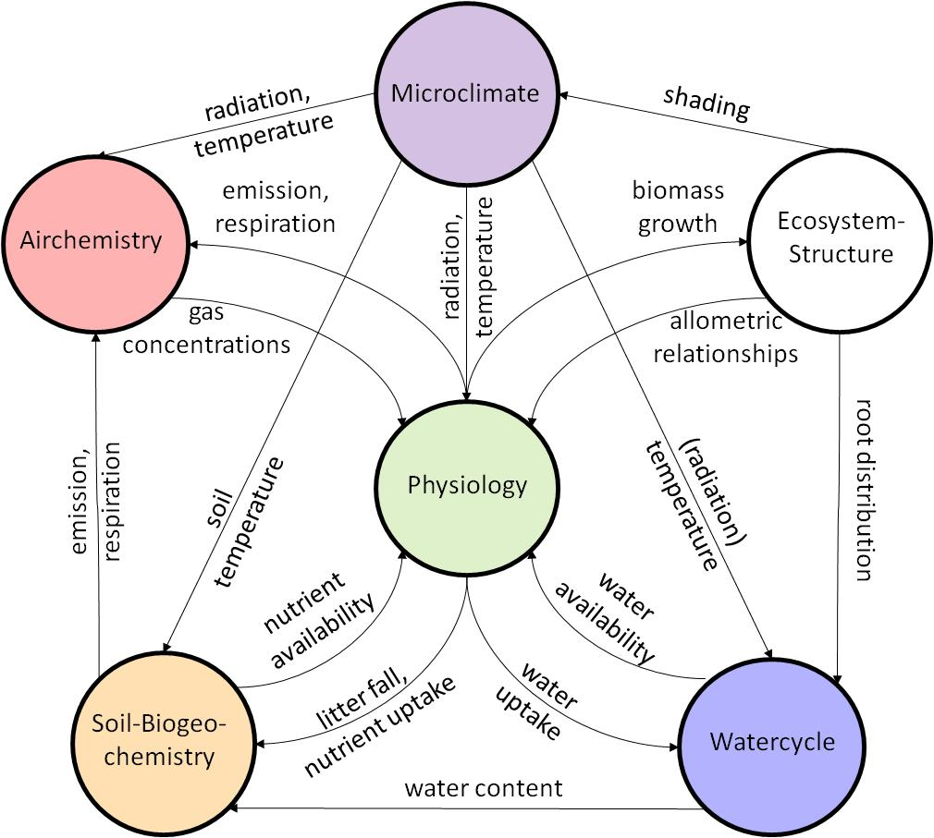
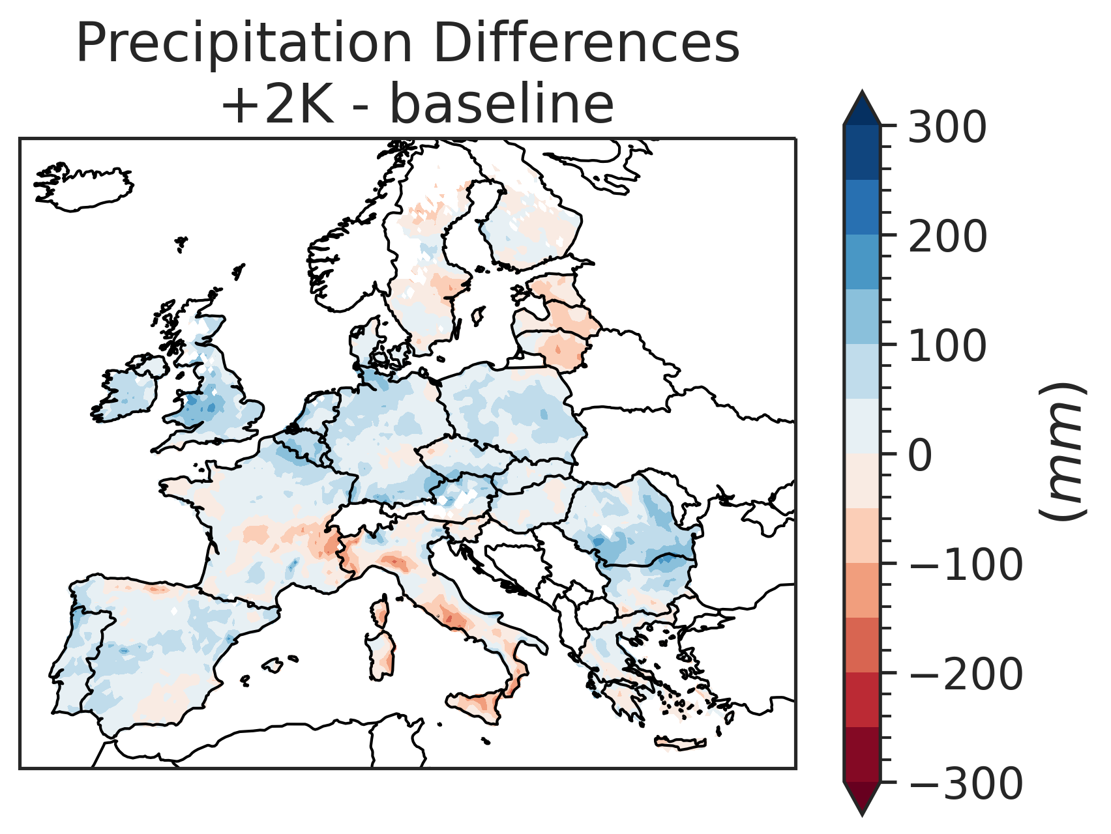
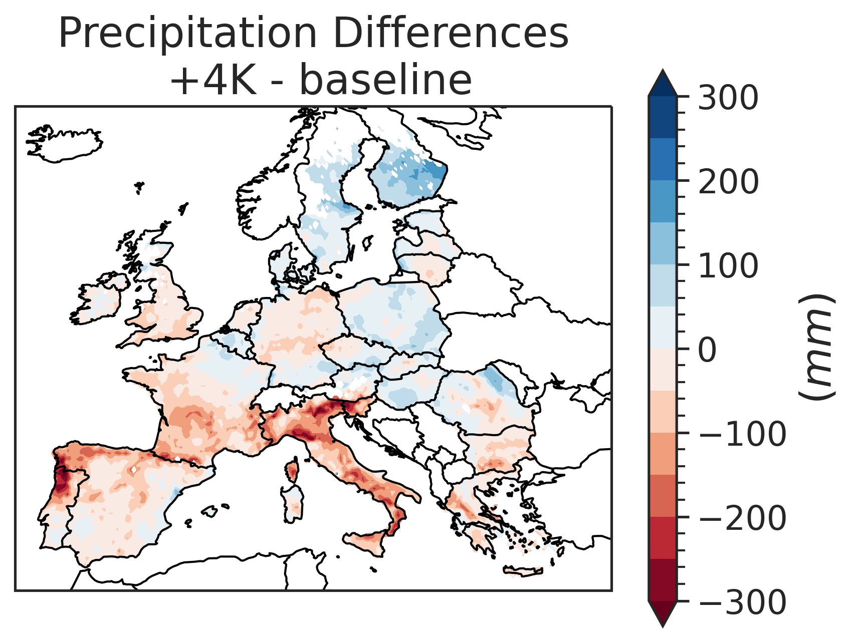
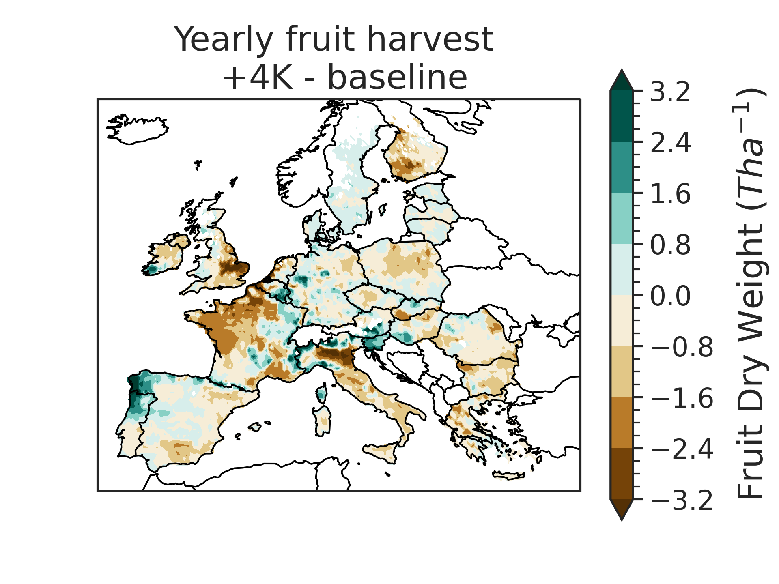
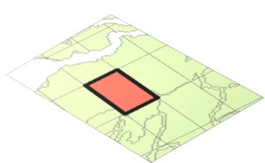
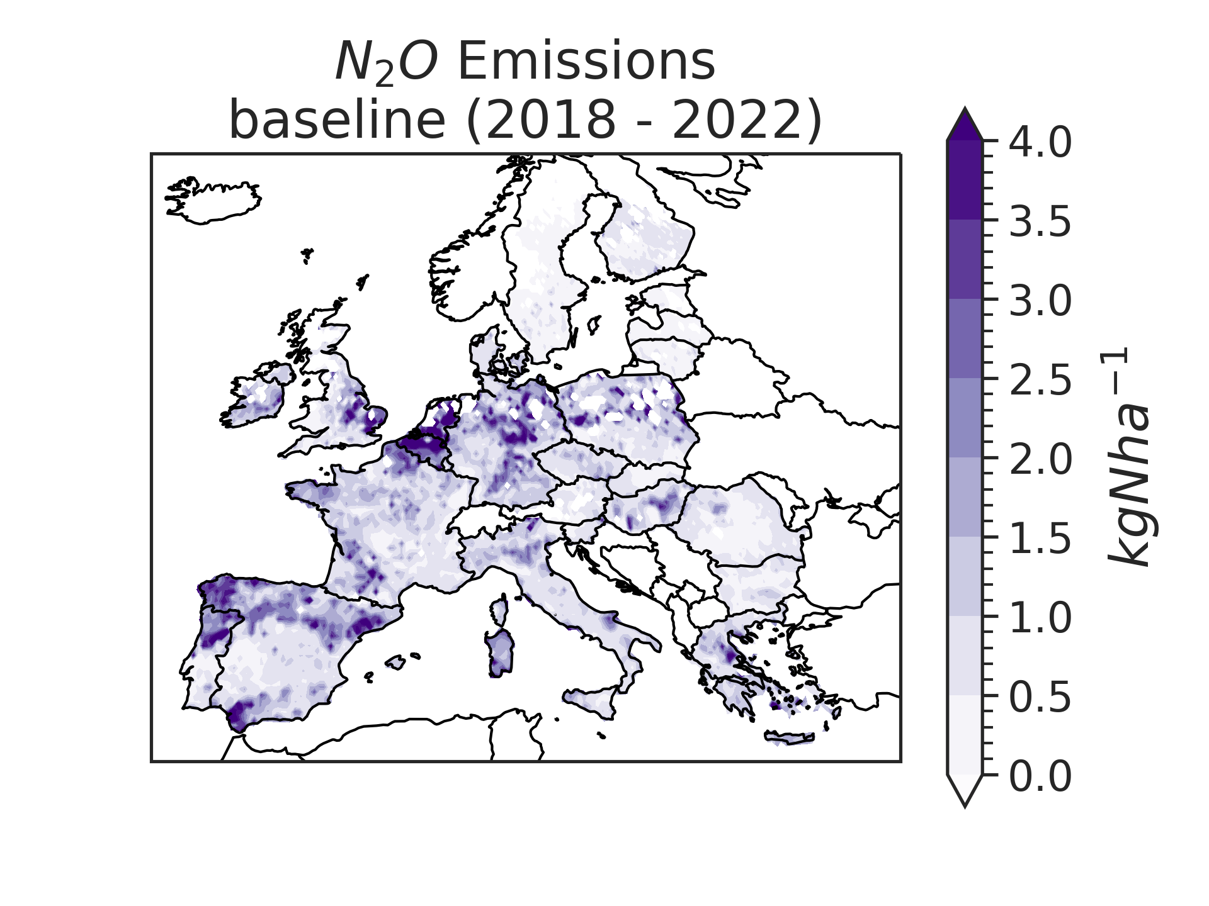

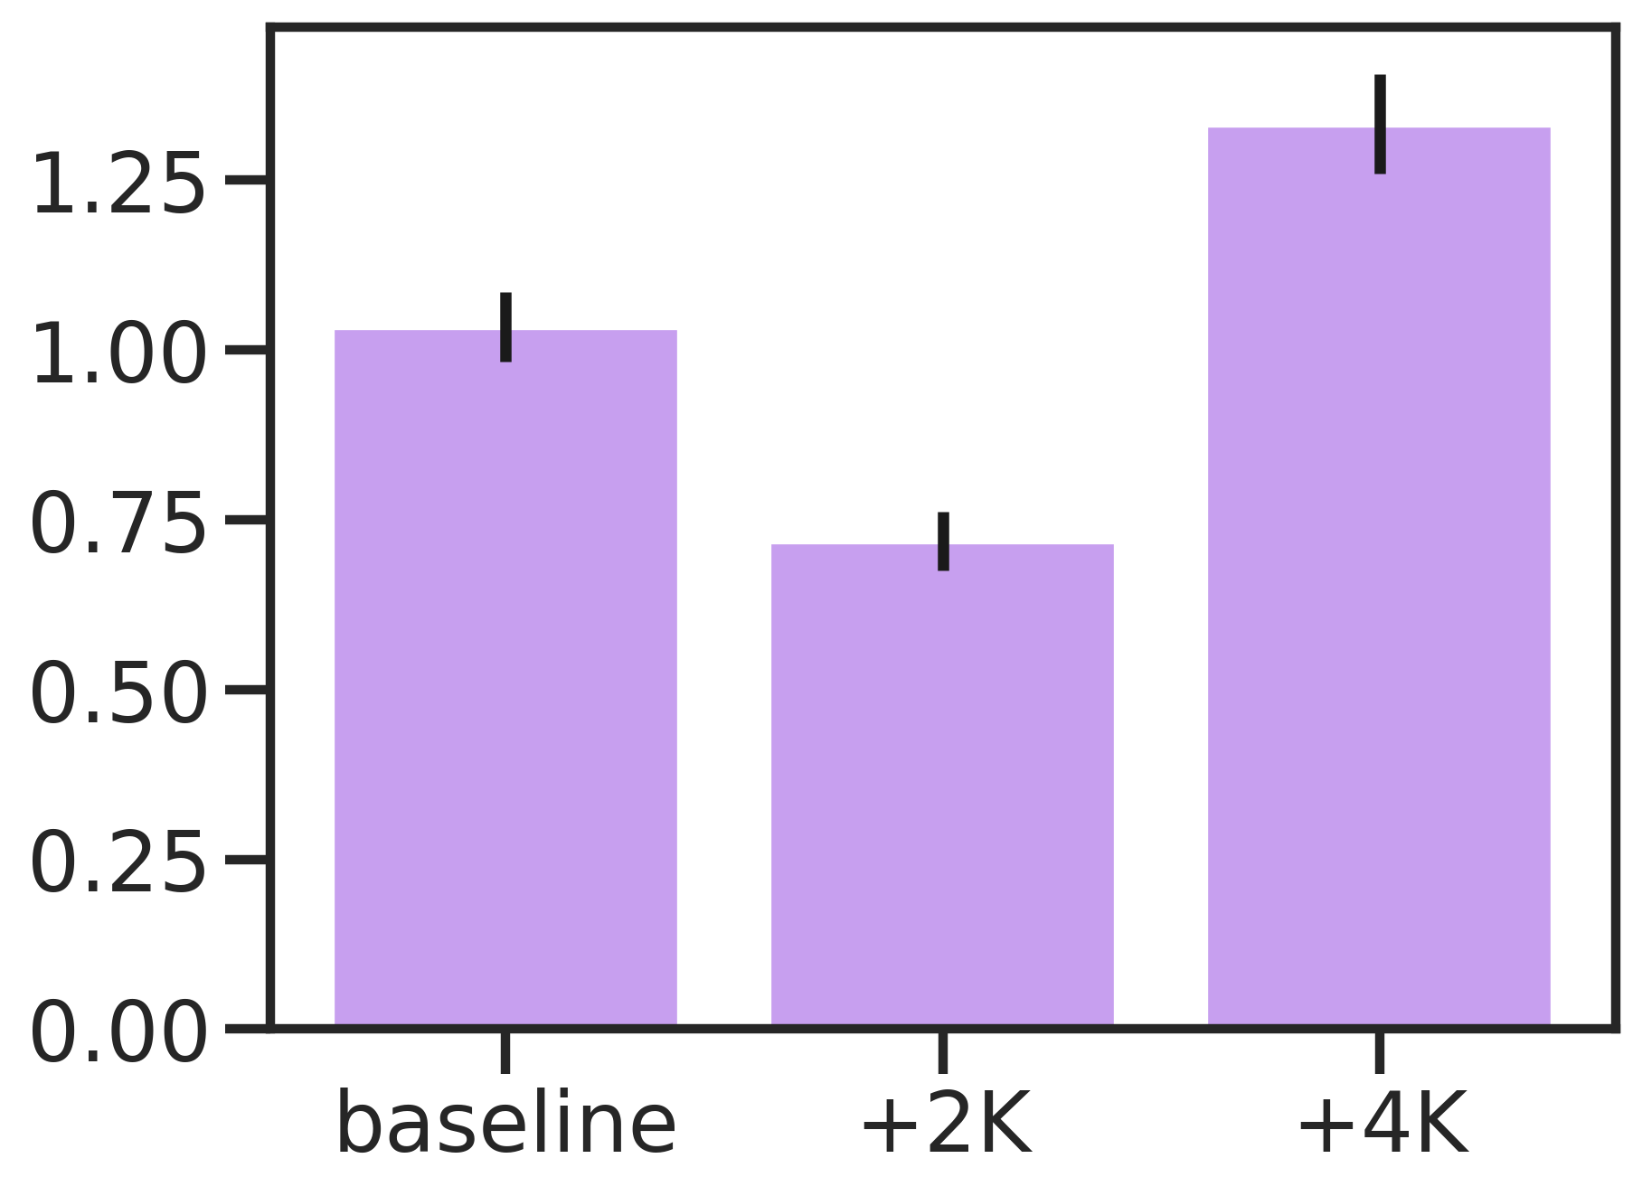
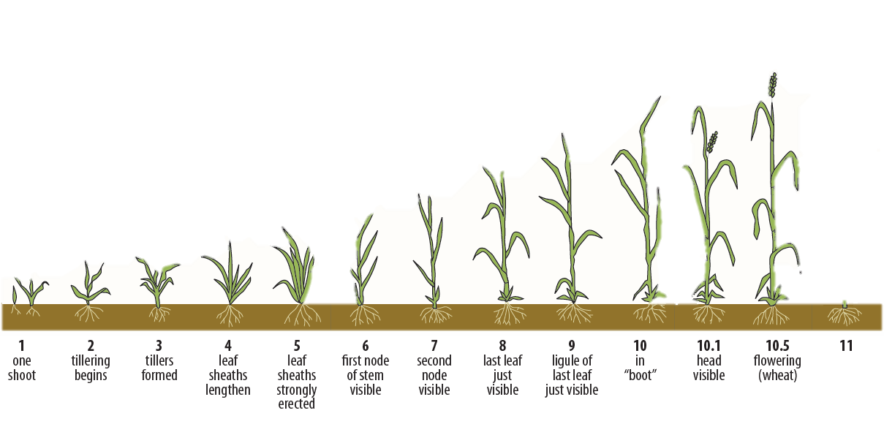

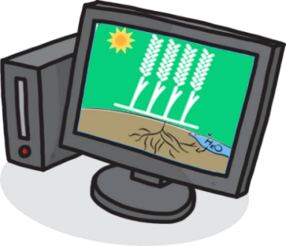
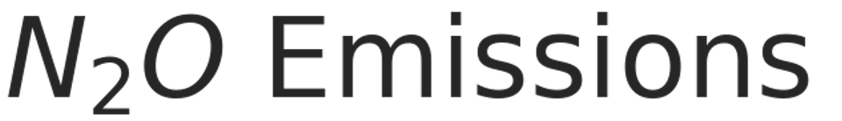
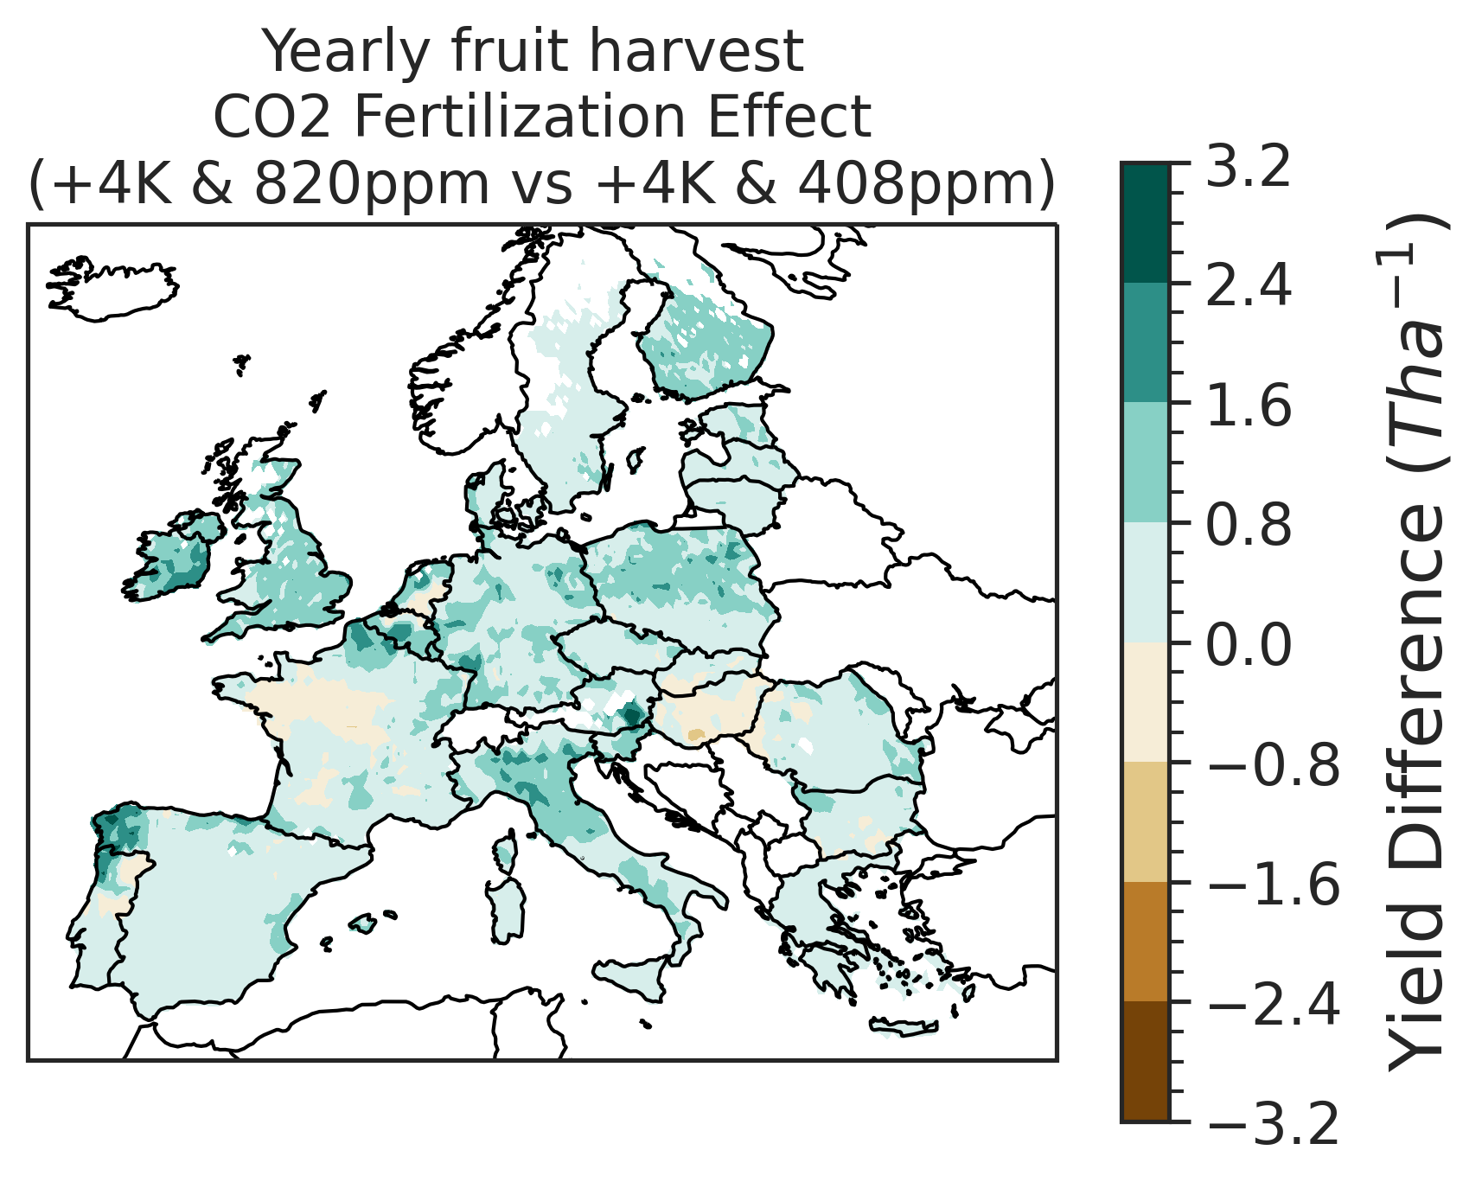
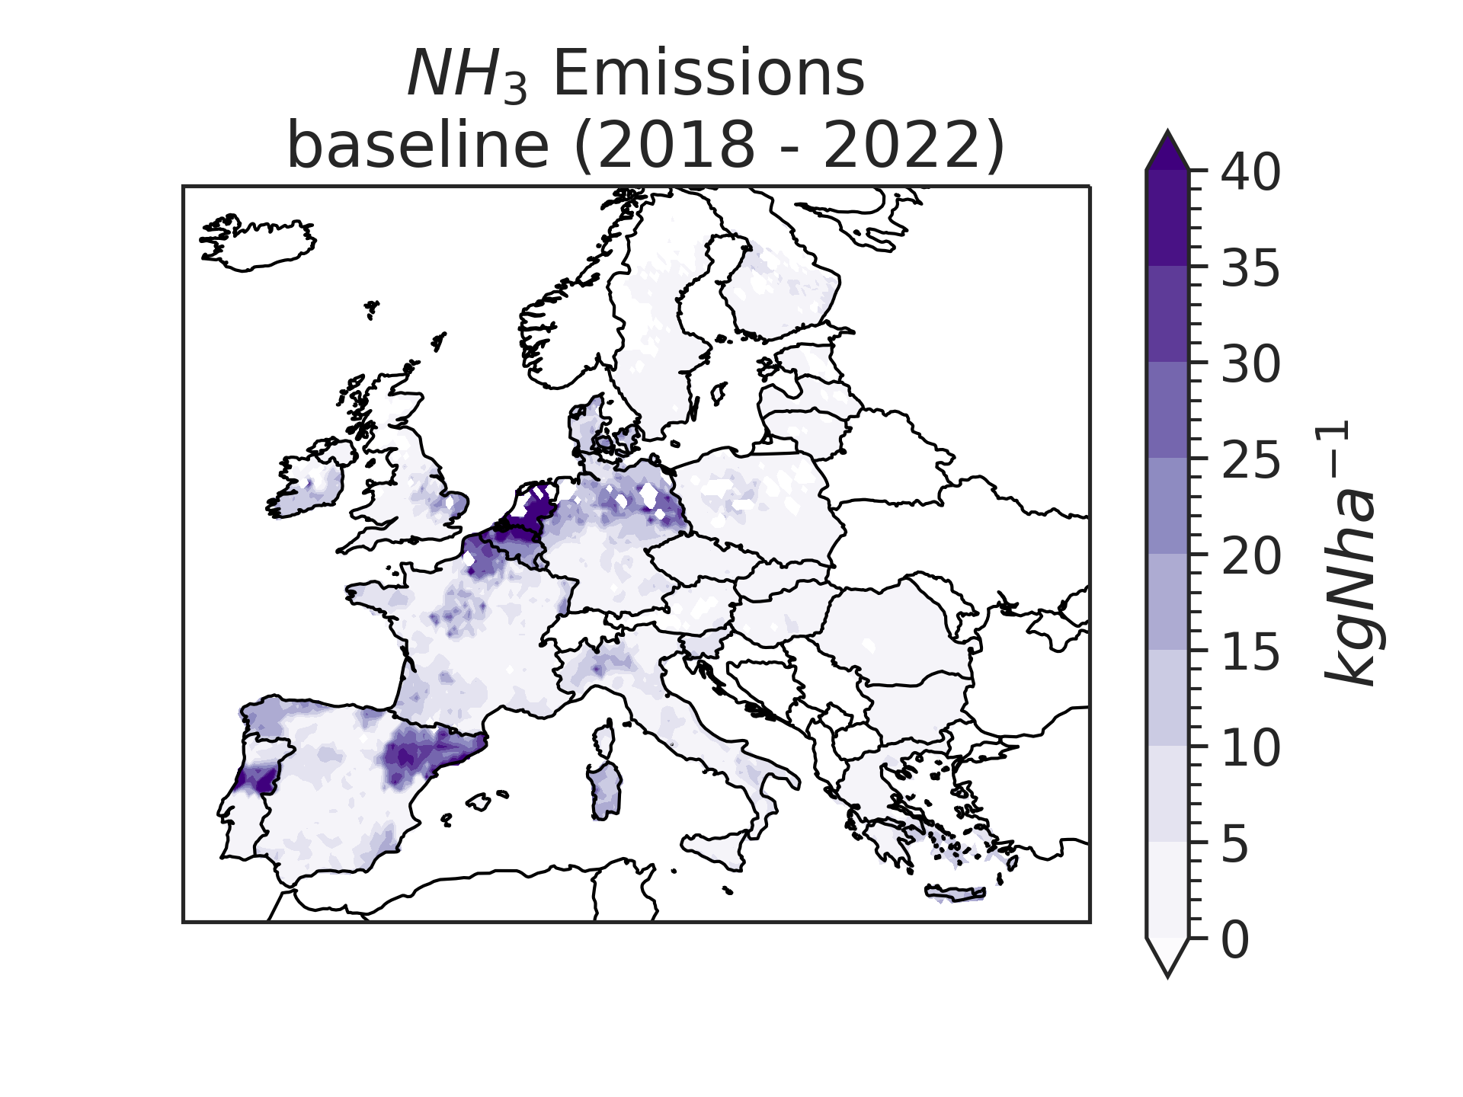
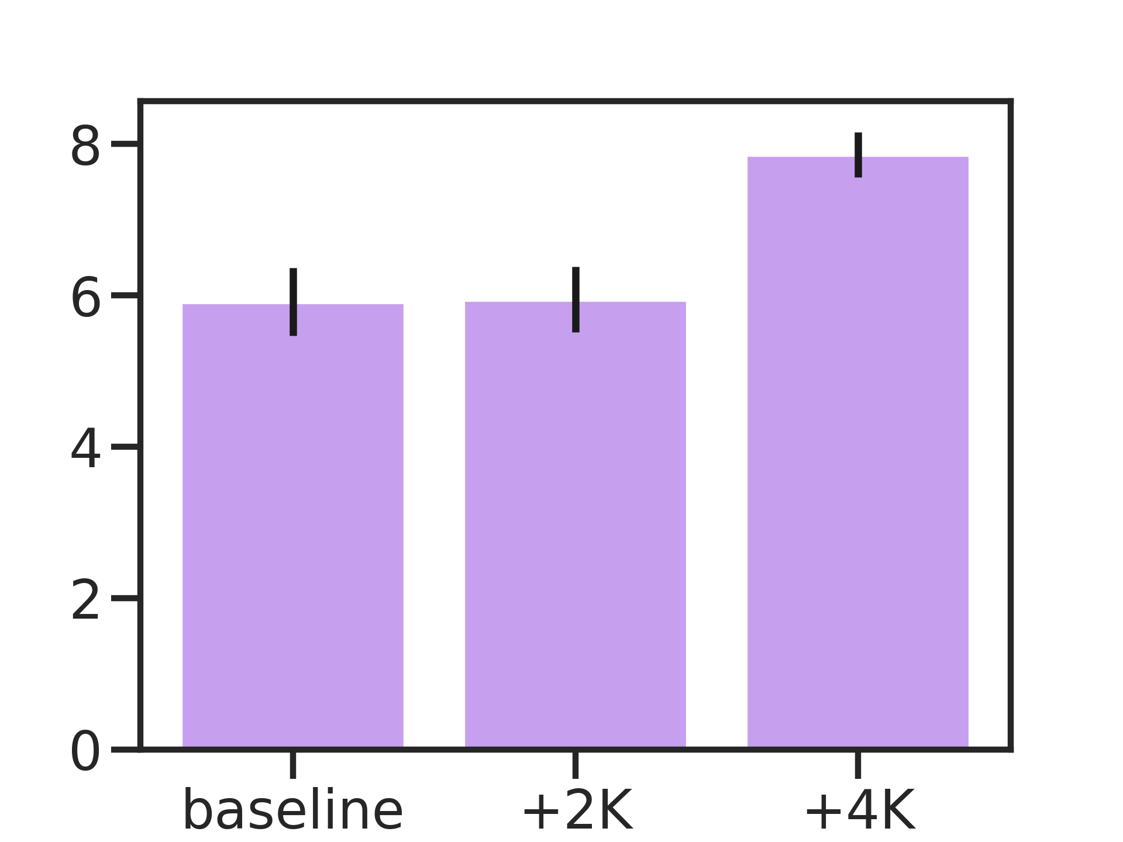
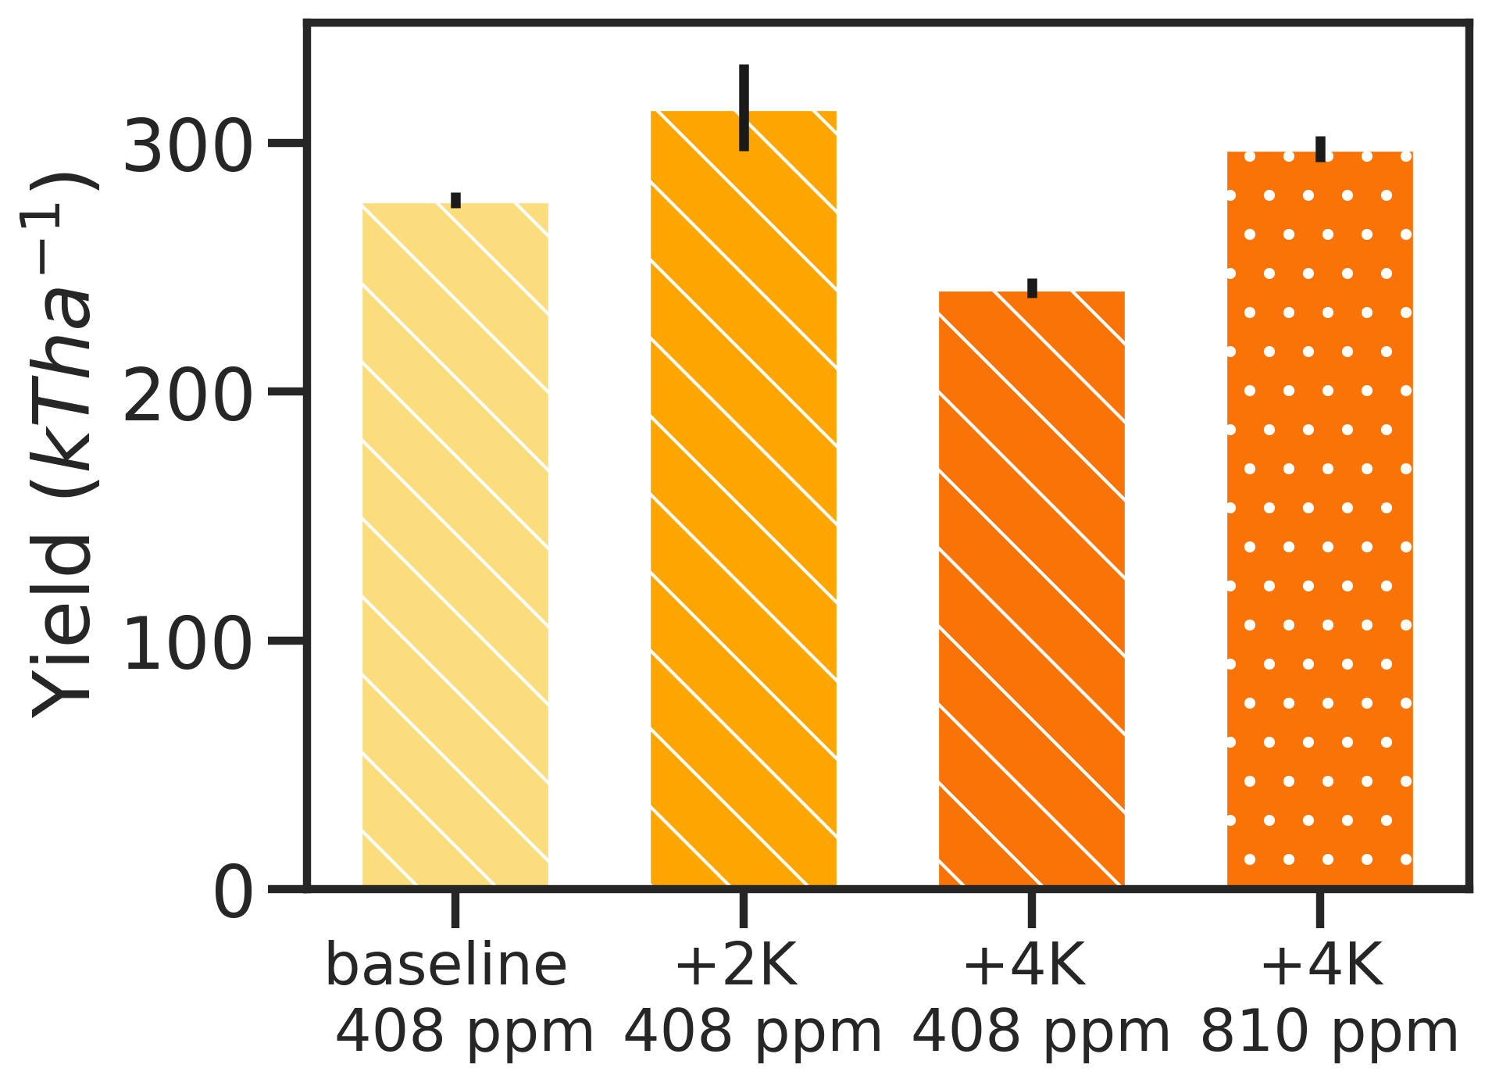








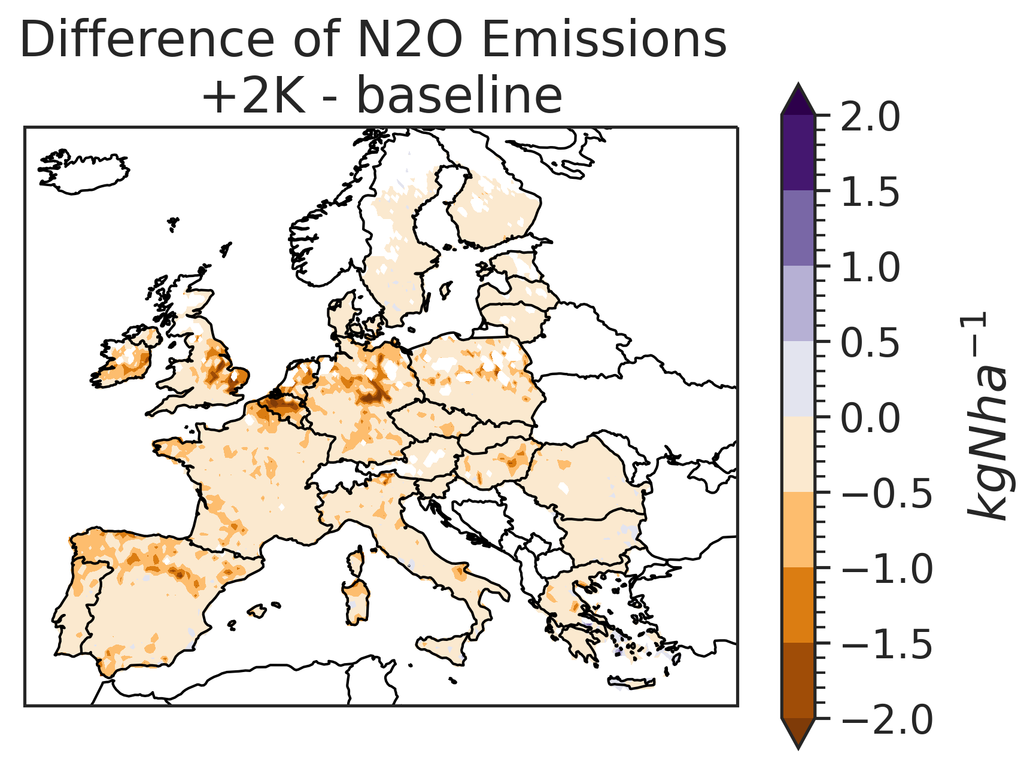
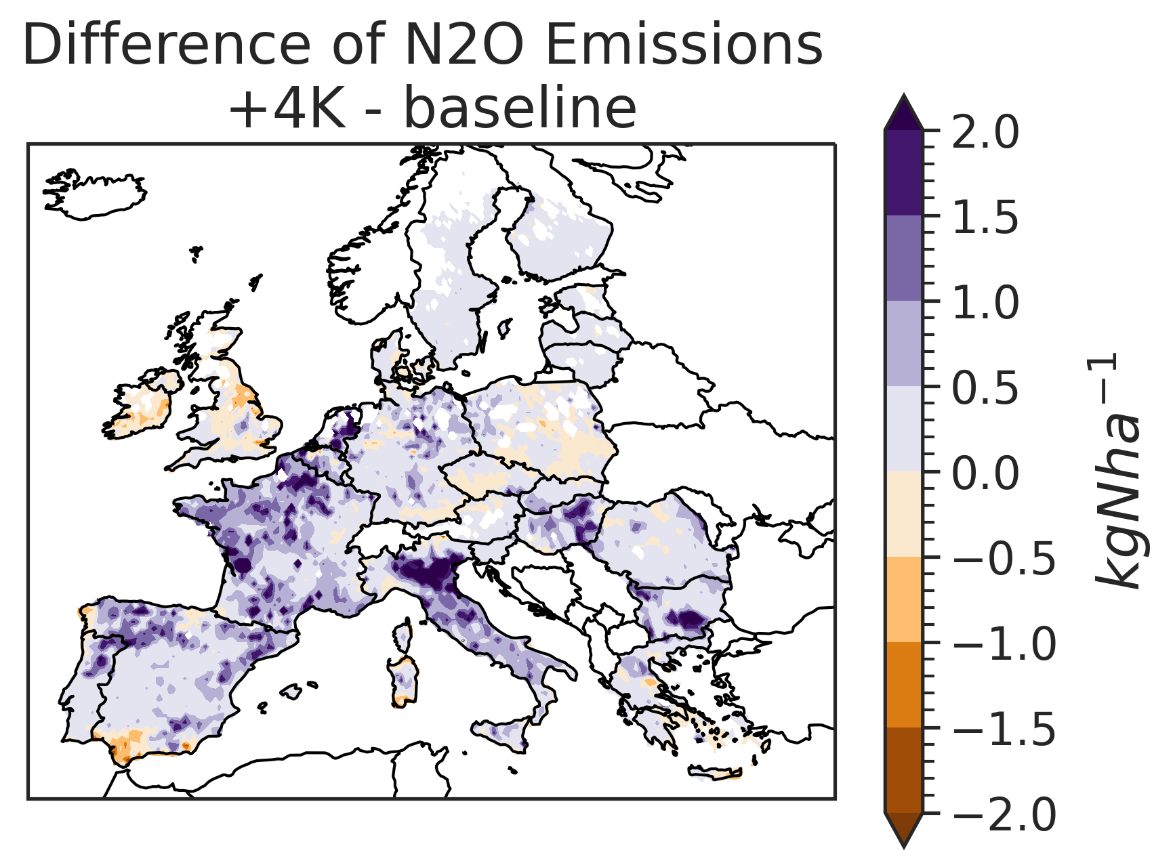
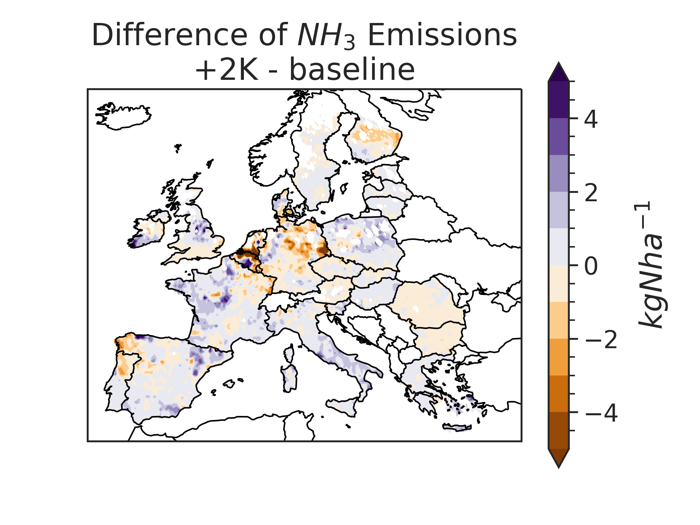
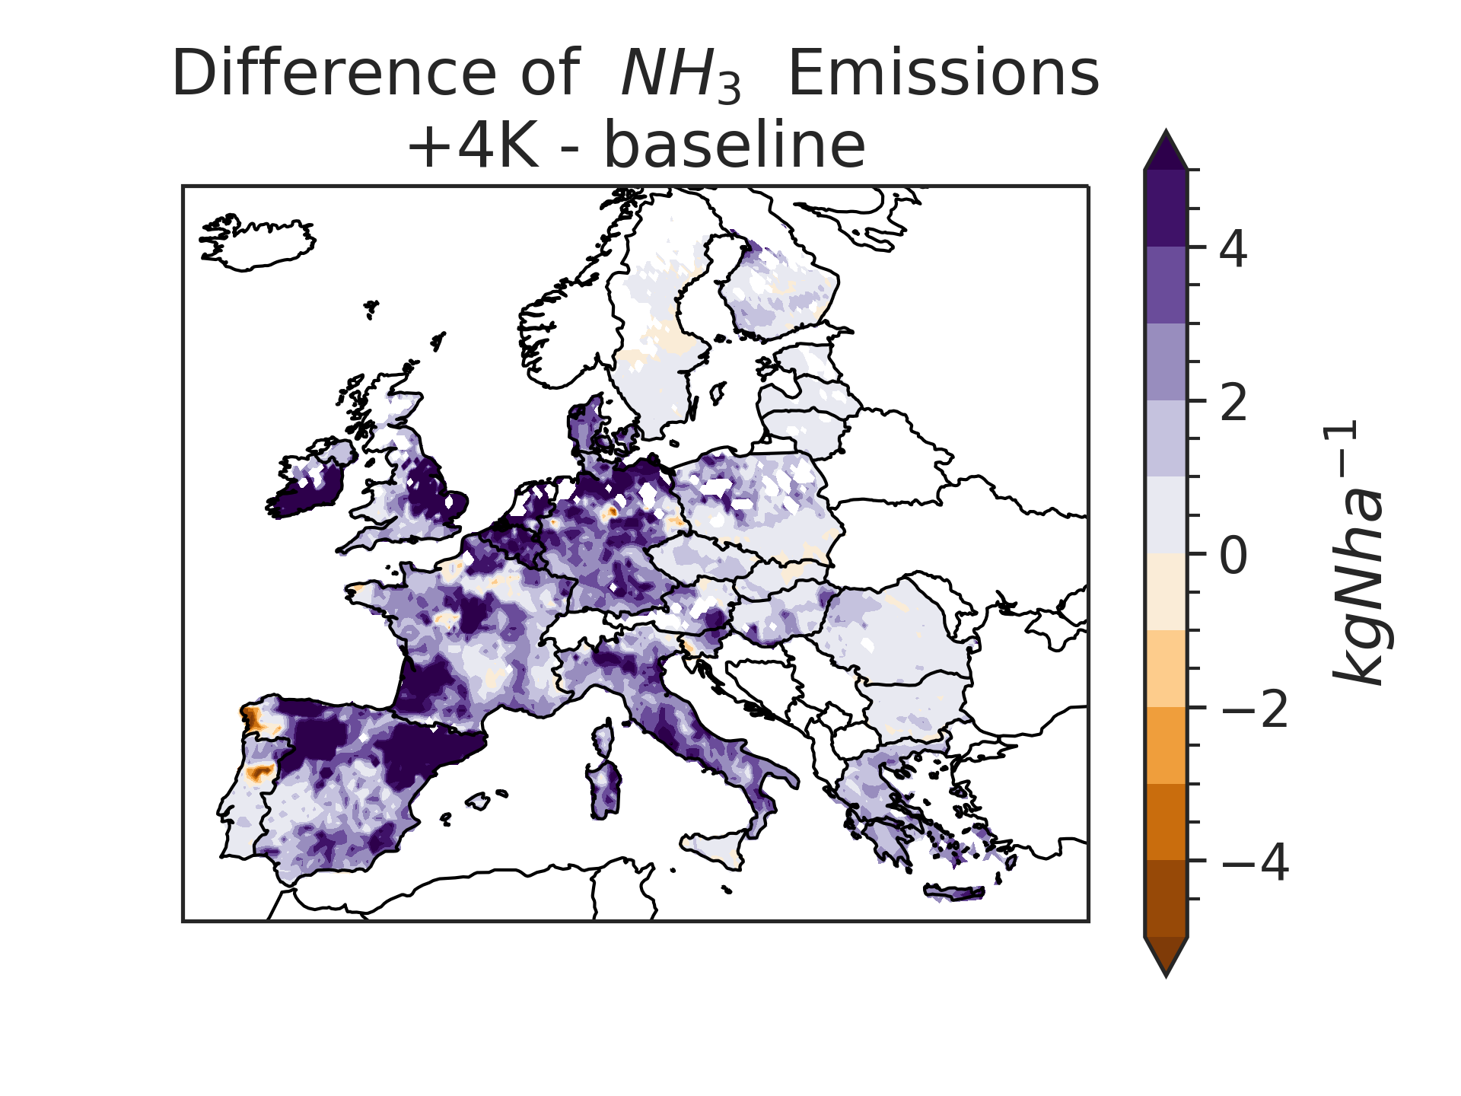
Using pseudo-global-warming storylines and process-based ecosystem models for impact assessment of extreme events on agricultural production
Lioba Martin¹ ; Edwin Haas¹; Clemens Scheer¹; David Kraus¹; Rüdiger Grote¹
¹KIT Campus Alpin, Kreuzeckbahnstraße 19, 82467 Garmisch-Partenkirchen
SCENIC - Storyline Drivers
Model Development
Taking the large-scale circulation of the 2018 - 2022 European heatwave, the atmosphere was nudged (Sánchez-Benítez et al. 2022)
For impacts within agriculture global nudging was dynamically downscaled to the European level.
The main drivers for agricultural production altered in the story line approach are temperature and precipitation.
Other drivers like management
and soil properties are
were set up following
Haas et al. 2022.
Impacts
LandscapeDNDC
Process based simulation framework (Haas et al. 2013)
Coupled Photosynthesis, plant growth, microclimate, soil chemistry and water cycle modules
Gridded setup allows for regional application
Climate
Areas with high fertilizer inputs and intensive agriculture show the highest yields.
The storyline results for the +2K simulation show that the temperature difference of approximately 0.5 K to baseline does not yet lead to negative effects on yields
A +4K rise until the end of the century will have detrimental effects in key agricultural regions
Key Crop Stress Improvements
Soil
Crop rotations
Grain yield reduction based on heat shock during the reproductive phase (Challinor et al. 2004, Moriondo et al. 2011)
Reduction of photosynthetic activity during and after stress events
Improvement of senescence under drought
Root growth adaption to drought
Nitrogen Cycling
The regional pattern of N₂O Emissions correspond with high input regions.
While on the long term emissions a strong increase in N₂O is shown alongside rising temperatures, the short term development regarding a +2K warmer world even shows a short term decrease in emissions.
NH₃ emissions are regionally constrained.
The regional variation between scenarios is around ± 5 % of the baseline value for +2K
Under a +4K scenarios NH₃ are to increase everywhere in Europe by ca. 10%.
CO₂ Fertilization Effect
CO₂ fertilization could compensate up to 50.000 Tonnes of Yield
This could potentially offset the loss due to higher temperatures and drought effects
Open Questions
How well do the proposed improvements represent varying crops over different environments?
Does the modelled CO₂ fertilization effect correspond with reality?
Could crop adaptation / management compensate
for climatic effects?
References:
Sánchez-Benítez, Antonio; Goessling, Helge; Pithan, Felix; Semmler, Tido; Jung, Thomas (2022): The July 2019 European heatwave in a warmer climate: Stroyline scenarios with a coupled model using spectral nudging.
Haas, Edwin; Carozzi, Marco; Massad, Raia Silvia; Butterbach-Bahl, Klaus; Scheer, Clemens (2022): Long term impact of residue management on soil organic carbon stocks and nitrous oxide emissions from European croplands.
Haas, Edwin; Klatt, Steffen; Fröhlich, Alexander; Kraft, Philipp; Werner, Christian; Kiese, Ralf et al. (2013): LandscapeDNDC: a process model for simulation of biosphere–atmosphere–hydrosphere exchange processes at site and regional scale.
Challinor, A. J.; Wheeler, T. R.; Craufurd, P. Q.; Slingo, J. M. (2005): Simulation of the impact of high temperature stress on annual crop yields.
Moriondo, M.; Giannakopoulos, C.; BINDI, M. (2011): Climate change impact assessment: the role of climate extremes in crop yield simulation.
Innopool
SCENIC
Lioba Martin
+49 8821 183-286
ldndc.imk-ifu.kit.edu
lioba.martin@kit.edu
www.imk-ifu.kit.edu

