Slide 1


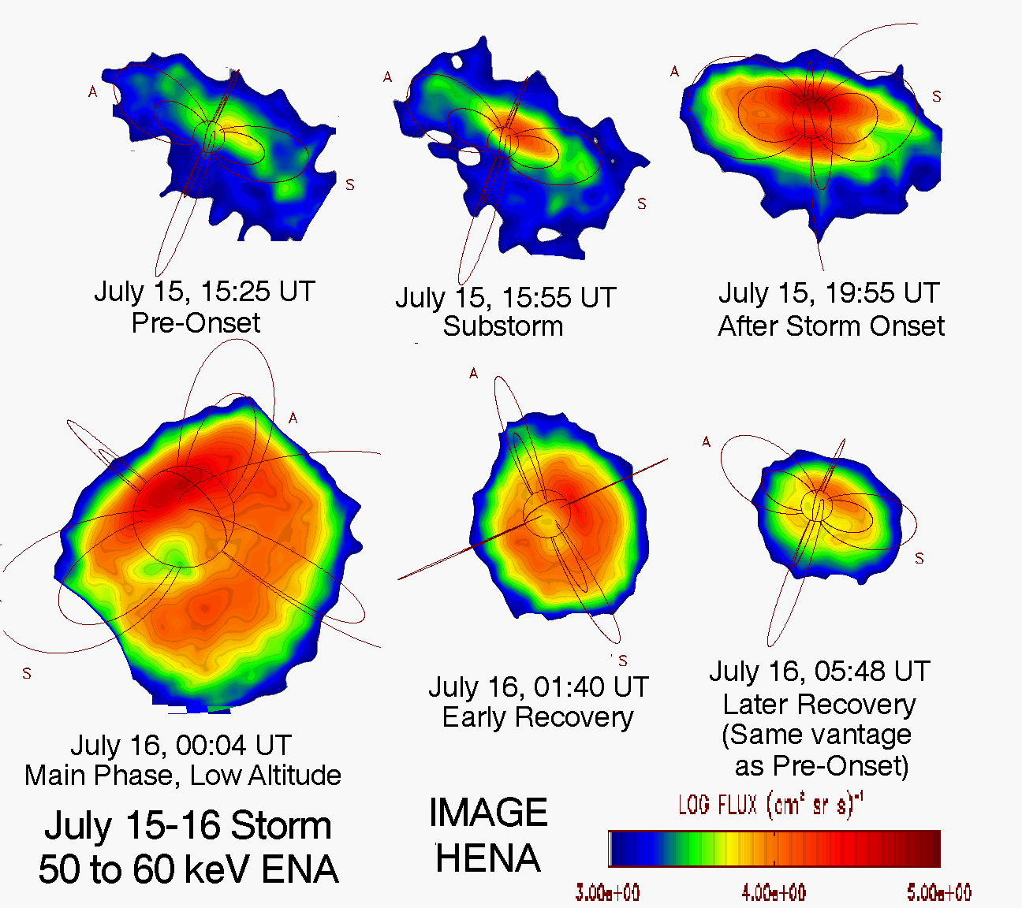
Exploring solar-terrestrial interactions via multiple imaging observers
G. Branduardi-Raymont¹, and 26 co-authors (see Experimental Astronomy https://doi.org/10.1007/s10686-021-09784-y)
¹MSSL - UCL (UK)
1. Introduction
How does solar wind energy flow through the Earth’s magnetosphere, how is it converted and distributed (Fig. 1)?
This are the questions we want to address so that we understand how geomagnetic storms and substorms start and grow.
This is not just a matter of scientific curiosity, but addresses a clear and pressing practical problem: space weather, which can influence the performance and reliability of our technological systems, in space and on the ground, and can endanger human life and health.
Fig. 1 - The Earth’s magnetosphere (NASA/GSFC)
Much knowledge has been acquired over the past decades, particularly by making use of multiple spacecraft measuring conditions in situ, such as Cluster, THEMIS, Swarm, MMS. A vast amount of learning, though, is still to be done.
A novel global approach is now being taken by a number of space imaging missions which are under development. In a White Paper, submitted to ESA in response to the Voyage 2050 Call, we proposed the next step to get a complete understanding of how the Sun controls the Earth’s plasma environment: a tomographic imaging approach comprising two spacecraft in highly inclined polar orbits.
2. Science questions
A – We have qualitative knowledge of magnetospheric dynamics (Fig. 2), but we do not know how to quantify the energy circulation in the magnetosphere and how to predict strength and temporal variations of storms and substorms.
B – Global imaging of the cusps can distinguish between proposed reconnection mechanisms (e.g. stationary or temporal, component or antiparallel), quantify their significance, and establish any asymmetry between North and South cusps.
C – Asymmetries in the
magnetosphere-ionosphere
field-aligned current system
are poorly understood and little
studied (Fig. 3). Continuous
and conjugate FUV monitoring
of both auroral ovals could
answer such question.
D – How efficiently does the magnetotail response energise the ring current ions, how transport and loss mechanisms affect the evolution of the ring current, what is the importance of electric fields and substorms in building it?
E – How is the
plasmasphere (Fig. 4)
refilled, how does the
plasma distribute itself
along the field lines, how
is the plasma lost and
transported within
the magnetosphere?
3. Observing methods and instruments to answer the open science questions
A & B – Magnetopause and cusps imaging in soft X-rays (0.2 – 2 keV) produced by solar wind charge exchange with atmospheric neutrals.
An enhanced version of
the SMILE Soft X-ray
Imager, SXI, can be
envisaged (Fig. 5).
From geocentric distance
30 R_{E} the entire dayside
magnetopause can be
captured within a FOV of
30º x 30º without
sacrificing spatial resolution.
C – Auroral imaging:
High energy precipitating
electrons excite atmospheric
constituents by impact (Fig. 6),
with FUV emissions from N2
transitions (140–180nm) and
OI at 135.6nm.
Proton precipitation
produces Lyα emission.
D – Ring current imaging:
The ring current
charge-exchanges
with the geocorona at
high altitudes, producing
Energetic Neutral Atoms
(ENAs, Fig. 7) that allow
imaging the ring current
and plasma sheet ions,
and track their evolution
with time.
E – Plasmasphere imaging: Global images of the plasmasphere can be obtained by observing EUV sunlight at 30.4nm resonantly scattered from singly-ionised Helium, a minor magnetospheric constituent.
4. A space mission to address the open questions
In situ measurements: Simultaneous in situ measurements of plasma and fields will set the imaging into context, with the advantage of measuring immediately upstream as opposed to relying on L1.
Ground measurements: Ground-based all-sky imagers and magnetometers in both polar regions, and ionospheric radars are an essential complement to the space-borne instruments, placing mesoscale auroral structures in their global context.
Orbit: Two circular, highly inclined, polar orbits, at a 30 R_{E} geocentric distance (Fig. 8), with a 9.65 day period and phased 90º away from each other, allow observations from both polar and equatorial vantage points and achieve the goals of tomography and conjugate auroral monitoring.
Fig. 8 - MHD simulations of the plasma conditions and viewing from a 30 R_{E} polar orbit
SXI
Field
of View
Fig. 2 - Progression
of the Dungey cycle
(Eastwood et al. 2015)
Fig. 5 - CAD model of SMILE SXI
(from B-R et al. 2018)
Fig. 6 - IMAGE WIC FUV imaging: Northern
aurora during a substorm (NASA/GSFC)
Fig. 3 - Simultaneous views of the North and South aurorae from Polar and IMAGE (Laundal & Østgaard 2009)
5. Summary and references
We propose the next step in the quest for a complete understanding of how the Sun controls the Earth’s plasma environment: a tomographic imaging approach comprising two spacecraft in highly inclined polar orbits, enabling global imaging of magnetopause and cusps in soft X-rays, of auroral regions in FUV, of plasmasphere and ring current in EUV and ENAs, alongside in situ measurements. No technological challenges are involved in the proposed mission in order to bear fruit.
B-R et al, https://doi.org/10.5270/esa.smile.definition_study_report-2018-12, Eastwood et al. Space Sci. Rev. 188, 251–286 (2015), Laundal & Østgaard, Nature. 460, 491–493 (2009), Mitchell et al. Geophys. Res. Lett. 28, 1151–1154 (2001), Sandel et al. Space Sci. Rev. 109, 25–46 (2003)
Fig. 7 - IMAGE ENA images of the fluctuation
of Earth’s ring current during July 15–16, 2000
geomagnetic storm (Mitchell et al. 2001)
Fig. 4 - Earth's plasmasphere and plume as
measured by IMAGE (Sandel et al. 2003)
Notes:
Copyright Colin Purrington (http://colinpurrington.com/tips/academic/posterdesign).

